Slide 1
Childhood vaccinations
Preventing Epidemics Is a No Brainer
Linda Minickiello

Slide 2
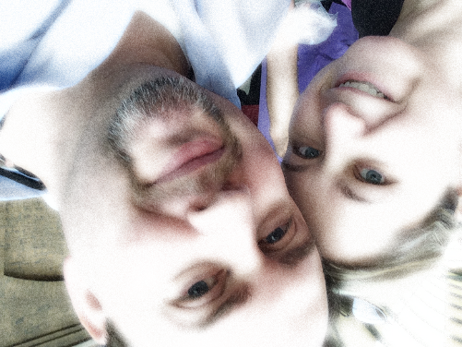
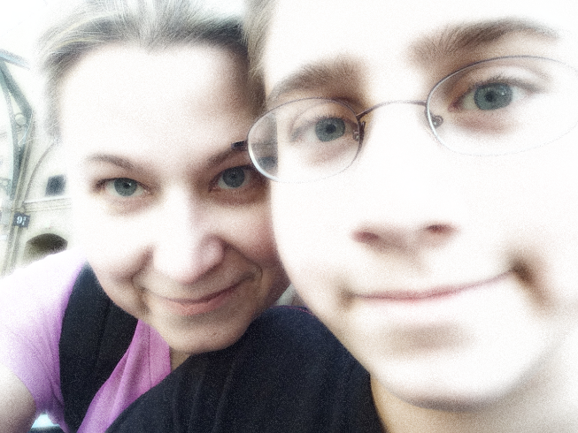
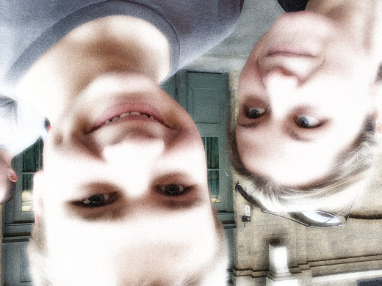
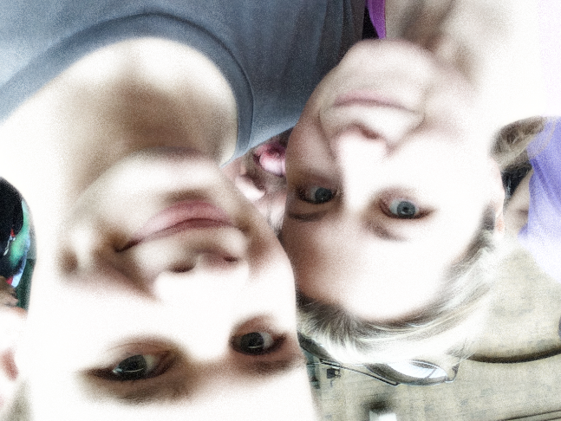
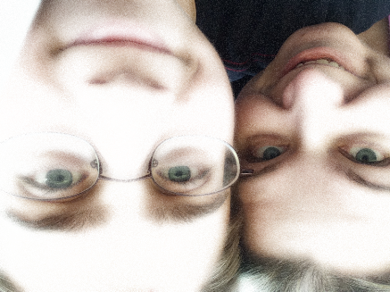
Why Vaccinations
First, my family
Second, it’s currently a hot topic
Prior knowledge
history of vaccines
American Academy of Pediatrics recommended
controversial

Slide 3
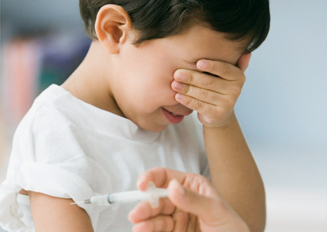
My Thesis
Parents should follow the American Academy of Pediatrics vaccination schedule because vaccines reduce drastically once prevalent and devastating disease, reduce the risk for those who cannot be given the vaccine, are cost effective, and do not impact brain development or function.

Slide 4
My Sources
Evaluation
Opposing Viewpoints
websites

Slide 5
What the Research Shows
Between 1940 and 1955, over 35,000 cases of polio were reported each year. With the introduction of Salk polio vaccine in 1955, the number of cases declined to under 2,500 in 1957. By 1965, only 61 cases of paralytic polio were reported. The United States has been polio free since 1979.
Savings in direct medical costs due to the eradication of smallpox exceed $300 million per year.
A study of 1,266,327 children provided confirmation that there is no relationship between vaccination and autism. There is no relationship between autism and the MMR vaccine (measles, mumps and rubella) or with the products of thimerosal and mercury which are found in vaccines.
Children who have undergone chemotherapy for cancer have immune systems that are rebuilding, and it may be months more before their bodies are healthy enough for immunizations. Until then, those children are dependent upon “herd immunity.”
vaccines reduce drastically once prevalent and devastating disease
vaccines reduce the risk for those who cannot be given the vaccine
vaccines are cost effective
vaccines do not impact brain development or function

Slide 6
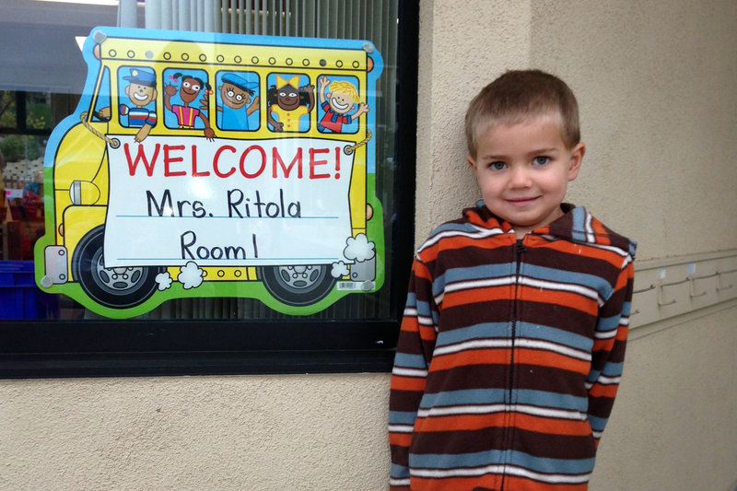
Herd Immunity
Rhett Krawitt, 6, outside his school in Tiburon, California.
Seven percent of the children in his school are not vaccinated.
Rhett’s father has had just about enough. "It's very emotional for me," he said. "If you choose not to immunize your own child and your own child dies because they get measles, OK, that's your responsibility, that's your choice. But if your child gets sick and gets my child sick and my child dies, then ... your action has harmed my child.“
"When your immune system isn't working as well, it allows many different infections to be worse. It's not just Rhett. There are hundreds of other kids in the Bay Area that are going through cancer therapy, and it's not fair to them. They can't get immunized; they have to rely on their friends and colleagues and community to help protect them."

Slide 7
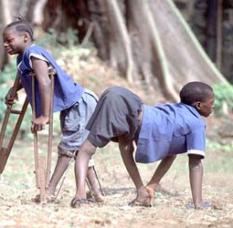
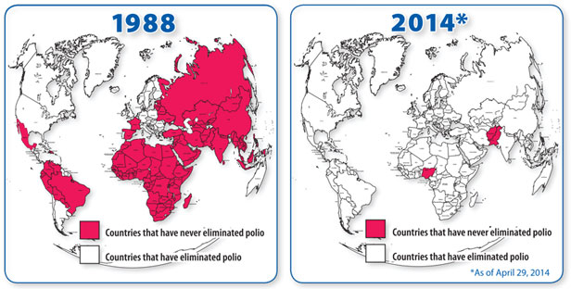
Now and in the Future
My personal response to the research
The global response

Slide 8
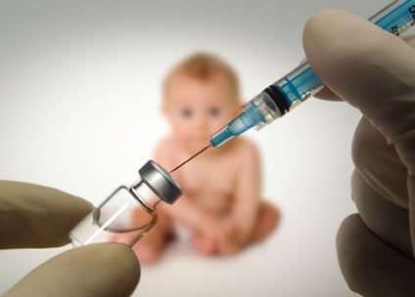
Challenges
PROBLEM: finding unbiased information
SOLUTION: narrowed my searches
PROBLEM: setting my own personal beliefs aside
SOLUTION: prepared to be open to new information

Slide 9
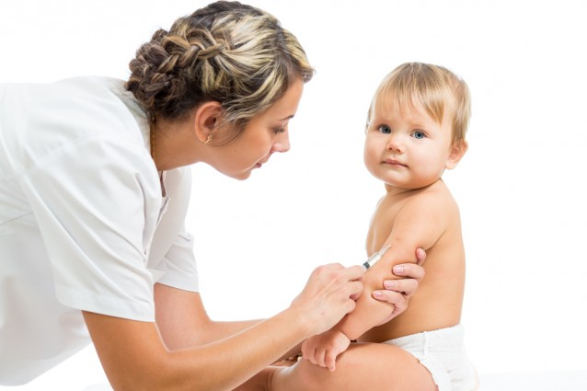
The Good and the Bad
Pros
followed a personal interest
current event status
lots of information
Cons
lots of information
lots of terribly biased information
sometimes too technical in nature
narrowing down what was best

Slide 10
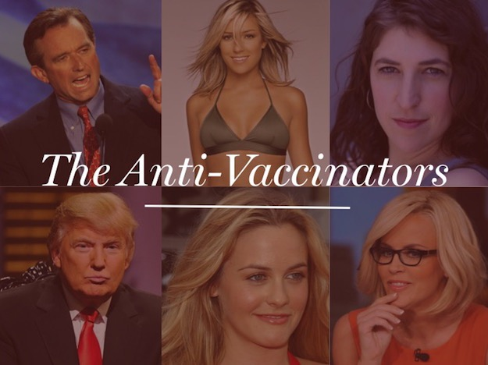
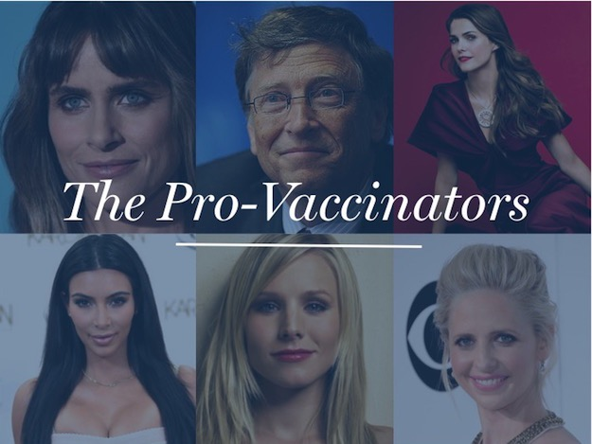
A New Direction
the other side of the fence
the global response

Slide 11
Thank You

