Slide 1
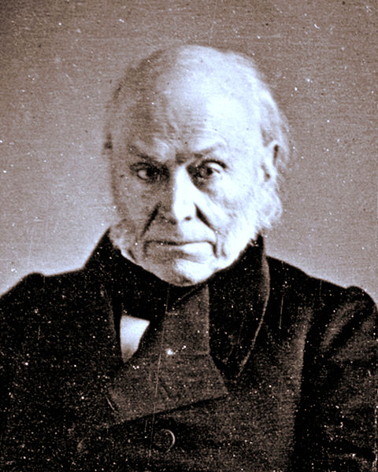

John Quincy Adams

Slide 2
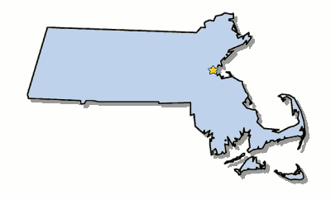
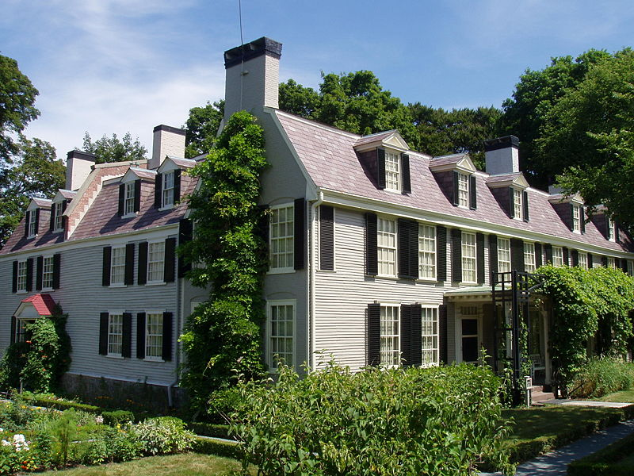
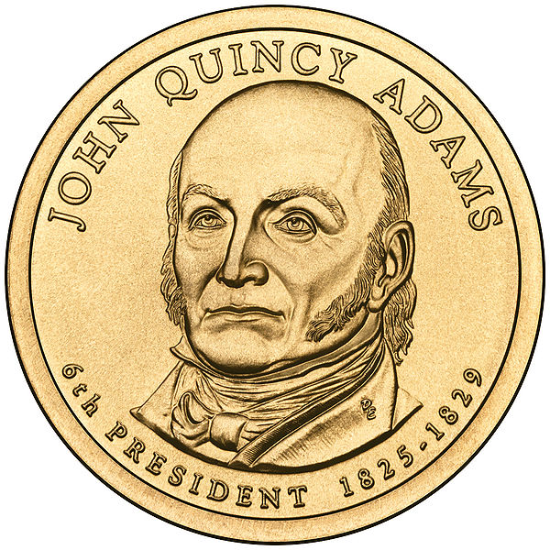
Elected in: 1824
President from: 1825-1829
Political Party: Dem-Rep
Home State: Massachusetts

Slide 3
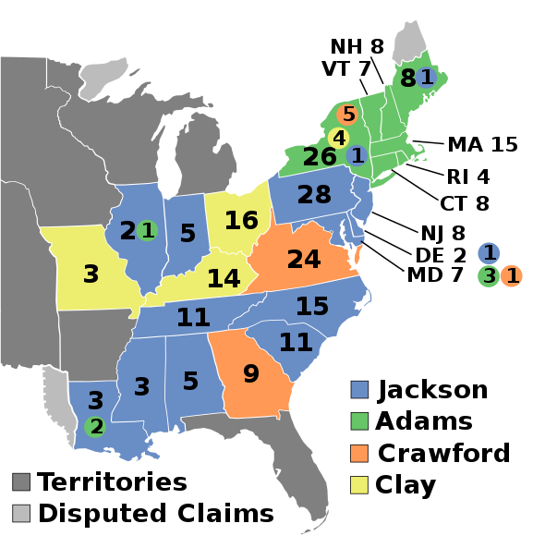
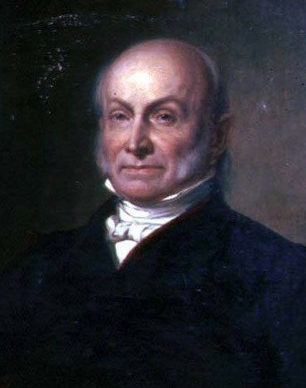
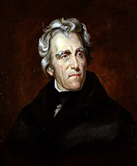
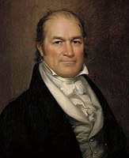
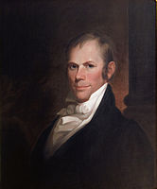
Election of 1824
Democratic-Republican: 84
President: John Quincy Adams
Democratic-Republican: 99
President: Andrew Jackson
Democratic-Republican: 41
President: William Crawford
Democratic-Republican: 37
President: Henry Clay

Slide 4
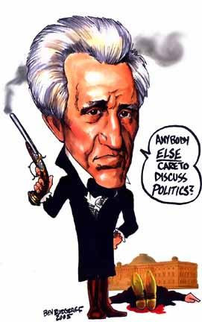
The “Corrupt Bargain”
  No candidate won a majority of the Electoral College in 1824, so the House of Rep. decided the presidency
  Henry Clay supported Adams, allowing Adams to win. Adams then made Clay the Secretary of State.
  Jackson accused Clay and Adams of a “Corrupt Bargain” and vowed to get revenge in 1828.

Slide 5
New States
None

Slide 6
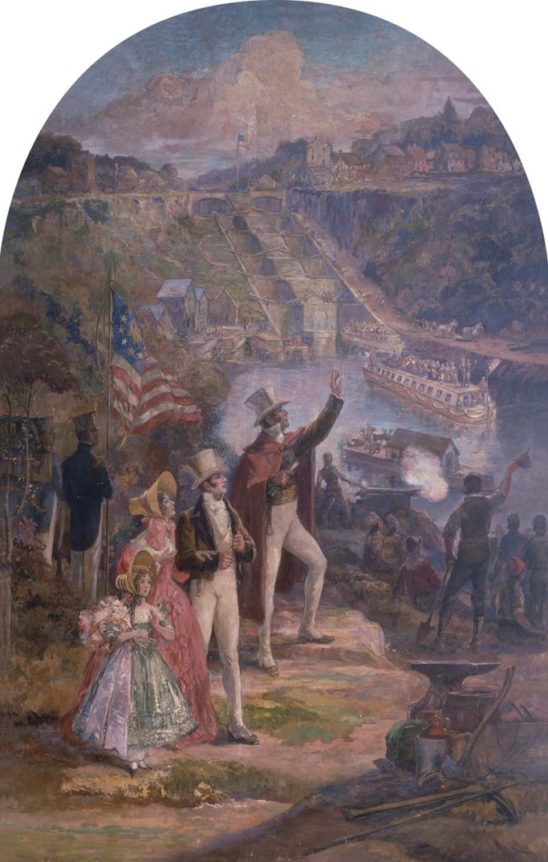
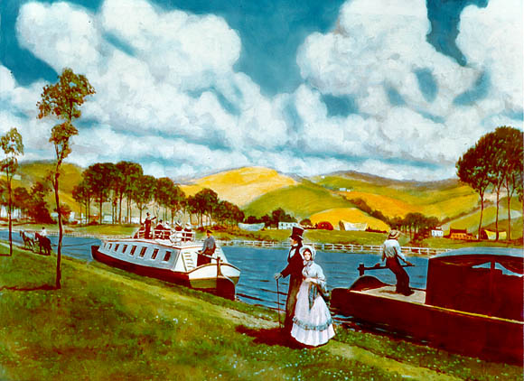
Erie Canal opens, opening the Upper Midwest/Great Lakes to settlement through New York City

Slide 7
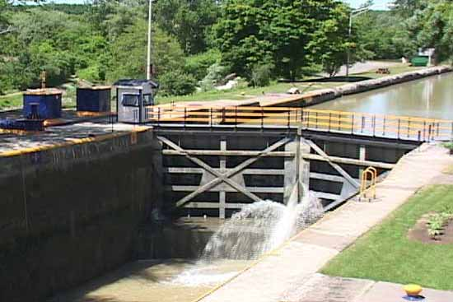
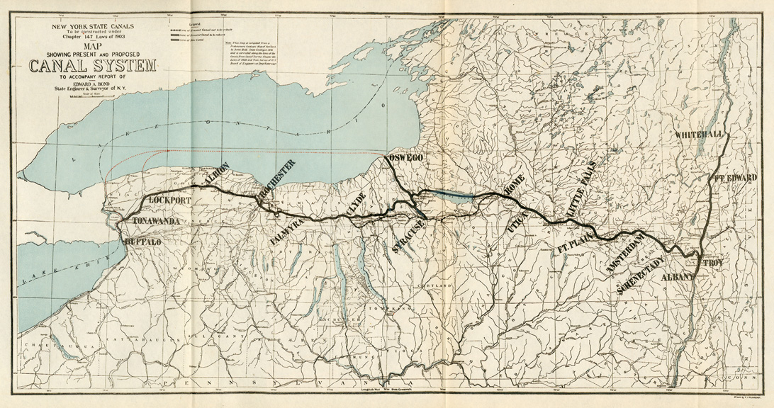

Slide 8
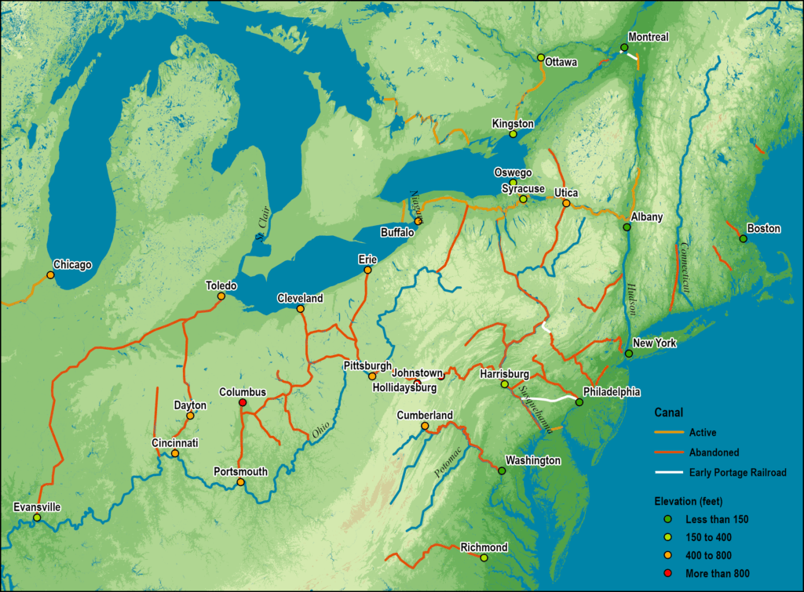

Slide 9
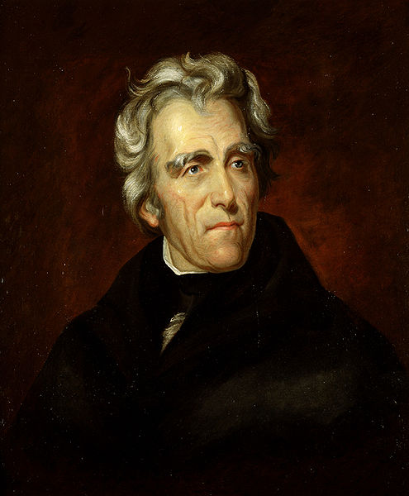

Andrew Jackson

Slide 10
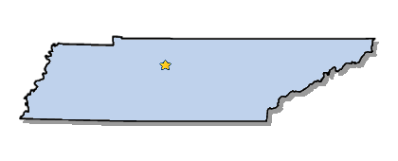
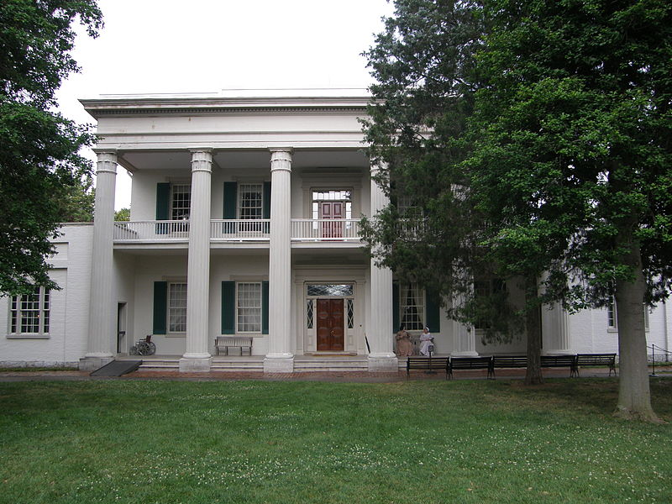
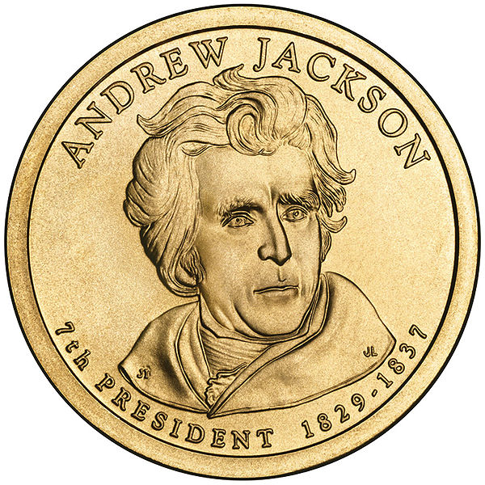
Elected in: 1828, 1832
Political Party: Democrat
President from: 1829-1837
Home State: Tennessee

Slide 11
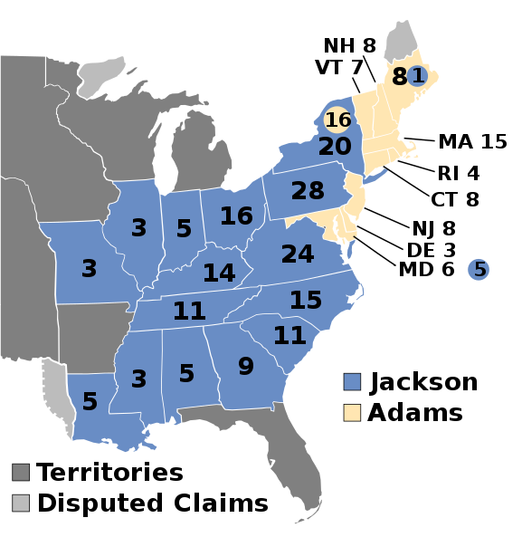

Election of 1828
“National Republican”: 83
President: John Quincy Adams
Vice President: Richard Rush
Democratic: 178
President: Andrew Jackson
Vice President: Rufus King

Slide 12
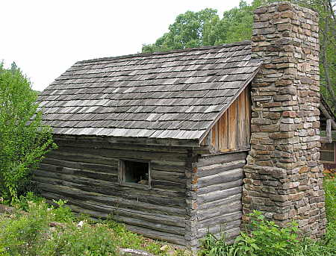
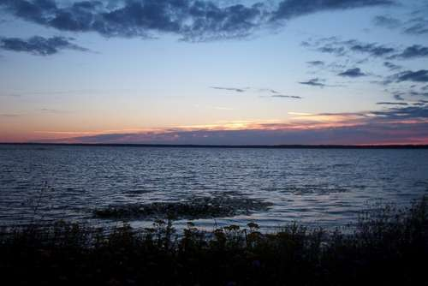
New States
25. Arkansas
26. Michigan

Slide 13
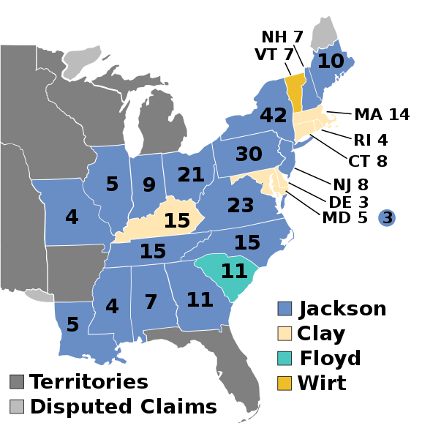

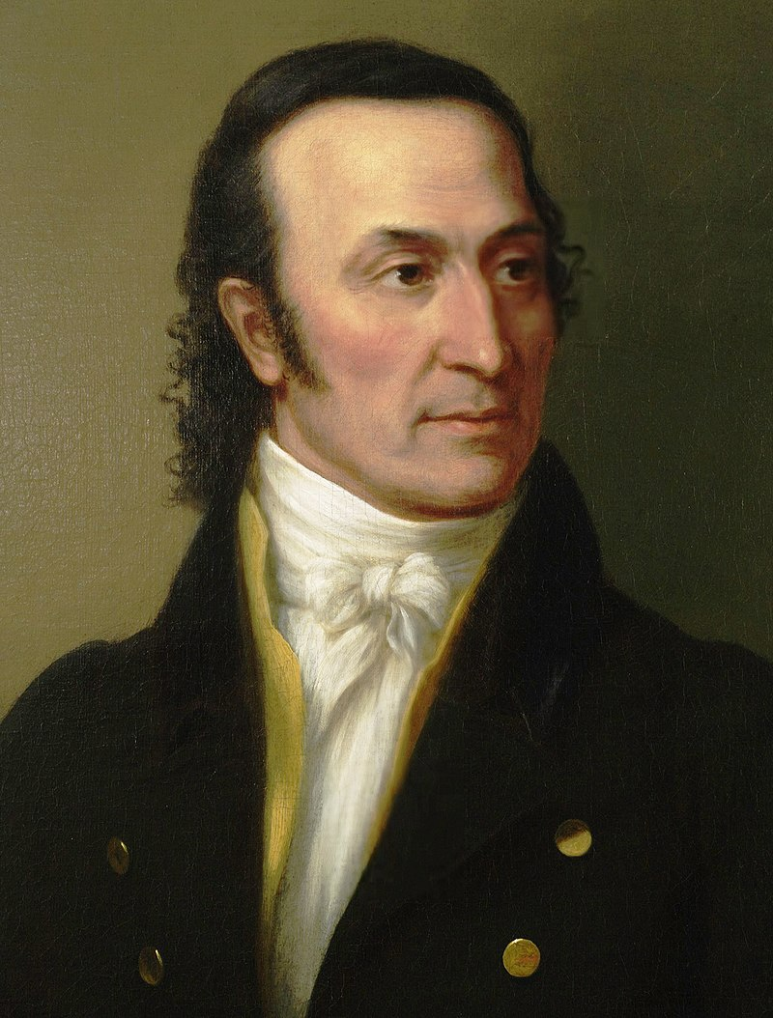
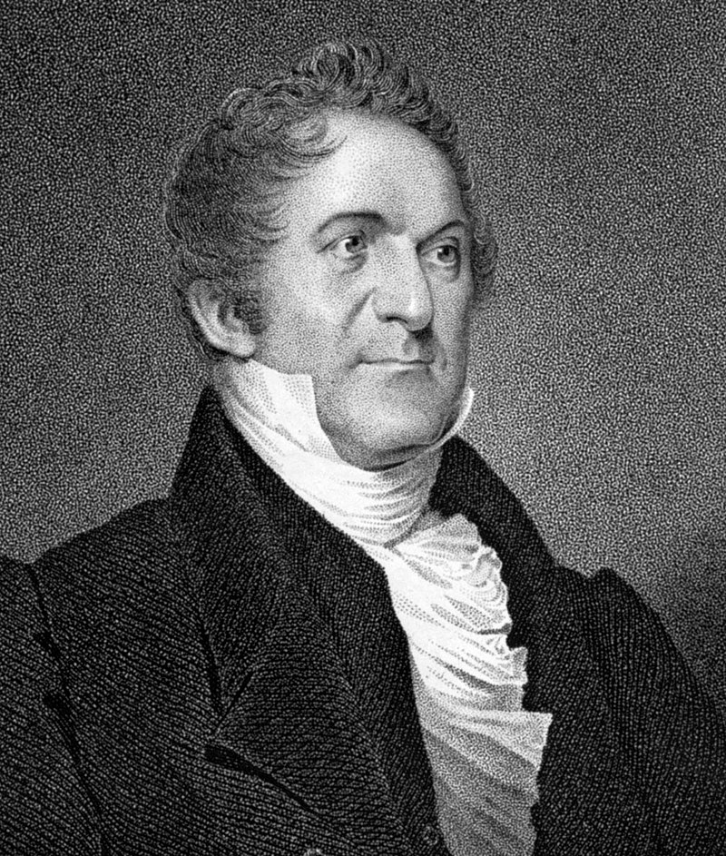
Election of 1832
Democratic: 219
President: Andrew Jackson
Vice President: Martin Van Buren
National Republican: 49
President: Henry Clay
Nullifier: 11
President: John Floyd
Anti-Masonic: 7
President: William Wirt

Slide 14
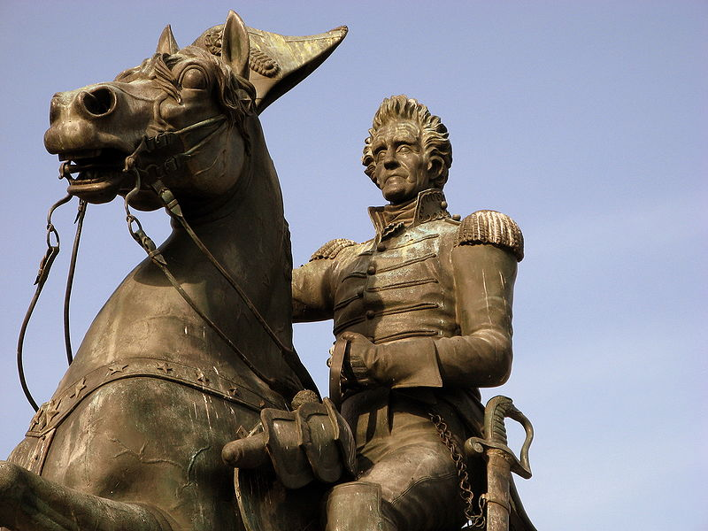

Slide 15
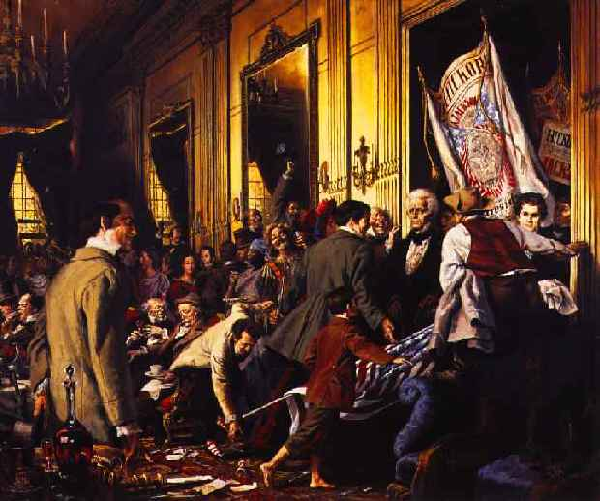
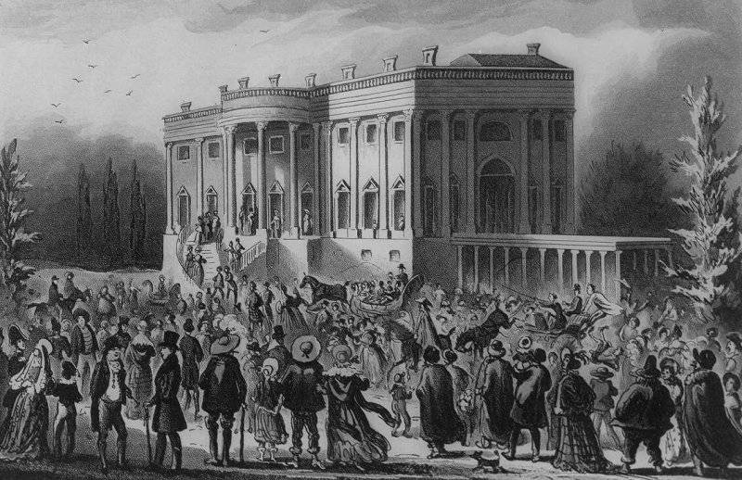
“Old Hickory”
“Jacksonian Democracy” – The Common Man’s President

Slide 16
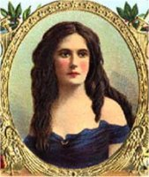
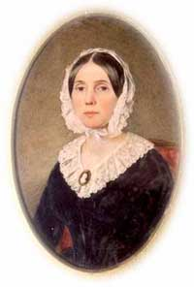
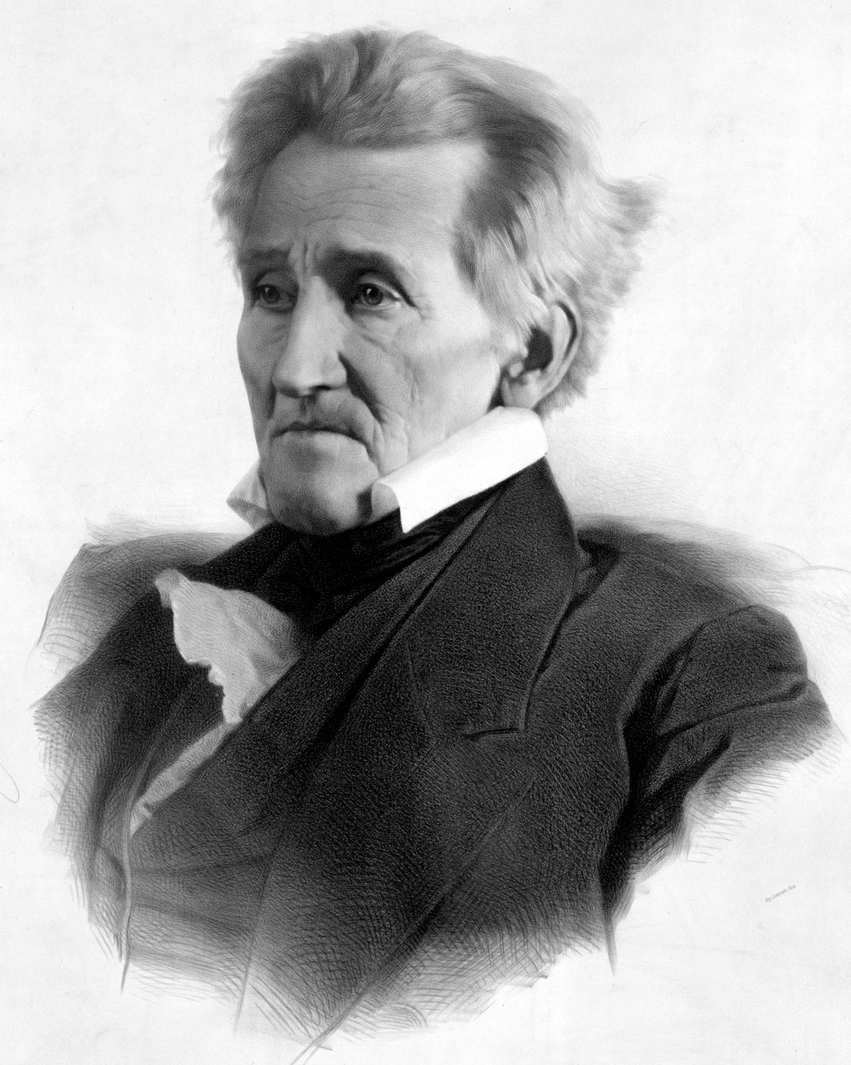
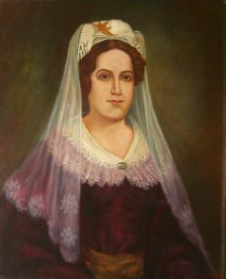
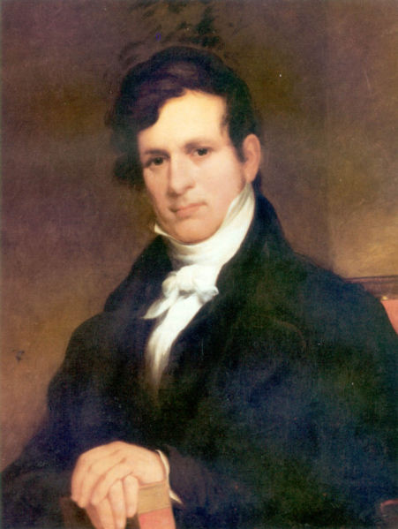
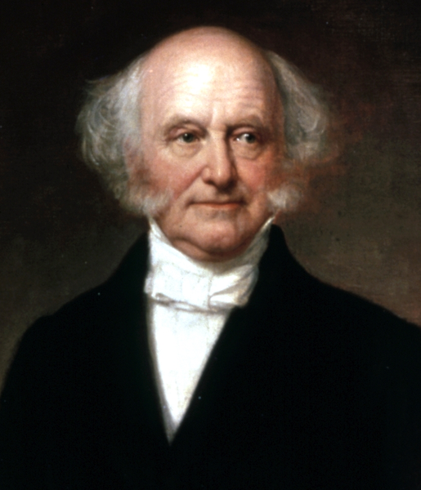
Petticoat Affair
Bitter hatred
Peggy Eaton
Madly in Love
Taking advantage of
Floride Calhoun
Rachel Jackson
Hates each other
In cahoots with
John Eaton
Martin Van Buren

Slide 17
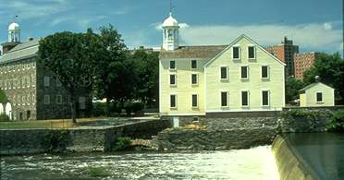
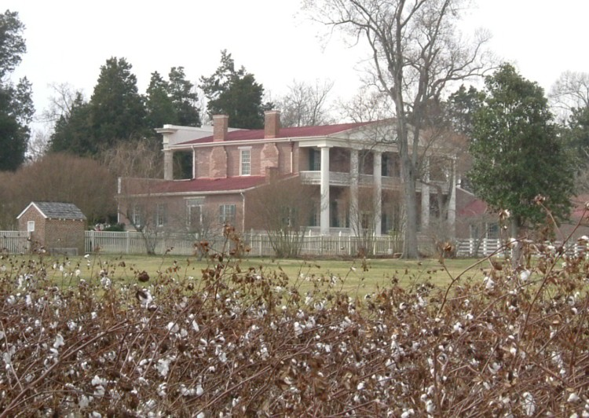
The Tariff of 1828 – AKA the ”Tariff of Abominations”
-Extremely high ( up to 45%) protective tariff supported mostly by Northerners, despised by Southerners
- The South is anti-tariff, which leads to the…

Slide 18
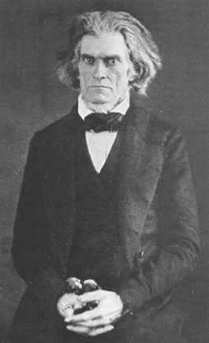
Nullification Crisis
-South Carolina threatens to nullify Federal laws it disagrees with (specifically the Tariff), or even secede from the Union. Jackson threatens to hang any “nullifier,” including his own Vice President, John C. Calhoun.
(who was in fact behind most of it.)

Slide 19
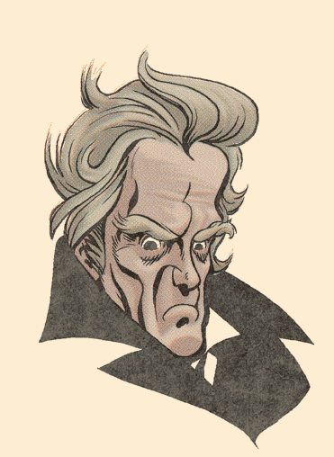
Our Federal Union:
It must be preserved!
Please give my compliments to my friends in your State and say to them, that if a single drop of blood shall be shed there in opposition to the laws of the United States, I will hang the first man I can lay my hand on engaged in such treasonable conduct, upon the first tree I can reach.

Slide 20
Nullification Crisis
-South Carolina threatens to nullify Federal laws it disagrees with (specifically the Tariff), or even secede from the Union. Jackson threatens to hang any “nullifier,” including his own Vice President, John C. Calhoun.
(who was in fact behind most of it.)
- Force Act: Gives power to the president to enforce nullified laws and collect tariffs.
-The South is eventually appeased by the compromise Tariff of 1833, which lowered most tariffs.

Slide 21
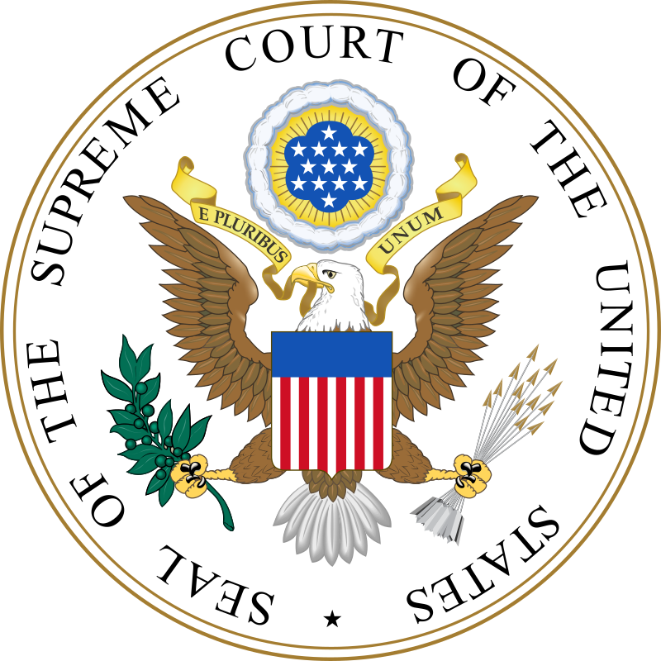
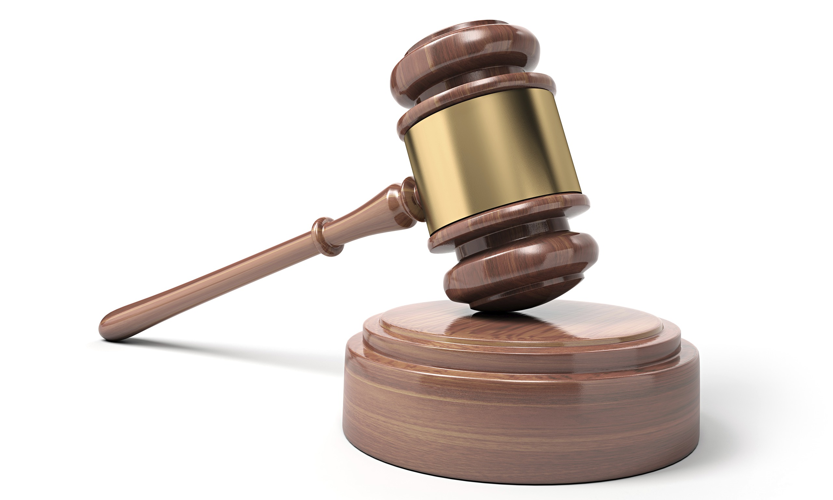
Cherokee Nation v. Georgia
1830
The case: The Cherokee sued Georgia over a state law that took away the Cherokee’s rights within their own boundaries.
The ruling: The Supreme Court refused to rule, saying the Cherokee had no right to sue.
The importance: The Supreme Court ruled that the tribes were “dependent domestic nations” and that they did not have the sovereign power to sue.
“Indian nations” are "nothing more than wandering hordes, held together only by ties of blood and habit, and having neither rules nor government beyond what is required in a savage state.” – Justice William Johnson

Slide 22
Worcester v. Georgia
1830
The case: The Cherokee sought to overturn a Georgia law that they believed illegally applied to their tribal lands.
The ruling: The Cherokee won their case, as the Court ruled Georgia had no right to interfere with tribal lands.
The importance: The Supreme Court had ruled on the relationship between tribes and the states, ruling the tribes were sovereign nations within the US.

Slide 23
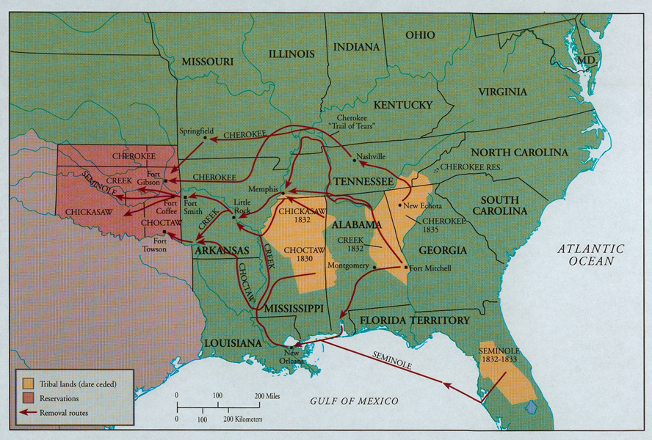
Indian Removal Act (1830): All Indian tribes living in the South (Cherokee, Creek, Chickasaw, Choctaw, and Seminole) & Northwest must be removed to a new “Indian Territory” in modern-day Oklahoma. This allowed more Southern land to be granted to white farmers and planters.
-Thousands died along the Cherokee “Trail of Tears” and in internment camps along the route.
- The Seminole Wars broke out across Florida as that tribe resisted relocation.

Slide 24
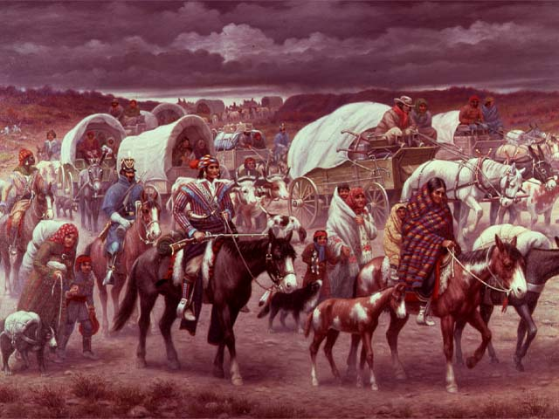

Slide 25
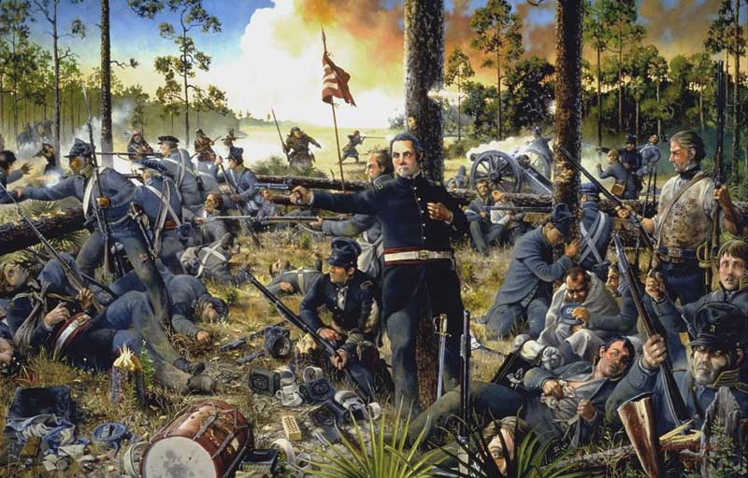

Slide 26
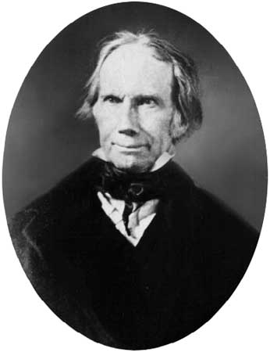
American System
Henry Clay’s
A plan to advance economic growth in the US
Had three parts:
  Protective tariffs (started in 1816)
  (To promote US manufacturing)
  A re-chartered Bank of the United States (re-chartered in 1816)
    (To issue a single currency and issue sovereign debt)
  Federal spending on internal improvements – new roads and canals (the government refused)
Though his plans dated to the Madison and Monroe years, they resurfaced during Jackson’s presidency, and Jackson was completely opposed.

Slide 27
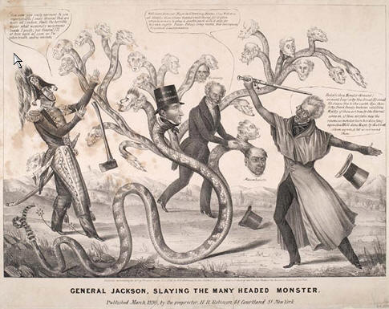
The Bank War
Jackson is against the Bank of the United States (and its head, Nicolas Biddle), believing it to be unconstitutional and favoring the wealthy elites. He vetoes the bill re-chartering the bank, and it closes in 1836.

Slide 28
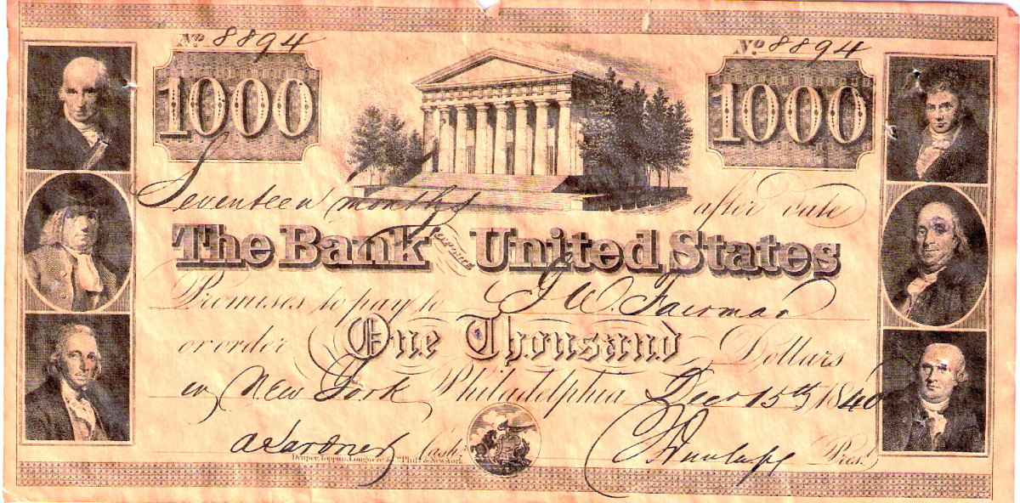
The Bank War
Pet banks: Jackson withdrew all Federal money from the bank of the United States and transferred it to state banks, or “pet banks”

Slide 29
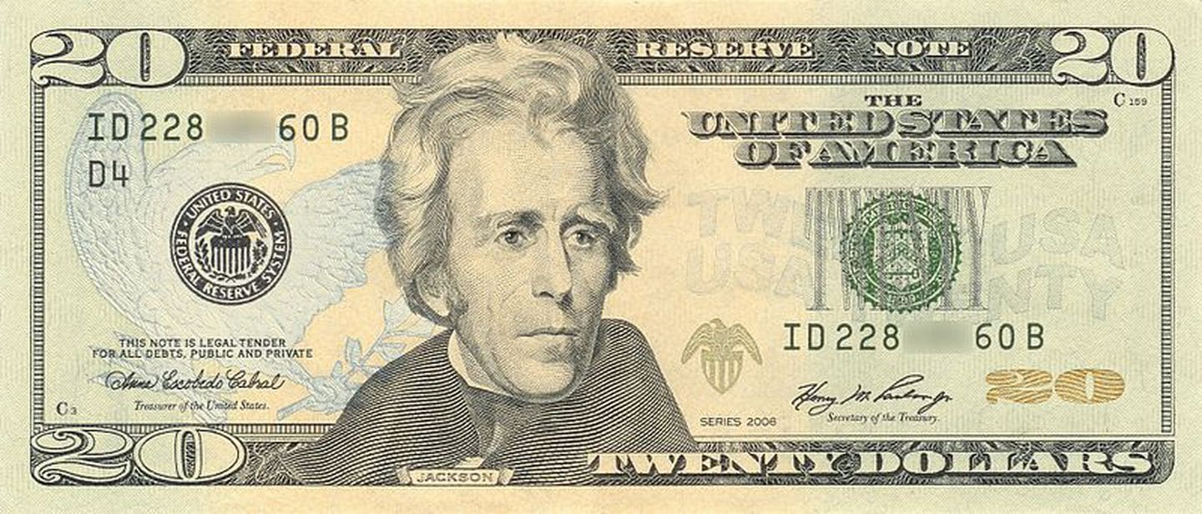
The Bank War
The Specie Circular: To counter rapid inflation (due to his own policies) in land prices, Jackson’s Specie Circular required future land sales be in gold and silver, not paper notes. This caused land prices to plummet, banknotes to lose their value, and led to the Panic of 1837 (conveniently after Jackson left office)
Oops

Slide 30
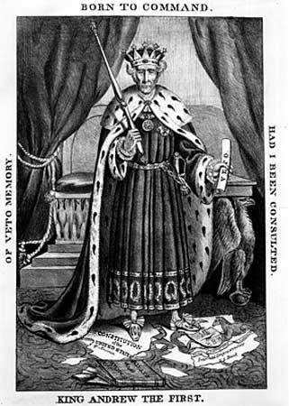
The Birth of the Whig Party
  Made up of people who oppose Andrew Jackson
  Favored Clay’s American System
  Generally anti-immigrant
  Leaders included Henry Clay and Daniel Webster
  Did not have a firm stance on slavery

Slide 31
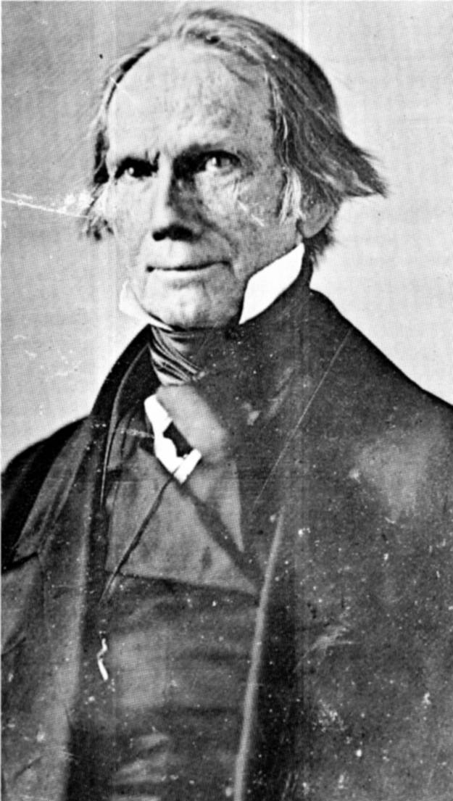
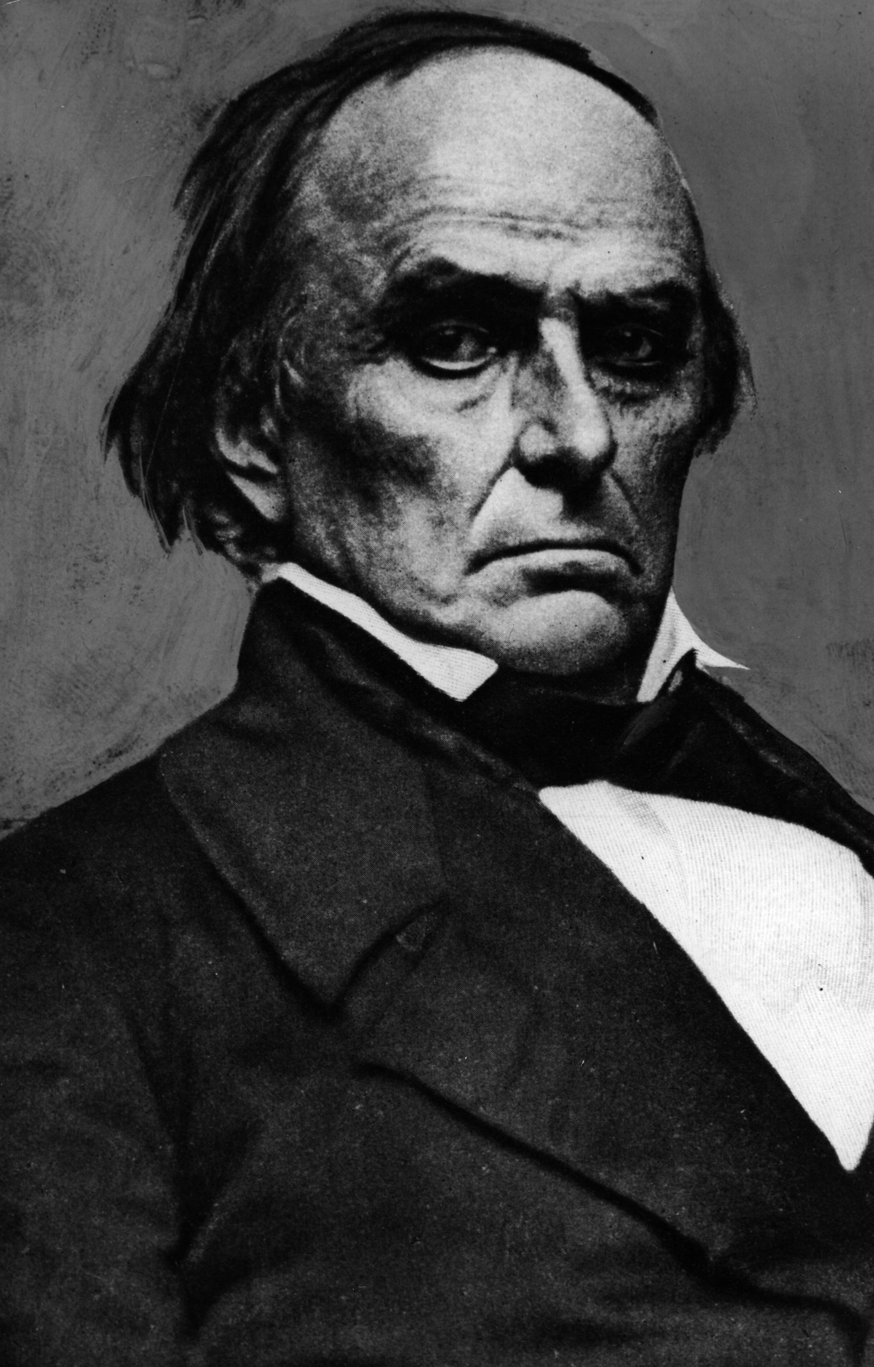
The “Great Triumvirate” (Three Great Senators)
Henry Clay
Kentucky
Daniel Webster
New Hampshire/
Massachusetts
John C. Calhoun
South Carolina

Slide 32

Liberty and Union, now and for ever, one and inseparable!

Slide 33




“Old Hickory”
Texas War for Independence
-Americans in Texas declare independence from Mexico
-Mexicans under Santa Anna invade, defeat the Texans at the Alamo, but are eventually defeated by Sam Houston at San Jacinto.

Slide 34


Slide 35


Slide 36



Slide 37


Slide 38


Martin Van Buren

Slide 39



Elected in: 1836
President from: 1837-1841
Political Party: Democrat
Home State: New York

Slide 40






Election of 1836
Democratic: 170
President: Martin Van Buren
Vice President: Richard Johnson
Whigs: 124
President: William Harrison (73)
President: Hugh White (26)
President: Daniel Webster (14)
President: Willie Mangum (11)

Slide 41
New States
None

Slide 42

The Panic of 1837
- Economic depression caused by the policies of Andrew Jackson (Specie Circular, the Bank War), overinvestment, and crashing agricultural prices.
- Lasts through the early 1840s

Slide 43

“Old Kinderhook”

Slide 44


William Henry Harrison

Slide 45





Slide 46
Let’s get the ball rolling
For Tippecanoe and Tyler too!

Slide 47



Election of 1840
Whig: 234
President: William Henry Harrison
Vice President: John Tyler
Democratic: 60
President: Martin Van Buren

Slide 48



Elected in: 1840
President from: 1841
Political Party: Whig
Home State: Ohio

Slide 49
New States
None

Slide 50


Dies in 1841

Slide 51


John Tyler

Slide 52



Elected in: Not elected
President from: 1841-1845
Political Party: Whig
Home State: Virginia

Slide 53

New States
27) Florida

Slide 54



Oregon Trail opens

Slide 55


Webster-Ashburton Treaty (1842): Settled US/Canada border in Maine and NH, avoiding war with Britain
(The Aroostook War)

Slide 56



USS Princeton Explosion:
An exploding cannon injured 20 and killed 6, including two Cabinet members, a Navy officer, and NY representative Gardiner.

Slide 57


James K. Polk

Slide 58


Elected in: 1844
President from: 1845-1849
Political Party: Democrat
Home State: Tennessee

Slide 59


Election of 1844
Democratic: 170
President: James K. Polk
Vice President: George Dallas
Whig: 105
President: Henry Clay
54 40’ Or Fight
And the Annexation of Texas!

Slide 60



New States
28) Texas
29) Iowa
30) Wisconsin

Slide 61

US takes control of the southern half of Oregon Country.

Slide 62

“Young Hickory”
Mexican War

Slide 63


Immediate Causes:
-Boundary & sovereignty disputes with Mexico
-Mexican refusal to sell California
Long-Term Causes:
-Manifest Destiny?
- “Slave Power”?

Slide 64


General Zachary Taylor
“Old Rough & Ready”
General Winfield Scott
“Old Fuss & Feathers”

Slide 65




Slide 66


Mexican War ends with the Treaty of Guadeloupe Hidalgo. The North generally opposes the war and the land, the South supports it.
Mexico recognizes the Rio Grande as the southern boundary of Texas
US takes possession of Mexican territories of California and New Mexico.
US gives Mexico $15 million
WILMOT PROVISO: Bill to forbid slavery in any territory acquired from Mexico. Bill fails to pass the Senate.

Slide 67


Millions of Irish immigrate to America due to the Potato Famine (1845-50). They tend to settle in cities.
-Nativist groups spring up across the US, notably the “Know-Nothings”
- Anti-Catholic/immigrant mob violence in major American cities

Slide 68





-- --- .-. … . -.-. --- -.. .

Slide 69


Slide 70



Mormons settle in Utah
The Church of Jesus Christ of Latter-Day Saints started in New York (The Burned Over Area) and New England in the 1820s. After being run out of Ohio, Missouri, and Illinois (where founder Joseph Smith was killed), Brigham Young lead the Mormons to a new settlement near the Great Salt Lake in 1847.

Slide 71


Zachary Taylor

Slide 72



Elected in: 1848
President from: 1849-1850
Political Party: Whig
Home State: Kentucky (?)

Slide 73



Election of 1848
Whig: 163
President: Zachary Taylor
Vice President: Millard Fillmore
Whig: 127
President: Lewis Cass

Slide 74
New States
None

Slide 75


California Gold Rush (1848-1855)
-300,000 arrive in California from across the world after the discovery of gold at Sutter’s Mill in California
-Miners often referred to as “49ers”
-Led to destruction of native communities, rapid population growth, and many boom towns (and then ghost towns).

Slide 76


Slide 77







Slide 78

Dies in 1850.
On a hot July day Taylor had attempted to cool himself with large amounts of cherries and iced milk. In the unhealthy climate of Washington, with its open sewers and flies, Taylor came down with acute gastroenteritis. He might have recovered but his doctors
drugged him with ipecac, calomel, opium and quinine (at 40 grains a whack), and bled and blistered him too.
On July 9, he gave up the ghost.

Slide 79


Millard Fillmore

Slide 80


Elected in: Not elected
President from: 1850-1853
Political Party: Whig
Home State: New York

Slide 81

New States
31) California

Slide 82

Compromise of 1850
California wants to become a free state, upsetting the free/slave state balance and setting precedent for Mexican Cession territory.
15 Free States
36 30
15 Slave States

Slide 83


I wish to speak to-day, not as a Massachusetts man, nor as a Northern man, but as an American…I speak to-day for the preservation of the Union. Hear me for my cause. There can be no such thing as peaceable secession. Peaceable secession is an utter impossibility…No, Sir! No, Sir! I will not state what might produce the disruption of the Union; but, Sir, I see as plainly as I see the sun in heaven what that disruption itself must produce; I see that it must produce war, and such a war as I will not describe…” -Daniel Webster, Massachusetts
In that case California will become the test question. If you admit her under all the difficulties that oppose her admission, you compel us to infer that you intend to exclude us from the whole of the acquired Territories, with the intention of destroying irretrievably the equilibrium between the two sections. We should be blind not to perceive in that case that your real objects are power and aggrandizement, and infatuated, not to act accordingly.
– John C. Calhoun, South Carolina

Slide 84


I have heard something said on this and a former occasion about allegiance to the South. I know no South, no North, no East, no West, to which I owe any allegiance. I owe allegiance to two sovereignty, and only two: one is the sovereignty of this Union, and the other is the sovereignty of the state of Kentucky. My allegiance is to this Union and to my state; but if gentlemen suppose they can exact from me an acknowledgement of allegiance to any ideal or future contemplated confederacy of the South, I here declare that I owe no allegiance to it.
– Henry Clay, Kentucky
The people of the whole country, North and South, are beginning to see that there is nothing in this controversy which seriously affects the interests, invades the rights, or impugns the honor of any section or State of the Confederacy. They will not consent that this question shall be kept open for the benefit of politicians…The people will not sanction any such movement…The Union will not be put in peril; California will be admitted; governments for the territories must be established; and thus the controversy will end, and I trust forever. - Stephen Douglas, Illinois

Slide 85


Compromise of 1850
California becomes a free state
No slave trading in the District of Columbia
Texas relinquishes land claims in New Mexico for debt relief

Slide 86



Compromise of 1850
A tough Fugitive Slave Act
  (all runaways must be returned to their masters, wherever found)
Popular Sovereignty in Utah, New Mexico - Texas gives up claims to New Mexico in return for debt relief.

Slide 87


Underground Railroad
Not underground or a railroad, but a secret way of getting escaped African Americans to Canada

Slide 88


Slide 89


Slide 90


Slide 91


Franklin Pierce

Slide 92



Elected in: 1852
President from: 1853-1857
Political Party: Democrat
Home State: New Hampshire

Slide 93



Election of 1852
Democratic: 254
President: Franklin Pierce
Vice President: William King
Whig: 42
President: Winfield Scott

Slide 94


Perry’s Expedition (1854): Commodore Matthew Perry and a fleet of US Navy ships arrived in Japan and, by threat of force, opened Japan to trade (Kanagawa Treaty).

Slide 95


Kansas-Nebraska Act
-Stephen Douglas of Illinois wants to build a northern transcontinental railroad through Chicago. In order to get Southern support, the bill will organize two new territories, and allow them popular sovereignty over slavery (they were formerly free areas according to the Missouri Compromise)

Slide 96


Slide 98


Slide 99


“Bleeding Kansas”
Northern (Jayhawks) and Southern (bushwhackers) migrants move to Kansas, hoping to influence the vote on slavery there.
Each form their own rival governments (Topeka and LeCompton) and, after Missouri “border ruffians” commit rampant election fraud. fighting breaks out (Sack of Lawrence, Pottawatomie Creek)

Slide 100



Gadsden Purchase
Ostend Manifesto
Walker Expedition

Slide 101

“I must say something of a general character [about] Senators who have raised themselves to eminence on this floor in championship of human wrongs. I mean the Senator from South Carolina (Mr. Butler), and the Senator from Illinois (Mr. Douglas), who…sally forth together in the same adventure….The Senator from South Carolina has read many books of chivalry, and believes himself a chivalrous knight, with sentiments of honor and courage. Of course he has chosen a mistress to whom he has made his vows, and who, though ugly to others, is always lovely to him; though polluted in the sight of the world, is chaste in his sight I mean the harlot, Slavery. For her, his tongue is always profuse in words. Let her be impeached in character, or any proposition made to shut her out from the extension of her wantonness, and no extravagance of manner or hardihood of assertion is then too great for this Senator…The asserted rights of Slavery, which shock equality of all kinds, are cloaked by a fantastic claim of equality. If the slave States cannot enjoy what, in mockery of the great fathers of the Republic, he misnames equality under the Constitution in other words, the full power in the National Territories to compel fellowmen to unpaid toil, to separate husband and wife, and to sell little children at the auction block then, sir, the chivalric Senator will conduct the State of South Carolina out of the Union!”
-Charles Sumner, The Crimes Against Kansas

Slide 102




Birth of the Republican Party (1854)
Against the spread of slavery (Free Soil)
Mostly made up of New England Yankees and their descendants in NY and upper Midwest
Often former Whigs
Free Land, Free Soil, Free Speech, Free Labor, Free Men

Slide 103


James Buchanan

Slide 104



Elected in: 1856
President from: 1857-1861
Political Party: Democrat
Home State: Pennsylvania

Slide 105




Election of 1856
Democratic: 174
President: James Buchanan
VP: John Breckinridge
Republican: 114
President: John C. Fremont
Know-Nothing: 8
President: Millard Fillmore

Slide 106



New States
32) Minnesota
33) Oregon
34) Kansas

Slide 107
Dred Scott v. Sandford
1857
The case: First a slave in Missouri, Dred Scott was brought to Wisconsin Territory for 2 years as a free man. He argued he was still free upon his return to Missouri.
The ruling: Supreme Court ruled against Scott, saying as a black man Scott had no right to sue; Congress had no right to deprive any person of their property, and therefore Missouri Compromise was unconstitutional.
The importance: Slavery now allowed in all US territories, African Americans are not citizens and have no rights according the Constitution.

Slide 108


“We think ... that [black people] are not included…under the word "citizens" in the Constitution, and can therefore claim none of the rights and privileges which that instrument provides for and secures to citizens of the United States. On the contrary, they were at that time [of America's founding] considered as a subordinate and inferior class of beings who had been subjugated by the dominant race…and had no rights or privileges but such as those who held the power and the Government might choose to grant them….”
“It is difficult at this day to realize the state of public opinion in relation to that unfortunate race, which prevailed in the civilized and enlightened portions of the world at the time of the Declaration of Independence, and when the Constitution of the United States was framed and adopted. ... They had for more than a century
before been regarded as beings of an inferior order ... and so far inferior, that they had no rights which the white man was bound to respect; and that the negro might justly and lawfully be reduced to slavery for his benefit.”
-Chief Justice Roger B. Taney

Slide 109

Lincoln-Douglas Debates (1858)
Series of debates between Abraham Lincoln (R) and Stephen Douglas (D), candidates for Senator from Illinois.
Douglas won the election, but the debates made Lincoln famous in Republican circles, leading to his nomination for President in 1860.

Slide 110


“I do not question Mr. Lincoln’s conscientious belief that the negro was made his equal, and hence is his brother, but for my own part, I do not regard the negro as my equal, and positively deny that he is my brother or any kin to me whatever. … Lincoln … holds that the negro was born his equal and yours, and that he was endowed with equality by the Almighty, and that no human law can deprive him of these rights which were guarantied to him by the Supreme ruler of the Universe. Now, I do not believe that the Almighty ever intended the negro to be the equal of the white man.” – Stephen Douglas
That is the real issue. That is the issue that will continue in this country when these poor tongues of Judge Douglas and myself shall be silent. It is the eternal struggle between these two principles -- right and wrong -- throughout the world. They are the two principles that have stood face to face from the beginning of time, and will ever continue to struggle. The one is the common right of humanity and the other the divine right of kings. It is the same principle in whatever shape it develops itself. It is the same spirit that says, 'You work and toil and earn bread, and I'll eat it.' No matter in what shape it comes, whether from the mouth of a king who seeks to bestride the people of his own nation and live by the fruit of their labor, or from one race of men as an apology for enslaving another race, it is the same tyrannical principle.
”There is no reason in the world why the negro is not entitled to all the natural rights enumerated in the Declaration of Independence--the right of life, liberty, and the pursuit of happiness. I hold that he is as much entitled to these as the white man. I agree with Judge Douglas he is not my equal in many respects--certainly not in color, perhaps not in intellectual and moral endowments; but in the right to eat the bread without the leave of any body else which his own hand earns, he is my equal and the equal of Judge Douglas, and the equal of every living man.“ -Abraham Lincoln

Slide 111



John Brown’s raid on Harper’s Ferry
-Abolitionist John Brown attempts to start a slave rebellion, but is caught, tried for treason, and hanged.

Slide 112


Slide 113





Election of 1860
Republican: 180
President: Abraham Lincoln
VP: Hannibal Hamlin
Democratic: 12
President: Stephen Douglas
Southern Democratic: 72
President: John Breckenridge
Constitutional Union: 39
President: John Bell

Slide 114


Southern secession
begins after Lincoln wins
election of 1860.

Slide 115


South Carolina – Dec. 20, 1860

Slide 116

Mississippi– January 9, 1861

Slide 117

Florida– January 10, 1861

Slide 118

Alabama– January 11, 1861

Slide 119

Georgia– January 19, 1861

Slide 120

Louisiana– January 26, 1861

Slide 121

Texas– February 1, 1861

