Slide 1
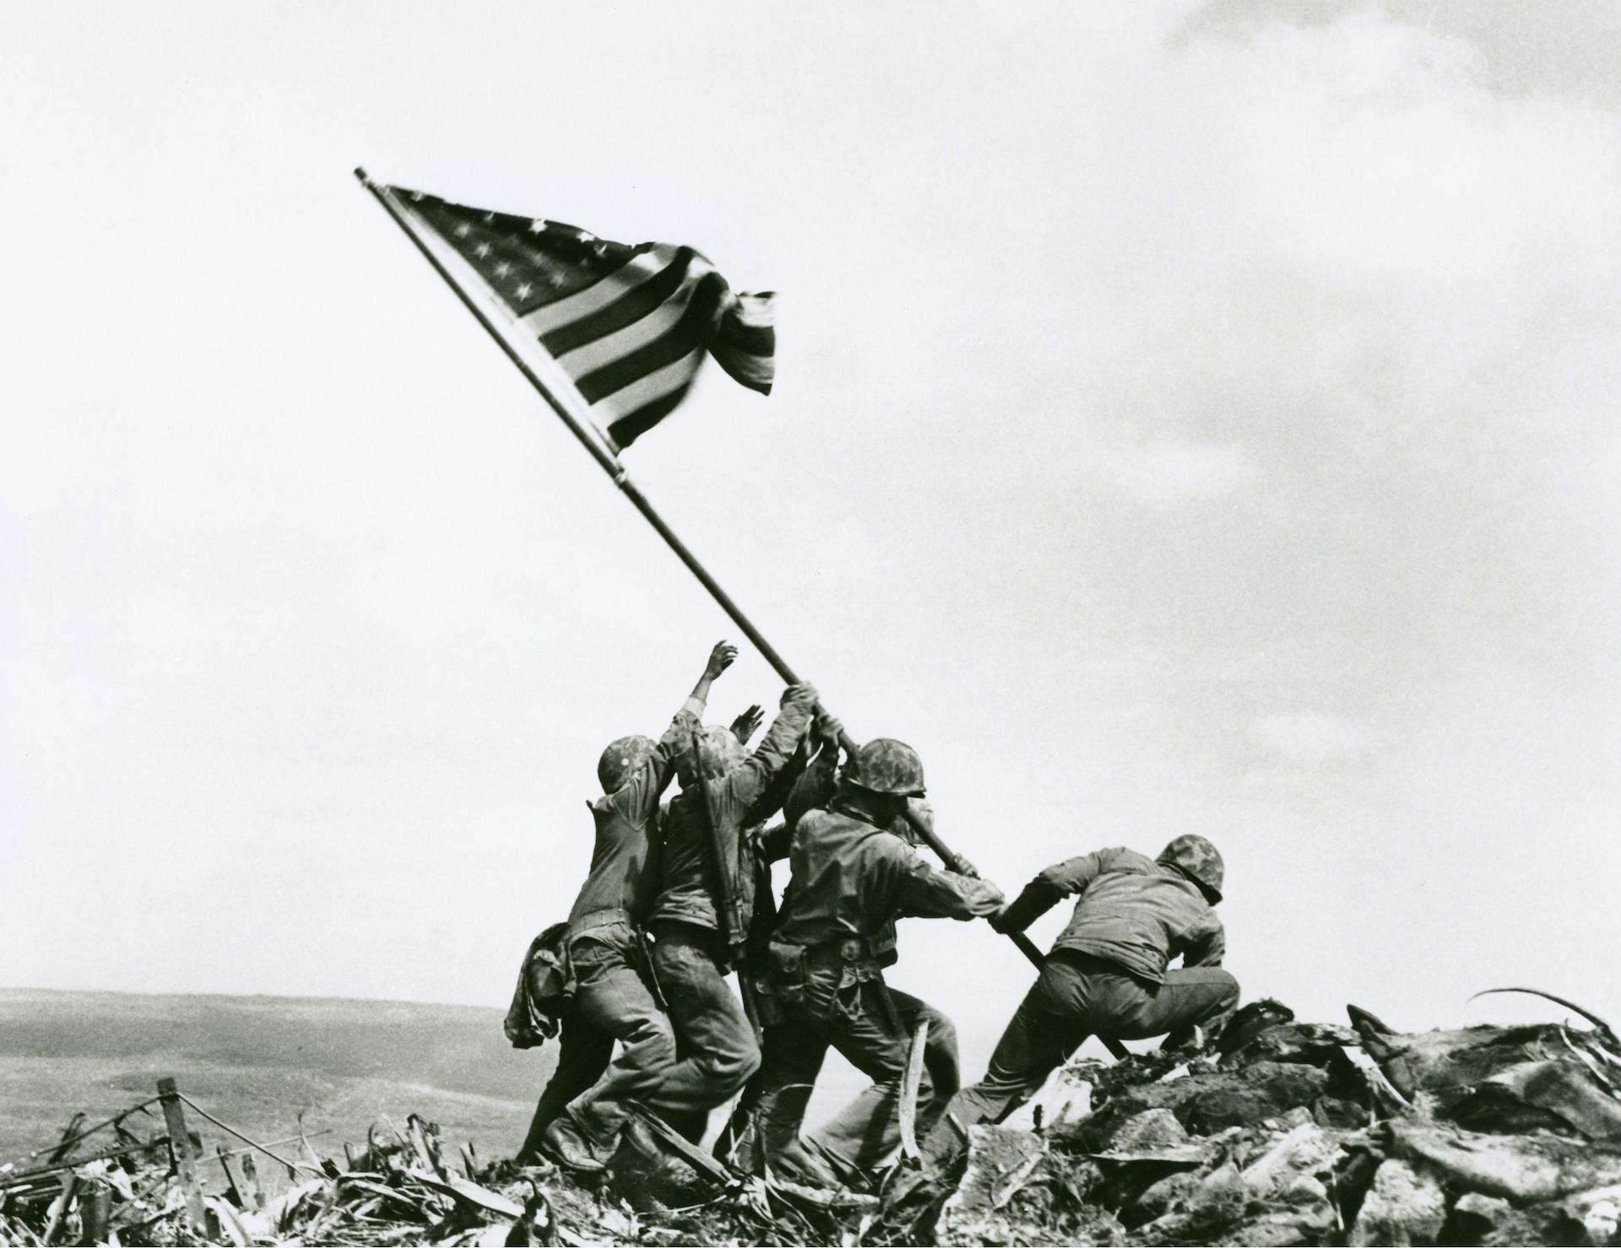
World War II

Slide 2
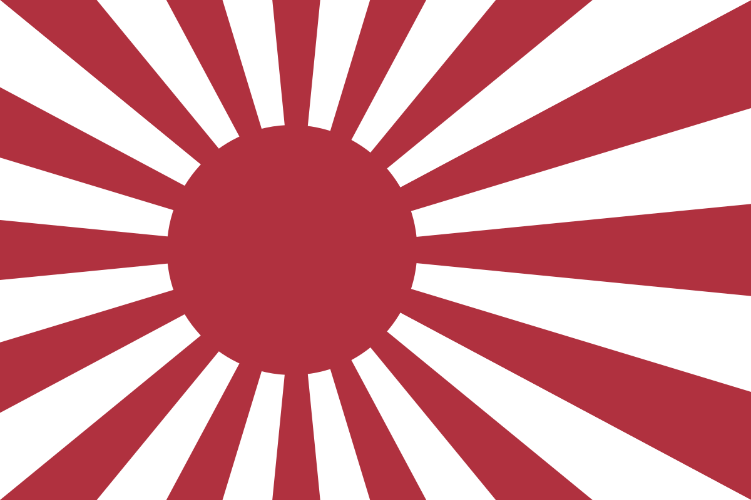
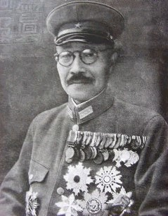
Rise of Fascists and Militarists JAPAN
Japanese leaders: Emperor Hirohito, Prime minister Hideki Tojo
In the 1930s it captured Korea, Manchuria, and invaded China committing multiple atrocities against the Chinese people, such as the “Rape of Nanjing”
Looked to southeast Asia for raw materials
Reason: Wanted an Empire, raw materials and resources

Slide 3
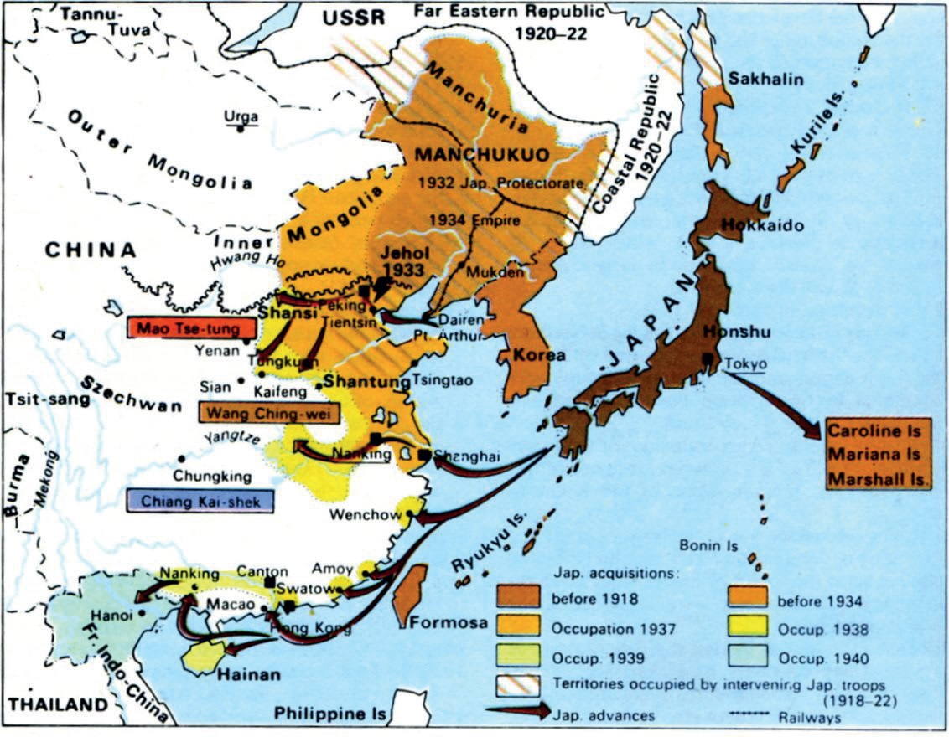

Slide 4
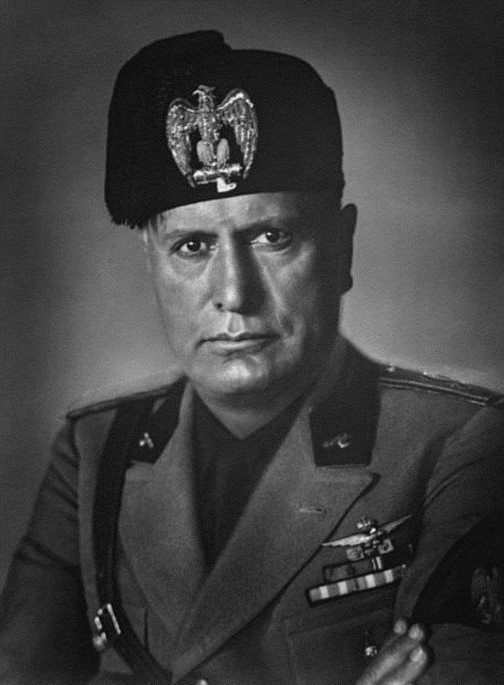
Rise of Fascists and Militarists ITALY
Leader: Benito Mussolini
Fascist totalitarian government pledged to control all aspects of people’s lives to improve the cultural, economic, and moral lives of Italians
In the 1920s and 30s Italy took control of Libya, Ethiopia, Albania, and was looking to form a “Second Roman Empire”
Reason: Nationalism, territorial ambitions

Slide 5
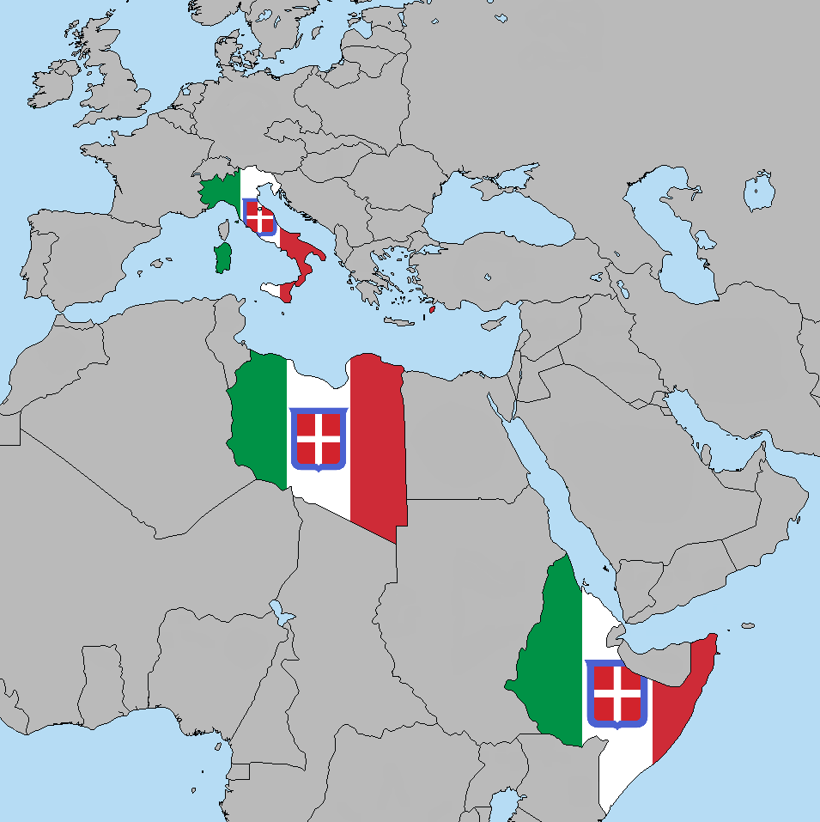

Slide 6
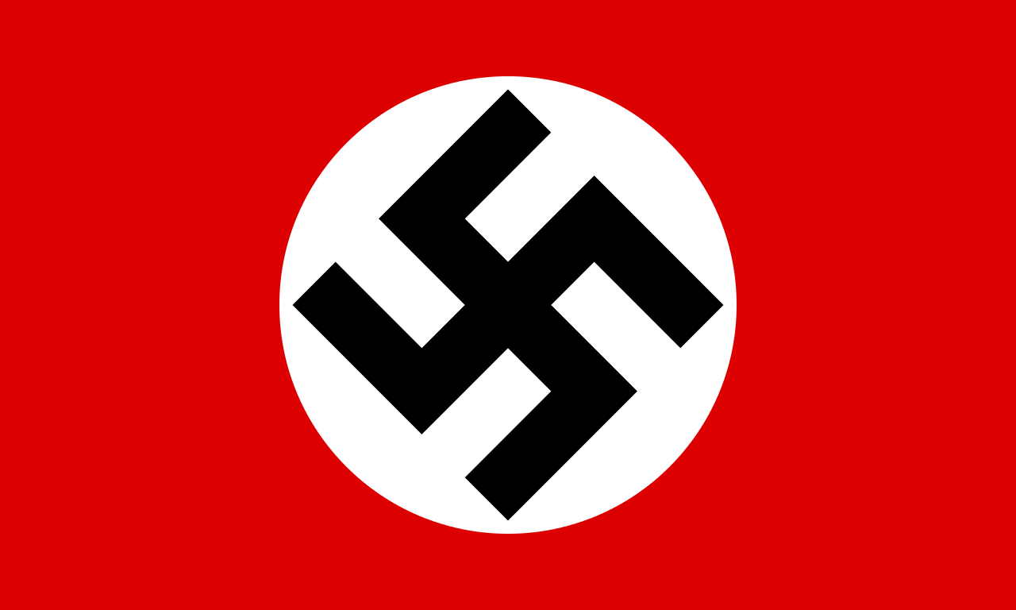
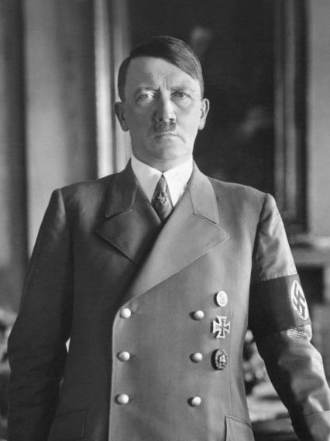
Rise of Fascists and Militarists GERMANY
Leaders: Adolf Hitler (Chancellor/Führer)
Heinrich Himmler – Leader of the SS
The National Socialist (Nazi) Party took control in Germany in the early 1930s through intimidation and political violence
It pledged to end the injustices of the Treaty of Versailles, eliminate the Jews and other undesirable (non-“Aryan”) people, unite all German people, destroy communism, and expand Germany’s territory
Reason: Nationalism, territorial ambitions, Social Darwinism

Slide 7
Rise of Nazi Germany
1920
1921
1922
1923
1924
Beer Hall Putsch
Hitler joins the Nazi Party
Hitler becomes leader of the Nazis, the “Brownshirts” are formed
Nazis attempt to overthrow the Bavarian government fails.
Hitler spends 10 months in jail, writes “Mein Kampf”

Slide 8
Rise of Nazi Germany
1925
1926
1927
1928
1929
The SS are formed – the Nazi party militia
Hitler Youth are formed
First party rally at Nuremburg
Great Depression hits – Nazis become much more popular

Slide 9
Rise of Nazi Germany
1930
1931
1932
1933
1934
Step 5 Title
Nazis become 2nd largest party in the Reichstag (German Parliament)
Nazis becomes largest party in German Parliament (37.4%)
Hitler appointed German Chancellor; Reichstag burns; Hitler given dictatorial powers; unions and parties banned and books burned, Dachau opened
Hitler combines roles of Chancellor and President of Germany

Slide 10
Rise of Nazi Germany
1935
1936
1937
1938
1939
Step 5 Title
Homosexuals, Jehovahs Witnesses outlawed. Anti-Semitic Nuremberg laws passed,
Saarland reoccupied
Berlin Olympics. Jesse Owens (USA) wins 4 gold medals.
Buchenwald concentration camp opens
Austria annexed, Munich Agreement, Sudetenland annexed.
Kristallnacht
Germany invades Poland, World War II starts

Slide 11
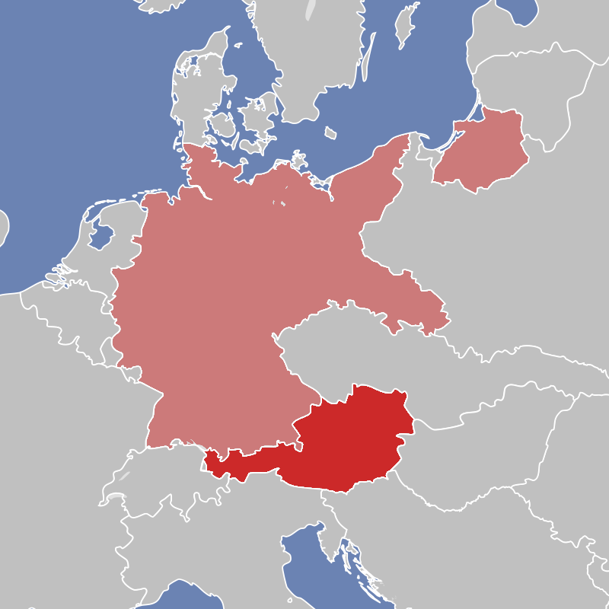
Annexation of Austria and Czechoslovakia
March 1938 Nazi Germany annexed Austria, called the “Anschluss”.
In September 1938, at the Munich Conference, Germany was allowed to annex the Sudetenland, an area of Czechoslovakia inhabited by Germans. The British and French agreed, so long as Hitler didn’t annex anywhere else. This was seen as appeasement.
In March 1939 Germany took the rest of the Czech Republic. Europe said nothing.

Slide 12
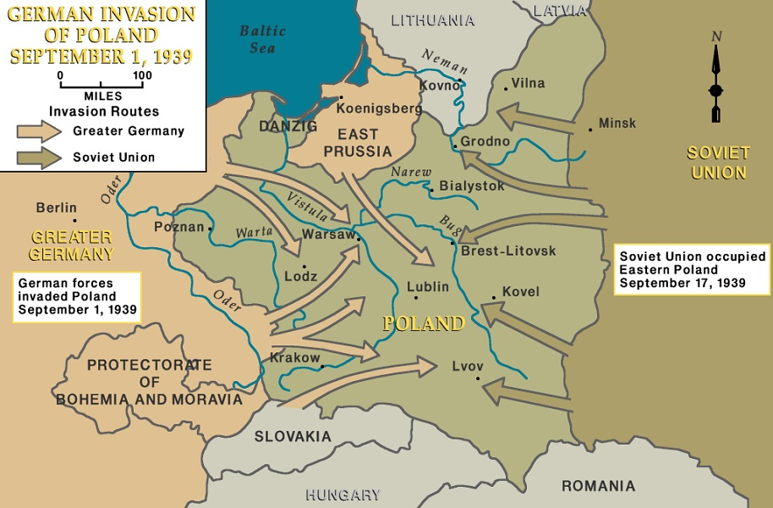
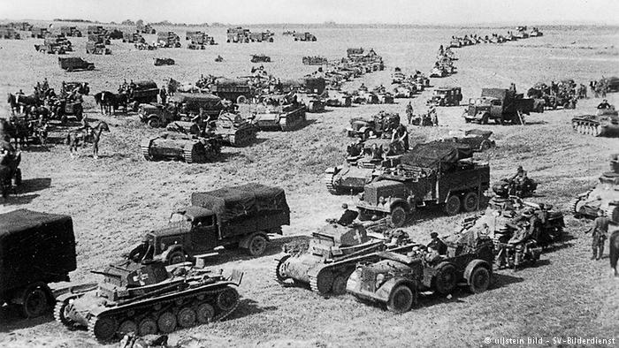
The War Begins
In August 1939 the USSR and Germany signed a non-aggression treaty, and divided Poland and the Baltic countries between them.
On September 1, 1939, Germany invaded Poland in a blitzkrieg – “lightning war.” USSR invaded from the east 2 weeks later.
France & the United Kingdom demanded Germany give back Poland or face war. War was declared a few days later.

Slide 13
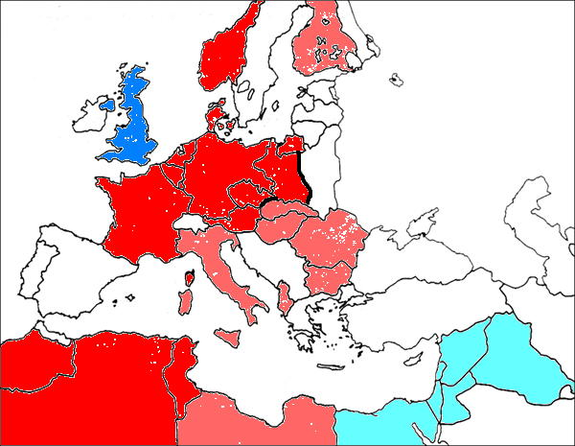
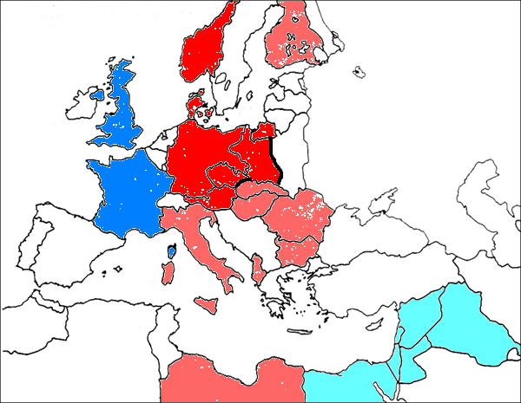
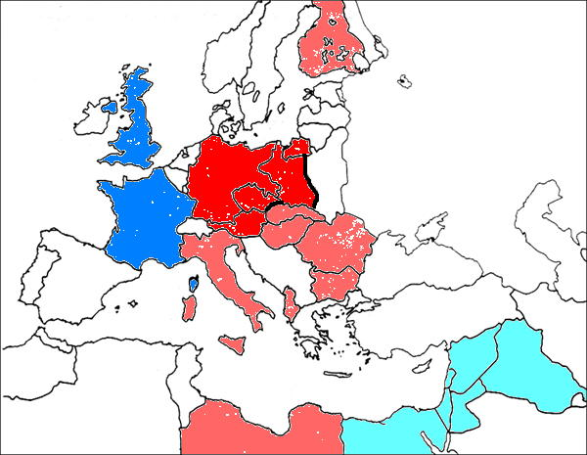
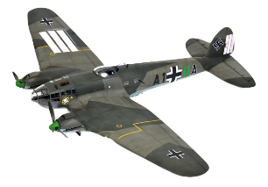
April 1940: Germany conquers Denmark and Norway
May 1940: Germany conquers the Netherlands, Belgium, and Luxembourg
June 1940: Germany conquers France, Allied troops evacuated from Dunkirk, France.
July 1940: Air battle over Britain begins, Russia conquers Baltic republics.
June 1941: Germany invades Russia

Slide 14
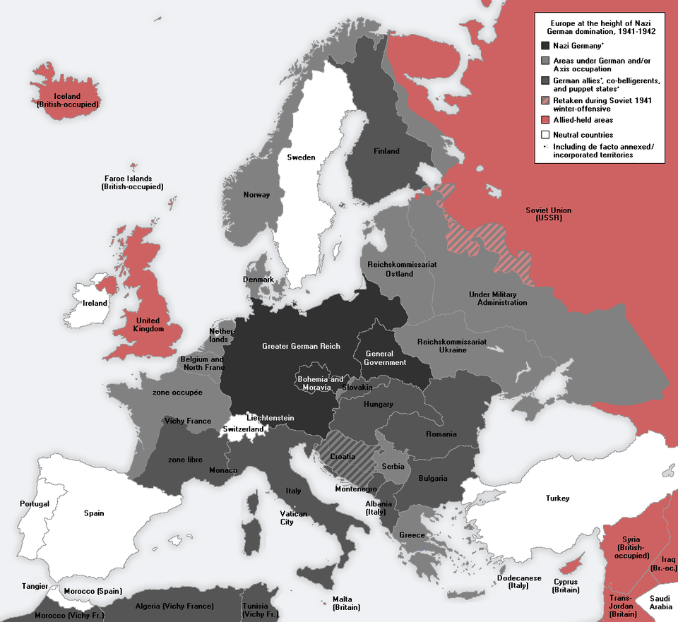

Slide 15
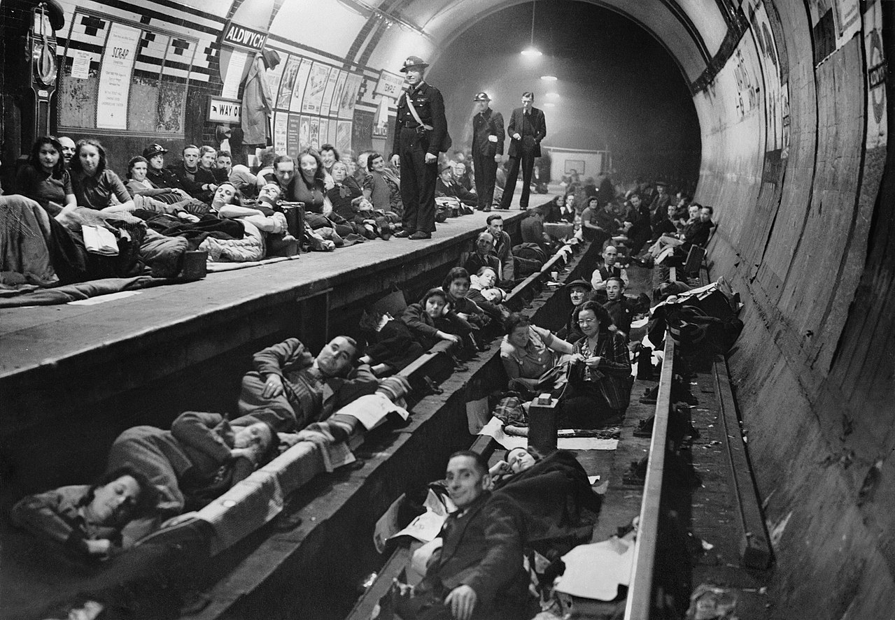
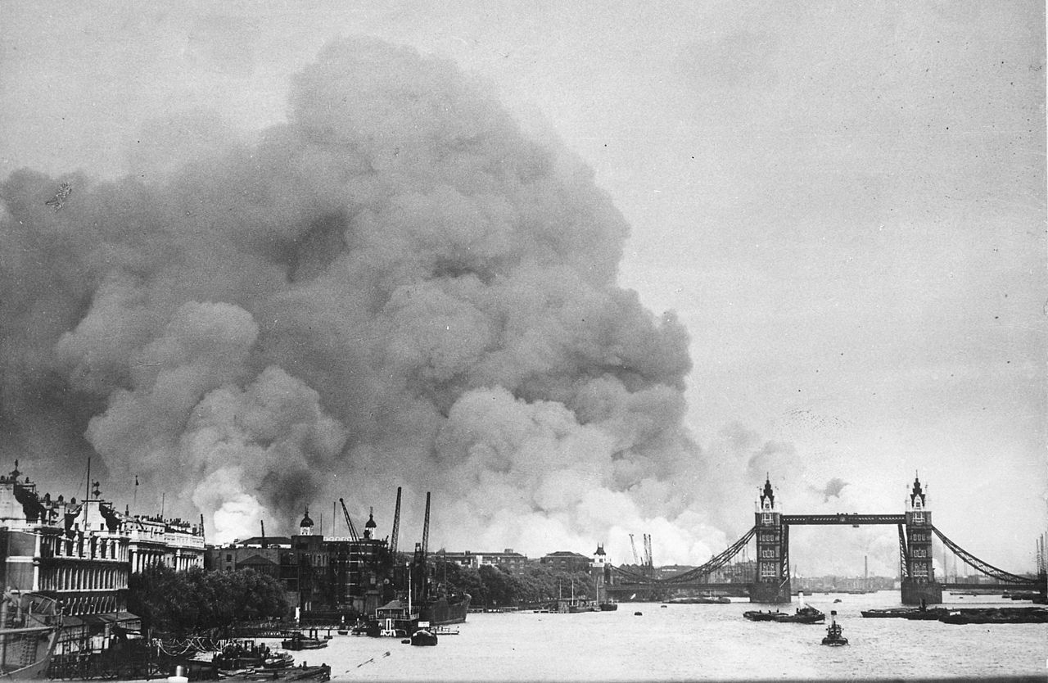

Slide 16
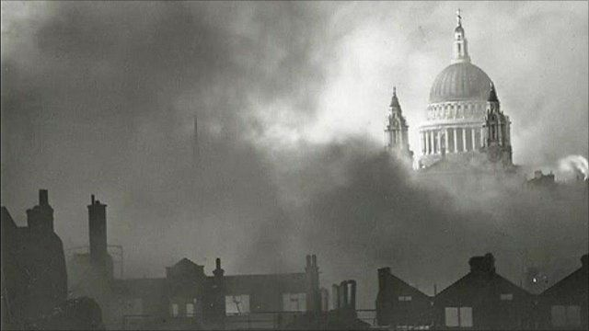
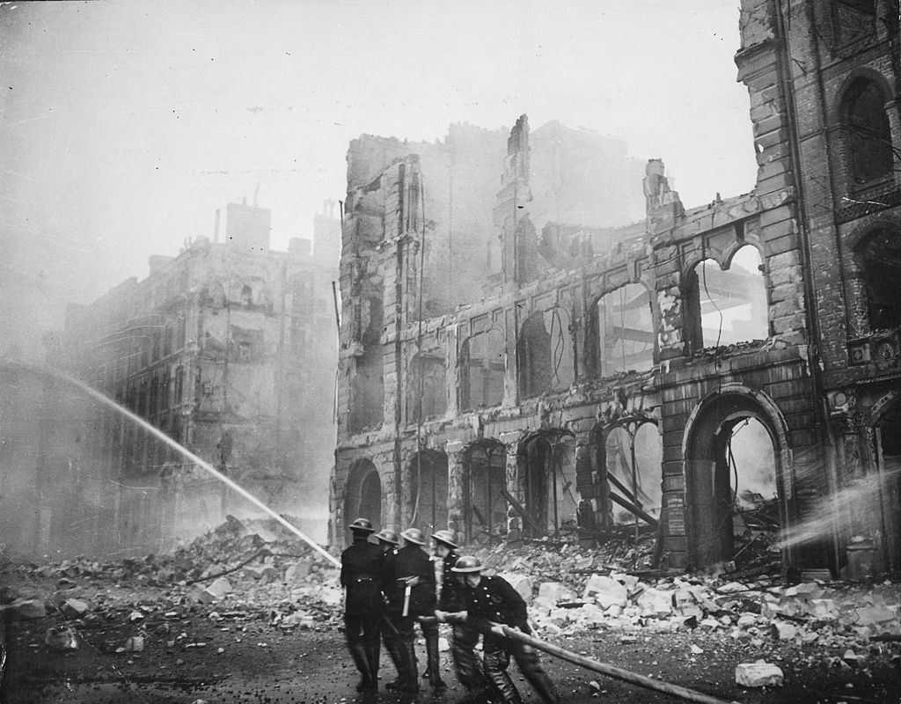

Slide 17
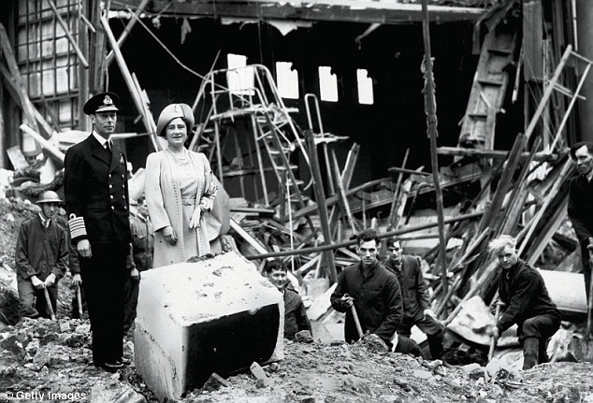
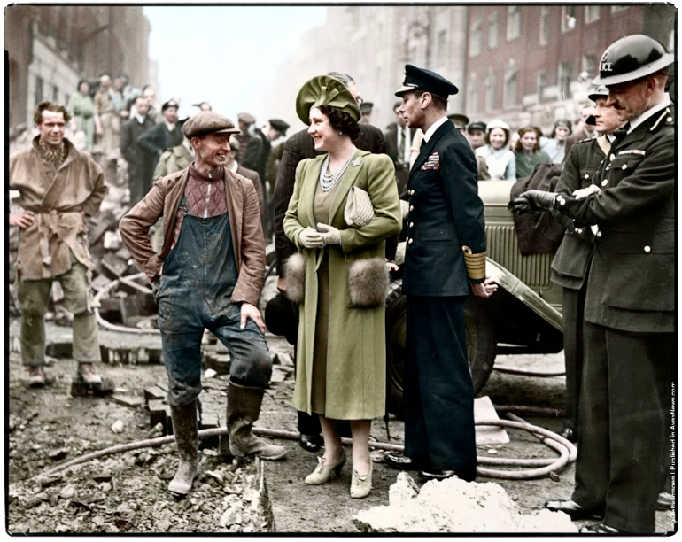
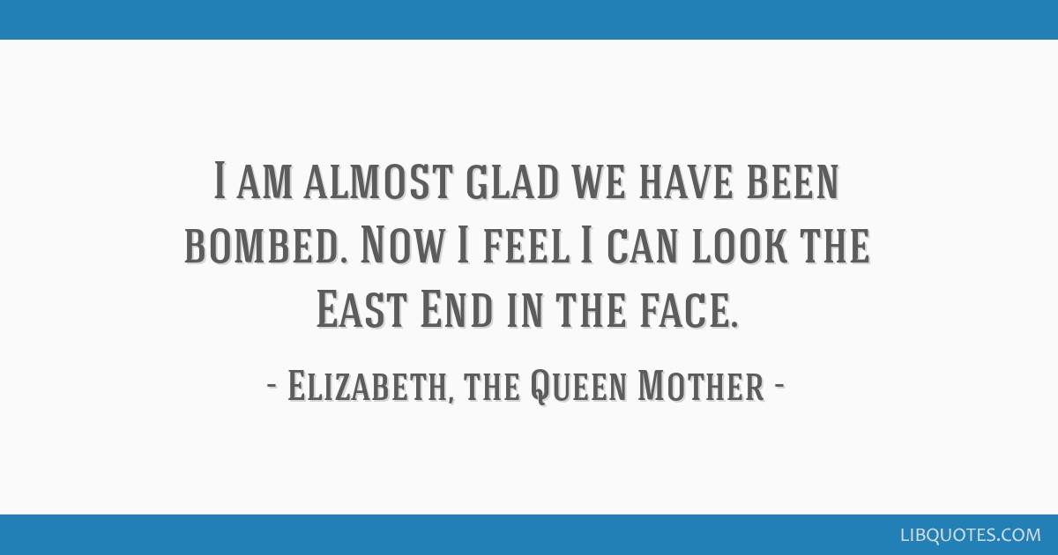

Slide 18
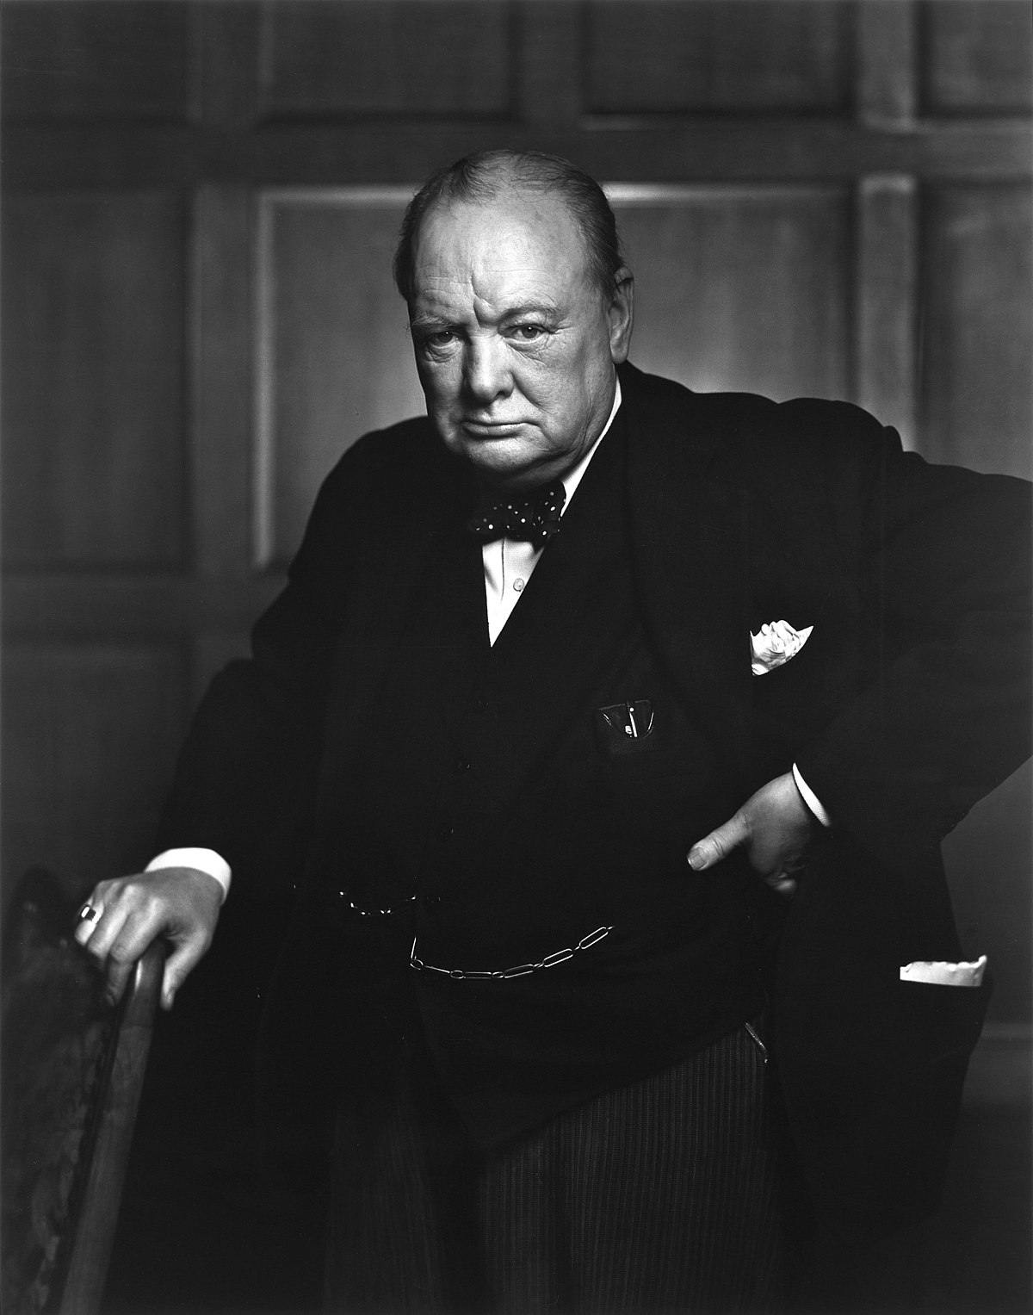
Winston Churchill
Prime Minster of the United Kingdom
Famous for his trademark cigar and his speeches
Pledged Britain would fight until the end, and pressed for help from Roosevelt and the USA.

Slide 19
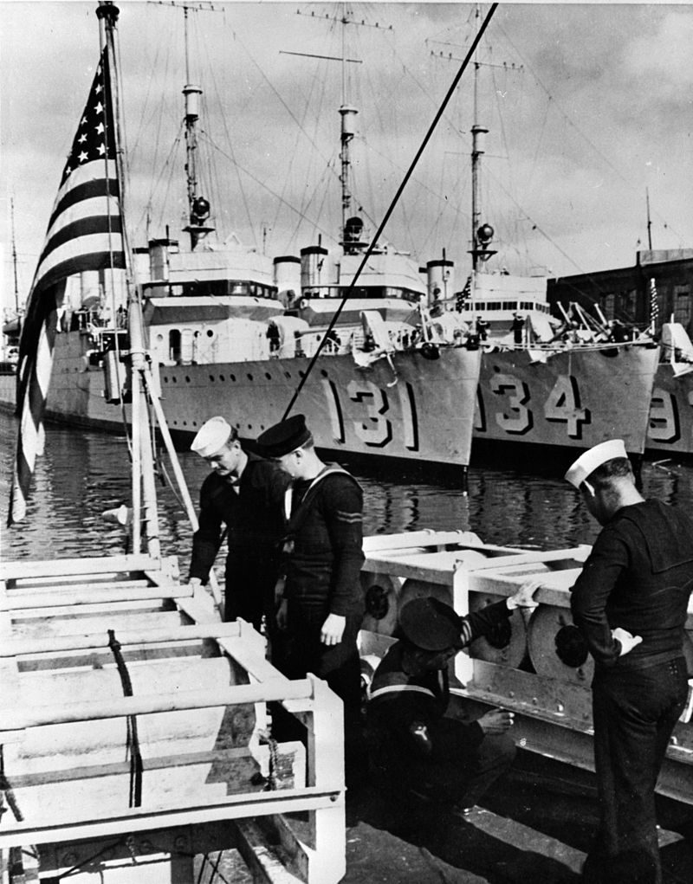
American Neutrality
The United States pledged neutrality throughout the 1930s
1937 “Cash and Carry” program: foreign countries could buy American non-military supplies, but had to pay cash and transport the supplies themselves.
1940: Destroyers for Bases: US trades 50 old destroyers to the British and Canadians in return for overseas bases.
1940: Draft begins
1941 “Lend-Lease” program: allowing for weapons, planes, destroyers, etc to be “loaned” to Allied countries.

Slide 20
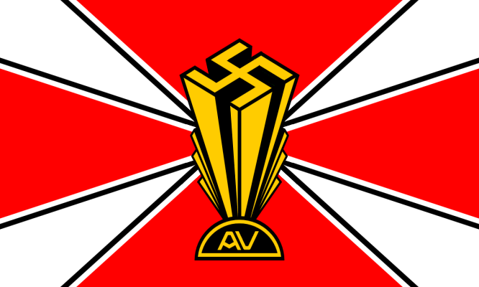
Anti-War Sentiment in America
America First: Largest anti-war group, favored a strong defense and staying out of the war. Some members were pro-fascist of anti-Semitic. Charles Lindbergh was a famous member.
German-American Bund: Made up of some German Americans, it promoted a favorable view of Nazi Germany. They were very pro-fascist and anti-Semitic.

Slide 21
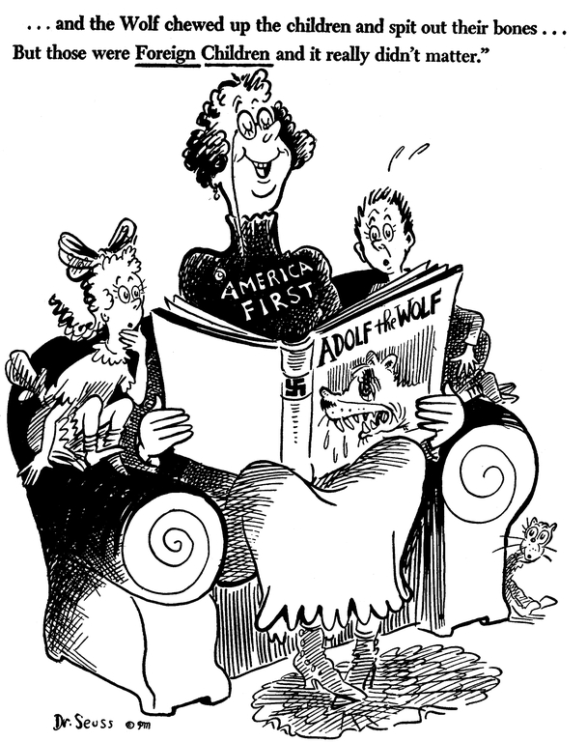

Slide 22
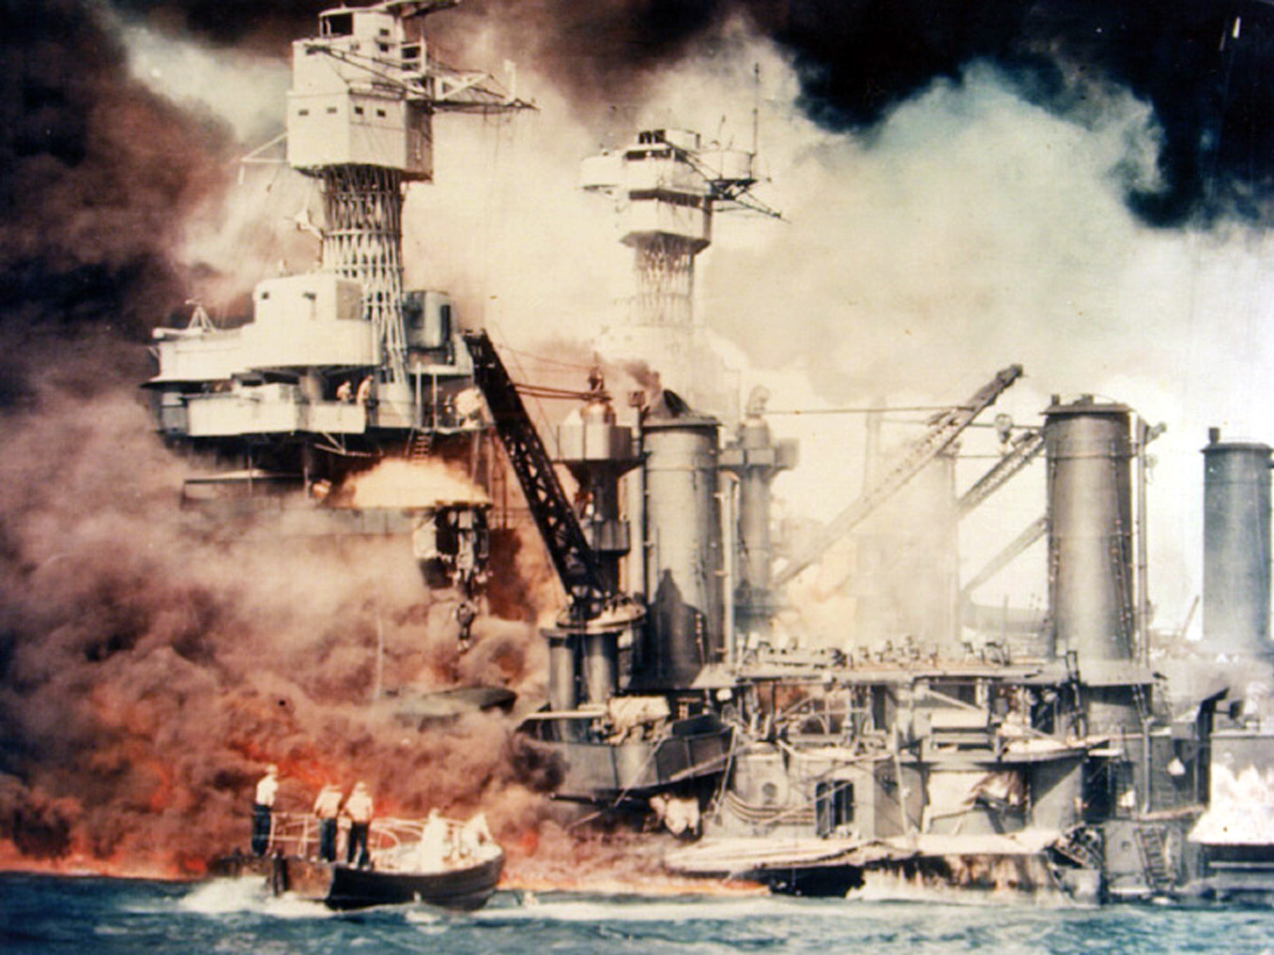
Attack on Pearl Harbor
On December 7, 1941, the Japanese attacked the US fleet at Pearl Harbor, Hawaii
They wanted to [prevent the fleet from interfering with their expansion into South Asia
3000 Americans killed; 6 warships sunk, 13 damaged; 188 aircraft destroyed.
The Japanese also attacked the Philippines, Guam, and British colonies at the same time.

Slide 23
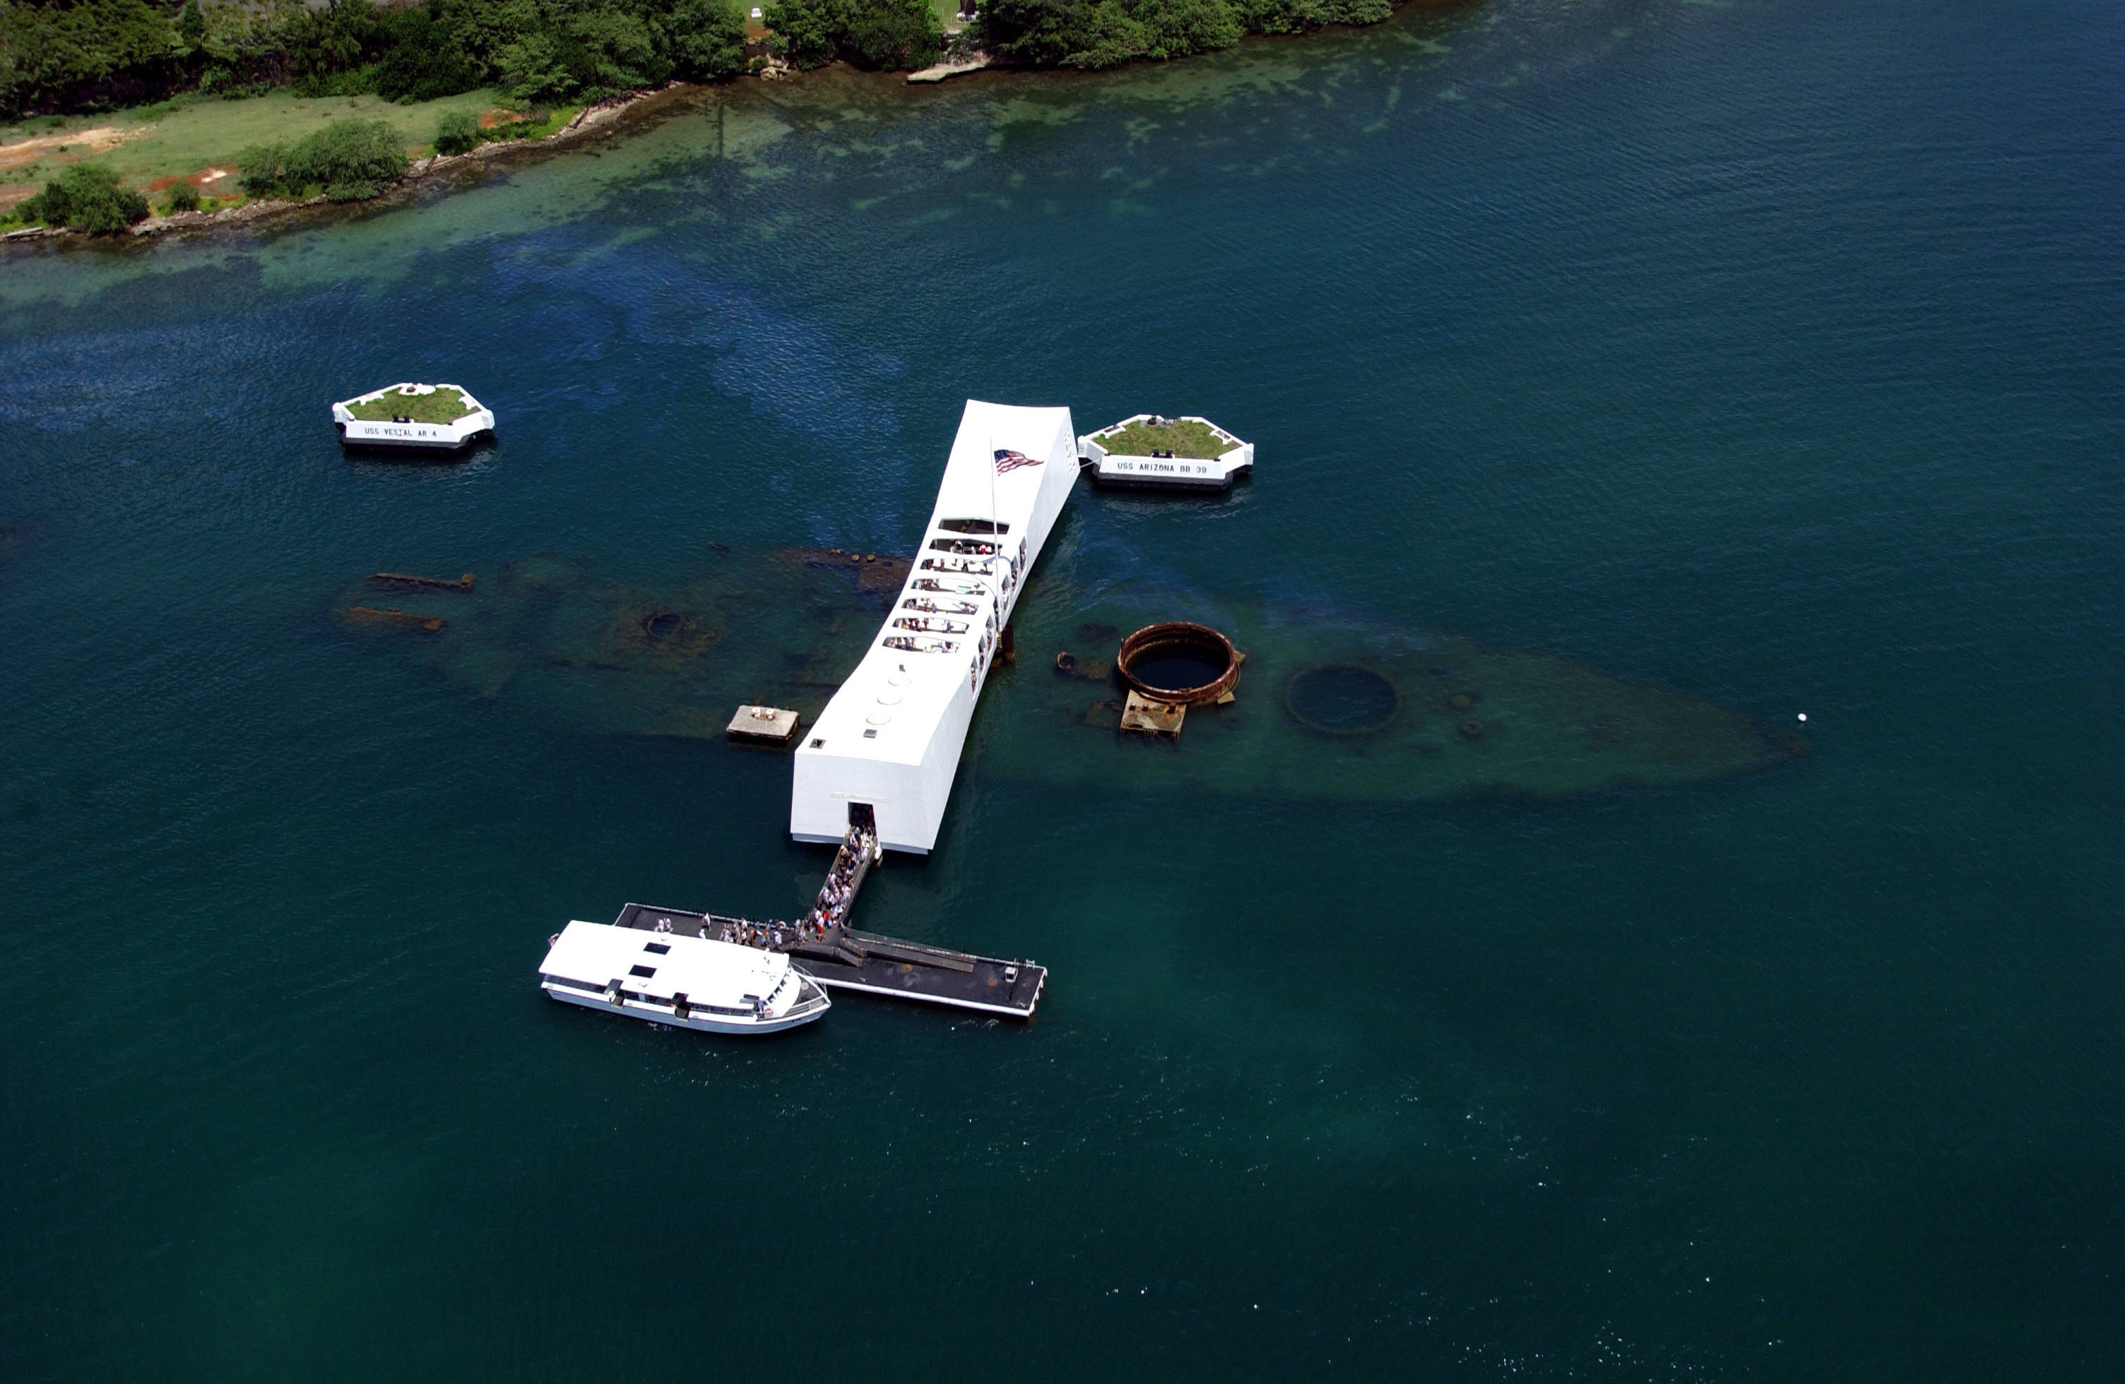

Slide 24
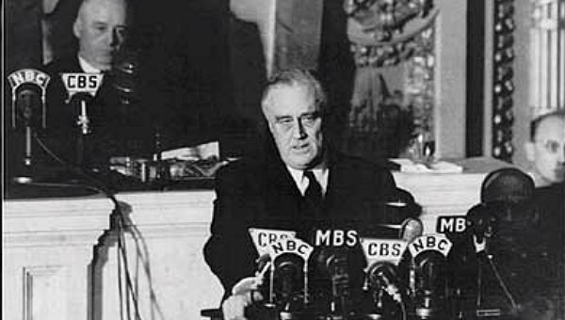
US Declares War
On December 8, FDR asks Congress to declare war on Japan.
Congress votes unanimously (-1) to declare war.
Within a week, the US was also at war with Germany and Italy.

Slide 25
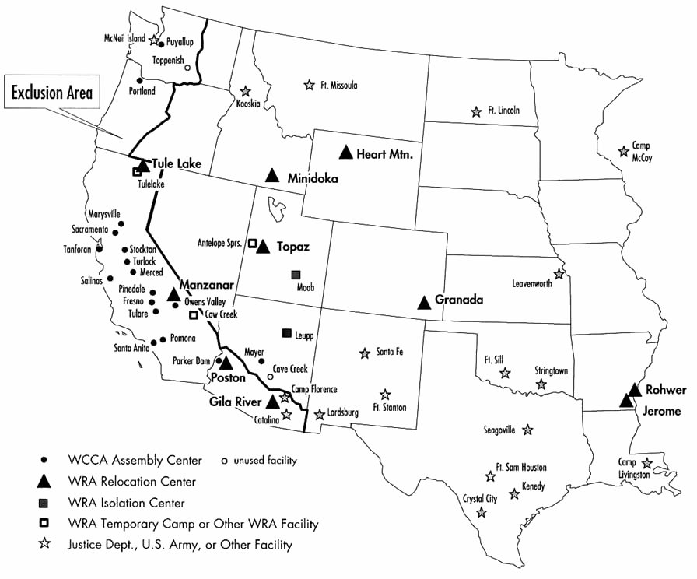
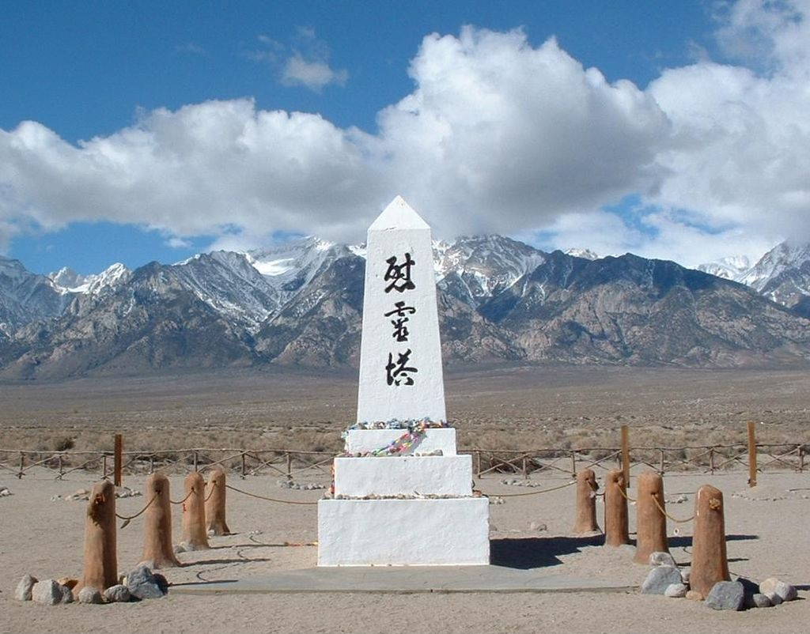
Japanese Internment
With FDR’s Executive Order 9066, hundreds of thousands of Japanese Americans (citizens or not) were ordered away from the Pacific coast in sent to internment camps for the duration of the war.

Slide 26
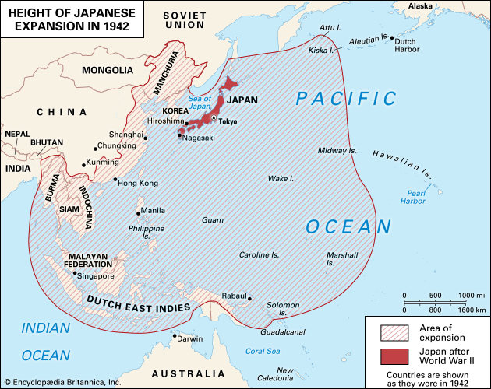
Japanese Expansion
By the middle of 1942 the Japanese controlled eastern China, Southeast Asia, Indonesia, and the western Pacific Ocean.
Bombing of Darwin, Australia
They committed atrocities on American POWs in the Philippines – the Bataan Death March

Slide 27
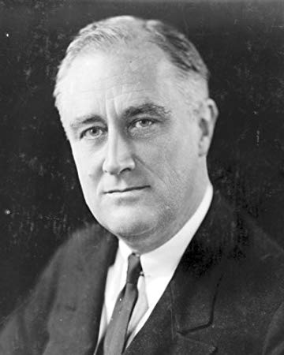
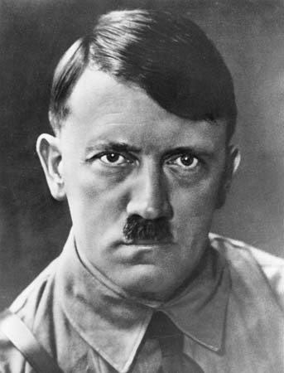
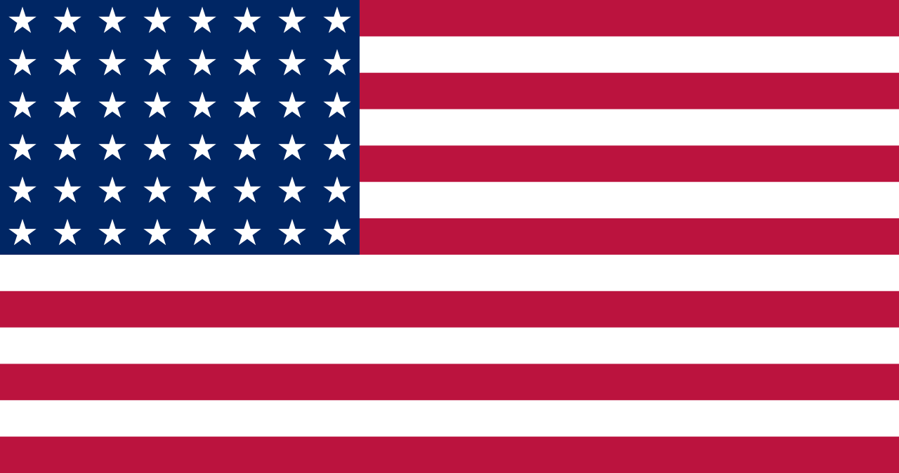
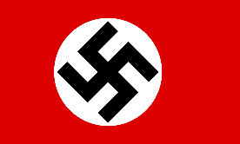
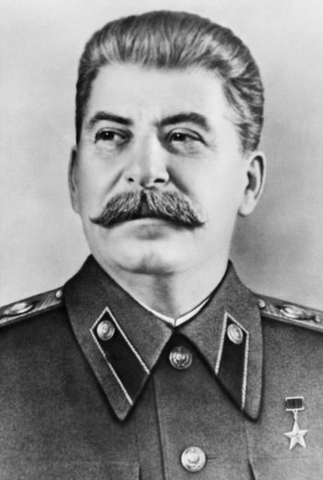
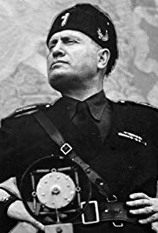
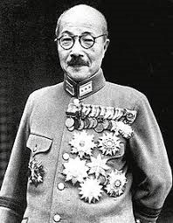
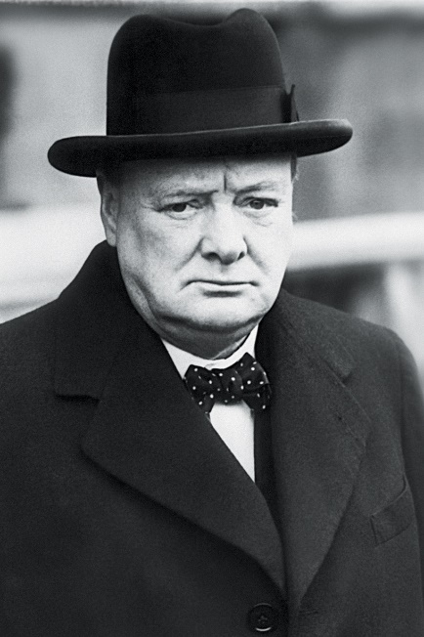
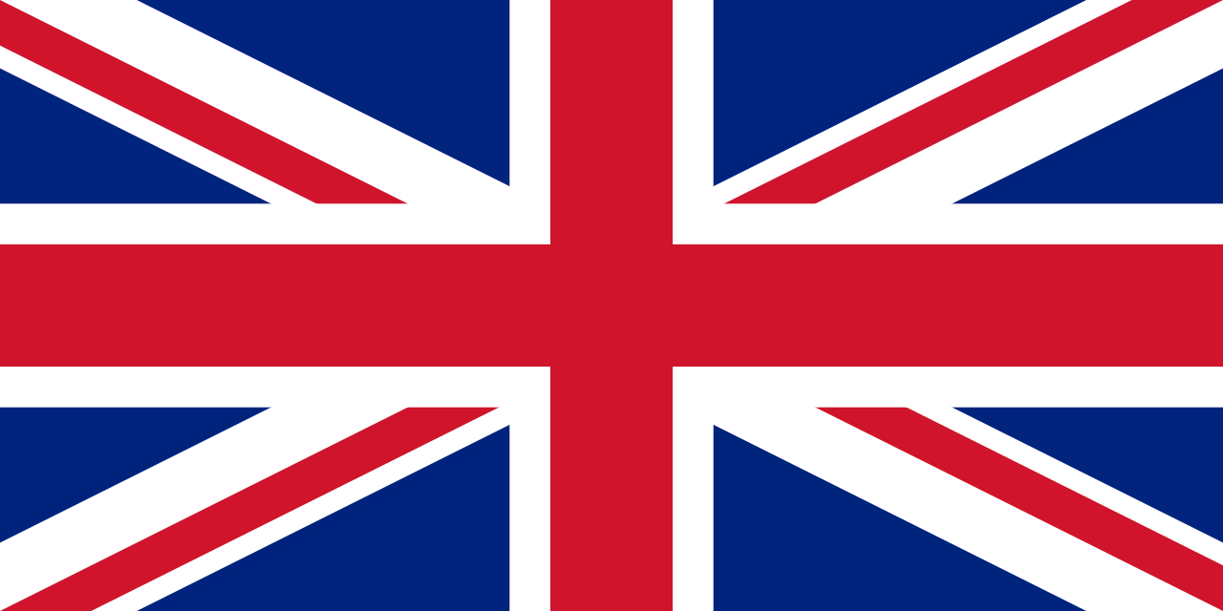
Allies
Axis
Franklin Roosevelt
USA
Adolf Hitler
Germany
Benito Mussolini
Italy
Hideki Tojo
Japan
Josef Stalin - USSR
Winston Churchill - UK

Slide 28
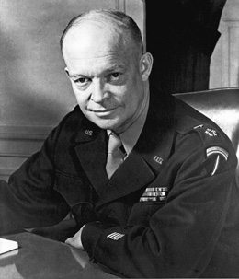
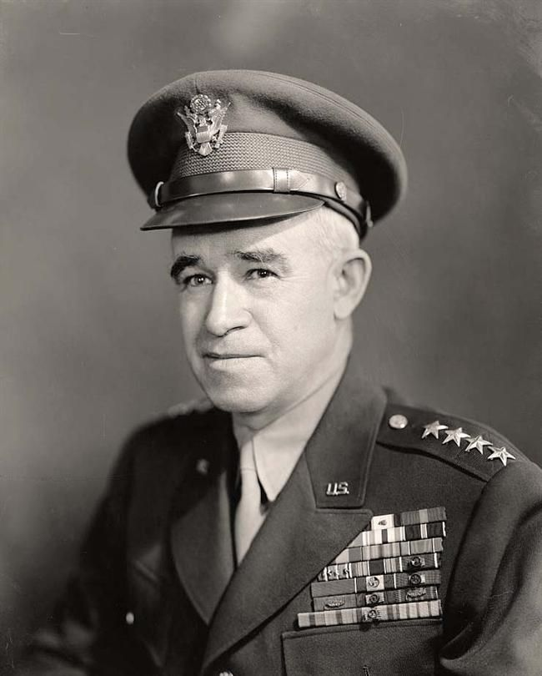
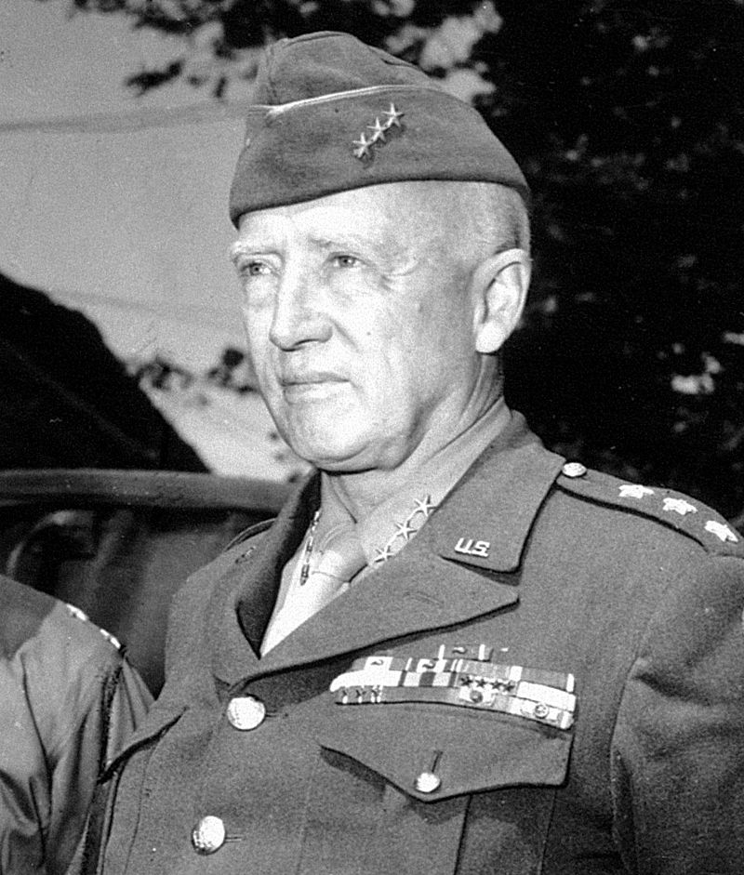
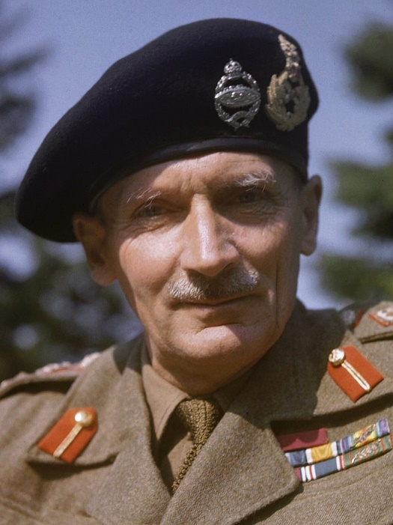
Allied Officers Europe
Dwight Eisenhower: US. Supreme Commander of all Allied forces in Europe
Omar Bradley: US. US Army Commander
George Patton: US. Tank Division commander
Bernard Montgomery: UK. Senior British Army officer
Eisenhower
Bradley
Patton
Montgomery

Slide 29
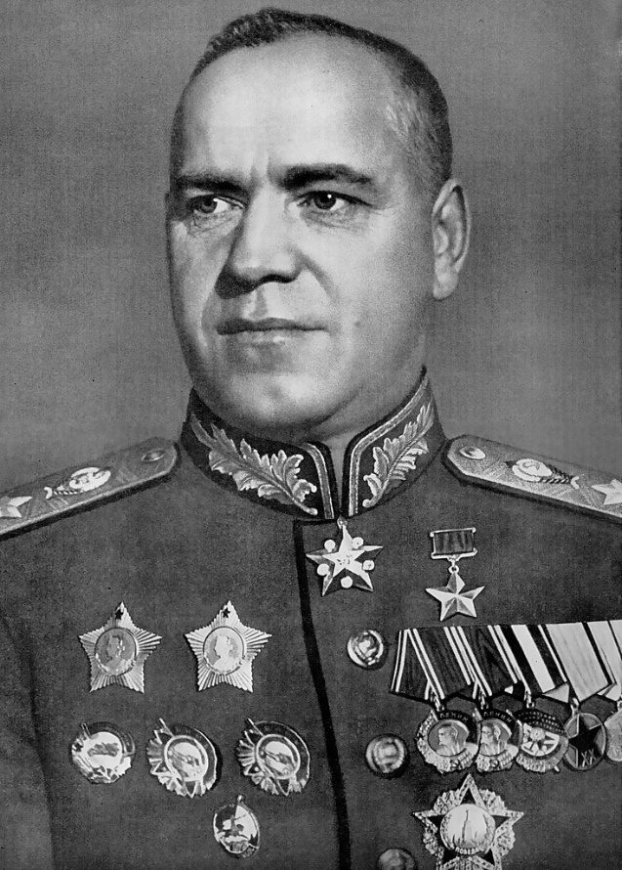
Allied Officers Europe
Georgy Zhukov: USSR. Commander, Soviet Red Army
Zhukov

Slide 30
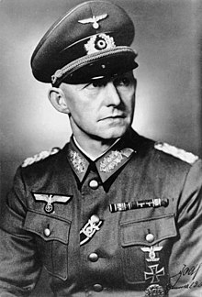
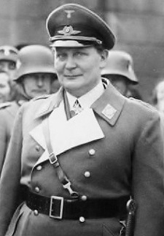
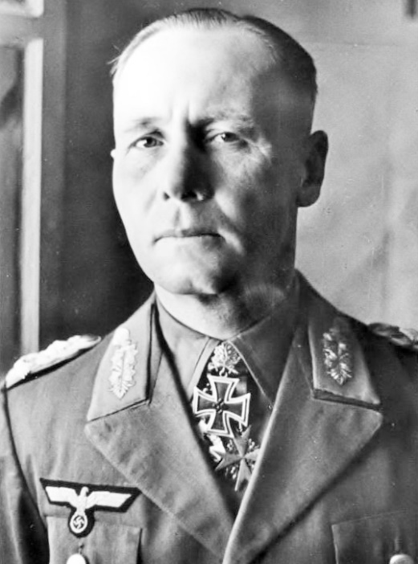
Axis Officers Europe
Alfred Jodl: Commander, German High Command
Hermann Goring: Commander, German Air Force (Luftwaffe)
Erwin Rommel: Field Marshal, German Army
Jodl
Goring
Rommel

Slide 31
Allied Officers Pacific
Chester Nimitz: Navy Admiral, Supreme US Commander
Douglas MacArthur: US Army Commander, Pacific
“Bull” Halsey: US Navy Admiral
“Hap” Arnold: Chief, United States Army Air Force (Europe and Pacific)
Nimitz
MacArthur
Halsey
Arnold

Slide 32
Axis Officers Pacific
Isoroku Yamamoto: Admiral, Imperial Japanese Navy
Tomoyuki Yamashita: Japanese General in SE Asia and Philippines
Yamamoto
Yamashita

Slide 33
1942 – In Europe

Slide 34
1942 - EUROPE
January: First US troops arrive in the United Kingdom
August-November: Russians stop the German advance at the Battle of Stalingrad.
November: Operation Torch. Allies invade North Africa to liberate it from the “Vichy French” (French government run by the Nazis).
Stalingrad

Slide 35
1942 – In The Pacific

Slide 36
1942 - Pacific
April 1942: Doolittle Raid: 16 B-25 bombers drop bombs on Tokyo – a morale boost for the US
May 1942: Battle of Coral Sea: Japanese advance on Australia stopped by US, Australian Navy.
June 1942: US Navy defeats the Japanese Navy at Midway Island, sinking 4 carriers
August-November: Battle of Guadalcanal. Allies drive Japanese out of the Solomon Islands, beginning of the “Island hopping” campaign.
AlCan Highway
Doolittle Raids
Midway
Coral Sea
Guadalcanal

Slide 37
1943 – In Europe

Slide 38
1943 - EUROPE
May: Allied troops drive Germans out of North Africa
July: Allies invade Sicily. Mussolini resigns and Italy surrenders.
September-October: Allies invade Italy – the “Soft underbelly of Europe”. Italy declares war on Germany.
Aerial bombing of Germany, day and night
Salerno
Sicily
Kasserine Pass

Slide 39
1943 – In The Pacific

Slide 40
1943 - Pacific
February: Last Japanese driven out of Guadalcanal
May: US drive Japanese out of the Aleutian Islands, Alaska.
August: PT 109 Incident: After his boat is destroyed, future President John F. Kennedy helps rescue survivors.
November: Battle of Tarawa Atoll. US military continues to “leapfrog” Pacific Islands and captures a strategic airstrip
Attu and Kiska Islands
Tarawa
PT 109 Incident
Guadalcanal

Slide 41
World War II – On the Homefront

Slide 42
19 million women fill jobs across most industries
Scrap metal drives to collect resources for war production
War Bond drives to raise money for the war effort
Food and gas rationing
Wartime propaganda to boost morale

Slide 50
1944 – In Europe

Slide 51
1944 - EUROPE
January: Soviet Army pushes Germans back into Poland
January-July: Allies land at Anzio, Italy, and liberate Rome.
June 6: D-Day invasion of Normandy.
August: Allies liberate Paris
October: Allies liberate Athens
December: Battle of the Bulge. German advance into Belgium halted.
December: Soviet Army captures Budapest, Hungary
The Bulge
Normandy
Paris
Rome
Anzio
Athens

Slide 52
1944 – In The Pacific

Slide 53
1944 - Pacific
February: Japanese driven out of the Marshall Islands
March: Allied forces begin liberating Burma (Merrill's Marauders”
June – August: US forces liberate Mariana Islands, including Saipan and Guam.
October: US invades Philippines; defeats Japanese at Leyte Gulf (1st kamikaze attacks)
Burma
Saipan
Guam
Leyte Gulf
Kwajalein Atoll

Slide 54
1945 – In Europe

Slide 55
1945 - EUROPE
January: Soviet Army liberates Warsaw, Poland, and Auschwitz Concentration Camp
March: US/UK troops cross into Germany.
April 12: Allied troops liberate Buchenwald/Belsen concentration camps. FDR dies.
April 21: Soviets capture Berlin
April 28: Mussolini killed
April 30: Hitler kills himself
May 7/8: Germany surrenders; VE Day (Victory in Europe)
Warsaw
Cologne
Berlin

Slide 56
Death of FDR
President Roosevelt died April 12, 1945 in Warm Springs, Georgia
New President is Harry S Truman

Slide 58
1945 – In The Pacific

Slide 59
1945 - Pacific
February: US Marines capture Iwo Jima
March: Allies capture Manila
April-June: US captures Okinawa; up to 300,000 casualties (military & civilian)
August 6: US drops atomic bomb on Hiroshima
August 9: US drops atomic bomb on Nagasaki
September 2: Japan surrenders to Allies on the USS Missouri
Hiroshima
Nagasaki
Okinawa
Iwo Jima
Manila

Slide 60
The Atomic Bomb
“I made one great mistake in my life – when I signed the letter to President Roosevelt recommending that atom bombs be made; but there was some justification – the danger that the Germans would make them.” – Albert Einstein
Scientists had been working in a secret program called “The Manhattan Project” since 1939 to construct an atomic bomb before Germany did.
Albert Einstein first brought attention to atomic energy, but Robert Oppenheimer was the scientist in charge.
The first was detonated near Alamogordo, New Mexico in July 1945

Slide 62
The atomic bomb dropped on Hiroshima – “Little Boy” – killed 66,000 people and injured 69,000
The atomic bomb dropped on Nagasaki – “Fat Man” – killed 40,000 people and injured another 60,000

Slide 66
World War II Casualties
Worldwide: between 70-85 million
Military: 20-25 million - Civilian: 50-55 million
USSR: 20,000,000 China: 20,000,000
Germany: 7,300,000 India: 2,000,000
Japan: 3,000,000 Poland: 5,500,000
Philippines: 500,000 Italy: 500,000
United Kingdom: 450,000 Canada: 43,000
United States: 419,400
New Hampshire: 325
MRSD: 11 (Fitzwilliam 2, Gilsum 1, Swanzey 6, Troy 2)

