Slide 1
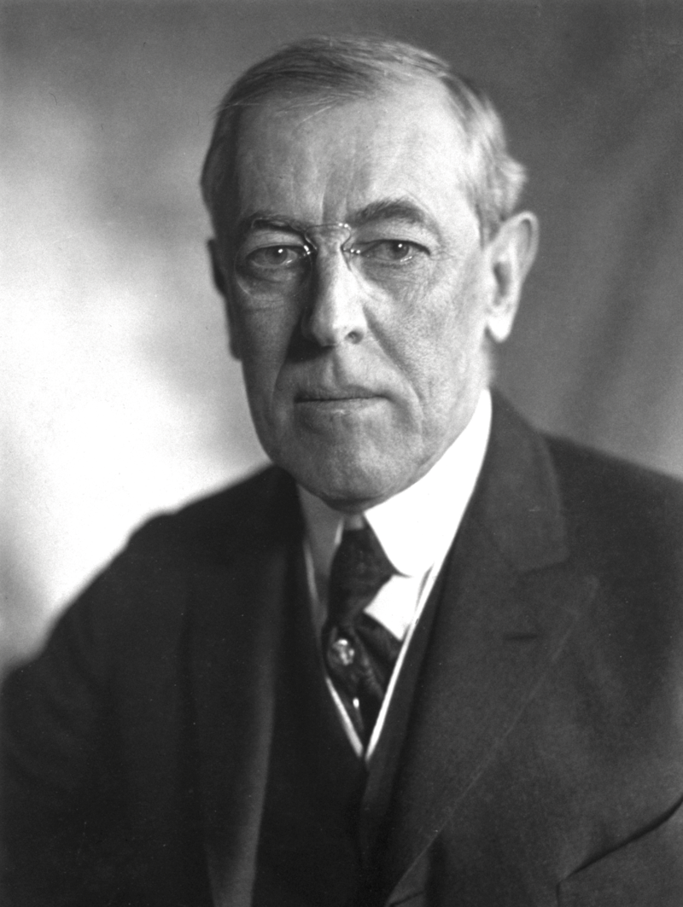
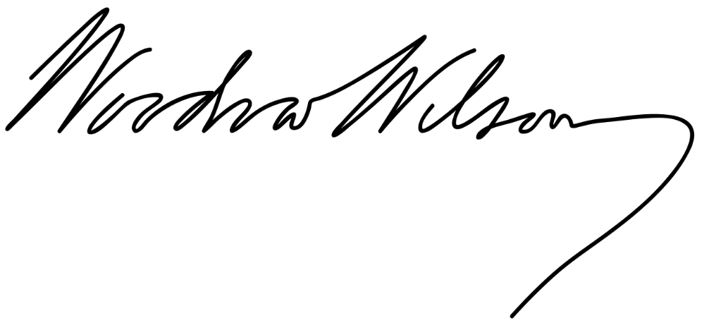
Woodrow Wilson

Slide 2
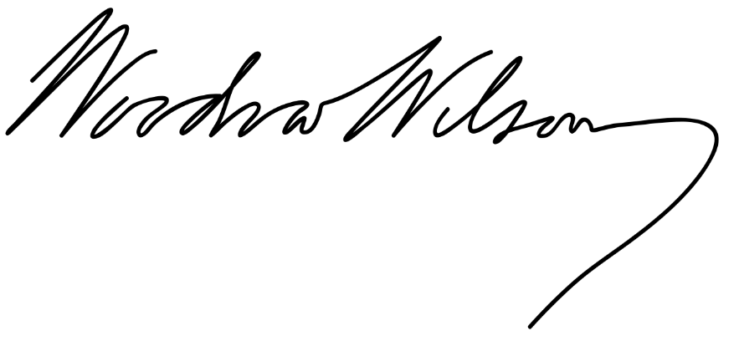
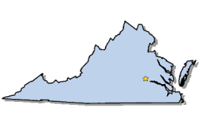
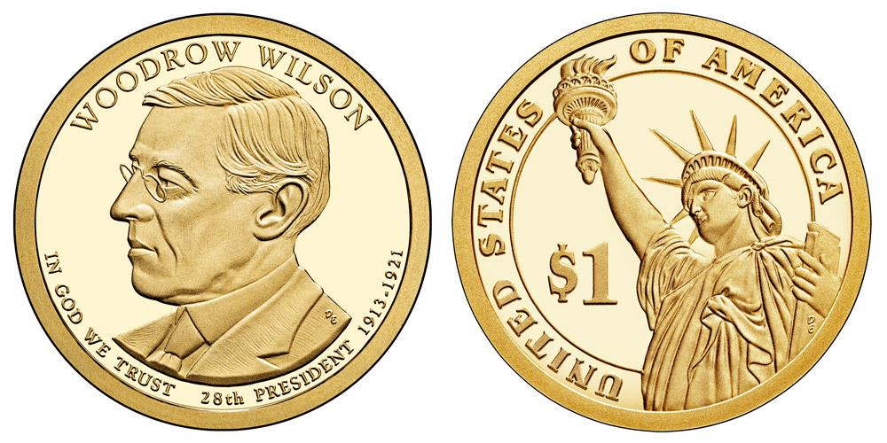
Elected in: 1912, 1916
President from: 1913-1921
Political Party: Democrat
Home State: Virginia

Slide 3
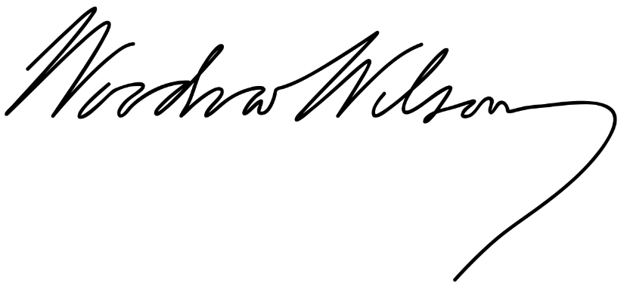
New States
None

Slide 4
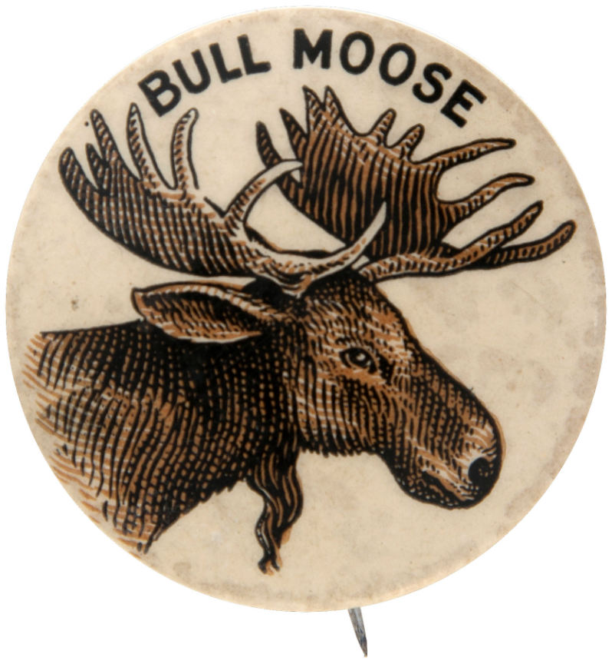
Election of 1912
-Theodore Roosevelt, fearing Taft isn’t up to the job, runs for President again under the “Progressive” or “Bull Moose” party.
-Roosevelt pledges a “New Nationalism” of a powerful federal government
protecting people’s rights, and national health,
social security, better pay, an 8-hour workday, and
other Progressive reforms.
-Woodrow Wilson stresses a “New Freedom” of
lower tariffs, business and banking reform,
individual freedom, and states rights. He railed
against the “Triple Wall” of banks, trusts, and tariffs.

Slide 5
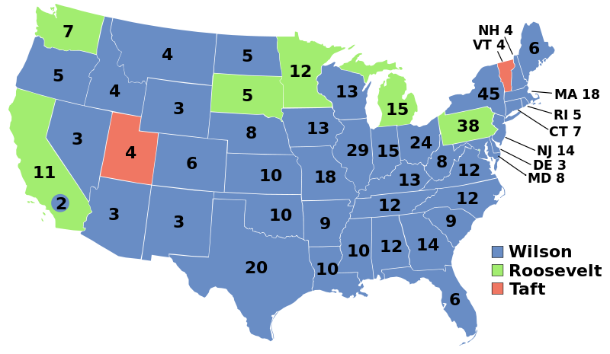
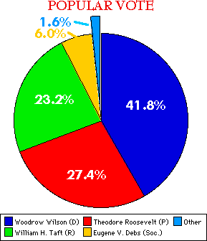
Election of 1912
Democratic: 435
President: Woodrow Wilson
Vice President: Thomas Marshall
Progressive (Bull Moose): 88
President: Theodore Roosevelt
Vice President: Hiram Johnson
Republican: 8
President: William Howard Taft
Vice President: Nicolas Butler

Slide 6
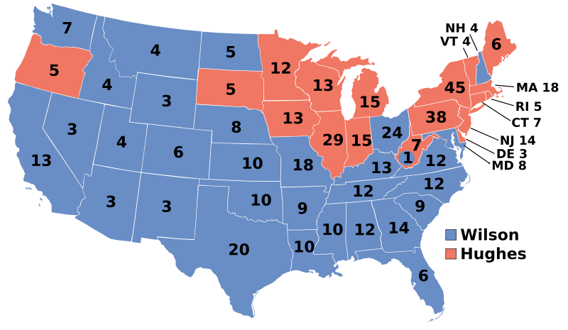
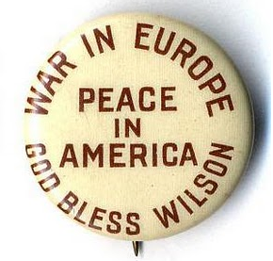
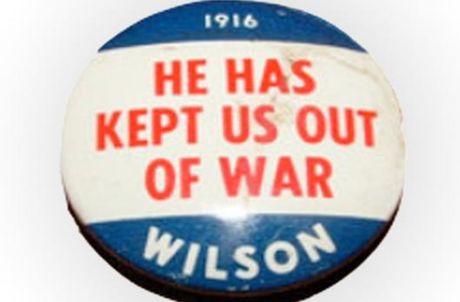
Election of 1916
Democratic: 277
President: Woodrow Wilson
Vice President: Thomas Marshall
Republican: 254
President: Charles Evans Hughes
Vice President: Charles Fairbanks

Slide 7
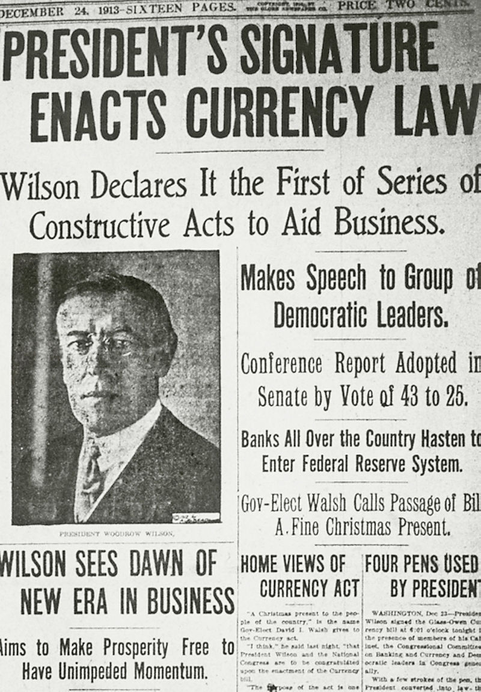
Federal Reserve System
A central bank for the United States
One central headquarters in Washington DC, and 12 branches in major cities
Designed to standardize interest rates, the amount of money in circulation, and implement other monetary and banking policies
Goal is to have banks answerable to the public and to government, and to control banking policies.

Slide 8
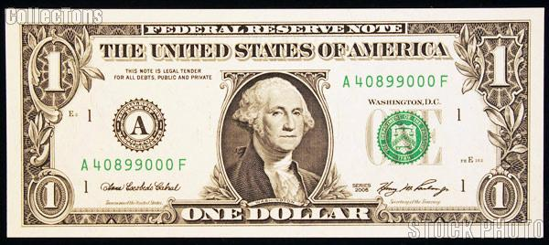
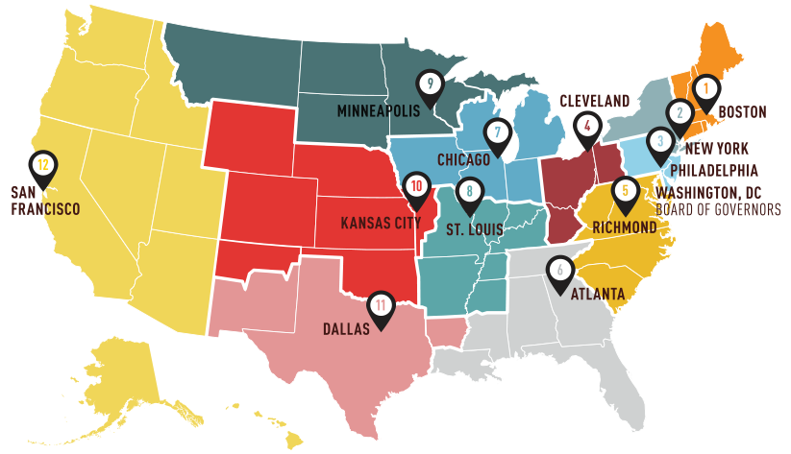
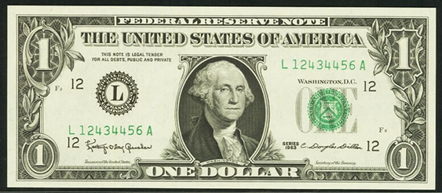

Slide 9
Federal Trade Commission
A government bureau designed to enforce anti-monopoly laws and protect consumers.
Enforced the Clayton Anti-Trust Act, a new (1914) law strengthening laws against monopolies and corrupt business practices.

Slide 10
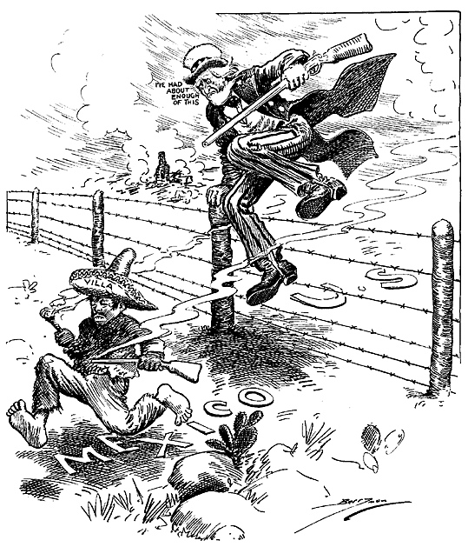
Pancho Villa Expedition (1916-1917)
Mexico was in the middle of yet another civil war, and Pancho Villa was a revolutionary fighting against the government of US-backed President Carranza.
After Villa attacked Columbus, NM, Wilson sent General John Pershing and 10,000 soldiers into Mexico to hunt Villa down.
They never caught him, but fought in several battles against Villa’s forces.

Slide 11
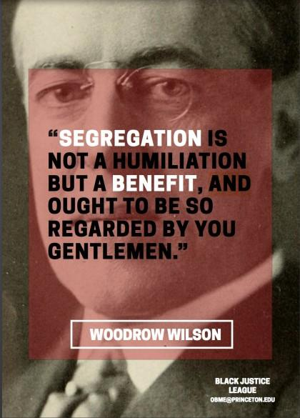
Wilson’s views on Race
Wilson was born and raised in the South, and his views on racial equality were typical of Southerners.
Thought slavery wasn’t immoral, Northerners had destroyed the post-war South, defended lynchings, and he discouraged African-Americans from applying to Princeton while he was the college president.
Segregated the US government upon becoming president, demanded racially segregated army units, and all government job applicants must submit a photograph.

Slide 12
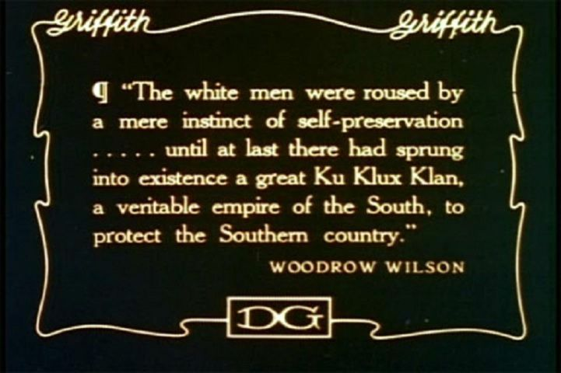
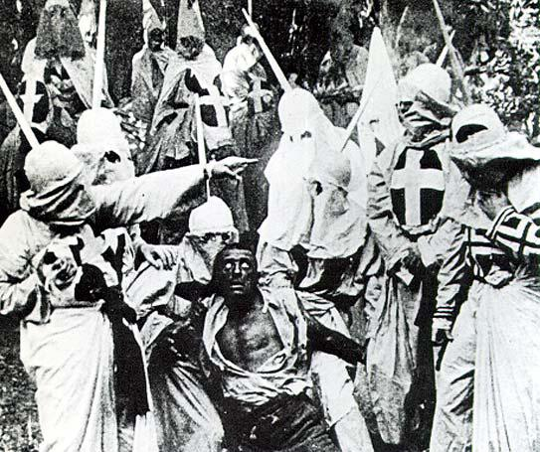
Birth of a Nation (1915)
3 hour film by director D.W. Griffith
Depicted life in the South before, during, and after the Civil War
Slaves and former slaves were depicted as unintelligent and sexually aggressive, and the KKK as the saviors of the American way of life.
Was extremely popular across the US, but many protests were also staged.
1:31:50
3:00:06

Slide 13
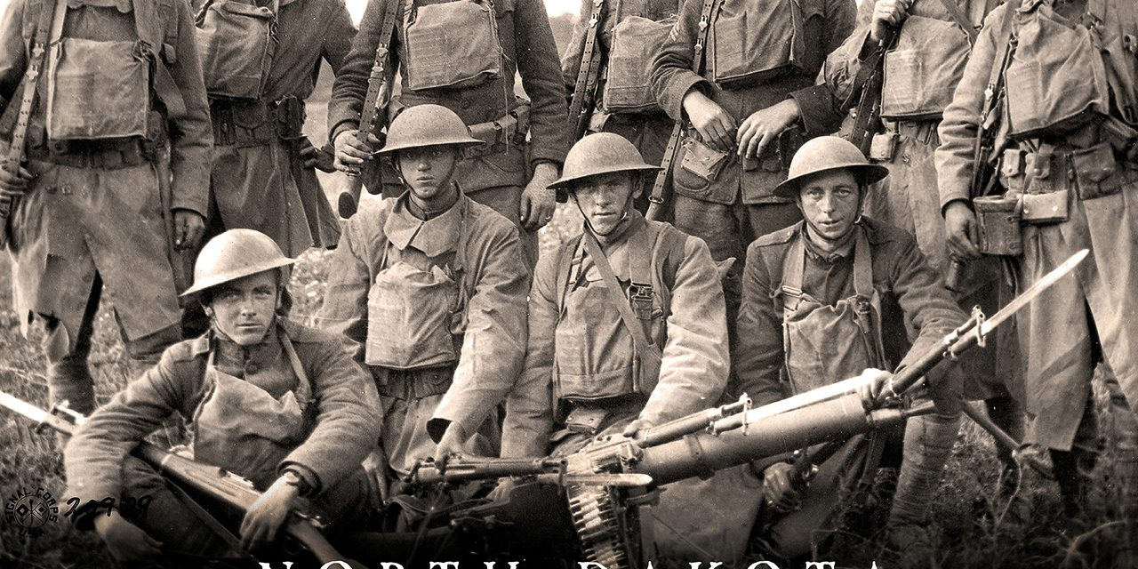
World War I – The Great War
World War I – The Great War

Slide 14
Pre-World War I European Alliances:
The Triple Alliance: Germany, Austria-Hungary, and Italy
The Triple Entente: United Kingdom, France, and Russia

Slide 15
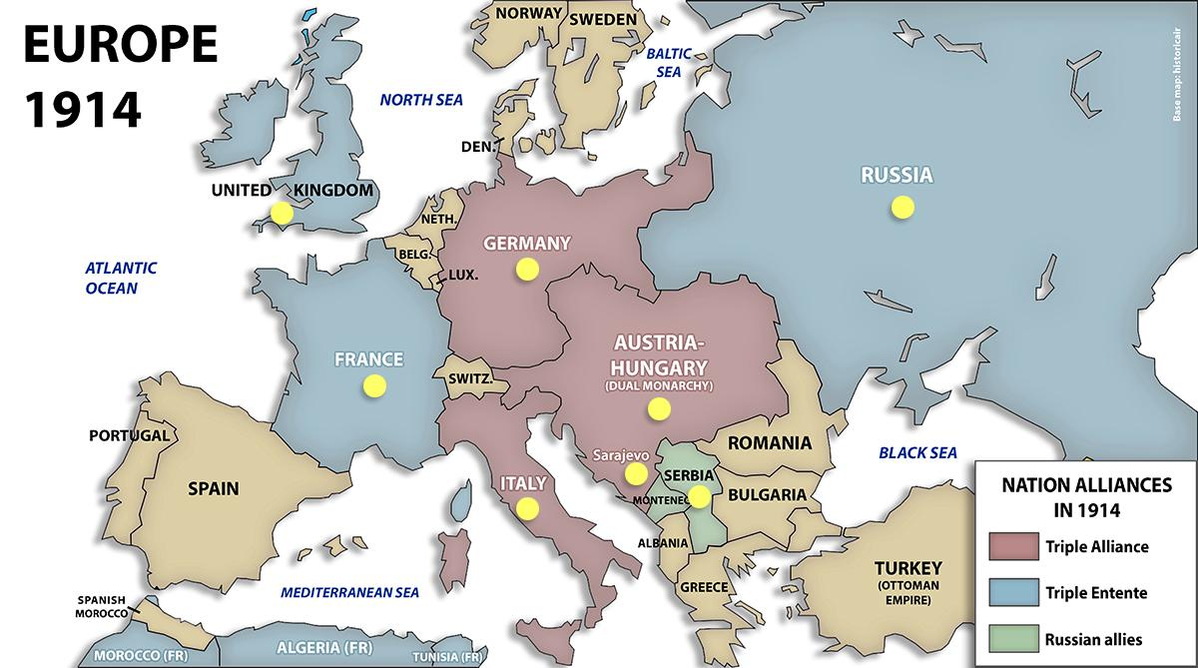
Pre-World War I European Alliances

Slide 16
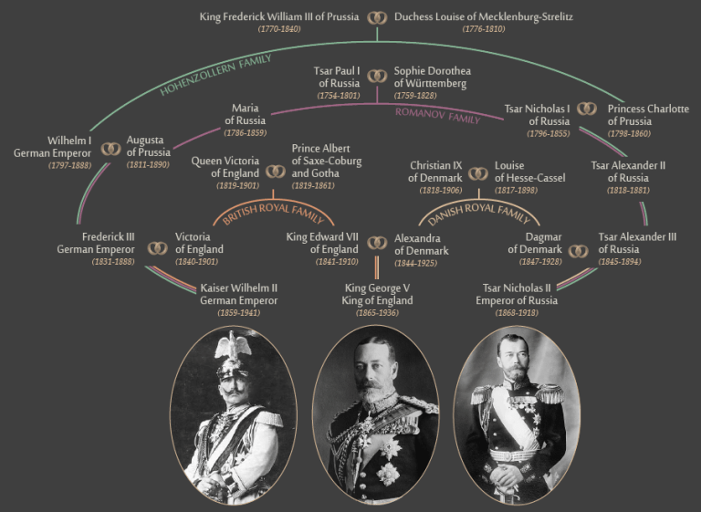

Slide 17
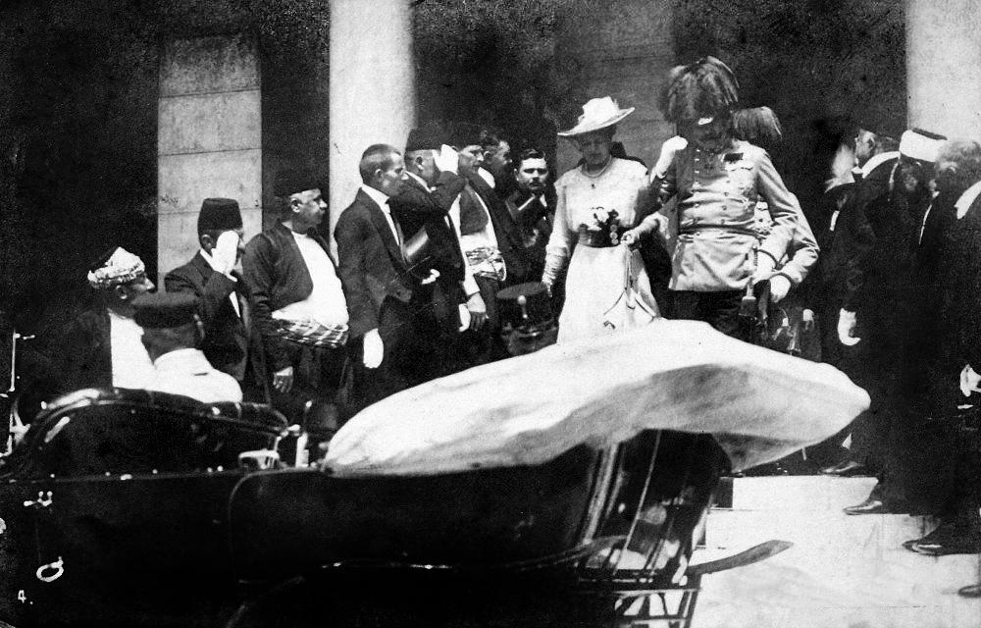
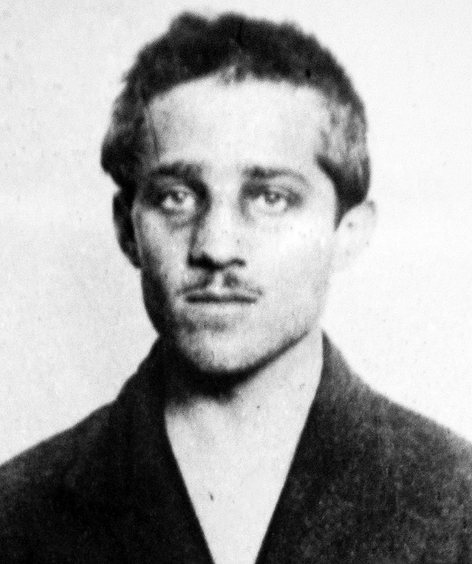
June 28, 1914: Gavrilo Princip, a Serbian Nationalist, assassinates Archduke Franz Ferdinand (and his wife) of Austria-Hungary in Sarajevo, Bosnia.

Slide 18
Pre-World War I European Alliances
July 1914: Austria-Hungary declares war on Serbia.
Russia declares war on Austria-Hungary
August 1914: Germany declares war on Russia
Germany declares war on France
Germany invades Luxembourg and Belgium
United Kingdom declares war on Germany
October 1914: Ottoman Empire declares war on Russia
November 1914: France and UK declare war on Ottomans
-Italy refuses to join her allies and in 1915 declares war on Austria-Hungary instead
-British Empire nations, including Canada, Australia, New Zealand, South Africa, and India, also join in the fight against Germany

Slide 19
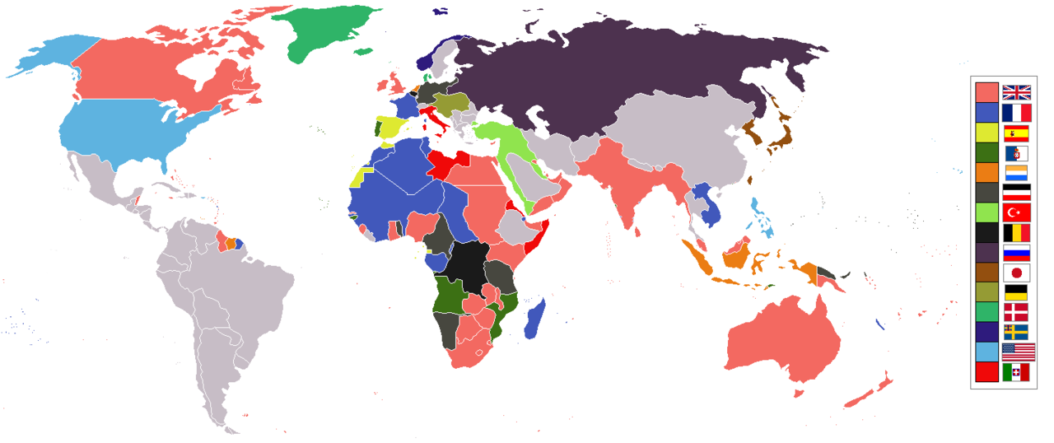

Slide 20
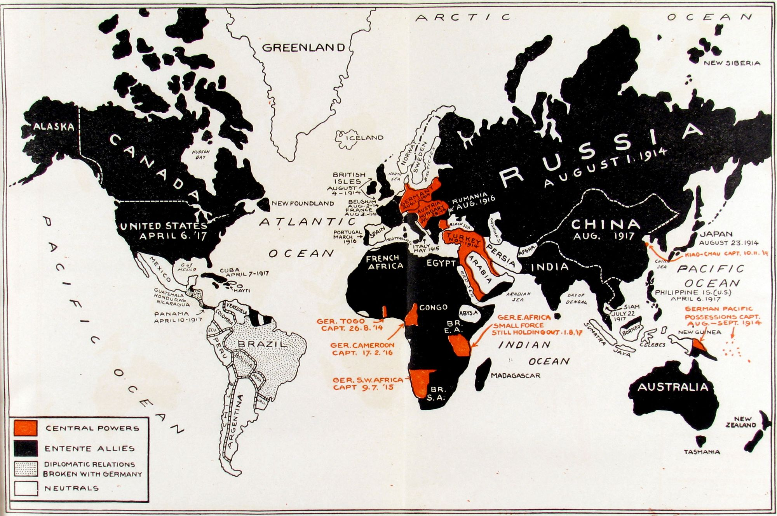

Slide 21
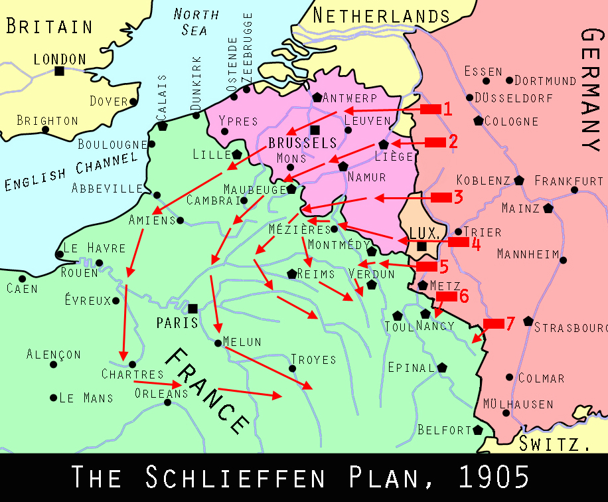
Schlieffen Plan
German strategy to quickly defeat France by way of Belgium, before Russia can mobilize its army.
German army invaded Belgium in August 1914 and conquered it in 2 months, in what was called the “Rape of Belgium.”
German advance was stopped outside Paris and both sides resort to trench warfare.

Slide 22
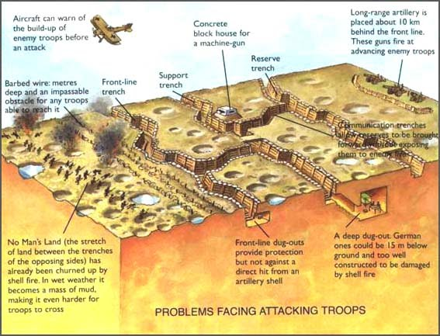

Slide 23
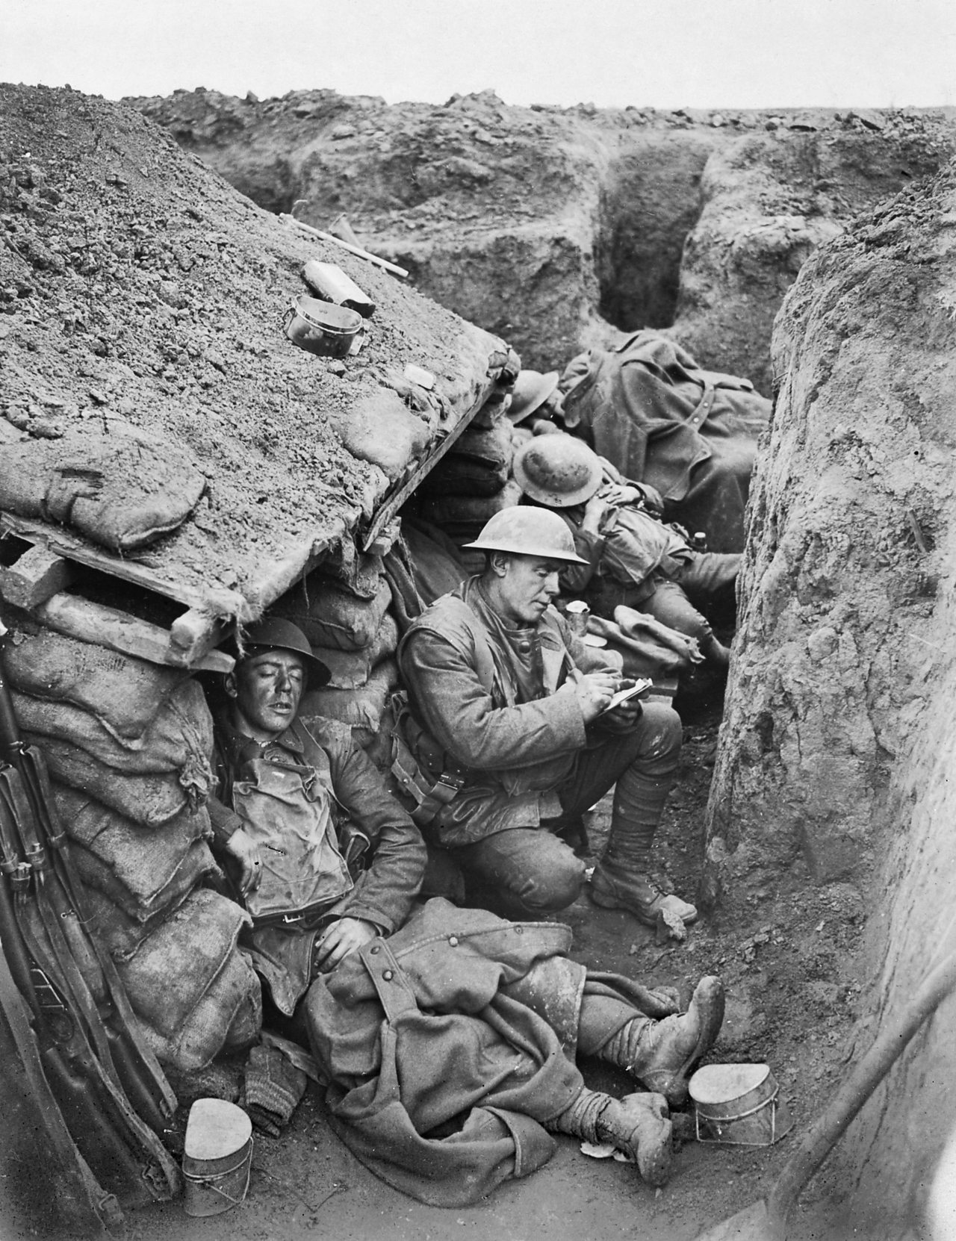
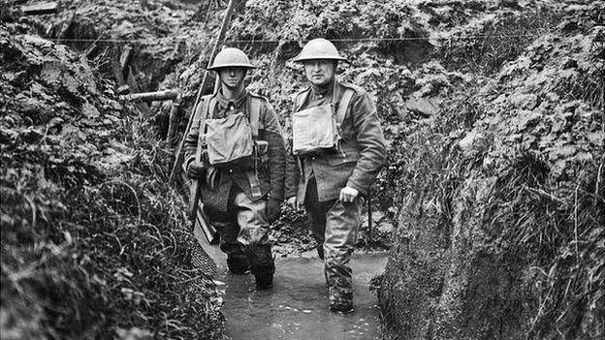
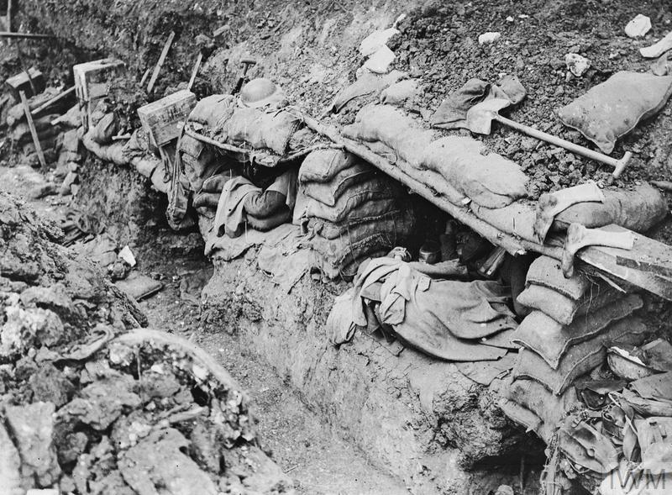
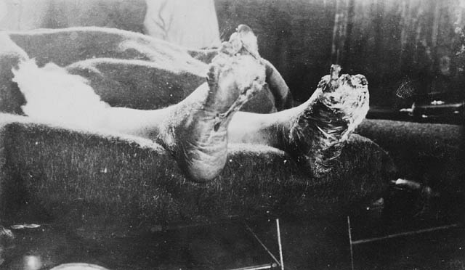

Slide 24
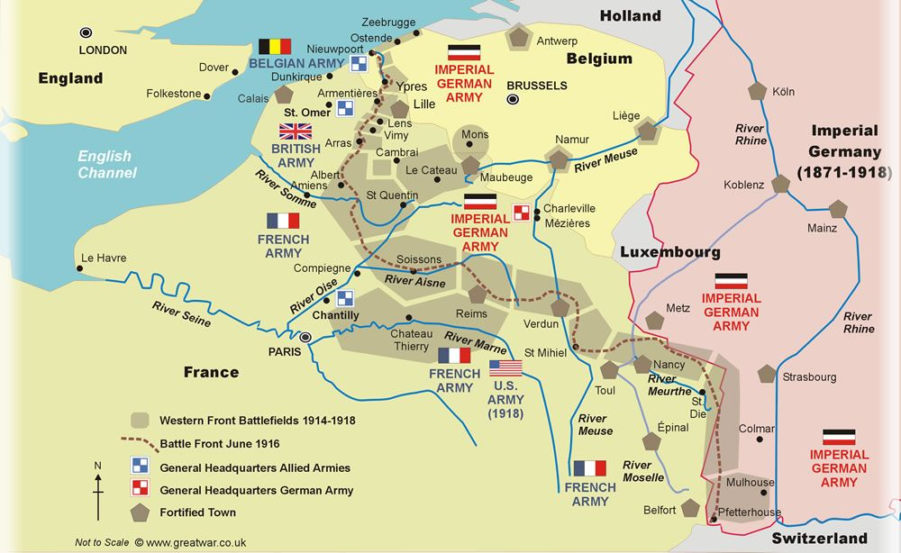

Slide 25
Songs of World War I
It’s a Long Way to Tipperary
Pack up your Troubles in your Old Kit -Bag
Mademoiselle from Armentieres
Keep the Home Fires Burning

Slide 26
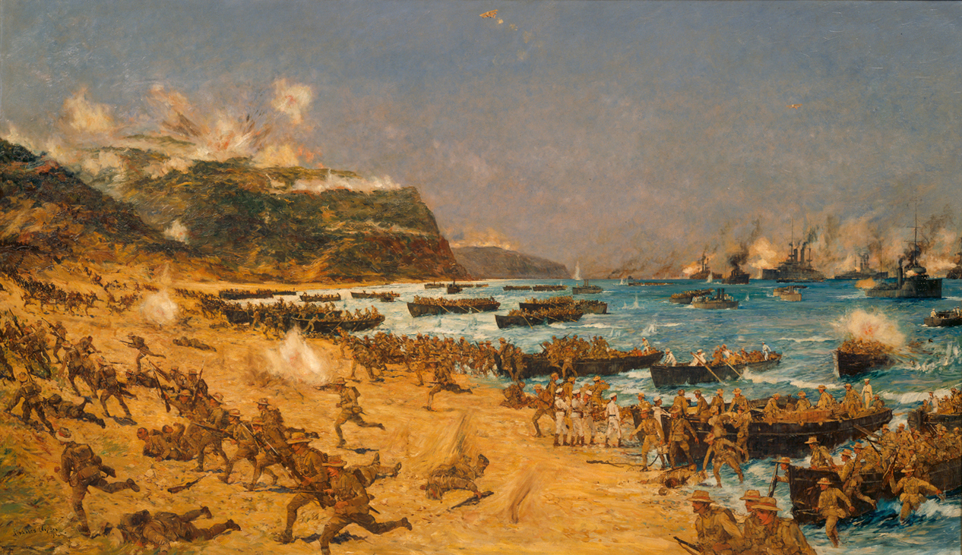
Other areas of the war
British, Australian, and New Zealand (“ANZAC”) troops fought in western Turkey, at the Battle of Gallipoli. It was a disaster, and they lost 175,000 men

Slide 27
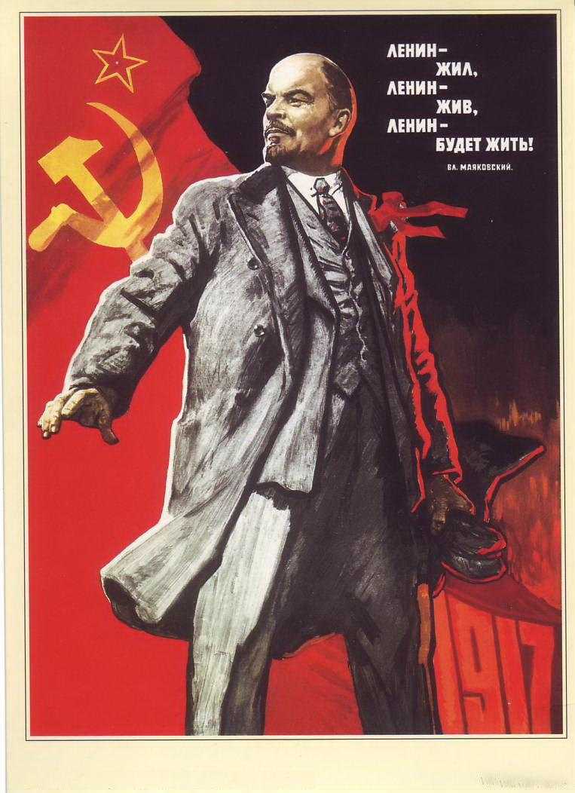
The Eastern Front
Germany destroyed the Russian army at the battle of Tannenberg in 1914.
In 1917, the Germans smuggled Vladimir Lenin, a Marxist/Communist agitator, into Russia to try to topple Russian Czar Nicolas II. Civil War broke out.
The “February Revolution” toppled the Czar, who was captured (with his family) by Bolsheviks (Russian Communist supporters of Lenin) and all were executed.
Russia, now known as the Soviet Union, signed the peace Treaty of Brest-Litovsk in 1917 with Germany.

Slide 28
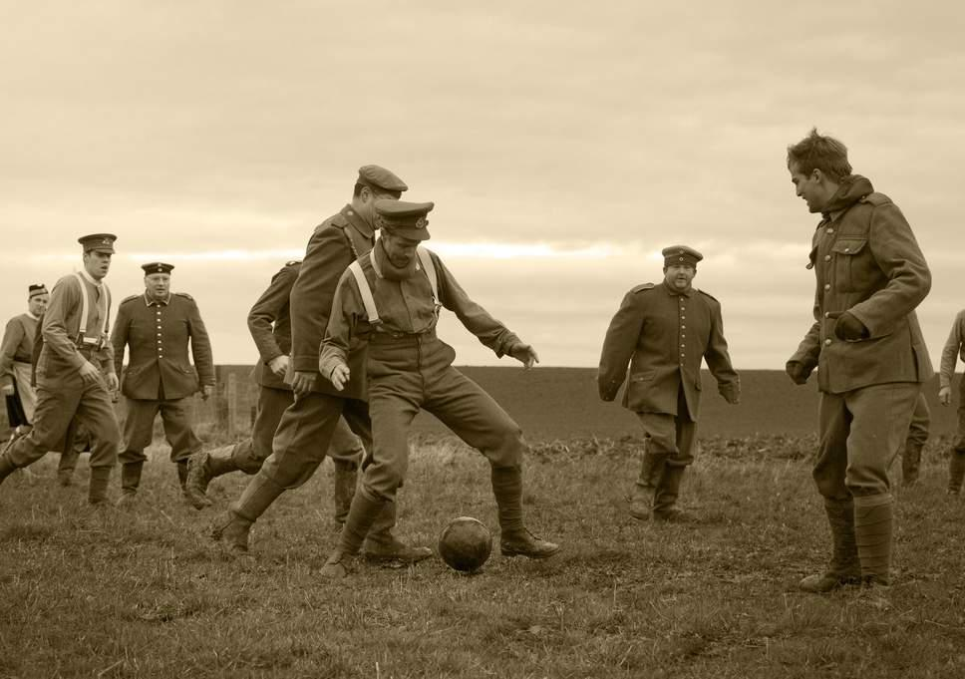
The Christmas Truce

Slide 29
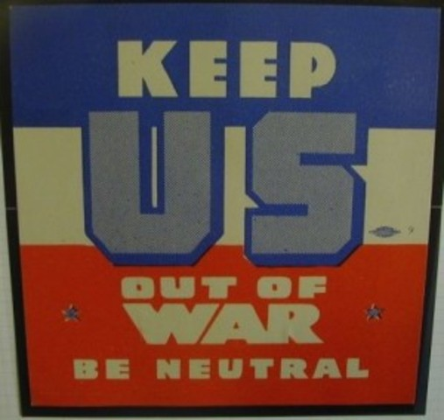
Americans were mostly against the war - a European problem
Most Americans favored the British and French, as word of German atrocities in France and Belgium became known.
Many German Americans, especially in the Midwest, favored Germany.
Irish Americans had historical reasons to refuse to help the British.
Wilson favored neutrality, but was not against selling supplies to the French and British

Slide 30
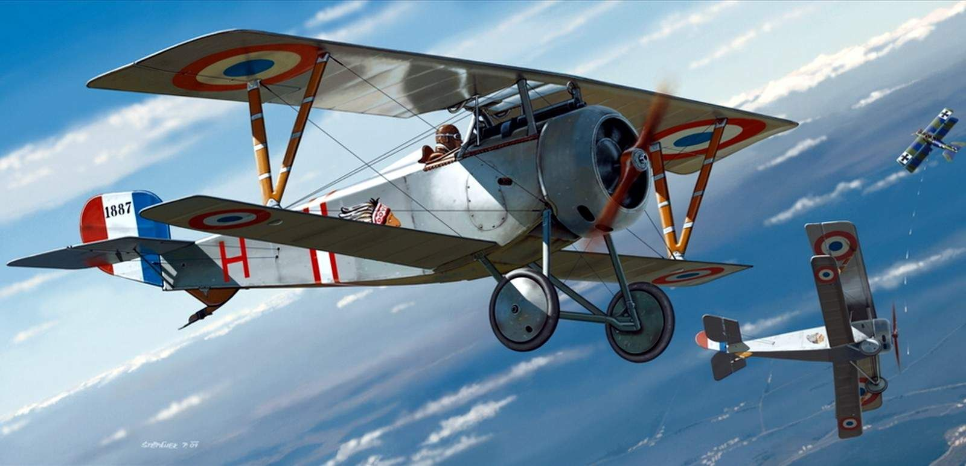
Lafayette Escadrille: American volunteer pilots who joined the French Air forces

Slide 31
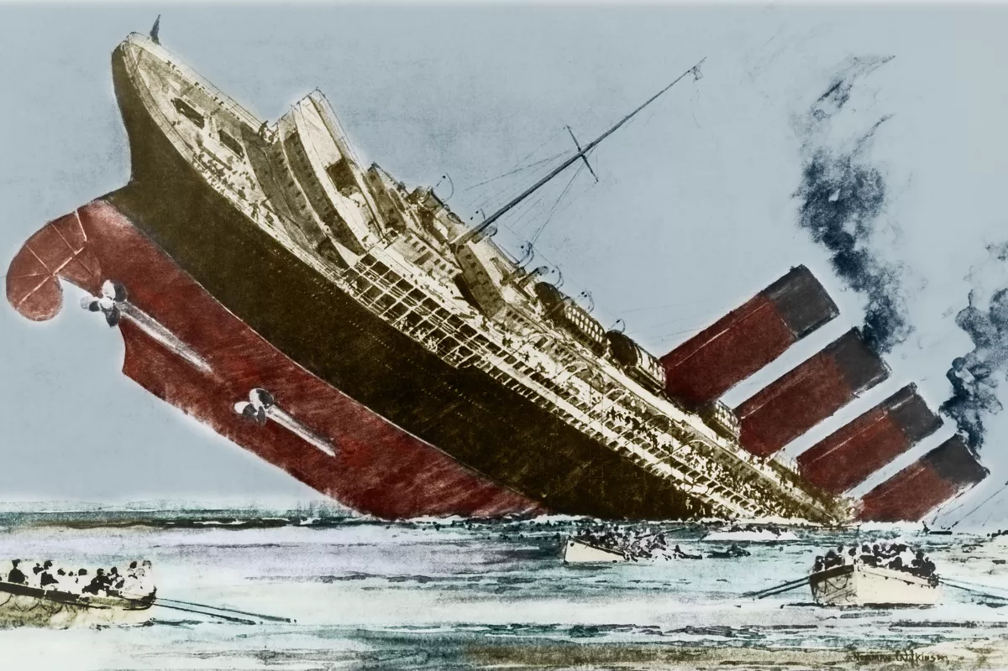
May 17, 1915: Sinking of the Lusitania
German U-boats (submarines) practiced unrestricted warfare, targeting any ship in British waters
The Lusitania was a passenger liner, also containing military supplies for Britain.
Torpedoed off the coast of Ireland, killing 1,200 people, including 128 Americans.
A furious US demanded Germany stop unrestricted submarine warfare.

Slide 32
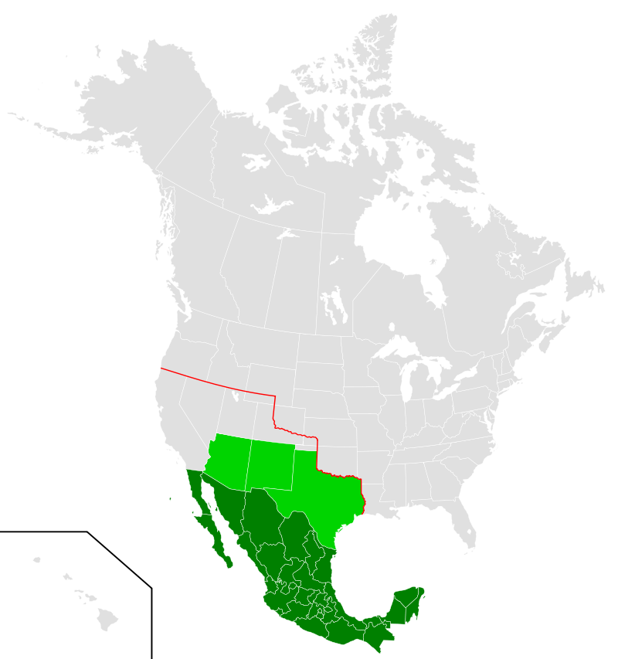
January 1917: Zimmermann Telegram
German telegram to diplomats in Mexico
Said if Mexico declared war on the US, Germany would help Mexico regain “lost territories” of Arizona, New Mexico, and Texas.
Mexico remained neutral during World War I, but the telegram pushed America closer to joining the war.

Slide 33
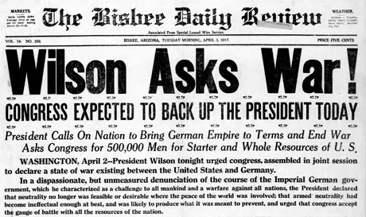
April 1917: US declares war on Germany
In February 1917, Germany announced it would again target any ship in British waters.
Wilson asked Congress to declare war April 2, war was declared April 6.
Another reason for war: Fear that if Germany won, Britain and France couldn’t repay millions of dollars in loans to the US Government and businesses.

Slide 34
“The new [German] policy has swept every restriction aside. Vessels of every kind…have been ruthlessly sent to the bottom without warning and without thought of help or mercy for those on board.…The present German submarine warfare…is a war against all nations.…Our motive will not be revenge or the victorious assertion of the physical might of the nation, but only the vindication of right, of human right.…We are…the sincere friends of the German people.…We shall, happily, still have an opportunity to prove that friendship in our daily attitude and actions towards the millions of men and women of German birth and native sympathy who live amongst us and share our life.… There are…many months of fiery trial and sacrifice ahead of us.
It is a fearful thing to lead this great peaceful people into war, into the most terrible and disastrous of all wars, civilization itself seeming to be in the balance. But the right is more precious than peace, and we shall fight for the things which we have always carried nearest our hearts,—for democracy, for the right of those who submit to authority to have a voice in their own Governments, for the rights and liberties of small nations, for a universal dominion of right…as shall bring peace and safety to all nations and make the world itself at last free. To such a task we can dedicate our lives and our fortunes, everything that we are and everything that we have, with the pride of those who know that the day has come when America is privileged to spend her blood and her might for the principles that gave her birth and happiness and the peace which she has treasured.…”

Slide 35
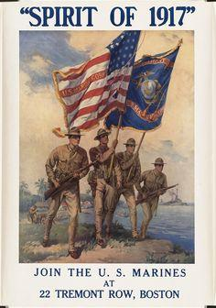
Over There
By George C. Cohan
Johnny, get your gun, get your gun, get your gun.
Take it on the run, on the run, on the run.
Hear them calling you and me,
Every Son of Liberty.
Hurry right away, no delay, go today.
Make your Daddy glad to have had such a lad.
Tell your sweetheart not to pine,
To be proud her boy's in line.
Johnny, get your gun, get your gun, get your gun.
Johnny, show the Hun you're a son-of-a-gun.
Hoist the flag and let her fly
Yankee Doodle do or die.
Pack your little kit, show your grit, do your bit.
Yankee to the ranks from the towns and the tanks.
Make your Mother proud of you
And the old Red, white, and blue!
Chorus
Over there, over there,
Send the word, send the word over there
That the Yanks are coming, the Yanks are coming
The drums rum-tumming everywhere.
So prepare, say a prayer,
Send the word, send the word to beware –
We'll be over, we're coming over,
And we won't come back till it's over, over there.

Slide 36
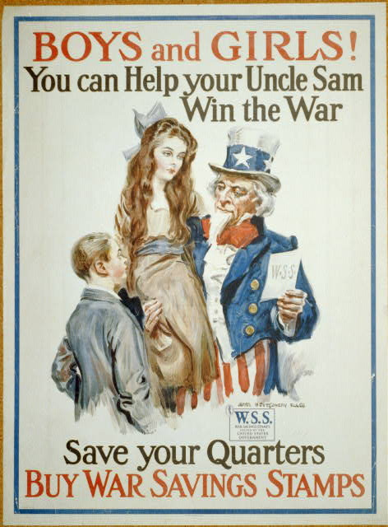
World War I on the Homefront
All men age 21-30 (later changed to 18-45) must register for the draft. By wars end, 2.8 million men volunteered, and 2 million more were drafted. African Americans served in segregated units.
Americans were urged to grow their own vegetables and eat less of most kinds of food.
Boy Scouts and others sold War Bonds to loan the government money.
The government put out patriotic, pro-war propaganda
Sedition Act: Outlawed any negative speech about the government, flag, or armed forces
Many other civil liberties were limited

Slide 37
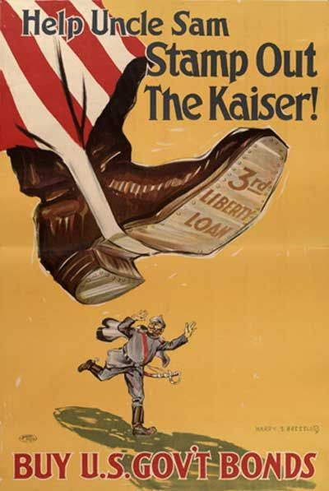
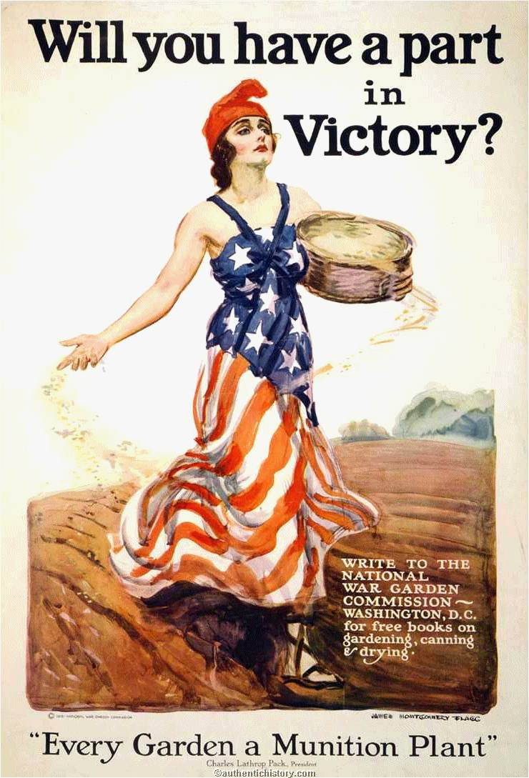
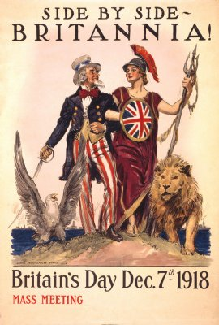

Slide 38
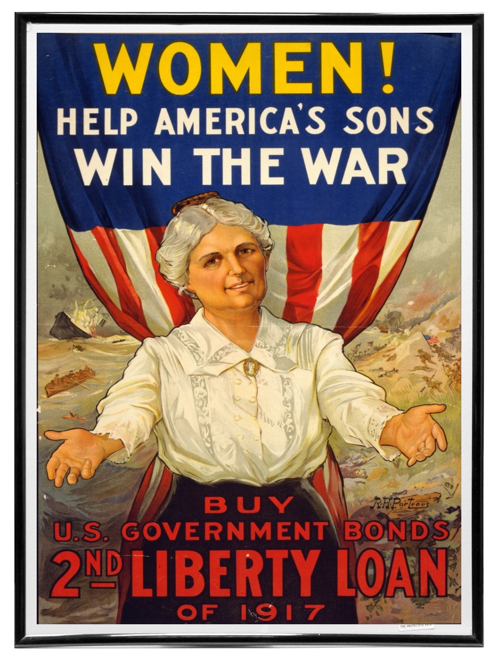
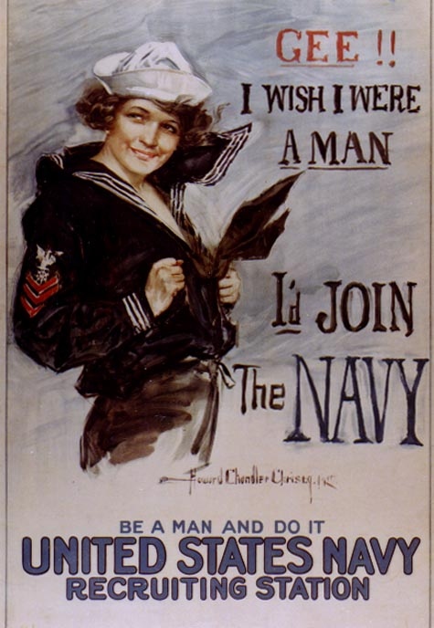
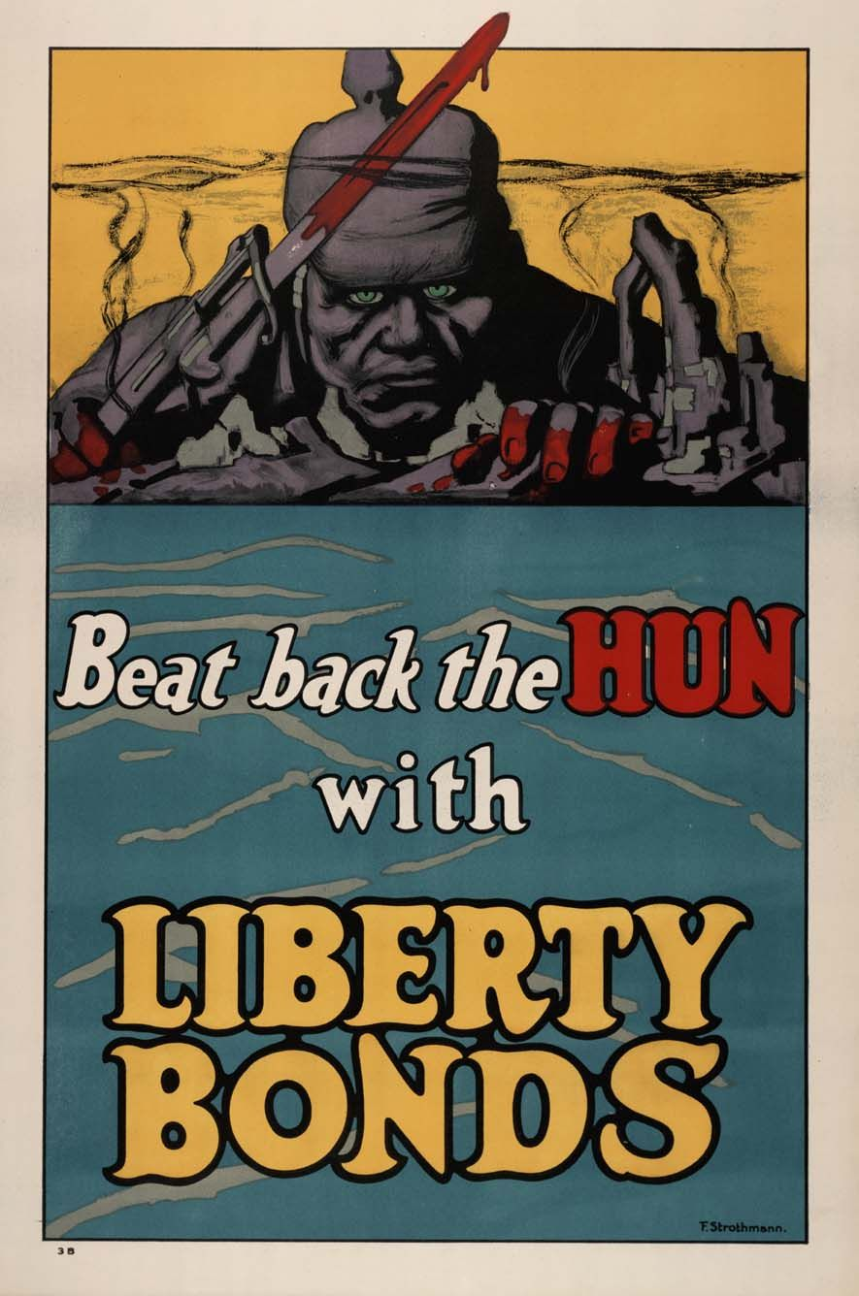

Slide 40
Sauerkraut = Liberty Cabbage
Hamburger = Liberty Sandwich
German Measles = Liberty Measles
Dachshund = Liberty Pup

Slide 41
“Lafayette, we are here!”
First US troops arrive in France in June 1917
US Military leader: Army General John J. Pershing

Slide 43
Gas attack!
Poison gas was first used by the Germans in 1915
Chlorine gas: Causes burning in the throat and causes death by asphyxiation
Mustard gas: blistered the skin, burning eyes, vomiting, internal and external bleeding.
Was used by all sides

Slide 44
Battles Involving US Troops
Battle of Cantigny (May 1918) – First battle involving US troops
Battle of Belleau Wood (June 1918): US Marines backed by US Army artillery hold back the Germans; Marines earn the nickname “Devil Dogs”
Battle of St-Mihiel (September 1918) – First US Offensive of the war, US Army drives the Germans east. US aggressively uses planes and tanks.
Argonne Forest (September – November 1918) – Allied forces force the Germans through the Argonne Forest out of France and Belgium towards Germany

Slide 45
“Harlem Hellfighters”
New York National Guard unit made up almost entirely of African Americans from Harlem
Initially assigned to the French Army in 1917 due to racism within the US Army
Served with distinction across Europe, earning two Medals of Honor and numerous Distinguished Sevice crosses and French Croix de Guerre medals’
Helped introduce jazz music to Europe

Slide 46
Sergeant York
Alvin York, a soldier from Tennessee
Originally a conscientious objector, but sent to the front lines anyway
Became one of the most decorated soldiers of World War I
Almost single-handedly killed 25 Germans, and captured 132

Slide 47
The Armistice
-With a revolution brewing in Germany and on the verge of defeat, Germany asked for an armistice (cease-fire)
- The agreement was signed in a railway car near Compiegne, France and took effect at 11:00 am on November 11, 1918.

Slide 48
Casualties of World War I
Allied Casualties: 5.5 million killed, 12 million wounded
Central Powers: 4.3 million dead, 8.3 million wounded
Civilians: 7.7 million dead
TOTAL: 17.5 million dead, at least 20.3 million wounded
US casualties: 116,000 killed, 204,000 wounded
New Hampshire: 697 killed
MRSD: 5 (4 from Swanzey, 1 from Troy)

Slide 49
Private George Dilboy
After his platoon had gained its objective along a railroad embankment, Pfc. Dilboy, accompanying his platoon leader to reconnoiter the ground beyond, was suddenly fired upon by an enemy machine gun from 100 yards. From a standing position on the railroad track, fully exposed to view, he opened fire at once, but failing to silence the gun, rushed forward with his bayonet fixed, through a wheat field toward the gun emplacement, falling within 25 yards of the gun with his right leg nearly severed above the knee and with several bullet holes in his body. With undaunted courage he continued to fire into the emplacement from a prone position, killing 2 of the enemy and dispersing the rest of the crew.

Slide 51
Wilson’s 14 Points
President Wilson’s attempt to establish the guidelines for peace after World War I, ending the issues that caused the war and ensuring another war wouldn’t occur.
Points 1-5 eliminate the causes of global conflict through free trade, disarmament, and freedom of the seas.
Points 6-13 establish new nations along cultural lines and the right of “self determination” for all nations.
Point 14 established a “League of Nations”
As most nations had significant issues with most of these points, Wilson had to negotiate and alter a few, and only a few made it into the final peace treaty.

Slide 52
Point 1 : Public diplomatic negations with more secret agreements or secret treaties
Point 2 : Freedom of navigation on all seas.
Point 3 : Free trade among nations and an end to all economic barriers between countries
Point 4 : Countries to reduce armaments and weapons to a level required for public safety.
Point 5 : Fair and impartial decisions for the resolution of colonial claims
Point 6 : Restoration of Russia territories and freedom to establish and develop its own political system
Point 7 : Preservation of the sovereignty of Belgium and that it should be independent as before the war.
Point 8 : France should be fully liberated, its territory restored and allowed to recover Alsace-Lorraine
Point 9 : All Italians are to be allowed to live in Italy and Italy's borders to be "along clearly recognizable lines of nationality."
Point 10 : Self-determination should be allowed for all those living in Austria-Hungary.
Point 11 : Self-determination and guarantees of independence for the Balkan states and its borders re-drawn.
Point 12 : Self-determination for the Turkish people and for Non-Turks under Turkish rule
Point 13 : An independent Polish nation should be created which should have access to the sea.
Point 14 : A League of Nations should be created to guarantee the political and territorial independence of all states.

Slide 53
Treaty of Versailles - 1919
The Big Four
- Officially ended World War I
Dominated by Britain, France, Italy, and the United States.
Germany was not allowed to negotiate.
Most of Wilson’s 14 Points were abandoned or twisted by France and Britain.
Lloyd George (Britain)
Woodrow Wilson (USA)
Vittorio Orlando (Italy)
Georges Clemenceau (France)

Slide 54
Treaty of Versailles - 1919
Germany must accept guilt for the war and pay reparations (upwards of $31 billion).
Parts of Germany given to France and 5 other nations
Poland created out of German territory
Austria-Hungary, Russia, and Ottoman Empire broken up into numerous independent nations or territories occupied by the Allies
German military restricted in size, land near Rhine River occupied by Allies.
German territories in Africa and the Pacific divided among the Allies
A League of Nations will be created

Slide 56
Wilson’s Treaty Fight
Months in Europe negotiating caused Wilson to loose touch with Washington.
His cross-country tour for support of the peace treaty was physically grueling and was ineffective
Major Republican opposition was led by Senator Henry Cabot Lodge of Massachusetts – fear of loss of US sovereignty.
Wilson suffered a series of massive strokes, refused to negotiate with the Senate, and the Senate rejected the Treaty.
The US made a separate peace with Germany, and never joined the League of Nations

Slide 57
18th Amendment - 1919
Alcohol was seen as a cause of many of the nation’s problems by “temperance” crusaders
Made the manufacture, sale, or transportation of “intoxicating liquors” illegal
The Volstead Act, passed soon after, made wine, beer, hard liquor, and anything above .5% alcohol qualify as “intoxicating”
Technically, consumption was not affected.
After one year from the ratification of this article the manufacture, sale, or transportation of intoxicating liquors within, the importation thereof into, or the exportation thereof from the United States and all the territory subject to the jurisdiction thereof for beverage purposes is hereby prohibited…

Slide 58
19th Amendment - 1920
Gave women the full right to vote (“suffrage”)
Women already had the right to vote in many states, especially in the West.
Women’s Suffrage campaigners, known as “Suffragettes”, had been campaigning for 100 years.
Famous Suffragettes included Susan B. Anthony, Elizabeth Cady Stanton, and Carrie Chapman Catt.
Wilson supported an amendment in return for Catt’s support of WWI
The right of citizens of the United States to vote shall not be denied or abridged by the United States or by any State on account of sex…

Slide 59
National Women’s Party (NWP) Protest, World War I
Carrie C. Catt,
Leader of the National
American Women’s Suffrage
Association (NAWSA)

Slide 60
Boston Molasses Flood
January 15, 1919, a tank containing 2.3 million gallons of molasses burst in Boston’s North End
The wave of molasses moved at 35 mph and killed 21, injured 150
The cleanup took weeks and molasses floated in the harbor until the summer.
“Anthony di Stasio, walking homeward with his sisters from the Michelangelo School, was picked up by the wave and carried, tumbling on its crest, almost as though he were surfing. Then he grounded and the molasses rolled him like a pebble as the wave diminished. He heard his mother call his name and couldn't answer, his throat was so clogged with the smothering molasses. He passed out, then opened his eyes to find three of his four sisters staring at him.”

Slide 61
Spanish Flu Pandemic of 1919
A Flu pandemic that lasted from 1917-1919
The flu has an unknown origin, but spread rapidly among soldiers in the trenches, and then among civilians
Probably killed 50 million worldwide, and 675,000 in the United States
“The first modern pandemic”

Slide 62
Romolo Vanni
Lena (Rondina) Vanni
Thomas McCue Ellen (Wallace) McCue

Slide 63
The Palmer Raids
The RED SCARE: Following the Communist takeover in Russia, Americans feared socialists, labor organizers, anarchists, and others were plotting the overthrow of the US Government.
Race Riots in 30 cities and several strikes had many Americans fearful.
Bombs were mailed to government officials, and several were killed. Anarchists were blamed, several of them Italian. One targeted the house of Attorney General A. Mitchell Palmer
The Justice Dept brutally raided the homes and businesses of suspected anarchists, Italian and Eastern European immigrants, and labor organizers. 500+ were deported.
The Raids violated the civil rights of many immigrants, and were undeniably unconstitutional.

