Slide 1
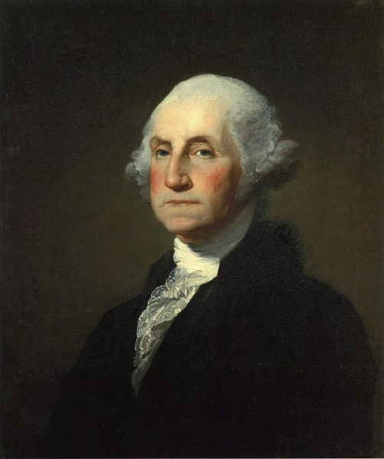
George Washington

Slide 2
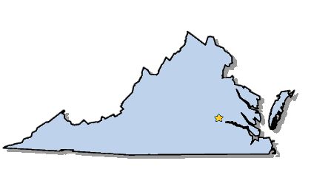
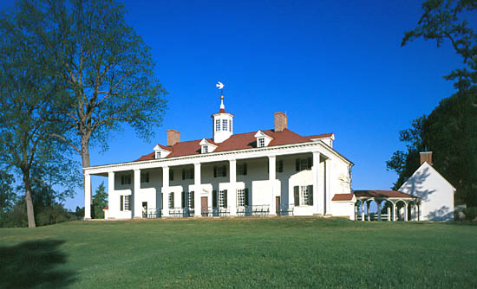
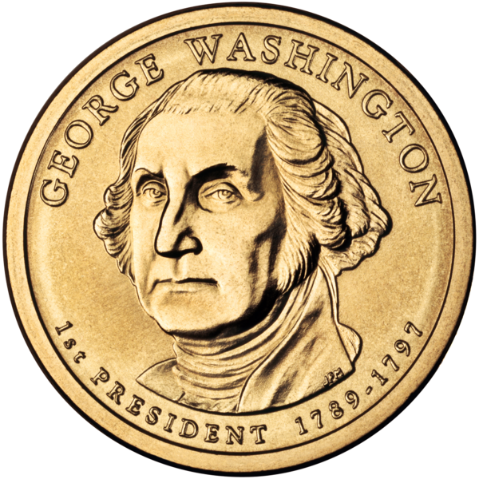
Elected in: 1789, 1792
President from: 1789-1797
Political Party: None
Home State: Virginia

Slide 3
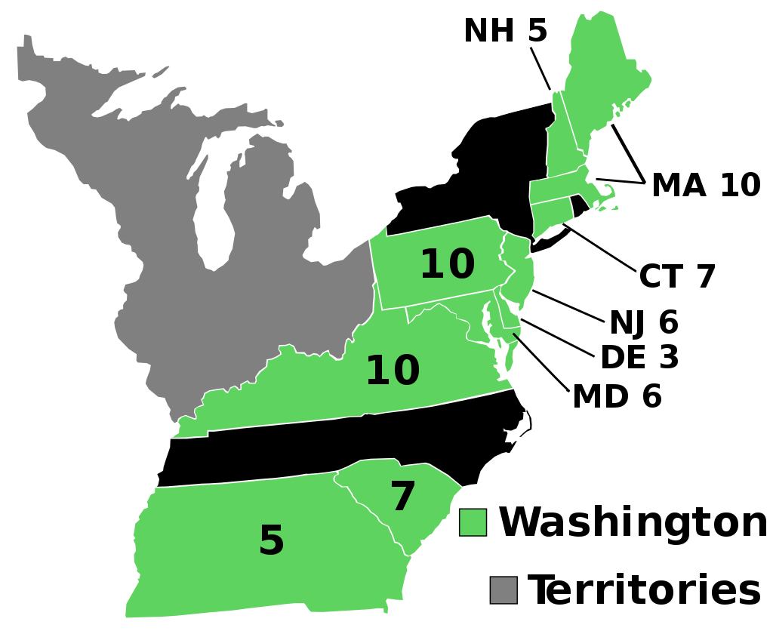
Election of 1789

Slide 4
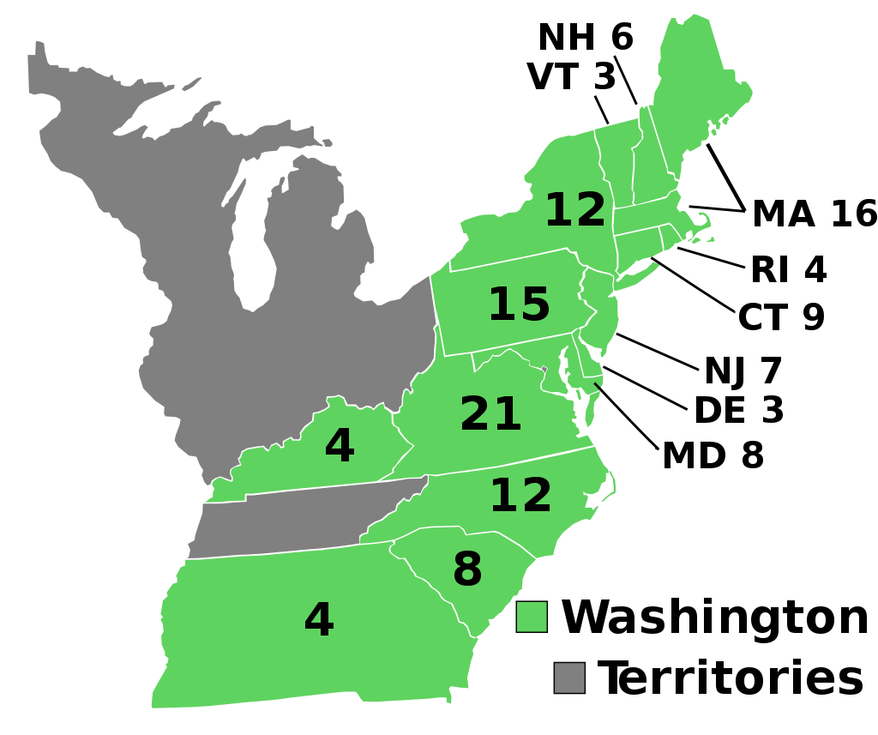
Election of 1792

Slide 5
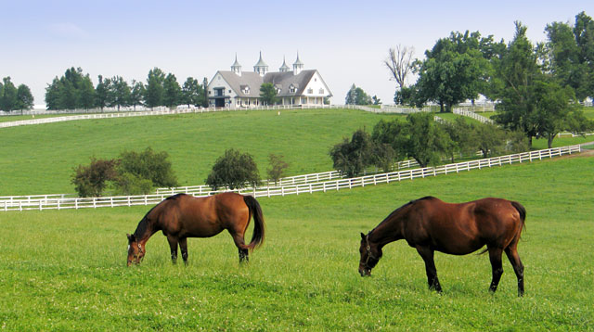
New States
14. Vermont
15. Kentucky
16. Tennessee

Slide 6
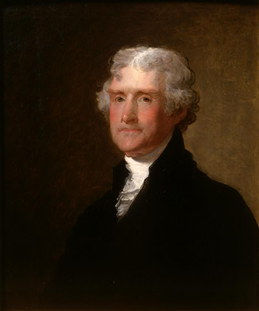
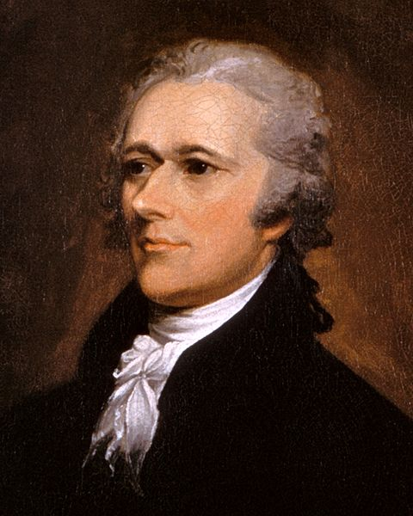
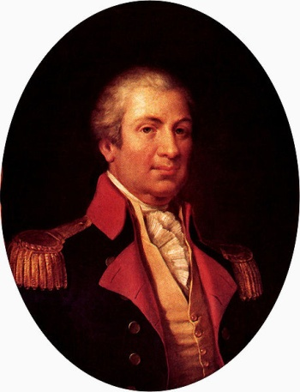
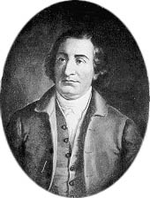
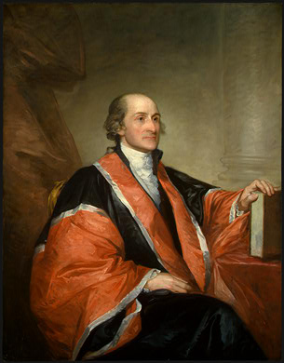
President Precedent
First Cabinet (Presidential advisors)
Secretary of State: Thomas Jefferson
Secretary of the Treasury: Alexander Hamilton
Secretary of War: Henry Knox
Attorney General: Edmund Randolph
Judiciary Act of 1789
- Sets up a Supreme Court, with 6 justices (John Jay is 1st Chief Justice)
- 13 District Courts, 3 Appeals Courts

Slide 7
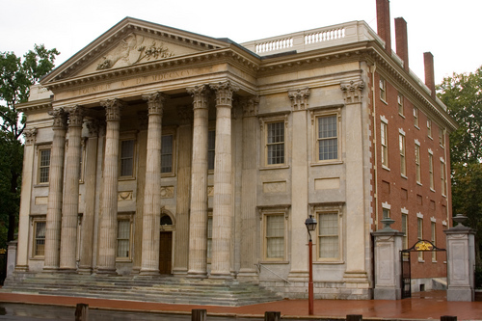
Hamilton’s Debt Plan
- Hamilton proposes that the Federal government assume all national and state debt
Federal government will issue new bonds to sell, and use the money to repay all old debt
- A new Bank of the United States would
issue paper money to loan out
- There would also be a protective tariff
- Southern states are against it because they
already repaid their debt
Jefferson opposes: it’s unconstitutional!
Compromise: South supports
Hamilton’s plan; in return, the new
capital city will be built in the South

Slide 8
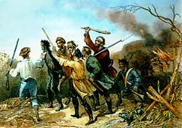
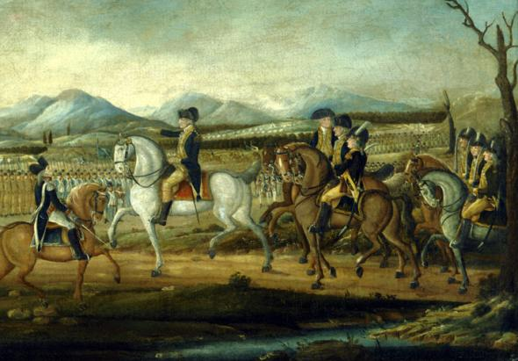
Whiskey Rebellion
- Hamilton’s excise (sales) tax on whiskey angers farmers in western Pennsylvania
- Washington sends out troops and ends rebellion
- Proof that new Federal government works

Slide 9
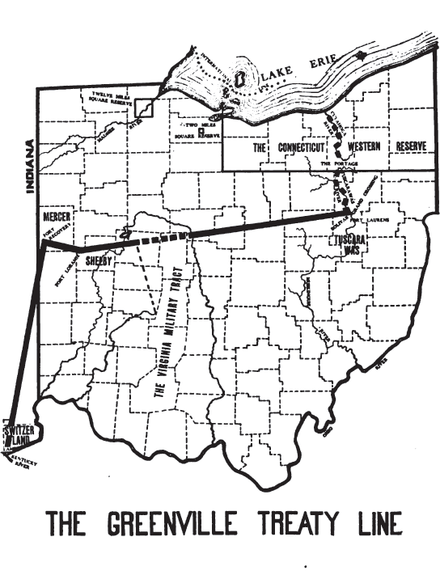
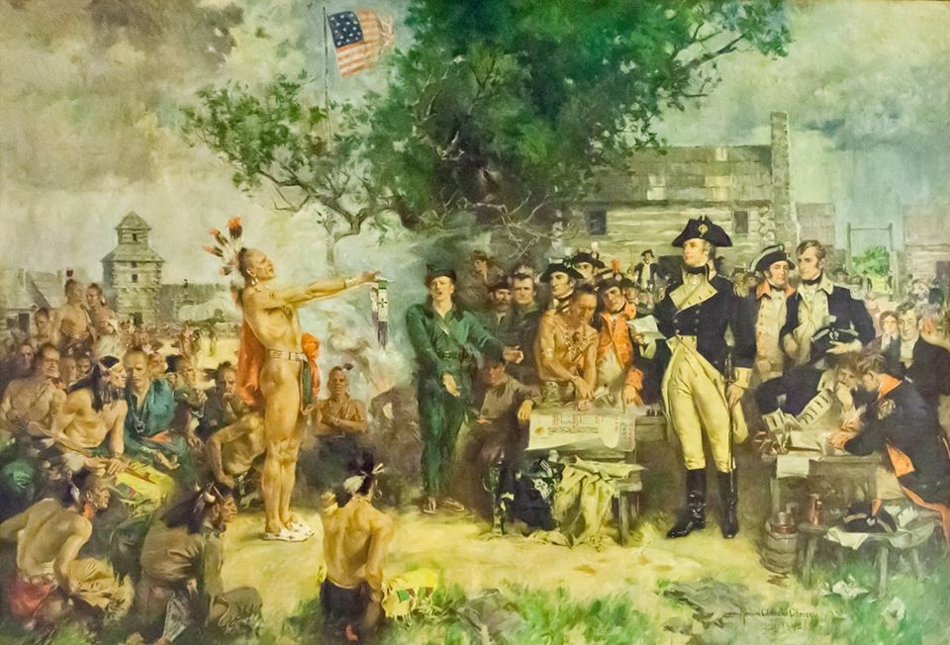
Battle of Fallen Timbers
US Army under Anthony Wayne defeated a confederacy of tribes (Shawnee, Delaware, Iroquois, Miami) in modern Ohio
Treaty of Greenville: Tribes surrender the Ohio territory to the US.

Slide 10
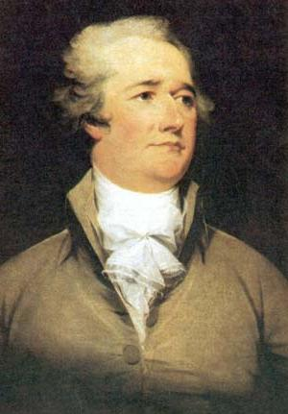
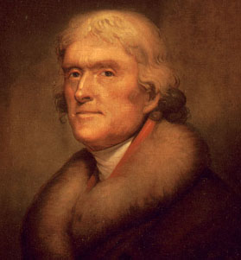
The 1st Political Parties

Slide 11
Federalists Democratic Republicans
Led by?
Hamilton
Jefferson
Who leads
the US?
Wealthy and well educated
Regular, common people
Which gov’t
is important?
National Government
State Governments
Economic
views?
Mills, manufacturing, and trade
Farms & agriculture
Foreign View
Pro-British
Pro-French
Constitution
“Loose” interpretation
“Strict” interpretation
Banking
National bank and protective tariffs
No national bank, hates protective tariffs
Powerful
where?
North, cities, and coast
South, rural, and inland

Slide 12
Federalists Democratic Republicans
Led by?
Who leads
the US?
Which gov’t
is important?
Economic
views?
Foreign View
Constitution
Banking
Powerful
where?

Slide 13
The French Revolution
The French overthrow/execute their king and declare war on Britain
Citizen Genet: French minster to US who publicly campaigned for American support for French Revolution, earning the wrath of Washington.
Washington issues a neutrality declaration, saying the US will stay out of it

Slide 14
Foreign Treaties
Problem 1: British are seizing US ships and taking sailors and cargo; Redcoats still in forts in the NW
Jay’s Treaty: Damages are paid to British, and Redcoats will leave the NW (nothing is said about ships, so treaty is unpopular)
Problem 2: Spanish are closing New Orleans and Mississippi River to US shipping
Pinkney’s Treaty: Spain agrees to let US use New Orleans and the river again

Slide 15
Washington’s Farewell Address
Written address at the end of Washington’s second term
Advised American citizens to view themselves as a cohesive unit and avoid political parties
Issued a special warning to be wary of attachments and entanglements with other nations.
“The basis of our political systems is the right of the people to make and to alter their Constitutions of Government.”

Slide 16
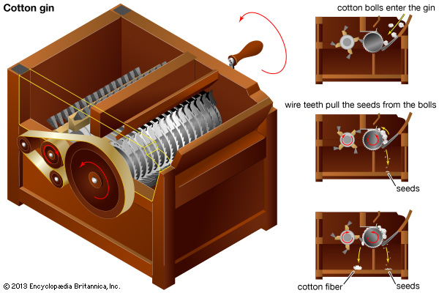
The Cotton Gin
Before: One Slave could separate up to one pound of cotton in one day.
After: One Slave could separate up to 50 pounds of cotton in one day.
Invented by Eli Whitney (Connecticut) in 1793.

Slide 17
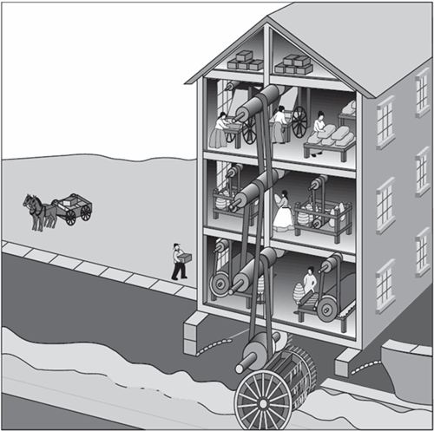
The Textile Mill
First in America: Slater’s Mill (in Rhode Island) in 1793.

Slide 18
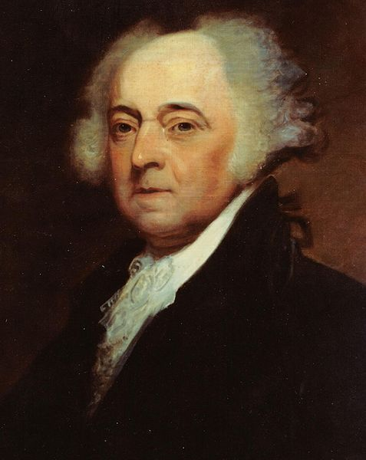
John Adams

Slide 19
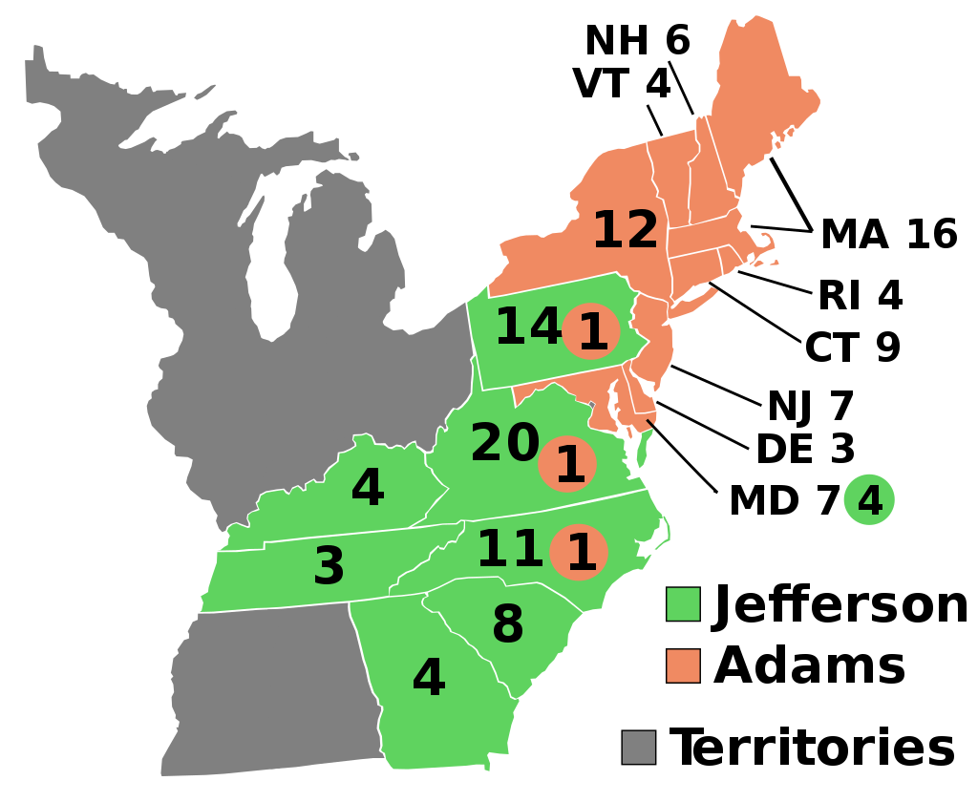
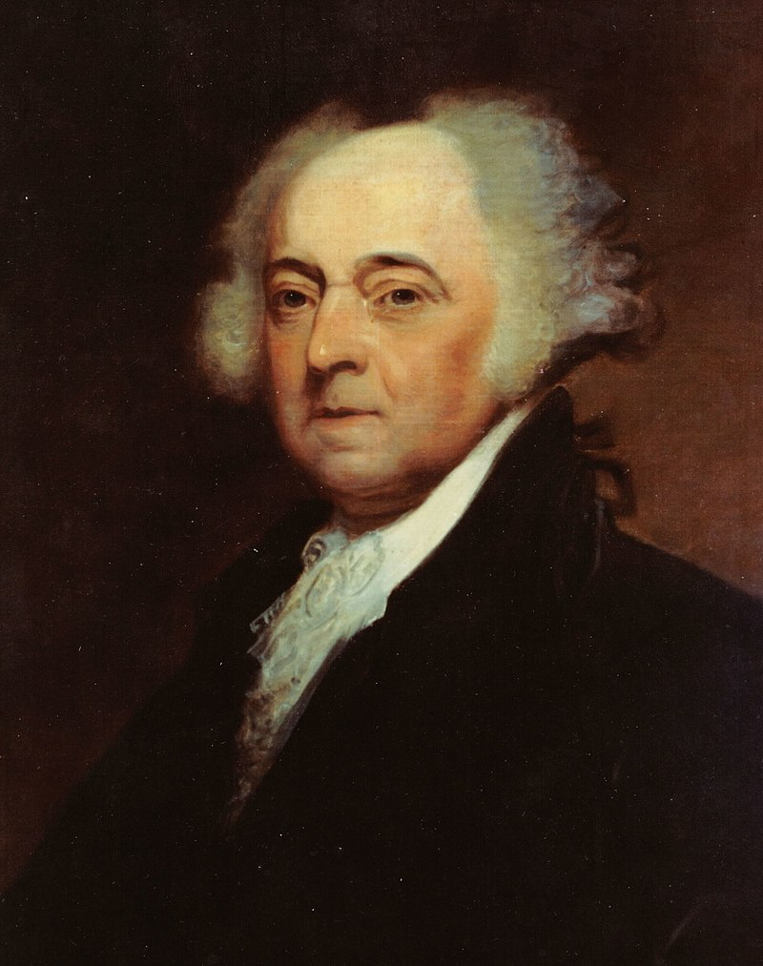
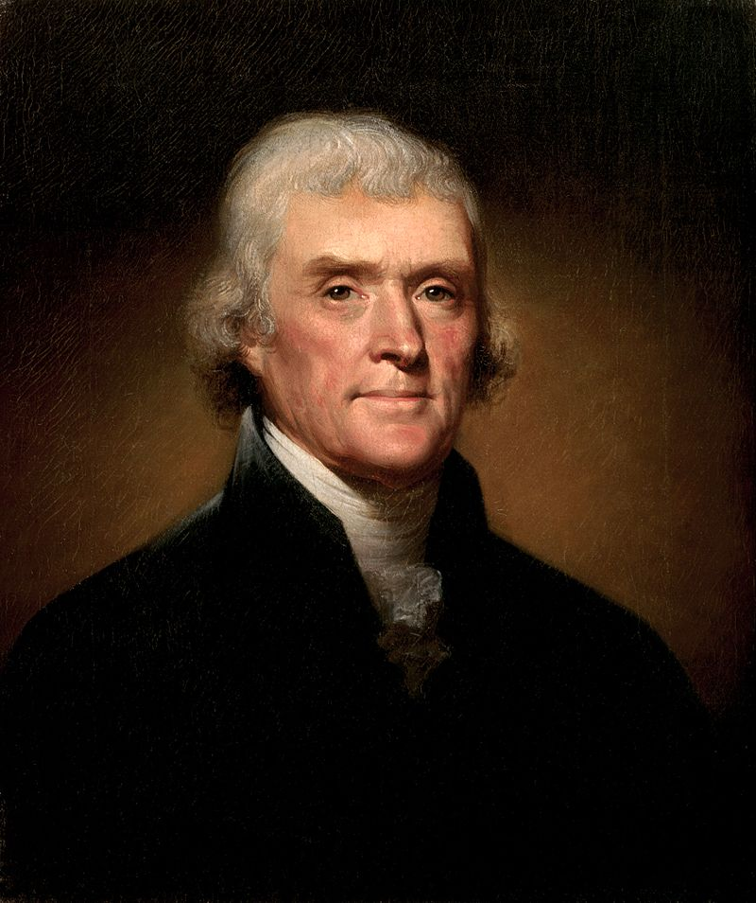
Election of 1796
Federalist: 71
President: John Adams
Democratic-Republican: 68
President: Thomas Jefferson
As he came in second in the Electoral College, Jefferson became the vice president

Slide 20
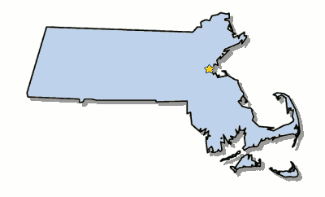
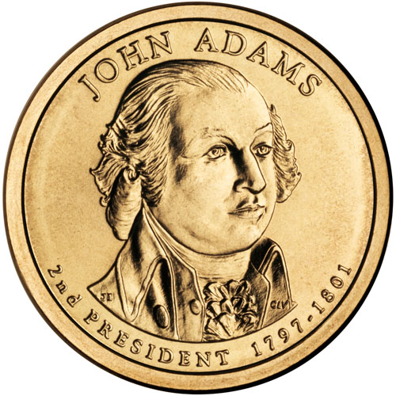
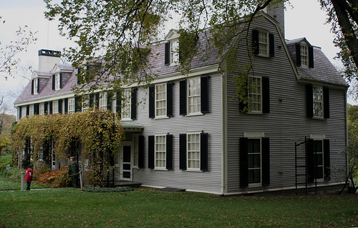
Elected in: 1796
President from: 1797-1801
Political Party: Federalist
Home State: Massachusetts

Slide 21
New States
None

Slide 22
XYZ Affair
France is angry that US will not declare war on Britain, so US sends envoys to write a treaty
Three French agents (“X, Y, and Z”) demand a $250,000 bribe and a $10 million loan, just to talk about a treaty.
Federalists are furious and want war with France, but Adams refuses, but allows the…

Slide 23
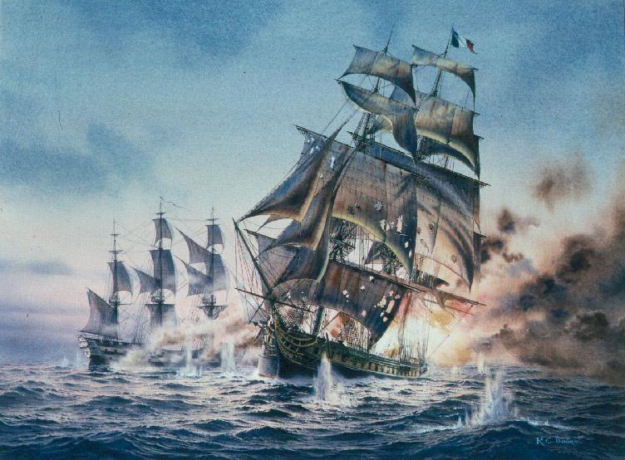
Quasi-War (Naval War) with France
- US Navy frigates (like the USS Constitution) attack French shipping, even though there is no declaration of war
- War ends after less than 2 years. US captured more than 20 French ships

Slide 24
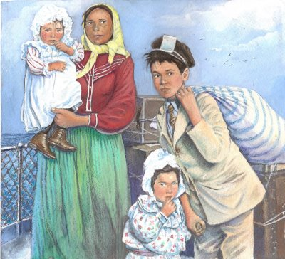
The Alien and Sedition Acts
- Laws designed to keep people from voting for the Dem-Reps and support the Federalists
Alien Act: Allowed President to deport or detain “dangerous” aliens.
Naturalization Act: Increased residency requirement to become a citizen from 5 to 14 years
Sedition Act: Newspaper editors criticizing the Federalist government could be fined or jailed
<NOT this kind of alien
This kind of alien >

Slide 25
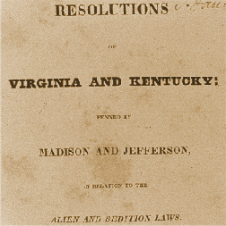
The VA and KY Resolutions
- Written by Dem-Reps (Jefferson & Madison) in response to the Alien/Sedition Acts
- Resolutions from VA and KY that said states could nullify (cancel) any Federal law it doesn’t like (unconstitutional) within its borders.

Slide 26
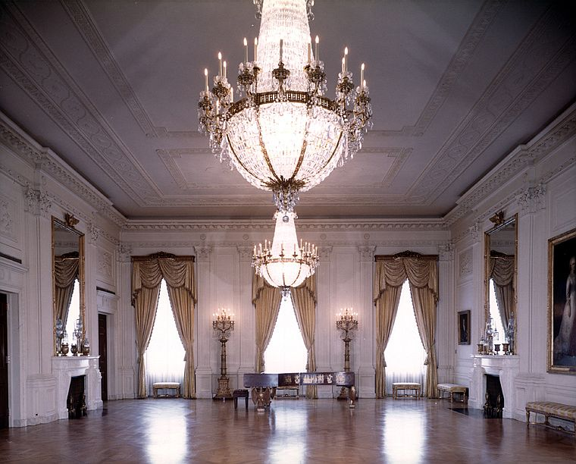
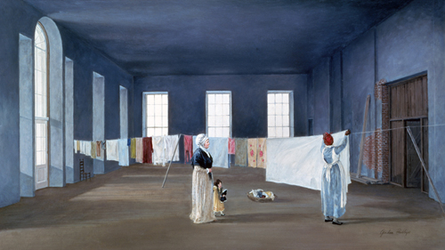
Washington, DC
Capital of the US finally moves to Washington, DC
Adams is the first president to live in the White House

Slide 27
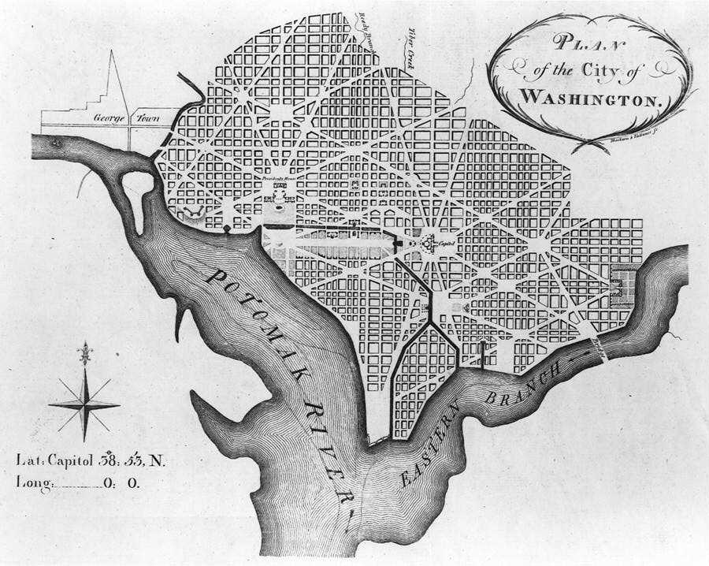
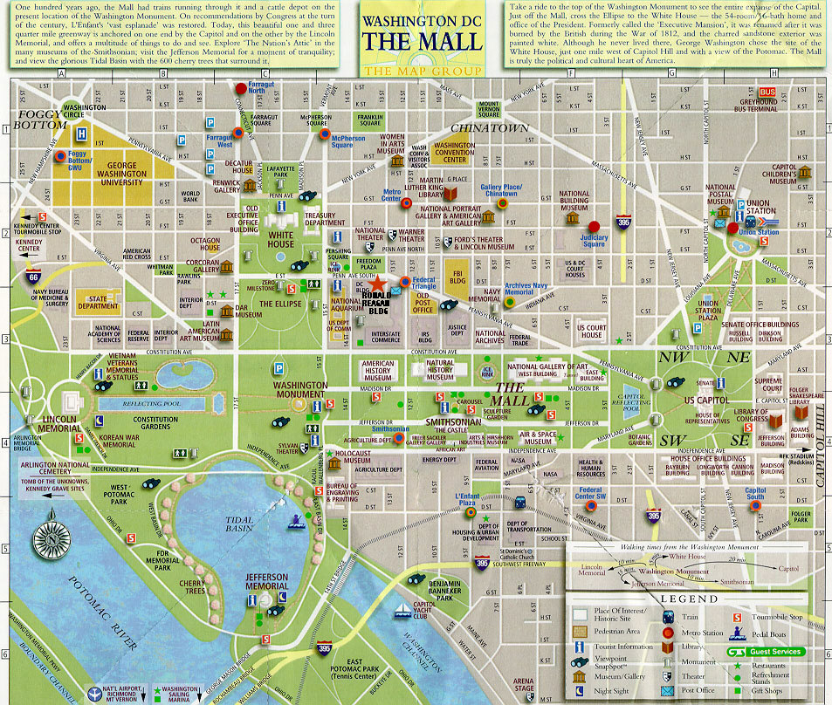

Slide 28
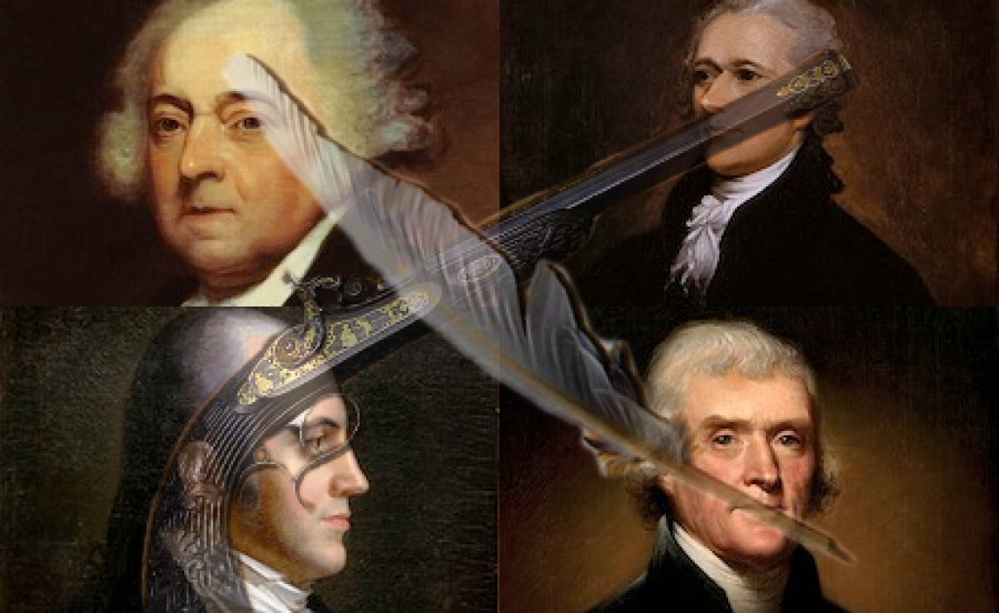
The Revolution of 1800
- The peaceful transition of power between Federalist and Democratic-Republican parties as a result of the election of 1800.

