Slide 1
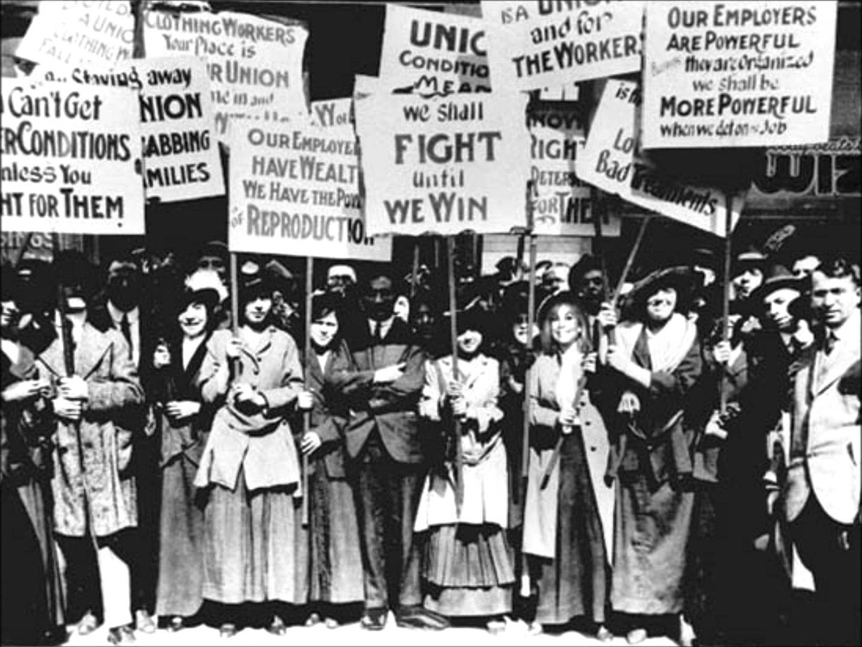
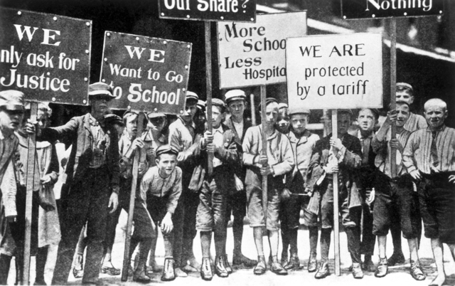
The Progressive Era
1890s-1920s
The Progressive Era is a period of widespread social activism and political reform across the United States that spanned from the 1890s to the 1920s. The main objectives of the Progressive movement were eliminating problems caused by industrialization, urbanization, immigration, and political corruption.

Slide 2
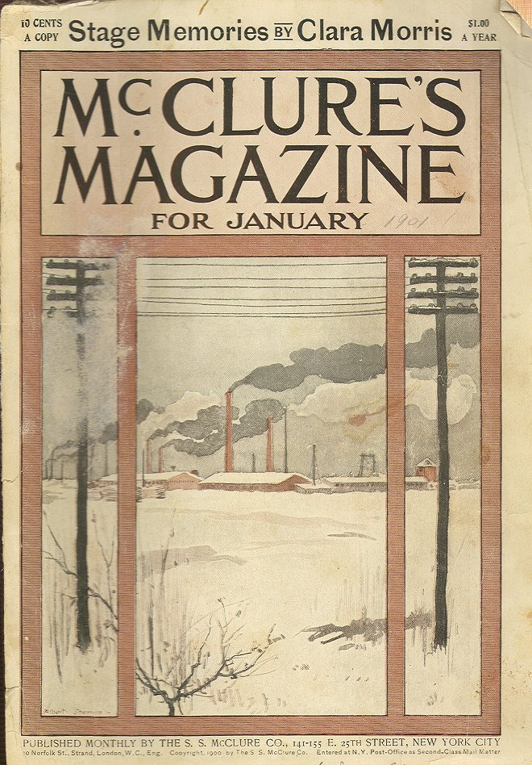
Muckrakers
“...you may recall the description of the Man with the Muck-rake, the man who could look no way but downward with the muck-rake in his hands; who was offered a celestial crown for his muck-rake, but who would neither look up nor regard the crown he was offered, but continued to rake to himself the filth of the floor.” – Theodore Roosevelt
Reform-minded investigative journalists who attacked established institutions and leaders as corrupt.
Ida Tarbell: History of Standard Oil: exposed the ruthlessness John D. Rockefeller used to create the Standard Oil monopoly – and ultimately led to its downfall.
Upton Sinclair: The Jungle
Lincoln Steffens: The Shame of the Cities: exposed corruption in urban political machines
Ray Stannard Baker: Following the Color Line: exposed racial discrimination
Jacob Riis: How the Other Half Lives

Slide 3
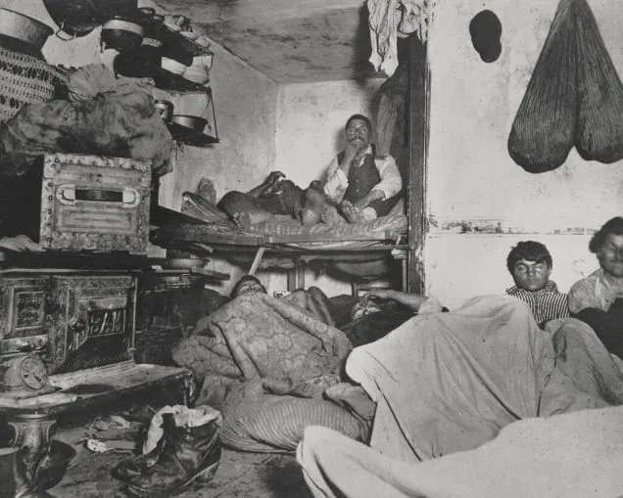

Slide 4
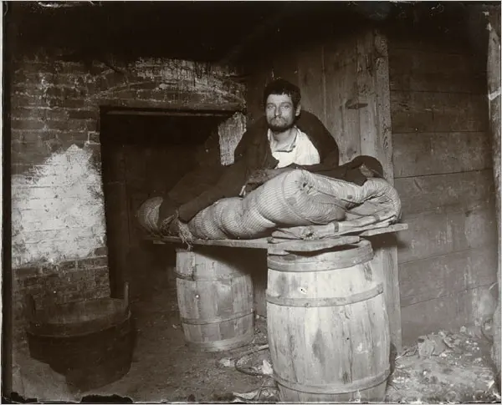
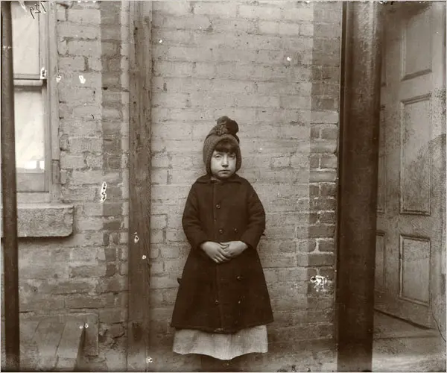
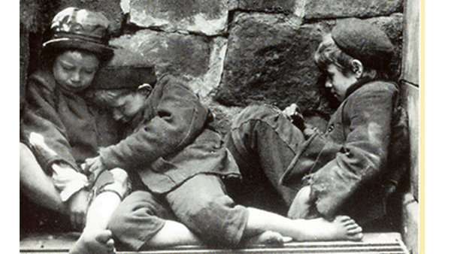

Slide 5
Excerpt from Chapter 14 of The Jungle, Upton Sinclair (1906)
There was never the least attention paid to what was cut up for sausage; there would come all the way back from Europe old sausage that had been rejected, and that was moldy and white—it would be dosed with borax and glycerin, and dumped into the hoppers, and made over again for home consumption. There would be meat that had tumbled out on the floor, in the dirt and sawdust, where the workers had tramped and spit uncounted billions of consumption germs. There would be meat stored in great piles in rooms; and the water from leaky roofs would drip over it, and thousands of rats would race about on it. It was too dark in these storage places to see well, but a man could run his hand over these piles of meat and sweep off handfuls of the dried dung of rats. These rats were nuisances, and the packers would put poisoned bread out for them; they would die, and then rats, bread, and meat would go into the hoppers together. This is no fairy story and no joke; the meat would be shoveled into carts, and the man who did the shoveling would not trouble to lift out a rat even when he saw one—there were things that went into the sausage in comparison with which a poisoned rat was a tidbit.
----------
Under the system of rigid economy which the packers enforced, there were some jobs that it only paid to do once in a long time, and among these was the cleaning out of the waste barrels. Every spring they did it; and in the barrels would be dirt and rust and old nails and stale water—and cartload after cartload of it would be taken up and dumped into the hoppers with fresh meat, and sent out to the public's breakfast. Some of it they would make into "smoked" sausage—but as the smoking took time, and was therefore expensive, they would call upon their chemistry department, and preserve it with borax and color it with gelatin to make it brown. All of their sausage came out of the same bowl, but when they came to wrap it they would stamp some of it "special," and for this they would charge two cents more a pound.

Slide 6
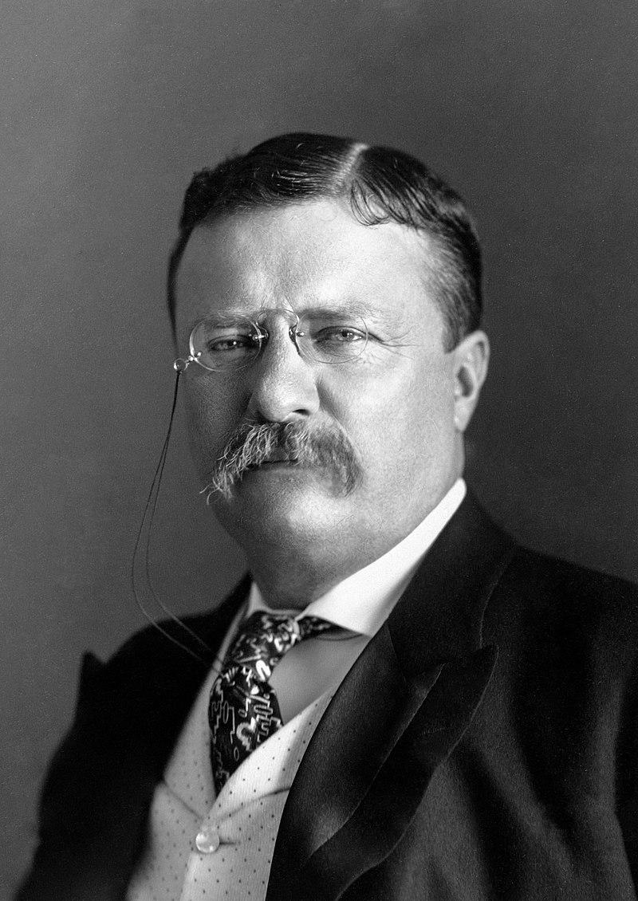
Theodore Roosevelt

Slide 7
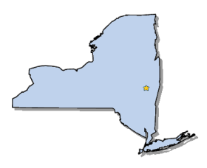
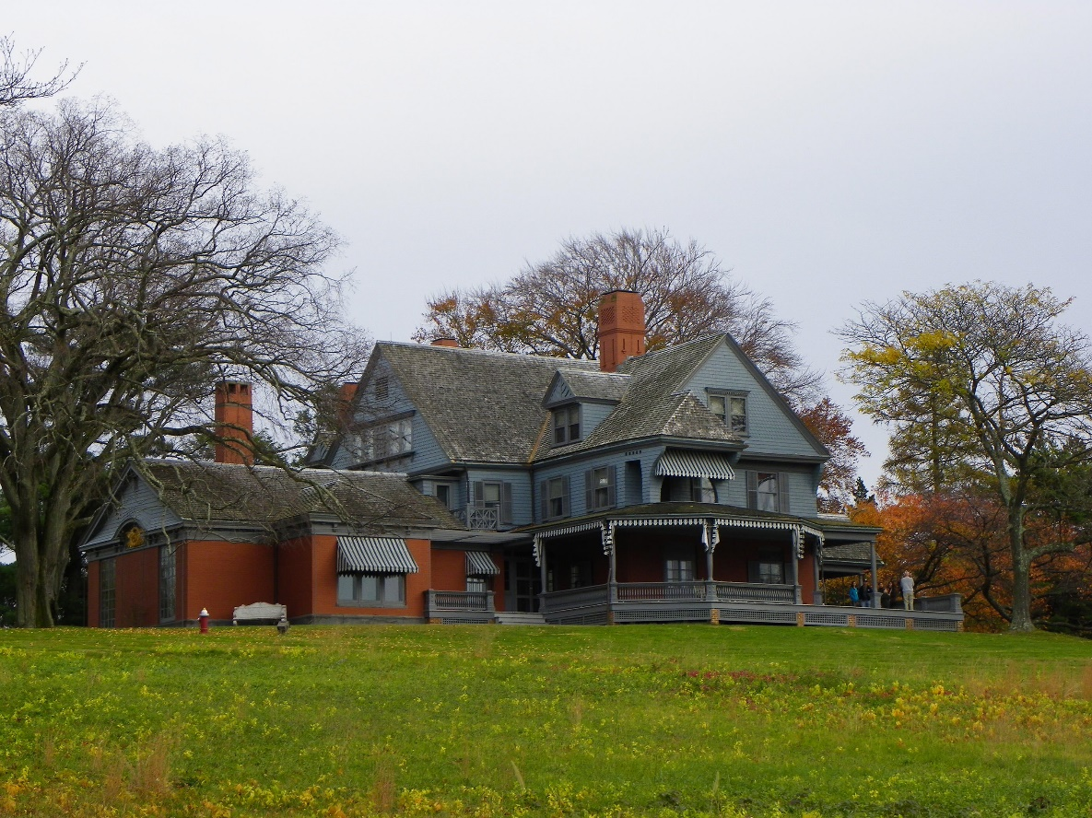
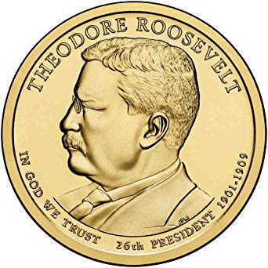
Elected in: 1904
President from: 1901 - 1909
Political Party: Republican
Home State: New York

Slide 8
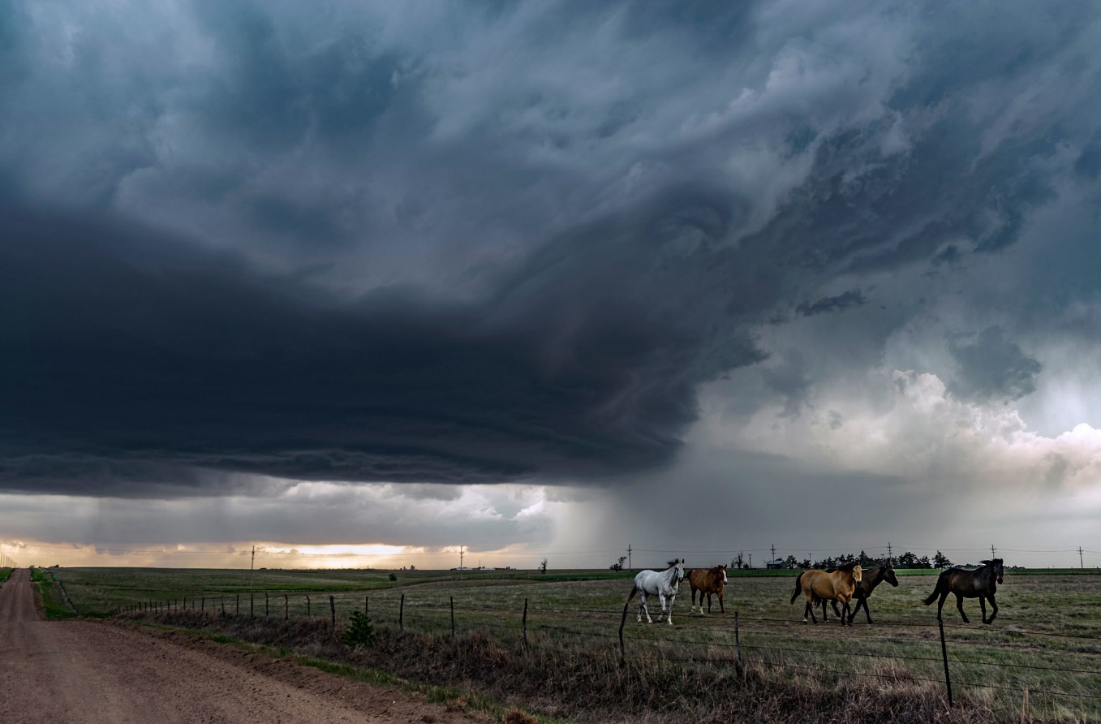
New States
46. Oklahoma

Slide 9
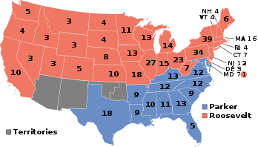
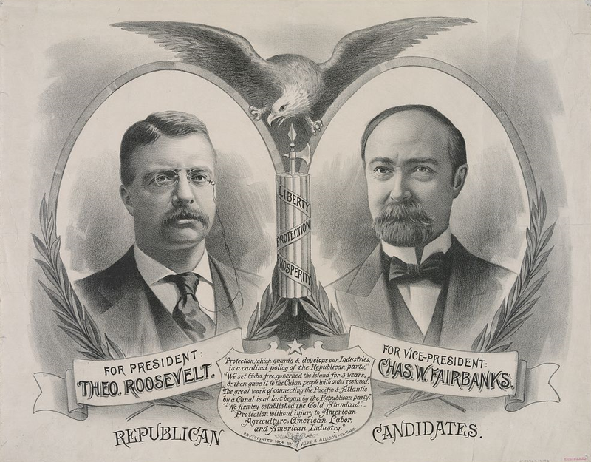
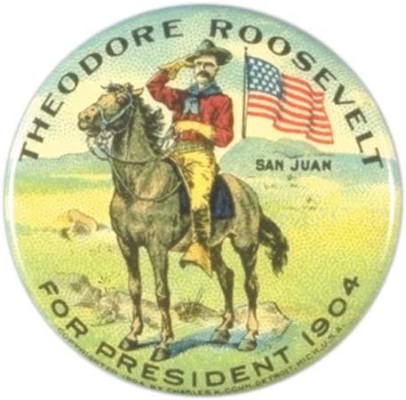
Election of 1904
Republican: 336
President: Theodore Roosevelt
Vice President: Charles Fairbanks
Democratic: 140
President: Alton Parker
Vice President: Henry Davis

Slide 10
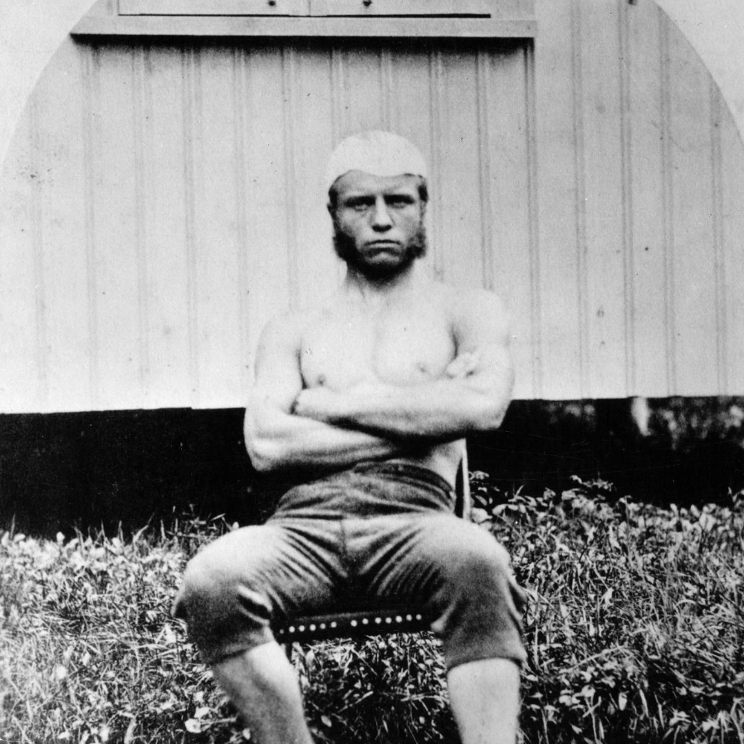
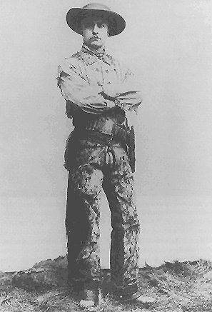
Amateur taxidermist as a child
Toured Europe and Middle East, climbed Matterhorn
Attends Harvard University, an avid boxer and wrestler. Graduated Magna cum laude.
Writes first book at age 24 (will write 45 books total)
Elected to NY legislature
Wife and mother die on same day – Feb 14 1884
Manages a ranch in North Dakota
New York City Police Commissioner
Assistant Secretary of the Navy, age 40
Colonel, US Volunteer Cavalry (Rough Riders) in Spanish American War
Governor of New York

Slide 11
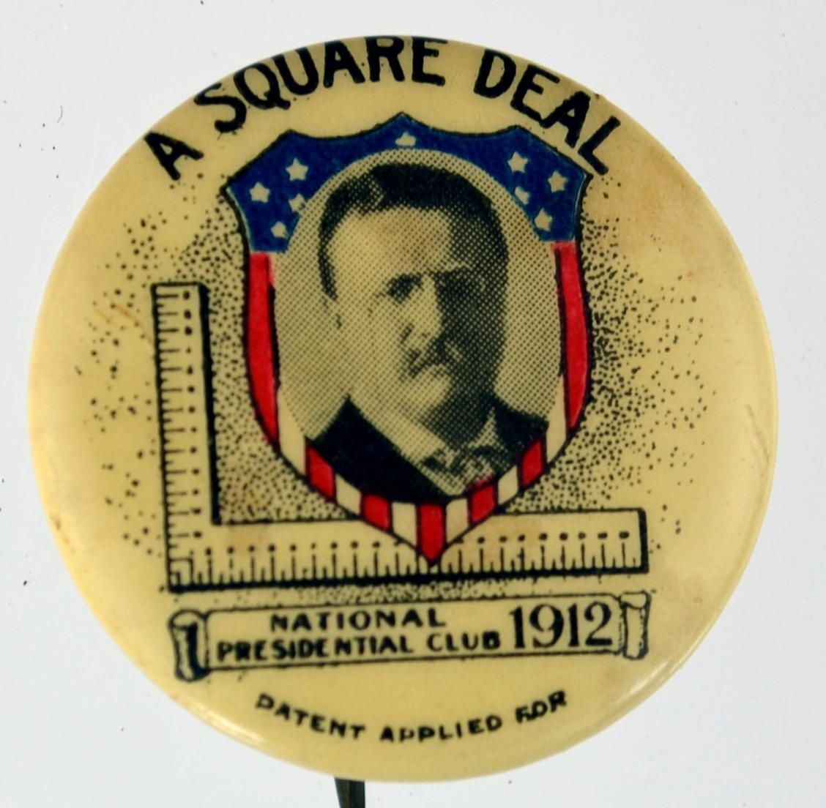
Domestic Program: A “Square Deal”
“When I say that I am for the square deal, I mean not merely that I stand for fair play under the present rules of the game, but that I stand for having those rules changed so as to work for a more substantial equality of opportunity and of reward for equally good service.”
-Roosevelts plan for progressive reforms
-The three C’s:
Control the Corporations
Consumer Protection
Conservation of Natural Resources
"It seems to me eminently fitting that the guard around the tomb of Lincoln should be composed of colored soldiers. It was my own good fortune at Santiago to serve beside colored troops. A man who is good enough to shed his blood for his country is good enough to be given a square deal afterwards."

Slide 12
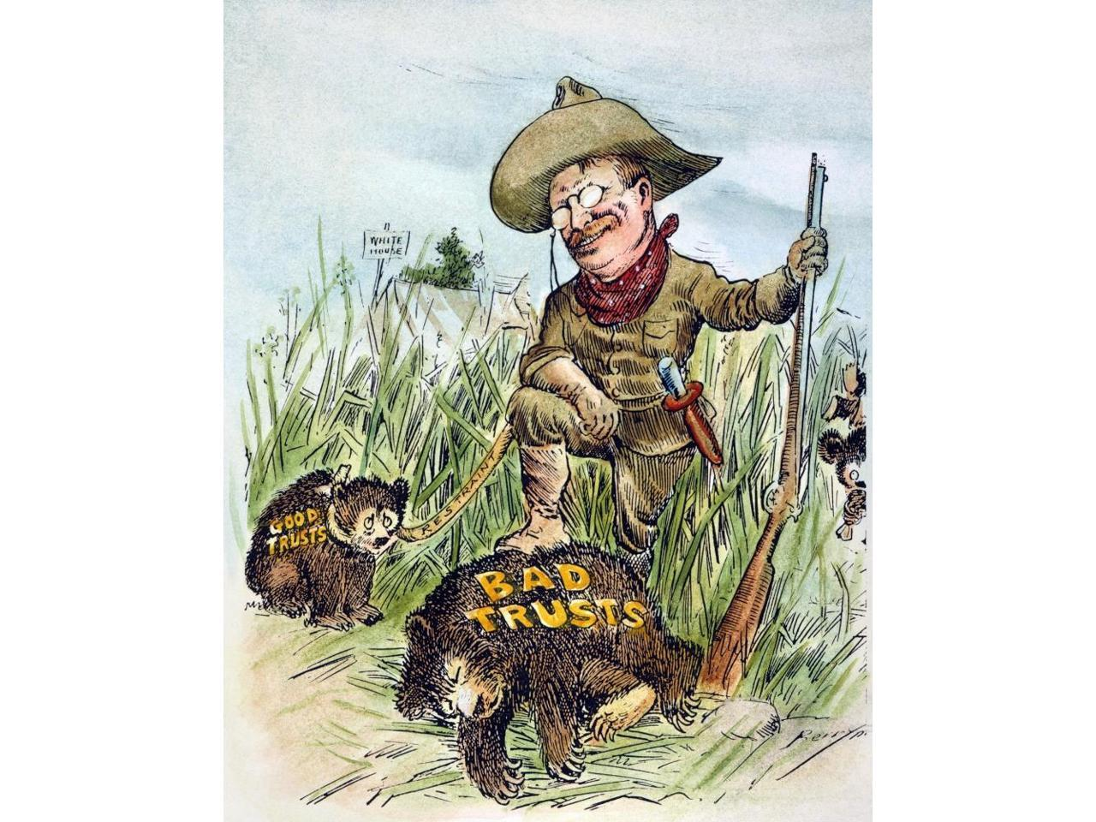
The Trustbuster
“There is a wide-spread conviction in the minds of the American people that the great corporations known as trusts are in certain of their features and tendencies hurtful to the general welfare. …It is based upon sincere conviction that combination and concentration should be, not prohibited, but supervised and within reasonable limits controlled; and in my judgment this conviction is right.”
Roosevelt was against the powerful trusts – the monopolies that corporations had over entire industries.
By 1900 they controlled 80% of US industry.
He believed there were good trusts and bad trusts, and used the Sherman Anti-Trust Act to regulate and control them.
Filed 44 antitrust suits against large corporations, Including Northern Securities (railroads), fuel oil, meatpacking, tobacco, etc.

Slide 13
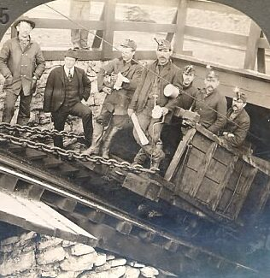
1902 – Pennsylvania Coal Strike
Coal miners led by the United Mine Workers union went on strike demanding better pay and working conditions.
Mine owners were in favor of the strike (less supply drove up prices) but against the union, and refused to negotiate.
Roosevelt sent in troops to protect everyone, and created a commission to arbitrate between the mine owners and union.
The strike ends as miners got a 10% raise and a 9 hour day; mine owners could continue to refuse to recognize the union.
First time in US History the government had settled a labor dispute.

Slide 14
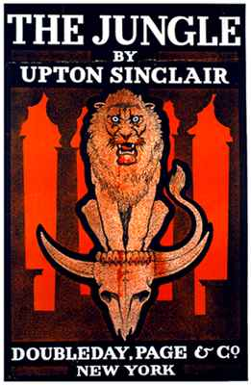
1906 – Pure Food and Drug Act
In 1904, Upton Sinclair’s book The Jungle, is published.
Meant to shed light on horrible working conditions in meat-packing plants, most readers focus on the unsanitary conditions of their food, and also medicines.
"I aimed at the public's heart and by accident I hit it in the stomach.“
-Upton Sinclair

Slide 15
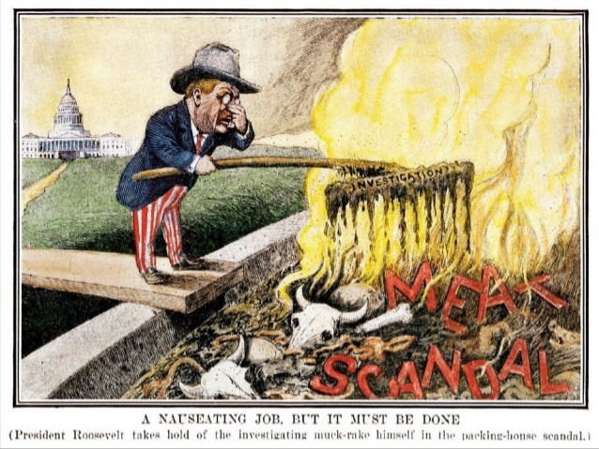
1906 – Pure Food and Drug Act
In Response:
Meat Inspection Act (1906): makes it illegal to mislabel meat products and allowing for inspection of slaughterhouses and packing plants.
Pure Food and Drug Act (1906): Created the Food and Drug Administration; bans the sale of mislabeled food and drugs, that ingredients be listed, and sets standard for food and ingredient purity.

Slide 16
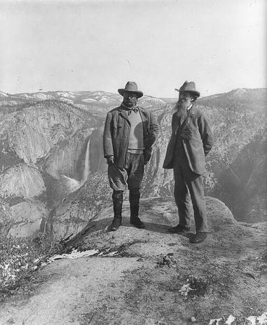
Roosevelt and Conservation
Roosevelt was always an outdoorsman and was concerned about industry taking over America’s natural resources
Created 5 new national parks, 150 national forests, 55 bird and game preserves.
Used the 1906 Antiquities Act to create 18 national monuments
In total, he preserved 230 million acres of land for wildlife and public use.
It is also vandalism wantonly to destroy or to permit the destruction of what is beautiful in nature, whether it be a cliff, a forest, or a species of mammal or bird. Here in the United States we turn our rivers and streams into sewers and dumping-grounds, we pollute the air, we destroy forests, and exterminate fishes, birds and mammals -- not to speak of vulgarizing charming landscapes with hideous advertisements. But at last it looks as if our people were awakening.

Slide 17
Grand Canyon, Arizona
“In the Grand Canyon, Arizona has a natural wonder which is in kind absolutely unparalleled throughout the rest of the world. I want to ask you to keep this great wonder of nature as it now is. I hope you will not have a building of any kind, not a summer cottage, a hotel or anything else, to mar the wonderful grandeur, the sublimity, the great loneliness and beauty of the canyon. Leave it as it is. You cannot improve on it. The ages have been at work on it, and man can only mar it.” – Theodore Roosevelt

Slide 18
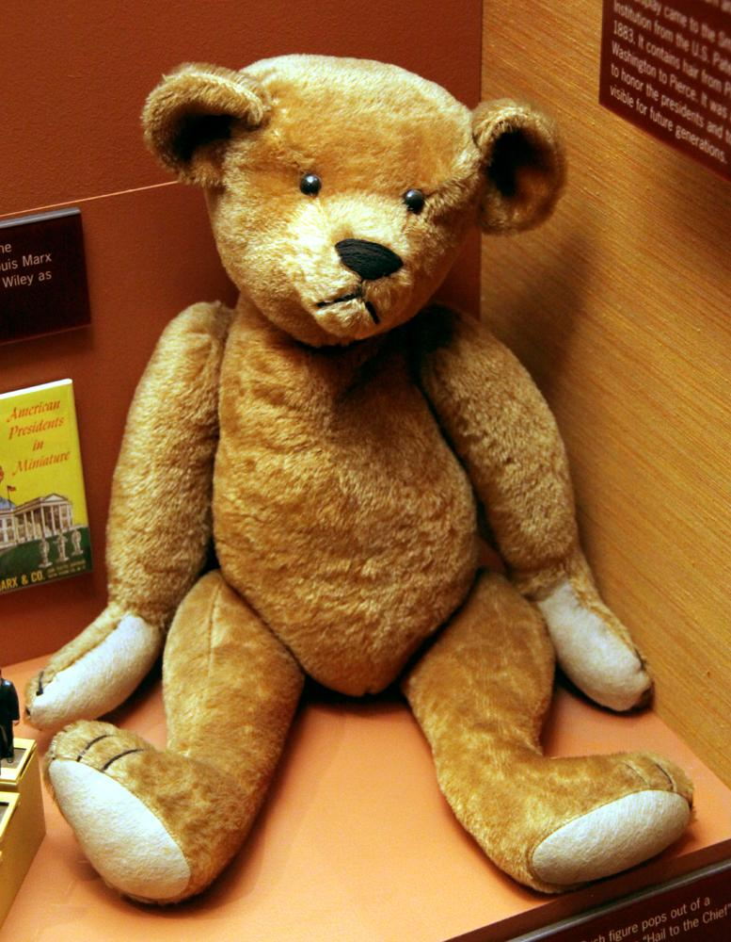
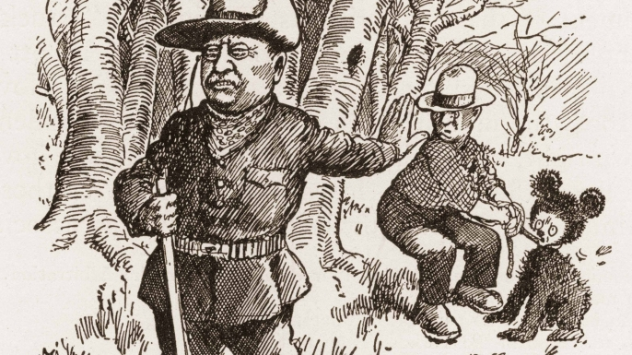
The Teddy Bear

Slide 19
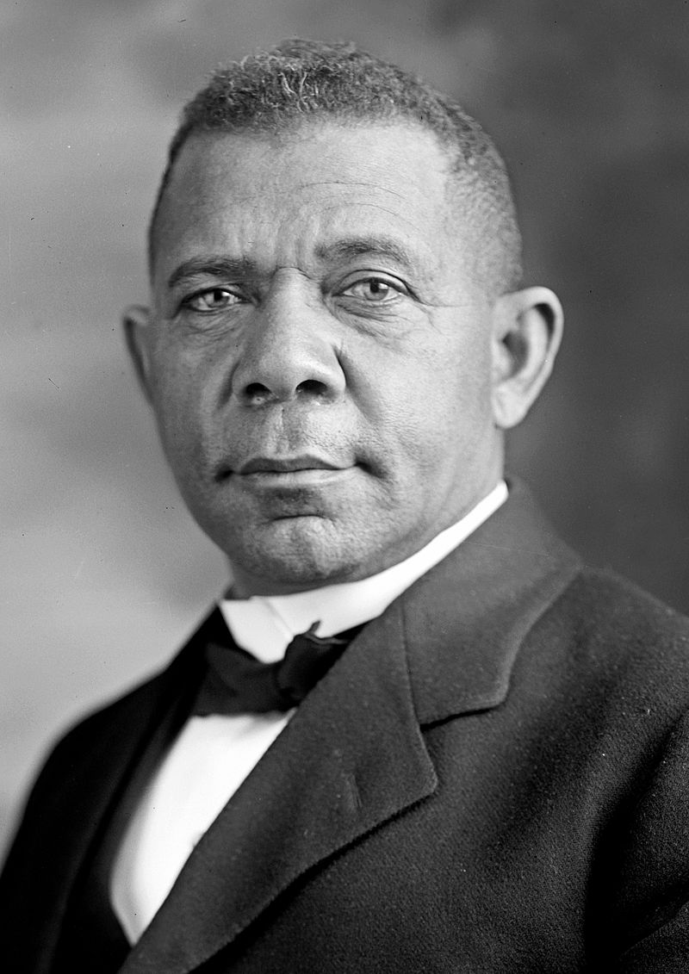
Booker T. Washington’s Dinner
Booker T. Washington was a former slave who founded the Tuskegee Institute, a school for African Americans.
He was considered a leader of the African-American community and focused on self-reliance.
In 1901 he was invited to dinner at the White House by Roosevelt, the first African American so honored.
There was significant backlash across the South for years.
“[The White House was] so saturated with the odor of the n----- that the rats have taken refuge in the stable…I am just as much opposed to Booker T. Washington as a voter as I am to the cocoanut-headed, chocolate-colored typical little c**n who blacks my shoes every morning.” – Gov. James Vardaman, Mississippi
"The action of President Roosevelt in entertaining that n----- will necessitate our killing a thousand n------ in the South before they will learn their place again.” – Senator Benjamin Tallmadge, South Carolina

Slide 20
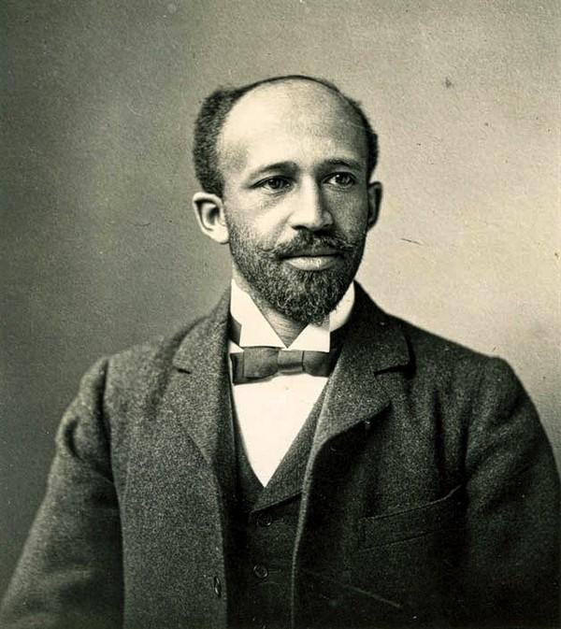
Booker T. Washington vs. W.E.B. DuBois
Booker T. Washington
Born in Virginia into slavery, leader of the Tuskegee Institute in Alabama to train African Americans in agriculture, trades, and education.
Stressed that African Americans should work their way up through society, through education and skills, so whites would eventually see them as equals.
“Atlanta Compromise” Speech: “Cast down your bucket where you are” – His five fingers/one hand analogy.
Popular with white audiences, some African American leader saw him as too compromising.
W.E.B. DuBois
Born in Massachusetts, attended Fisk University and Harvard, eventually earning a Ph.D, and became a teacher and sociologist.
Used data and research to study African American history and their social issues
Wrote “The Souls of Black Folk” , demanding immediate civil rights for African Americans, stressing education and political action, and criticizing Washington’s approach.
Eventually helped found the National Association for the Advancement of Colored People (NAACP), one of America's most influential civil rights organization.
Seen as too radical by supporters of Booker T. Washington.

Slide 21
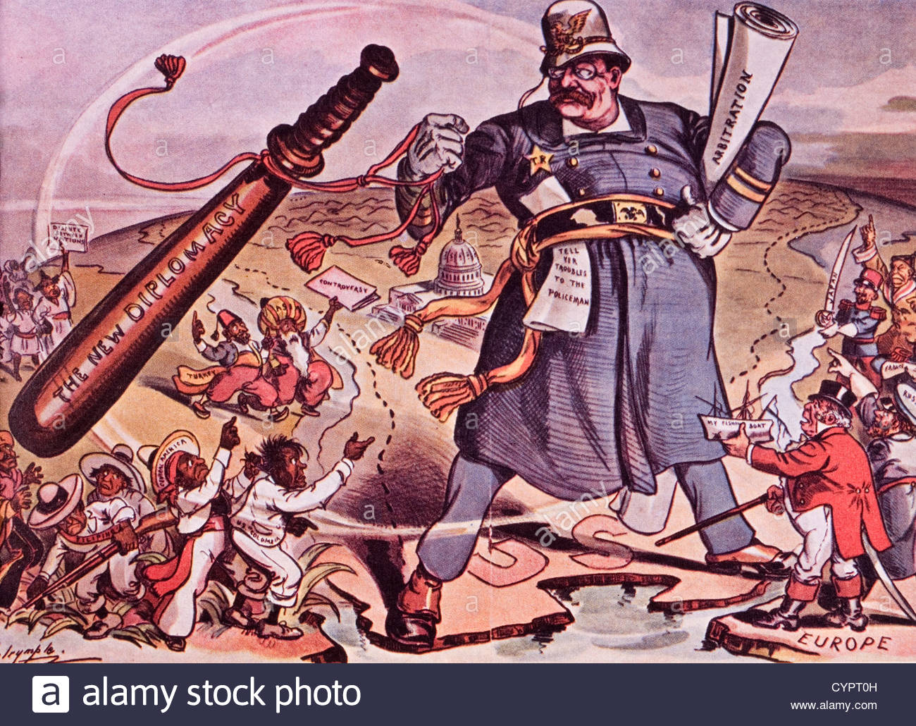
Foreign Program: Speak Softly and Carry a Big Stick
Negotiating peacefully, but with power.
“I have always been fond of the West African proverb, “Speak softly and carry a big stick, you will go far.”
“[It is] the exercise of intelligent forethought and of decisive action sufficiently far in advance of any likely crisis.”

Slide 22
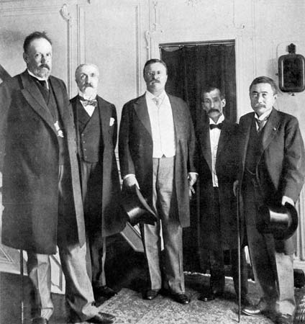
Treaty of Portsmouth - 1905
Russia and Japan had been at war for more than a year in the Pacific.
TR felt that US intervention would improve US prestige and limit Russian and Japanese power
The peace talks were held at the Portsmouth Naval Shipyard, and the final peace treaty signed at the Wentworth Hotel.
Only International Peace Treaty signed in the US
TR won the Nobel Peace Prize in 1906 for his efforts

Slide 23
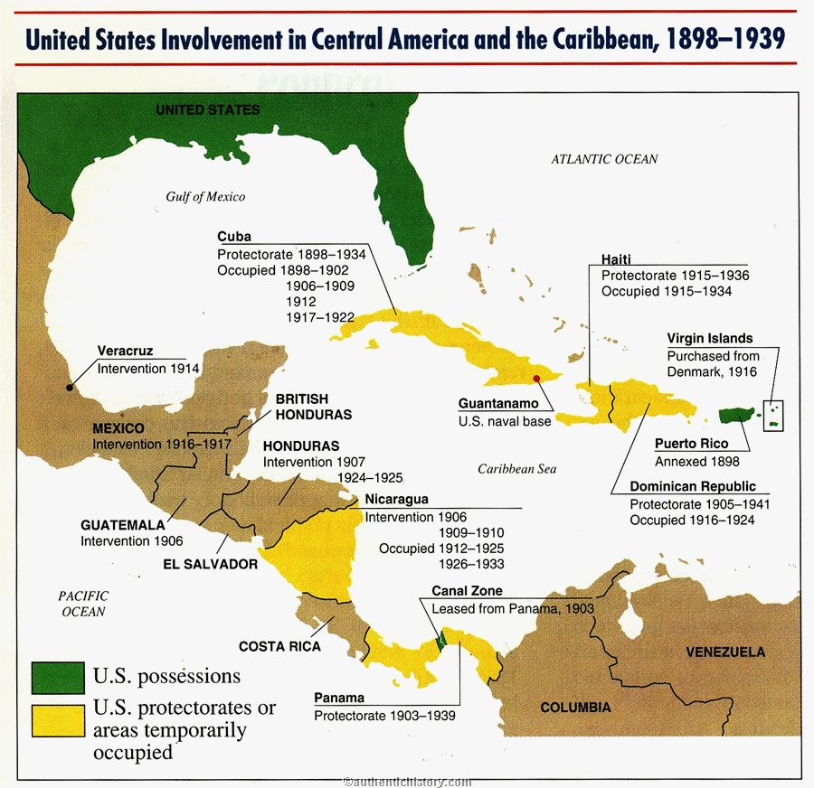
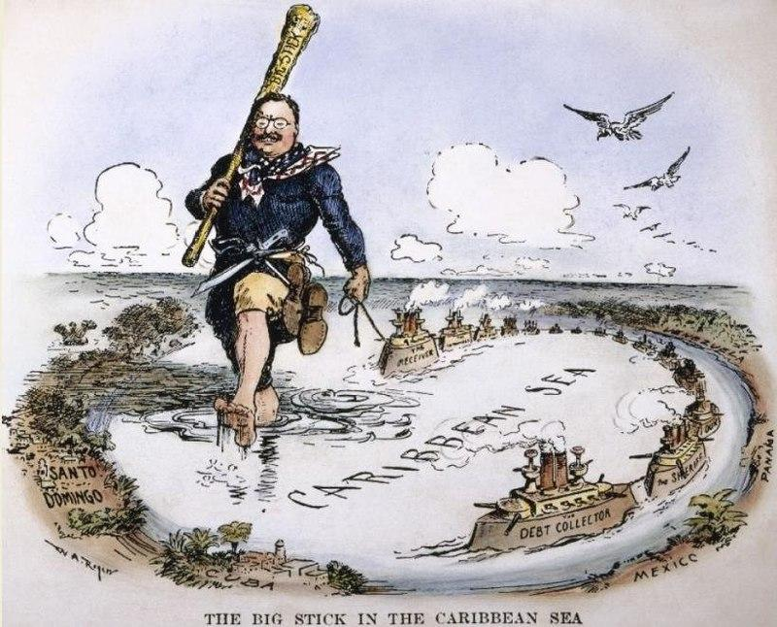
Roosevelt Corollary
Since the 1820s, the US followed the Monroe Doctrine: that the US would not allow European powers to meddle in the Western Hemisphere.
Roosevelt added: The US reserves the right to intervene in the affairs of Latin America that is incapable of governing itself.

Slide 24
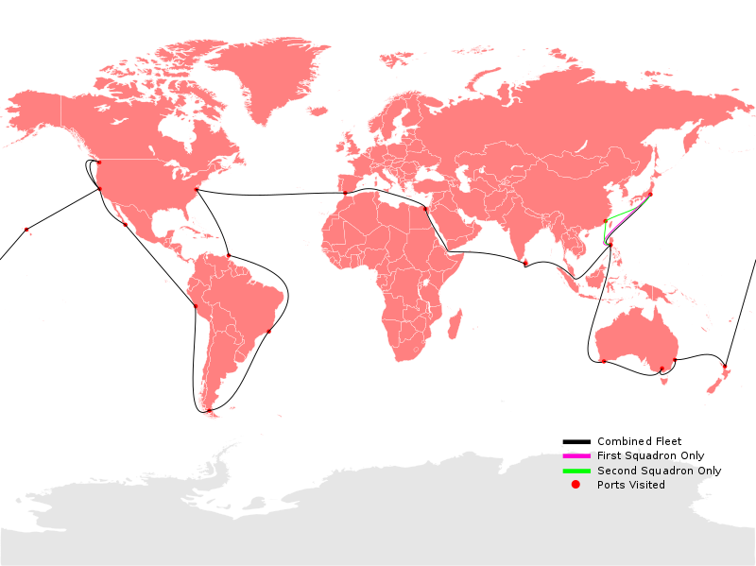
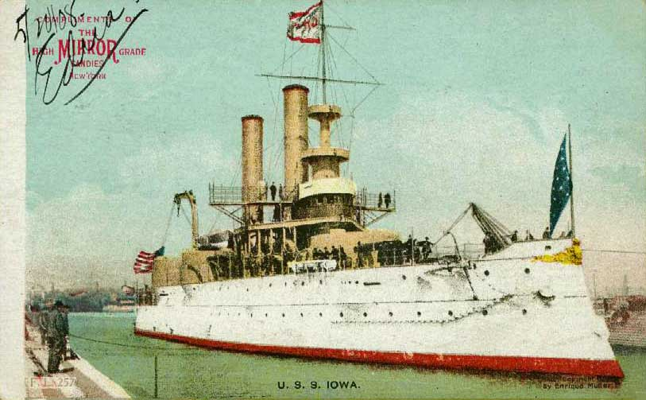
The Great White Fleet
TR sent a fleet of 16 large battleships around the world to pay “friendly visits” but, in reality, to show the world American naval power.
TR was a proponent of naval power, taking the British Navy and Empire as a good example to follow.
He also brought the remains of John Paul Jones, the “Father of the US Navy”, back from France.

Slide 25
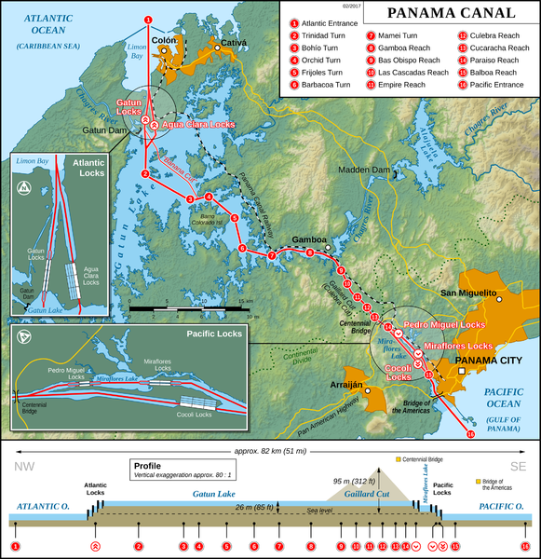
The Panama Canal
US had wanted to build a canal through Central America since the 1850s, but the increased size US Navy made it very important by the 1900s.
Using “gunboat diplomacy” Roosevelt helped Panama declare independence and sign a treaty giving US permission to dig a canal.
It took 10 years and $500 million to complete the 51 mile long canal.
US owned the “Canal Zone” from 1903-1979, when it was handed over to the Panamanians.

Slide 26
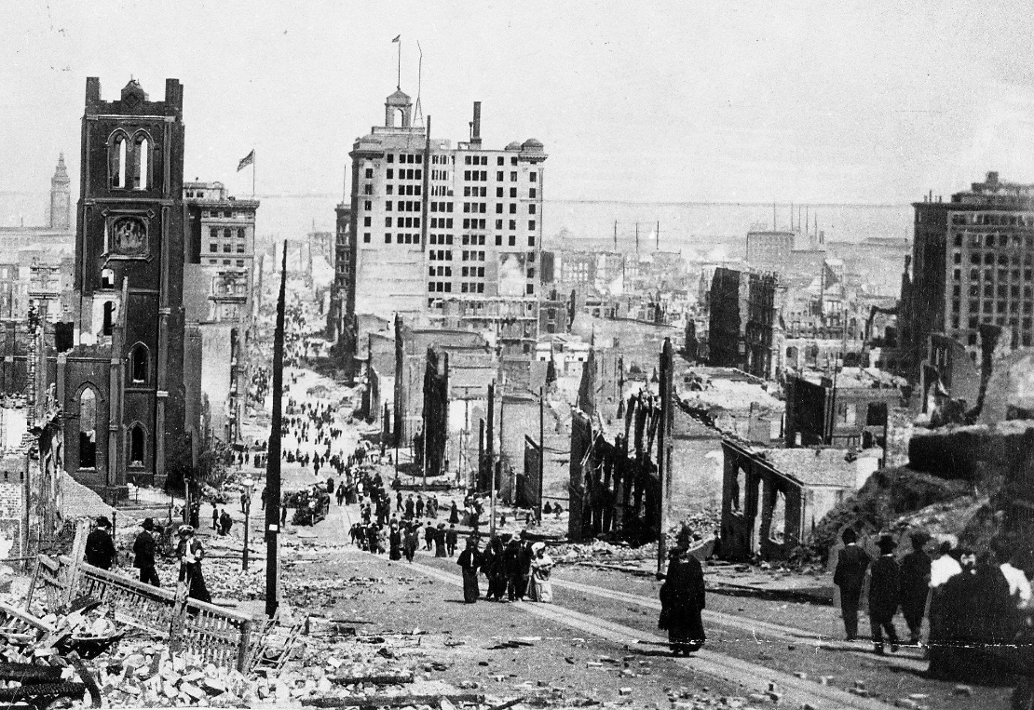
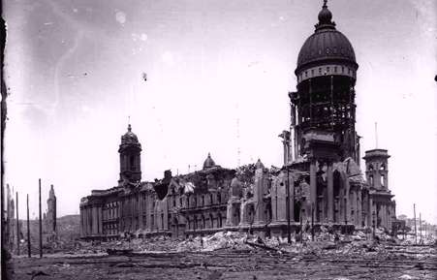
San Francisco Earthquake
1906
Massive earthquake hits San Francisco, April of 1906 - 7.9 on Richter scale.
Killed 700-3,000 people, 300,000+ homeless, destroyed 80% of the city and $400 million in damage (more than $10 billion today)

Slide 27
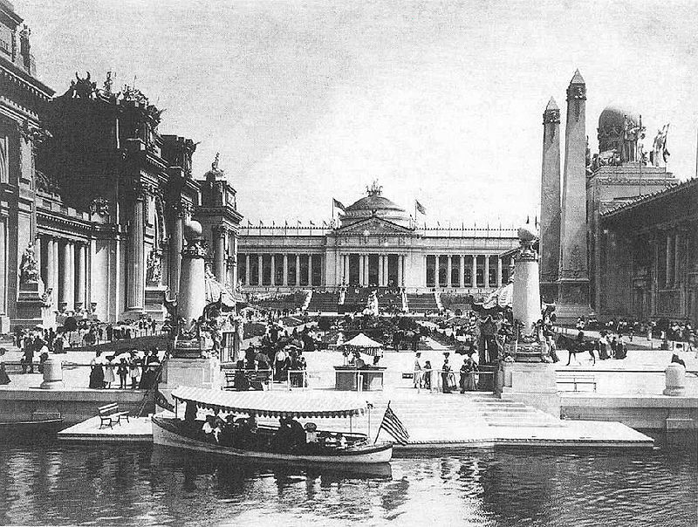
St. Louis World’s Fair
1904
An enormous World’s Fair to celebrate 100 years since the Louisiana Purchase
Hosted 20 million visitors, to see scientific and cultural exhibits, foreign pavilions, exotic people and animals on display, and the 3rd Summer Olympics.
Known to have introduced (or popularized) foods, such as:
ice cream cone - peanut butter
Hamburger - cotton candy
Hot dog - Dr. Pepper
Iced tea

Slide 28
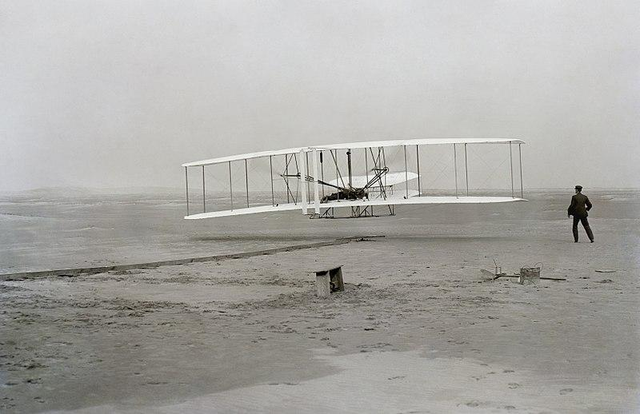
Invention of the Airplane
1903
Invented by Orville and Wilbur Wright, amateur inventors and bicycle builders in Dayton, Ohio
On Dec 17, 1903, they made the first “controlled flight of a heavier-than-air craft” at Kitty Hawk, North Carolina. Each flight was between 120-200 feet and 10 feet in the air.

Slide 29
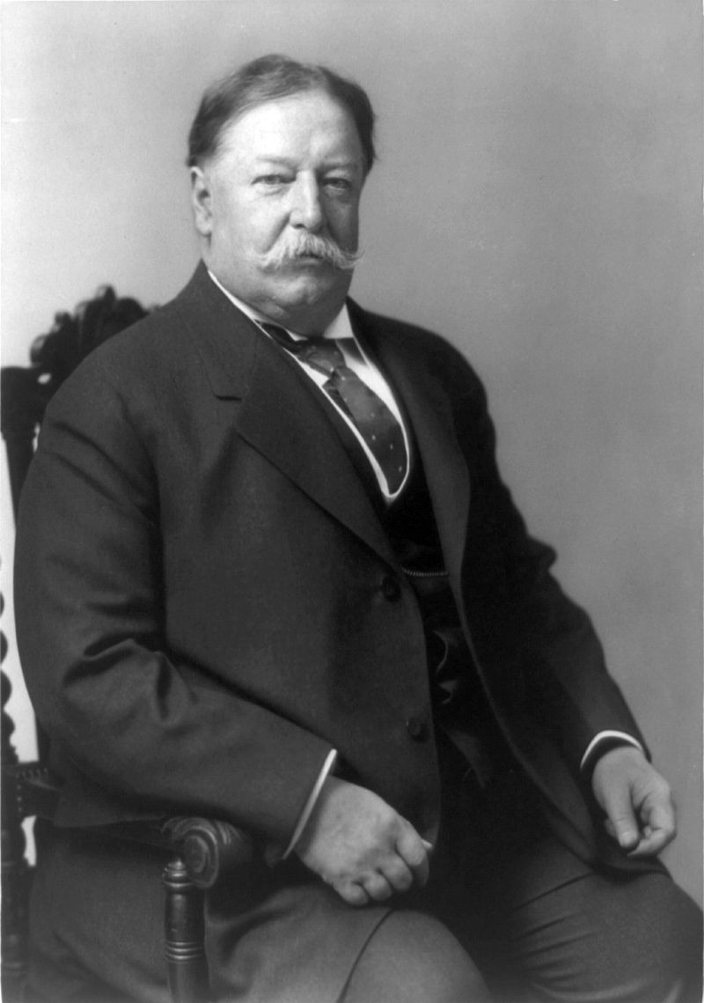
William Howard Taft

Slide 30
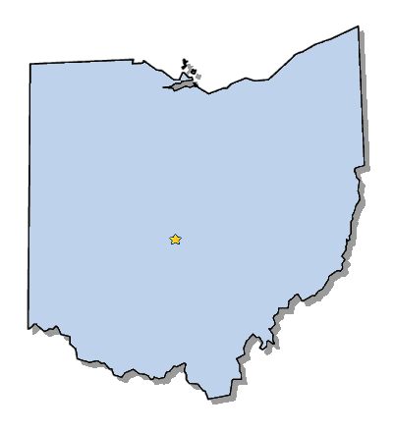
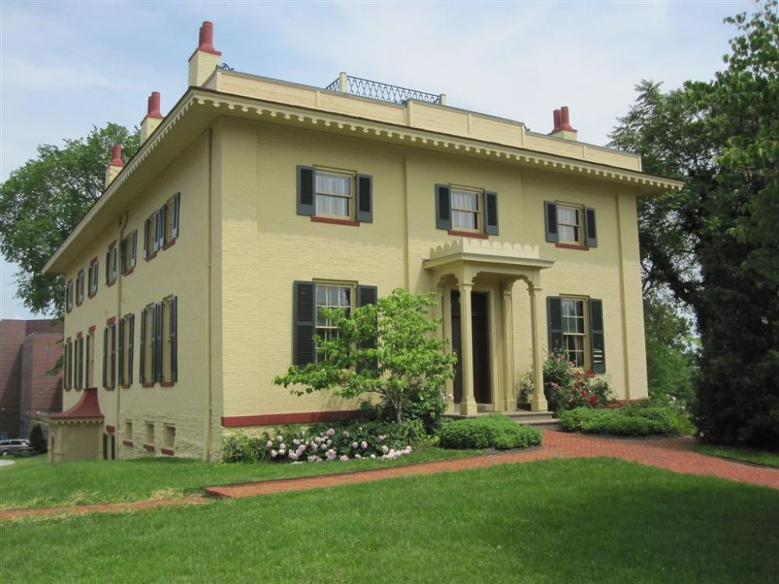
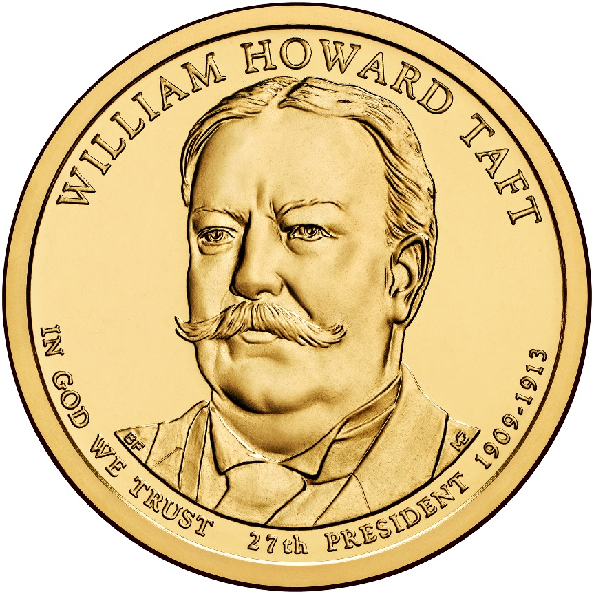
Elected in: 1908
President from: 1909-1913
Political Party: Republican
Home State: Ohio

Slide 31
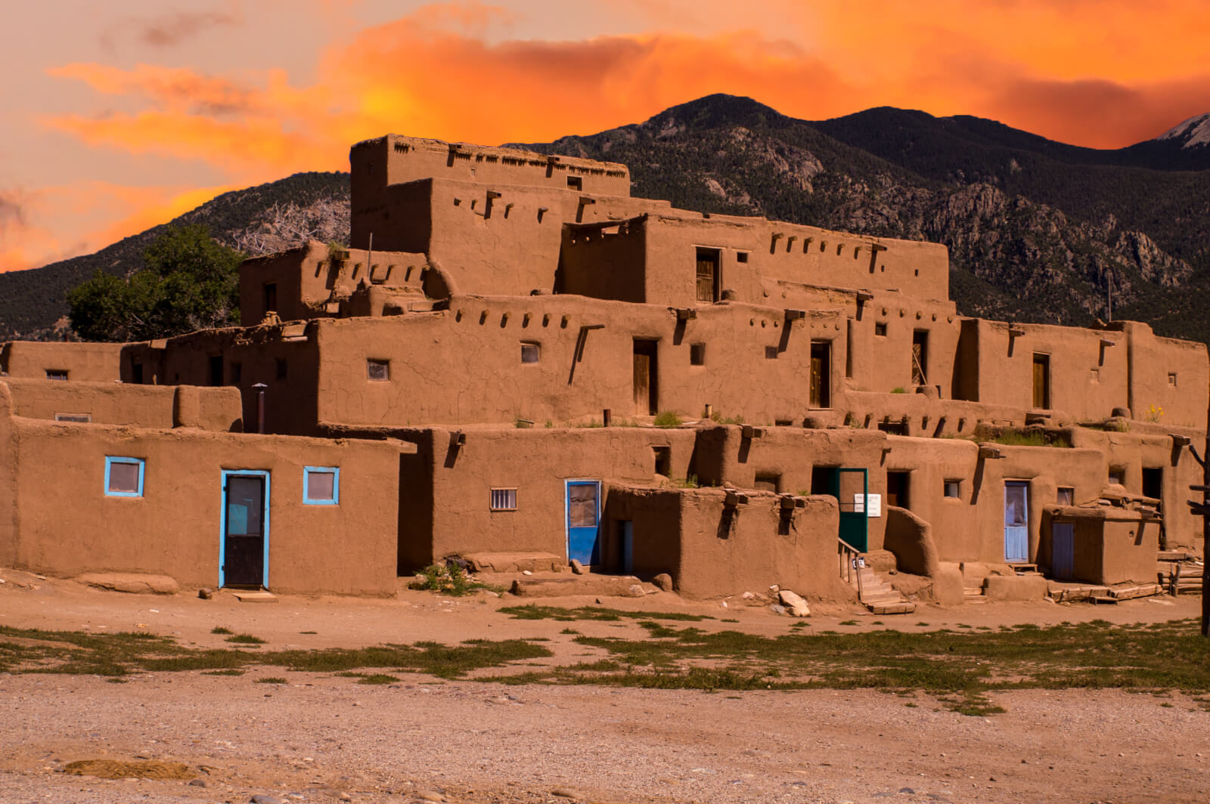
New States
47. New Mexico
48. Arizona

Slide 32
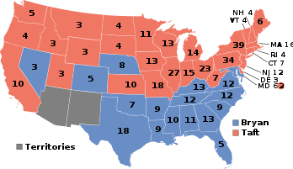
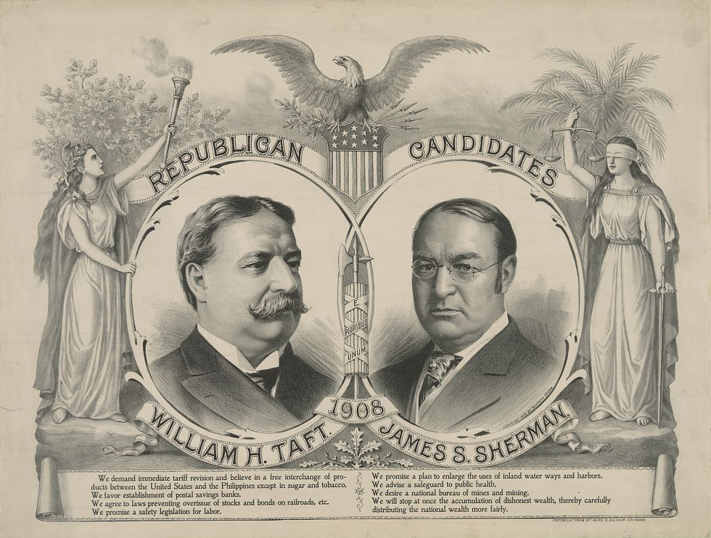
Election of 1908
Republican: 321
President: William Howard Taft
Vice President: James Sherman
Democratic: 162
President: William Jennings Bryan
Vice President: John Kern

Slide 33
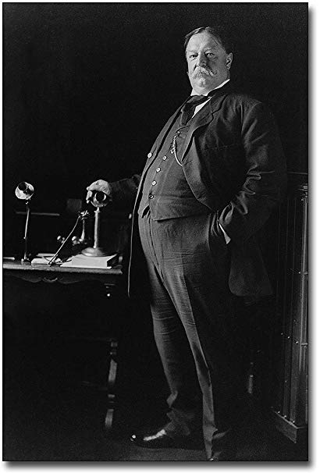
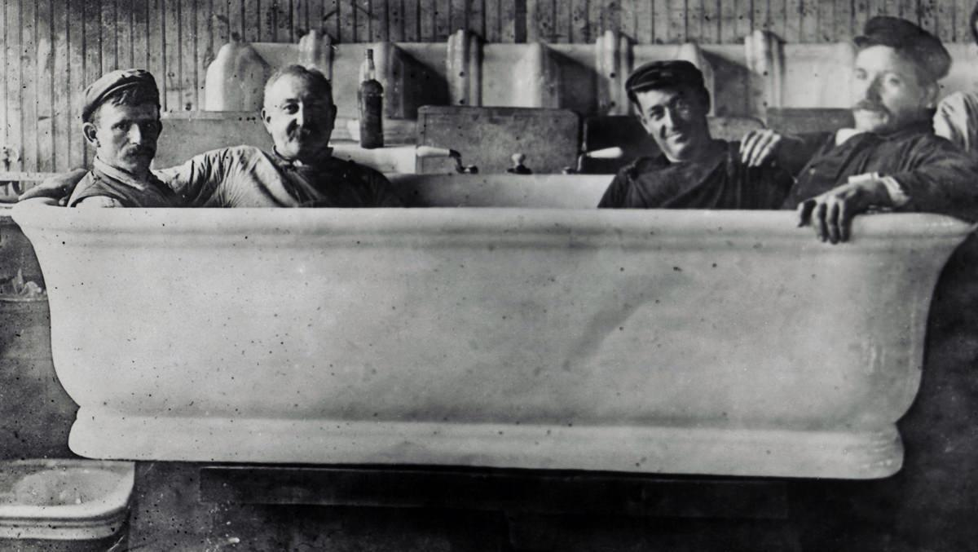

Slide 34
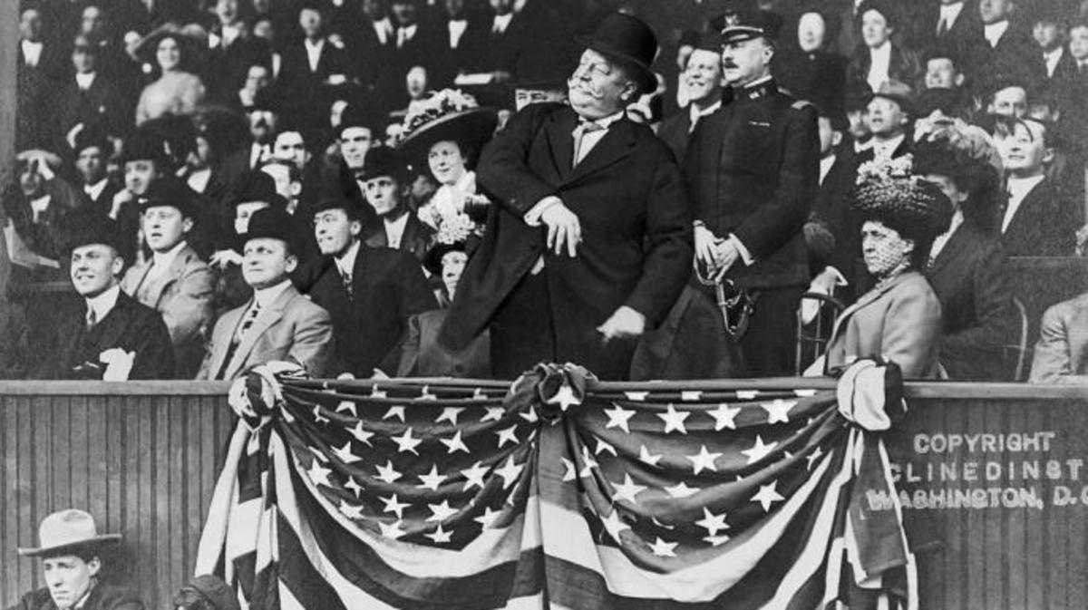

Slide 35
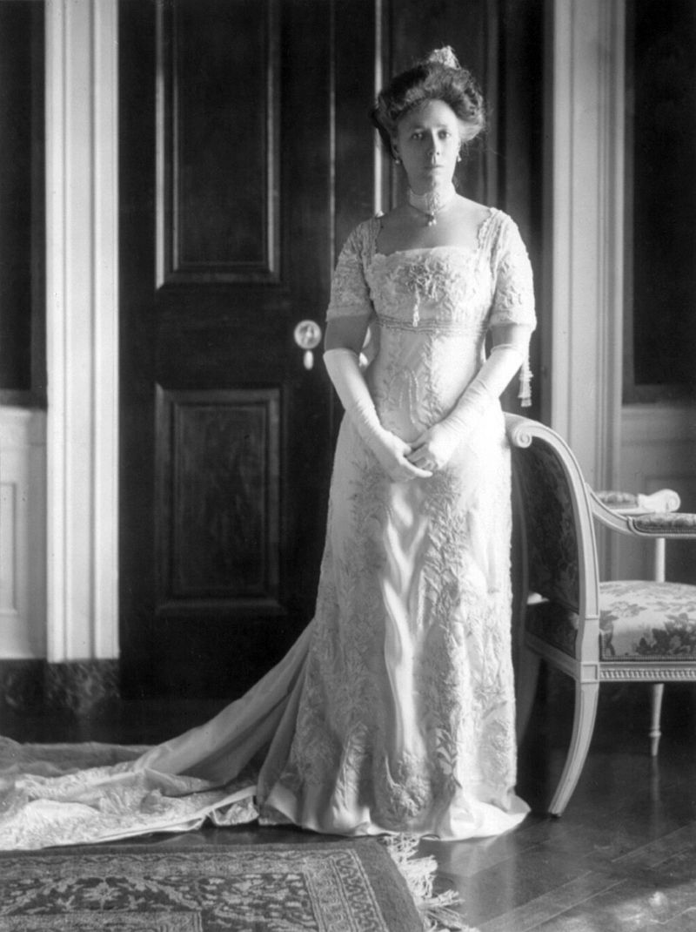

Slide 36
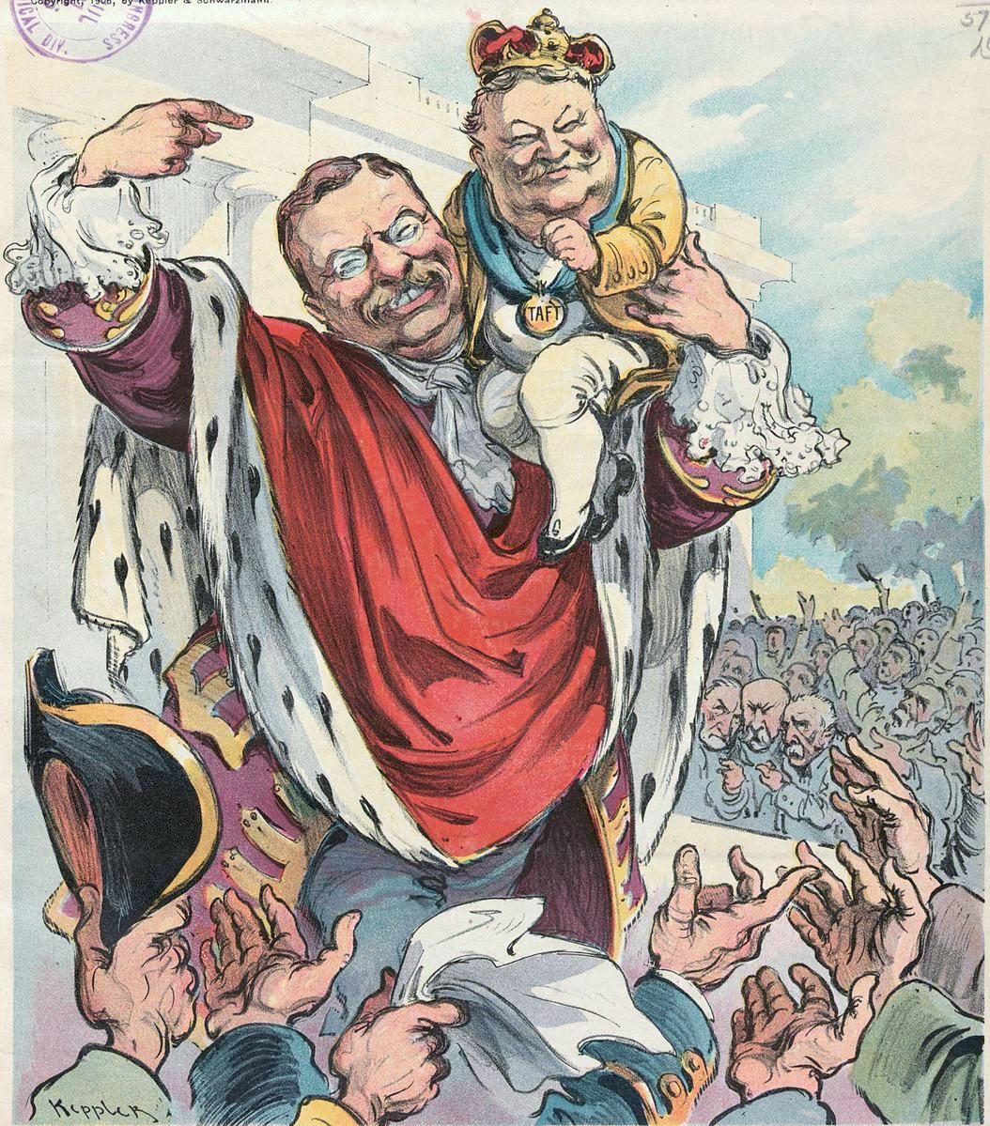

Slide 38
-Conserved land, including land with oil and coal
“Busted” twice as many monopolistic corporations and trusts as Roosevelt did
-Federal Government given power to regulate telephone and telegraph lines
-Supported new mining regulations
-Seen as too progressive by Conservative Republicans
-Appointed his own Cabinet, instead of Roosevelt’s men
-Left most tariffs untouched, instead of lowering them.
-Fired Gifford Pinchot, head of US Forest Service
-Sues US Steel for being a monopoly, infuriating Roosevelt
-Didn’t back Roosevelt’s “New Nationalism”
-Seen as too Conservative by Progressive Republicans

Slide 39
Progressive Movement
Led by Senator Robert M. Lafollette of Wisconsin
Called for the progressive legislation and popular election of government officials
- Direct election of US Senators (at the time, chosen by state legislatures)
- An income tax
- Primary elections for party conventions and delegates
- States to allow referendums and recall elections
- More workplace pay and safety regulations
More controversial:
- Women’s suffrage
- Prohibition of alcohol

Slide 40
1911 – Triangle Shirtwaist Fire
Fire on upper floors of a garment factory in New York City
Poor safety measures (locked doors, only one fire escape) caused the death of 146 workers, mainly women
State and federal workplace safety regulations will be passed to protect workers

Slide 41
1911 – Standard Oil broken up
Supreme Court ruled Standard Oil violated the Sherman Anti-Trust Act and should be broken up.
Broken up into 34 companies
John D. Rockefeller owned 25% of the shares in each company, and he ended up becoming even wealthier – worth at least $900 million within a few years

Slide 43
1908 – The Ford
Model T
First mass-produced automobile
Made by Henry Ford in his factory in Detroit, Michigan
Sold for $850 in 1909, but less than $300 by the 1920s
Price was affordable due to Ford’s use of the assembly line for production, few options, and cost-cutting measures.
The first car affordable to regular people
In production until 1927, sold 15,000,000 cars

Slide 44
16th Amendment - 1913
- Allows a national income tax
Was intended to shift tax burden from the working class to the rich, and was demanded by the Socialist Party & Progressives
The Congress shall have power to lay and collect taxes on incomes, from whatever source derived, without apportionment among the several States, and without regard to any census or enumeration.

Slide 45
17th Amendment - 1913
Allowed for the election of senators directly by the people of each state.
Previously, state legislatures had chosen senators.
Designed to reduce corruption
The Senate of the United States shall be composed of two Senators from each State, elected by the people thereof, for six years; and each Senator shall have one vote…

Slide 46
Rise of Socialism
Eugene Debs, a labor organizer with the American Railway Union, and founder of the Industrial Workers of the World (IWW) – a radical labor union known as “The Wobblies”
leader of the Socialist Party of America, ran for President 5 times between 1900-1920.
Was jailed numerous times for sedition
Socialists called for wealth and power to be transferred from the wealthy to the lower classes, and were tied in with Marxists and eventually Communists.

Slide 47
April 1912 Sinking of RMS Titanic

Slide 48
April 1912 – Opening of Fenway Park

