Slide 1
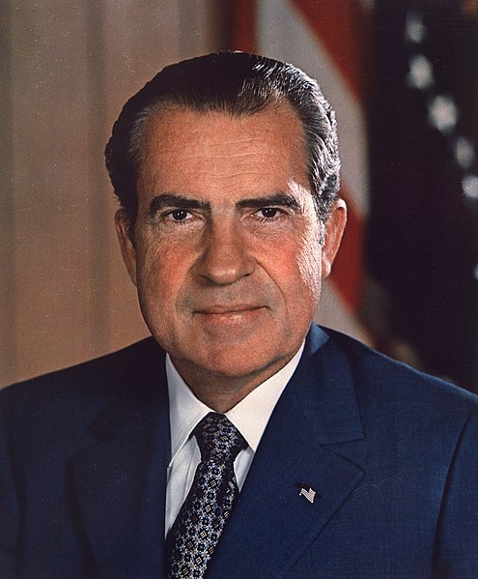
Richard Nixon

Slide 2
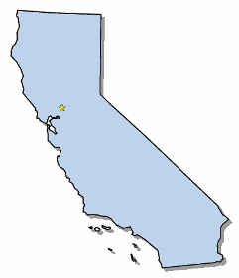
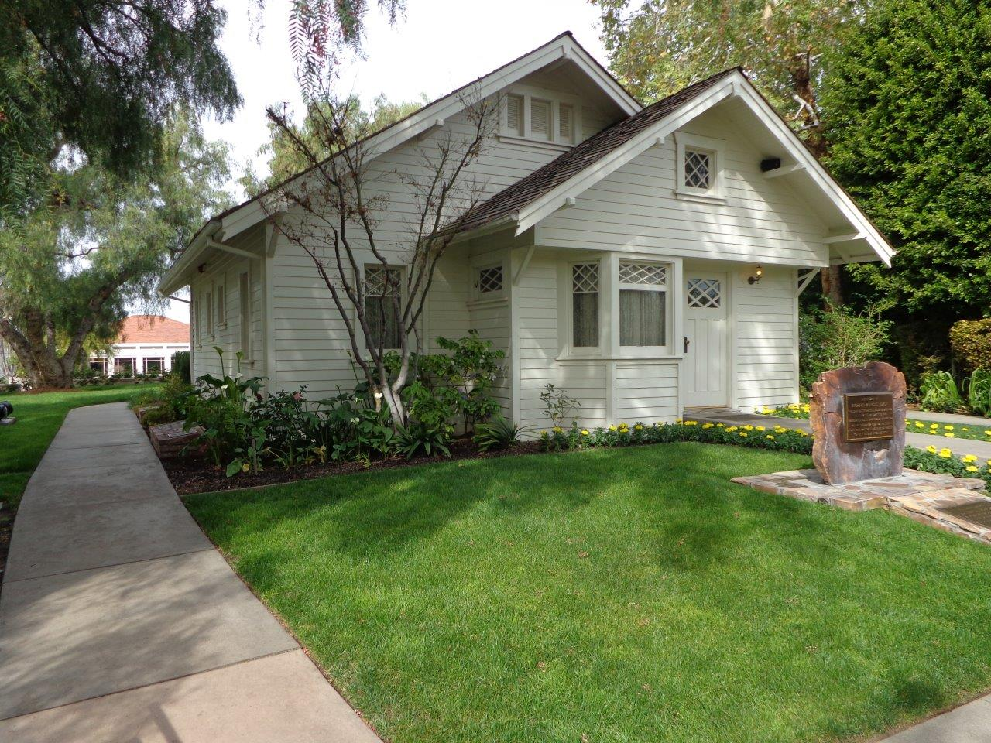
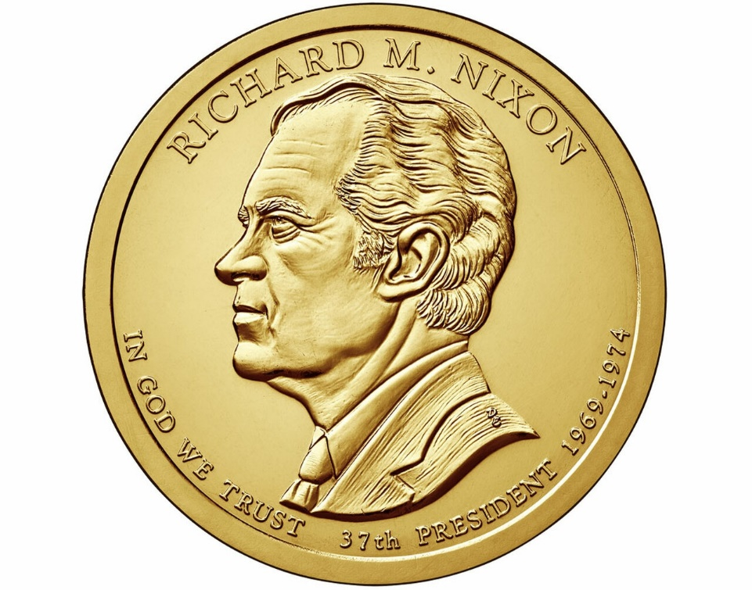
Elected in: 1968, 1972
President from: 1969-1974
Political Party: Republican
Home State: California

Slide 3
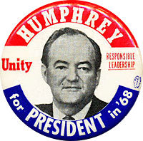
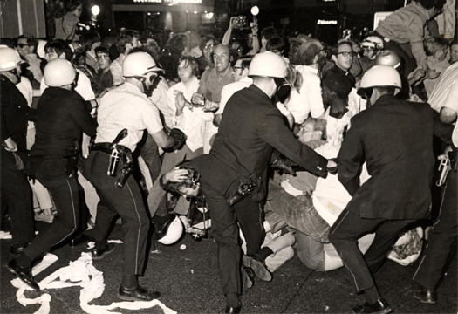
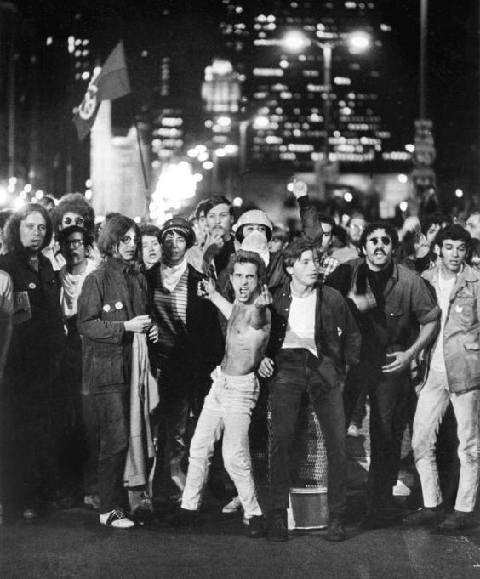
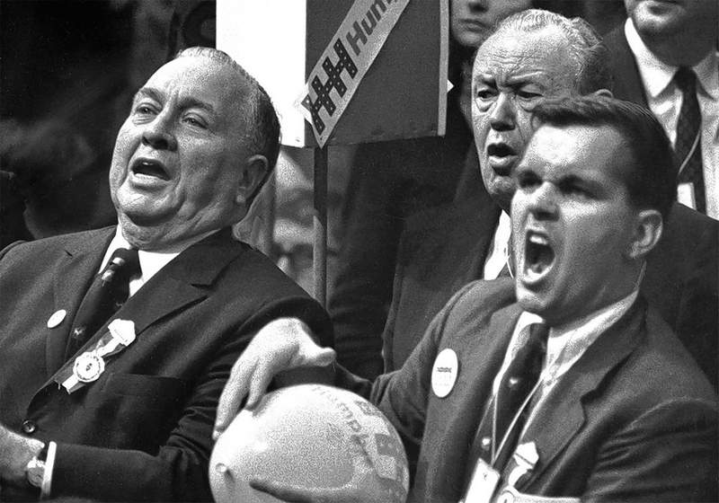

Slide 4
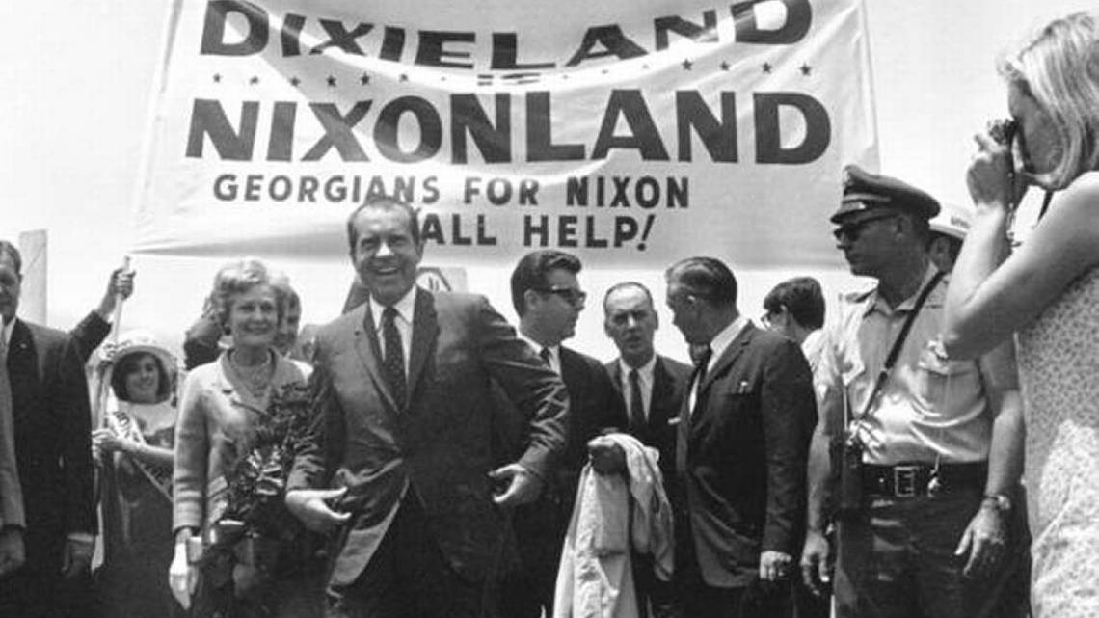
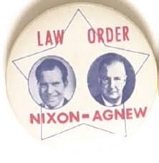

Slide 5
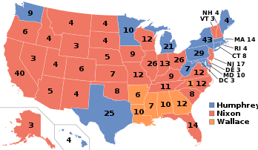
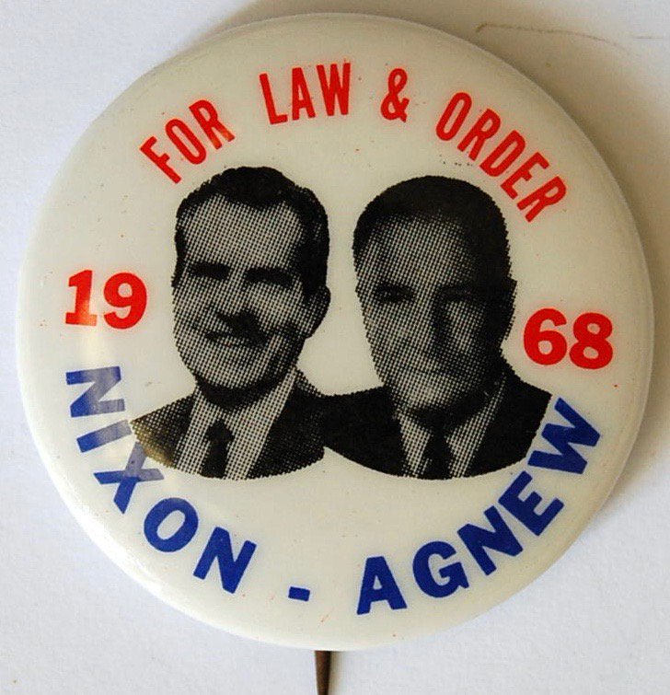
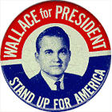
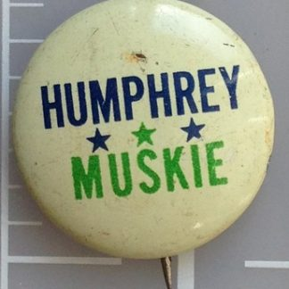
Election of 1968
Republican: 301
President: Richard Nixon
Vice President: Spiro Agnew
Democratic: 191
President: Hubert Humphrey
Vice President: Edmund Muskie
American Independent: 46
President: George Wallace
Vice President: Curtis LeMay

Slide 6
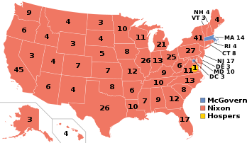
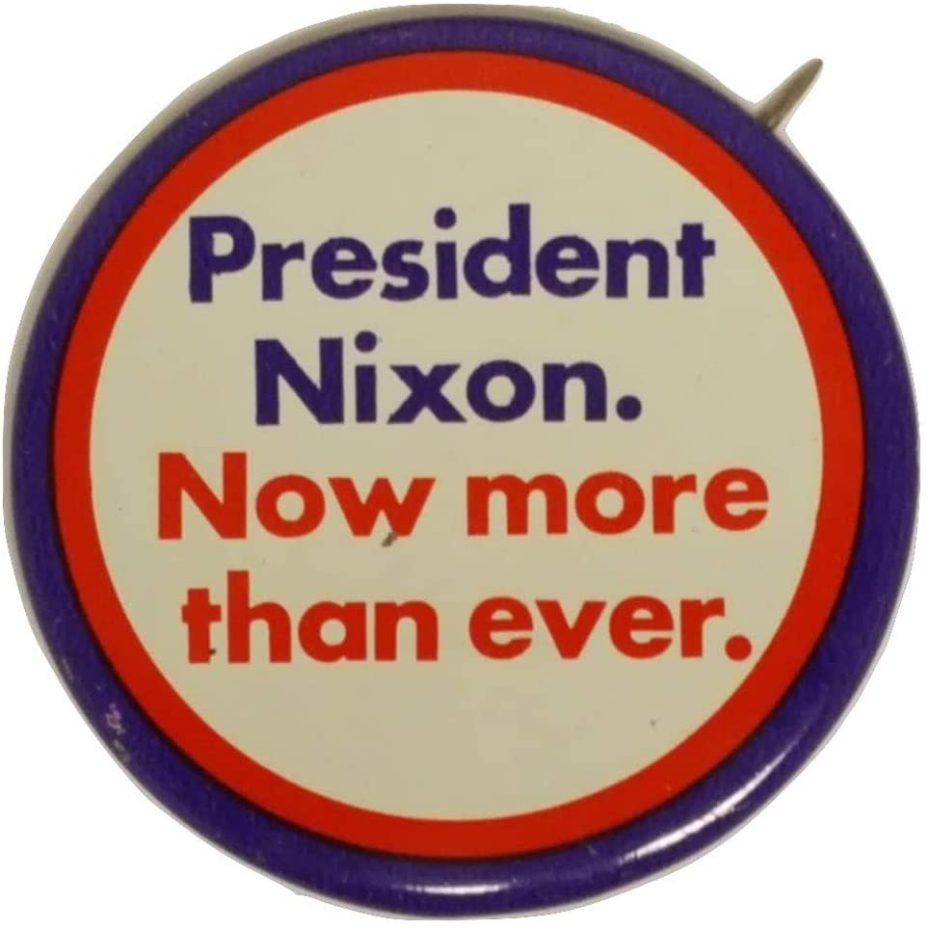
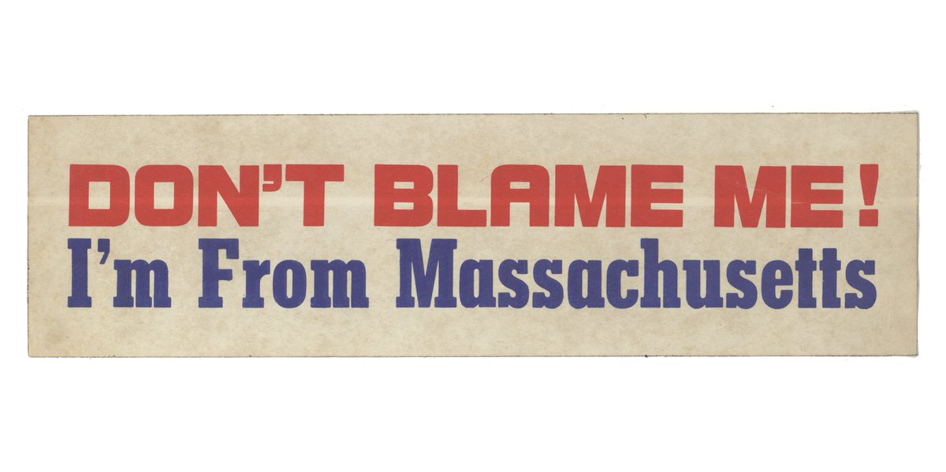
Election of 1972
Republican: 520
President: Richard Nixon
Vice President: Spiro Agnew
Democratic: 17
President: George McGovern
Vice President: Sargent Shriver*

Slide 7
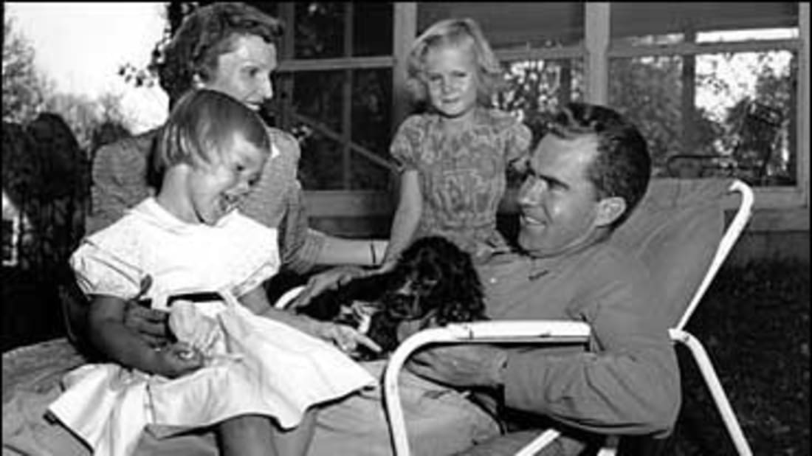
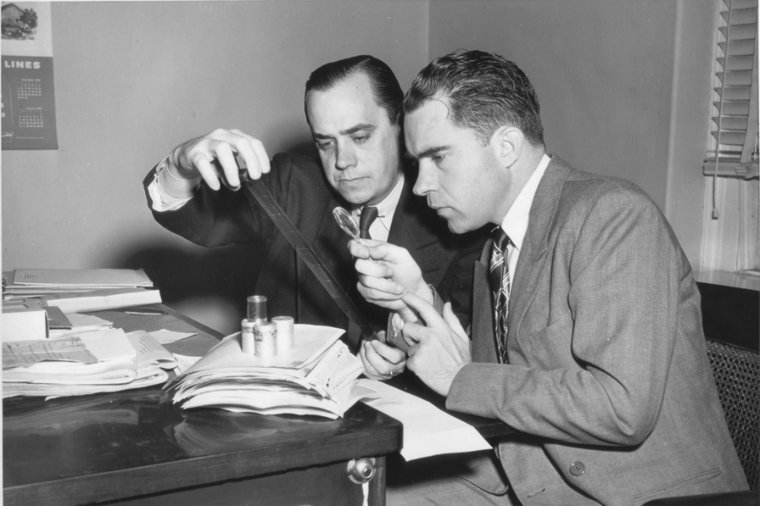
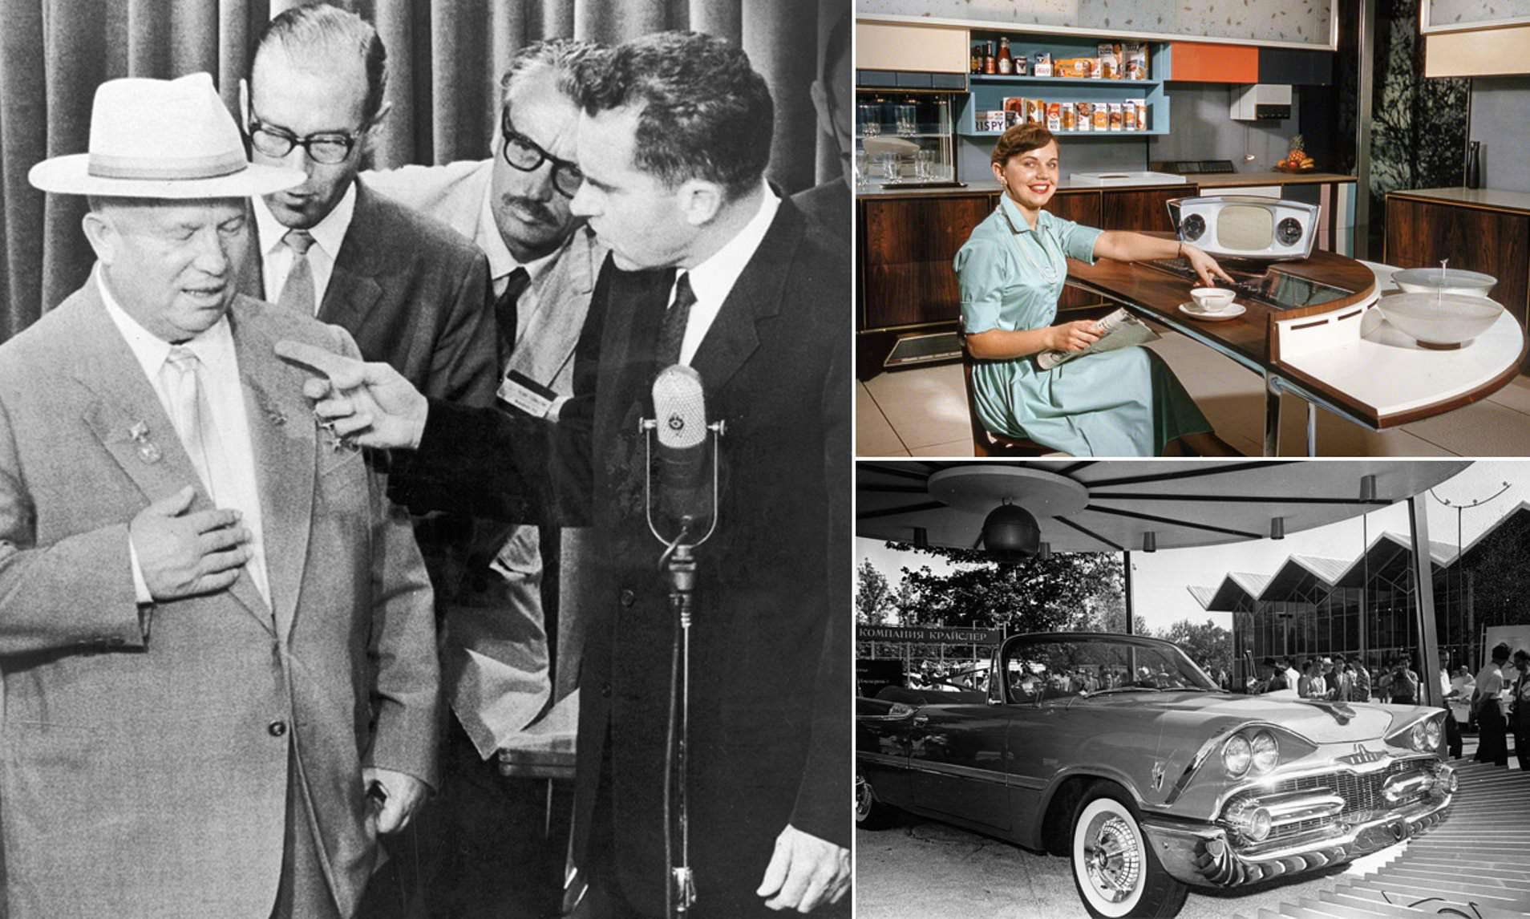
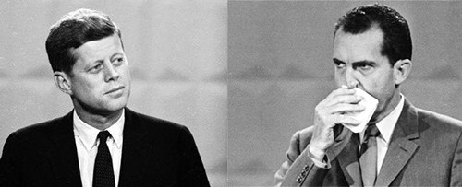
Alger Hiss Investigation
1948
Checkers Speech, 1952
Kennedy-Nixon Debate, 1960
Kitchen Debate 1959

Slide 8
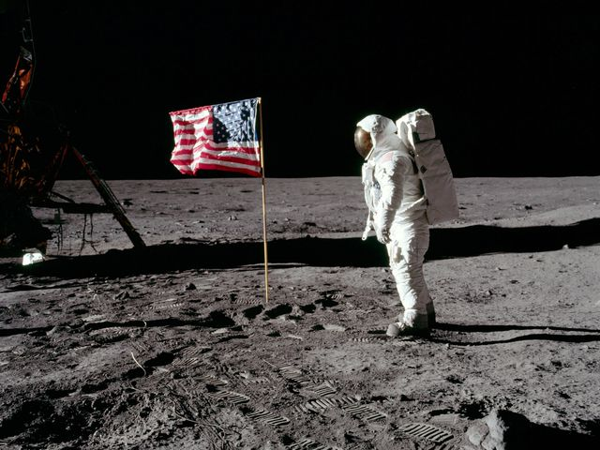
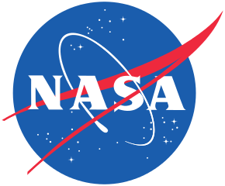
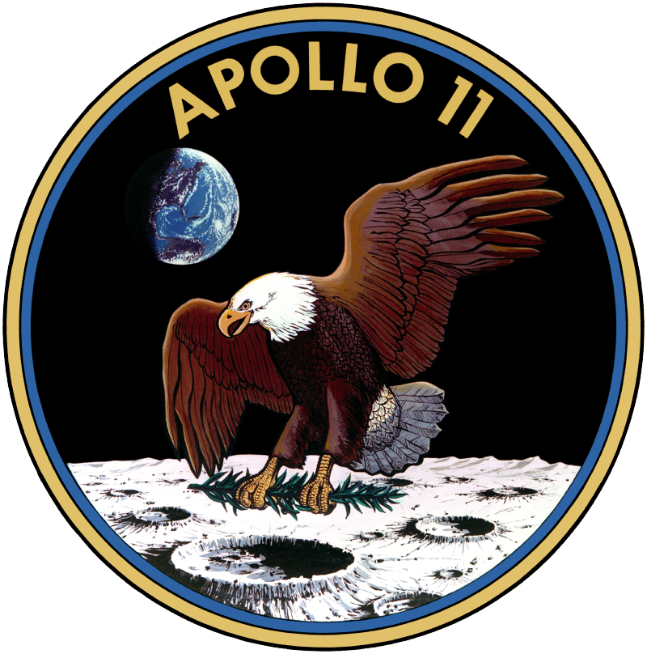
July 20, 1969: Apollo 11 astronauts Neil Armstrong and Buzz Aldrin become the first humans to walk on the moon.
In total, 12 Americans walked on the Moon from Apollo 11-17 – the only people, so far.

Slide 9
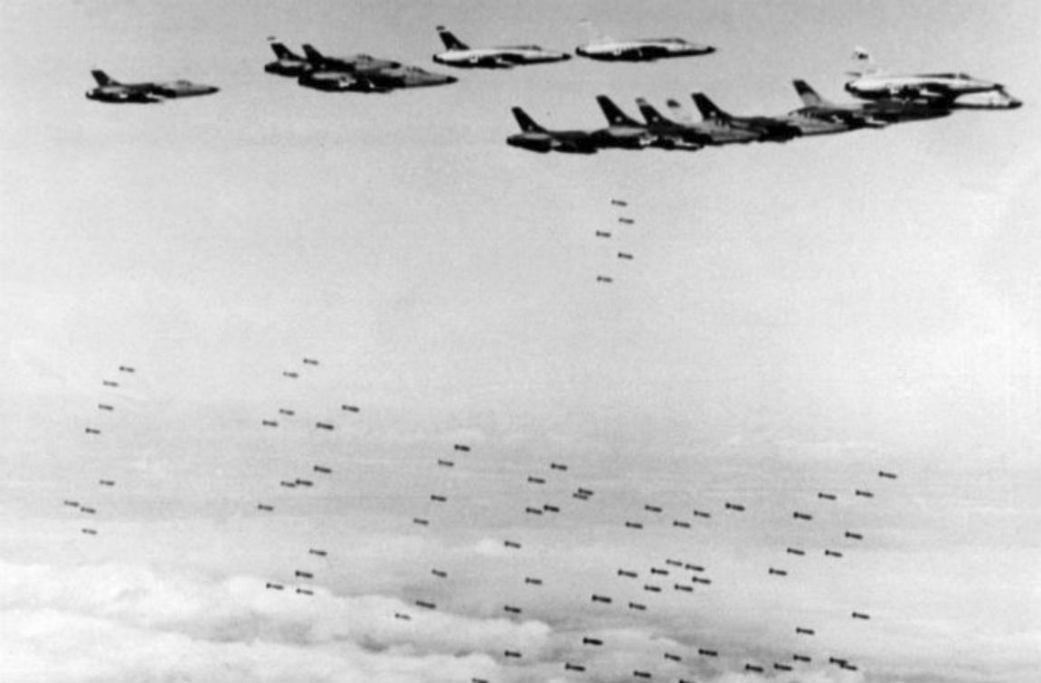
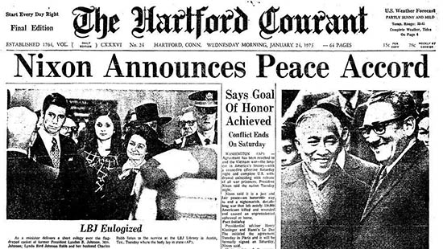
Nixon and Vietnam
Probably persuaded North Vietnam to keep fighting so he could defeat L. B. J.
Promised a “Secret Plan” to end the war
Promised a “Vietnamization” of the war
1969: Bombing of North Vietnamese cities
1970: Invaded Laos and Cambodia
1972: The Christmas Bombings of North Vietnam
1973: Paris Peace Talks result in a cease fire, withdrawal of US Combat troops, and release of POWs

Slide 10
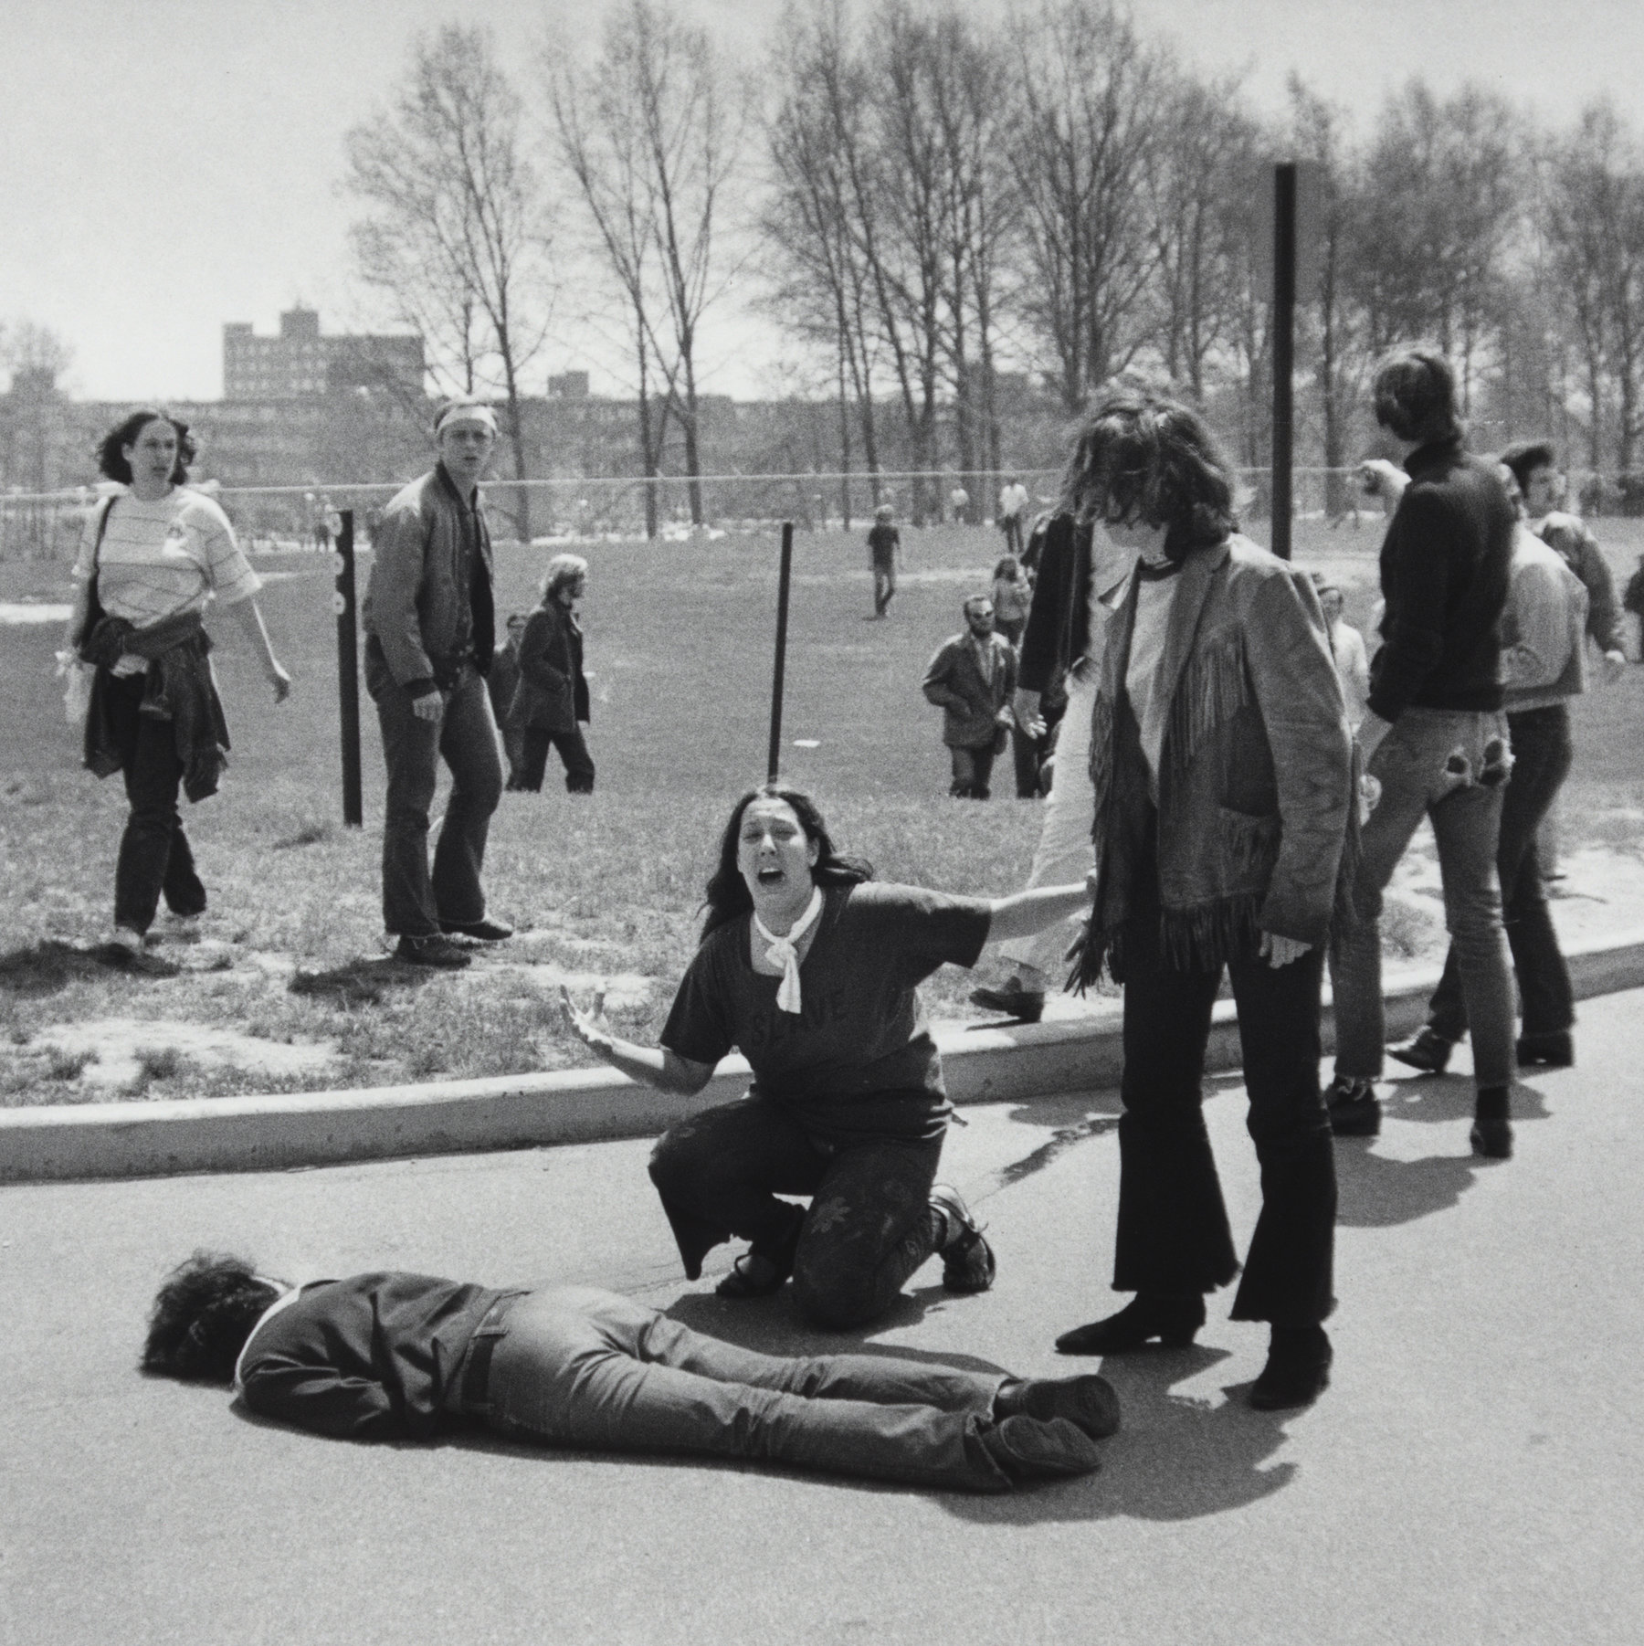
“Kent State Massacre”
Student protests against the Invasion of Cambodia at Kent State University, Ohio
Following some violent clashes, the governor of Ohio sent in the National guard
May 4, 1970: 4 students were killed, 9 wounded when the National Guardsmen fired into a crowd of angry protestors.

Slide 11
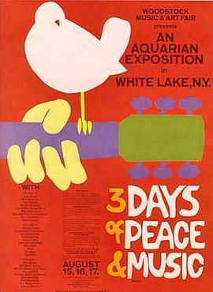
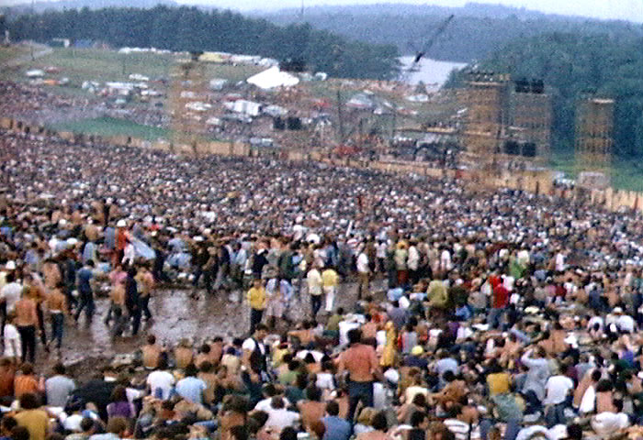
Woodstock Music Festival
- 4 day music Festival held on a farm in Woodstock, NY (August 1969)
“Three Days of Peace and Music”
Crowd of 400,000
Major acts included:
Richie Havens Arlo Guthrie
Joan Baez Santana
Grateful Dead Janis Joplin
The Who Jefferson Airplane
Blood, Sweat, and Tears Jimi Hendrix
Crosby, Stills, Nash, and Young
-Became a defining moment for the “hippie” generation

Slide 12
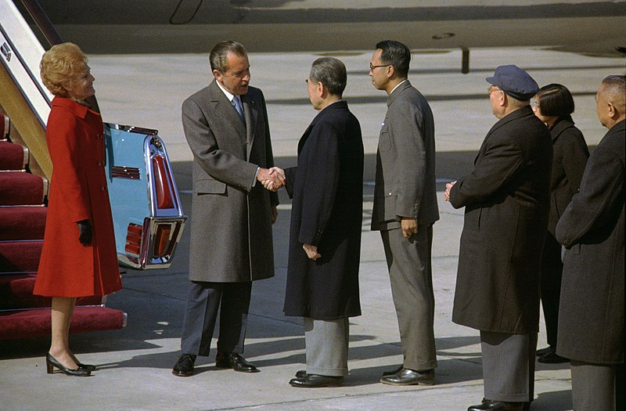
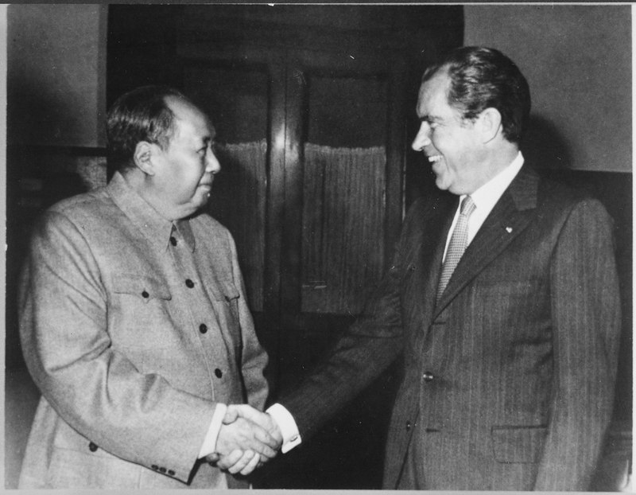
Nixon in China - 1972
Presidential state visit to the Communist People’s Republic of China – the first ever
Part of Nixon’s plan to gain leverage with the Soviet Union
US/PRC normalized relations in 1979

Slide 13
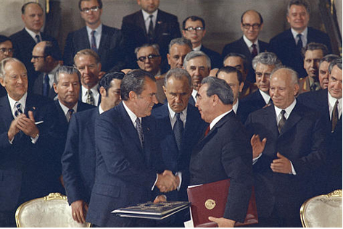
SALT Treaty
(Strategic Arms Limitation Talks)
Treaty signed by Nixon and Soviet leader Brezhnev in 1972
Limited the number and size of certain nuclear missiles and anti-missile systems
Followed by SALT II in 1979

Slide 14
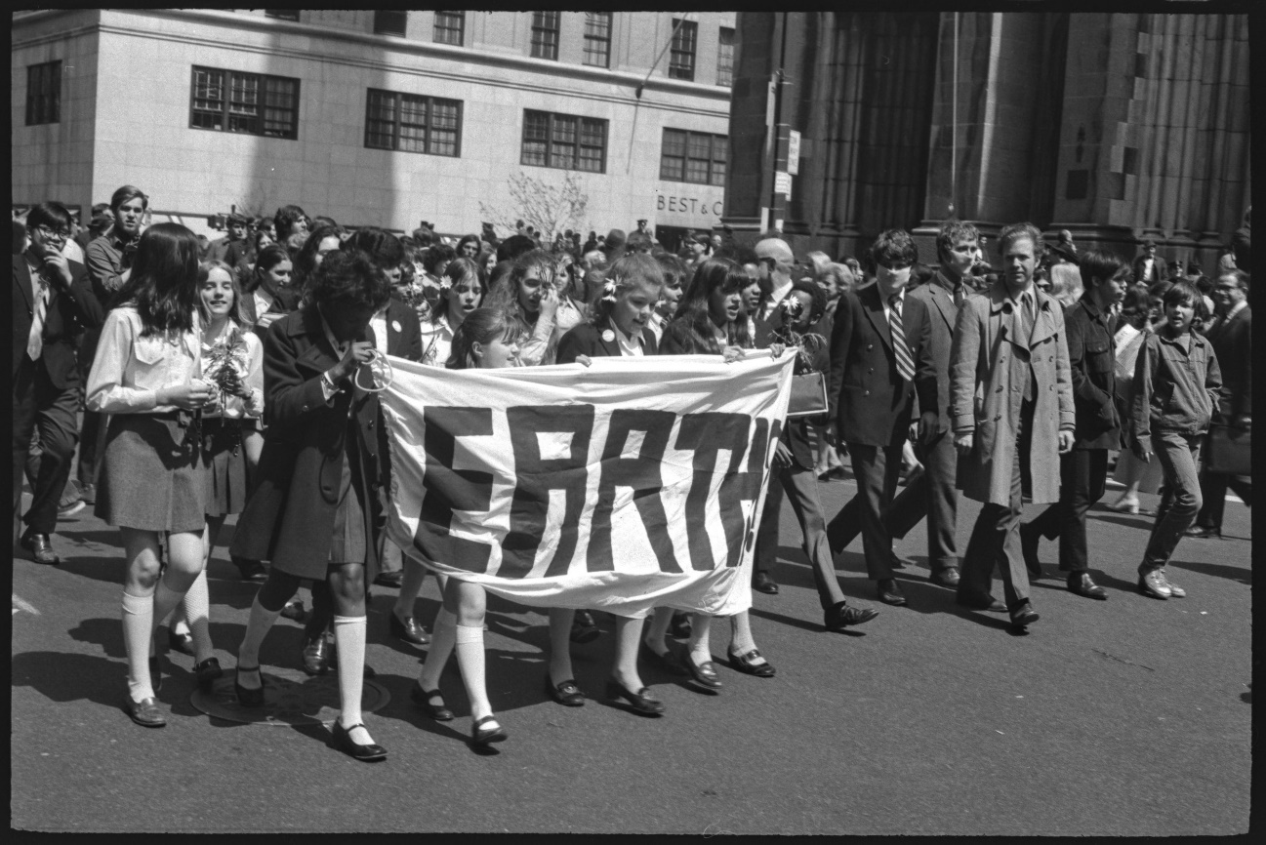
Created OSHA (Occupational Safety and Health Administration)
Attempted to stop inflation through currency devaluation and wage/price controls (they didn’t work – up to 12.2% in 1974)
Took the US dollar off the “gold standard”
1970: First Earth Day
1970: Clean Air Act: Allowed the US government to regulate air pollution
1972: Clean Water Act: Allowed the US government to regulate water pollution
1970: Environmental Protection Agency started

Slide 15
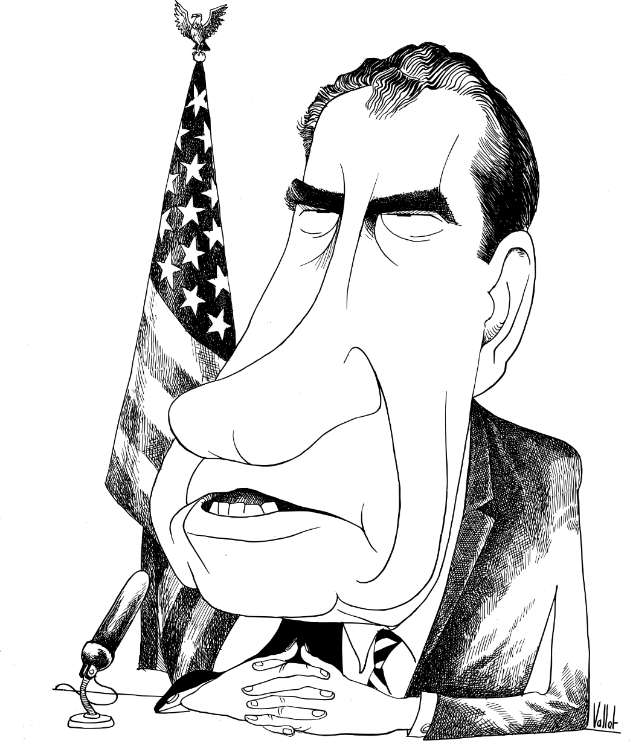
WATERGATE
June 1972: Five burglars arrested while attempting to break into the Democratic Party HQ at the Watergate complex in Washington DC - some worked for the Committee to Re-Elect the President (CREEP).
Nixon attempts to cover up his involvement in planning the break-in, part of a massive “dirty tricks” campaign (like “the Canuck Letter”)
Washington Post reporters Woodward and Bernstein did most of the investigating, though an anonymous source known as “Deep Throat” (FBI deputy director Mark Felt)

Slide 16
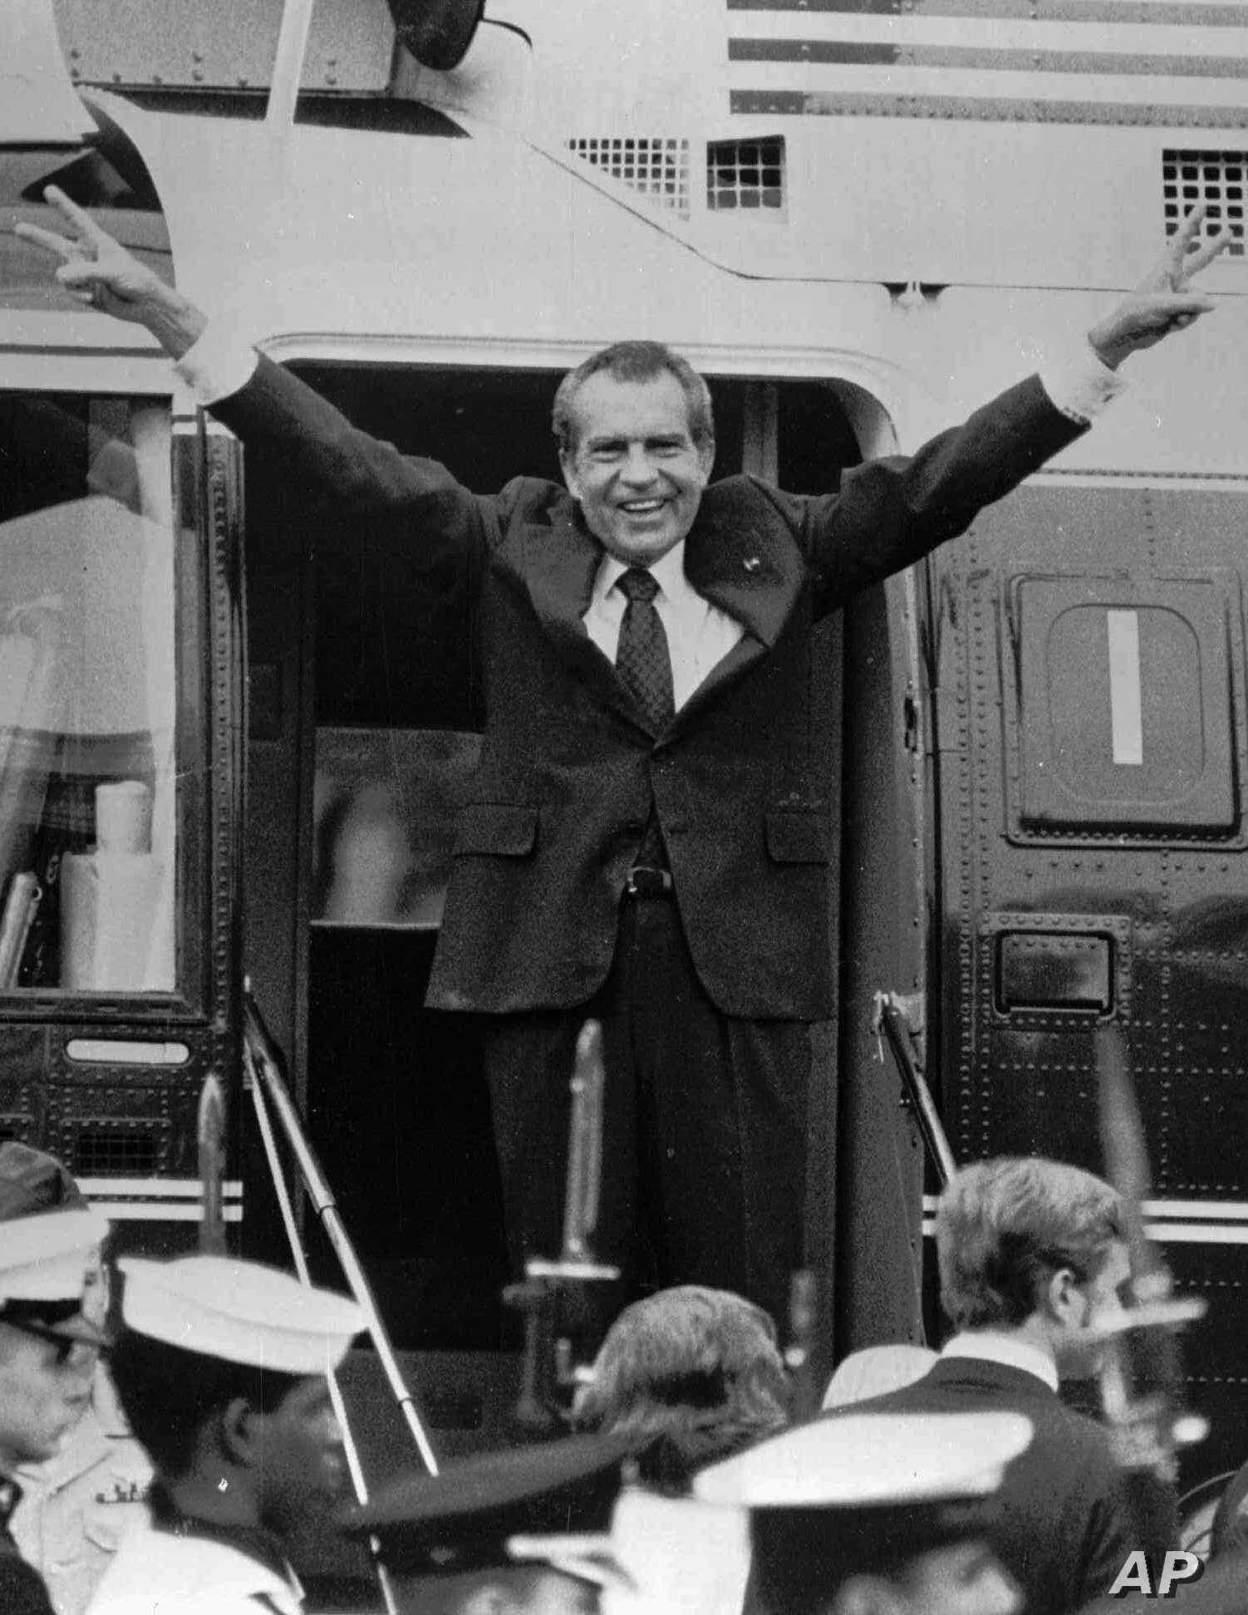
WATERGATE
Nixon refused to hand over secret recordings that proved his connection, and when he did, they contained long silent gaps.
Nixon fired multiple Justice department officials when they refused to fire the Special Watergate Persecutor looking into the crimes (The "Saturday night Massacre”)
When the House of Representatives began impeachment hearings and the secret tapes were revealed, Nixon resigns in August 1974.

Slide 17
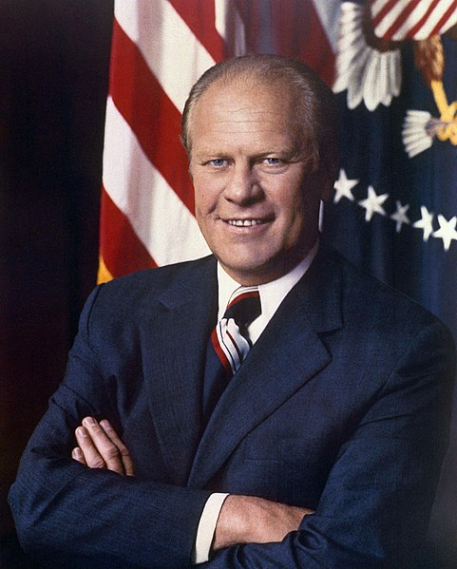
Gerald Ford

Slide 18
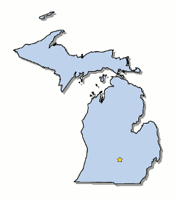
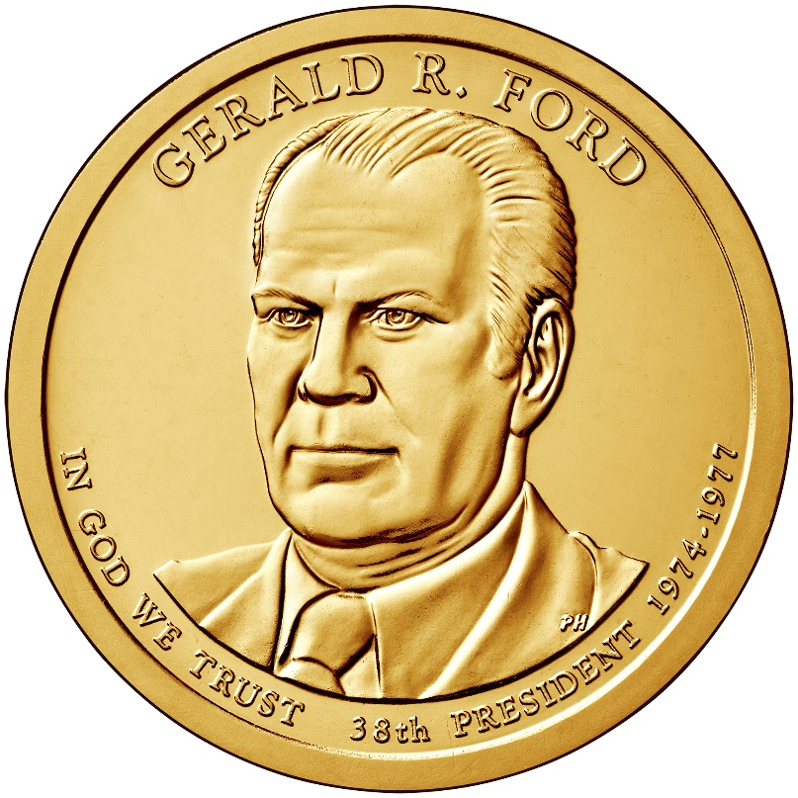
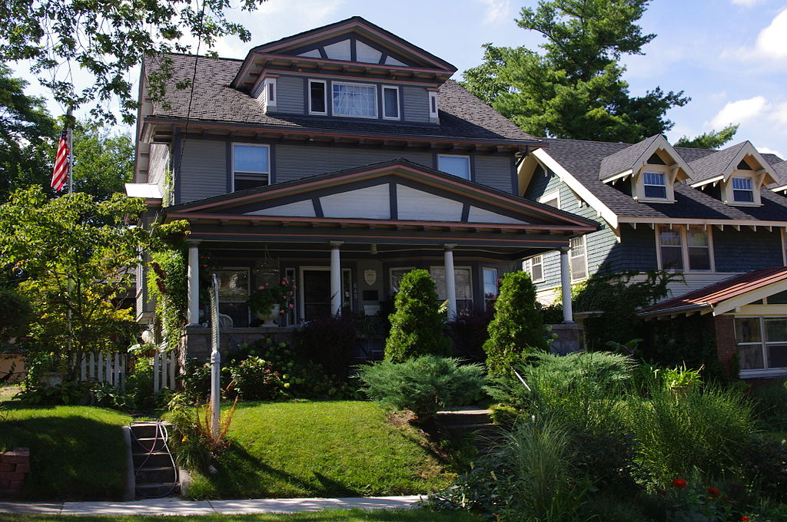
Elected in: Not elected
President from: 1974-1977
Political Party: Republican
Home State: Michigan

Slide 19
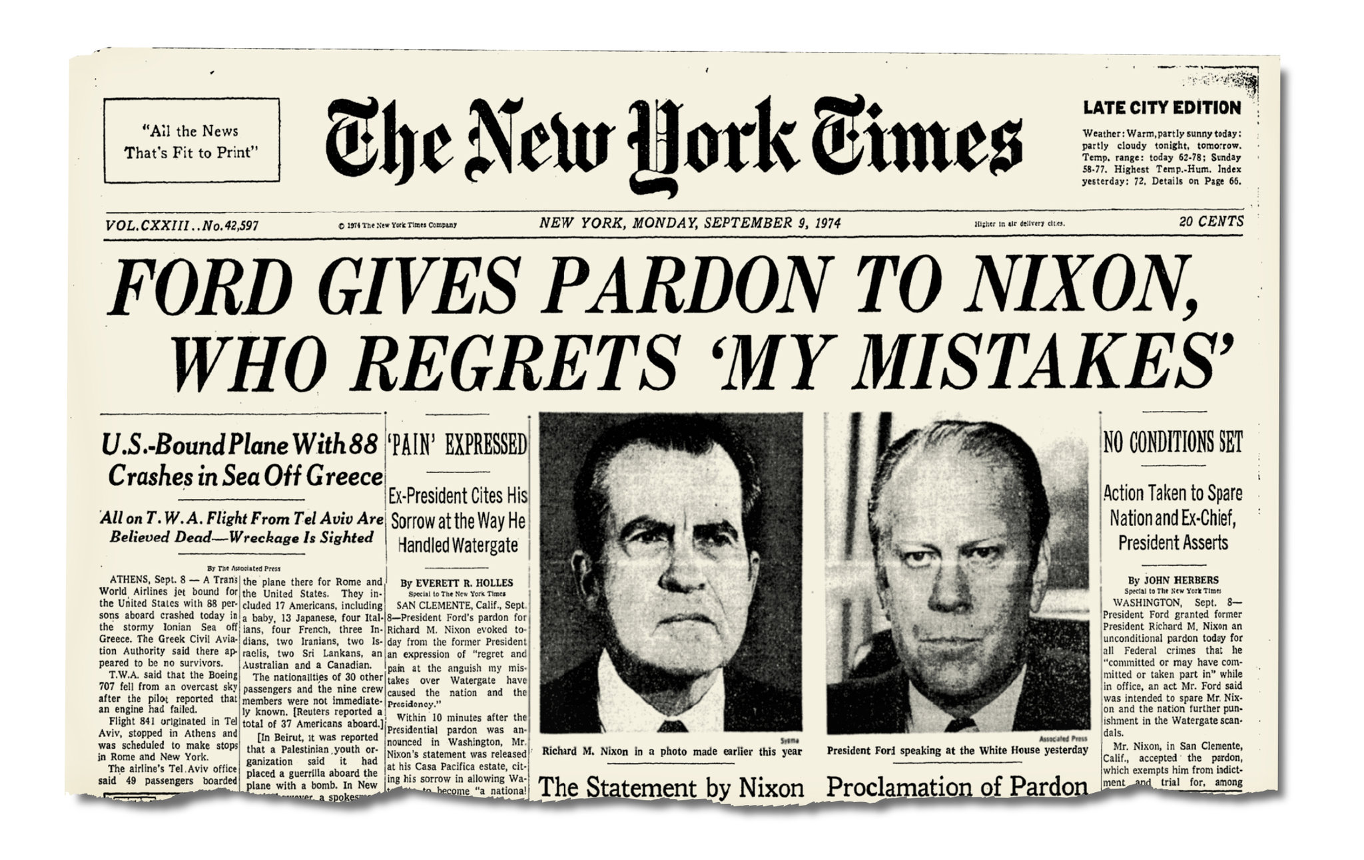
1974: Ford pardons Richard Nixon, saying he wanted to unite the country.
Fords approval rating drops from 74% to 49%
Historians still debate this action.

Slide 20
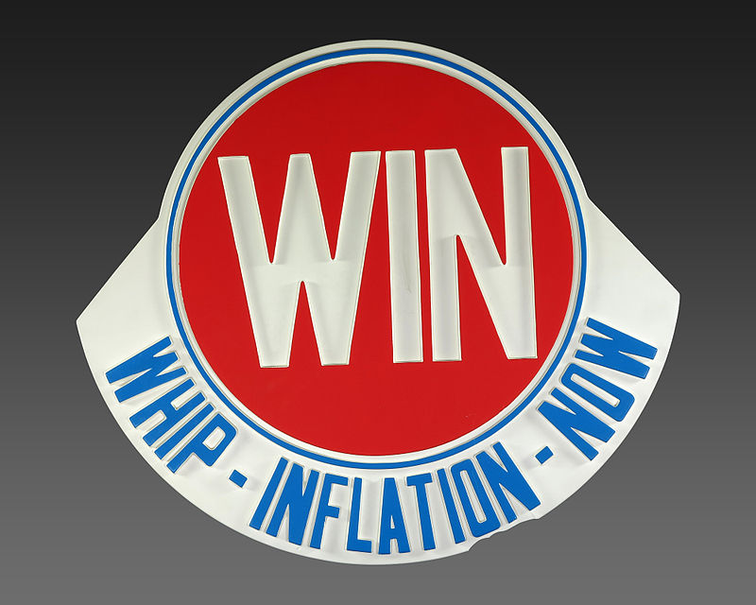
Whip Inflation Now
US faced an economic crisis – high unemployment, 12% inflation, and an oil crisis
WIN campaign encouraged Americans to save money, carpool, and turn down thermostats
The campaign was a spectacular failure.

Slide 21
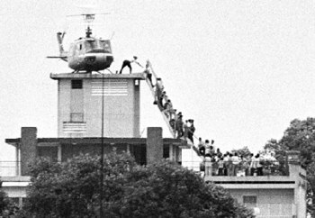
Fall of Saigon
1975: North Vietnamese soldiers finally take Saigon, and South Vietnam falls
US had been out of the war for 2 years, but the US helicopter evacuating Americans from the embassy roof was seen as a symbol if US defeat in Vietnam

Slide 22
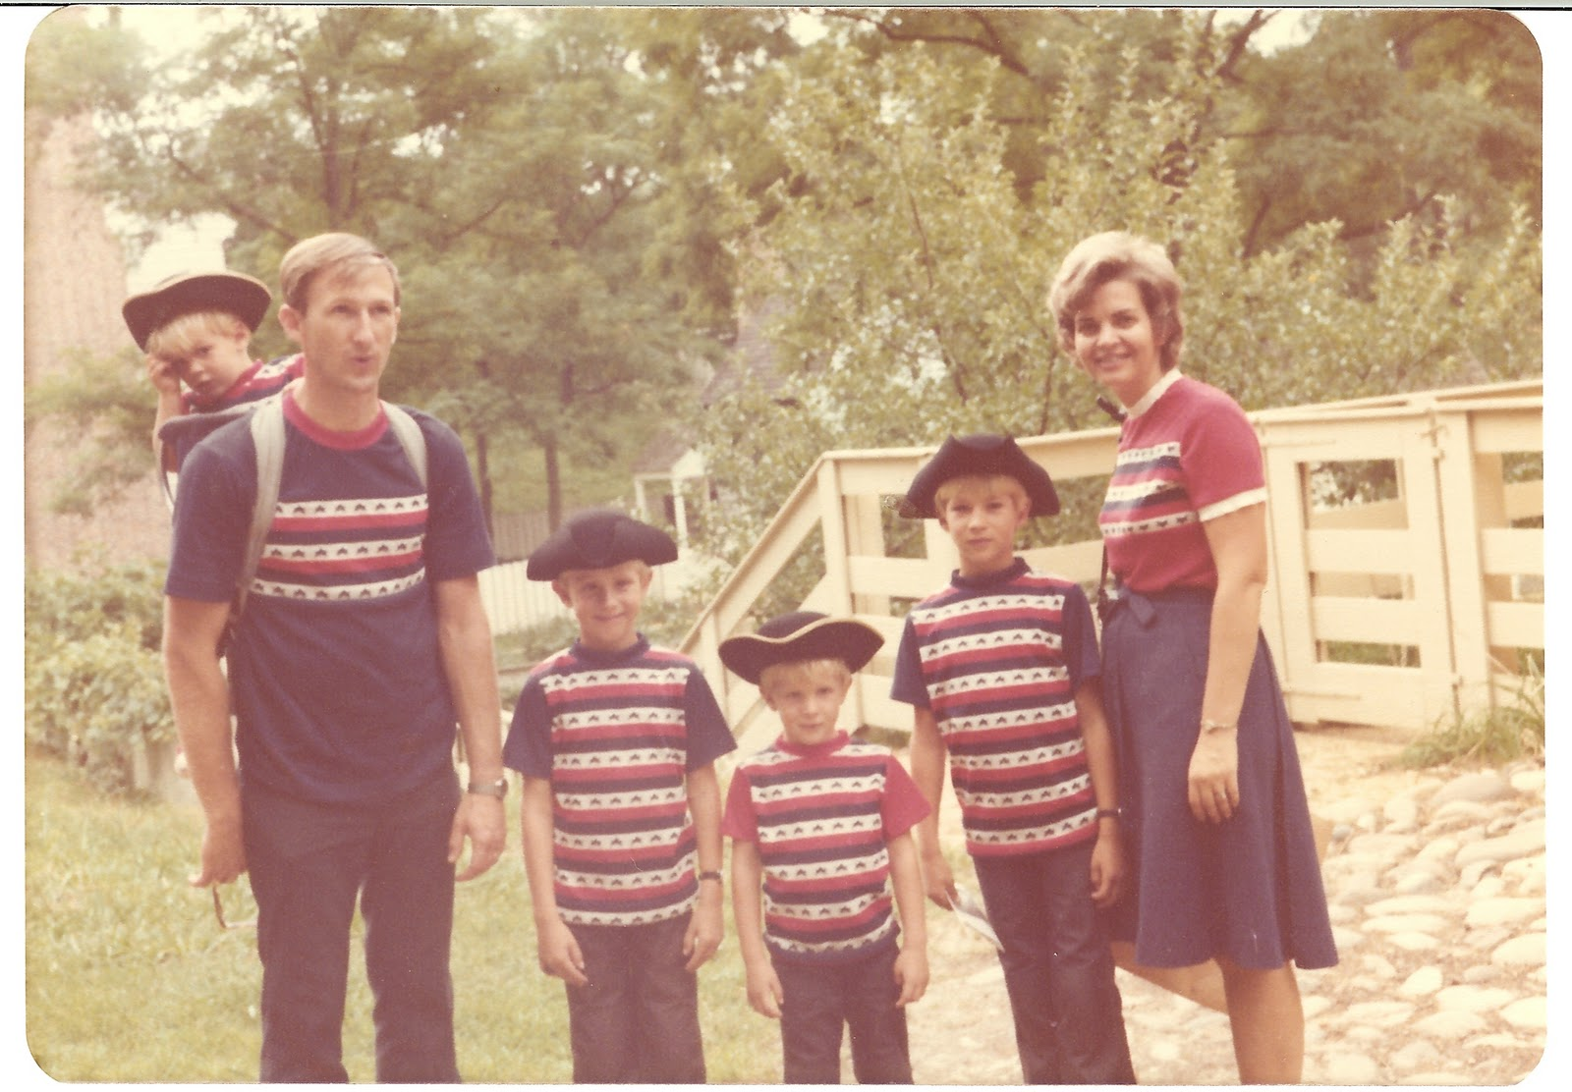
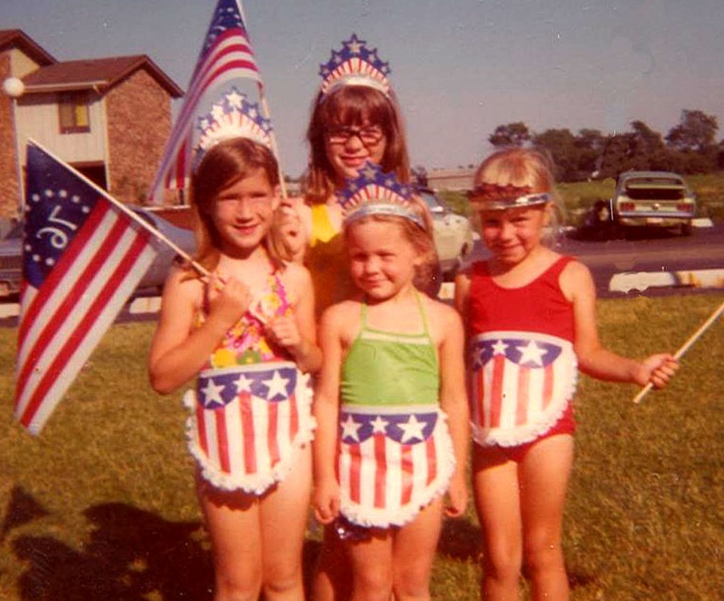
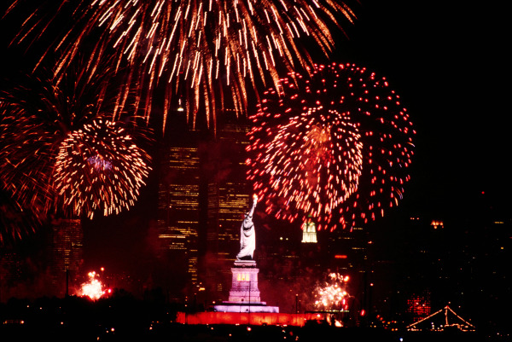
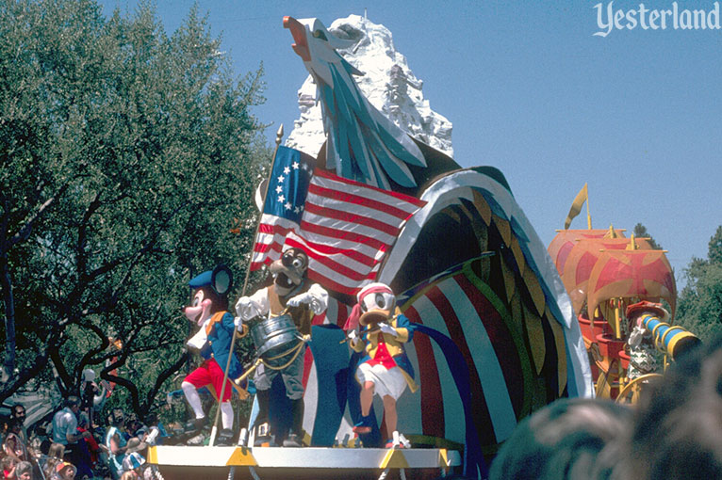

Slide 23
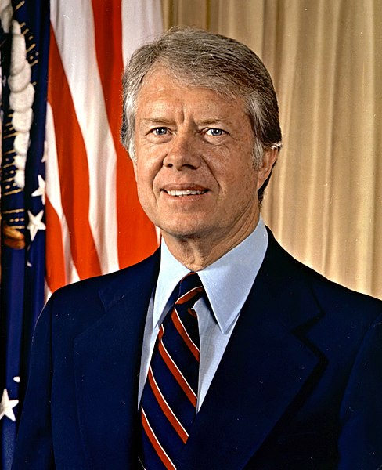
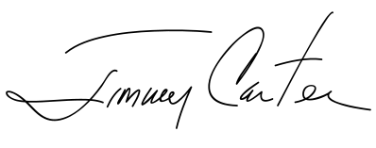
Jimmy Carter

Slide 24
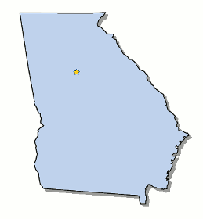
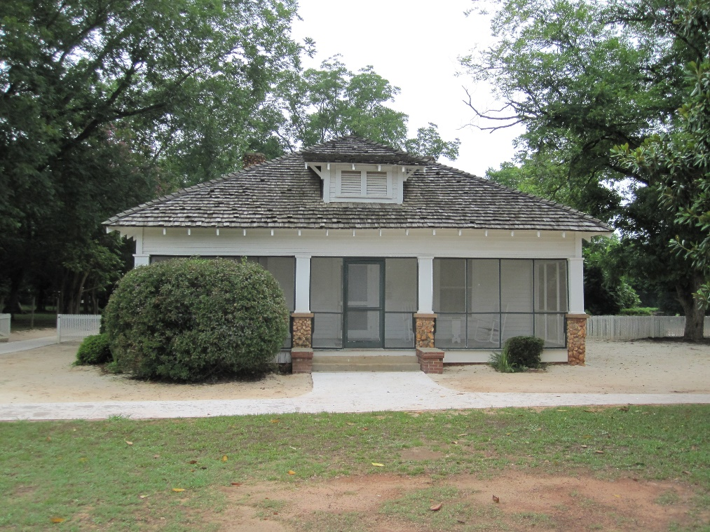
Elected in: 1976
President from: 1979-1981
Political Party: Democrat
Home State: Georgia

Slide 25
Election of 1976
Democrat: 297
President: Jimmy Carter
Vice President: Walter Mondale
Republican: 240
President: Gerald Ford
Vice President: Bob Dole

Slide 26
Camp David Accords
Political agreements between Egypt (Anwar Sadat) and Israel ( Menachem Begin) at Camp David, Maryland
Led to a peace treaty between the two nations, and Egypt became the first Arab nation to recognize Israel.
Partially bankrolled by the US
Sadat and Begin won the Nobel Peace Prize for the agreement, and was partially the reason Sadat was assassinated two years later
Oil crisis
Invasion of Afghanistan
Iranian revolution/hotages
Giantm swimming rabbit

Slide 27
Iranian Revolution & Hostage Crisis
1979: Iran overthrew their former leader, the Shah, and instituted a new Islamic-based government.
The Shah fled to the US for cancer treatment, and when Iran demanded he be returned the US refused.
November 1979: Militarized Iranian students stormed the US embassy in Tehran, taking 52 Americans hostage.
Carter’s inability get them hostages returned, as well as a disastrously failed rescue attempt, hurt his image in the US.
The lack or Iranian oil contributed to a second oil crisis in 1979 (prices went up 100%)
The hostages were released 444 days later, just minutes after Ronald Reagan was inaugurated president.
We still (2021) do not have normal relations with Iran.

Slide 28
1970s Energy Crisis
A decade of substantial oil shortages and elevated prices, notably in 1973 and 1979, across US and Europe
Led to Stagflation, a combination of stagnant economic growth and inflation. Gas prices went up 300%, and rationing followed.
-Contributing Factors-
Decreased domestic production
Arab/Israeli conflicts
Iranian Revolution (1979)
US goes off the gold standard
-Long term effects-
Increased domestic production
Move towards conservation and better efficiency
Alternative energy sources
Highlighted the importance of Middle Eastern policy

Slide 29
Malaise Speech
I want to talk to you right now about a fundamental threat to American democracy... I do not refer to the outward strength of America, a nation that is at peace tonight everywhere in the world, with unmatched economic power and military might. The threat is nearly invisible in ordinary ways. It is a crisis of confidence. It is a crisis that strikes at the very heart and soul and spirit of our national will. We can see this crisis in the growing doubt about the meaning of our own lives and in the loss of a unity of purpose for our nation...

Slide 30
Ronald Reagan

Slide 31
Elected in: 1980, 1984
President from: 1981-1989
Political Party: Republican
Home State: California

Slide 32
Election of 1980
Republican: 489
President: Ronald Reagan
Vice President: George bush
Democratic: 49
President: Jimmy Carter
Vice President: Walter Mondale

Slide 33
Election of 1984
Republican: 525
President: Ronald Reagan
Vice President: George Bush
Democratic: 13
President: Walter Mondale
Vice President: Geraldine Ferraro

Slide 35
Reaganomics
Reduce federal spending (except on defense)
Dramatic tax cuts, especially for wealthier Americans
Reduce Federal regulations
Reduce inflation my reducing the money supply
The Laffer Curve
“Trickle-Down Economics”
Effects:
Reduced inflation
After a brief recession, the economy boomed
Enormous growth in Federal spending
Dramatic increase in National Debt
Widened the gap between rich and non-rich

Slide 36
Relations with the Soviet Union
Reagan called the Soviet Union an “Evil Empire”
Pledged to build up a stronger US military, including a larger navy, better missiles, and the B-1 bomber
Started research into “SDI” – Strategic Defense Initiative (AKA “Star Wars”) a space-based anti-nuclear missile program
Had multiple summits with Soviet leader Mikhail Gorbachev, and signed numerous treaties, including reducing the number of medium-range nuclear missiles in Europe
Coordinated with British Prime Minister Margaret Thatcher and Pope John Paul II

Slide 37
Mikhail Gorbachev
Perestroika: The policy or practice of restructuring or reforming the economic and political system of the Soviet Union – mainly, ending central planning
Glasnost: The policy or practice of more open consultative government and wider dissemination of information.

Slide 38
We welcome change and openness; for we believe that freedom and security go together, that the advance of human liberty can only strengthen the cause of world peace. There is one sign the Soviets can make that would be unmistakable, that would advance dramatically the cause of freedom and peace. General Secretary Gorbachev, if you seek peace, if you seek prosperity for the Soviet Union and Eastern Europe, if you seek liberalization, come here to this gate. Mr. Gorbachev, open this gate. Mr. Gorbachev... Mr. Gorbachev, tear down this wall![

Slide 40
Relations with Latin America
Mexico: Made it illegal for businesses to employ “illegal aliens” but allowed those people to apply for citizenship under some conditions
Grenada: Invaded Grenada to stop Cuban-backed troops after their prime minster was assassinated
El Salvador: Supported the Contras, El Salvadorian rebels fighting Marxists from Nicaragua
Nicaragua: Froze aid to Nicaragua as the pro-Soviet Sandanistas took over the government

Slide 41
Lebanon: A terrorist attack on a US Marine Corps Barracks in 1983 kills 241 Marines. Troops are withdrawn in 1984. Pro-Iranian groups kidnap US hostages and hold them for years.
Iran: No relations with the US – routine protests calling for the Death to America.
BUT: US sells arms so hostages can be released.
US bombs targets in Libya after its leader Qaddafi plans terrorist attacks on US. Libya blows up a US passenger plane over Scotland in 1988
WAR
Israel: US backs Israel in most things, and defends it in the UN. The two nations coordinate military plans.
Sold AWACS planes to Saudi Arabia

Slide 42
Iran-Contra Affair
The US secretly sold weapons to Iran, in return for American hostages being released.
The money from the weapon sales were sent to Nicaraguan Contras, who were fighting against the Communist Sandinista government there.
This was all done in secret, even from the US Congress
The deals were exposed in 1986. Reagan took responsibility, though he said he was not fully informed about the deals
Congress held hearings in 1987, and eventually six officials were found guilty of conspiracy (but pardoned by George Bush in 1992)
-

Slide 43
AIDS Crisis: the disease first appears in the 1980s and quickly became epidemic among homosexual men. A level of panic and hysteria set in, and the government was criticized for not doing enough (or anything, really).
Drug crisis: Concerned about drug use, the government launched a War on Drugs, targeting narcotics (especially crack cocaine). Nancy Reagan launched a “Just say No!” campaign for US children.

Slide 44
George Bush

Slide 45
Elected in: 1988
President from: 1989-1993
Political Party: Republican
Home State: Texas

Slide 46
Election of 1988
Republican: 426
President: George Bush
Vice President: Dan Quayle
Democratic: 111
President: Michael Dukakis
Vice President: Lloyd Bentsen

Slide 47
Exxon Valdez Spill - 1989
-An oil tanker ran aground in Prince William Sound, Alaska, spilling 240,000 barrels of oil (over 120 million gallons) of crude oil.
-Largest oil spill in US History (until 2010)
-Killed 400,000 animals

Slide 48
Fall of the Berlin Wall
After political change in East Germany loosened restrictions, the Soviets declined to overrule the changes
Huge protests and rallies at the Berlin Wall led to the literal destruction of the Wall
Germany officially reunited in 1990

Slide 49
Invasion of Panama - 1990
US invaded Panama to arrest President Manual Noriega, who the US accused of trafficking drugs to the US.
Noriega was a dictator who had overthrown the Panamanian government, and had declared war on the US in December 1985.
Noriega was captured and eventually died in prison

Slide 50
1990 Budget
-To reduce the national debt, income taxes were raised $140 billion over 5 years – after Bush had promised not to raise taxes.
Clean Air Act (1990)
-Limited air pollution from industry, automobiles, and phased out CFC use
Americans With Disabilities Act (1990)
-Prohibits discrimination on account of physical disabilities

Slide 51
Operation Desert Storm
Saddam Hussein, dictator of Iraq, invaded Kuwait in August 1990.
US and other allied forces invaded Kuwait via Saudi Arabia in winter 1991 and drove out Iraqi forces. They stopped short of conquering Iraq and capturing Saddam Hussein

Slide 52
Collapse of the USSR
In August 1991 Soviet leaders attempted to overthrow Mikhail Gorbachev
Across the USSR, the people rose up in defiance of the coup, led by Russian President Boris Yeltsin
One by one, the republics of the USSR declared their independence
The Soviet Union officially collapsed December 25, 1991

