Slide 1
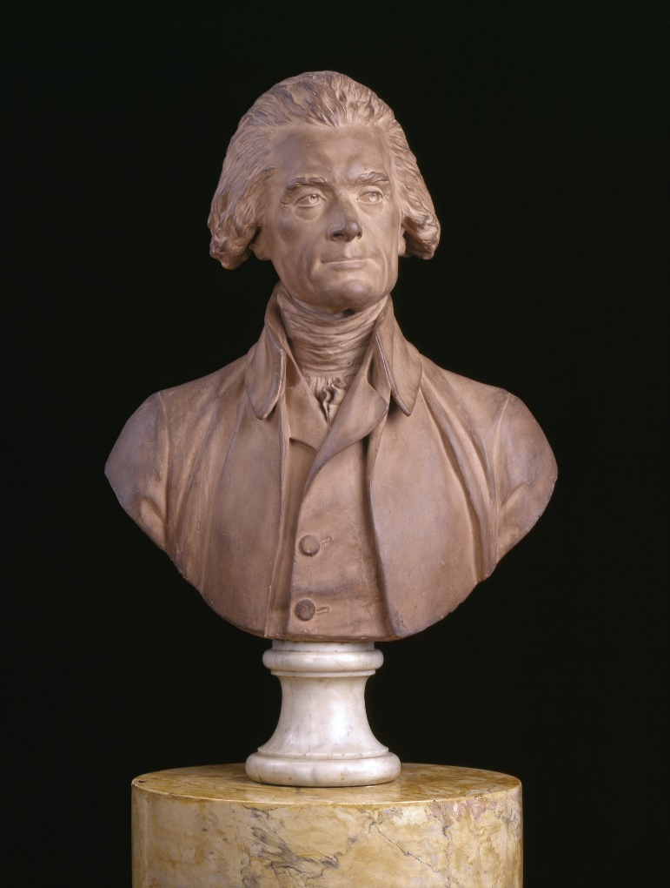
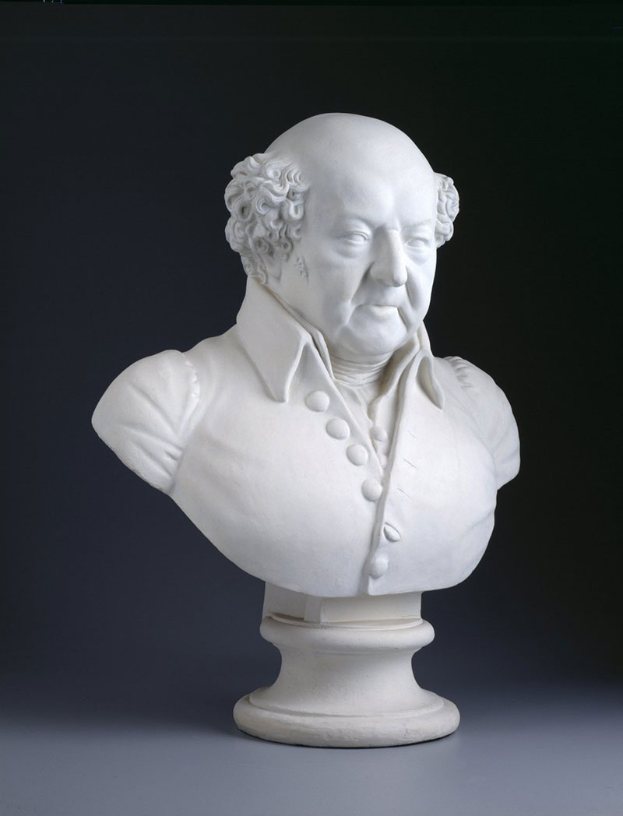
The Revolution of 1800
- The peaceful transition of power between Federalist and Democratic-Republican parties as a result of the election of 1800.

Slide 2
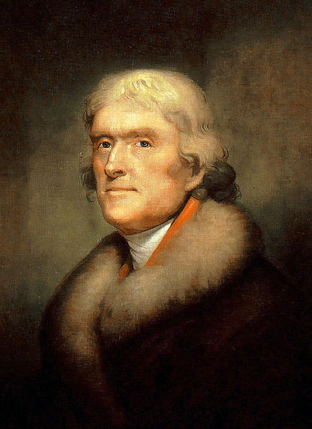
Thomas Jefferson

Slide 3
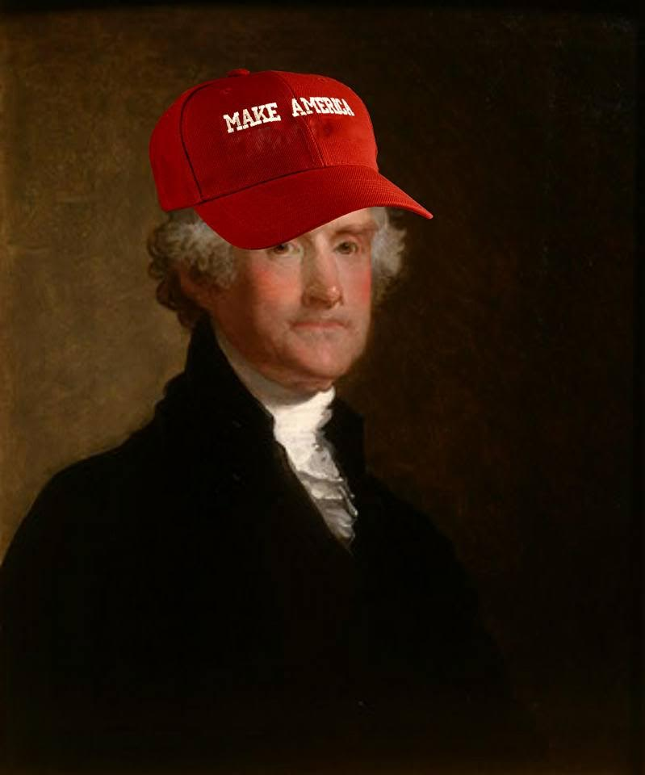

Slide 4
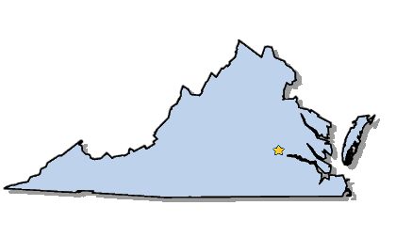
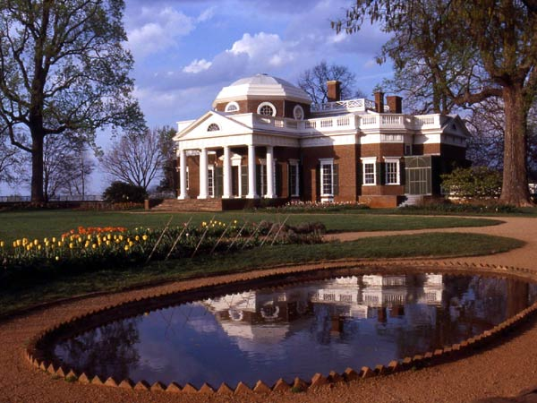
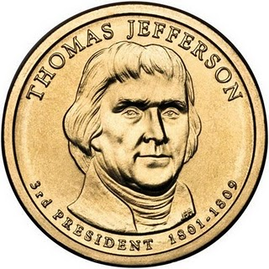
Elected in: 1800, 1804
President from: 1801-1809
Political Party: Dem-Rep
Home State: Virginia

Slide 5
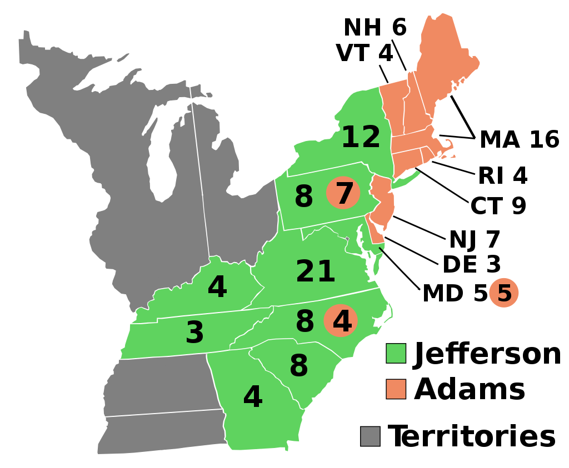
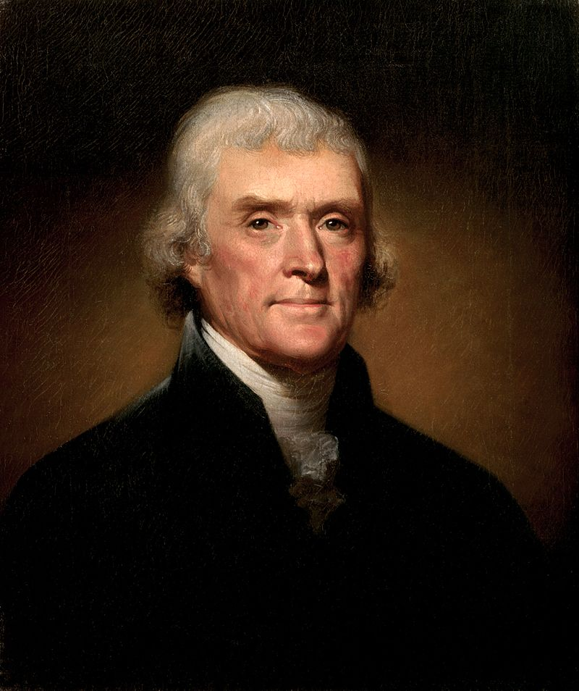
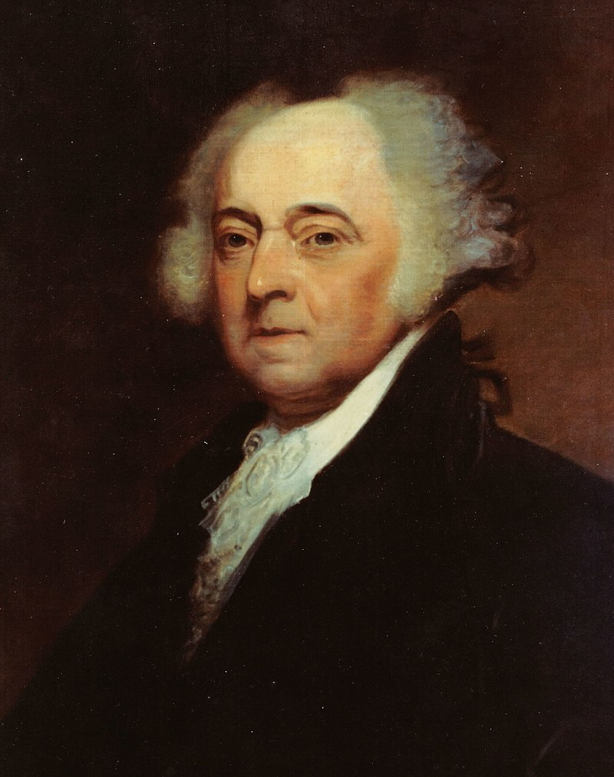
Election of 1800
Federalist: 65
President (i) John Adams
Vice President: Charles Pinckney
Democratic-Republican: 73
President: Thomas Jefferson
Vice President: Aaron Burr*
As Jefferson and Burr received an equal number of electoral votes, the election was decided by the House of Representatives.

Slide 6
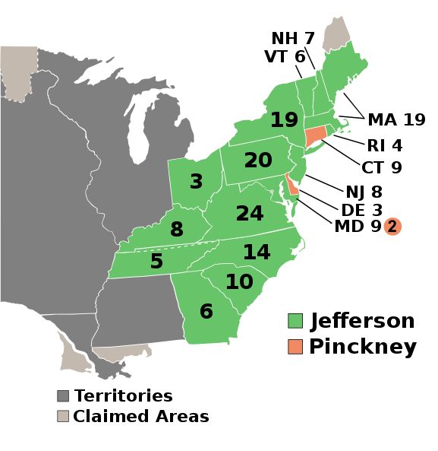
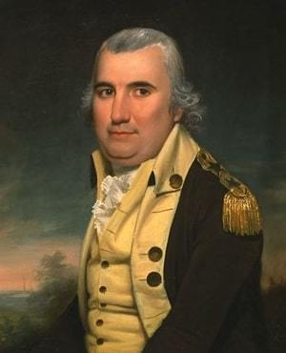
Election of 1804
Democratic-Republican: 162
President (i) Thomas Jefferson
Vice President: George Clinton
Federalist: 14
President: Charles Pinckney
Vice President: Rufus King

Slide 7
New States
17. Ohio

Slide 8
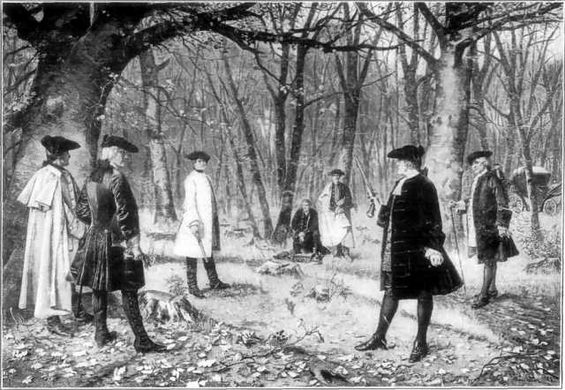
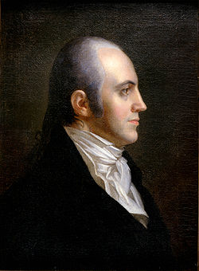
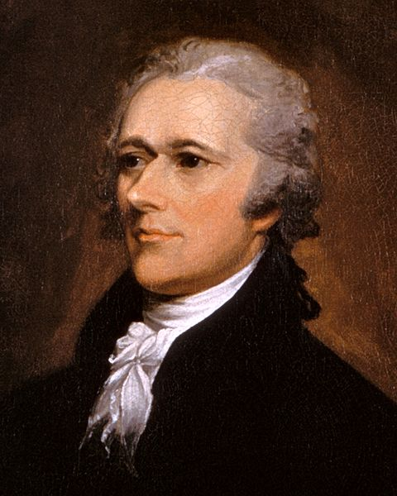
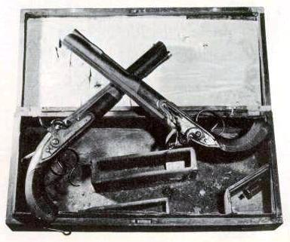
Aaron Burr shoots Alexander Hamilton over political disagreements, including Election of 1800 (Hamilton supported Jefferson)

Slide 9
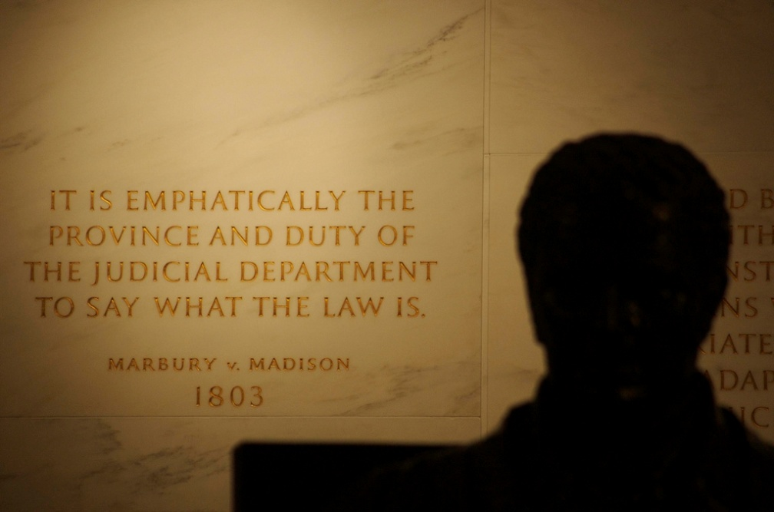
Marbury v. Madison
John Adams appointed “midnight judges” before he leaves office; Jefferson orders the commissions returned
William Marbury refuses, and sues James Madison
The Supreme Court rules that the Federal law allowing the judges was unconstitutional
1st time the Supreme Court has used “judicial review” – deciding if a law is constitutional or not.

Slide 10
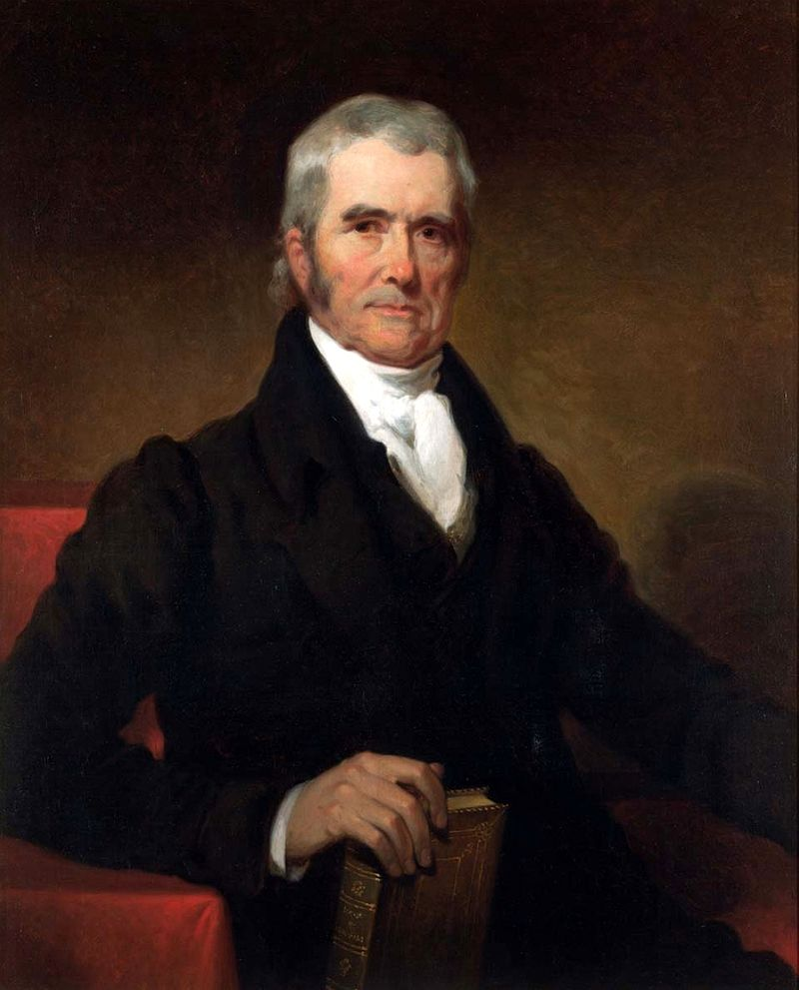
John Marshall:
Chief Justice of Supreme Court, 1801-1835
One of the most important & influential justices in history
Marbury v. Madison: established judicial review
Fletcher v. Peck: judicial review over state laws
McCulloch v. Maryland: Federal government supremacy over states, established the concept of “necessary and proper” implied Federal powers
Dartmouth v. Woodward: validated the sanctity of contracts
Cohen v. Virginia: Court has right to review state court ruling
Gibbons v. Ogden: Gov’t has the right to regulate trade & navigation
Worcester v. Georgia: Established native tribal sovereignty

Slide 11
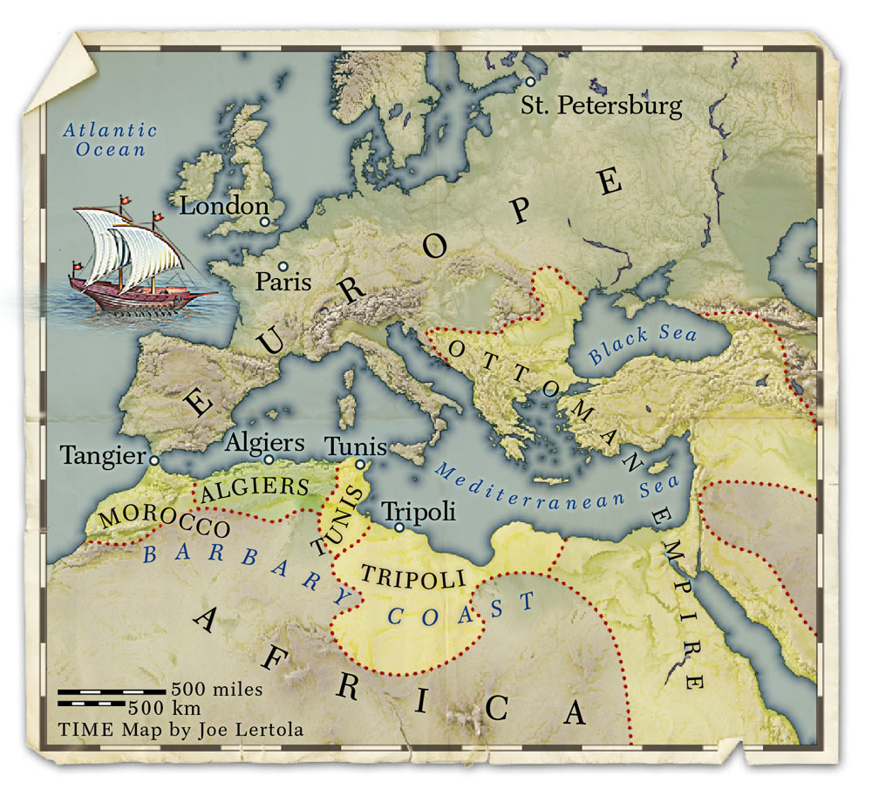

Slide 12
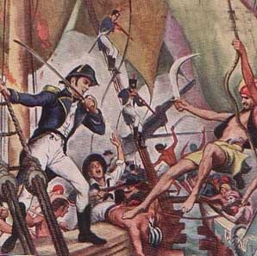
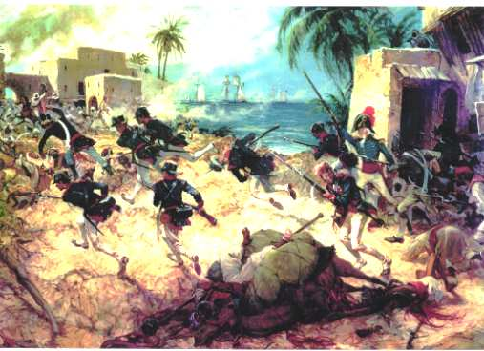
The Barbary Pirate Wars
Barbary Pirates: lived in northern Africa
Pirates demanded “tribute” – money in return for safe sailing on the Mediterranean Sea
Jefferson refuses, and sends the Navy to attack Tripoli
The Pirates later agree to stop charging Americans

Slide 13
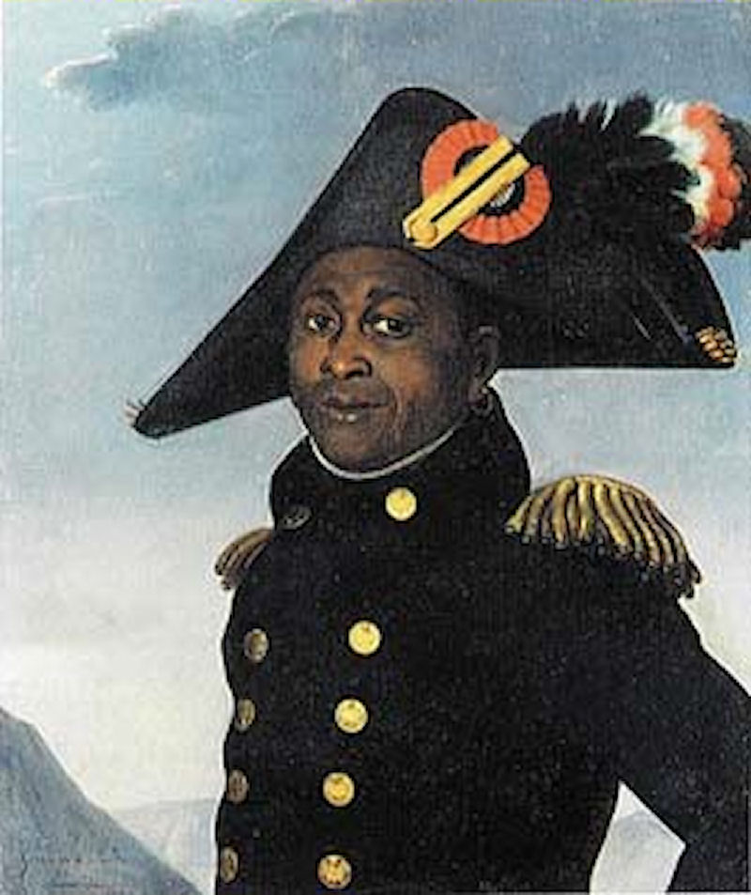
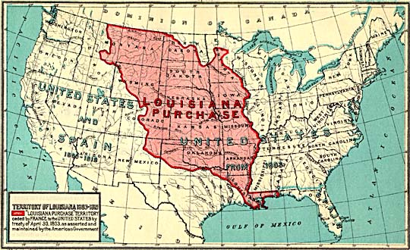
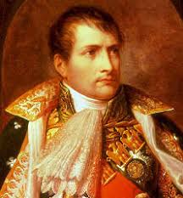
4) Louisiana Purchase
US attempts to buy New Orleans for up to $10 million
France offers to sell all of Louisiana for $15 million
US doubles in size for about 3 cents per acre (Constitutional?)
Why did Napoleon sell?
Haitian Revolution destroyed his plans for an American Empire

Slide 14
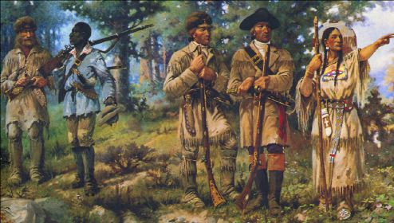
Lewis and Clark Expedition (1804-1806)
Meriwether Lewis & William Clark lead the “Corps of Discovery” to explore Louisiana and find a water route to the Pacific

Slide 16
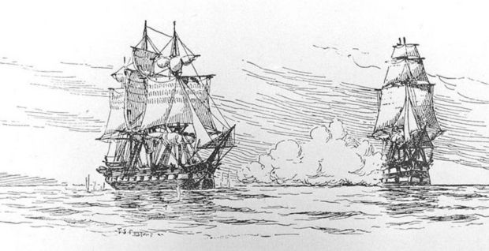
James Madison
USS Chesapeake Affair:
HMS Leopard attacks US Navy frigate USS Chesapeake, after demanding it be inspected for British deserters. Jefferson is furious but sticks by neutrality & diplomacy
HMS Leopard attacks USS Chesapeake, 1807

Slide 17
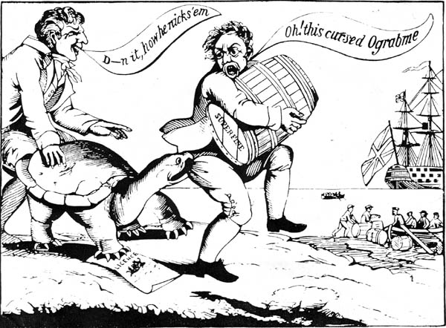
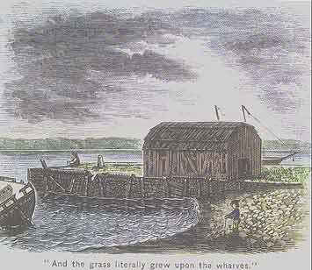
Embargo Act
In response to British and French violations of US neutrality, Jefferson declares US ships will not sail to any foreign port.
Leads to economic disaster, unemployed sailors, and very angry New England merchants
Repealed in 1809 and replaced with the Non-Intercourse Act, which allows ships to trade with everyone except France & Britain

Slide 18
Monticello: Jefferson’s Home in Virginia
(Designed by Jefferson himself)

Slide 19
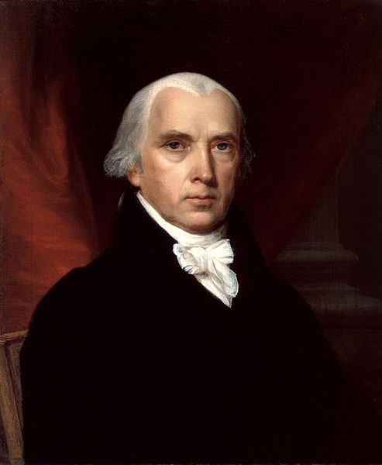
James Madison
James Madison

Slide 20
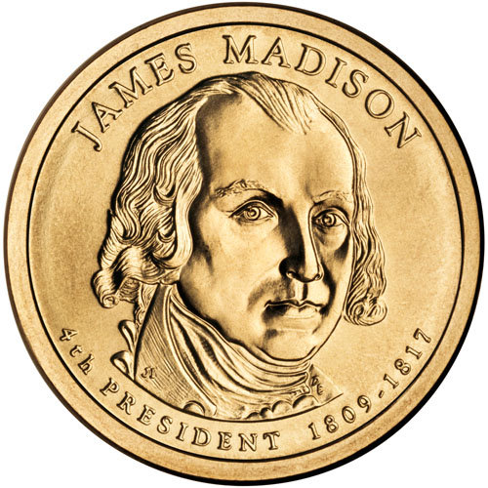
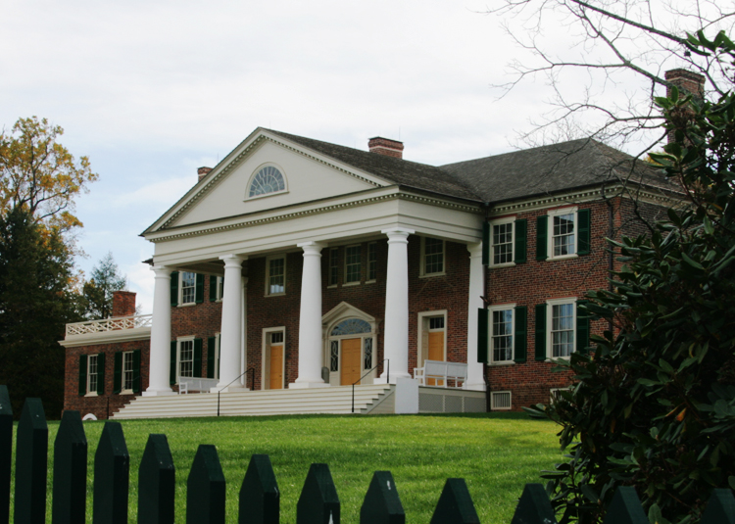
Elected in: 1808, 1812
President from: 1809-1817
Political Party: Dem-Rep
Home State: Virginia

Slide 21
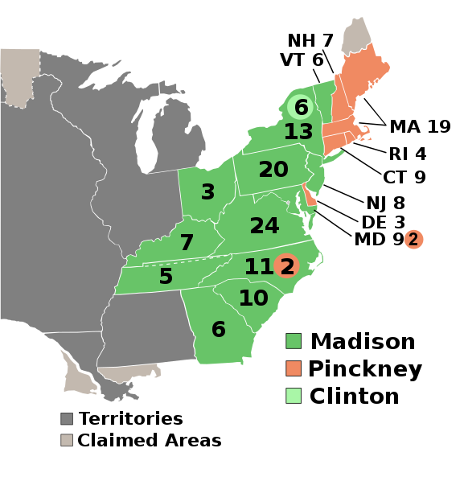
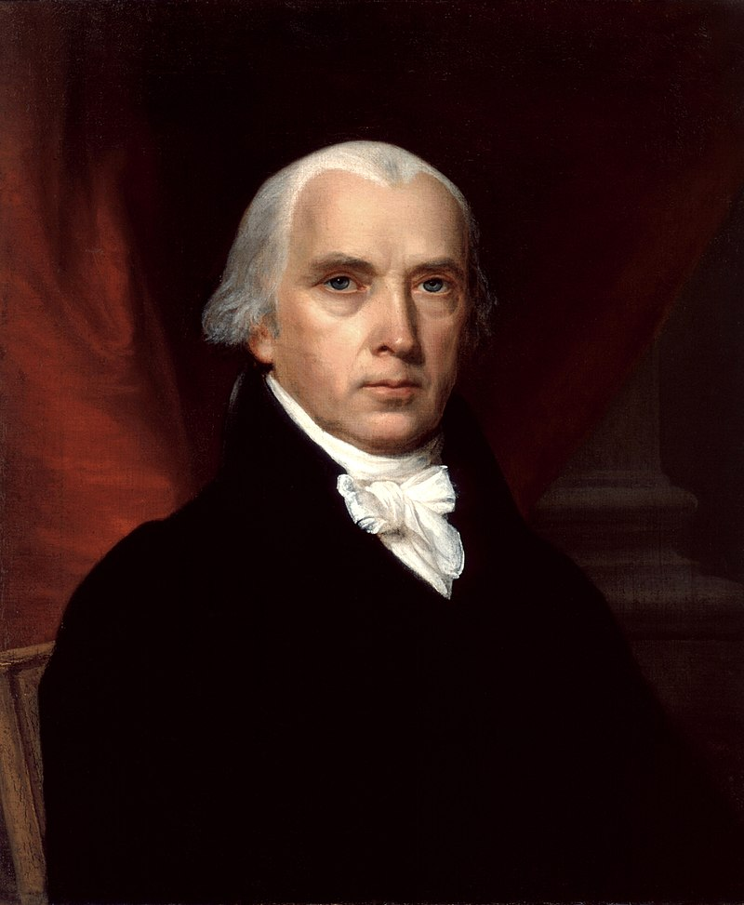
Election of 1808
Democratic-Republican: 122
President: James Madison
Vice President: George Clinton
Federalist: 47
President: Charles Pinckney
Vice President: Rufus King

Slide 22
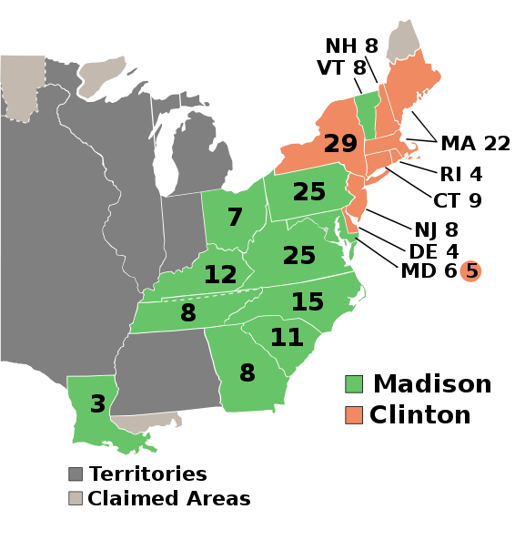
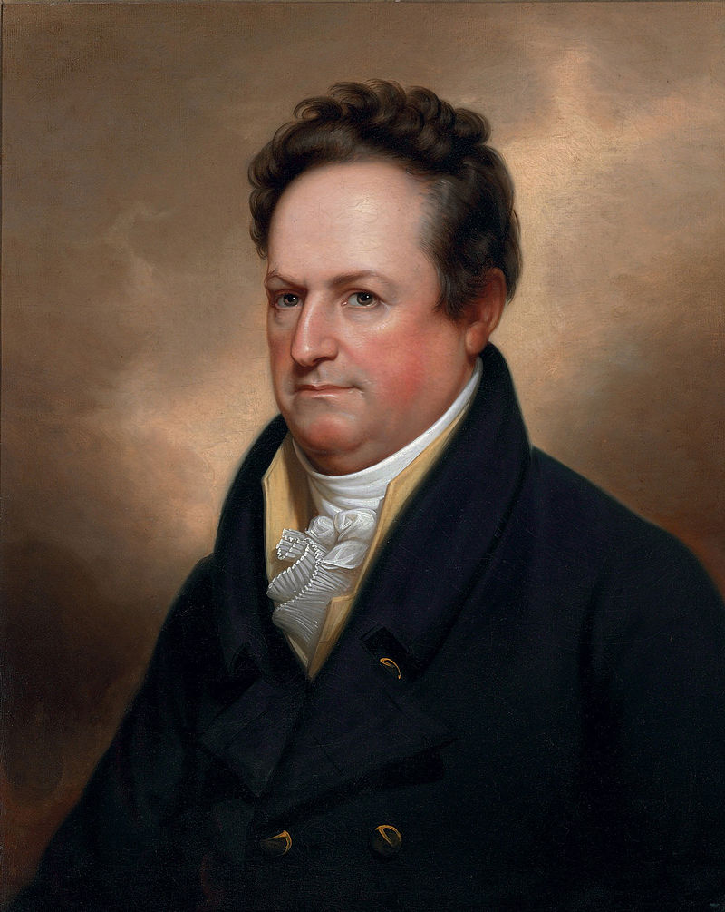
Election of 1812
Democratic-Republican: 128
President (i) James Madison
Vice President: Elbridge Gerry
Federalist: 89
President: DeWitt Clinton
Vice President: Jared Ingersoll

Slide 23
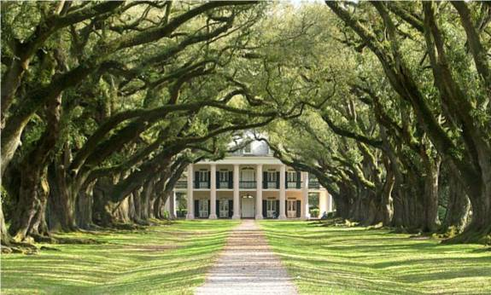
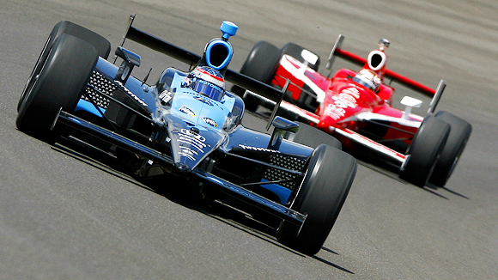
New States
18. Louisiana
19. Indiana Indiana

Slide 24
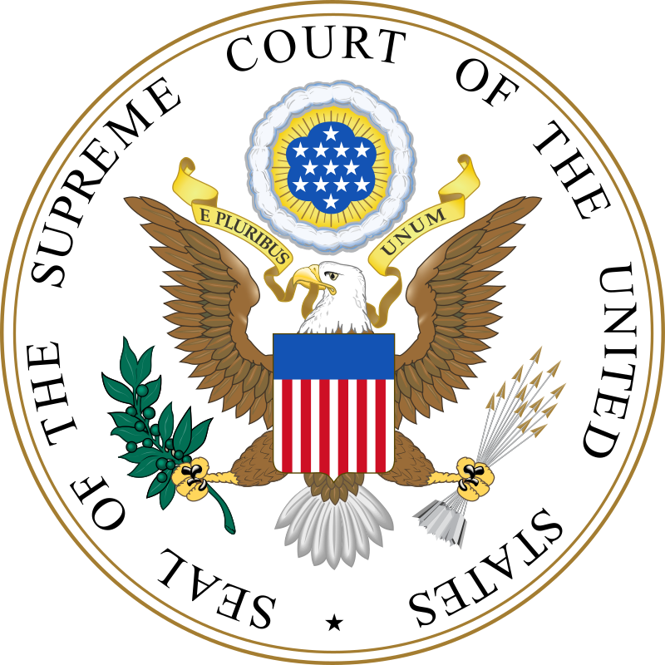
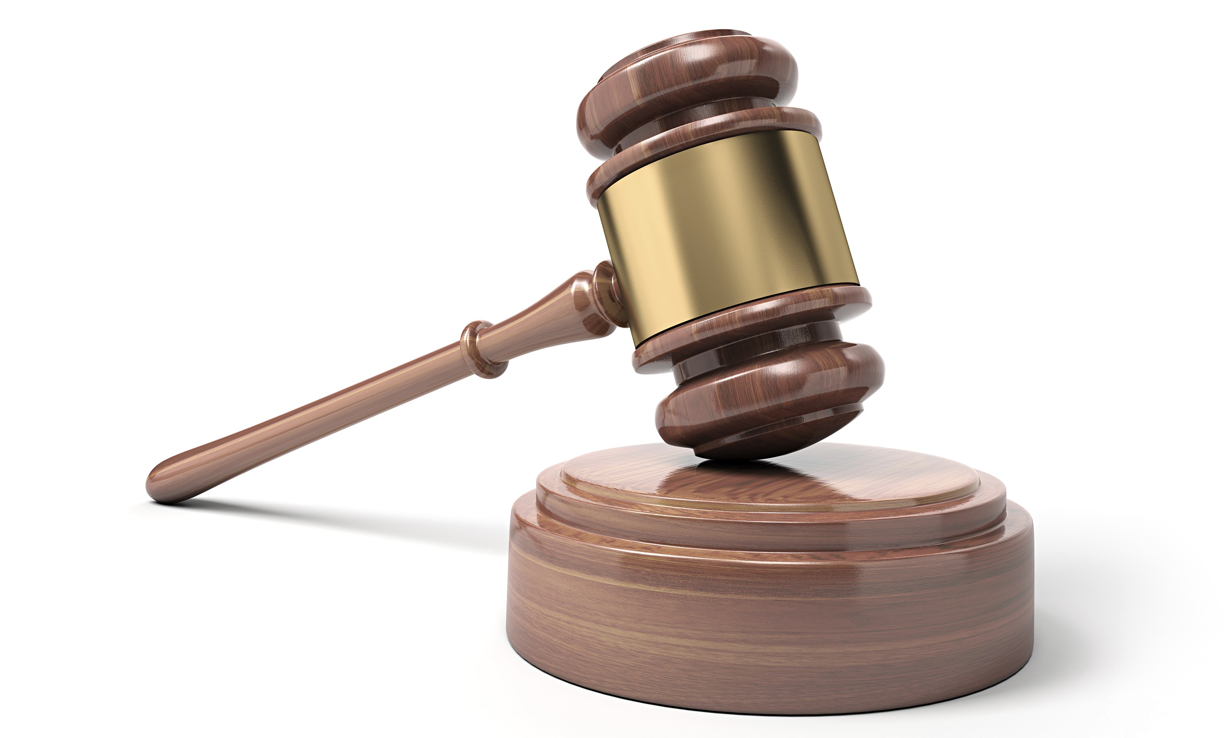
Fletcher v. Peck 1810
The case: Georgia attempted to repossess land it had sold, after evidence the land grants were only possible because of bribery.
The ruling: The state could not repossess the land grants, because the contracts selling them were constitutionally protected.
The importance: The Supreme Court had ruled a state law unconstitutional for the first time, and protected landowners’ rights.

Slide 25
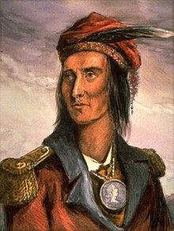
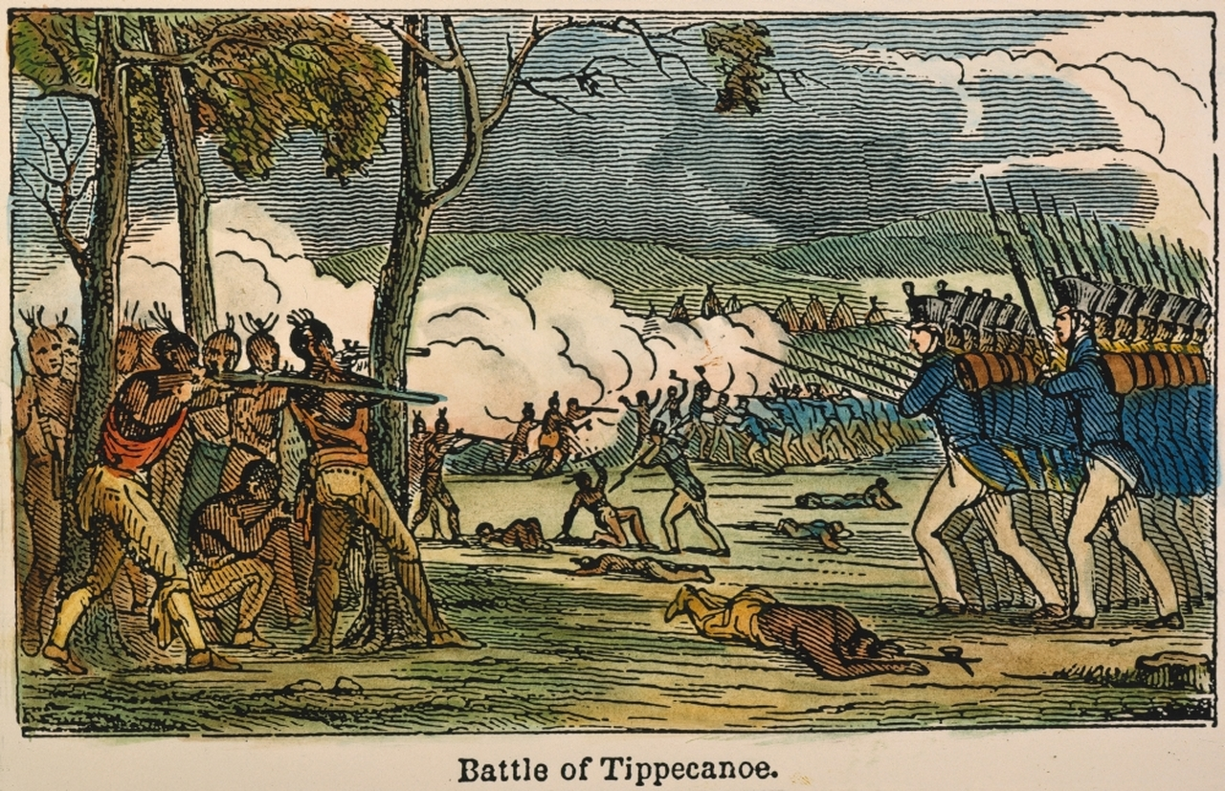
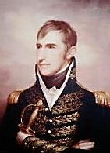
Battles of Tippecanoe (1811)
-Tecumseh, leader of the Shawnee, and his brother The Prophet attempted to unite the Eastern tribes against American settlement. They received limited British aid.
General William Henry Harrison defeated Tecumseh at Tippecanoe Creek, Indiana Territory.
Tecumseh was later killed at the Battle of the Thames River, during the war of 1812.

Slide 27
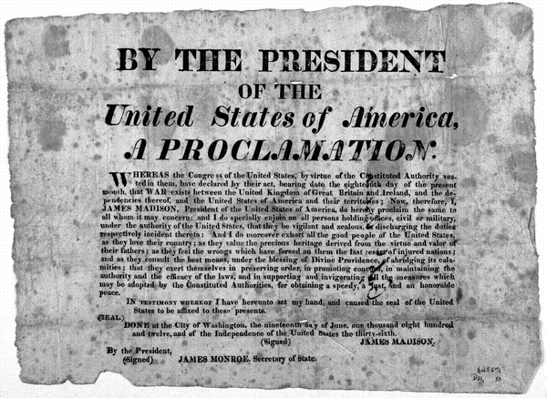
US declares war in Great Britain in 1812 due to pressure from the “War Hawks” in Congress
War goals: 1. End British impressment of US sailors
2. Conquer Canada

Slide 28
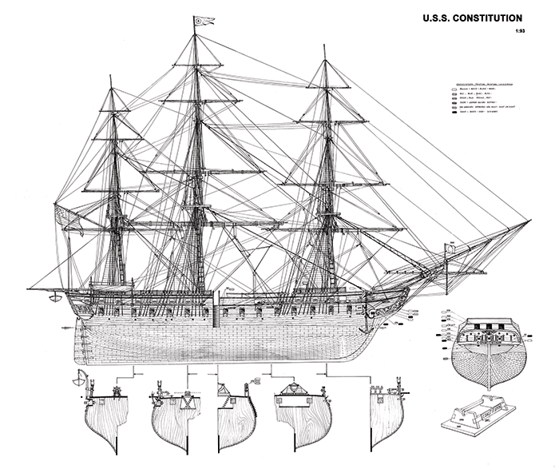
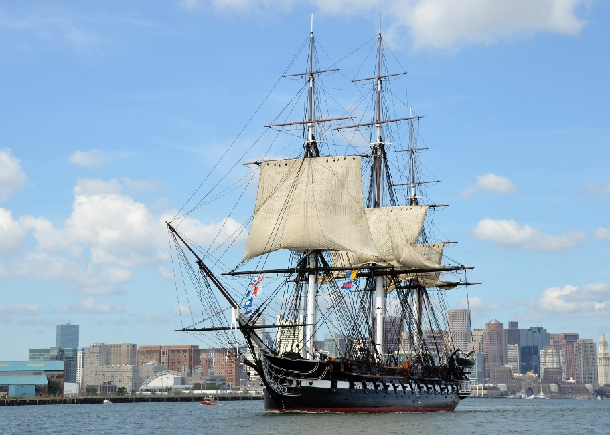
American Super Frigates
36-44 gun ships designed to be strong enough to defeat enemy frigates, or fast enough to get away from enemy ships-of-the-line.
USS Chesapeake – Gosport, VA
USS Constitution – Boston, MA
USS President – New York, NY
USS United States – Philadelphia, PA
USS Congress – Portsmouth, NH
USS Constellation – Baltimore, MD

Slide 29
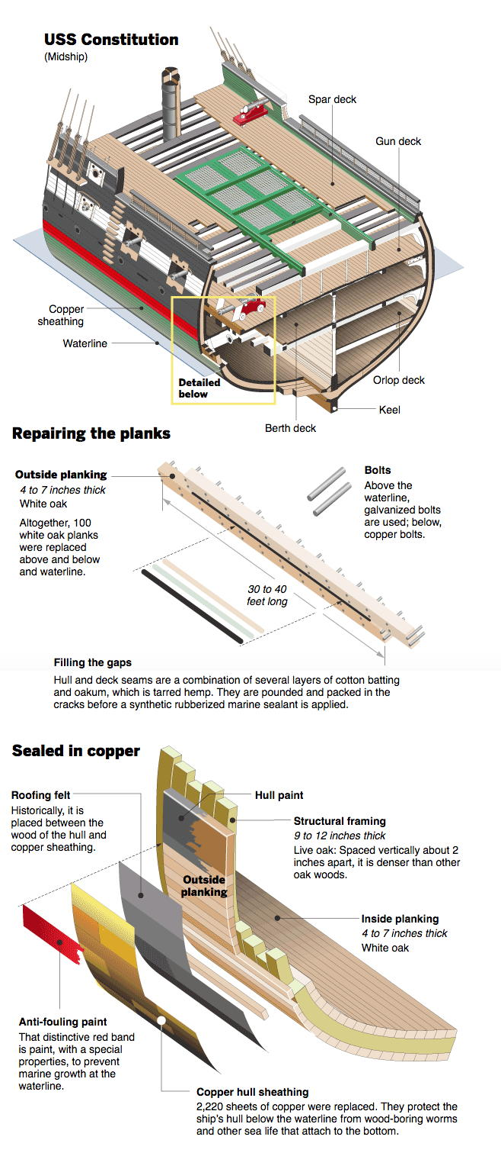
American Super Frigates

Slide 30
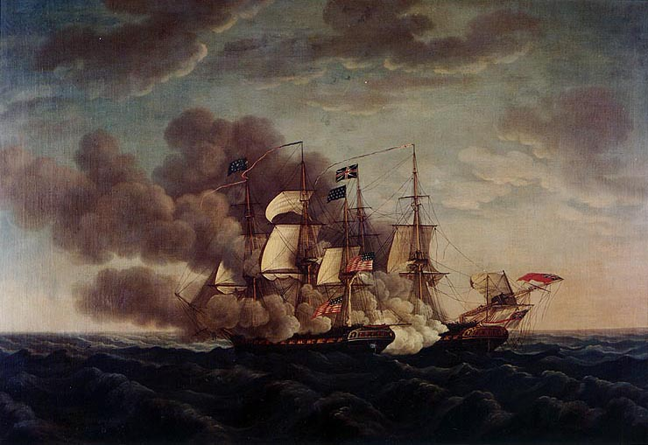
-US Navy has some success at sea (namely, USS Constitution)
USS Constitution vs. HMS Guerriere

Slide 31
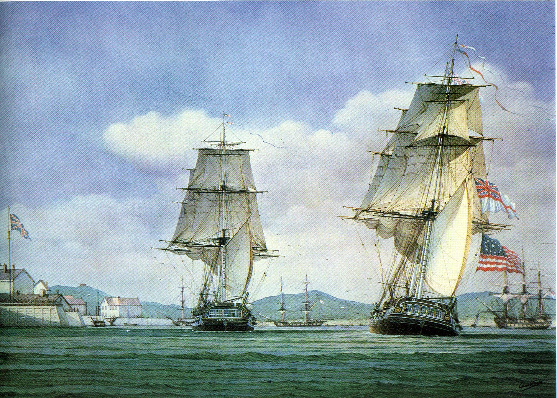
USS Chesapeake captured by HMS Shannon

Slide 32
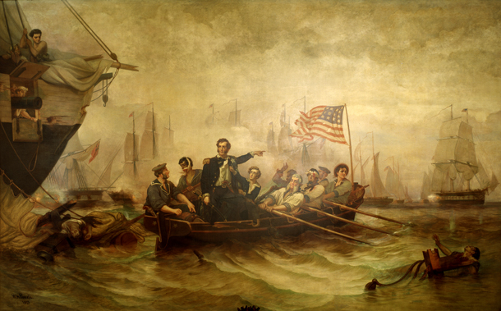
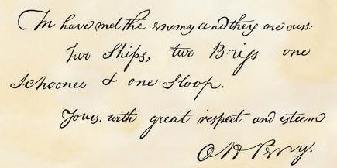
-US Navy under Oliver Hazard Perry wins Battle of Lake Erie (1813), ending British threat of invasion via the Great Lakes

Slide 33
-US Navy under Thomas Macdonough wins on Lake Champlain (1814), ending British invasion plans via Canada towards New York/New England

Slide 34
-US repeatedly invades Canada, each one fails
American victory
British victory

Slide 35
Baltimore
Washington
New Orleans
-1814: War between Britain and France ends with Napoleon exiled to Elba (and after Waterloo, St. Helena).
-British plan two new invasions of the US, centering on the Chesapeake Bay area and New Orleans.

Slide 36
-British win at Bladensburg, Maryland and march into Washington DC, burning it to the ground (1814)

Slide 38
- The British attempt to capture Baltimore fails at the Battle of Fort McHenry. Francis Scott Key wrote the Star- Spangled Banner during this battle.

Slide 39
42 ft
30 ft

Slide 40
O! say can you see by the dawn’s early light, What so proudly we hailed at the twilight’s last gleaming, Whose broad stripes and bright stars through the perilous fight, O’er the ramparts we watched, were so gallantly streaming? And the rockets’ red glare, the bombs bursting in air, Gave proof through the night that our flag was still there; O! say does that star-spangled banner yet wave, O’er the land of the free and the home of the brave??

Slide 41
On the shore dimly seen through the mists of the deep, Where the foe’s haughty host in dread silence reposes, What is that which the breeze, o’er the towering steep, As it fitfully blows, half conceals, half discloses? Now it catches the gleam of the morning’s first beam, In full glory reflected now shines in the stream: ’Tis the star-spangled banner, O! long may it wave O’er the land of the free and the home of the brave.

Slide 42
O! thus be it ever, when freemen shall stand Between their loved home and the war’s desolation. Blest with vict’ry and peace, may the Heav’n rescued land Praise the Power that hath made and preserved us a nation! Then conquer we must, when our cause it is just, And this be our motto: “In God is our trust;” And the star-spangled banner in triumph shall wave O’er the land of the free and the home of the brave!

Slide 43
THIRD VERSE – NOT SUNG SINCE WWI
And where is that band who so vauntingly swore That the havoc of war and the battle’s confusion, A home and a country, should leave us no more? Their blood has washed out their foul footsteps’ pollution. No refuge could save the hireling and slave From the terror of flight, or the gloom of the grave: And the star-spangled banner in triumph doth wave, O’er the land of the free and the home of the brave.

Slide 44
January 1815: Gen. Andrew Jackson defeats British at Battle of New Orleans
British suffer 2,400 casualties, Americans suffer 62.

Slide 45
The Hartford Convention
-New England Federalists, who were against the war, held a convention in 1815 to discuss plans
-They called for several constitutional changes designed to limit the power of Southern and Western Democratic-Republicans
-They did not call for secession from the Union
- By this time the war was over, the Federalists were cast as traitors, and the party died off shorty thereafter.

Slide 46
December 1814: Treaty of Ghent ends the war, restoring “status quo antebellum” – nothing was said about territory, impressment, or blockades (by now, a moot point)

Slide 47
Importance of the War of 1812
American patriotism at an all-time high. We feel like we won the war , or at least, we didn’t lose.
Andrew Jackson becomes a new American hero
The Federalist Party is seen as unpatriotic, and soon dies off.

Slide 48
James Monroe

Slide 49
Elected in: 1816, 1820
President from: 1817-1825
Political Party: Dem-Rep
Home State: Virginia

Slide 50
Election of 1816
Democratic-Republican: 183
President: James Monroe
Vice President: Daniel Tompkins
Federalist: 34
President: Rufus King
Vice President: John Howard

Slide 51
Election of 1820
Democratic-Republican: 231
President: (i) James Monroe
Vice President: Daniel Tompkins

Slide 52
New States
20. Mississippi
21. Illinois
22. Alabama
23. Maine
24. Missouri

Slide 53
“The Era of Good Feelings” – Only one political party is left (The Dem-Reps) since the Federalist lost all support after their opposition to the War of 1812.

Slide 54
Border Treaties with Great Britain
Rush-Bagot Agreement (1817): Limited naval forces on the Great Lakes, later extended to limiting fortifications.
Treaty of 1818: Set the US-Canada border at 49° North, and agreed to the joint occupation of the Oregon territory

Slide 55
Florida Campaign (1818):
-General Andrew Jackson invades Florida to stop escaping slaves and Seminole warrior attacks.
-Jackson also captures multiple towns and hangs several “enemies”, angering Spain

Slide 56
Border Treaties with Spain
Adams-Onís Treaty (1819): Western border with Spanish Mexico is delineated, US pays $5 million in damages and gives up claims to Texas, Florida given to the US.

Slide 57
Monroe Doctrine (1823)
- European nations were thinking of retaking former colonies in Latin America and recolonizing. Russian colonies in Alaska also worried the US.
-US announces it will no longer allow any further colonization or “meddling” in the Western Hemisphere
-This was supported by the
British, who had a navy to
back it up.
-Remained American policy
until the 21st century.

Slide 58
Missouri Compromise (1820)
Missouri wants to become a state with slavery, but this would upset the balance of free/slave states in the Senate (at the time, 11 states each).
It also could set a precedent, allowing slavery in the Louisiana Purchase territory.

Slide 59
Missouri Compromise (1820)
-Missouri becomes a slave state and Maine becomes a free state (a pattern that will continue for nearly 30 years)
-Slavery is banned in any territory north of 36’ 30”° N, except Missouri itself.
Henry Clay
“The Great Compromiser”

Slide 61
McCulloch v. Maryland 1819
The case: Maryland attempted to tax the earnings of the Bank of the United States.
The ruling: A state can’t tax Federal institutions, as “the power to tax is the power to destroy.”
The importance: Settled the issue of the constitutionality of the Bank of the US, as the Supreme Court ruled creating the Bank was an “implied” power of the US government.

Slide 62
Dartmouth v. Woodward 1819
The case: The New Hampshire legislature passed a law turning Dartmouth from a private institution to a public university.
The ruling: The Court ruled the NH law as unconstitutional, as Dartmouth already had
a legally-binding charter (given by Royal
Governor Wentworth in 1769).
The importance: The Supreme Court protected
legal contracts and charters by ruling they
could not be altered by a state.

Slide 63
Gibbons v. Ogden 1821
The case: New York granted monopolies for steamboats on all waters in the state, which interfered with shipping companies authorized by Congress crossing the Hudson from New Jersey.
The ruling: The New York-granted monopolies were unconstitutional.
The importance: Established the Federal government’s authority to regulate interstate trade and commerce.

Slide 64
John Quincy Adams

Slide 65
Elected in: 1824
President from: 1825-1829
Political Party: Dem-Rep
Home State: Massachusetts

Slide 66
Election of 1824
Democratic-Republican: 84
President: John Quincy Adams
Democratic-Republican: 99
President: Andrew Jackson
Democratic-Republican: 41
President: William Crawford
Democratic-Republican: 37
President: Henry Clay

Slide 67
New States
None

Slide 68
The “Corrupt Bargain”
No candidate won a majority of the Electoral College in 1824, so the House of Rep. decided the presidency
Henry Clay supported Adams, allowing Adams to win. Adams then made Clay the Secretary of State.
Jackson accused Clay and Adams of a “Corrupt Bargain” and vowed to get revenge in 1828.

Slide 69
Erie Canal opens, opening the Upper Midwest/Great Lakes to settlement through New York City

