Slide 1
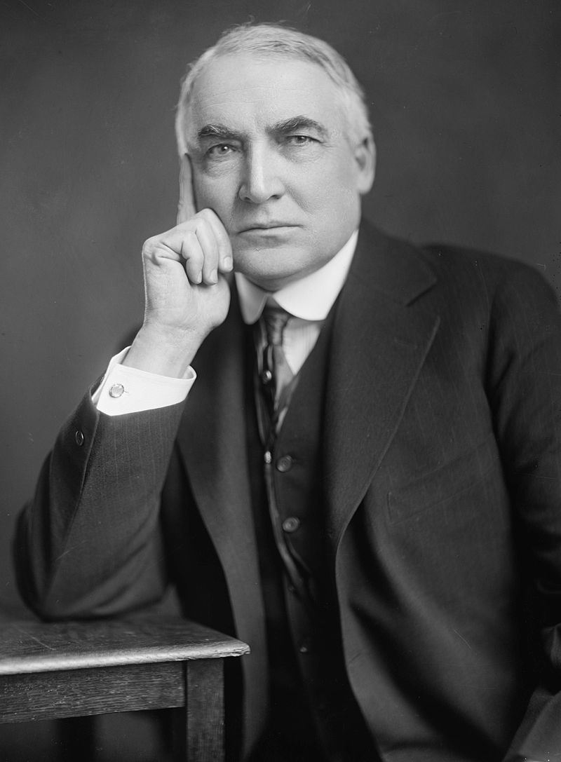
Warren G. Harding

Slide 2
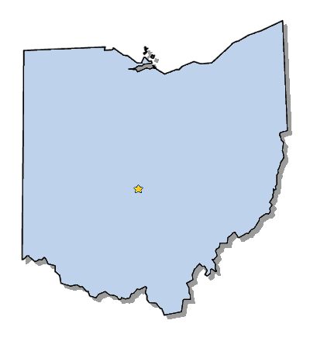
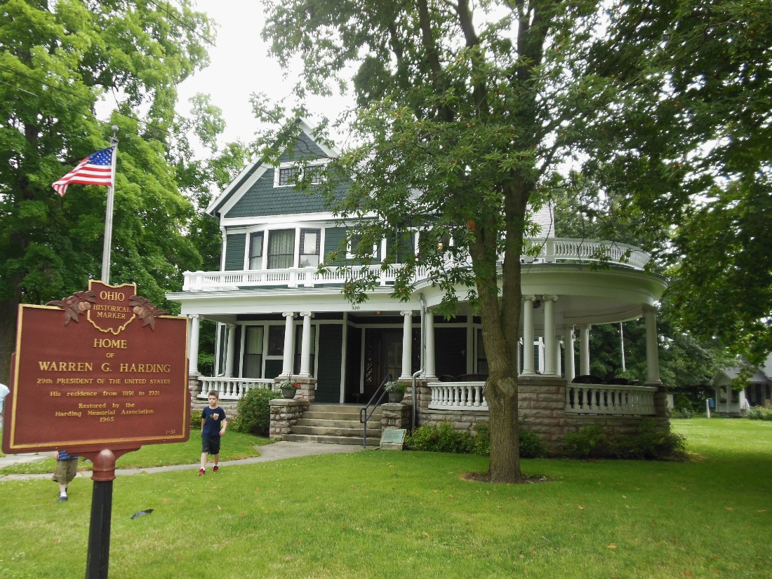
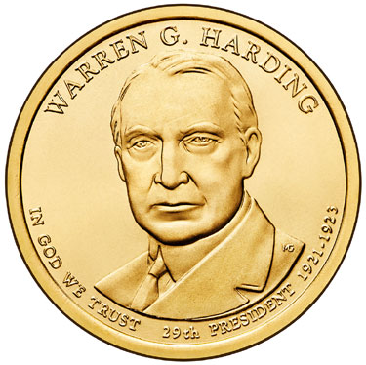
Elected in: 1920
President from: 1921-1923
Political Party: Republican
Home State: Ohio

Slide 3
New States
None

Slide 4
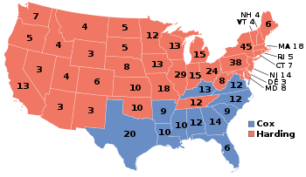
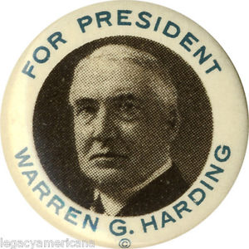
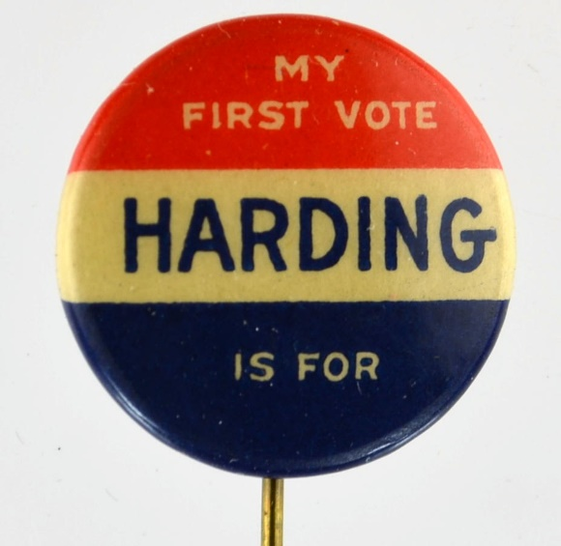
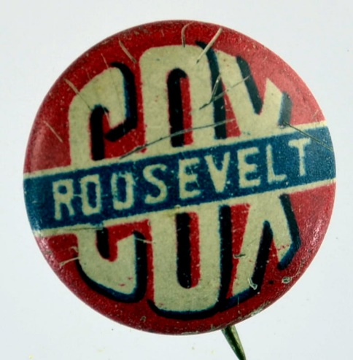
Election of 1920
Republican: 404
President: Warren G. Harding
Vice President: Calvin Coolidge
Democratic: 127
President: James Cox
Vice President: Franklin Roosevelt

Slide 5
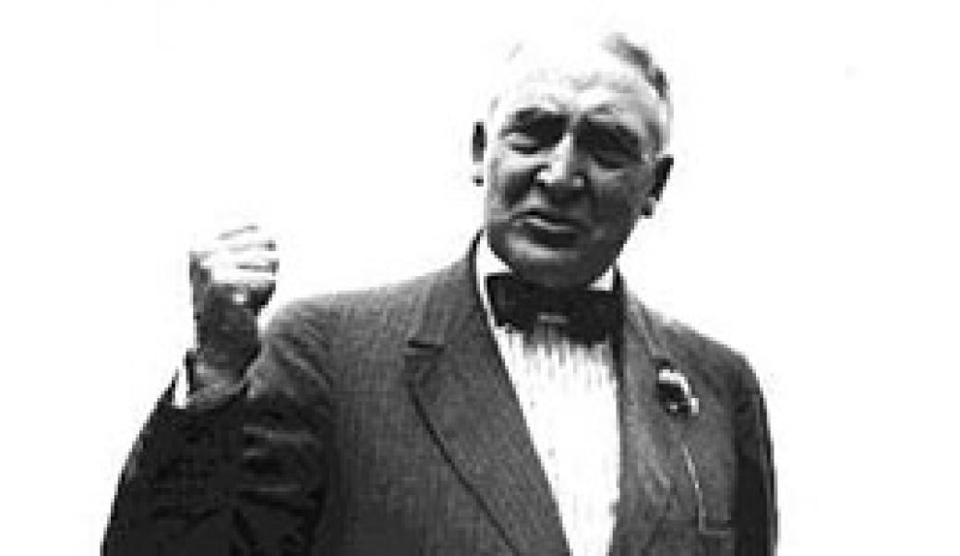
“Gamalielese”
"Progression is not proclamation nor palaver. It is not pretense nor play on prejudice. It is not of personal pronouns nor perennial pronouncement. It is not the perturbation of a people passion-wrought, nor a promise proposed. Progression is everlastingly lifting the standards that marked the end of the world's march yesterday and planting them on new and advanced heights today.“ – Warren G. Harding
“He writes the worst English that I have ever encountered. It reminds me of a string of wet sponges; it reminds me of tattered washing on the line; it reminds me of stale bean soup, of college yells, of dogs barking idiotically through endless nights. It is so bad that a sort of grandeur creeps into it. It drags itself out of the dark abysm of pish, and crawls insanely up the topmost pinnacle of posh. It is rumble and bumble. It is flap and doodle. It is balder and dash.” – H. L. Mencken
“America's present need is not heroics, but healing; not nostrums, but normalcy; not revolution, but restoration; not agitation, but adjustment; not surgery, but serenity; not the dramatic, but the dispassionate; not experiment, but equipoise; not submergence in internationality, but sustainment in triumphant nationality.” – Warren G Harding

Slide 6
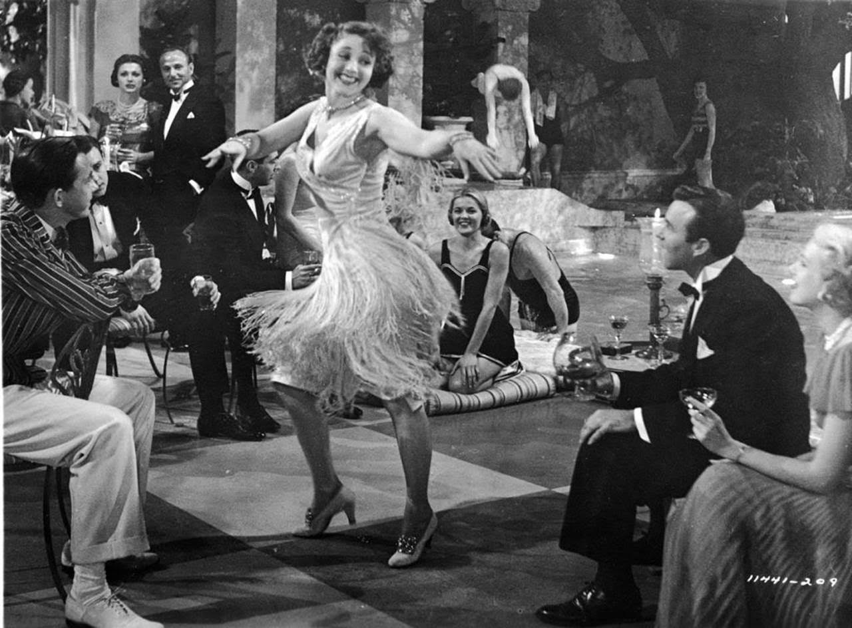

Slide 7
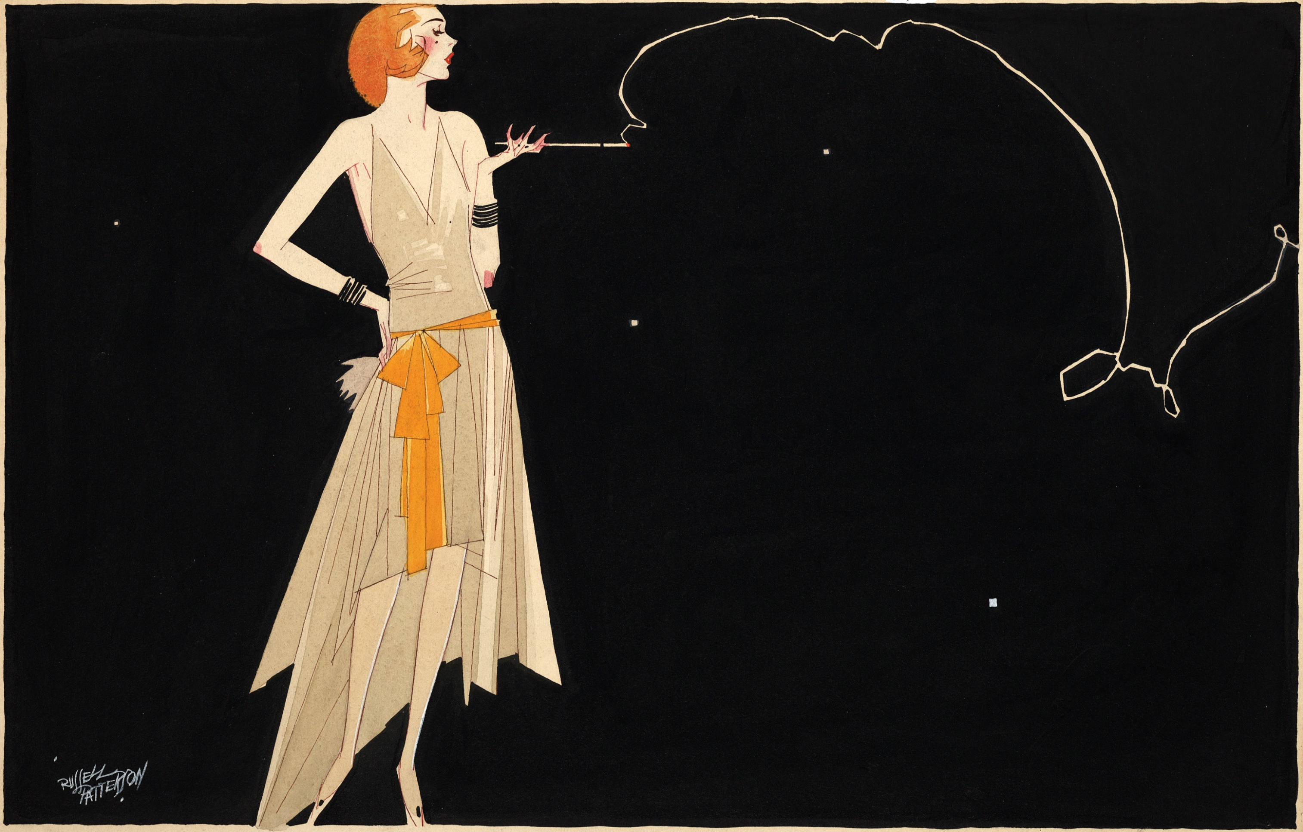
The Roaring Twenties
Called “Roaring” because of the exuberant, freewheeling popular culture of the decade.
The Roaring Twenties was a
time when many people defied Prohibition, indulged in new styles of dancing and dressing, and rejected many traditional moral standards.

Slide 8
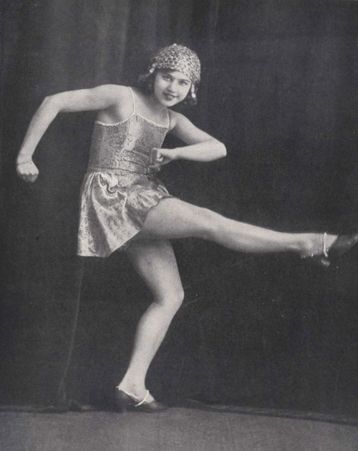
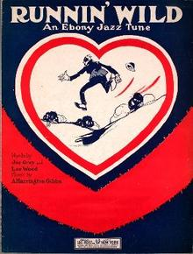
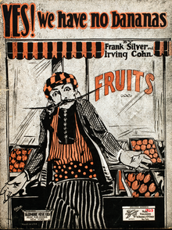
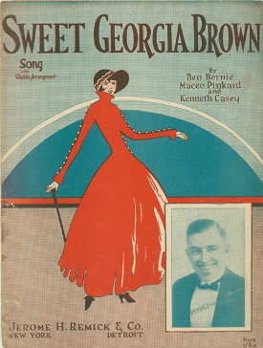
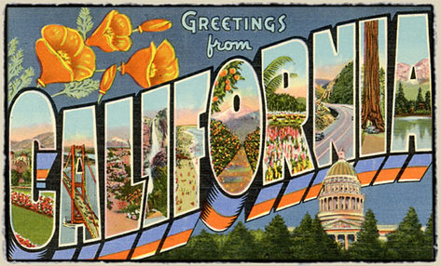
The Charleston
Runnin’ Wild
Yes, We Have No Bananas
Sweet Georgia Brown
Rhapsody in Blue
California Here I Come

Slide 9
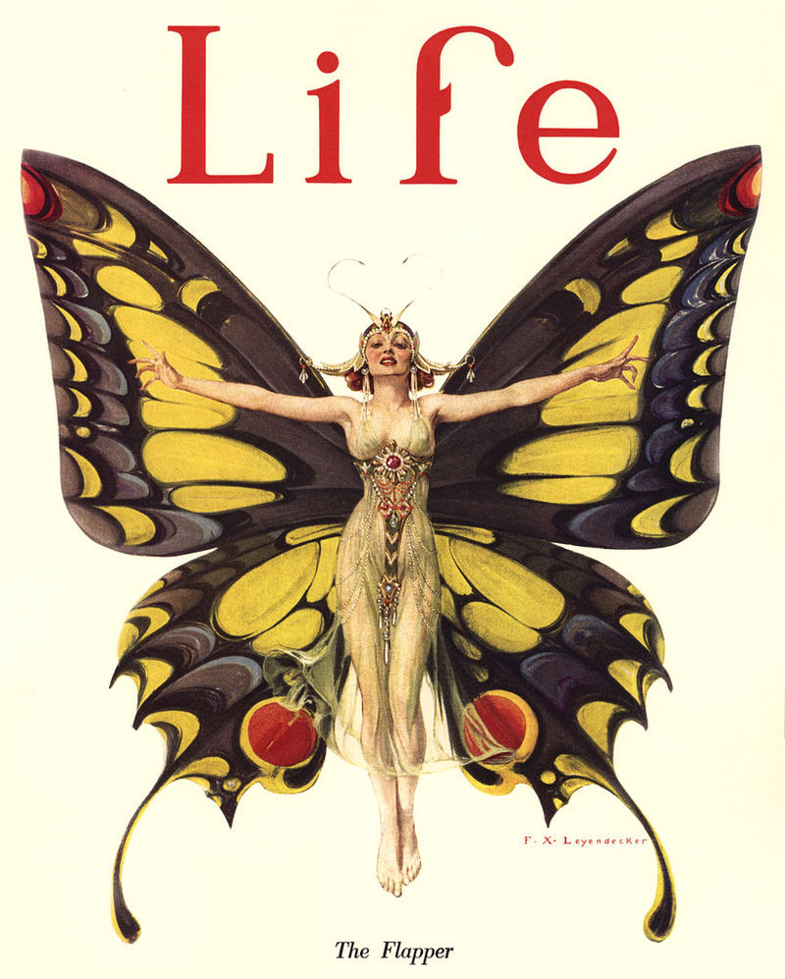
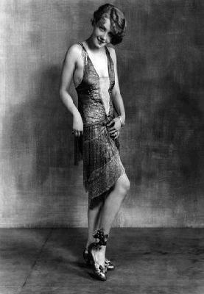
Flappers: Women who wore short skirts, bobbed their hair, listened to jazz, and broke other social rules (smoking, drinking, makeup, sex, etc)

Slide 10
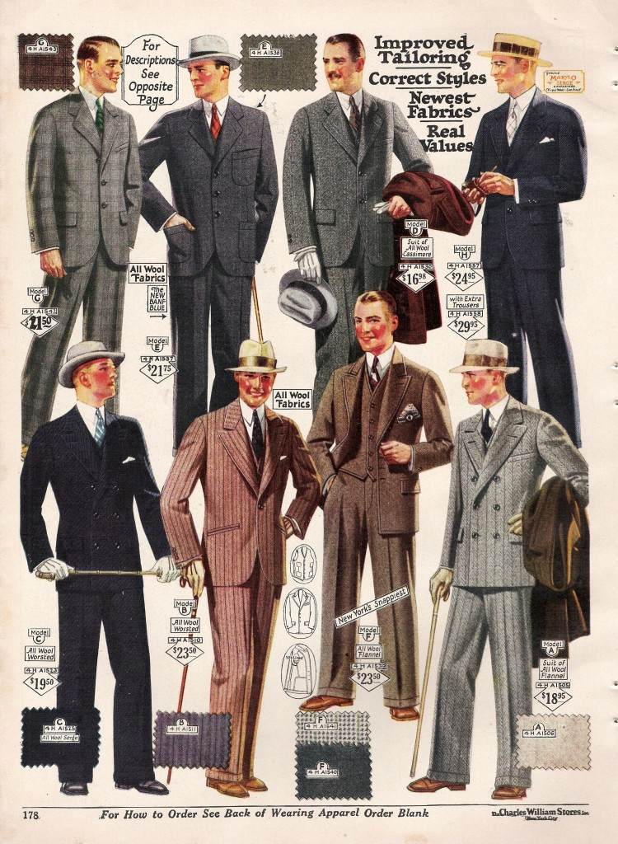

Slide 11
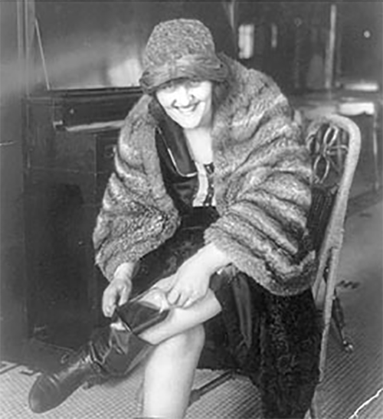
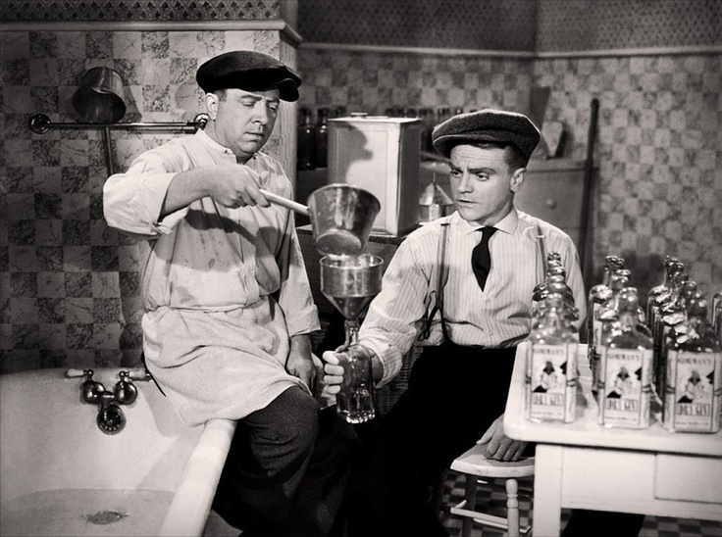
“Listen, I'm against sin. I'll kick it as long as I've got a foot, I'll fight it as long as I've got a fist, I've butt it as long as I've got a head, and I'll bite it as long as I've got a tooth. And when I'm old, fistless, footless, and toothless, I'll gum it till I go home to glory and it goes home to perdition.” – Billy Sunday
Prohibition
-In effect in the US from 1920-1933
-Although alcohol consumption dramatically fell, as did medical issues associated with alcohol, illegal smuggling and criminal activity went up (or seemed to).
“Bootleggers” – people who smuggled illegal alcohol, either from overseas and Canada, or homemade moonshine.
Bathtub gin: Homemade alcohol, often said to be made in the bathtub

Slide 12
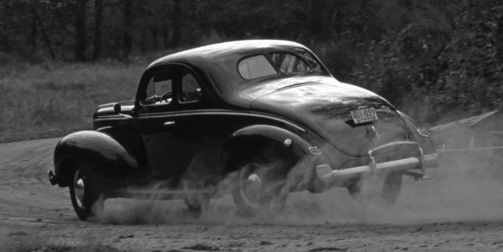
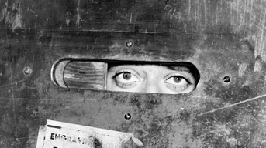
“I am certain that the good Lord never intended grapes to be made into jelly.”
-Fiorello LaGuardia, Mayor of New York
Prohibition
“Speakeasies”: Hidden, secret clubs where patrons could drink smuggled alcohol
“Rum runners”: boats used to sneak alcohol into the US
Organized crime flourished, making money by smuggling alcohol.
Mob Boss Al Capone’s crime organization made $60 million a year smuggling alcohol, but was also involved in prostitution and gambling

Slide 13
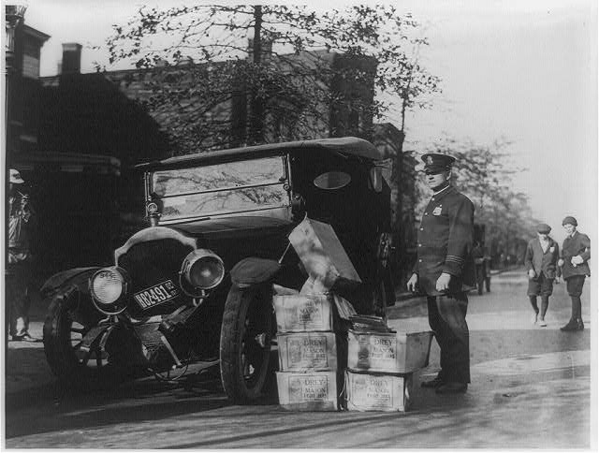
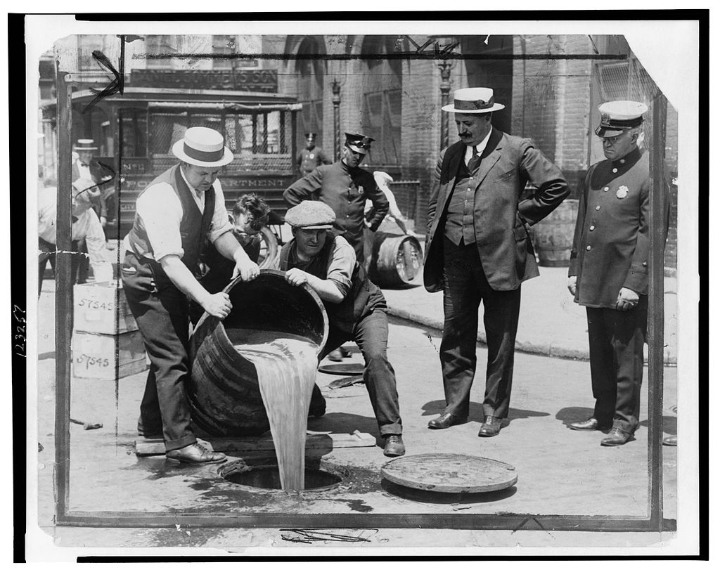
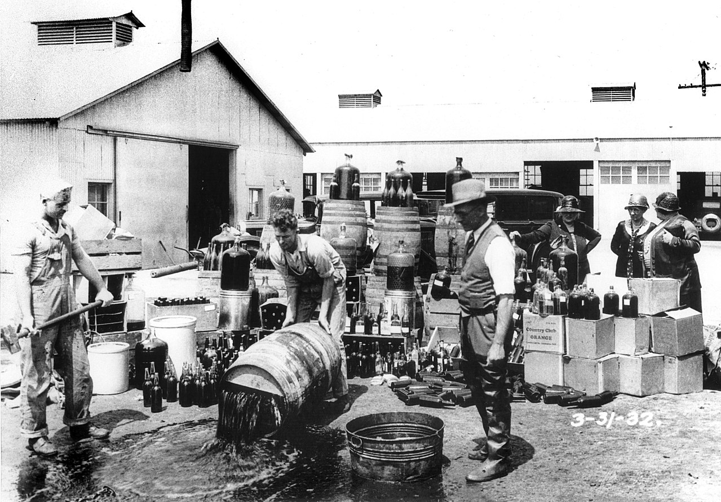

Slide 14
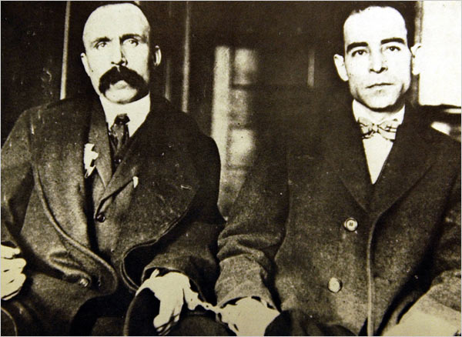
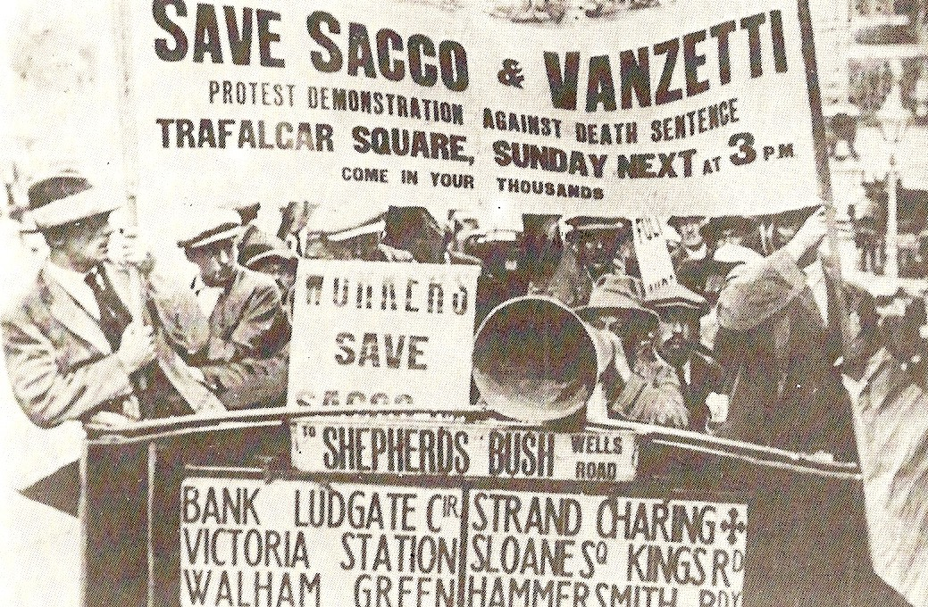
Sacco and Vanzetti
Vanzetti
Sacco
Italian-American anarchists accused of murdering two men in a robbery of a shoe factory near Boston in 1920
Found guilty in 1921 and sentenced to death
Evidence in the trial was later found to be biased, false, or misrepresented
Worldwide protests against their execution, which occurred in 1927
Were proclaimed innocent by Massachusetts Governor Dukakis in 1977

Slide 15
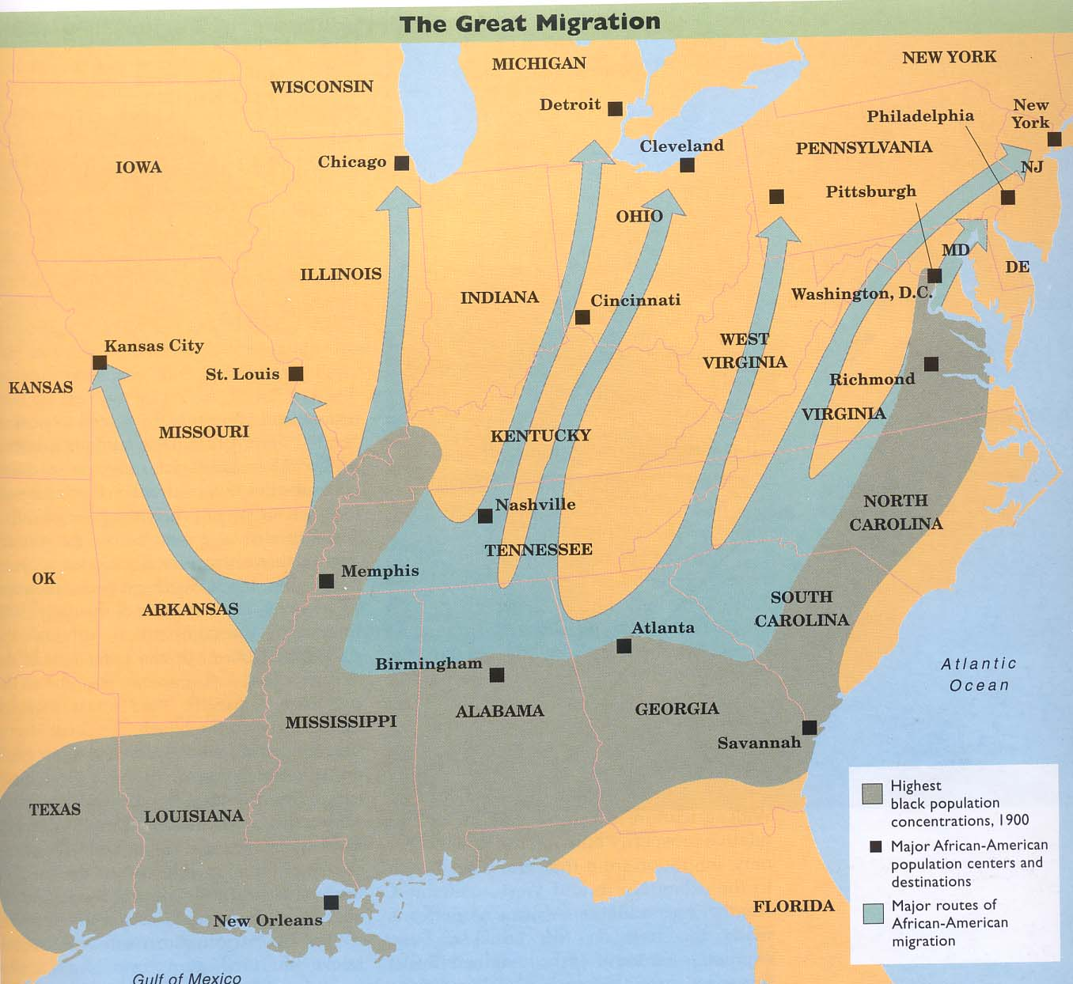
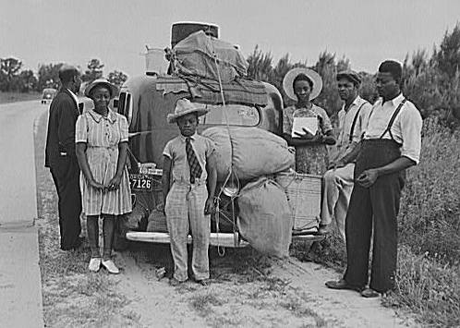
The “Great Migration”
Living conditions were poor in the South for African Americans, and discrimination & violence was rampant
Factories across the North need more workers, causing many African American families to migrate out of the South
By the end of the 1920s, over a 1.5 million people had moved out of the South for cities in the North – Detroit’s black population rose 1900% from 1910-1930
Led to racial issues in Northern cities, which also became centers of African American Culture (The Harlem Renaissance)

Slide 16
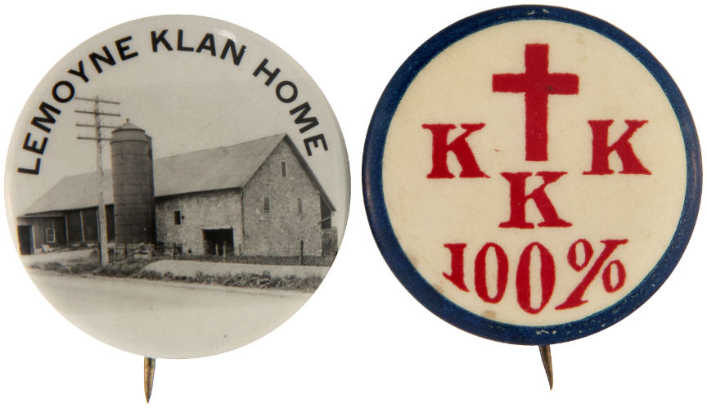
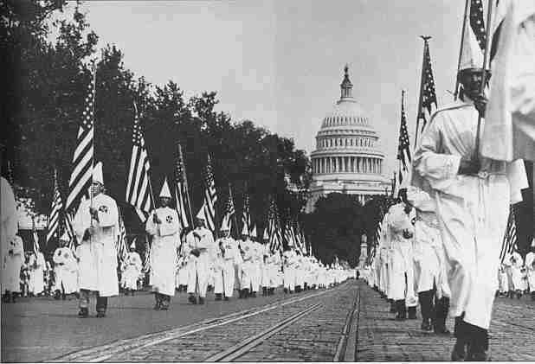
Reemergence of the KKK
After decades of dormancy in the South, the Ku Klux Klan reemerged after WWI across the entire nation, including the North
Made up almost entirely of white Protestant men
Not just against African Americans, the new Klan was also against immigrants, Jews, Catholics, and anyone else seen as “Un-American”
By the late 1920s, anti-Klan activism and education had dramatically reduced its power.

Slide 17
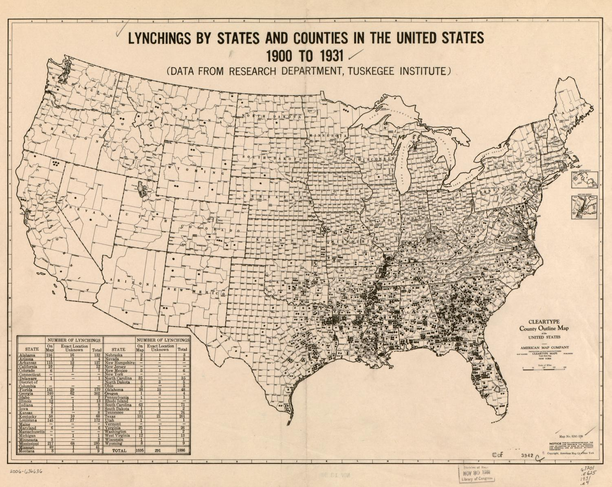
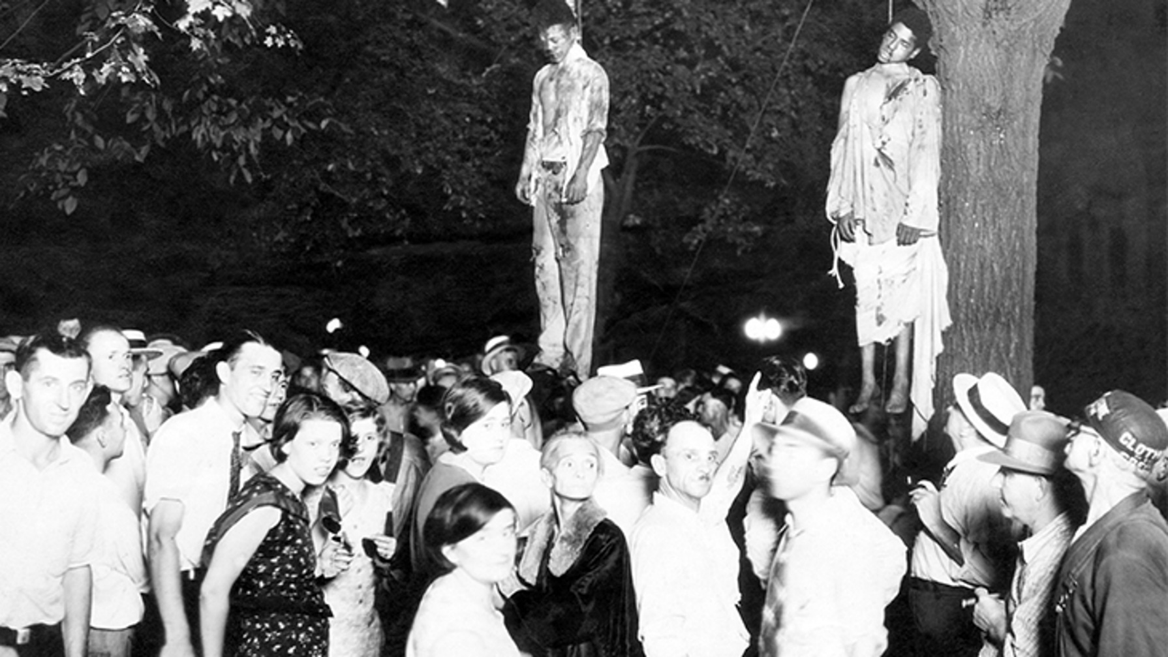

Slide 18
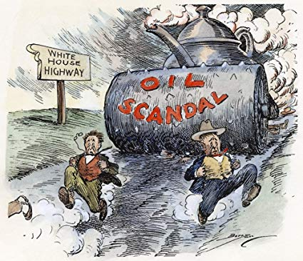
Teapot Dome Scandal
Harding’s administration was rocked by numerous scandals, including embezzling money from Veteran’s Hospitals and fraud involved German assets from WWI.
The worst was a scandal involving US Navy oil reserves in Teapot Dome, Wyoming
Interior Secretary Albert Fall was accused (later convicted) of selling off oil drilling rights for bribes and kickbacks

Slide 19
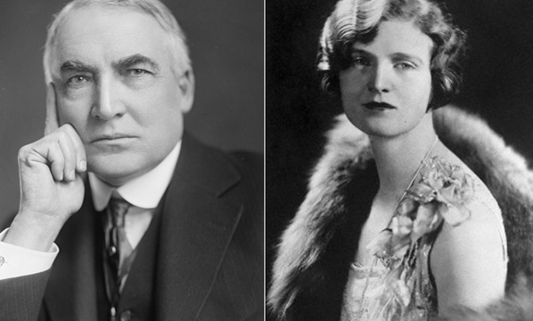

Slide 20
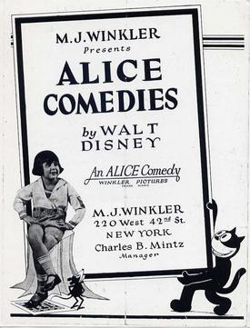
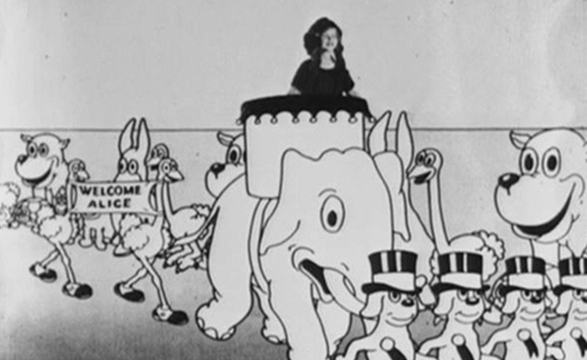
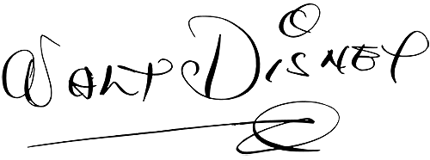

Slide 21
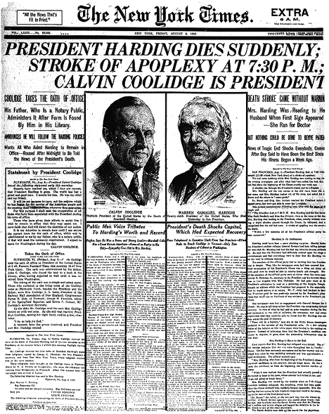
Warren Harding dies in 1923 in San Francisco of a heart attack
“They can’t hurt you now, Warren…”

Slide 22
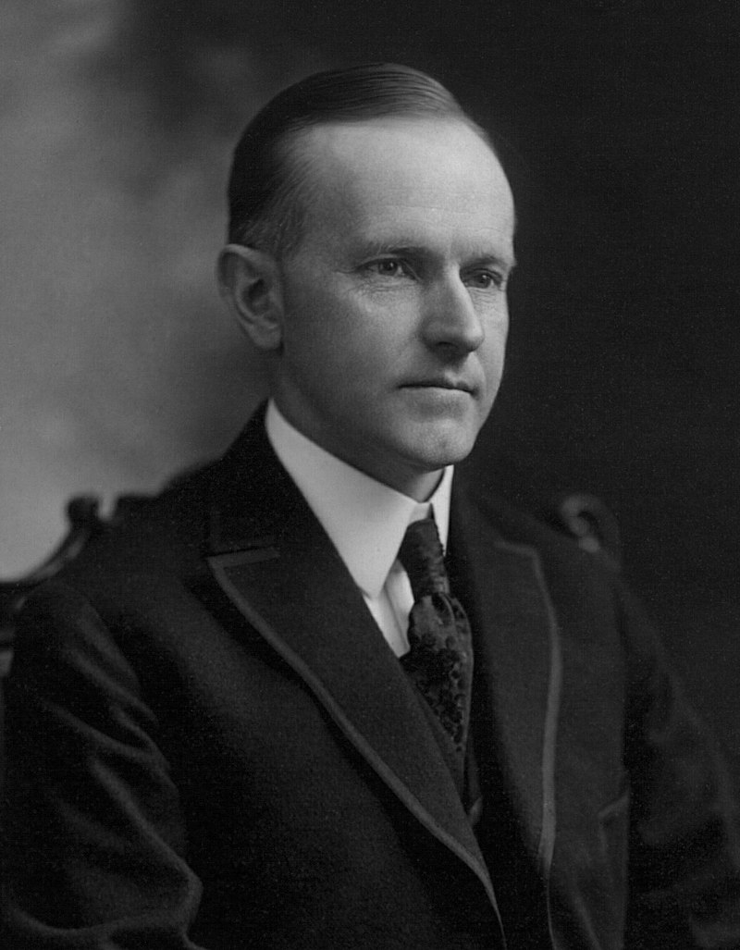
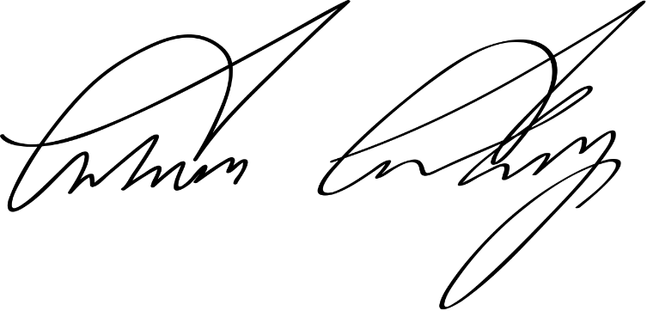
Calvin Coolidge

Slide 23
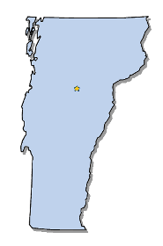
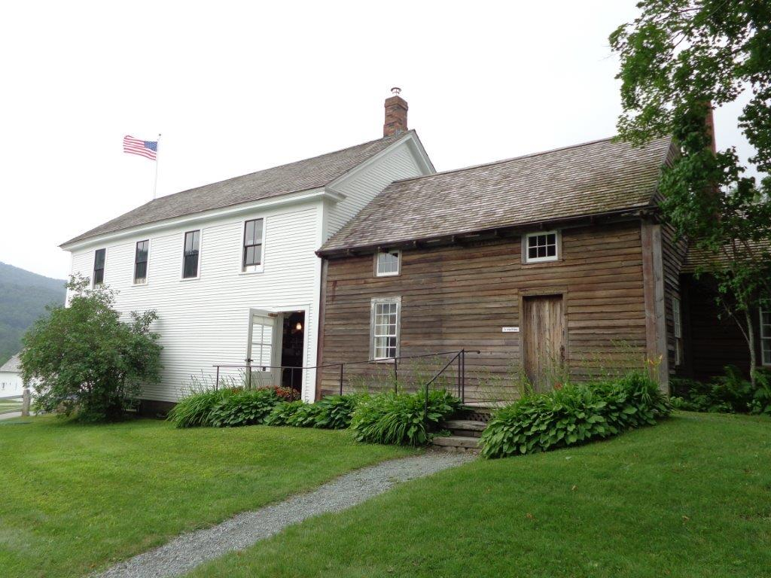
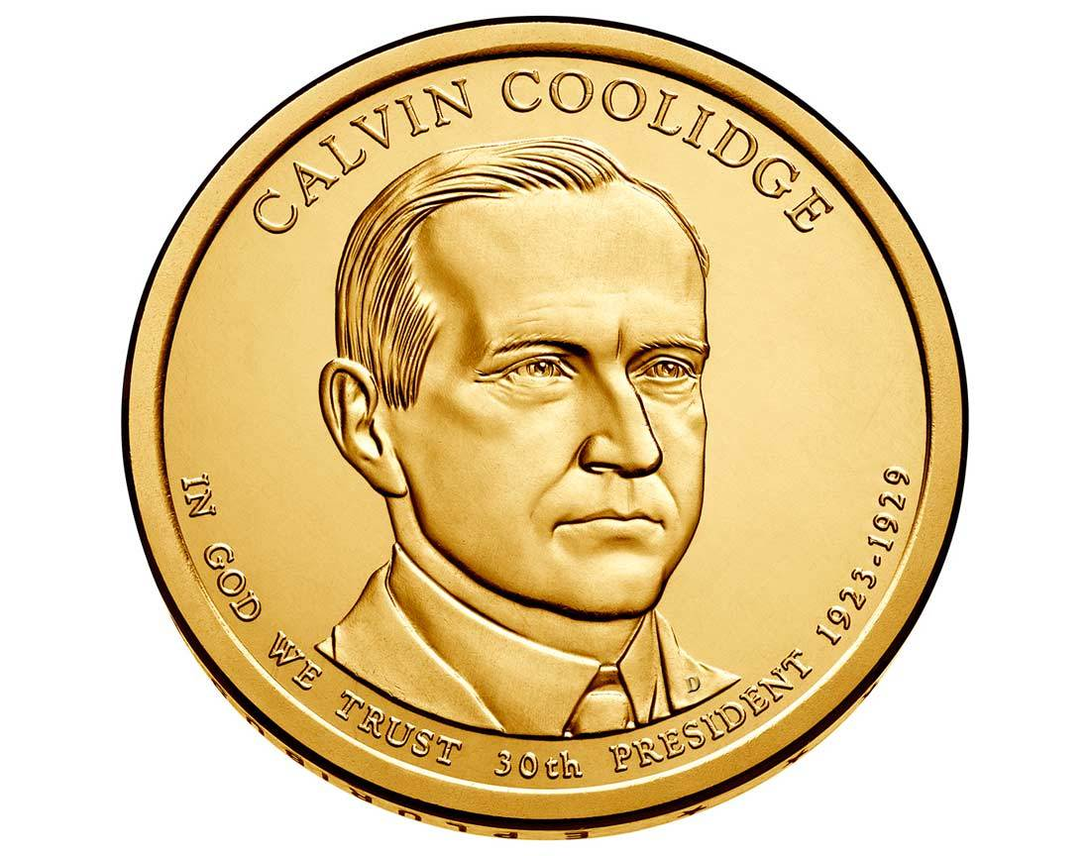
Elected in: 1924
President from: 1923-1929
Political Party: Republican
Home State: Vermont

Slide 24
New States
None

Slide 25
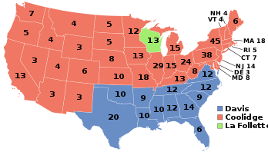
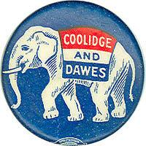
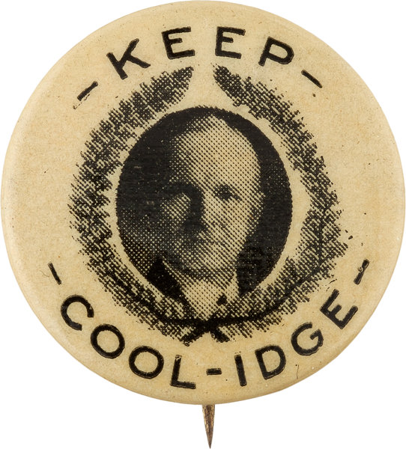
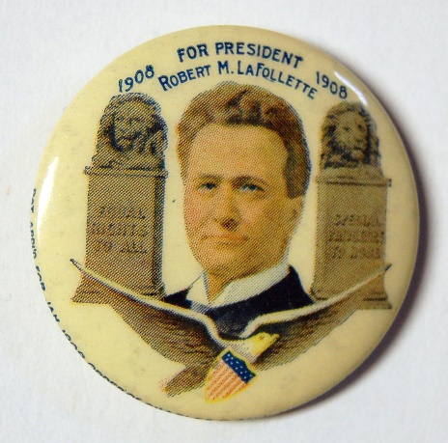
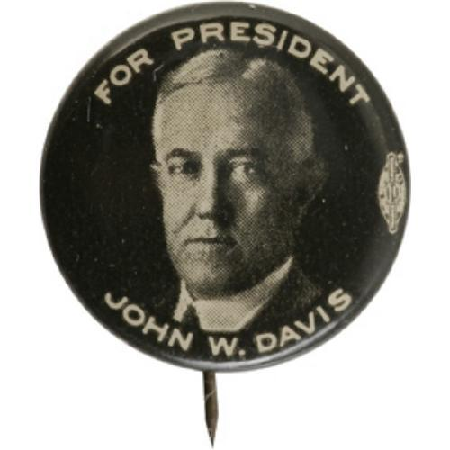
Election of 1924
Republican: 382
President: Calvin Coolidge
Vice President: Charles Dawes
Democratic: 136
President: John Davis
Vice President: Charles Bryan
Progressive: 13
President: Robert LaFollette
Vice President: Burton Wheeler

Slide 26
Coolidge Policies
Coolidge preferred lowering taxes, low government regulation, and cutting government spending.
This led to increased jobs and prosperity, but some starting being
Liked “laissez-faire” capitalism – a government hands-off approach.
Signed laws giving citizenship to Native Americans
Proposed anti-lynching laws, but was blocked by Southern Democrats
risky with their investments

Slide 27
First Presidential Radio Address

Slide 28
RADIO
Many inventors, but mostly perfected by Guglielmo Marconi
Used before World War I, but commercial broadcast didn’t begin until the 1920s.
First broadcast station was KDKA-Pittsburgh
Radio stations broadcast entertainment, news, sports, weather, and music – just like today.
First, only AM radio existed, with FM not broadcast until the late 1950s/1960s.

Slide 29
Marcus Garvey
Black activist who was in favor of “Pan-Africanism” – to connect and unify people of African descent worldwide
Believed that African-Americans should “return to Africa” and set up new nations near Liberia – and was elected President of Africa at a conference in New York
Started a shipping company to bring migrants to Africa – the Black Star Line
Believed in segregation of the races
Imprisoned for fraud in 1923
“If you want liberty you yourselves must strike the blow. If you must be free, you must become so through your own effort … Until you produce what the white man has produced you will not be his equal.”

Slide 30
The 1920s New York Yankees
-
New York Yankees “bought” baseball star George “Babe” Ruth from the Boston Red Sox in 1919.
With the addition of other legendary players like Lou Gehrig, the Yankees became a dominant team, winning the World Series 3 times in the 1920s, including the legendary 1927 championship.
The Yankees also built Yankee Stadium, the largest in the country at the time.
They still suck.

Slide 31
Charles Lindbergh
- American pilot who became the first person to fly solo across the Atlantic from New York to Paris in May 1927.

Slide 32
Mississippi River Flood of 1927
Most destructive flood in US History – 27,000 square miles covered in 30 feet of water
Displaced 630,000 people, mostly in Mississippi, Arkansas, and Louisiana
Damages exceeded $1 billion – almost $1 trillion today
Following the flood, the US Army Corps of Engineers was put in charge of flood control along the Mississippi – constructing the enormous levee and floodway system still used today.

Slide 33
Decline of Amoskeag Manufacturing
The Amoskeag Mills in Manchester, NH were the largest in the world.
In the 1920s, an economic downturn, labor unrest, and cheaper working conditions in the South led to the decline of textile mills across the North.
The mills would finally close during the Great Depression.
In 1911, Amoskeag produced 711,000,000 feet of cloth – that’s 134,659 miles, enough to reach halfway to the moon.

Slide 34
The Jazz Singer and Steamboat Willie
The Jazz Singer: 1927
The first “talkie” – a movie with sound – starring Al Jolson
Steamboat Willie: 1928
One of the first “talkie” cartoons, and the first starring Disney’s Mickey Mouse

Slide 35
I do not choose to run for President in 1928.

Slide 36
Herbert Hoover

Slide 37
Elected in: 1928
President from: 1929-1933
Political Party: Republican
Home State: Iowa

Slide 38
New States
None

Slide 39
Election of 1928
Republican: 444
President: Herbert Hoover
Vice President: Charles Curtis
Democratic: 87
President: Al Smith
Vice President: Joseph Robinson

Slide 40
Al Smith
A product of New York City’s Tammany Hall political machine
Governor of New York
First Roman Catholic to be nominated for President
Was against Prohibition
Known as “The Happy Warrior”, and always with a trademark brown derby hat and cigar
Experienced significant opposition due to his stance on Prohibition and his religion
Later helped build the Empire State Building and was honorary superintendent of the Central Park Zoo

Slide 41
Stock Market Crash

Slide 42
Stock Market Crash
Why did the Stock Market Crash?
The wild economic overexpansion “bubble” of the 1920s was not sustainable - Production had fallen, unemployment had risen
Banks had loaned out too much money to risky investments
Farmers were producing too much food, leading to oversupply and a drop in prices
Many stocks in companies were sold “on margin” – meaning they were purchased using borrowed money, relying on future gains.

Slide 43
After some initial drops, the big crash on October 29 (“Black Tuesday”) – 16 million shares traded, and billions of dollars lost.
Businesses began closing and laying off workers
Banks lost huge investments, and panicked account holders withdrew their savings.
By 1933, shares were worth only 30% of what they had been worth in 1929, half of America’s banks had failed, and unemployment was at 30%

Slide 45
Hoover’s Recovery Policy
Tried getting companies to stop laying off workers and expand
Was against Federal welfare money to the poor, worrying that people would grow too accustomed to hand outs
Had the amount of income taxes lowered
Invested in some new public works projects (like future Hoover Dam)
Limited immigration and increased deportations, especially to Mexico
He was convinced that, given enough time, and the economy would recover on its own.

Slide 46
Hawley-Smoot Tariff (1930)
A law that raised tariffs to nearly all-time highs on more than 20,000 imports
The goal was to protect American jobs
Many nations retaliated with tariffs of their own, including Canada, Great Britain, and France
The amount of Imports and exports was reduced by 50%, and historians and economists believe this made the Great Depression worse.

Slide 47
HOOVER FLAGS
HOOVER VILLE
HOOVER BLANKET

Slide 49
The Bonus Army (1932)
Thousands of World War I veterans marched on Washington DC, demanding early payment of bonus money they had been promised for their military service.
Formed camps south of the Capitol
After sporadic violence between protestors and police, Hoover sent in the US Army under General Douglas MacArthur, who cleared out the camps by force and destroyed them
At least 4 were killed and over 1000 injured

Slide 50
The Dust Bowl (1930-1936)
Due to a drought and poor farming practices, in 1930-31 crops began to fail in the Great Plains.
By 1934, over 35 million acres of land was unusable for agriculture
“Black Blizzards” of topsoil reached as far east as New York City and Washington DC
2.5 million farmers and their families abandoned their farms and migrated away – many to California.
Those from Oklahoma were known as “Okies”

Slide 51
The Dust Bowl

