Slide 1
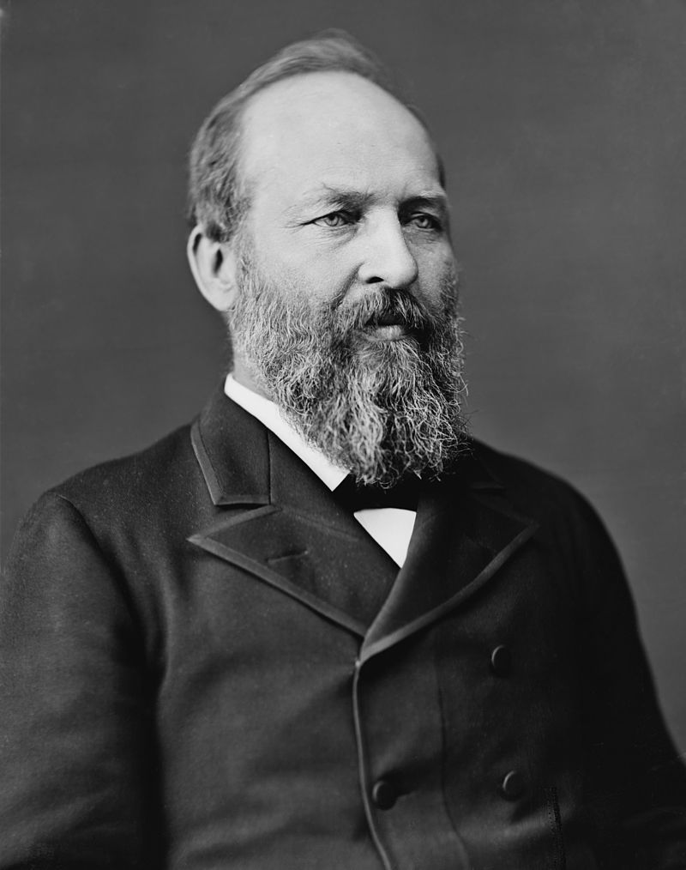
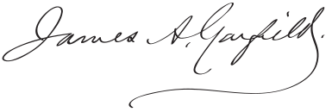
James A. Garfield

Slide 2
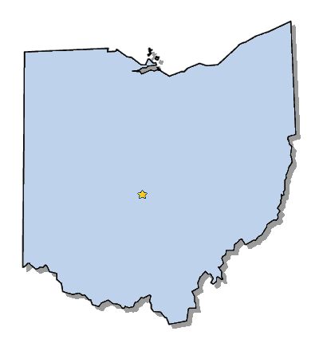
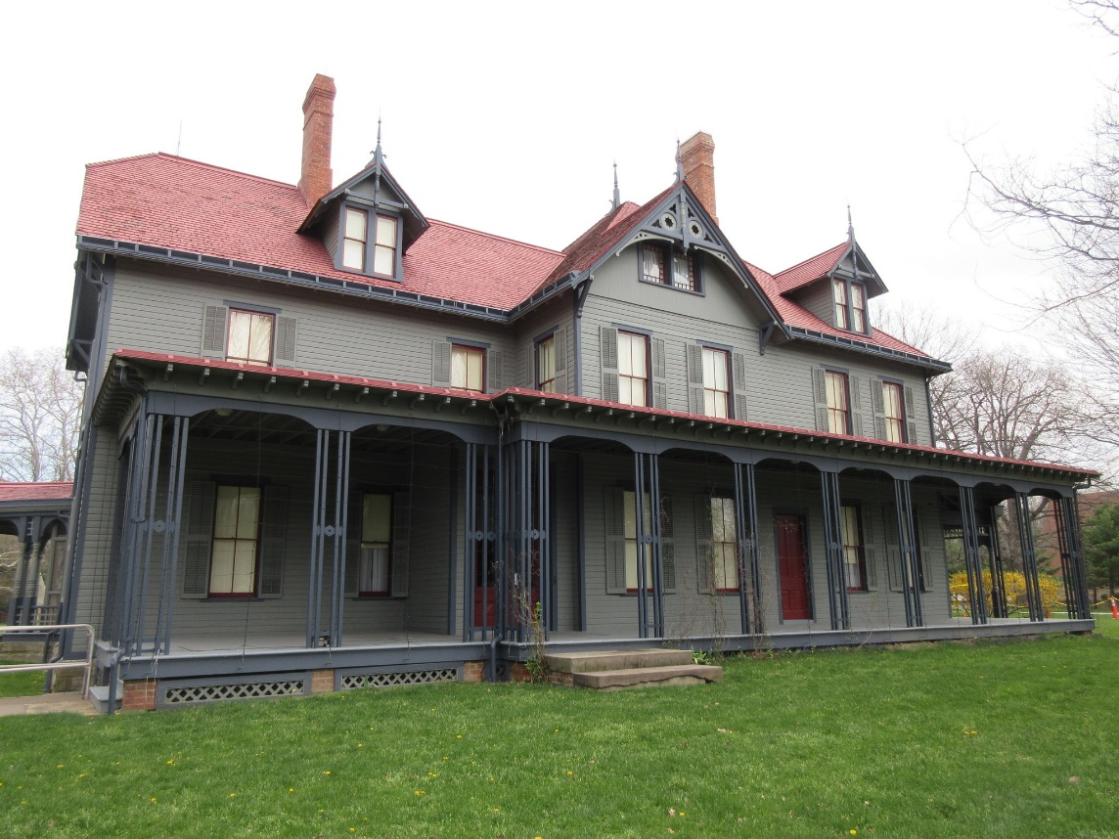
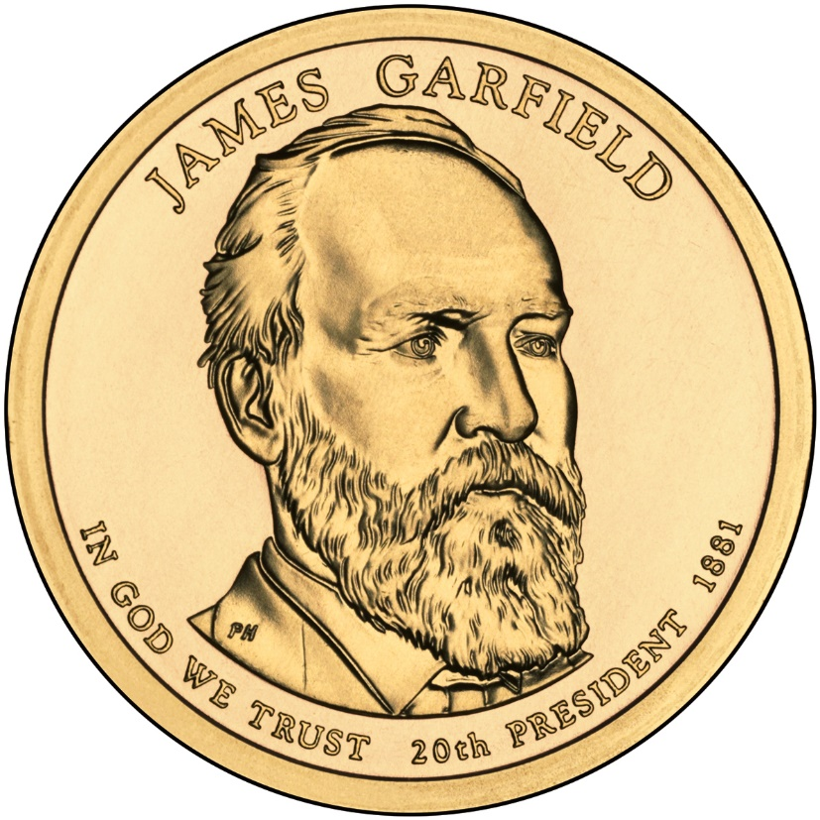
Elected in: 1880
President from: 1881
Political Party: Republican
Home State: Ohio

Slide 3
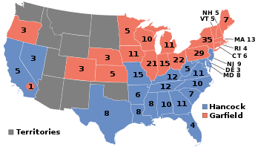
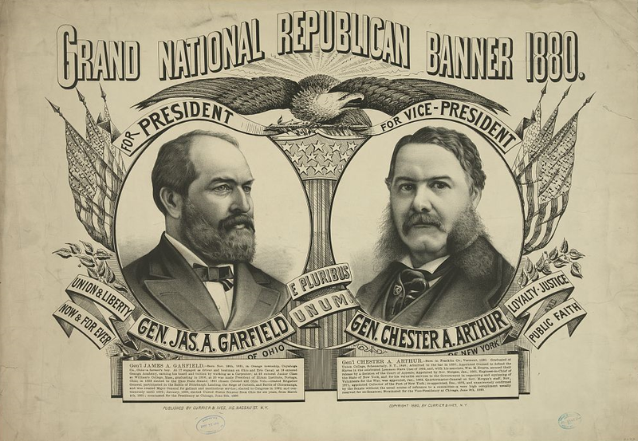
Election of 1880
Republican: 214
President: James A. Garfield
Vice President: Chester Arthur
Democratic: 155
President: Winfield S. Hancock
Vice President: William English

Slide 4
New States
None

Slide 5
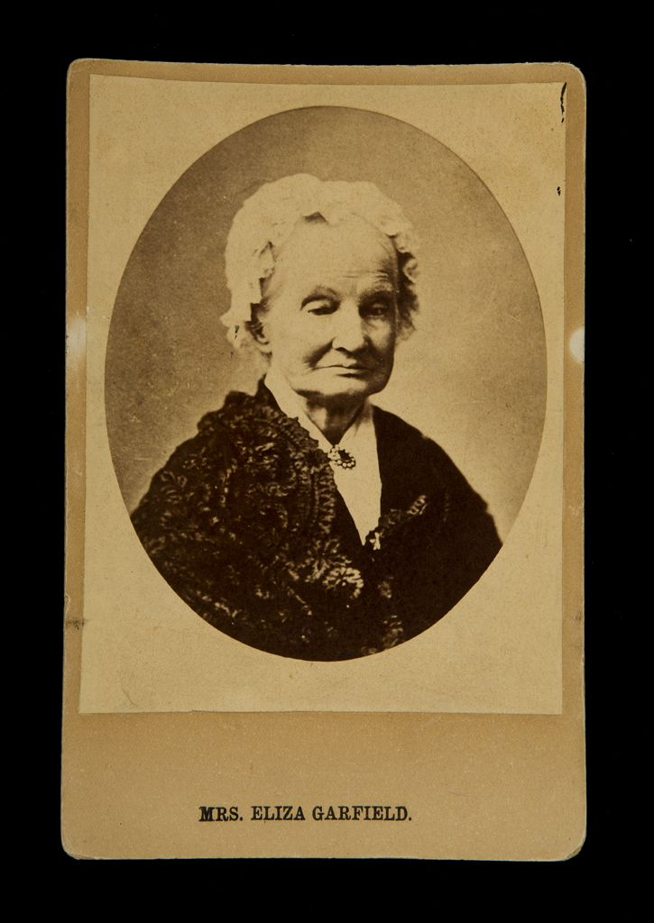
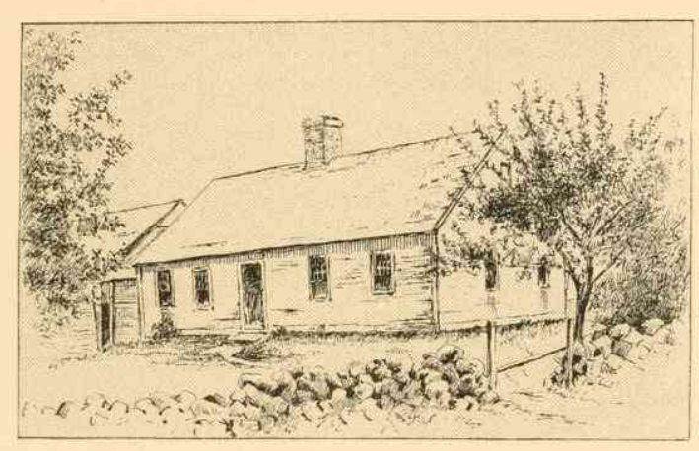
Mrs. Eliza Ballou Garfield (1801-1888)

Slide 6
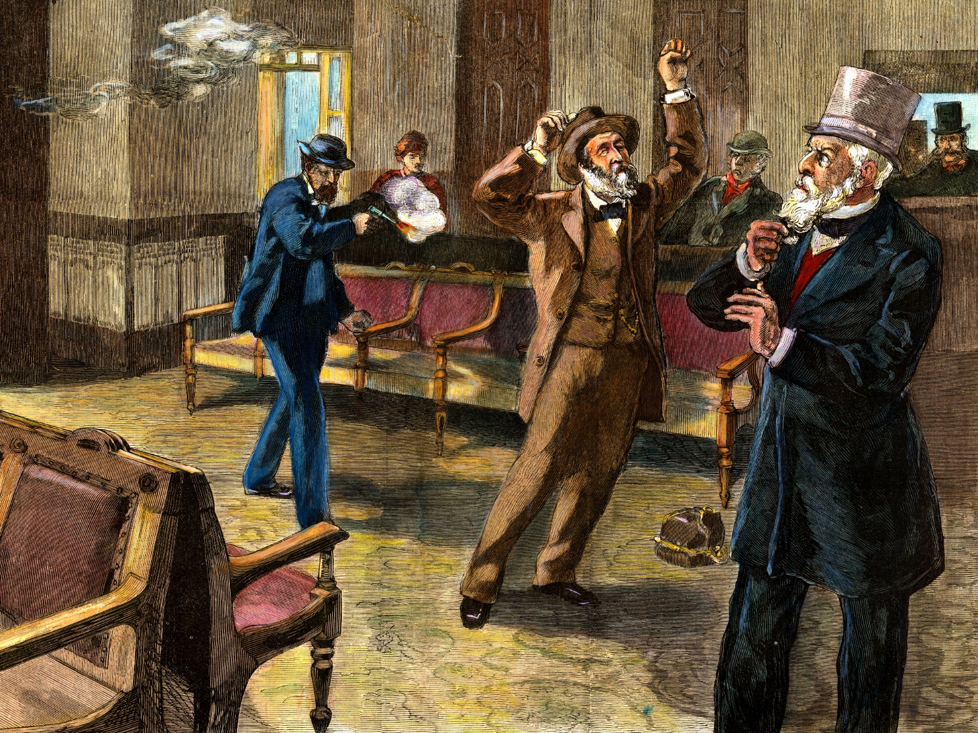
Assassination!
July 2, 1881 – Garfield shot
-President Garfield is shot by Charles Guiteau,
an insane pro-Stalwart lawyer who had
hoped to receive a political job.
Garfield dies September 19, 1881
Guiteau is hanged in June 1882, after unsuccessfully pleading not guilty by temporary insanity.

Slide 7
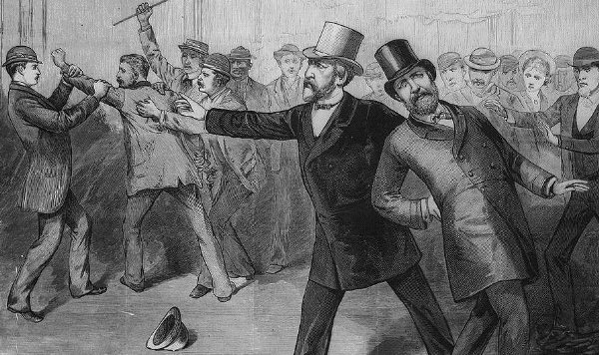
Go to https://www.smithsonianmag.com/history/garfield-assassination-altered-american-history-woefully-forgotten-today-180968319/ And answer these questions after reading the article:
1. Why did Charles Guiteau shoot President Garfield?
2. What really killed President Garfield?
3. Why did Roscoe Conkling resign from the Senate?
4. In a paragraph, tell me why (or, why not) the site of Garfield's assassination should have a historic marker.

Slide 8
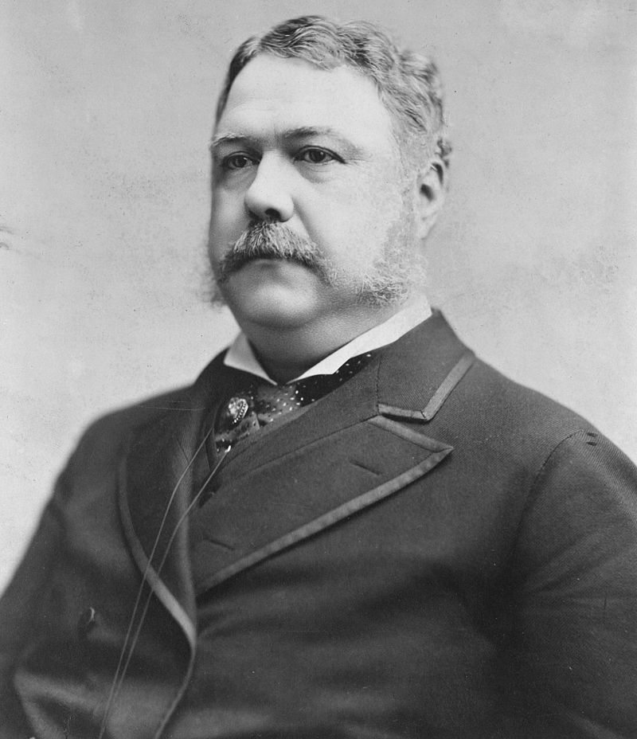
Chester A. Arthur

Slide 9
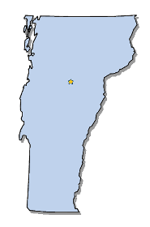
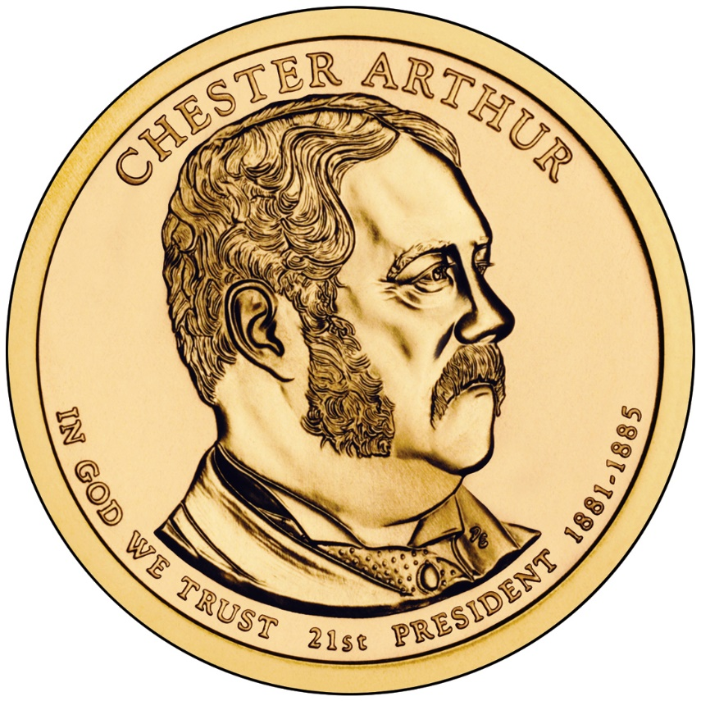
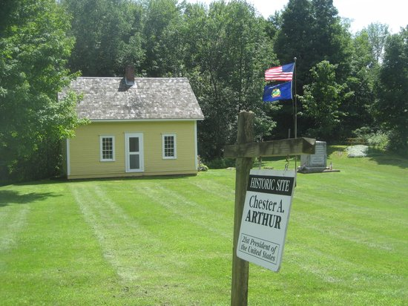
Elected in: Not elected
President from: 1881-1885
Political Party: Republican
Home State: Vermont

Slide 10
New States
None

Slide 11
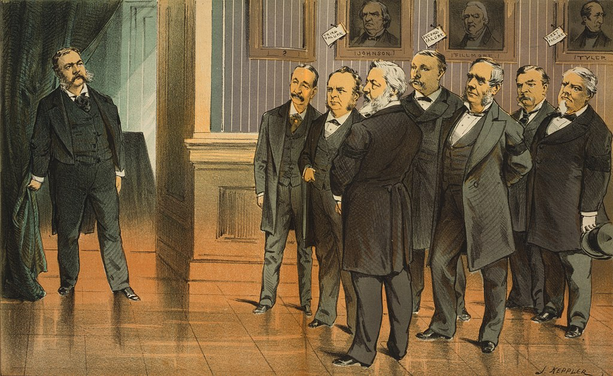

Slide 12
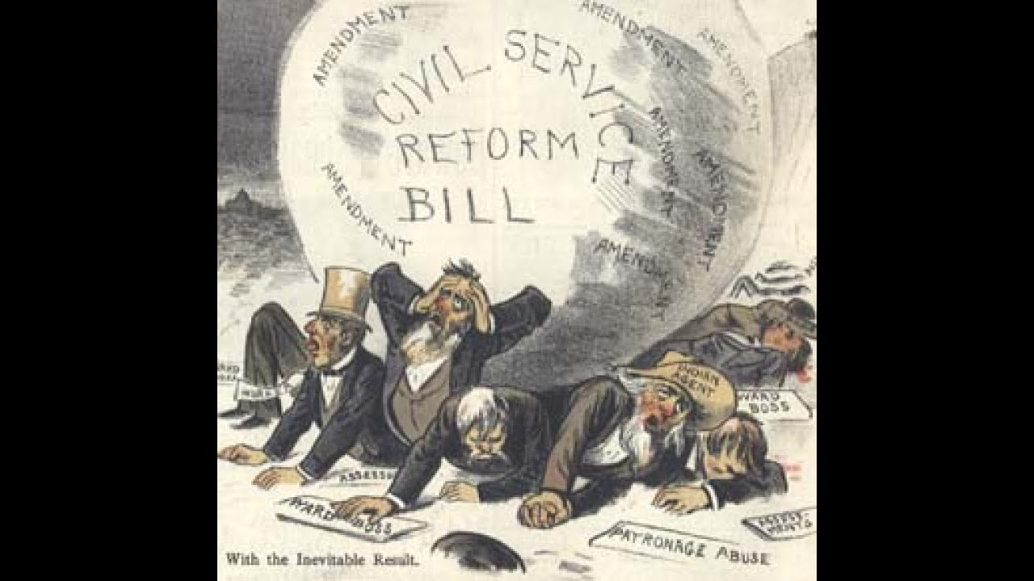
Pendleton Civil Service Reform Act - 1883
Reformed the US Government by making many government jobs should be awarded by merit, not political party affiliation.
Also made it illegal to fire government workers for political reasons
Arthur stunned Washington by signing it, earning the wrath of machine politicians

Slide 13
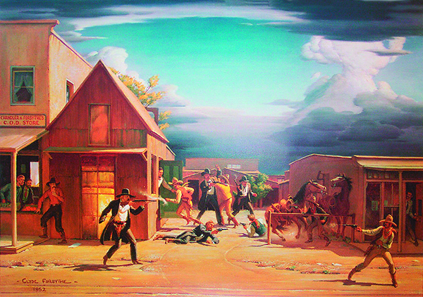
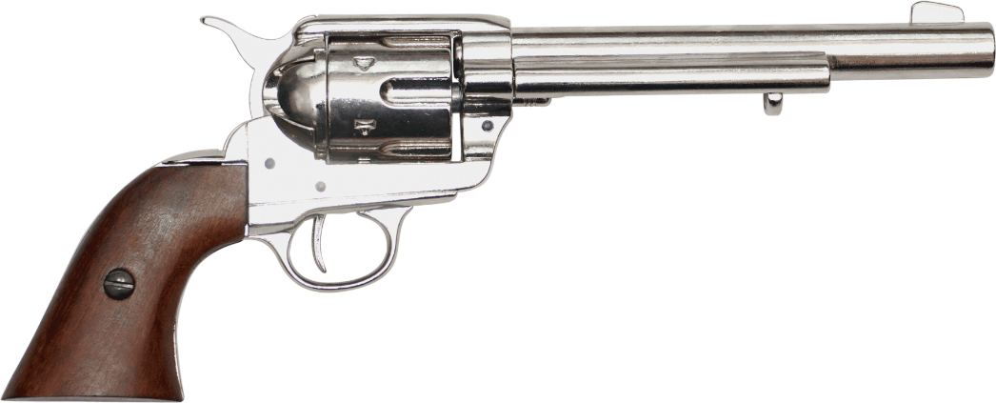
Gunfight at the O.K. Corral
-Wyatt Earp, a famous Kansas lawman, his brothers, and “Doc” Holliday have a 30-second shootout with the Clanton and McLaury brothers (“The Cowboys”), who were known criminals.
-The Earps are found not guilty (“justifiable homicide) in the most famous gunfight in the west.

Slide 14
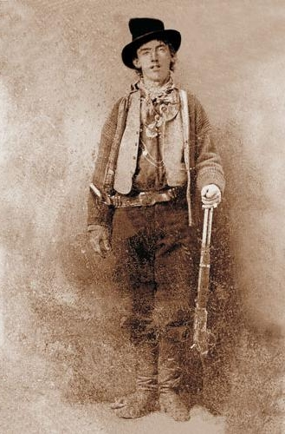
Death of Billy the Kid
-Billy “The Kid” Bonney had been a outlaw and gunman across the west.
- Had taken part in the Lincoln County War in New Mexico and killed 8 men.
-Was gunned down by Sheriff Pat Garrett when he was 21 years old.
-One of the west’s most famous outlaws

Slide 15
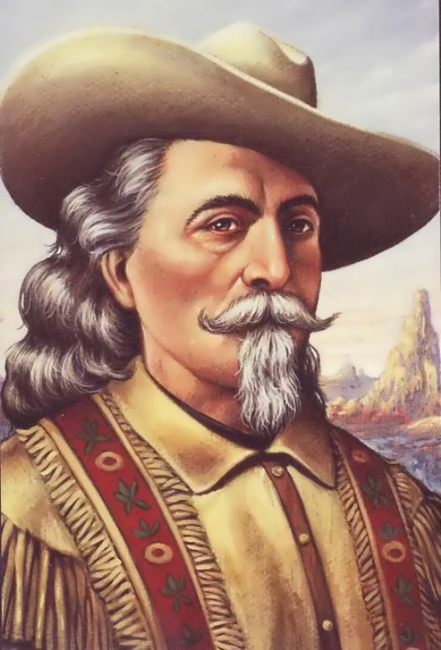
Buffalo Bill’s Wild West Show
William “Buffalo Bill” Cody had originally been a buffalo hunter for the railroad, and later a military scout and courier.
Toured America and later 8 tours of Europe
Featured “historical reenactments”, displays of horsemanship, shooting, racing, and rodeo.
Shows included cowboys, Native Americans, herds of buffalo, and celebrities like Annie Oakley, Sitting Bull, and Calamity Jane.
Lasted until 1913

Slide 16
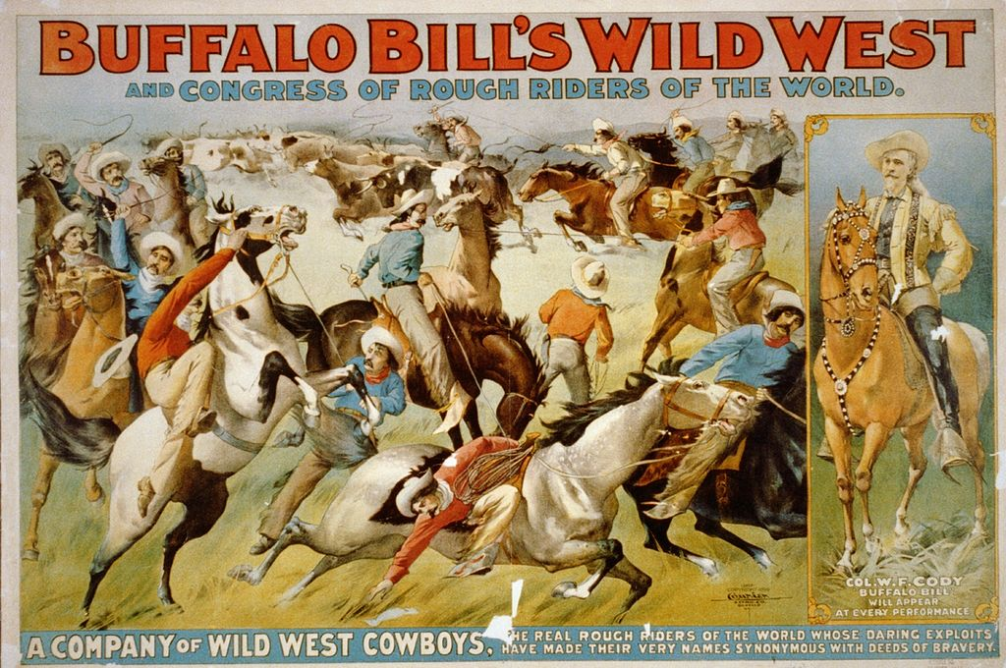
-Billy “The Kid” Bonney had been a outlaw and gunman across the west.
- Had taken part in the Lincoln County War in New Mexico and killed 8 men.
-Was gunned down by Sheriff Pat Garrett when he was 21 years old.
-One of the west’s most famous outlaws

Slide 17
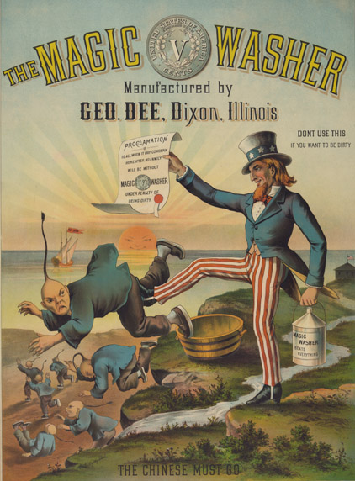
Chinese Exclusion Act - 1882
Chinese labor was unpopular in the West, especially California, where it was blamed for lowering wages
Made it illegal for any Chinese to immigrate to the United States, and banned Chinese from becoming citizens.
First US law that restricted immigration.
Anti-Chinese violence swept the West, and most Chinese immigrants moved to enclaves in major cities, known as “Chinatowns.”

Slide 18
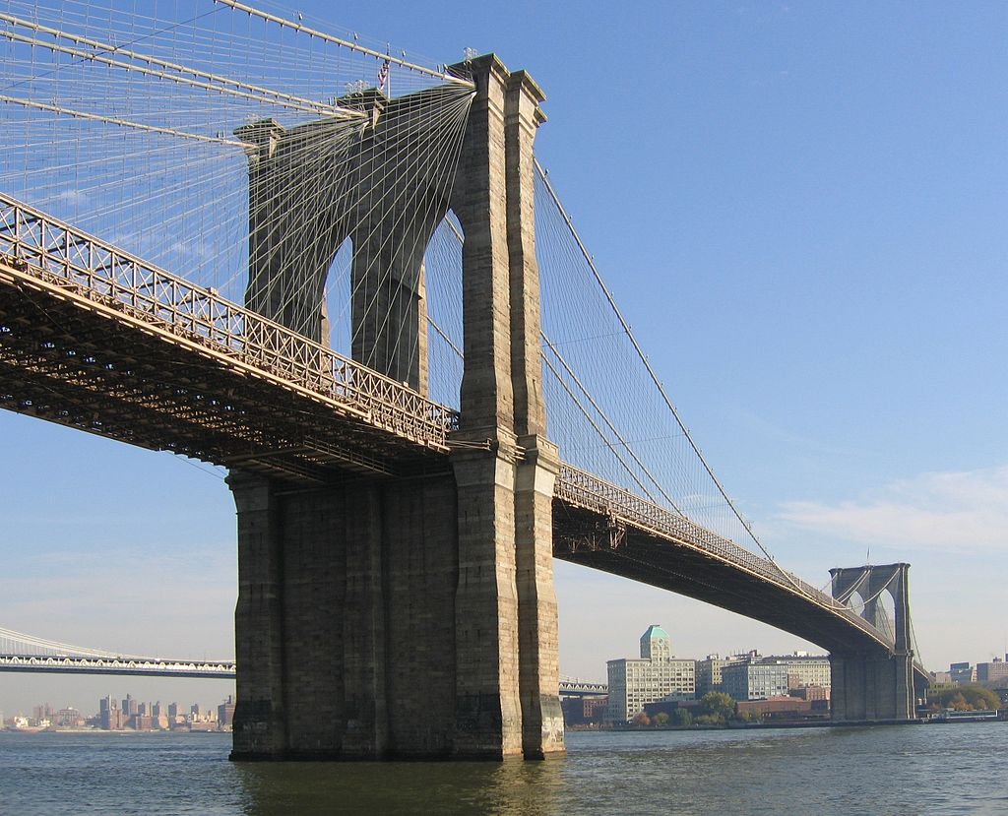
Brooklyn Bridge Opens - 1883
Over a mile-long bridge crossing the East River, connecting Manhattan and Brooklyn
At the time, the longest suspension bridge in the world, and the first steel-cable suspension bridge ever built

Slide 19
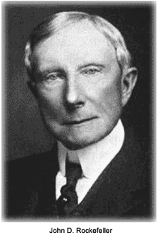
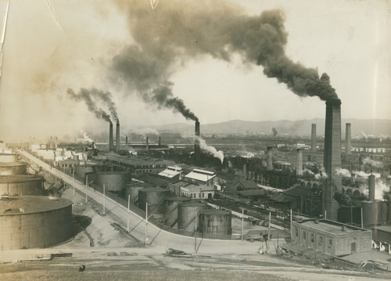
Birth of Standard Oil
John D. Rockefeller starts his business in 1863 by investing in a Cleveland oil refinery
He then slowly buys out all the competition, often closing them, to expand his business
1882: Standard Oil Trust of New York founded, controlling 90% of US oil refineries and pipelines
Often artificially lowered prices to drive out competition and colluded with railroads to gain his monopoly

Slide 20
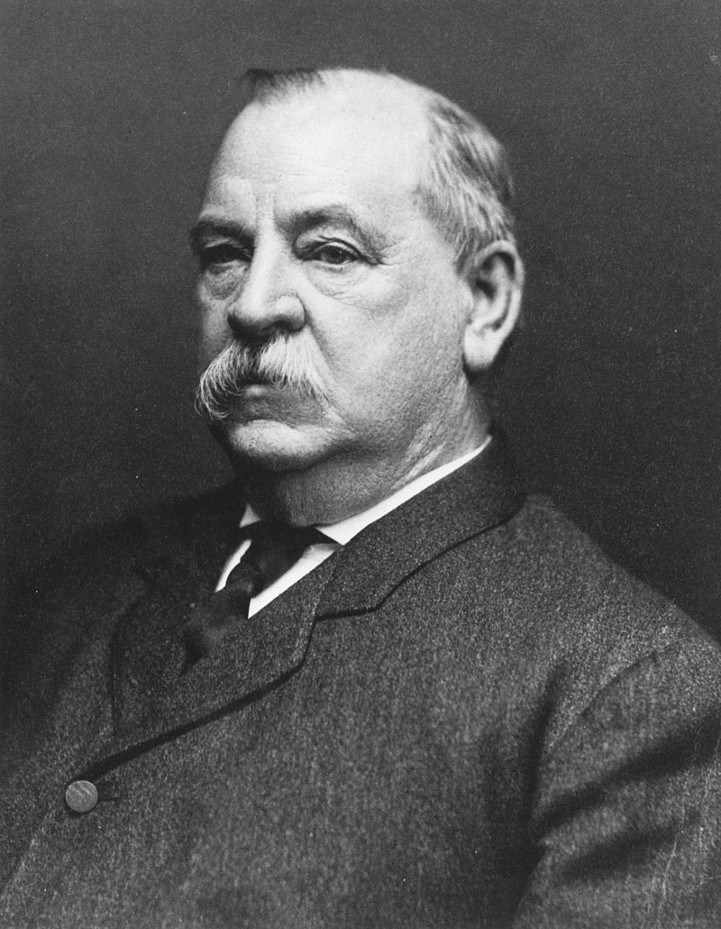
Grover Cleveland

Slide 21
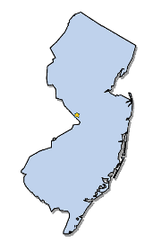
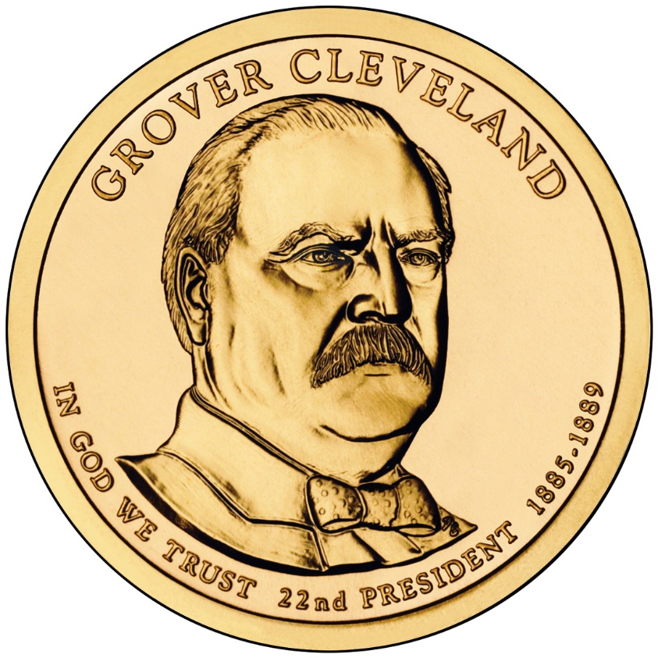
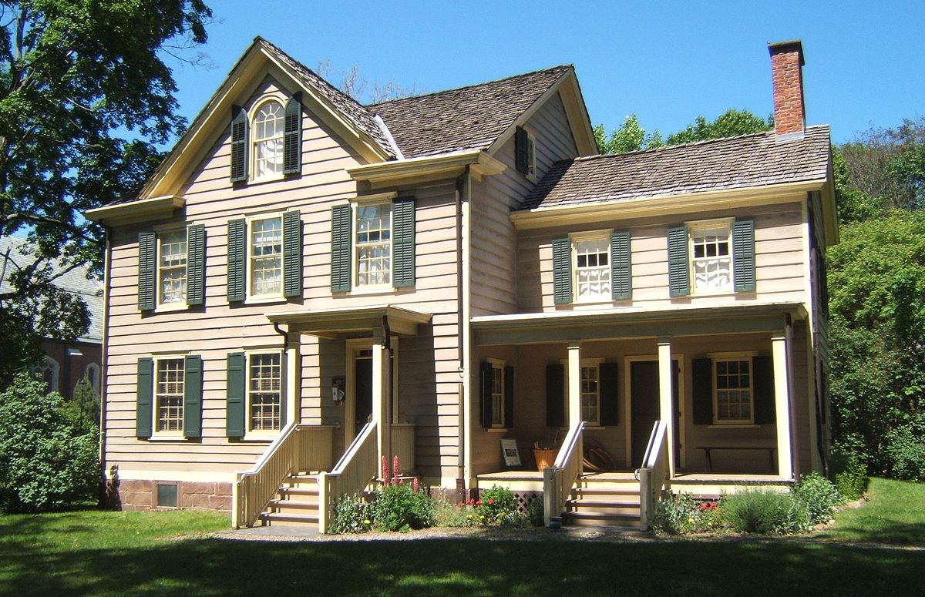
First Term
Elected in: 1884
President from: 1885-1889
Political Party: Democrat
Home State: New Jersey

Slide 22
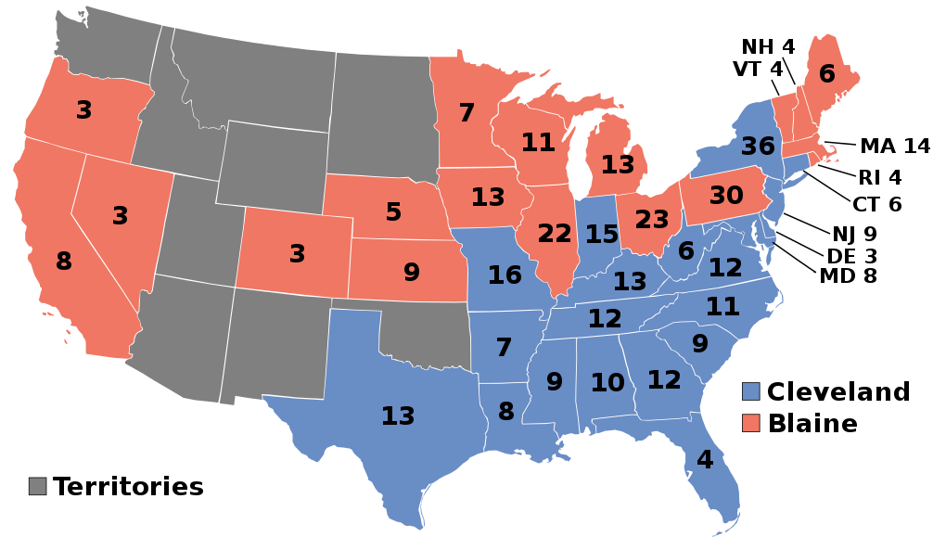
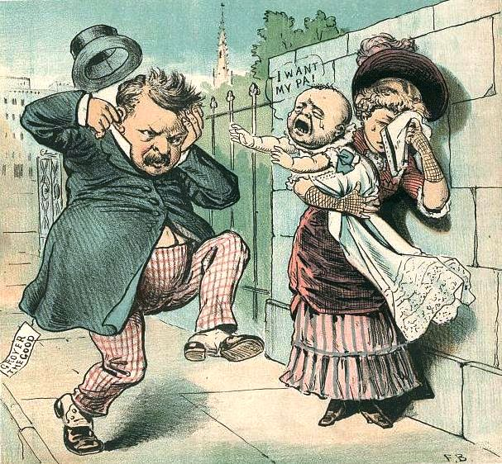
Election of 1884
Democratic: 219
President: Grover Cleveland
Vice President: Thomas Hendricks
Republican: 182
President: James G. Blaine
Vice President: John Logan
"We are Republicans, and don't propose to leave our party and identify ourselves with the party whose antecedents have been rum, Romanism, and rebellion.” – Rev. Samuel Burchard

Slide 23
New States
None

Slide 24
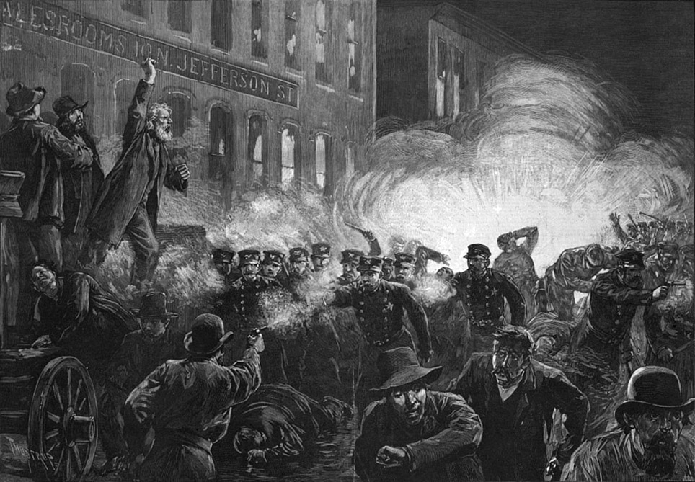
Haymarket Massacre - 1886
May 1: Up to 500,000 union workers begin a strike, centered in Chicago, asking for an 8-hour day.
Police open fire at a rally of locked-out workers from the McCormick Harvester factory, killing a few strikers.
The next day a bomb kills several policemen, who open fire into the crowd. 4 labor organizers are later hanged.

Slide 25
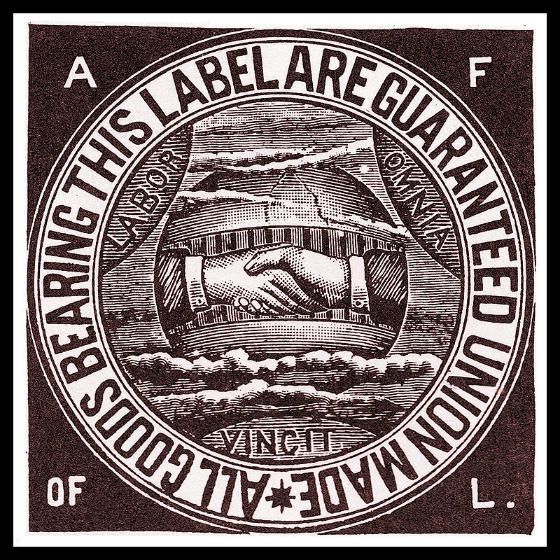
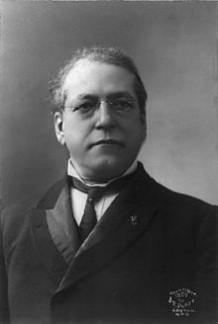
Birth of the American Federation of Labor
A “union of unions” founded by Samuel Gompers in December 1886
Previous union movements (like “The Knights of Labor” led by Terence Powderly) tried to achieve their goals through political activity.
The K of L was also more educational and didn’t like strikes.
The AFL preferred using collective bargaining power with big businesses
Demanded higher wages and a shorter work day

Slide 26
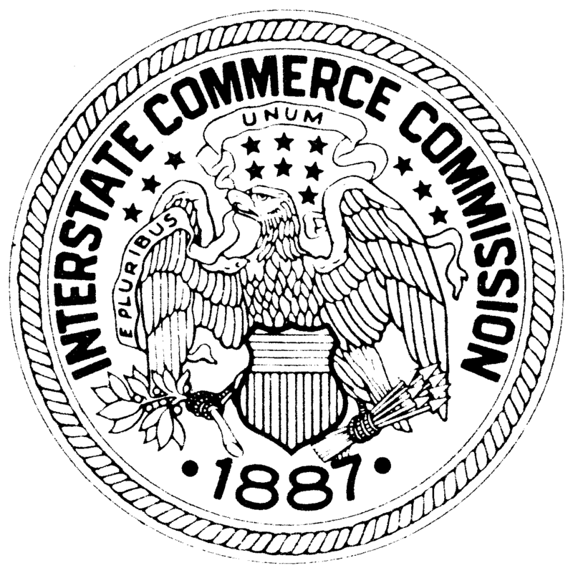
Interstate Commerce Commission - 1887
First regulatory agency ever created by Congress
First designed to regulate railroads and ensure they only charged “reasonable and just” rates
Powers eventually grew to oversee any transportation carrier that crossed state lines – bus lines, trucking companies, etc.
Also had power to regulate and inspect safety along these lines.

Slide 27
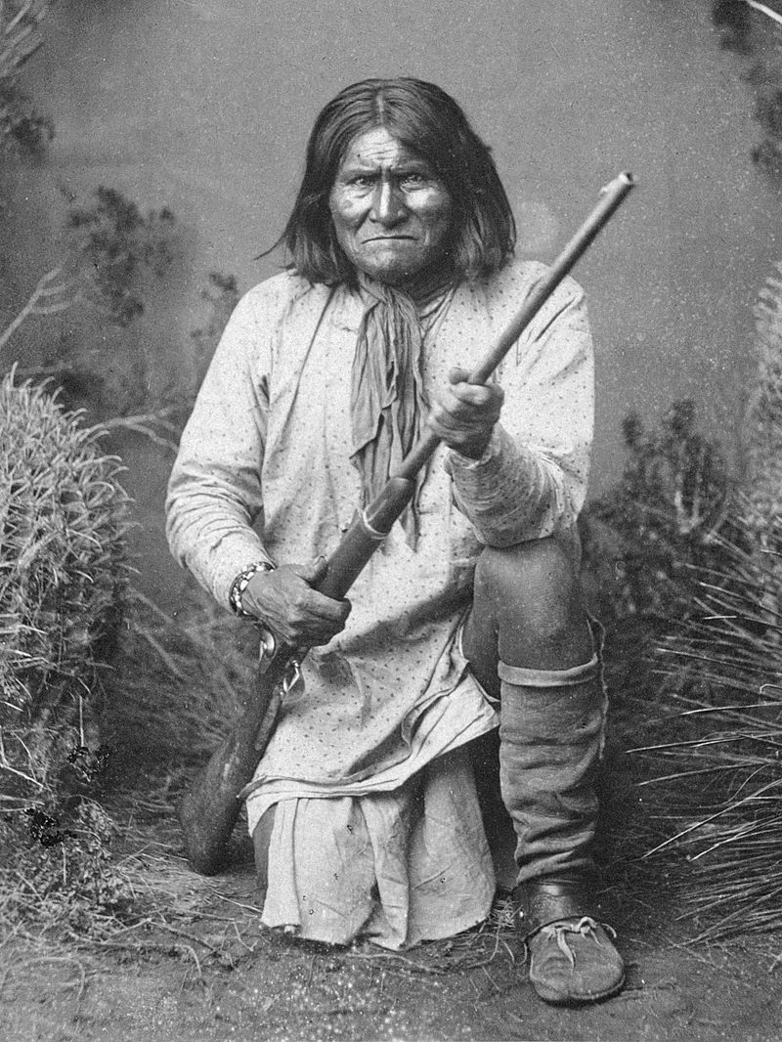
Surrender of Geronimo - 1886
Last Indian War in the West – the Chiricahua Apache of Arizona, led by Geronimo
Geronimo led Apache resistance to US military from 1850-1886
Surrendered to US Army in 1886, on the promise that after his exile to Florida, he could return to Arizona
He was never allowed to return, and was buried in Oklahoma

Slide 28
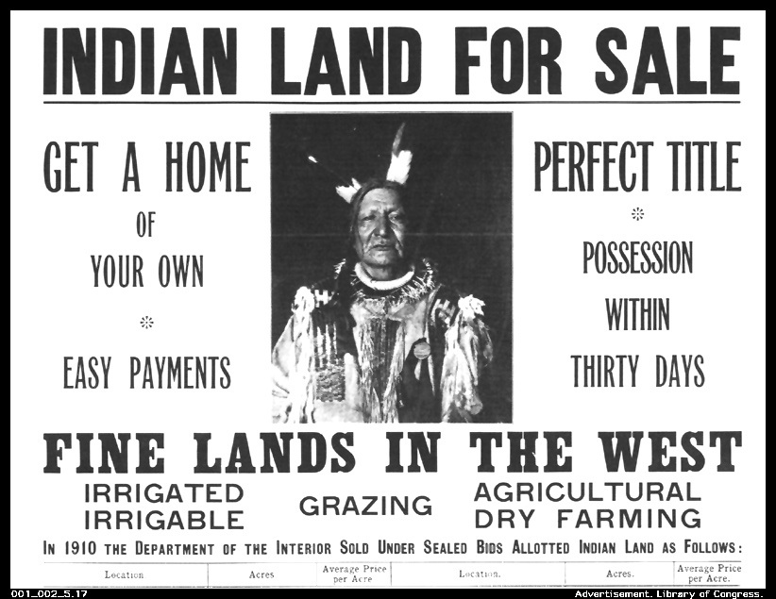
Dawes Act - 1887
Passed due to pressure from well-intentioned white Americans
Law granted Indians citizenship and a parcel of land (in 25 years) if they renounced their tribal membership
Law was devastating for the tribes, since native cultural view of land ownership was very different, and whites took advantage of Indian land

Slide 29
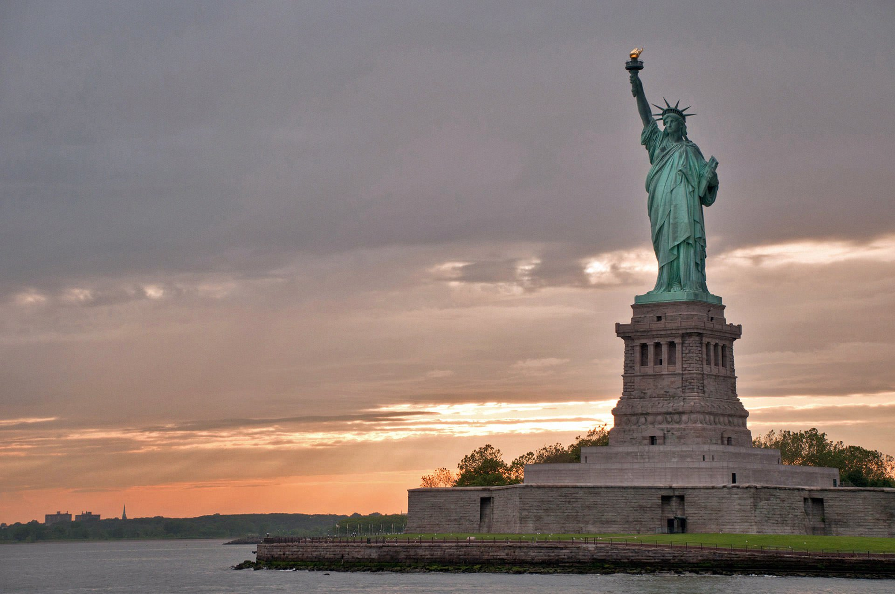
Statue of Liberty Dedicated
A gift from France to the United States to celebrate liberty
France paid for the copper statue (by Frederic Bartholdi, internal supports by Pierre Eiffel), Americans paid for the pedestal
Dedicated October 28, 1886

Slide 30
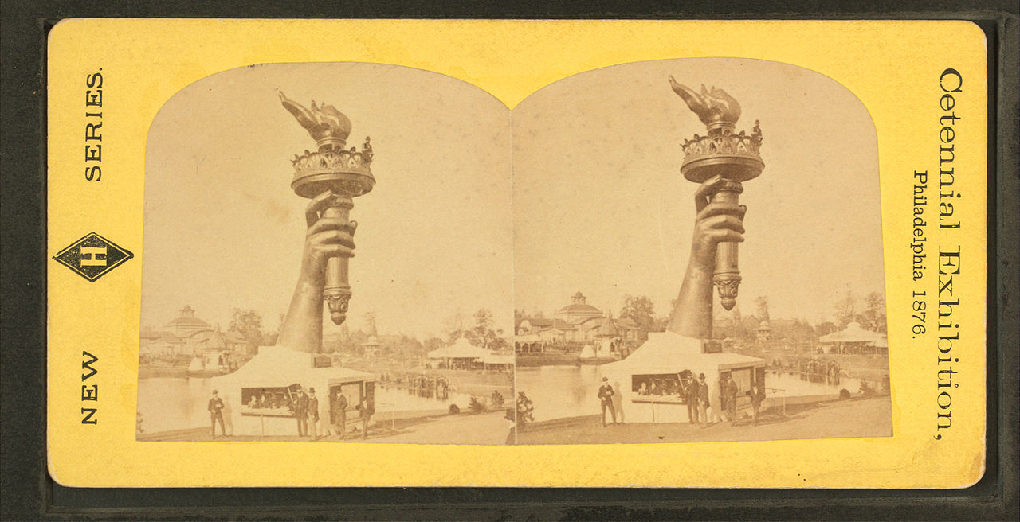
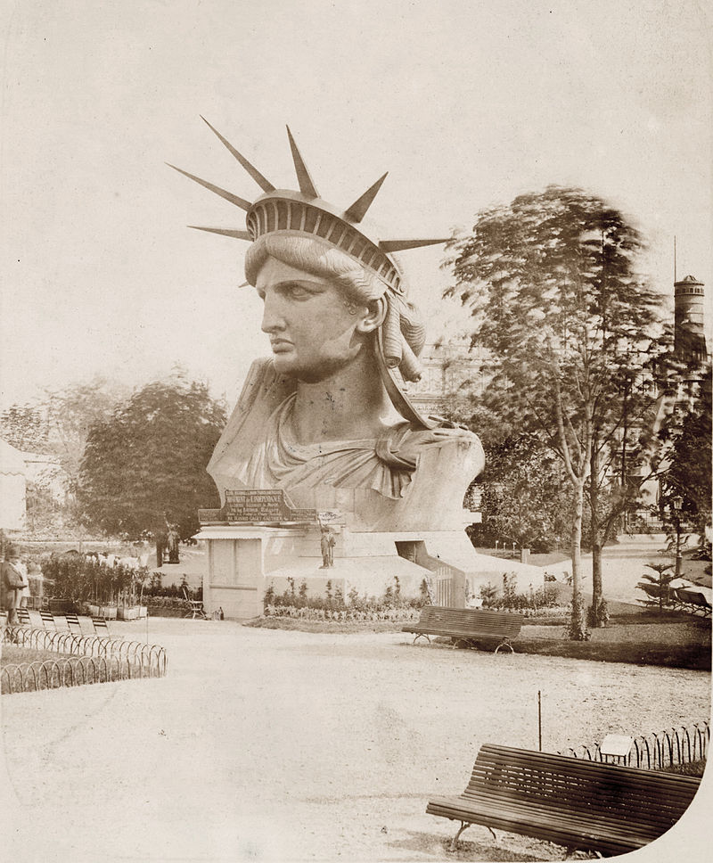

Slide 31
Statue of Liberty
Original name: “Liberty Enlightening the World”
151 feet, 1 inch tall, 305 feet including pedestal
Weighs 450,000 pounds
Copper thickness: 3/32nds of an inch
Torch designed to function as a lighthouse/beacon, but replaced with gold in 1986
Statue is walking forward, her feet in sandals and broken chains
Tablet says “July 4 1776” in Roman numerals
Visitors could originally go to the torch, but now only to the crown, on a special tour.

Slide 32
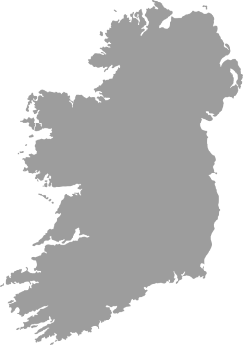
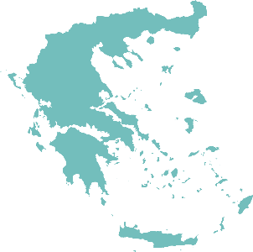
The New Colossus
Not like the brazen giant of Greek fame, With conquering limbs astride from land to land; Here at our sea-washed, sunset gates shall stand A mighty woman with a torch, whose flame Is the imprisoned lightning, and her name MOTHER OF EXILES. From her beacon-hand Glows world-wide welcome; her mild eyes command The air-bridged harbor that twin cities frame. "Keep, ancient lands, your storied pomp!" cries she With silent lips. "Give me your tired, your poor, Your huddled masses yearning to breathe free, The wretched refuse of your teeming shore. Send these, the homeless, tempest-tossed to me, I lift my lamp beside the golden door!"
-Emma Lazarus

Slide 33
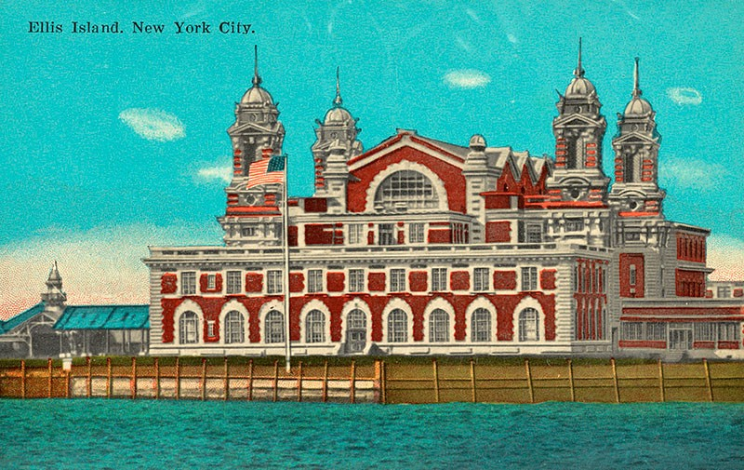
Ellis Island opens - 1892
Immigration station built on Ellis Island in New York harbor
All immigrants coming into New York City were registered, given a health inspection, and either let into the US, checked into a quarantine station, or sent back to Europe
Over 12,000,000 entered between 1892-1954, with over 1,000,000 in 1907 alone

Slide 34
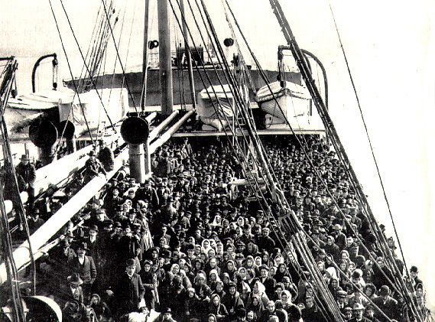
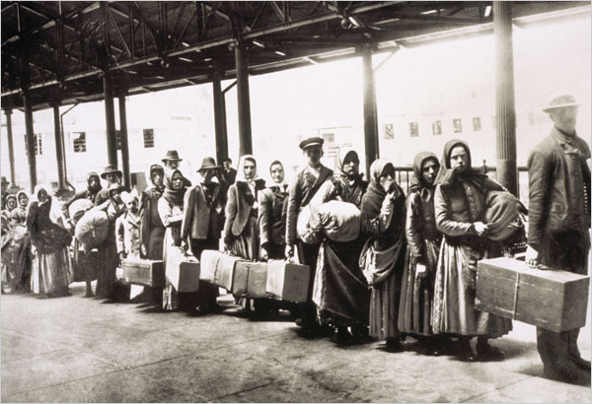

Slide 35
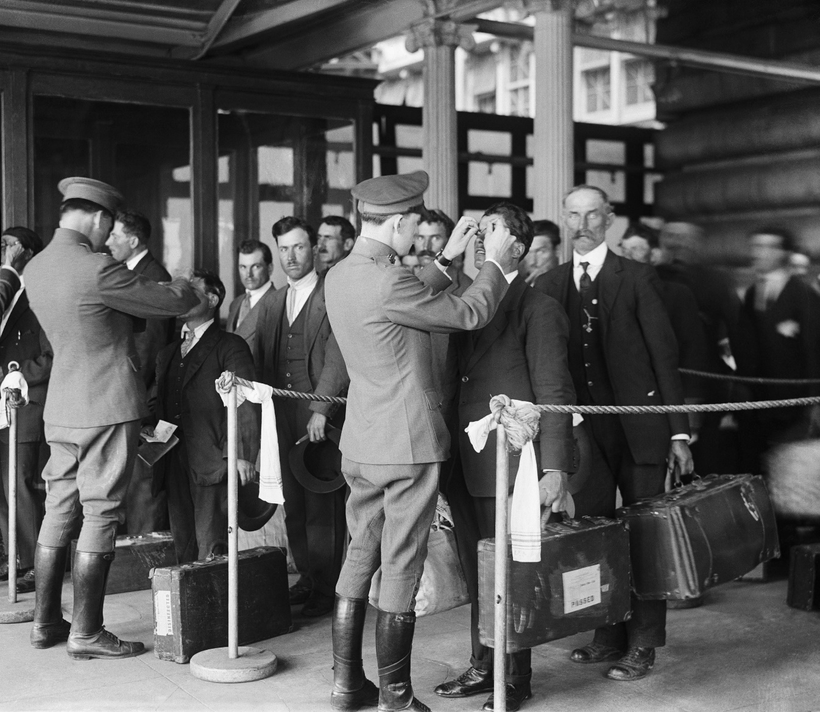
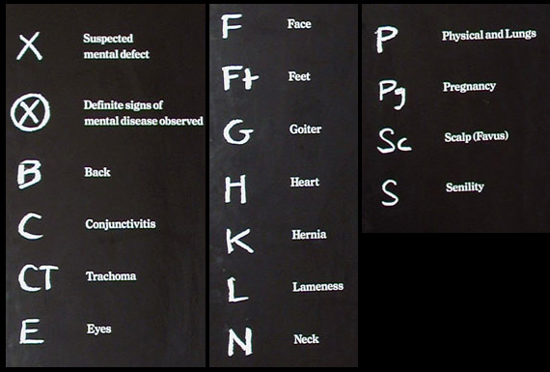
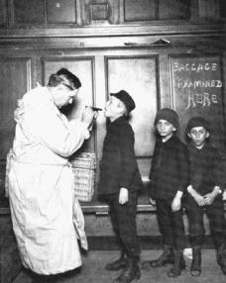

Slide 36
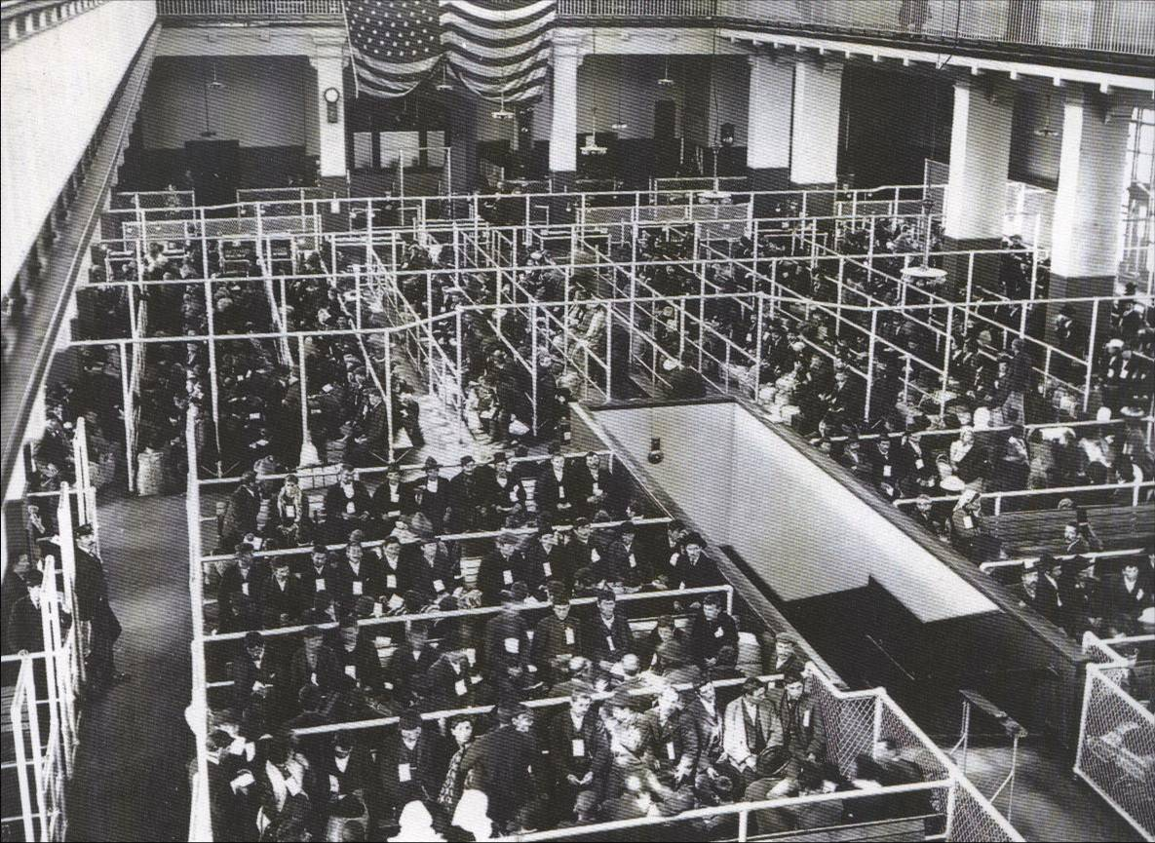

Slide 39
Coca-Cola invented, 1886
Invented in 1886 in Atlanta by John Pemberton
Containing coca leaf (now cocaine-free) and kola nut extract (caffeine), it was marketed as a morphine substitute

Slide 40
Cleveland Marries Frances Folsom, 1886
First president to get married in the White House
Cleveland was 49, Folsom 21
They later had a child named Ruth, allegedly the namesake of the “Baby Ruth” candy bar.

Slide 41
Benjamin Harrison

Slide 42
Elected in: 1888
President from: 1889-1893
Political Party: Republican
Home State: Indiana

Slide 43
Election of 1888
Republican: 233
President: Benjamin Harrison
Vice President: Levi Morton
Democratic: 168
President: Grover Cleveland
Vice President: Allen Thurman

Slide 44
New States
39. North Dakota
40. South Dakota
41. Montana
42. Washington
43. Idaho
44. Wyoming

Slide 45
Wounded Knee Massacre
Sioux holy man Wovoka preached that by participating in the Ghost Dance, Indians would be impervious to bullets, and their ancestors would come back.
Worried US officials started rounding up Indians and their leaders, who mostly surrendered peaceably.
December 1890: In a botched attempt at disarming them, soldiers start shooting into the crowd of peaceful Indians. Up to 300 are killed.

Slide 46
Oklahoma Land Rush - 1889
Congress opened “unassigned lands” in Indian Country to settlers.
Settlers could claim the best land by getting there first – leading to a land rush race on April 22.
Those who snuck out and claimed land before the allowed time were called “Sooners.”
“At twelve o'clock on Monday, April 22d, the resident population of Guthrie was nothing; before sundown it was at least ten thousand. In that time streets had been laid out, town lots staked off, and steps taken toward the formation of a municipal government.” – Harper’s Weekly

Slide 47
Sherman Anti-Trust Act - 1890
Law sponsored by Senator John Sherman (R-Ohio) to limit the power of the big business “trusts.”
Bans contracts and combinations “in restraint of trade” and bans groups conspiring to form monopolies.
Originally, most businesses found ways around the laws, and it was most successfully used against labor unions.
Was the first anti-trust law in US History

Slide 48
Homestead Strike - 1892
Andrew Carnegie owned the largest steel manufacturing mills in the world, mostly around Pittsburgh PA.
After weeks of unsuccessful negotiations between the union and Henry Clay Frick (plant manager) armed Pinkerton guards brought in to control the strikers.
Violence on July 6, 10,000 strikers defeat 300 Pinkertons, but 16 men are killed.
PA Governor sent in the militia, and ended the strike, destroying the union. The company immediately raised hours and lowered wages.

Slide 49
Carrie Nation
Anti-alcohol, pre-temperance activist
Protested by smashing up bars and saloons across Kansas, then paying her fines through money earned with speaking tours and selling souvenir hatchets

Slide 50
Overthrow of Hawaiian Monarchy
American and British businessmen, planters, and missionaries write a new constitution for Hawaii
Queen Liliuokalani attempts to maintain control, but has to abdicate
Within 3 years the US annexes the Republic of Hawaii as a territory
Aloha ʻoe, aloha ʻoe | Farewell to thee, farewell to thee
E ke onaona noho i ka lipo | The charming one who dwells in the shaded bowers
One fond embrace, | One fond embrace,
A hoʻi aʻe au | Ere I depart
Until we meet again | Until we meet again

Slide 51
Grover Cleveland

Slide 52
Second Term
Elected in: 1892
President from: 1893-1897
Political Party: Democrat
Home State: New Jersey

Slide 53
Election of 1892
Democratic: 277
President: Grover Cleveland
Vice President: Adlai Stevenson I
Republican: 145
President: Benjamin Harrison
Vice President: Whitelaw Reid
Populist: 22
President: James Weaver
Vice President: James Field

Slide 54
New States
45. Utah

Slide 55
The Panic of 1893
Nationwide depression that starts in 1893
Caused by confusion over the value of silver, and the failure of several banks and railroads
Up to 19% unemployment
Had nothing to do with Grover Cleveland, but he refused to start any relief programs
Awareness raised by Jacob Coxey, who led a march on Washington demanding government action (Coxey’s Army)

Slide 56
The Silver Debate
US paper money was backed by gold, keeping the amount of paper money limited and keeping prices high.
Farmers, westerners, miners supported “bimetallism” – that US money be backed by gold AND silver, increasing the amount of money in circulation.
Easterners, bankers, and the rich were in favor of keeping “sound money” - “the gold standard”
The Populist party in 1892, and Democrats from 1896 on, support “free silver” bimetallism.

Slide 57
The Silver Debate, cont.
Starting when Harrison was President, the US Government bought massive amounts of silver with gold, but the US gold supply was limited
Cleveland and Congress stopped the silver purchases, but needed to be bailed out by banker J.P. Morgan

Slide 58
The Pullman Strike - 1894
The Pullman Car Co. manufactured passenger cars for the railroads. Workers lived in a highly regulated company town, lived in company owned houses, bought from company owned stores
The Company laid off hundreds, lowered wages, but refused to lower rents
Workers were joined by the American Railway Union, led by Eugene Debs, and went on strike, shutting down railroads
Federal government sent in troops to break the strike, killing 30, wounding others, and damages of $80 million.

Slide 59
The First Breakfast Cereals - 1895
Dr. John Harvey Kellogg, head of the Battle Creek Sanitarium in Michigan, invents Corn Flakes as a healthy alternative to animal-based foods.
A patient, C.W. Post, invents Grape Nuts in 1897 to compete.

