Slide 1
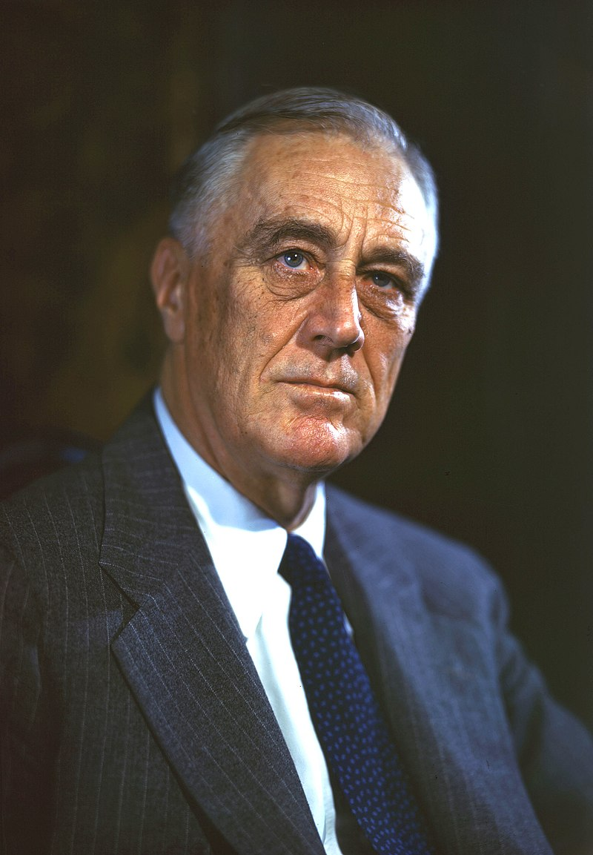
Franklin D. Roosevelt

Slide 2
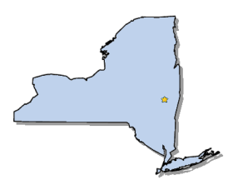
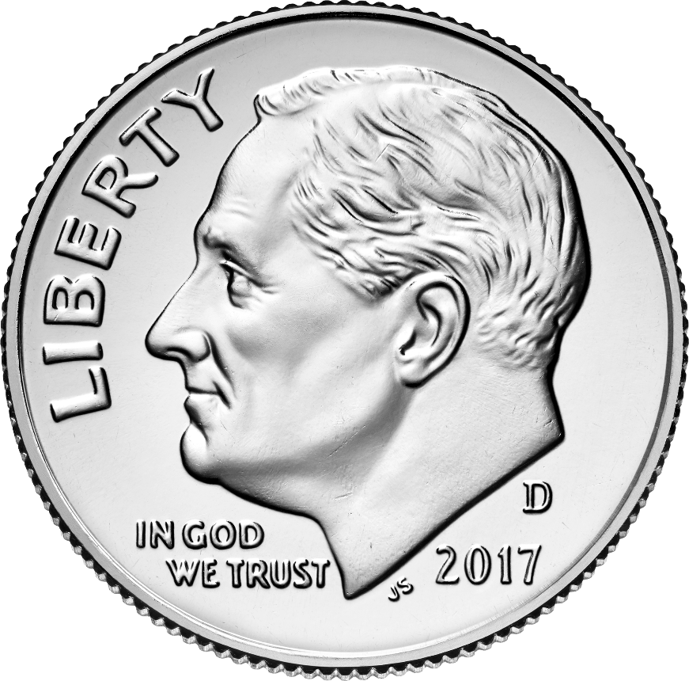
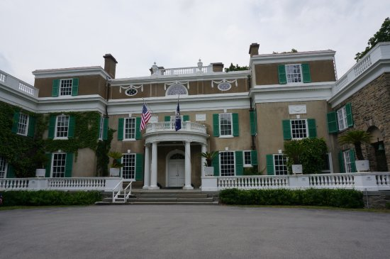
Elected in: 1932, 1936, 1940, 1944
President from: 1933-1945
Political Party: Democrat
Home State: New York

Slide 3
New States
None

Slide 4
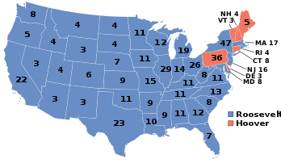
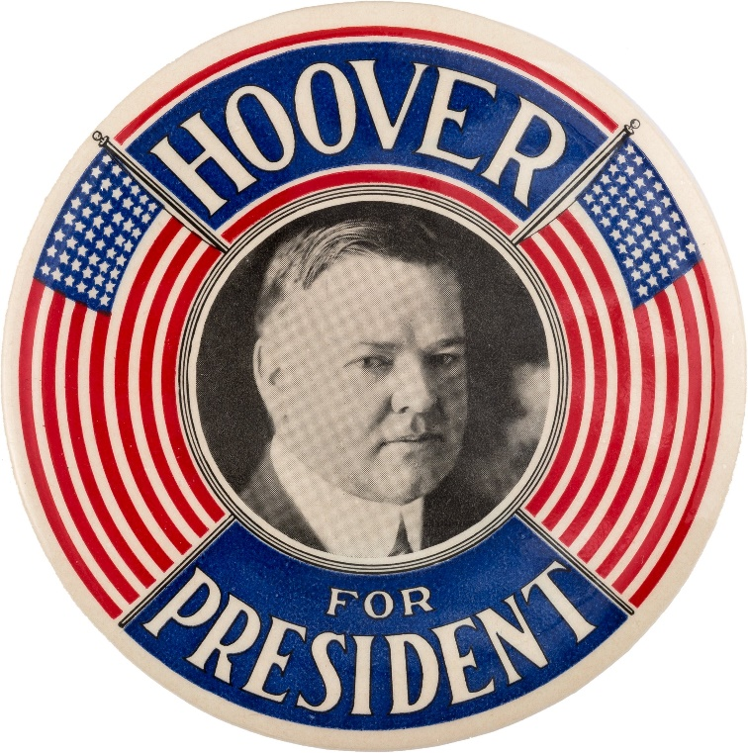
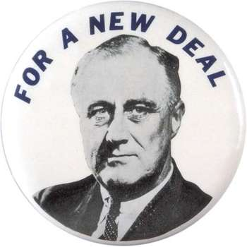
Election of 1932
Democrat: 472
President: Franklin Roosevelt
Vice President: John Nance Garner
Republican: 59
President: Herbert Hoover
Vice President: Charles Curtis

Slide 5
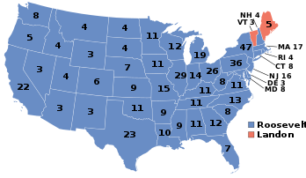
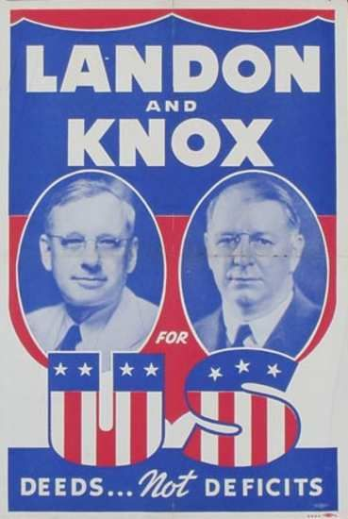
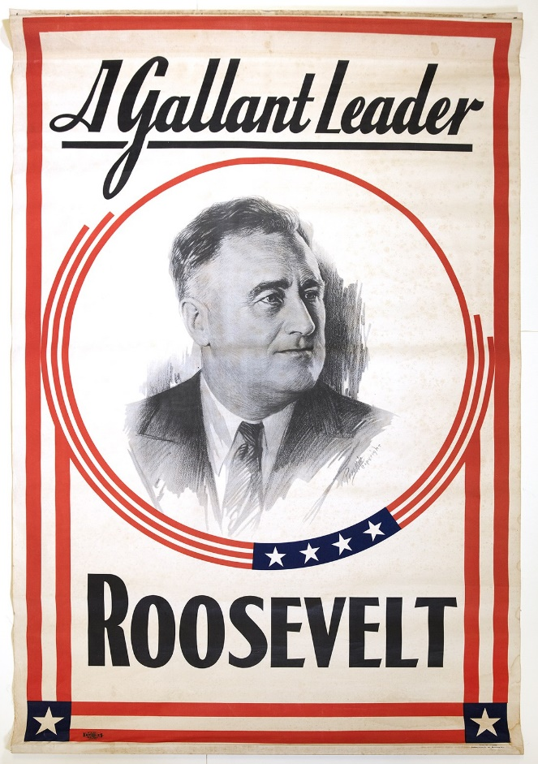
Election of 1936
Democrat: 523
President: Franklin Roosevelt
Vice President: John Nance Garner
Republican: 8
President: Alf Landon
Vice President: Frank Knox

Slide 6
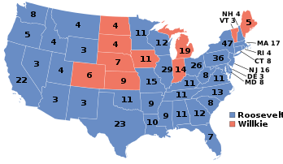
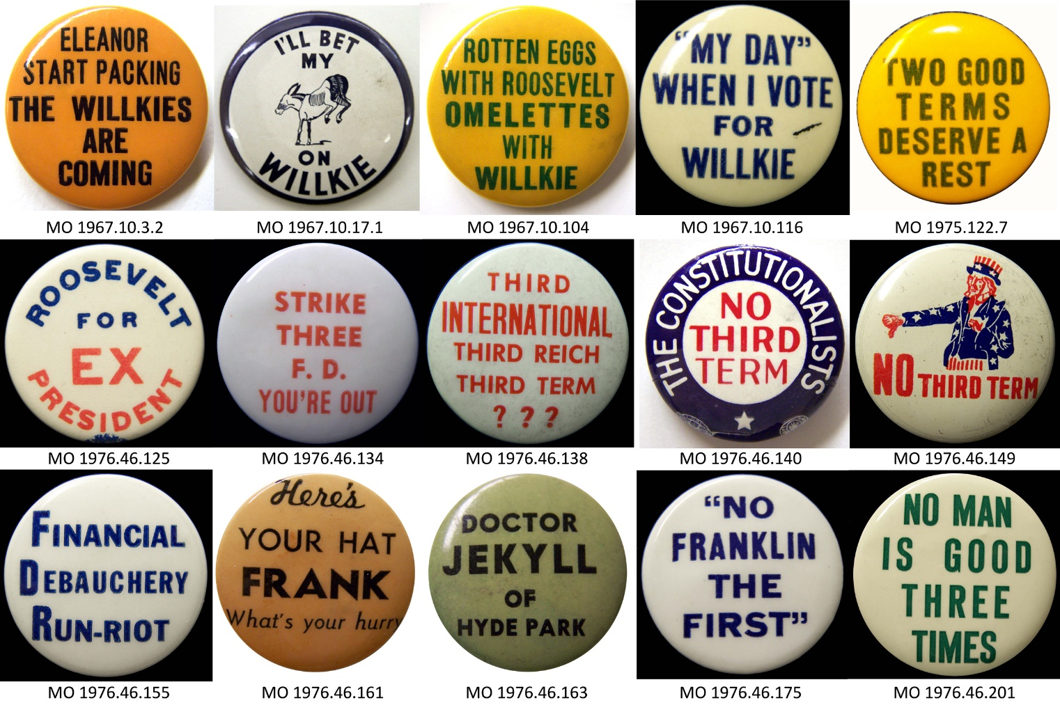
Election of 1940
Democrat: 449
President: Franklin Roosevelt
Vice President: Henry Wallace
Republican: 82
President: Wendell Willkie
Vice President: Charles McNary

Slide 7
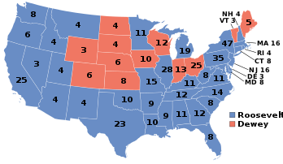
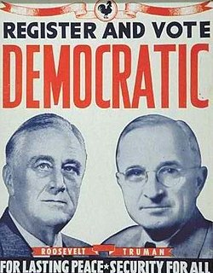
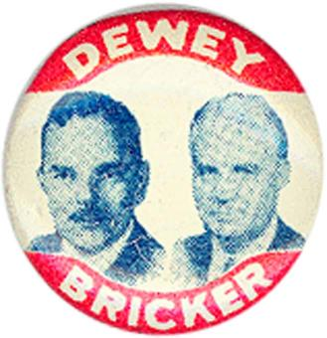
Election of 1944
Democrat: 432
President: Franklin Roosevelt
Vice President: Harry S Truman
Republican: 99
President: Thomas Dewey
Vice President: John Bricker

Slide 8
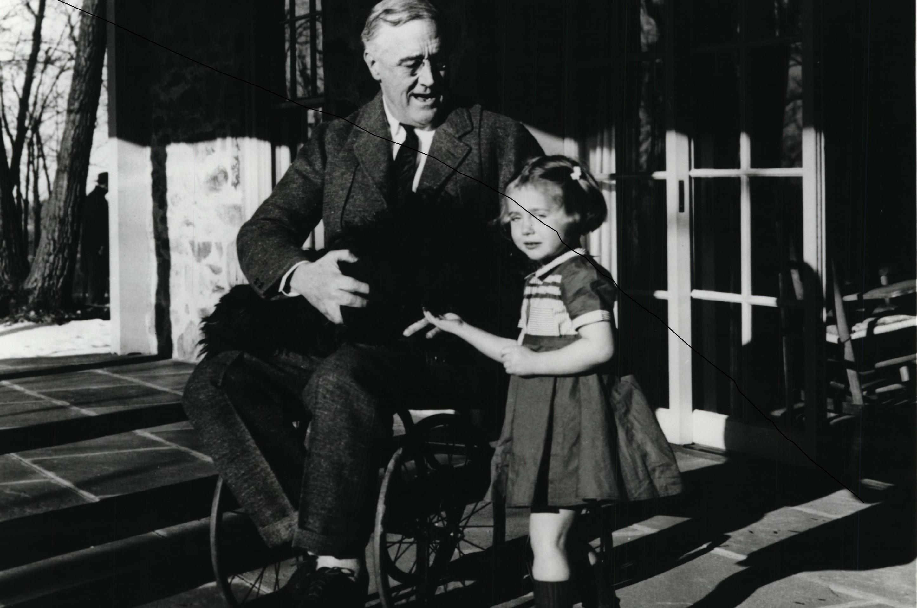
Franklin Roosevelt Biography
Born into a prominent, wealthy New York family – Theodore Roosevelt was a cousin.
Married his 5th cousin Eleanor (TR’s niece)
Contracted polio while vacationing at Campobello Island, New Brunswick – never regained full use of his legs, remaining in a wheelchair.
Served as Assistant Secretary of the Navy, and the Governor of New York

Slide 9
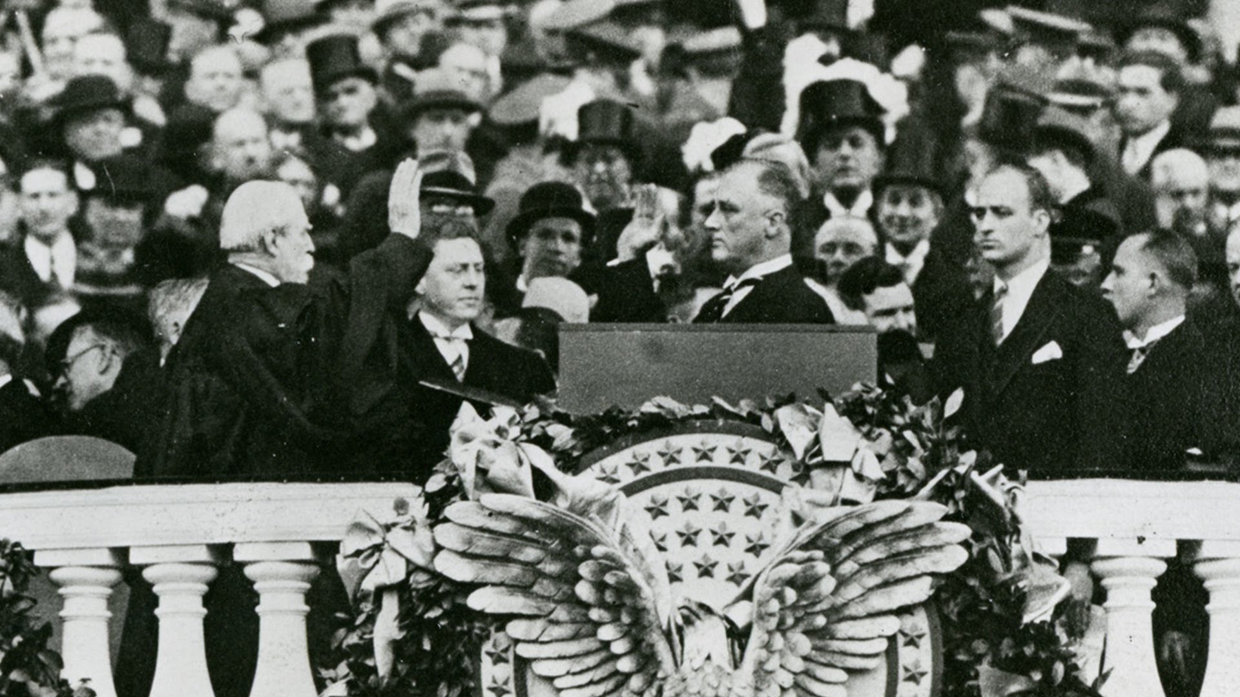

Slide 10
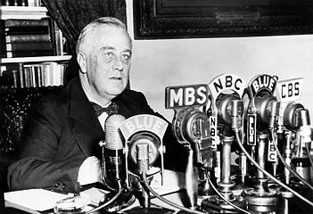
Fireside Chat
-A series of radio broadcasts by FDR starting in 1933

Slide 11
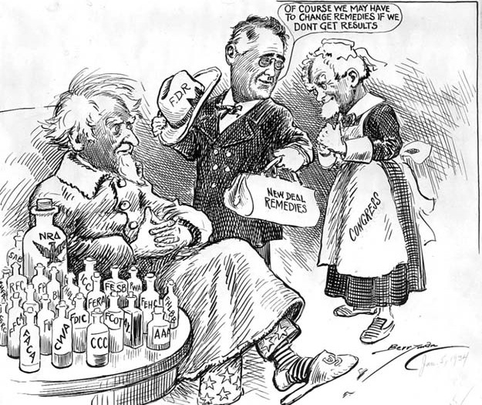
The New Deal
"I pledge you, I pledge myself to a New Deal for the American people... This is more than a political campaign. It is a call to arms."
Government action to deal with the Great Depression and improve the lives of Americans – many passed in his “First Hundred Days”
The Three R’s
Relief: To help people cope with the Depression
Recovery: To help end the Depression.
Reform: To prevent future economic problems

Slide 12
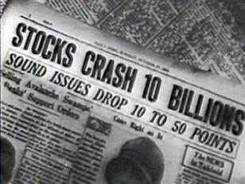
Problem
Solution
The Stock Market Crash
Federal Securities Act - FSA
Set up a set of rules to enforce new government regulations on the stock market and protect investors.
Buying “on Margin”
Insider Trading
Over-valuing of stock
Reform

Slide 13
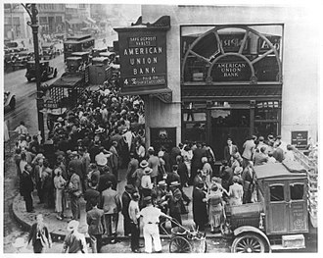
Problem
Solutions
“Runs” on the Bank
Emergency Banking Act
Banks closed for a number of days until enough money was on hand.
Relief
FDIC – Federal Deposit Insurance Corporation
Federal government insured bank deposits
Lack of faith in the banking system due to fear of banks running out of money
Reform

Slide 14
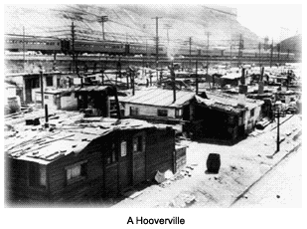
Problem
Solution
“Hoovervilles”
Federal Housing Administration - FHA
Regulated interest rates for home mortgages, and insured those loans.
-Lack of Affordable Housing
Relief - Recovery

Slide 15
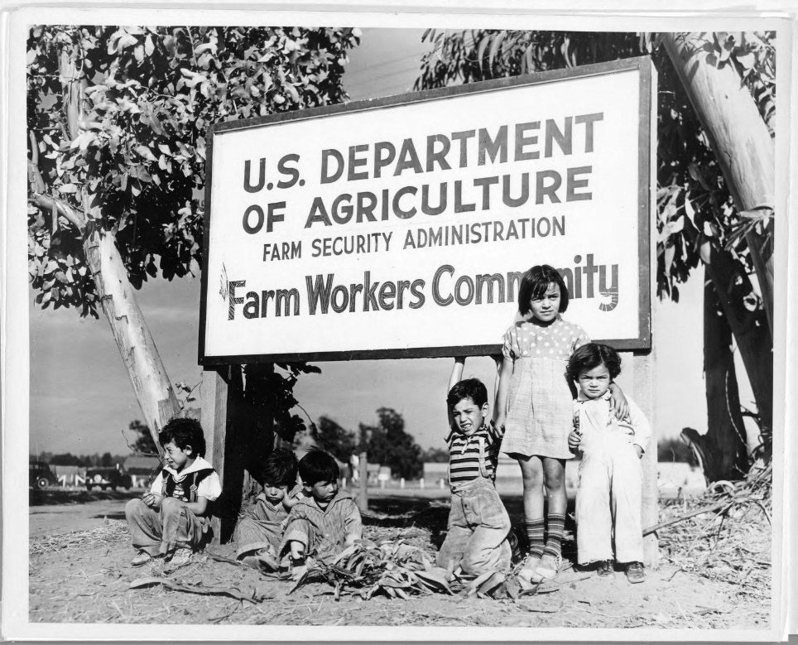
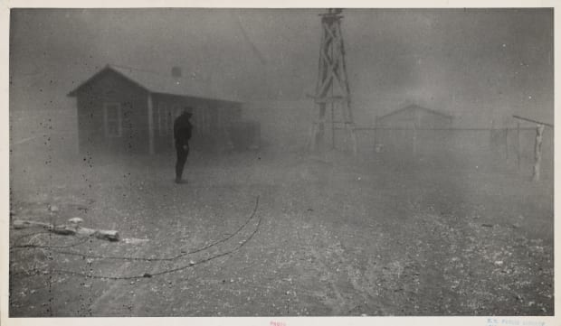
Problem
Solution
The Dust Bowl
FSA- Farm Security Administration
Drought on the plains that reduced available farmland and destroyed crops
Improve the lives of poor farmers, teach better farming practices, and resettle farmers on better farmland
Relief

Slide 16
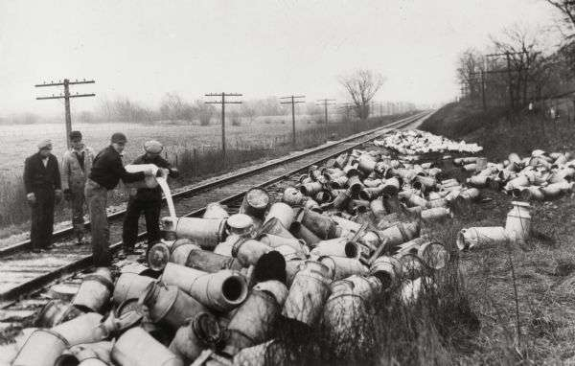
Problem
Solution
Overproduction of farm products
Agricultural Adjustment Act - AAA
Farmers received subsidies in return for destroying or limiting production.
Recovery

Slide 17
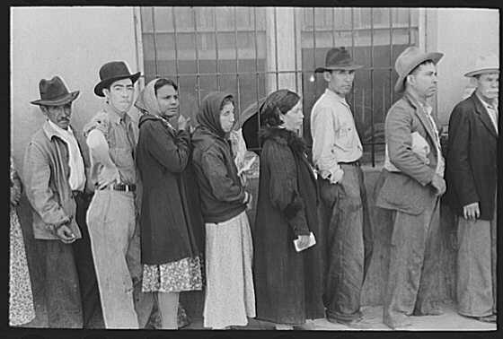
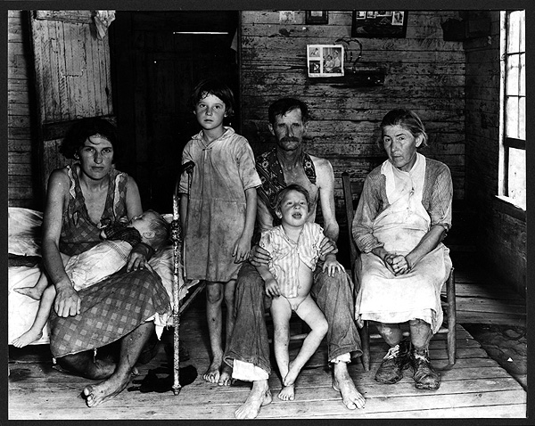
Problems
Massive Unemployment
Extreme Poverty

Slide 18
Solutions
Works Progress Administration (WPA)
WPA Artist Sketches WPA Workers
Recovery
Puts people to work on government projects.
- Both manual and intellectual projects.
- Federal Writers Project
- Artists Paint Public Murals
Federal Theater Project

Slide 19
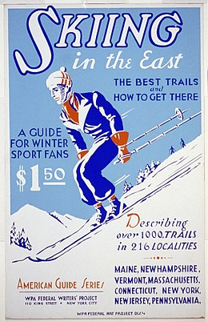

Slide 20
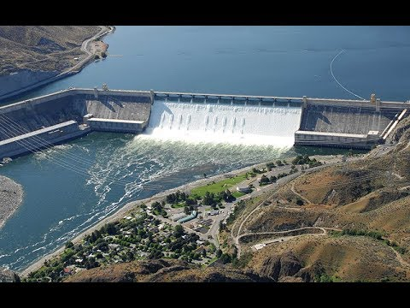
Solutions
Public Works Administration (PWA)
-Built large-scale public works projects such as dams, hospitals, highways, and bridges
Recovery

Slide 21
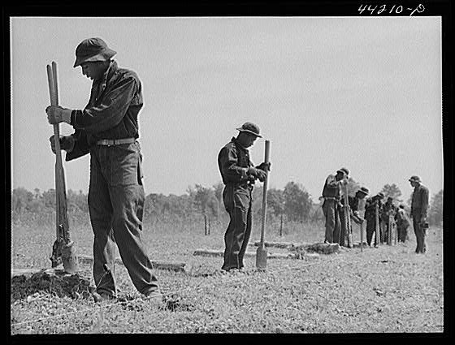
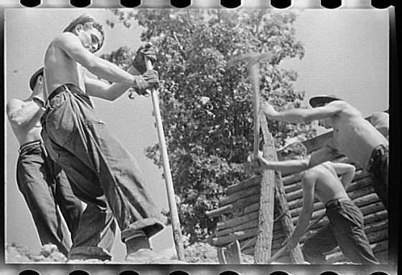
Solutions
Civilian Conservation Corps (CCC)
Young people were given jobs doing conservation & recreation related projects, like tree planting, stream conservation, and building state parks.
Recovery

Slide 22
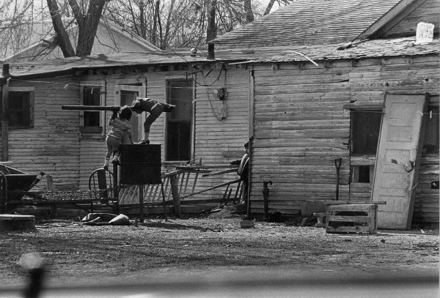
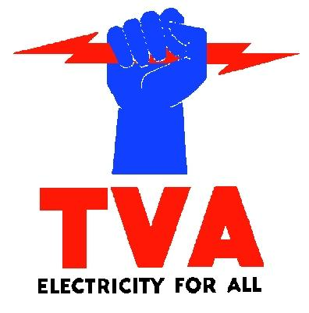
Problem
Solution
-Underdevelopment in the South
TVA – Tennessee Valley Authority
Construction of hydroelectric dams along the Tennessee River provided power and employment
The South was still very rural and many areas lacked electricity
Recovery

Slide 23
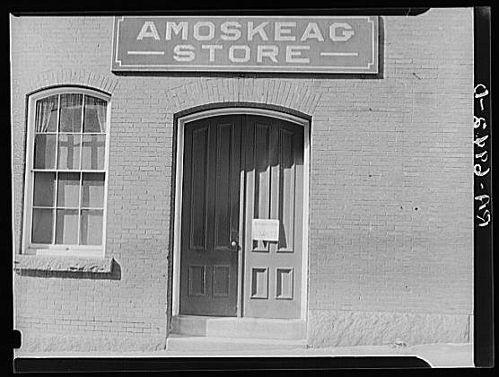
Problem
Solution
Closing Factories and Unemployment
National Industries Recovery Act (NRA)
Required industries to create codes regulating wages, hours, working conditions, & prices. It was designed to promote recovery by ending wage & price deflation
Recovery

Slide 24
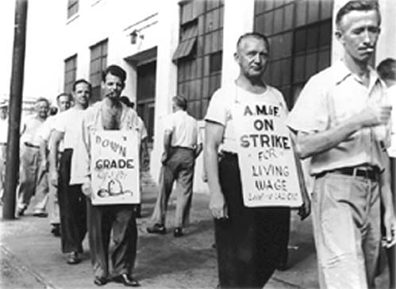
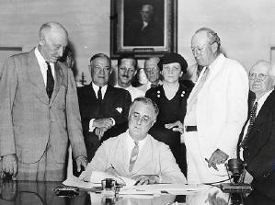
Problem
Solution
Labor Disputes
National Labor Relations Act
Guaranteed workers the right to bargain collectively and form unions w/out fear of punishment from management.
Reform

Slide 25
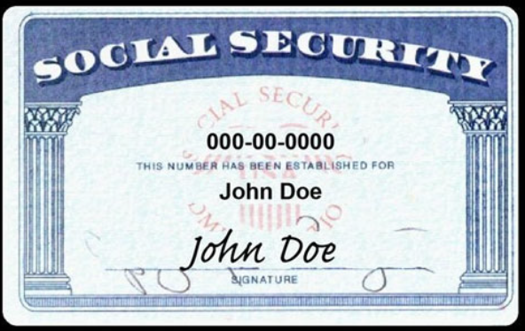
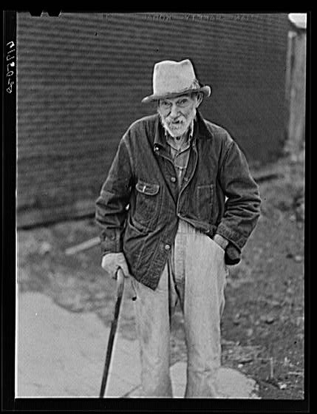
Problem
Solution
Poverty among the elderly and disabled
Social Security Act
Old Age Pensions, Aid to Disabled
Encouraged states to provide matching benefits.
Reform - Relief

Slide 26
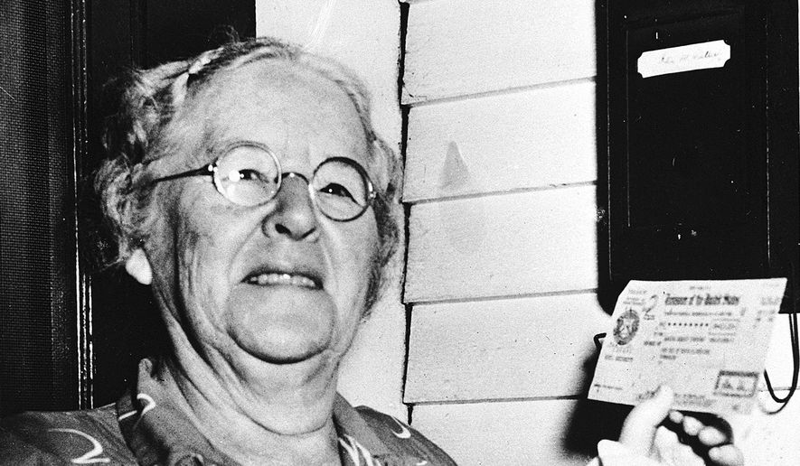

Slide 27
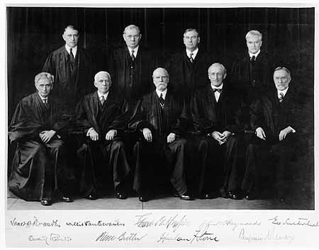
Court-Packing Plan - 1937
Many of Roosevelt’s New Deal programs were declared unconstitutional by the Supreme Court – including the NRA in Schechter v. United States
Roosevelt called the Court the “9 Old Men” and proposed a law to add one justice, up to 6, for every existing justice over age 70.
This was seen even by Democrats as an attempt to take over the Judicial Branch, and was not passed
The Court was friendlier to Roosevelt’s policies after the defeat of this plan.

Slide 28
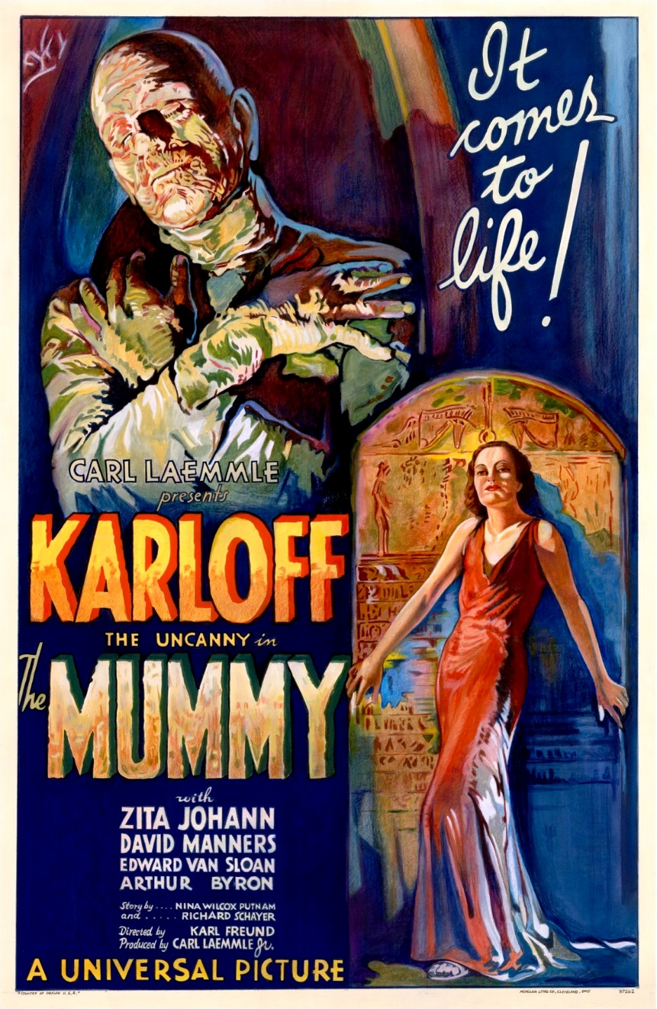
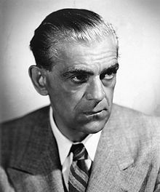
Boris Karloff
In…
Frankenstein
1931
The Mummy
1932

Slide 29
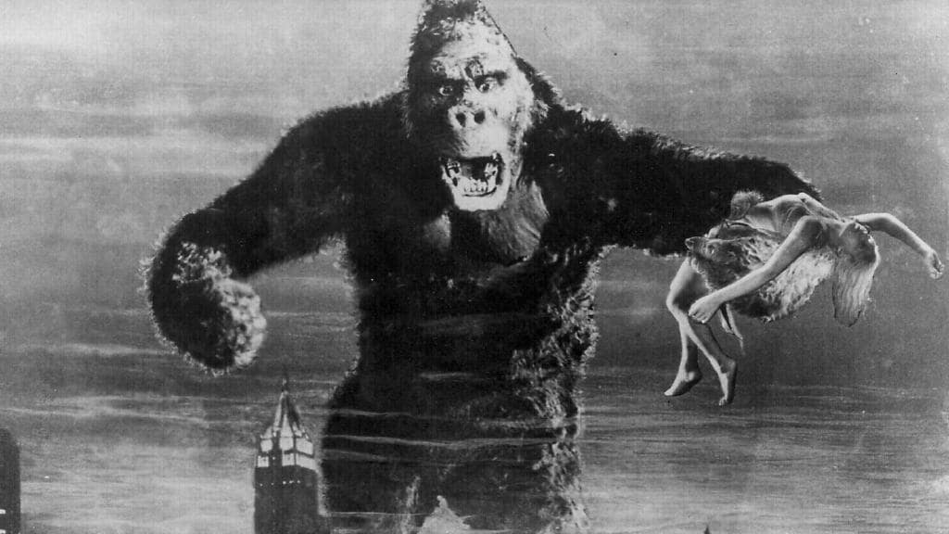
King Kong
1933
Fay Wray
In…

Slide 30
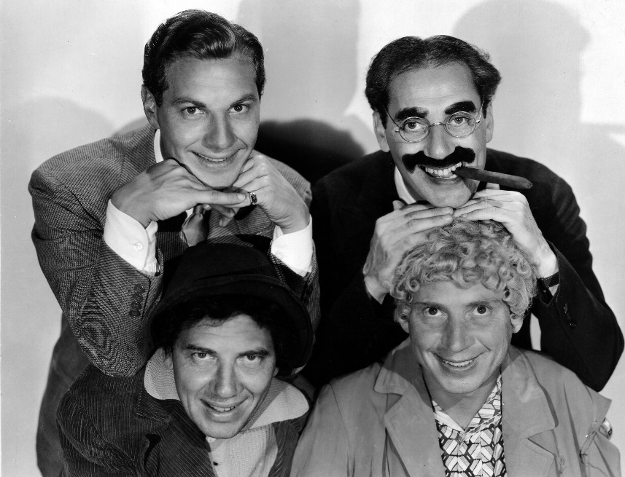
A Night at
The Opera
1935
The Marx
Brothers
In…
Duck Soup
1933

Slide 31
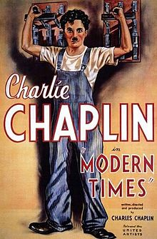
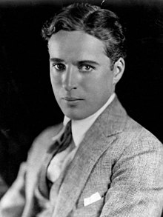
Charlie
Chaplin
In…
Modern Times
1936

Slide 32
First full length
Animated movie
Walt Disney’s
Snow White
1937

Slide 33
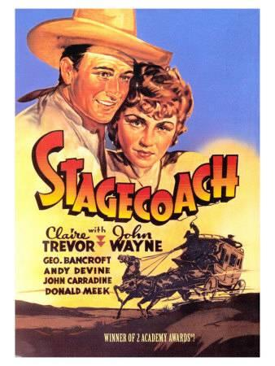
John Wayne
In…
Stage Coach
1939

Slide 34
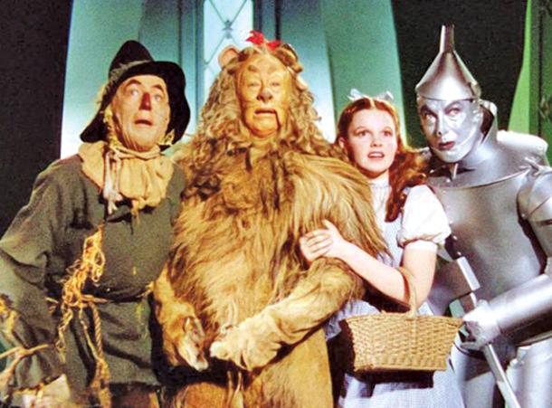
Judy Garland
In…
Wizard of Oz
1939

Slide 35
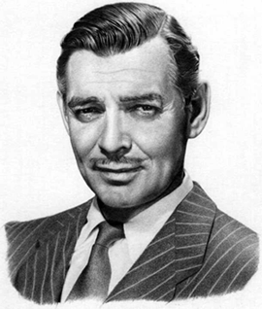
Clark Gable
&Vivien Leigh
In…
Gone With
The Wind
1933

Slide 36
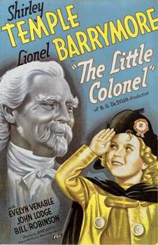
Shirley
Temple
In…
Bright Eyes
1934
The Little
Colonel
1935

Slide 37
James
Cagney
In…
Public Enemy
1931
Angels with
Dirty Faces
1938

Slide 38
Captain
Blood
1936
Robin Hood
1938
Errol Flynn &
Olivia de Havilland
In…

Slide 39
Fred Astaire
&
Ginger Rogers
In…
Top Hat
1935
Swing Time
1936

Slide 40
Charles Coughlin, the Radio priest
Anti-Semitic, wealth redistribution
Huey Long, Governor and Senator from Louisiana
“Dictator” of Louisiana
“Share our Wealth” and “Every Man a King”

