Slide 1
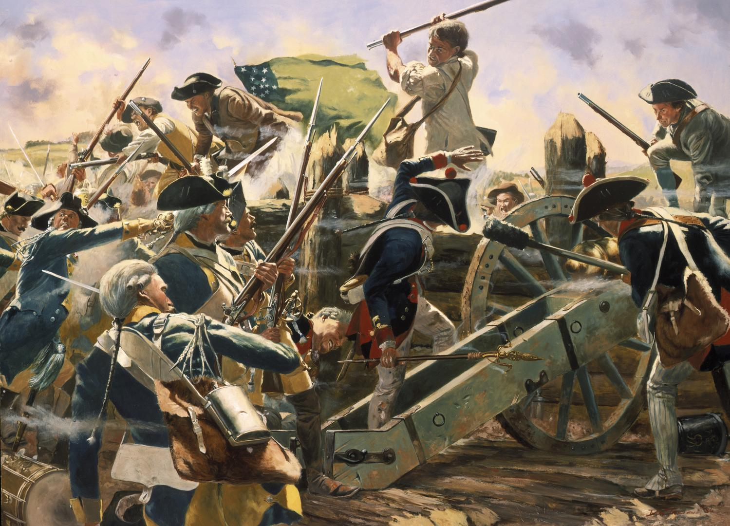
The American Revolution

Slide 2
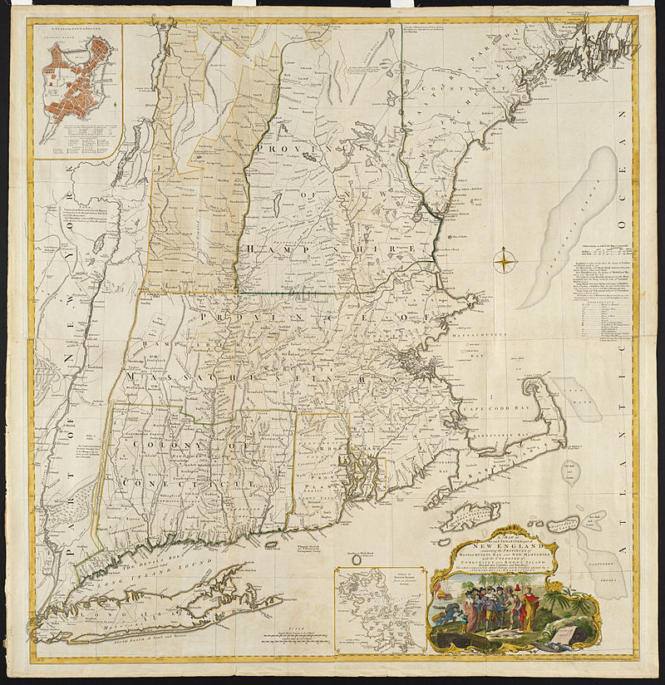
May 1775: Capture of Ft. Ticonderoga
The War - 1775
Fall/Winter 1775: Attack on Quebec City fails
April 1775: Battles of Lexington & Concord,
Colonial siege of Boston begins
June 1775 Battle of Bunker Hill

Slide 3
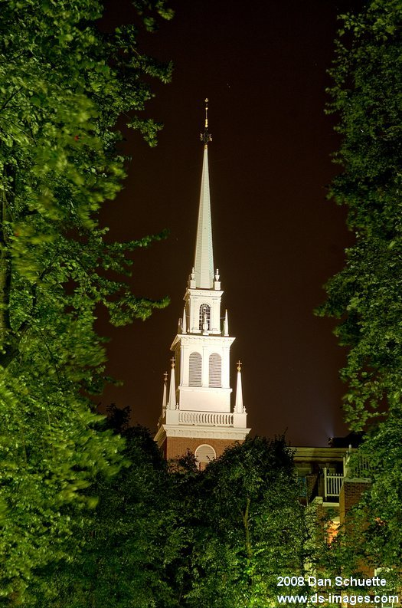
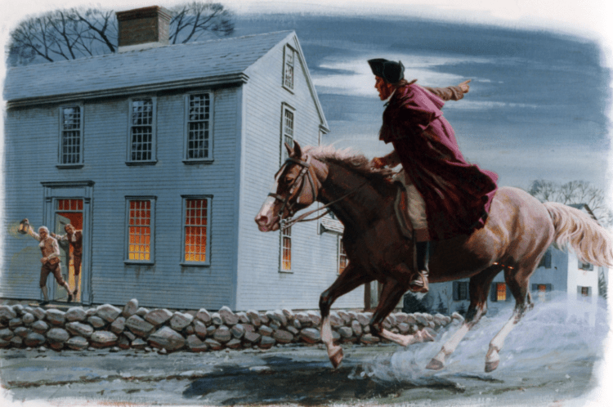

Slide 4
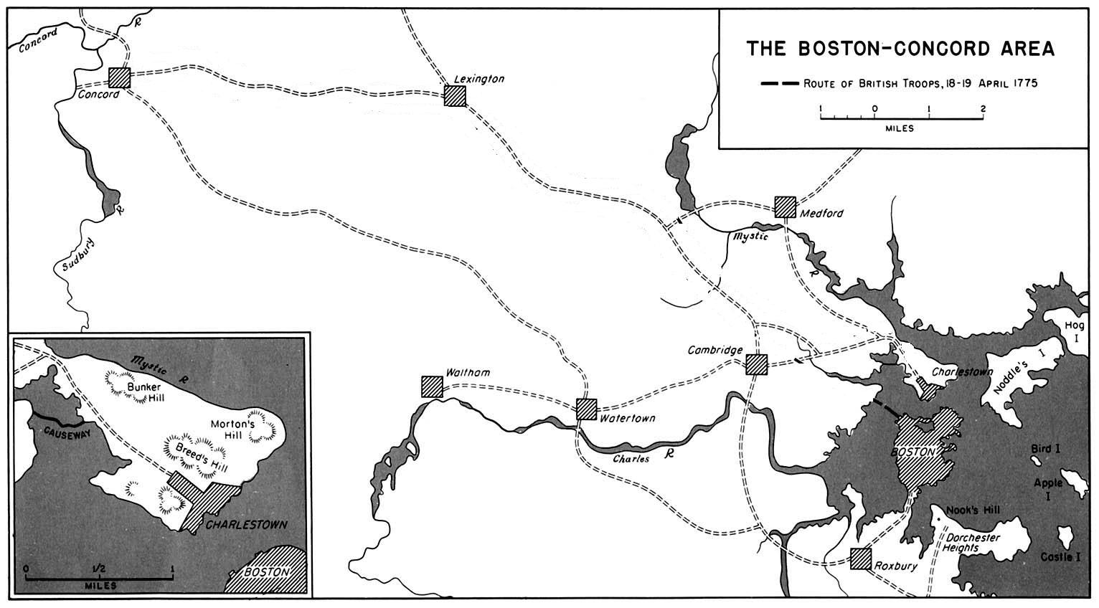
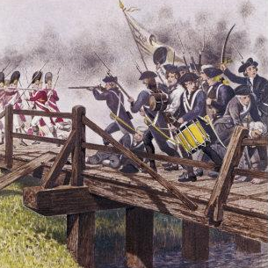
Paul Revere
Dr. Samuel Prescott
William Dawes
The Redcoats

Slide 5
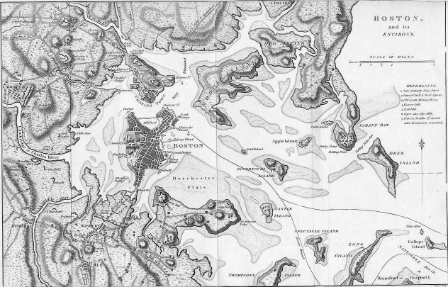
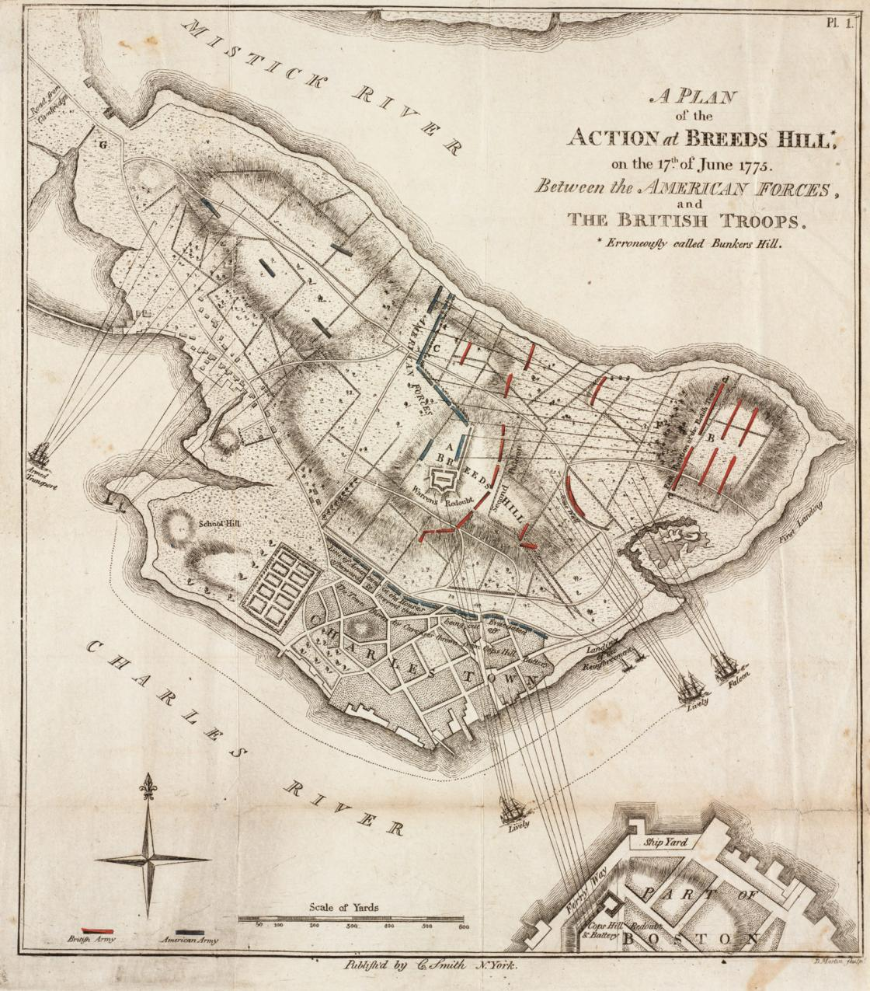

Slide 6
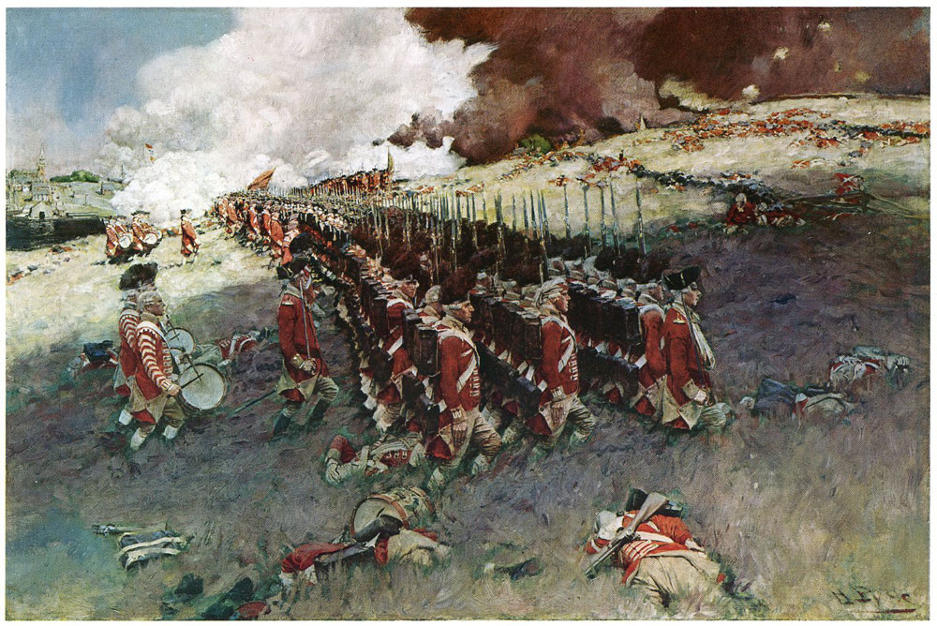

Slide 7
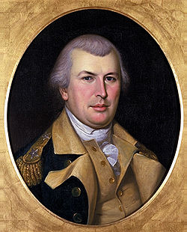
June 17, 1775: Battle of Bunker Hill: British take a hill outside Boston but suffer massive casualties; the bloodiest battle of the entire war. NH provides at least half of all colonial troops.
Served: 2,400
Killed: 115
Wounded: 305
Captured: 30
Total: 450
I wish we could sell them another hill at the same price…
Served: 3,000
Killed: 226
Wounded: 828
Total: 1054

Slide 8
The Olive Branch Petition
- (June 1775)A last attempt by colonists to avoid war with Great Britain, written by John Dickinson (author of Letters from A Pennsylvania Farmer)
- Pledged allegiance to King George III but rejected Parliamentary power over the colonies. It was rejected by the King
“We solemnly assure your Majesty, that we not only most ardently desire the former harmony between her and these colonies may be restored but that a concord may be established between them upon so firm a basis, as to perpetuate its blessings uninterrupted by any future dissentions to succeeding generations in both countries…We beg leave further to assure your Majesty that …our breasts retain too tender a regard for the kingdom from which we derive our origin to request such a reconciliation as might in any manner be inconsistent with her dignity or her welfare….
We therefore beseech your Majesty, that your royal authority and influence may be graciously interposed…that in the meantime measures be taken for preventing the further destruction of the lives of your Majesty’s subjects; and that such statutes as more immediately distress any of your Majesty's colonies be repealed…”

Slide 9
Declaration of the Causes and Necessity of Taking up Arms
- (July 1775) – Resolution adopted by the Continental Congress that justified the rebellious actions taken by colonists; that they were necessary to preserve their liberty against Parliamentary intrusion.
With hearts fortified with these animating reflections, we most solemnly, before God and the world, declare, that, exerting the utmost energy of those powers, which our beneficent Creator hath graciously bestowed upon us, the arms we have been compelled by our enemies to assume, we will, in defiance of every hazard, with unabating firmness and perseverance, employ for the preservation of our liberties; being with our [one] mind resolved to die Free-men rather than live Slaves.

Slide 10
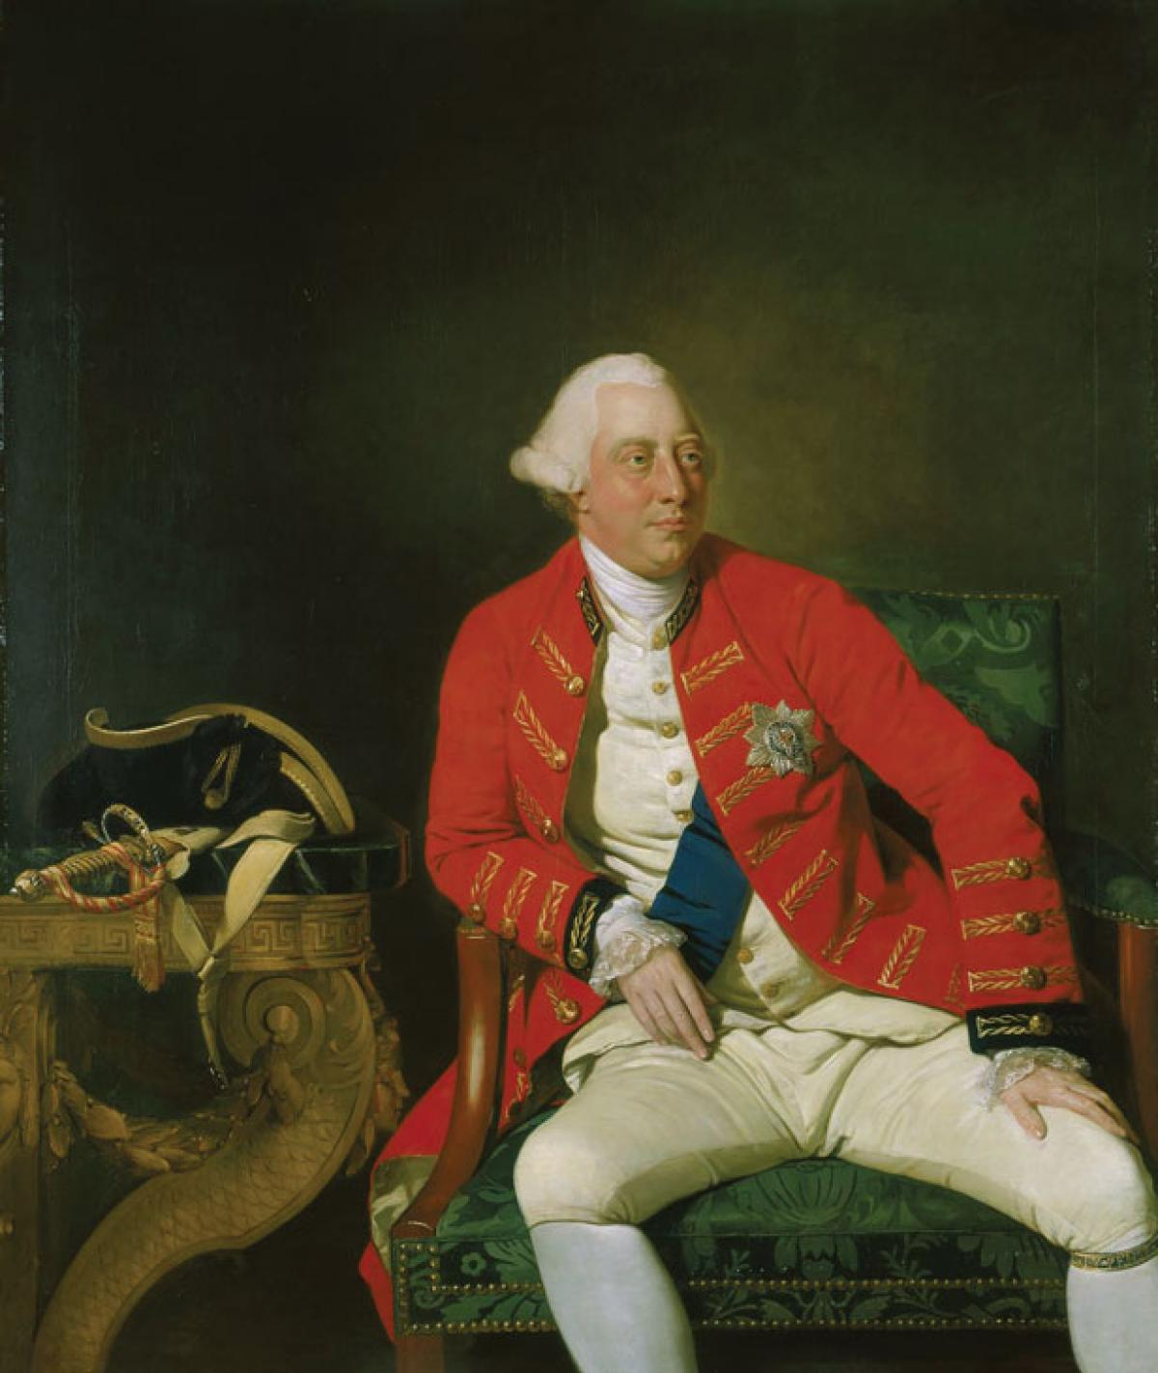
Prohibitory Act (1775)
- Declaration by King George III and Parliament making trade with the colonies illegal and declaring colonists outside royal protection.

Slide 11
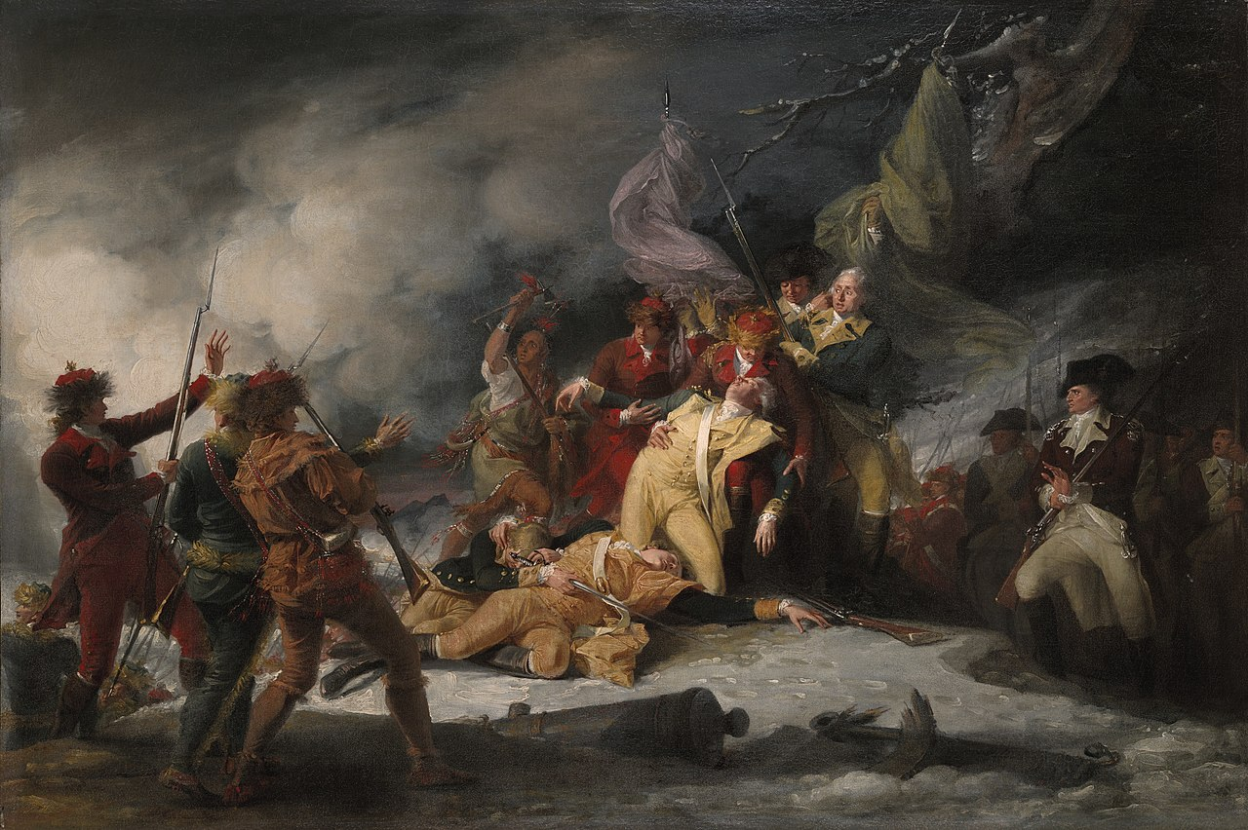

Slide 12
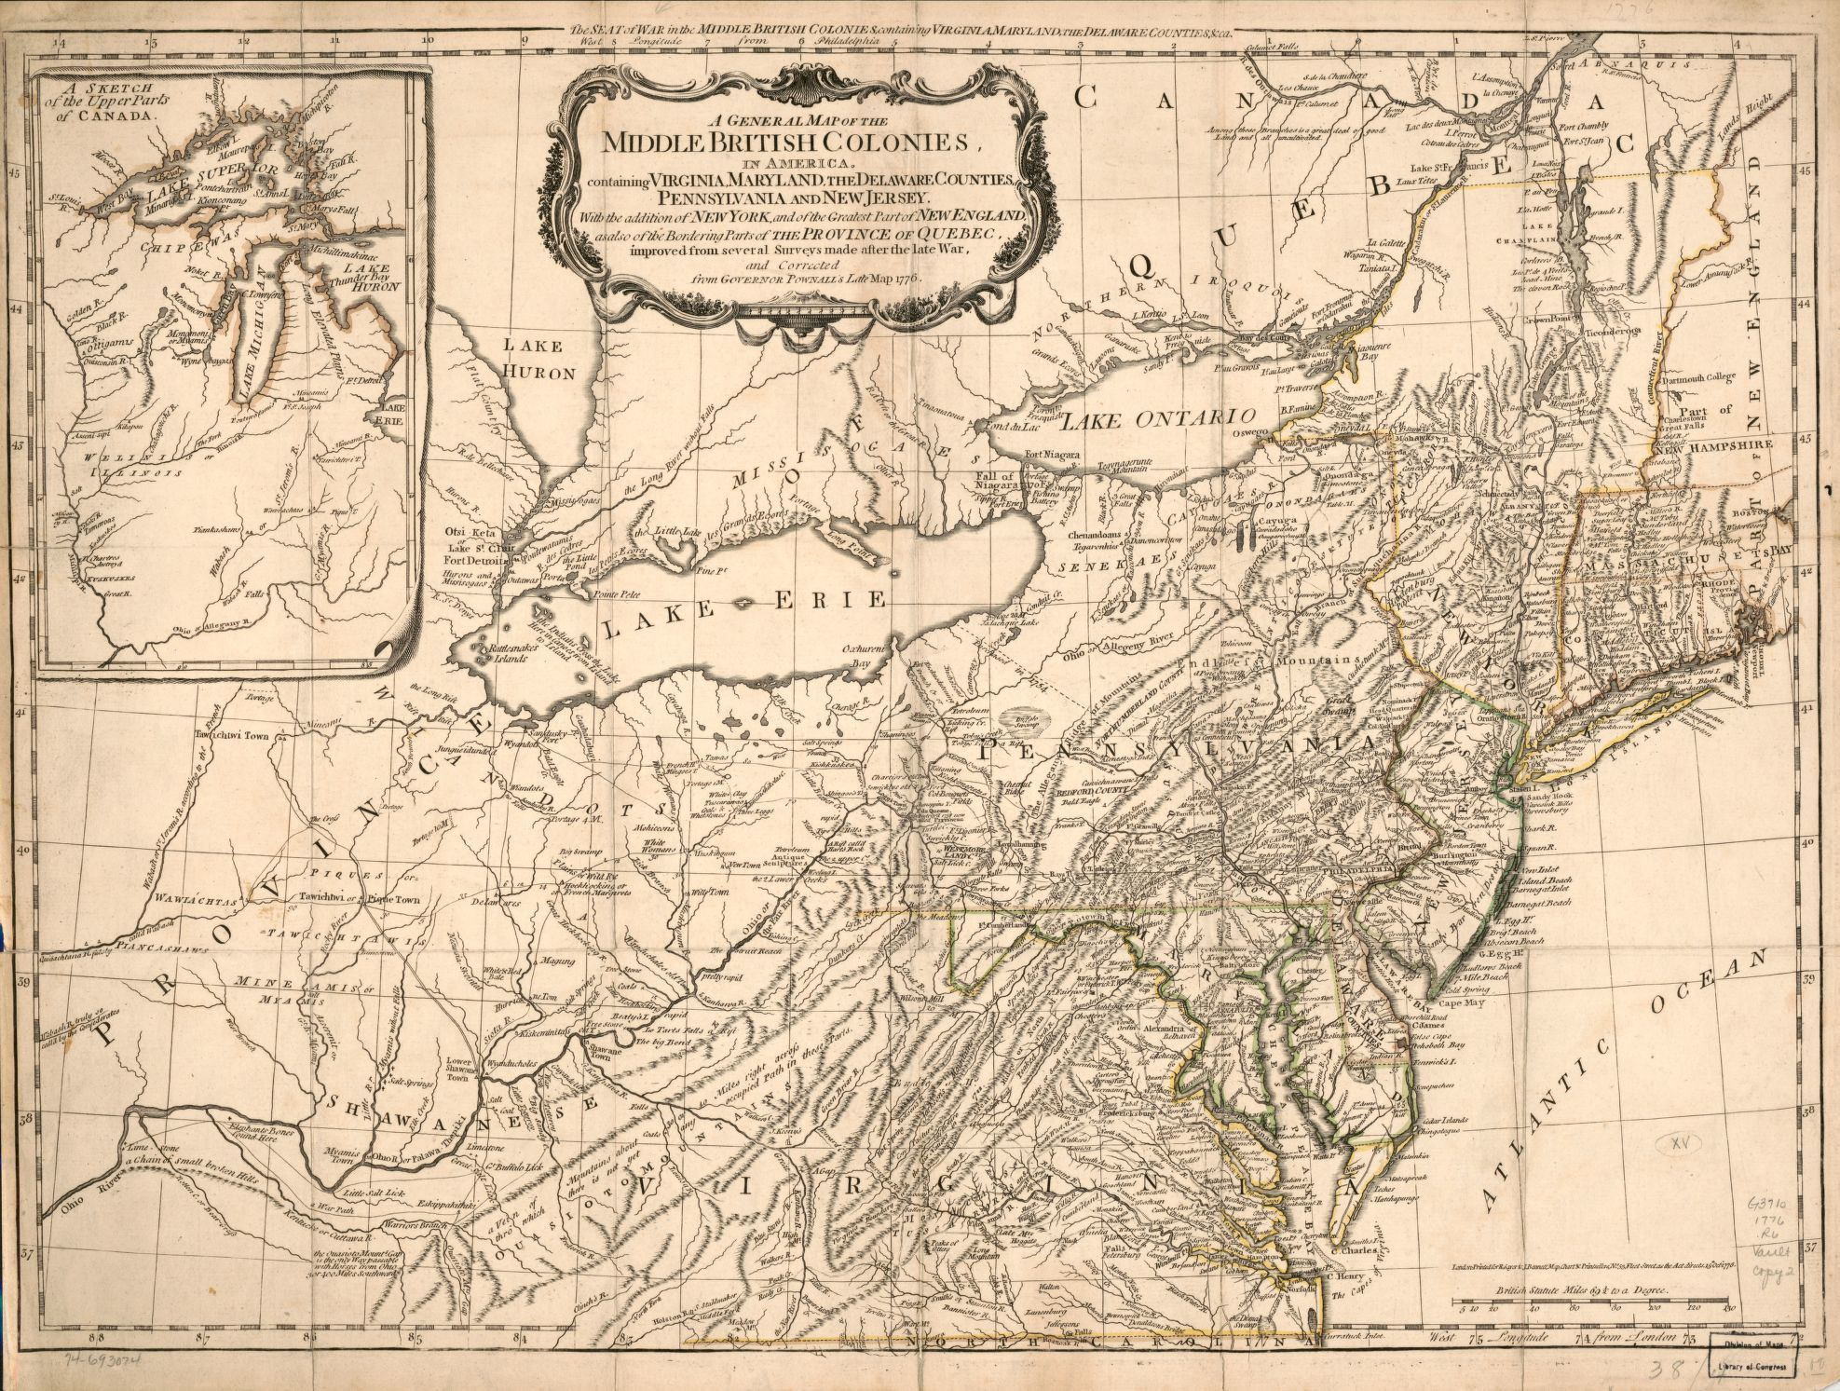
The War - 1776
March 1776: British driven out of Boston
July 1776: British capture New York City and, southern NY, and northern NJ
December 1776: Battle of Trenton, NJ

Slide 13
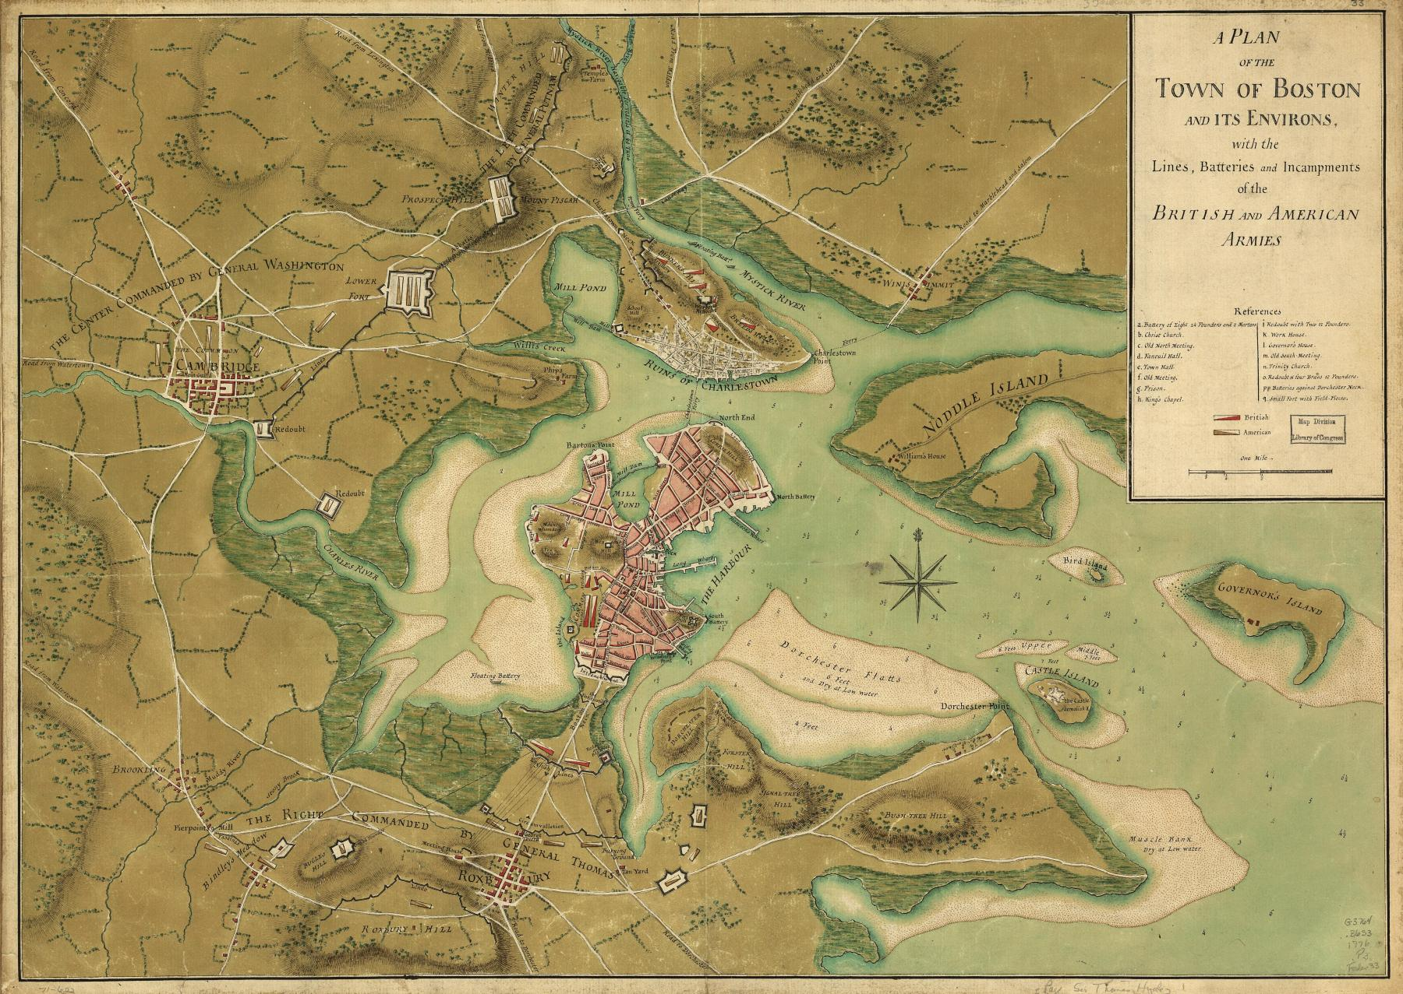
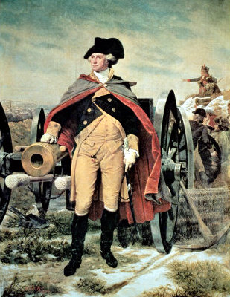
March 1776: Washington uses cannons to force the British to evacuate Boston, they sail to Halifax NS.

Slide 14
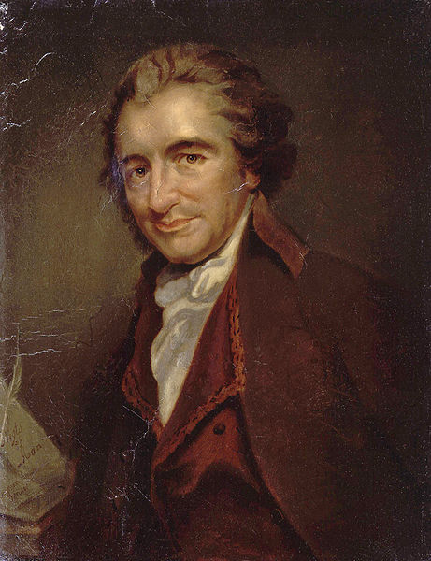
“Common Sense”: Popular pamphlet by Thomas Paine, encouraging American independence
Of more worth is one honest man to society and in the sight of God, than all the crowned ruffians that ever lived.
In England a king hath little more to do than to make war and give away places; which in plain terms, is to impoverish the nation…
But where, say some, is the King of America? I'll tell you, friend, he reigns above, and doth not make havoc of mankind like the Royal Brute of Great Britain... so far as we approve of monarchy, that in America the law is king.
Small islands not capable of protecting themselves are the proper objects for kingdoms to take under their care; but there is something very absurd in supposing a continent to be perpetually governed by an island.
Every thing that is right or natural pleads for separation. The blood of the slain, the weeping voice of nature cries, 'tis time to part.
O ye that love mankind! Ye that dare oppose, not only the tyranny, but the tyrant, stand forth!

Slide 15
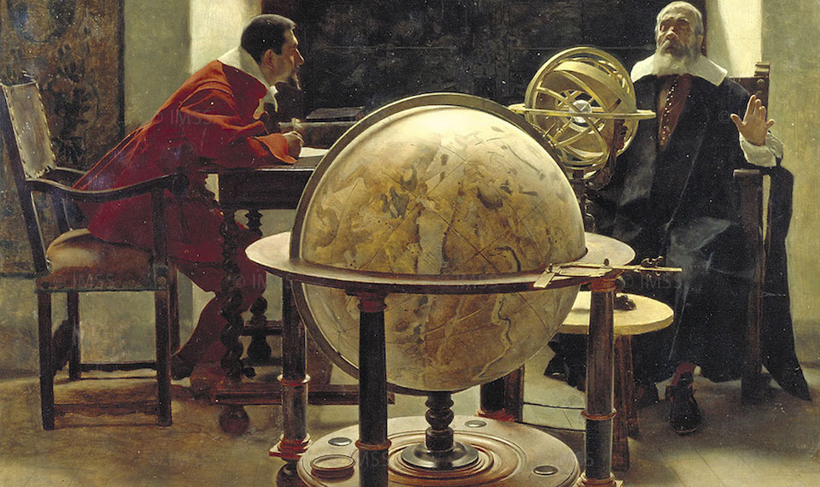
Age of Enlightenment: 18th century European era, based on ideas of rationalism, knowledge, and the concepts of liberty and brotherhood.
Rationalism: a belief or theory that opinions and actions should be based on reason and knowledge rather than on religious belief or emotional response.
Deism: Religious belief in a Supreme Being or Creator who does not get involved in the universe.

Slide 16
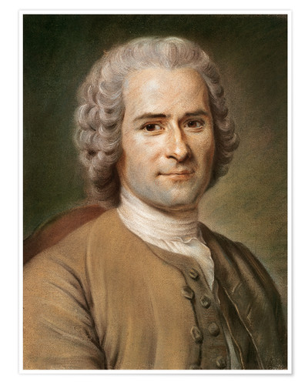
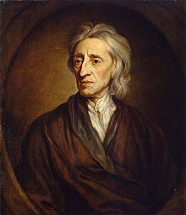
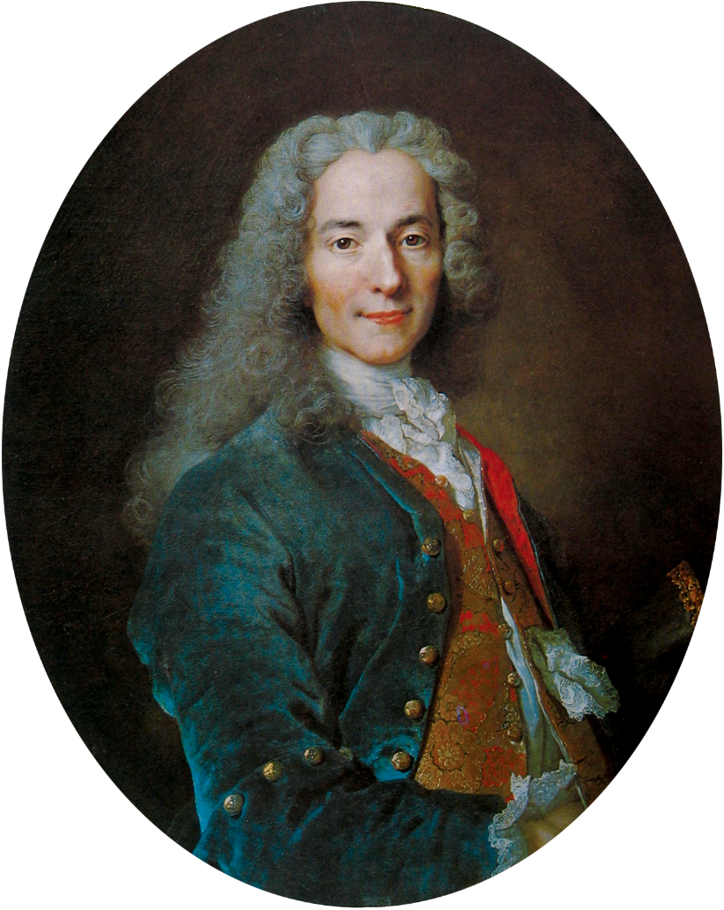
John Locke: English philosopher. His belief was that people give power to governments in return for protection of their rights: Life, Liberty, and Property.
Jean Jacques Rousseau: Swiss philosopher. His belief was that laws are binding only when they are supported by the will of the people. “Man is born free, but he is everywhere in chains.”
Voltaire: French philosopher. A strong proponent of freedom of speech, religion, and the separation of church and state.

Slide 17
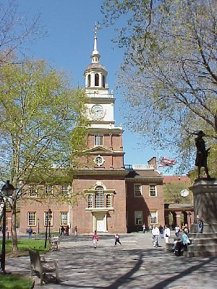
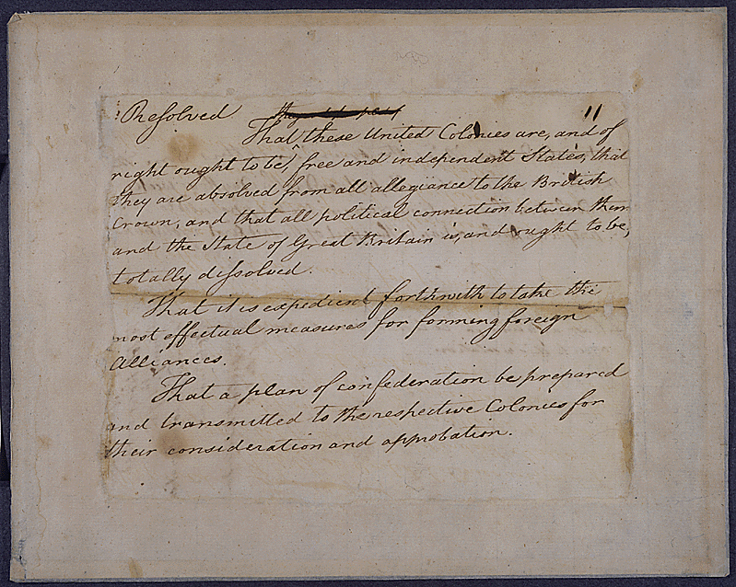
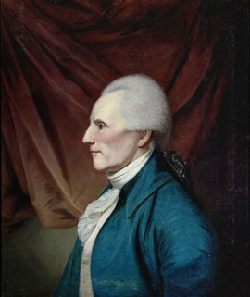

Slide 18
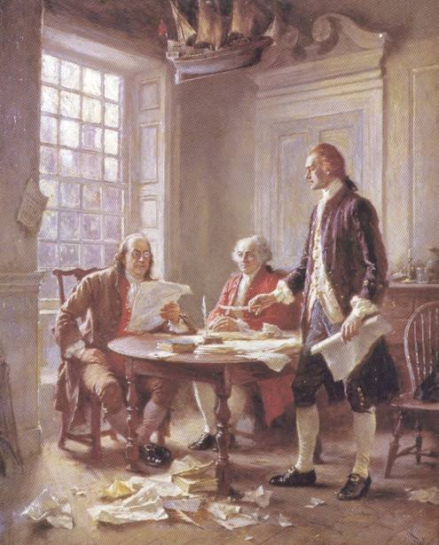
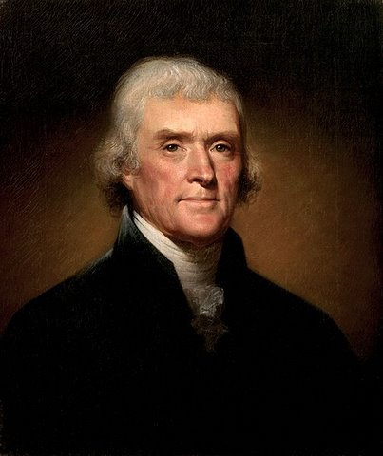
Independence was proposed by Richard Henry Lee of VA in June 1776. The Declaration of Independence was written by Thomas Jefferson, and edited by John Adams and Benjamin Franklin.

Slide 19
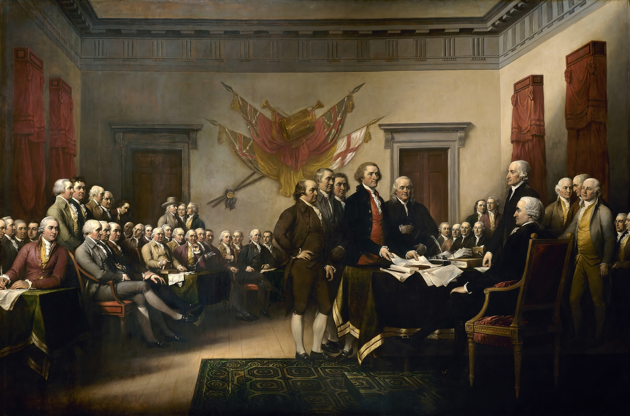
Independence was declared July 2, 1776, and the Declaration of Independence adopted July 4.
It was signed between August 2, 1776 and 1780.

Slide 20
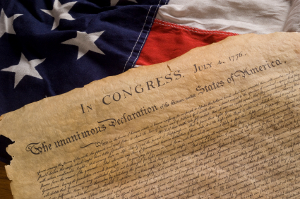
The Declaration of Independence
When in the Course of human events, it becomes necessary for one people to dissolve the political bands which have connected them with another, and to assume among the powers of the earth, the separate and equal station to which the Laws of Nature and of Nature's God entitle them, a decent respect to the opinions of mankind requires that they should declare the causes which impel them to the separation.

Slide 21
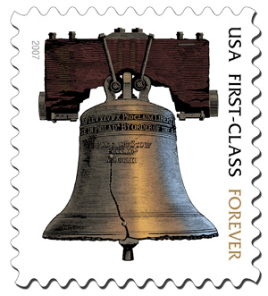
We hold these truths to be self-evident, that all men are created equal, that they are endowed by their Creator with certain unalienable rights, that among these are life, liberty and the pursuit of happiness.

Slide 22
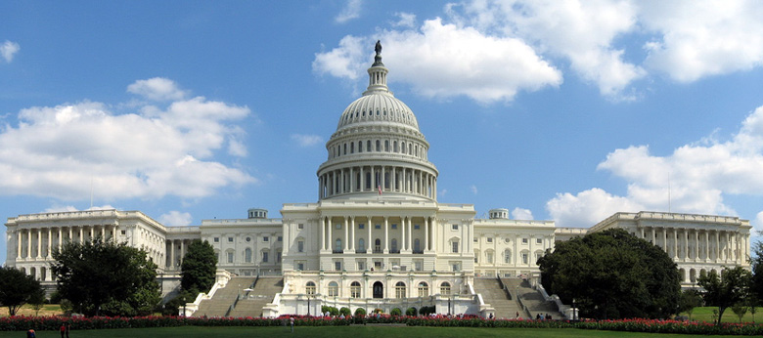
That to secure these rights, governments are instituted among men, deriving their just powers from the consent of the governed. That whenever any form of government becomes destructive to these ends, it is the right of the people to alter or to abolish it, and to institute new government, laying its foundation on such principles and organizing its powers in such form, as to them shall seem most likely to effect their safety and happiness.

Slide 23
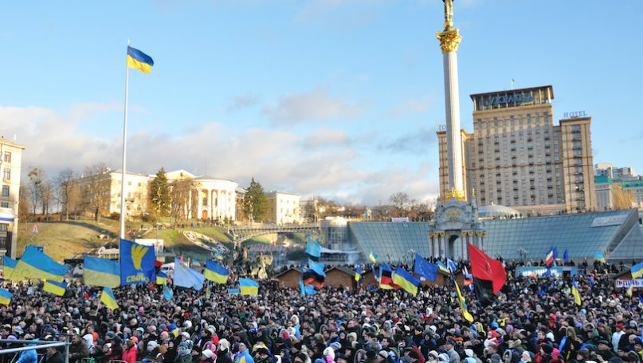
Prudence, indeed, will dictate that governments long established should not be changed for light and transient causes; and accordingly all experience hath shown that mankind are more disposed to suffer, while evils are sufferable, than to right themselves by abolishing the forms to which they are accustomed.
But when a long train of abuses and usurpations, pursuing invariably the same object evinces a design to reduce them under absolute despotism, it is their right, it is their duty, to throw off such government, and to provide new guards for their future security.

Slide 24
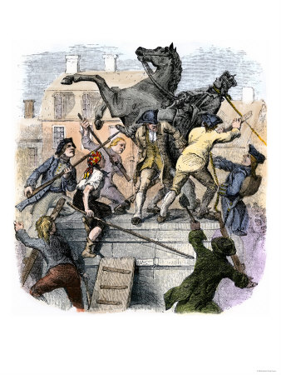
Such has been the patient sufferance of these colonies; and such is now the necessity which constrains them to alter their former systems of government. The history of the present King of Great Britain is a history of repeated injuries and usurpations, all having in direct object the establishment of an absolute tyranny over these states. To prove this, let facts be submitted to a candid world:

Slide 25
He has refused his assent to laws, the most wholesome and necessary for the public good.
He has forbidden his governors to pass laws of immediate and pressing importance, unless suspended in their operation till his assent should be obtained; and when so suspended, he has utterly neglected to attend to them.
He has refused to pass other laws for
the accommodation of large districts
of people, unless those people would
relinquish the right of representation
in the legislature, a right inestimable
to them and formidable to tyrants only.

Slide 26
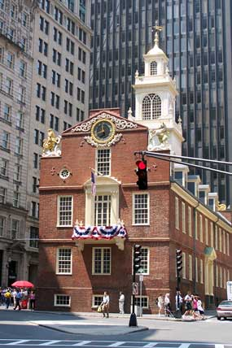
He has called together legislative bodies at places unusual, uncomfortable, and distant from the depository of their public records, for the sole purpose of fatiguing them into compliance with his measures.
He has dissolved representative houses repeatedly, for opposing
with manly firmness his invasions on the
rights of the people.
He has refused for a long time, after such
dissolutions, to cause others to be elected; whereby the legislative powers, incapable of
annihilation, have returned to the people at
large for their exercise; the state remaining in the meantime exposed to all the dangers of invasion from without, and convulsions within.

Slide 27
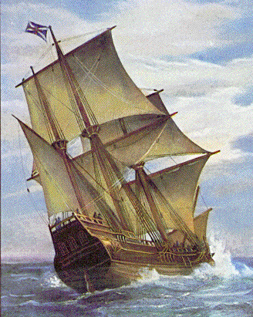
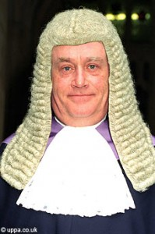
He has endeavored to prevent the population of these states; for that purpose obstructing the laws for naturalization of foreigners; refusing to pass others to encourage their migration hither, and raising the conditions of new appropriations of lands.
He has obstructed the administration of justice, by refusing his assent to laws for establishing judiciary powers.
He has made judges dependent on his will alone, for the tenure of their offices, and the amount and payment of their salaries.

Slide 28
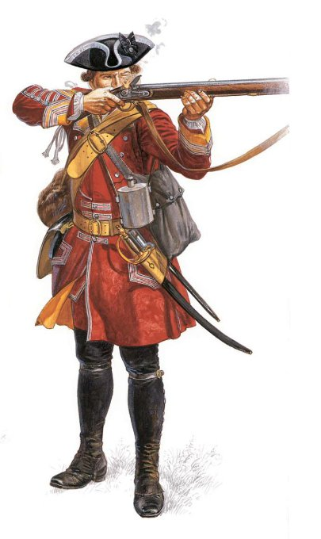
He has erected a multitude of new offices, and sent hither swarms of officers to harass our
people, and eat out their
substance.
He has kept among us, in times of peace, standing armies without the consent of our legislature.
He has affected to render the military independent of and superior to civil power.

Slide 29
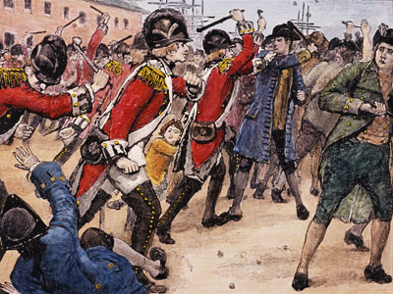
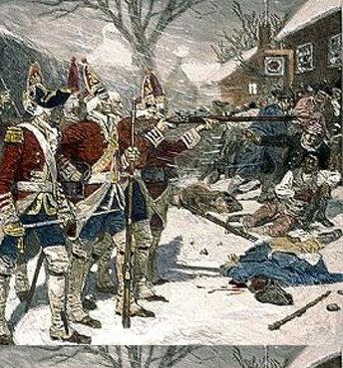
He has combined with others to subject us to a jurisdiction foreign to our constitution, and unacknowledged by our laws; giving his assent to their acts of pretended legislation:
For quartering large bodies of armed troops among us:
For protecting them, by mock trial, from punishment for any murders which they should commit on the inhabitants of these states:
For cutting off our trade with all parts of the world:

Slide 30
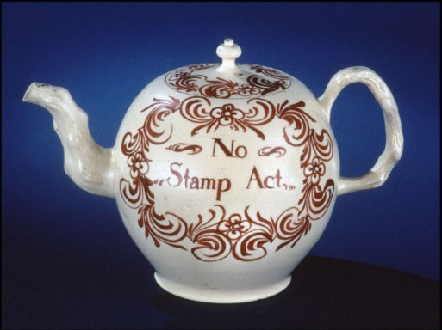
For imposing taxes on us without our consent:
For depriving us in many cases, of the benefits of trial by jury:
For transporting us beyond seas to be tried for pretended offenses:
For abolishing the free system of English laws in a neighboring province, establishing therein an arbitrary government, and enlarging its boundaries so as to render it at once an example and fit instrument for introducing the same absolute rule in these colonies:

Slide 31
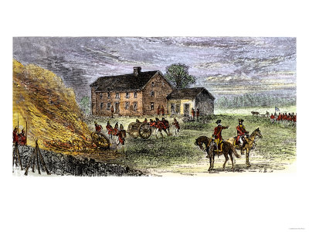
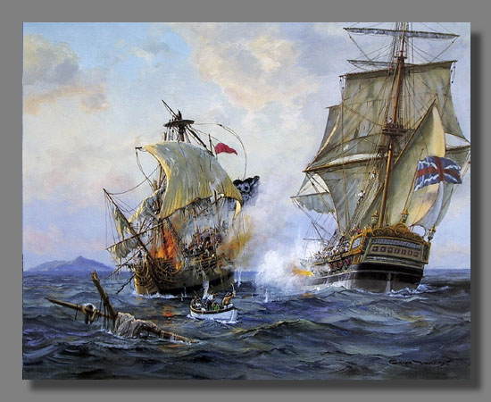
For taking away our charters, abolishing our most valuable laws, and altering fundamentally the forms of our governments:
For suspending our own legislatures, and declaring themselves invested with power to legislate for us in all cases whatsoever.
He has abdicated government here, by declaring us out of his protection and waging war against us.
He has plundered our seas, ravaged our coasts, burned our towns, and destroyed the lives of our people.

Slide 32
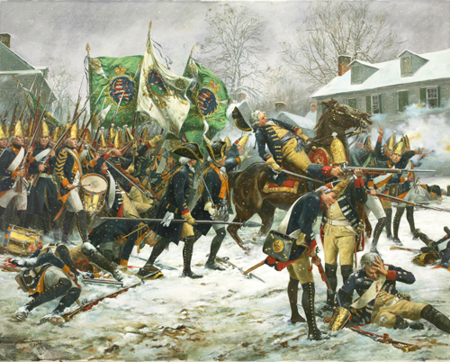
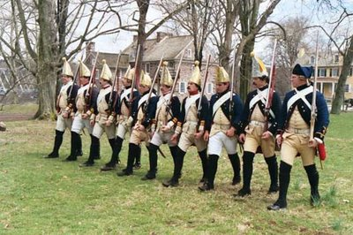
He is at this time transporting large armies of foreign mercenaries to complete the works of death, desolation and tyranny, already begun with circumstances of cruelty and perfidy scarcely paralleled in the most barbarous ages, and totally unworthy the head of a civilized nation.
He has constrained our fellow citizens taken captive on the high seas to bear arms against their country, to become the executioners of their friends and brethren, or to fall themselves by their hands.

Slide 33
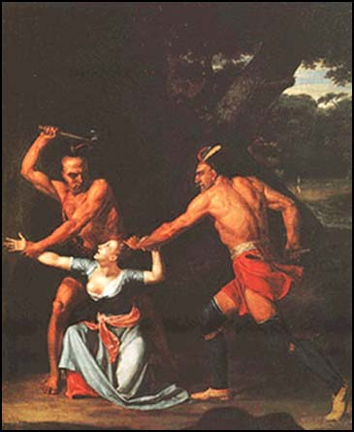
He has excited domestic insurrections amongst us, and has endeavored to bring on the inhabitants of our frontiers, the merciless Indian savages, whose known rule of warfare, is undistinguished destruction of all ages, sexes and conditions.
In every stage of these oppressions we have petitioned for redress in the most humble terms: our repeated petitions have been answered only by repeated injury. A prince, whose character is thus marked by every act which may define a tyrant, is unfit to be the ruler of a free people.

Slide 34
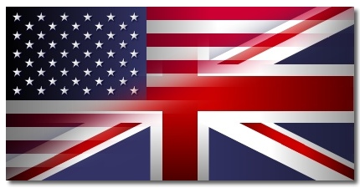
Nor have we been wanting in attention to our British brethren. We have warned them from time to time of attempts by their legislature to extend an unwarrantable jurisdiction over us. We have reminded them of the circumstances of our emigration and settlement here. We have appealed to their native justice and magnanimity, and we have conjured them by the ties of our common kindred to disavow these usurpations, which, would inevitably interrupt our connections and correspondence. They too have been deaf to the voice of justice and of consanguinity. We must, therefore,
acquiesce in the necessity,
which denounces our
separation, and hold them,
as we hold the rest of
mankind, enemies in war,
in peace friends.

Slide 35
We, therefore, the representatives of the United States of America, in General Congress, assembled, appealing to the Supreme Judge of the world for the rectitude of our intentions, do, in the name, and by the authority of the good people of these colonies, solemnly publish and declare, that these united colonies are, and of right ought to be free and independent states; that they are absolved from all allegiance to the British Crown, and that all political connection between them and the state of Great Britain, is and ought to be totally dissolved;

Slide 36
and that as free and independent states, they have full power to levy war, conclude peace, contract alliances, establish commerce, and to do all other acts and things which independent states may of right do. And for the support of this declaration, with a firm reliance on the protection of Divine Providence, we mutually pledge to each other our lives, our fortunes and our sacred honor.

Slide 37
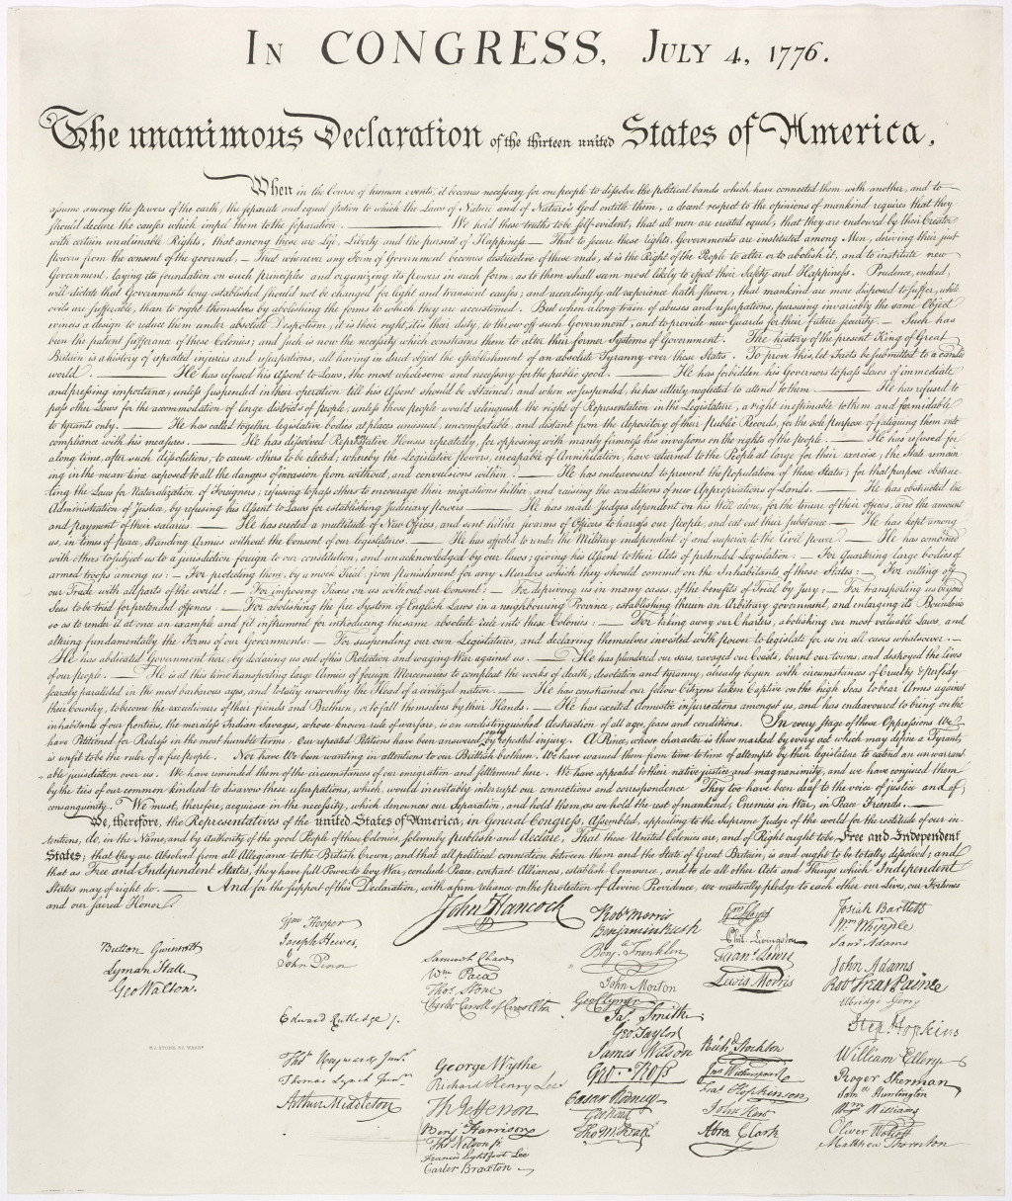

Slide 38
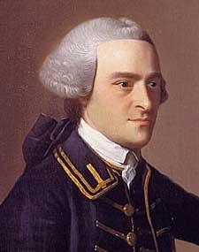
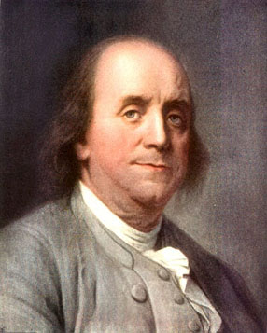
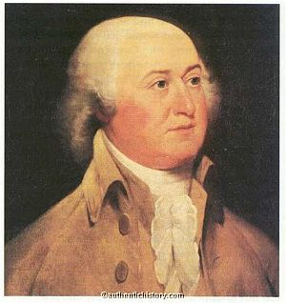
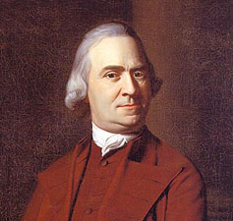
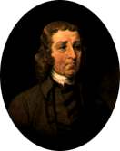

Slide 41
June 14, 1777: The American flag is adopted
It was NOT made by Betsy Ross…

Slide 42
July 1777: British recapture Ft. Ticonderoga, NY
August 1777:
Battle of Bennington, VT
The War - 1777
August 1777: Battle of Oriskany, NY
October 1777:
Battle of Saratoga, NY
Fall 1777: Battles of Brandywine
and Germantown PA, Philadelphia captured

Slide 43
1777:
British General John Burgoyne plans a 3-part attack plan to conquer New England by sending armies from Canada and New York towards Albany.

Slide 44
I’ve got a craving for a Cheesesteak!
Part 1 fails when General Howe attacks and captures Philadelphia instead, defeating Washington at Brandywine and Germantown, PA.

Slide 45
Part 2 fails when St. Leger is defeated in upstate New York (Battles of Oriskany and Fort Stanwix.)

Slide 47
Battle of Bennington:
NH General John Stark attacks 1500 Hessians with over 2000 NH militia, killing over 200 and capturing 700

Slide 50
Battle of Saratoga: General Burgoyne is defeated and surrenders his entire army to the Americans. This is the major turning point of the American Revolution.
Part 3 ends when Burgoyne surrenders to General Horatio Gates at Saratoga, NY
Colonel Cilley
John Stark
Henry Dearborn
William Whipple
Alexander Scammell
Colonel Lewis

Slide 51
Alliance with France: Because of Saratoga, in 1778 King Louis XVI and Benjamin Franklin form an alliance.

Slide 52
Valley Forge: Washington’s army suffers through the winter of 1777-1778, but is trained by Prussian captain Baron von Steuben

Slide 54
The War – 1778 & 1779
June 1778: Battle of Monmouth, NJ
Battles of Kaskaskia, Vincennes,
and Fort Sackville ((Illinois, Indiana))

Slide 55
I have not yet begun to fight!
John Paul Jones: USS Ranger (from Portsmouth, NH) attacks British ships and a town in Scotland. His second ship, Bonhomme Richard, defeated the HMS Serapis the following year.

Slide 57
The War – 1780
October: Battle of Kings Mountain, NC
August: Battle of Camden, SC
March-May: Siege of Charleston, SC

Slide 58
Arnold’s Betrayal: General Benedict Arnold betrays the United States and switches to the British side in 1780

Slide 59
Marquis de Lafayette
French nobleman who volunteered to fight with the Americans.

Slide 60
The War – 1781
October: Battle of Yorktown, VA
January: Burning of Richmond, VA
September: Battle of the Capes
March: battle of Guilford Courthouse, NC
January: Battle of Cowpens, SC
September: Battle of Eutaw Springs, SC

Slide 61
The Yorktown Plan: Washington and Rochambeau will bring the combined American and French Armies to Virginia and surround Cornwallis by land; De Grasse’s French Navy will surround the British by sea
Rochambeau
Washington
Clinton
Cornwallis
Greene
De Grasse

Slide 62
Battle of Yorktown: begins in September 1781
Chesapeake Bay
Williamsburg
York River
Cape Charles
Yorktown
James River
Cape Henry
Norfolk

Slide 64
Chesapeake Bay
Williamsburg
York River
Cape Charles
Yorktown
James River
Cape Henry
Norfolk

Slide 65
Cornwallis surrenders to Washington in October, 1781

Slide 67
Treaty of Paris - 1783
1. Great Britain recognizes the independence of the United States.
2.The US is given all the land south of Canada, east of the Mississippi River, and north of Florida.
3. US gets fishing rights near Newfoundland.
4. Congress will recommend that the states repay loyalists for seized property.
5. Florida is given back to Spain.

Slide 68
In 1783, Washington resigns his commission and goes home.

