Slide 1
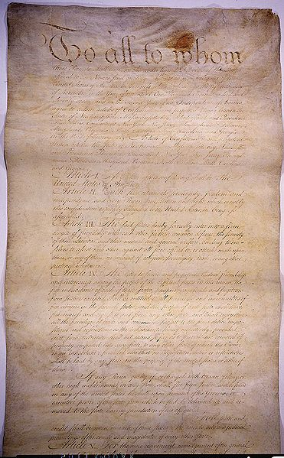
The Articles of Confederation

Slide 2
How the AoC Government worked:
One vote per state in Congress
Congress can declare war, coin money, and
  conduct foreign affairs.
At least 9/13 states must approve laws – amendments to the articles must be unanimous.
How the AoC Government didn’t work:
Can’t regulate trade
Can’t tax.
Must ask for money from states
No president or court system (except for pirates!)

Slide 3
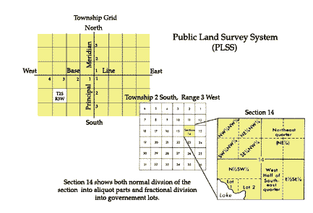
Land Ordinance of 1785
Accomplishments
-Divided new land into 36 square mile townships, and sold off 1 square mile sections at $1/acre

Slide 4
6 miles
Township
Half Section – 320 acres
Half-quarter Section
80 acres
Quarter Section
160 acres
Quarter quarter Section
40 acres

Slide 5
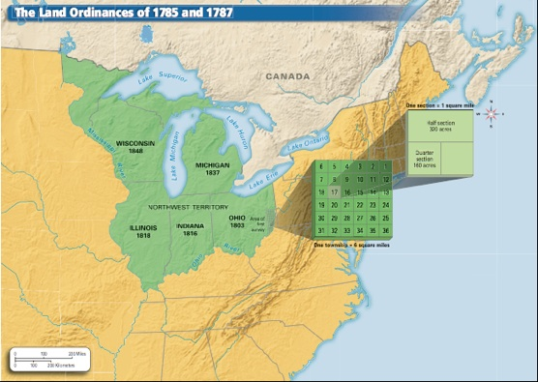

Slide 6
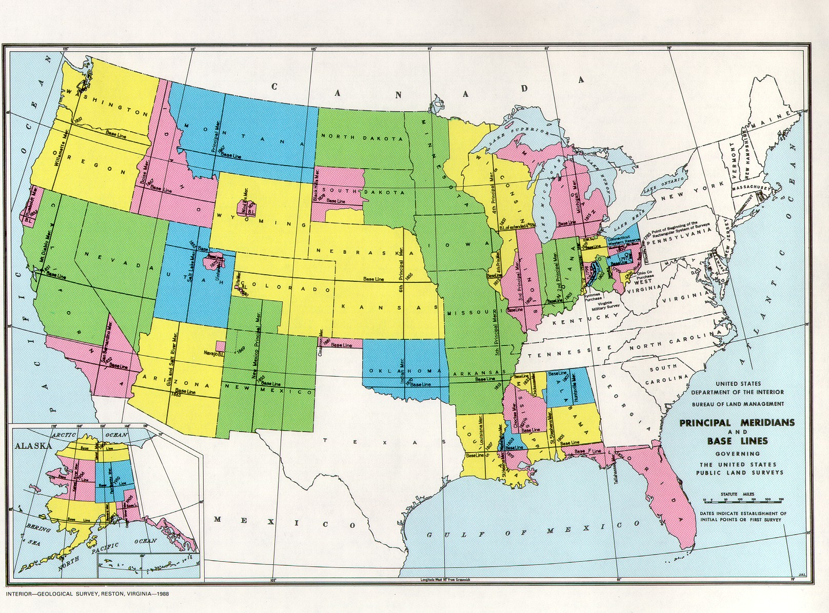

Slide 7
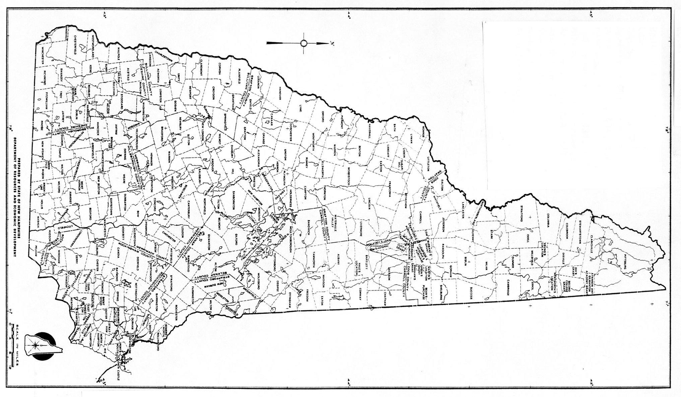

Slide 8
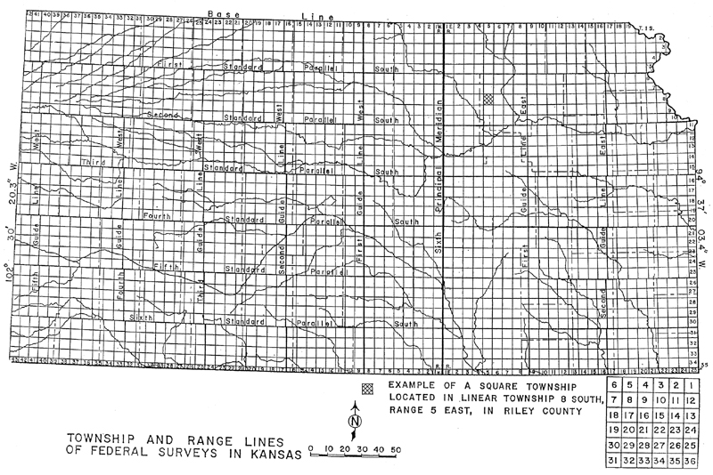

Slide 9
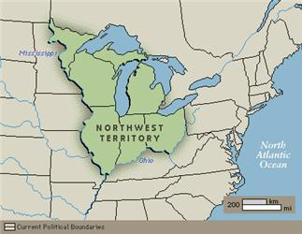

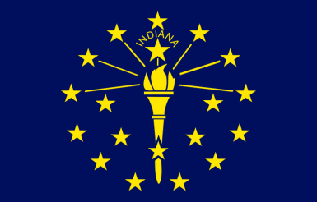
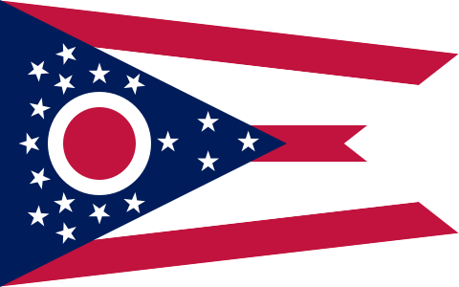
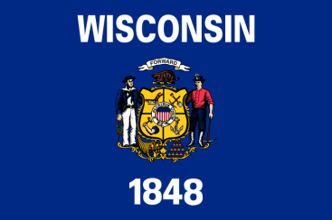
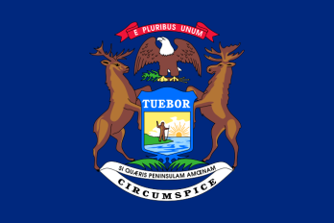
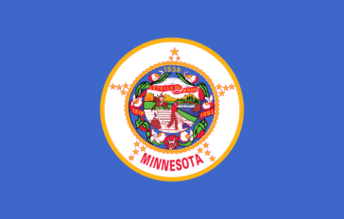
Northwest Ordinance
Accomplishments
Guaranteed basic rights in Northwest Territory
Bans slavery there
Will be divided into 3 to 5 new, equal states
Set up system to create new states

Slide 10
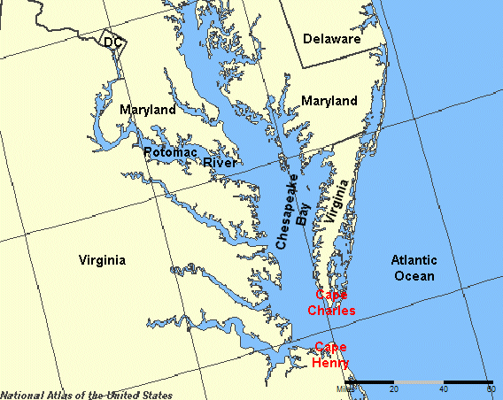
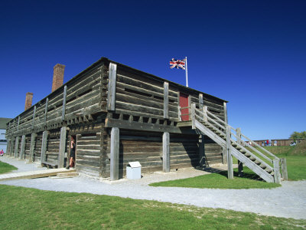
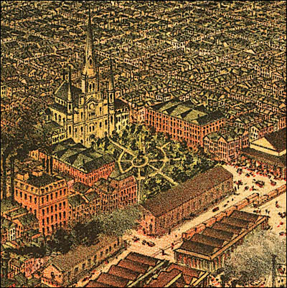

Virginia vs. Maryland dispute
Failures
British still occupy Northwest Territory
Spanish close Mississippi River
America can’t pay back war debt

Slide 11
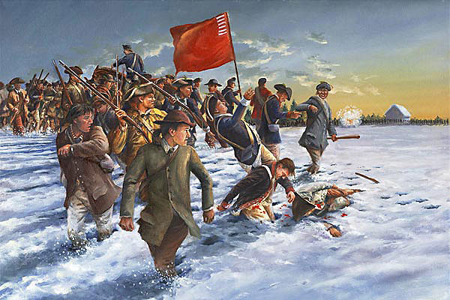

Shays’ Rebellion
-Farmers in Western MA rebel against property repossession and not being paid for Revolutionary service.
- It takes a privately funded army to stop the rebellion.
Failures

Slide 12

The Mount Vernon Conference
I think we better sort this mess out!
Off to Philly!

Slide 13
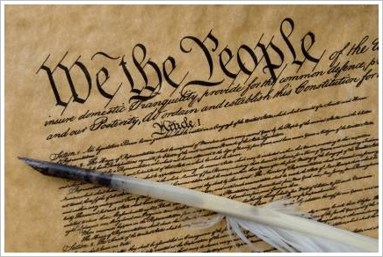
The United States Constitution

Slide 14
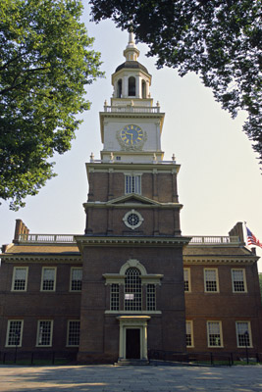
*The Convention:
May 25 – September 17, 1787
Independence Hall, Philadelphia, PA
President of the Convention: George Washington
12 of the 13 states attend (Rhode Island refuses)
NH arrives in June
All debate to be top secret

Slide 15
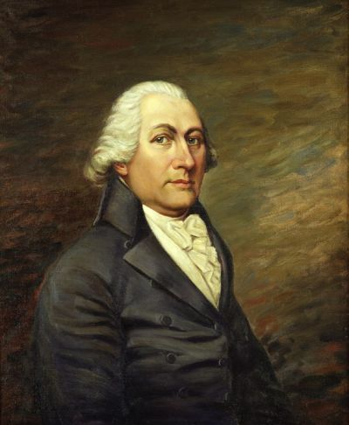
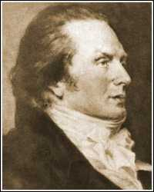
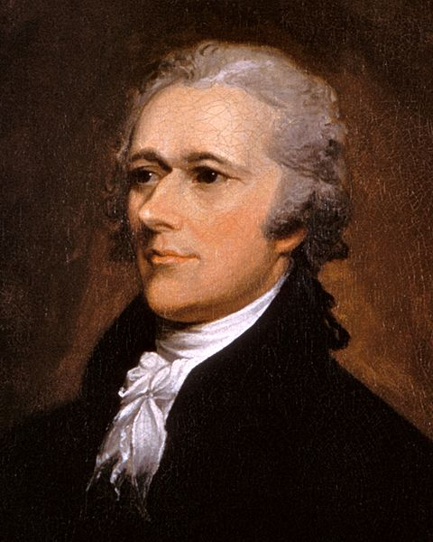
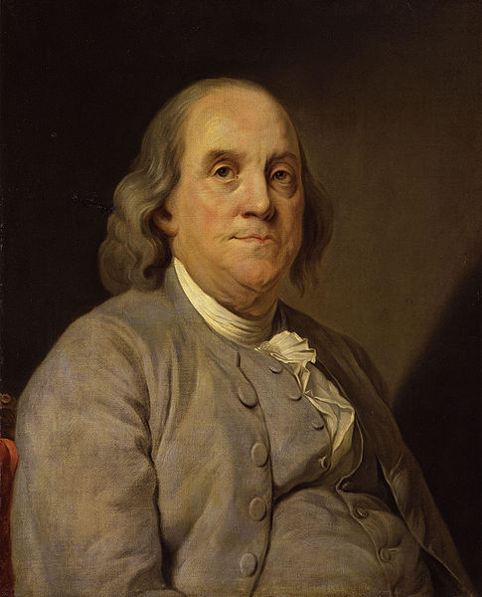
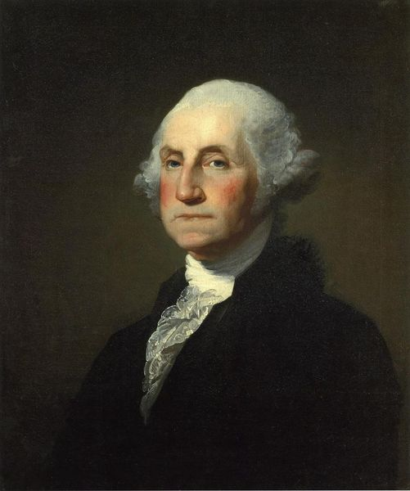
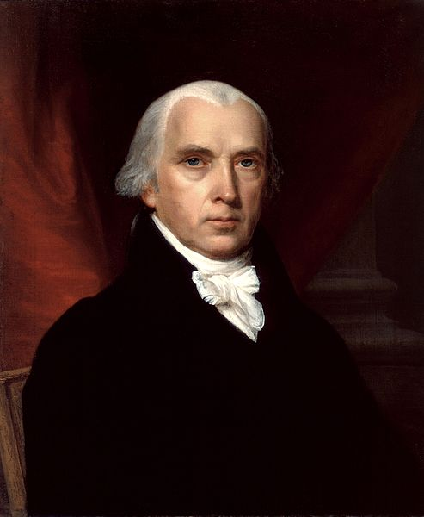
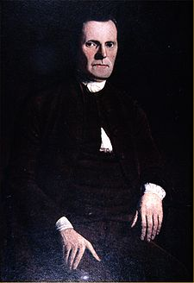
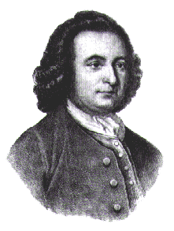
Important delegates:
John Langdon
Nicholas Gilman
Alexander Hamilton
Benjamin Franklin
George Washington
James Madison
Roger Sherman
George Mason
Not present: Thomas Jefferson, Samuel Adams, John Hancock, John Adams

Slide 16
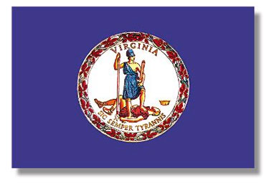
The Virginia Plan
-Favored states with large populations by giving them more votes in Congress
Proposed by Edmund Randolph, created by James Madison
Three Branches of Government
Legislative branch: Two “houses” (groups of legislators)
  Upper House: The “Senate”
  Lower House: “House of Representatives”
  # of legislators per state determined by population
Big states (VA, MA, PA, NC) like the plan
Small states (NJ, NH, CT, DE, GA) concerned that big states will always outvote them

Slide 17
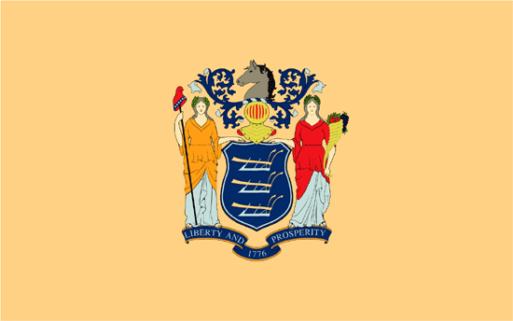
The New Jersey Plan
-Favored states with small populations by giving them equal votes in Congress
Proposed by William Patterson
Three Branches of Government
Legislative branch: One “house”
  States have equal votes (1 per state)
Small states like the plan
Big states angry that they don’t have more of a vote

Slide 18

The Connecticut Compromise
Proposed by Roger Sherman
Three Branches of Government
  – Legislative, Executive, Judicial
Legislative branch: Two “houses”
  House of Representatives: number of votes per state determined by population
  Senate: Each state gets 2 votes
Small states have their say in the Senate
Big states have their say in the House of Representatives
The Compromise is approved!

Slide 19
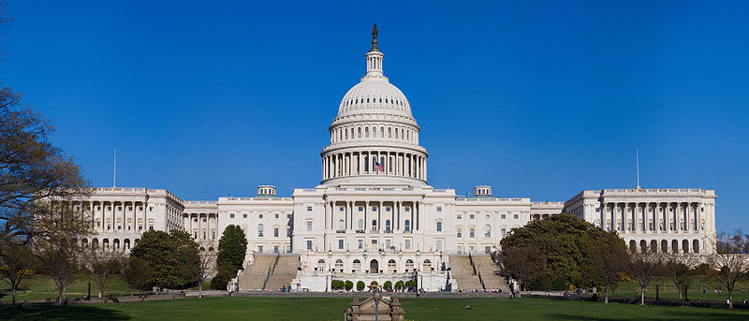
1. Legislative Branch:
The Congress
Job: To make laws

Slide 20
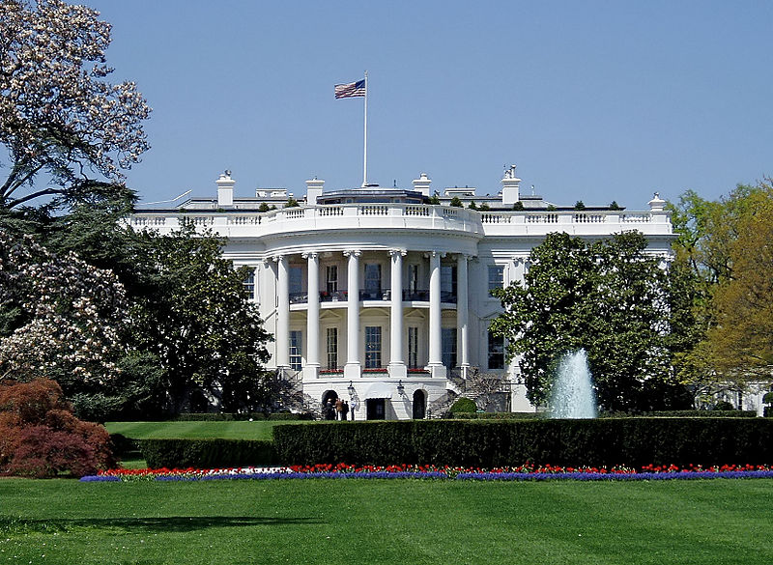
2. Executive Branch:
The President
Job: To carry out laws

Slide 21
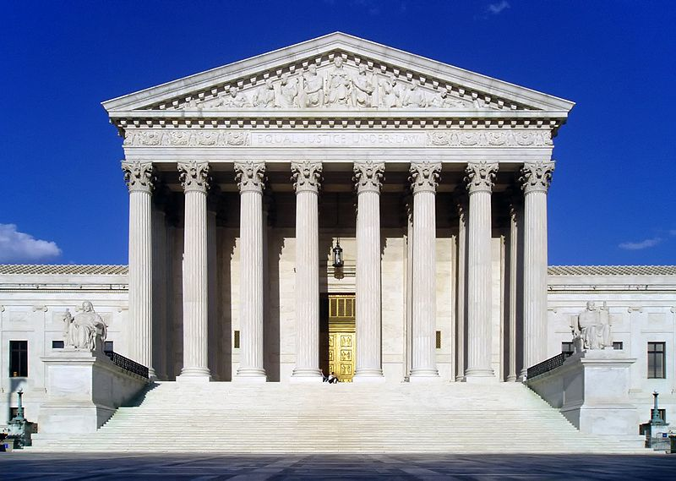
3. Judicial Branch:
The Supreme Court
Job: To rule on laws

Slide 22
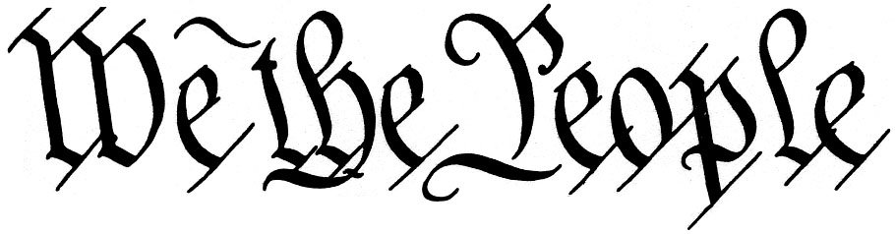
Other Constitutional “stuff”
A Census will be held every 10 years (years that end with a 0) to determine representation in the House.
3/5 Compromise: Only 3/5 of the population of slaves and Indians will count towards Representation
Slave trade will end 20 years after ratification
Treason: Giving Aid/comfort to an enemy of the US, or fighting against it during a war
Constitution can be amended if the change is approved by 2/3 of Congress, and 3/4 of the states.
Constitution will go into effect once 9 of the states ratify (approve) it

Slide 23
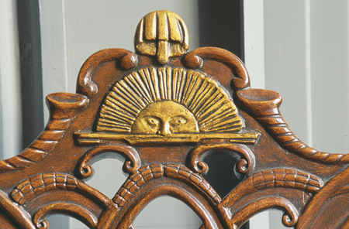
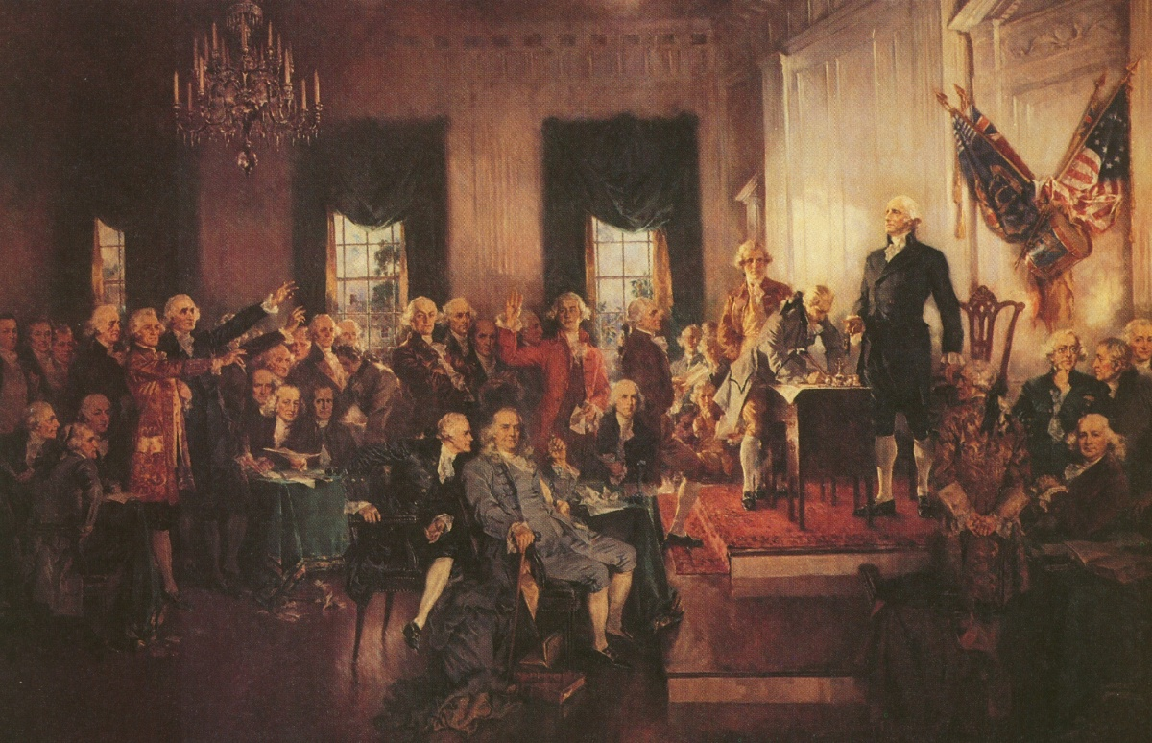

Slide 24
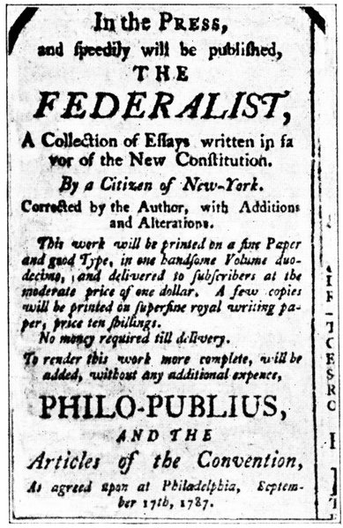
Ratification - Federalists
Federalists: People who supported the Constitution and a strong Federal Government
Believed a strong government was necessary to keep the country united and prosperous
The Federalist Papers: Series of 85 essays and articles written by Hamilton, Madison, and John Jay to explain how the Constitution would work and promote its ratification.

Slide 25
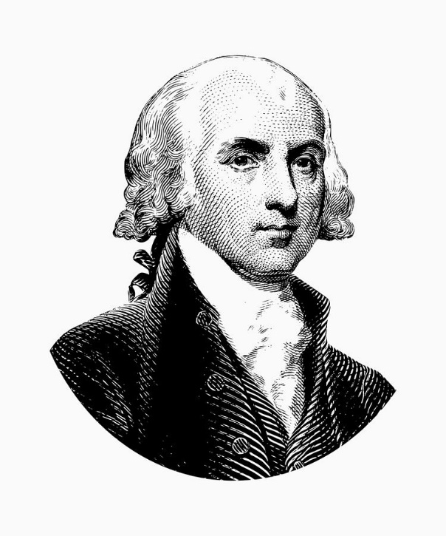

“…it may be concluded that a pure democracy, by which I mean a society consisting of a small number of citizens, who assemble and administer the government in person, can admit of no cure for the mischiefs of faction. A common passion or interest will, in almost every case, be felt by a majority of the whole…and there is nothing to check the inducements to sacrifice the weaker party or an obnoxious individual. Hence it is that such democracies have ever been spectacles of turbulence and contention; have ever been found incompatible with personal security or the rights of property; and have in general been as short in their lives as they have been violent in their deaths…. “
“If men were angels, no government would be necessary.”

Slide 26
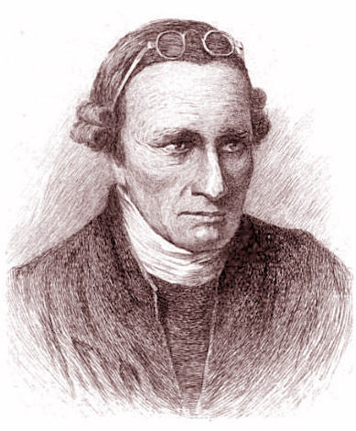
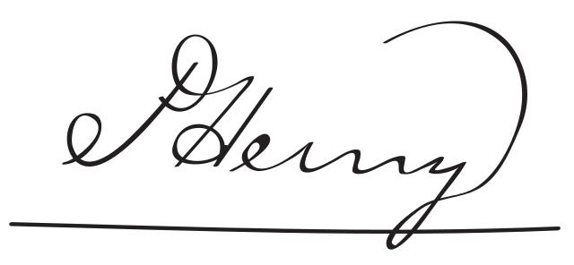
Ratification - Antifederalists
Antifederalists: People who are against the ratification of the Constitution
Reasons: - Feared a strong central government unresponsive to the needs of the people
- Presidency may become a monarchy
- Too much power taken away from the states
- No Bill of Rights
“I smell a rat!”

Slide 27
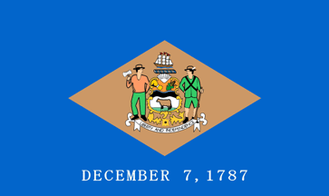
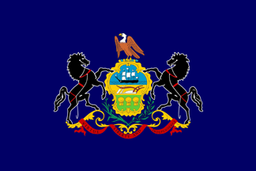

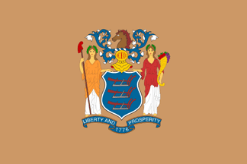


Delaware
2. Pennsylvania
3. New Jersey
4. Georgia
5. Connecticut

Slide 28



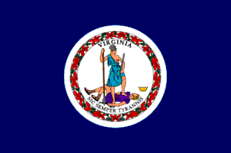
6. Massachusetts
But only if there is a Bill of Rights included!
7. Maryland
8. South Carolina
9. New Hampshire
The Constitution can now go into effect!
10. Virginia

Slide 29
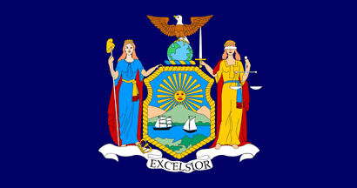


11. New York
12. North Carolina
13. Rhode Island

Slide 30
