Slide 1
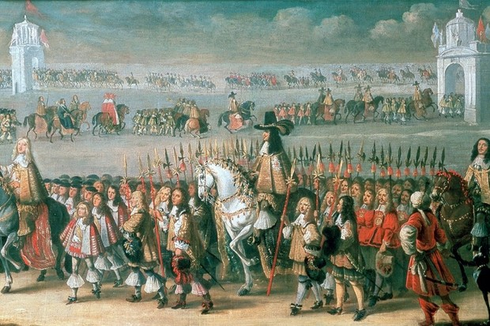
The Restoration

Slide 2
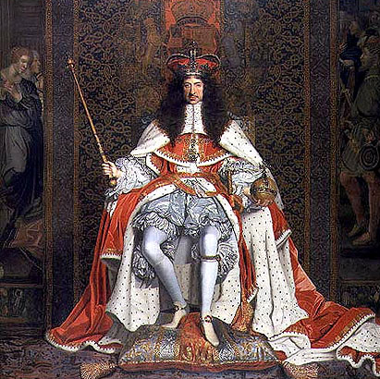
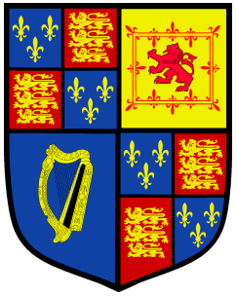
Charles II "Charles the Second, by the Grace of God, King of England, Scotland, France and Ireland, Defender of the Faith, etc."
Reign: 1660-1685
Notes:
Son of Charles I
Declared war on the Dutch
Owed many powerful supporters

Slide 3
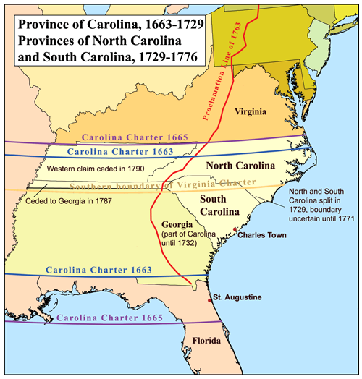
NORTH CAROLINA
SOUTH CAROLINA

Slide 4
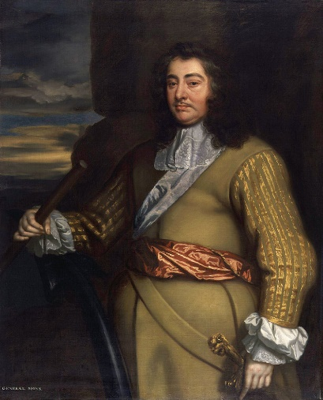
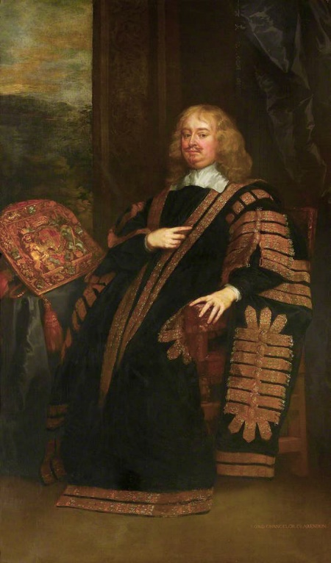
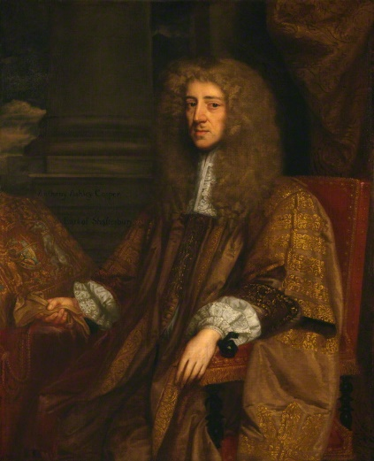
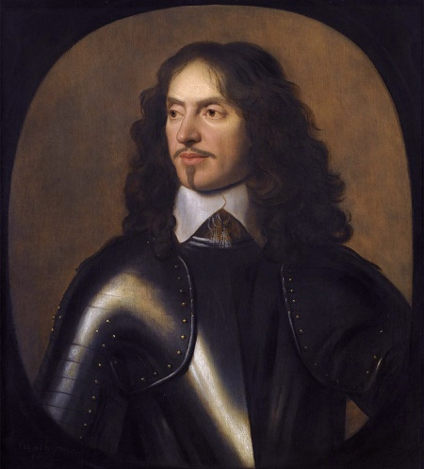
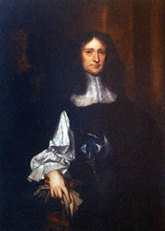
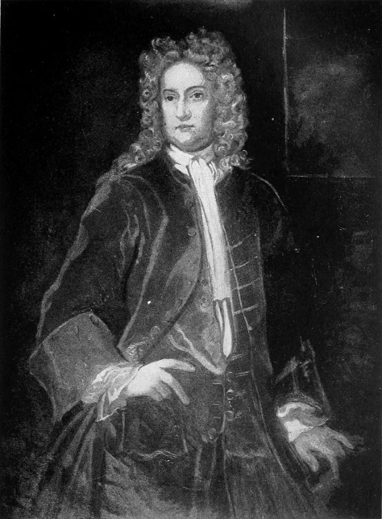
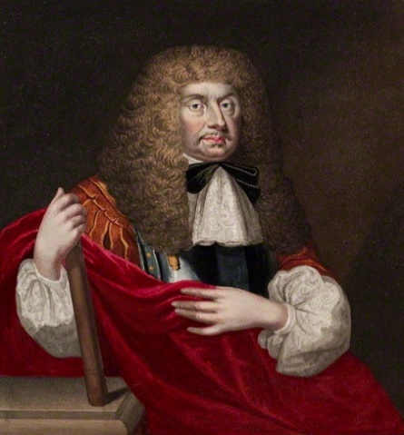
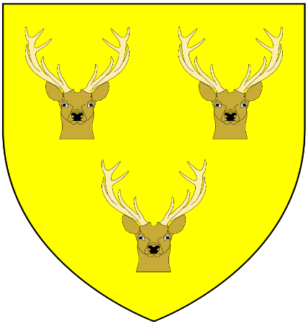
CAROLINA
Founded: 1663, Split in 1729
Duke of Albemarle
Earl of Clarendon
Earl of Craven
Earl of Shaftesbury
Lord George Carteret
Sir William Berkeley
Lord JohnBerkeley
Sir John Colleton
Founders: Eight Lord Proprietors

Slide 5
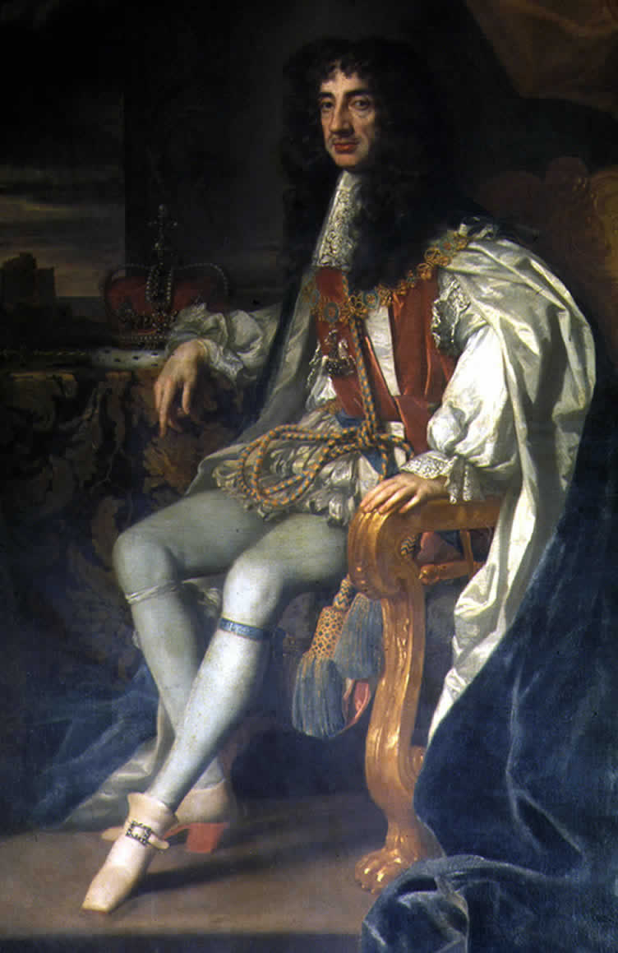
CAROLINA
I owe you, big time
Reason:
Buffer against Spanish Florida, and to reward loyal supporters

Slide 6
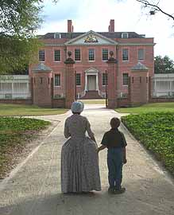
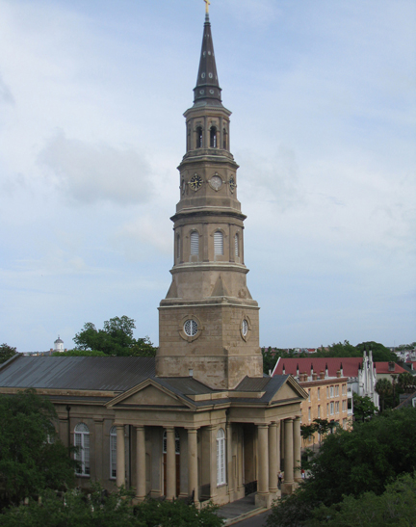
CAROLINA
Capital:
North Carolina: New Bern
South Carolina: Charleston

Slide 7
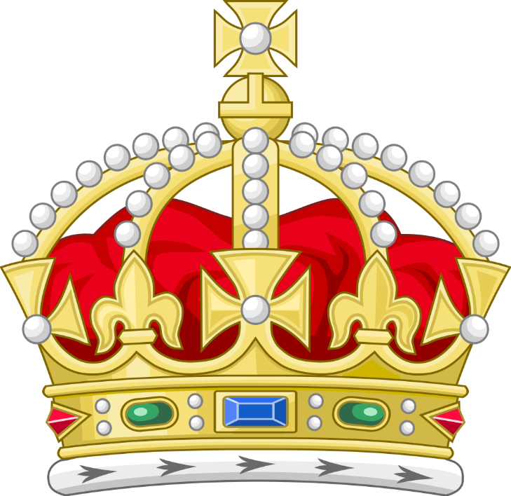
CAROLINA
Colony type: Proprietary, then Royal

Slide 8
CAROLINA
Name: For King Charles II
Yup, me again
Charles in Latin: Carolus
But really, I named it for my Dad, Charles I

Slide 9
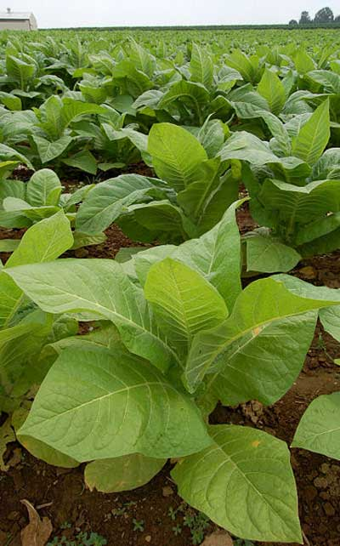
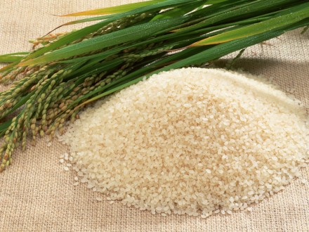
CAROLINA
Agriculture & Economy:
North Carolina: Tobacco
South Carolina: Indigo, Rice

Slide 10
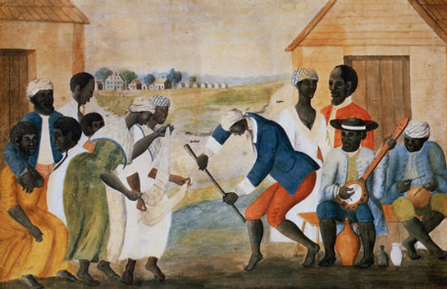
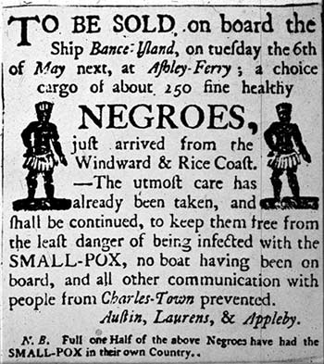
CAROLINA
Other:
South Carolina: Largest % of population are slaves of any other colony, Large Huguenot population

Slide 11
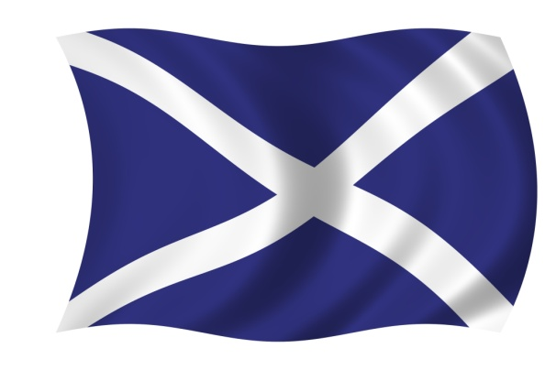
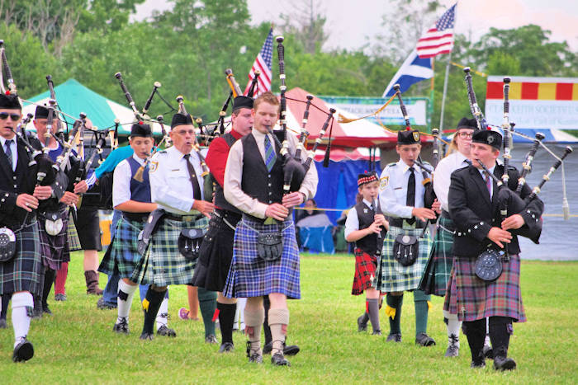
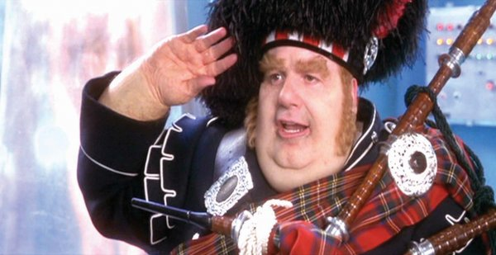
CAROLINA
Other:
North Carolina: Large Scots population

Slide 12
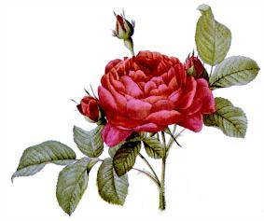
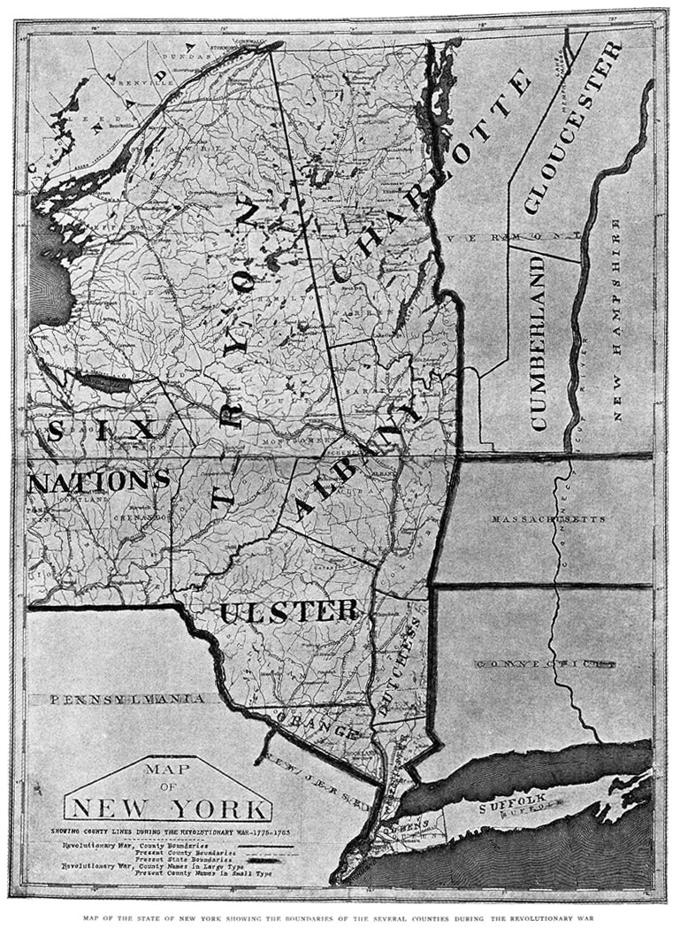
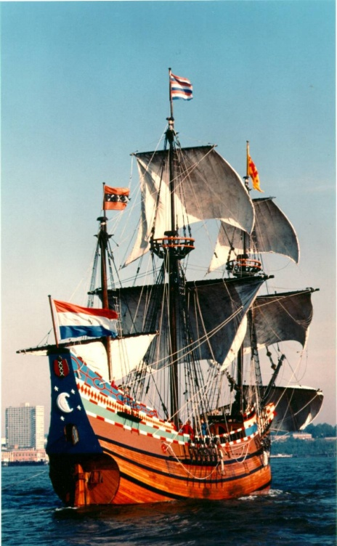
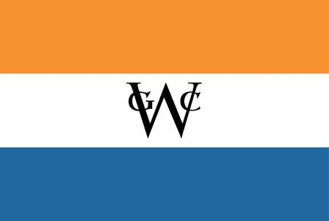
NEW YORK

Slide 13
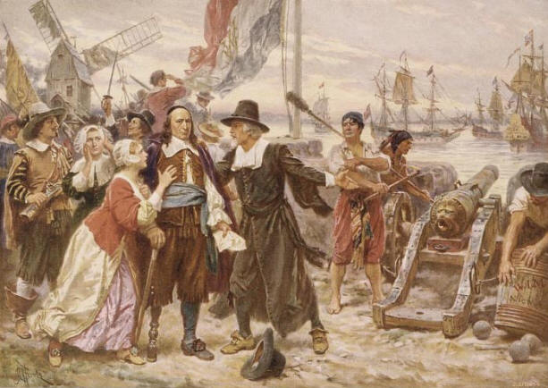
NEW YORK
Founded: 1624, as New Netherlands
Founder: Pieter Minuit & The Dutch

Slide 14
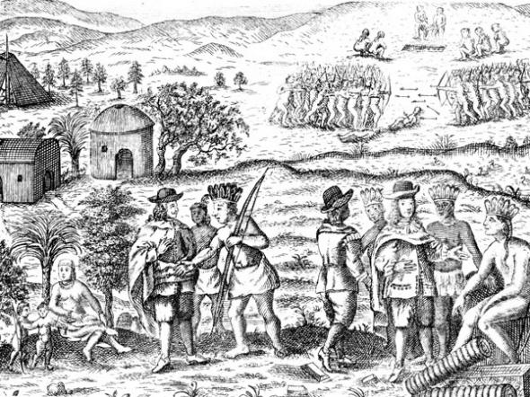
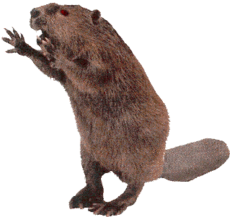
NEW YORK
Reason: To make money in the fur trade
Can’t you people find something else to make your hats?!?!

Slide 15
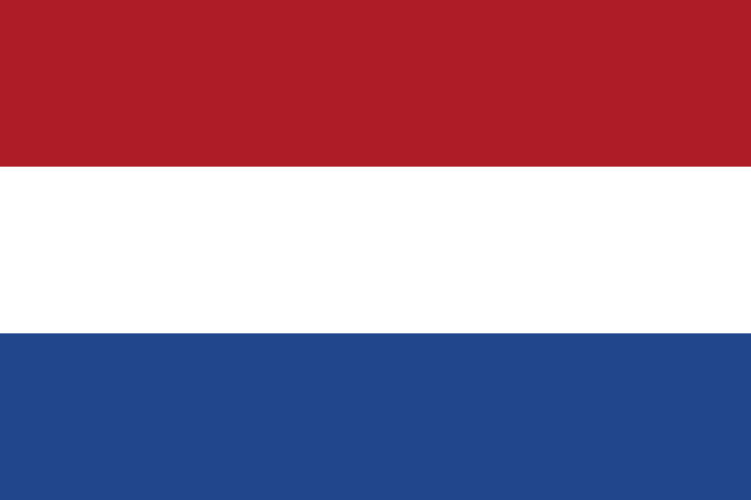
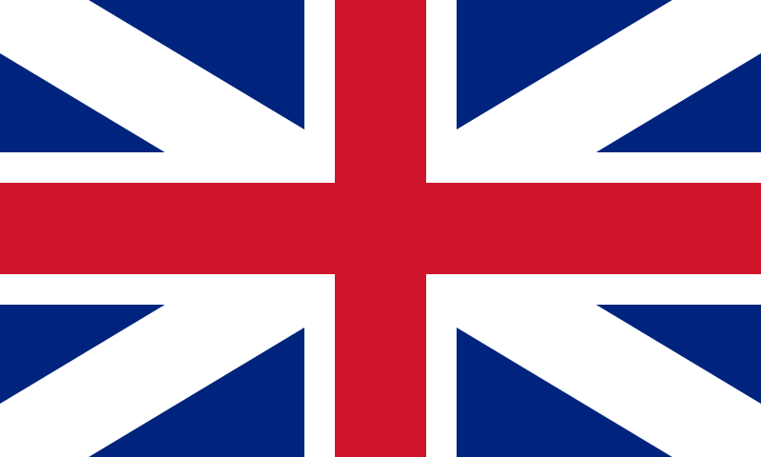
NEW YORK
Became British In: 1664

Slide 16
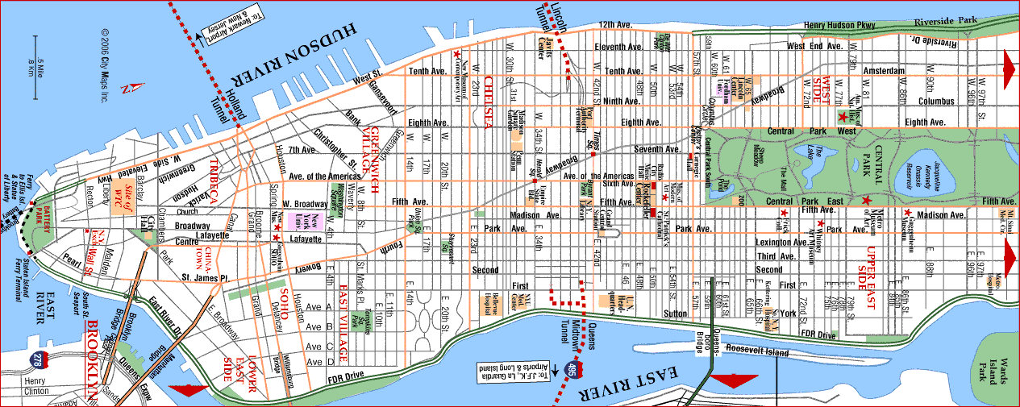
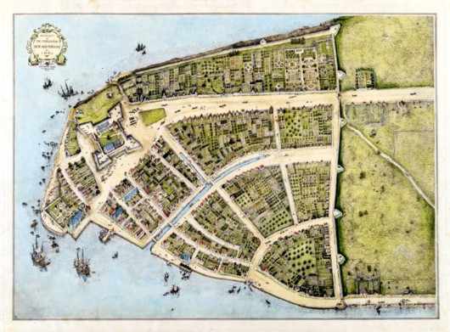
NEW YORK
Capital: New York City

Slide 17
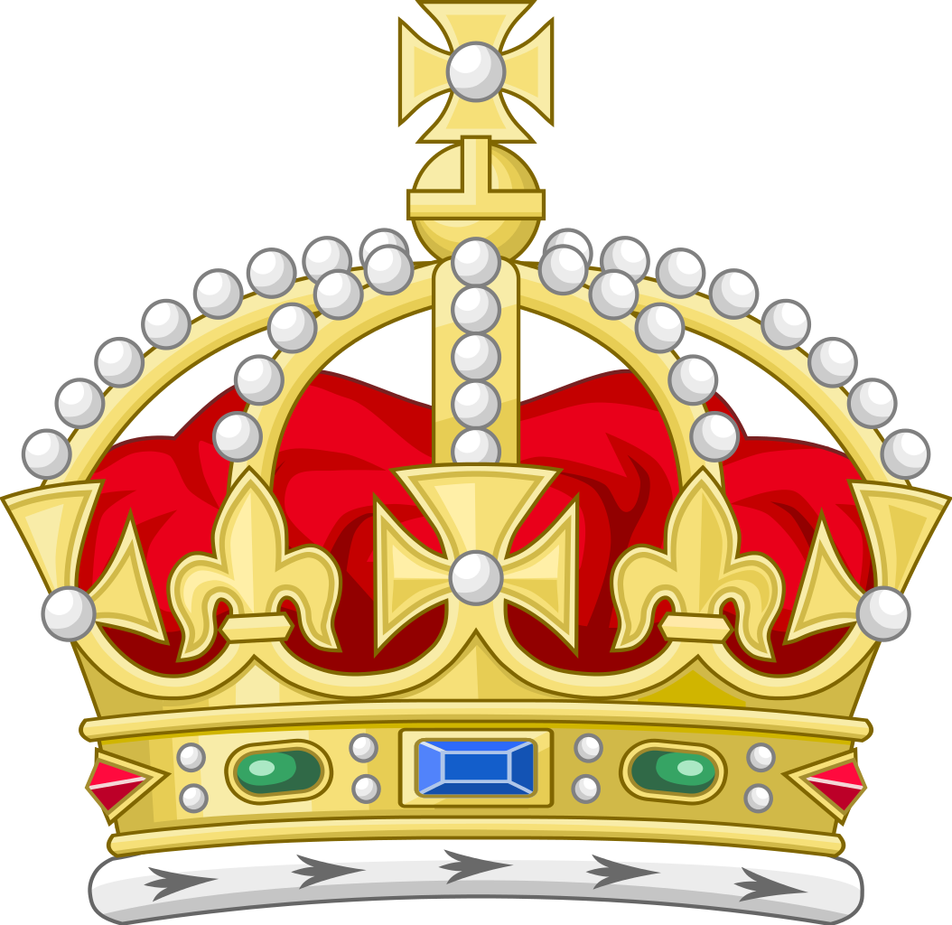
NEW YORK
Colony type: Proprietary, then Royal

Slide 18
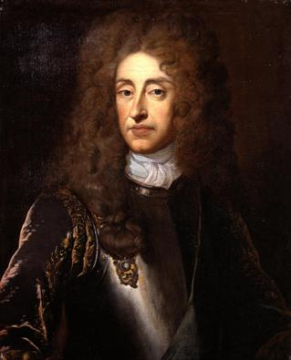
NEW YORK
Name: For James, Duke of York (brother of King Charles II and future king himself)
I’m in a New Me State of Mind…

Slide 19
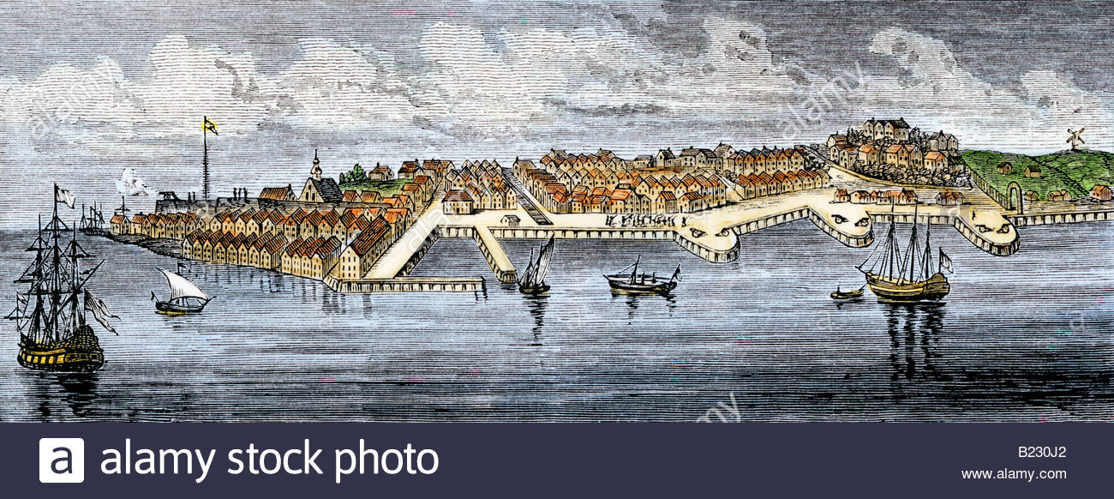
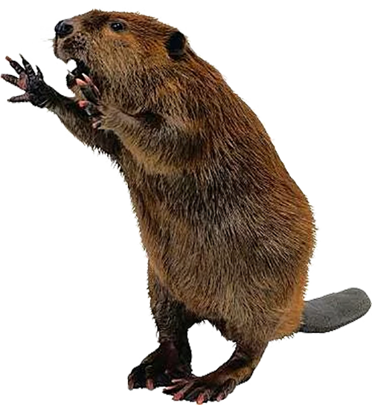
NEW YORK
Save the Beavers!
Agriculture: Large farms, often owned by old Dutch families (“Patroons”)
Economy: Furs; New York City was a major trading port

Slide 20
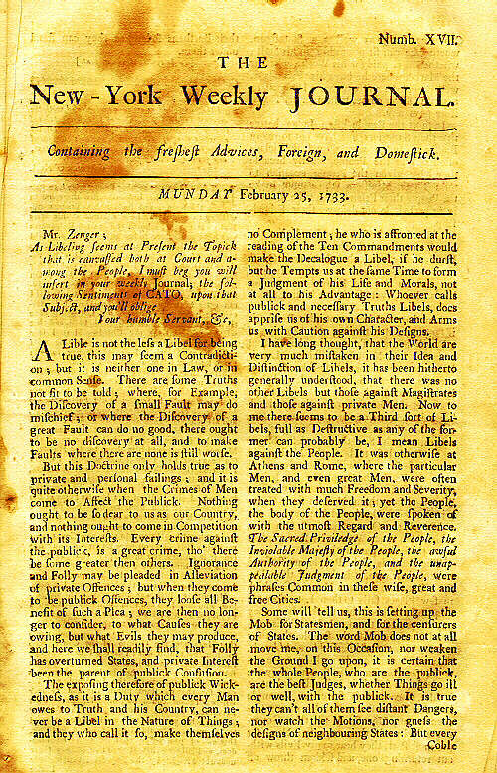
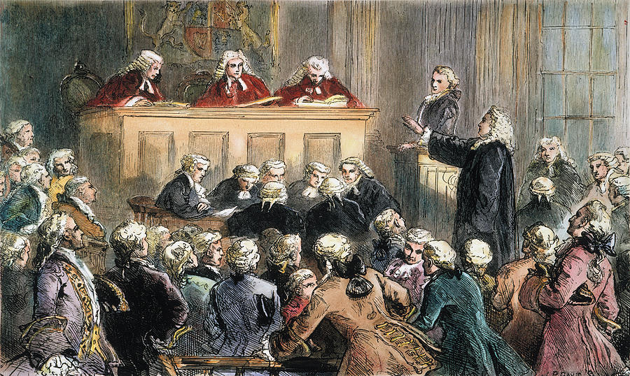
NEW YORK
Other Terms:
The Zenger Case (1735) - John Peter Zenger is accused of libel against Royal Governor Cosby – his acquittal helped set a precedent for freedom of the press.

Slide 21
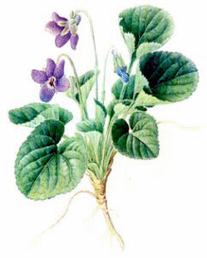
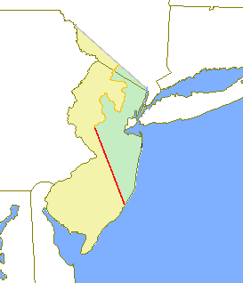
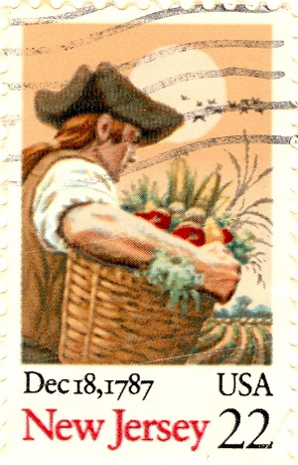
NEW JERSEY

Slide 22
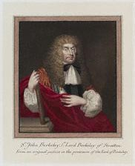
NEW JERSEY
Founded: 1664, split from New York
Founder: Lords Carteret & Berkeley

Slide 23
NEW JERSEY
Reason: Gift from the Duke of York
Mom told me not to gamble!

Slide 24
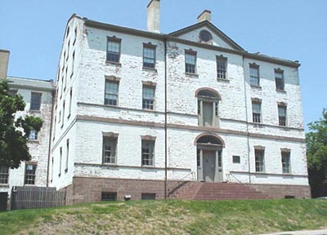
NEW JERSEY
Capitals:
East Jersey: Perth Amboy
West Jersey: Burlington
Perth Amboy
Burlington

Slide 25
NEW JERSEY
Colony type: Proprietary, then Royal

Slide 26
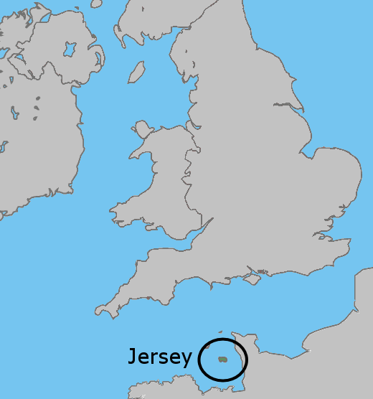
NEW JERSEY
Name:
After the Island of Jersey, in the English Channel

Slide 27
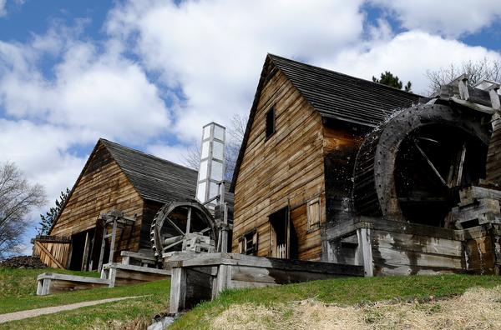
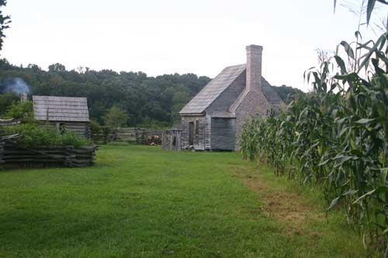
NEW JERSEY
Agriculture: Large farms (wheat, corn, vegetables)
Economy: Iron ore, iron products, shipping

Slide 28
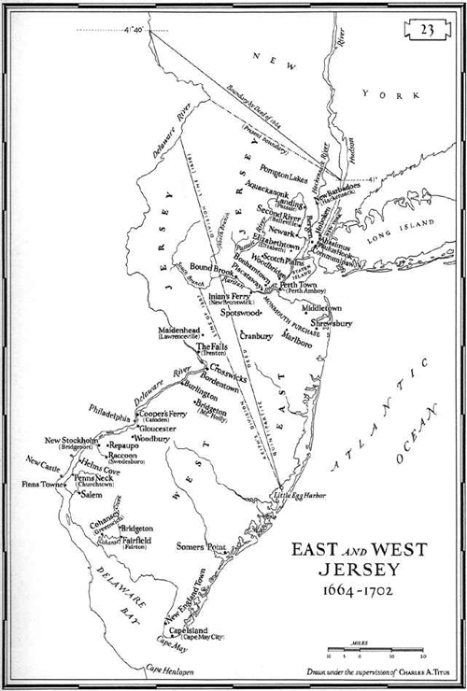
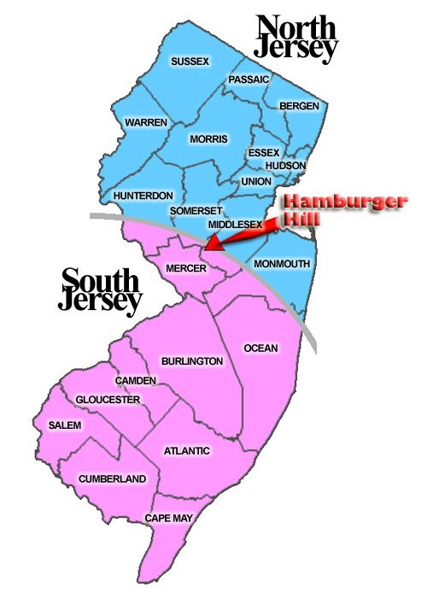
NEW JERSEY
Other Stuff:
West Jersey and
East Jersey joined in 1702

Slide 29
DELAWARE

Slide 30
DELAWARE
Founded: 1638, as New Sweden
Founder: The Swedes and Finns

Slide 31
DELAWARE
Reason: To make money in the fur trade
What will it take for you people to stop this madness?!?!

Slide 32
DELAWARE
Became British In: 1664

Slide 33
DELAWARE
Capital: As an English colony: New Castle

Slide 34
DELAWARE
Colony type: Proprietary, owned by Pennsylvania until 1776 (sort of)

Slide 35
DELAWARE
Name: Virginia Governor Lord De la Warr

Slide 36
DELAWARE
Agriculture & Economy: Large farms (north),
tobacco plantations (south)

Slide 37
DELAWARE
Other Stuff:
First log cabins in America
----------------
Was part of Pennsylvania until 1704

Slide 38
King Philip’s War
1675-1676
-War between several Native tribes and the New England colonies.
-Named for Metacom, AKA King Philip, leader of the Wampanoag

Slide 39
New England Towns burned in King Phillip’s War

Slide 40
Casualties
English: Approximately 600 killed. Plymouth Colony lost 8% of its male population (compare to 1% during World War II, or 4.5% during the Civil War).
Indians: 8,000 casualties: 2,000 dead in battle, 3,000 of sickness or hunger, 1,000 shipped out as slaves, 2,000 fled north. This is between 60-80% of the Indian population of southern New England.

Slide 41
Consequences
New England Indian tribes devastated. Future Indian attacks in New England will be from the north (NH, VT, ME, Canada).
New England population convinced all Indians are evil, and must be destroyed.
Colonial towns begin to develop militias to protect themselves.
Having received no help from England, New Englanders decide they are on their own, and start to feel they have their own identity, separate from other English.

Slide 42
PENNSYLVANIA

Slide 43
PENNSYLVANIA
Founded: 1680
Founder: William Penn

Slide 44
PENNSYLVANIA
Reason: Land grant to Penn family from King Charles II; Penn’s “Holy Experiment”

Slide 45
PENNSYLVANIA
Capital: Philadelphia

Slide 46
PENNSYLVANIA
Colony type: Proprietary (Penn family)

Slide 47
PENNSYLVANIA
Name: For William Penn Sr.
Sylvania = Latin for “Woods” = Penn’s Woods
You named your peace-loving hippie colony after ME? Thanks for nothing, son.

Slide 48
PENNSYLVANIA
Agriculture & Economy: Large farms -
“The breadbasket colony”. Philadelphia is the largest city/port in America

Slide 49
PENNSYLVANIA
Other Terms:
Frame of Government: Gave PA an elected assembly and a written constitution Charter of Liberties/Privileges: Guaranteed religious freedom in the colony and allowed unrestricted immigration

Slide 50
James II ”James the Second, by the Grace of God, King of England, Scotland, France and Ireland, Defender of the Faith, etc."
Reign: 1685-1688
Notes:
Catholic son of Charles I
Overthrown by his daughter and son-in-law

Slide 51
The Dominion of New England
James II ordered the revocation of colonial charters and combined NH, Mass, Plymouth, RI, CT, NY, and NJ into a single province.
Designed to centralize power, weaken the colonial economy, and keep the Puritans in check.
-Governor Edmund Andros was very unpopular, and when James II was overthrown, the Dominion ended and Andros was arrested.

Slide 52
The Glorious Revolution
The Glorious Revolution
Bloodless overthrow of James II in favor of his daughter Mary and her husband, William III of Netherlands.
Adoption of the English Bill of Rights, which further limited the powers of the monarchy
Established Parliament as the ruling power in Great Britain

Slide 53
William & Mary "William and Mary, by the Grace of God, King and Queen of England, Scotland, France and Ireland, Defenders of the Faith, etc."
Reign: 1688-1702
Notes:
Dutch prince chosen to replace James II (Mary’s father)
Gave more power to Parliament, and the English Bill of Rights

Slide 54
King William’s War (1690-1697)
AKA: “The War of the Grand Alliance”
-starts in Europe
In America:
1. Indian raids in NH, ME, NY, MA
2. Hannah Dustin captured, escapes
3. Death of Major Waldron in Dover
Some blame for the Salem Witch Trials
Treaty of Ryswick – nothing changes

Slide 56
Anne I ”Anne, by the Grace of God, Queen of Great Britain, France and Ireland, Defender of the Faith, etc."
Reign: 1702-1714
Notes:
United Scotland and England into Great Britain
Last Stuart monarch

Slide 57
Queen Anne’s War (1702-1714)
AKA: “The War of Spanish Succession”
-starts in Europe
In America:
1. Indian raids in NH, MA
(Deerfield MA – 56 dead, 109 captured)
2. Colonists capture Acadia, which becomes Nova Scotia
Treaty of Utrecht – British keep Acadia/Nova Scotia, Newfoundland, and Hudson’s Bay

Slide 58
George I ”George, by the Grace of God, King of Great Britain, France and Ireland, Defender of the Faith, Duke of Brunswick-Lüneburg, Archtreasurer and Prince-Elector of the Holy Roman Empire, etc."
Reign: 1714-1727
Notes:
Unpopular German who spoke no English

Slide 59
George II ”George the Second, by the Grace of God, King of Great Britain, France and Ireland, Defender of the Faith, Duke of Brunswick-Lüneburg, Archtreasurer and Prince-Elector of the Holy Roman Empire, etc."
Reign: 1727-1760
Notes:
Defeated a Scots rebellion
England took control of India

Slide 60
GEORGIA

Slide 61
GEORGIA
Founded: 1732
Founder: James Oglethorpe

Slide 62
GEORGIA
Reason:
Refuge for Debtors
&
Buffer against Spanish Florida

Slide 63
GEORGIA
Capital: Savannah

Slide 64
GEORGIA
Colony type: Proprietary, then Royal

Slide 65
GEORGIA
Name: For King George II

Slide 66
GEORGIA
Agriculture & Economy:
Indigo and Rice

Slide 67
GEORGIA
Other :
- Tried to grow mulberry trees for silkworms, and to ban alcohol and slavery, but was not successful.

Slide 68
King George’s War (1744-1748)
AKA: “The War of the Austrian Succession”
-starts in Europe
In America:
1. Indian raids in NY, NH.
2. Attacks on Upper and Lower Ashuelot, NH (Keene and Swanzey)
3. Three day siege of Fort at #4 (Charlestown NH)
4. Colonial forces capture Fortress Louisbourg

Slide 69
Number 4
Number 1
Number 3
Number 2
Number 2
Number 3
Number 1
Upper Ashuelot
Peterborough
Lower Ashuelot
Fort Dummer
Rowley Canada
Number 4
Arlington
Fort Hinsdale
Northfield

Slide 71
July 1745 Josiah Fisher killed & scalped
April 1747: Upper Ashuelot abandoned, burned by the Indians a few days later
April 1746: 100+ Indians attack Keene. Several settlers killed as the rest rush into the fort. Nathan Blake captured and taken to Canada.

Slide 72
May 1746: Two settlers captured on the road to Keene
April 1747: Lower Ashuelot abandoned, burned by the Indians a few days later
March 1745: Rev. Harrington’s house

Slide 75
King George’s War (1744-1748)
AKA: “The War of the Austrian Succession”
-starts in Europe
In America:
1. Indian raids in NY, NH.
2. Attacks on Upper and Lower Ashuelot, NH (Keene and Swanzey)
3. Three day siege of Fort at #4 (Charlestown NH)
4. Colonial forces capture Fortress Louisbourg
Treaty of Aix La Chapelle: British give most things back, including Louisbourg

Slide 76
George III "George the Third, by the Grace of God, of the United Kingdom of Great Britain and Ireland King, Defender of the Faith."
Reign: 1760-1820 (In America until 1776)
Notes:
Lost 13 American colonies

