Slide 1
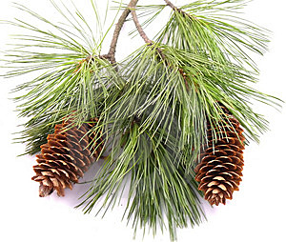
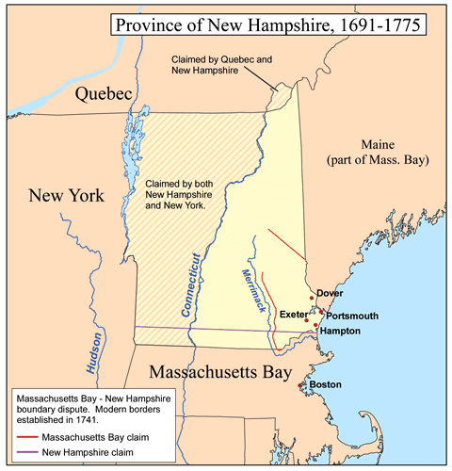
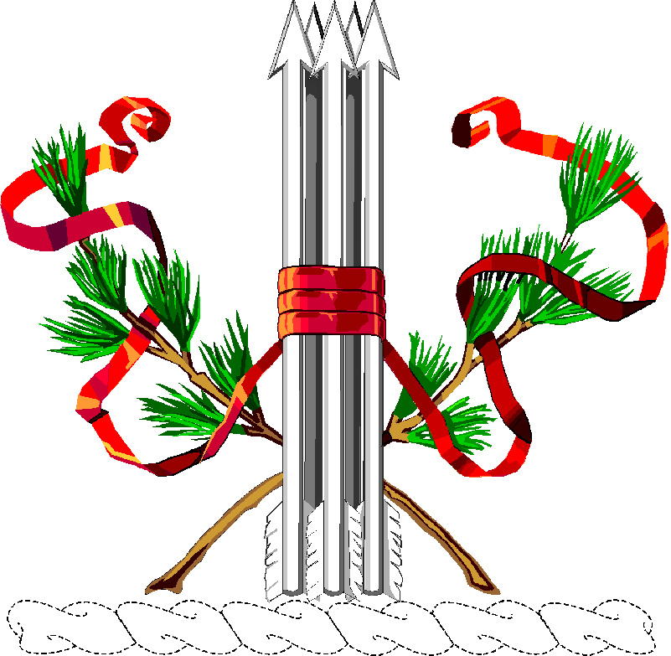
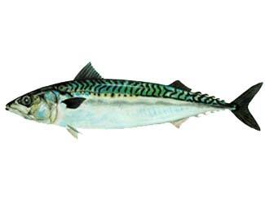
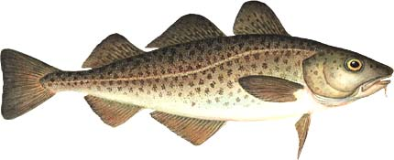
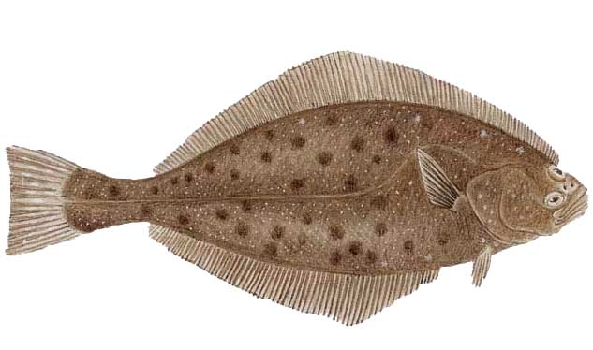
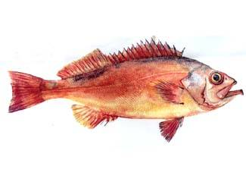
New Hampshire

Slide 2
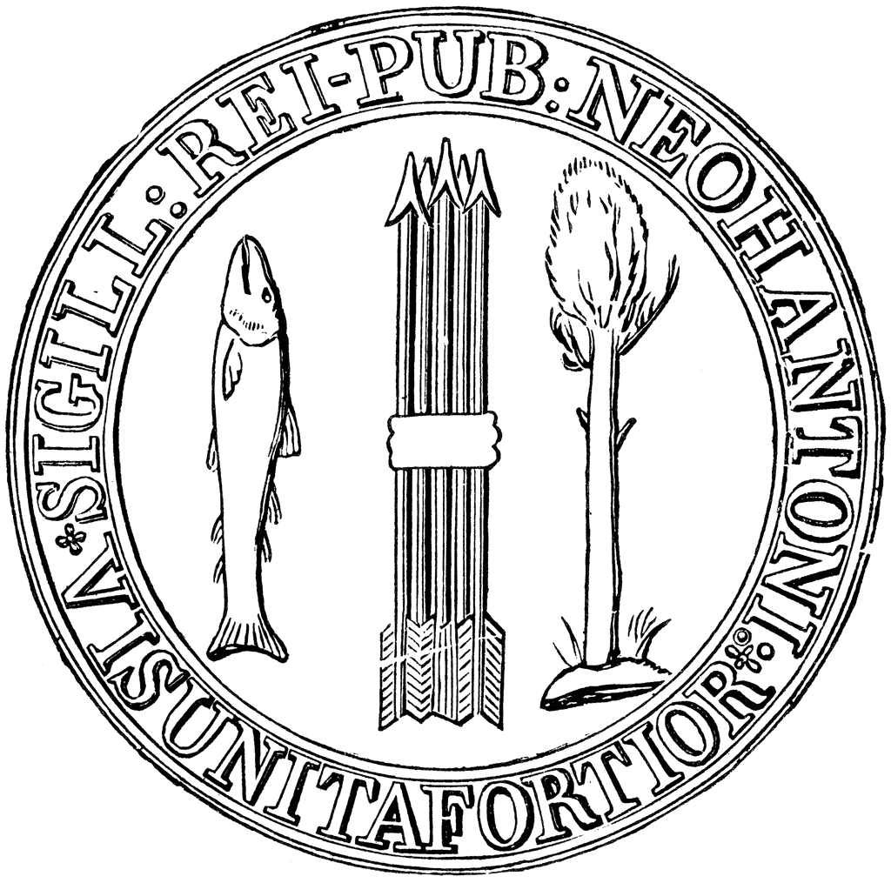
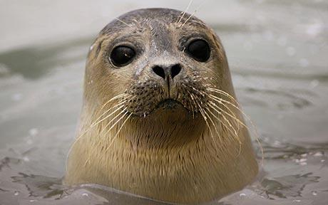

Slide 3
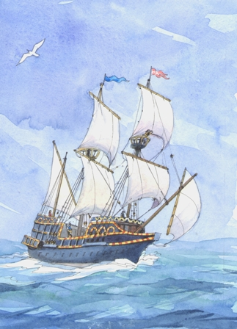
New Hampshire
1603:
Martin Pring (English) sails past coast of New Hampshire looking for sassafras (he didn’t find any)
“We beheld very good groves and woods replenished with tall Okes, beeches, pine-trees, firre-trees, hasels, wich-hasels, and maples. We saw here also all sundry sort of beasts, as stags, deere, beares, wolves, foxes, lusernes, and dogges with sharpe noses.”
Later explorers:
1605: Samuel de Champlain
1614: John Smith

Slide 4
New Hampshire
1629: Land between Merrimack and Kennebec Rivers granted to John Mason and Sir Fernando Gorges (The “Council for New England”).
- North of the Piscataqua River: Gorges’ “Maine” colony
- South of Piscataqua River: Mason’s “New Hampshire” colony.
Kennebec River
Maine
Piscataqua River
New Hampshire
Merrimack River

Slide 5
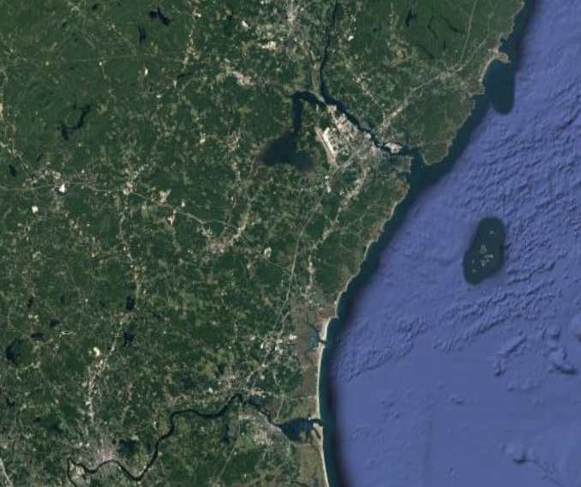
New Hampshire
First Settlements
1623: Pannaway (fishermen under David Thompson, later abandoned)
1623: Dover (fishermen under Hilton Bros.)
1630: Strawberry Bank (Later Portsmouth) (Mason’s Co)
1638: Hampton (MA Puritans)
1638: Exeter (Rogue Mass Puritans under Rev. John Wheelwright)
Dover
Portsmouth
Pannaway
Exeter
Hampton

Slide 6
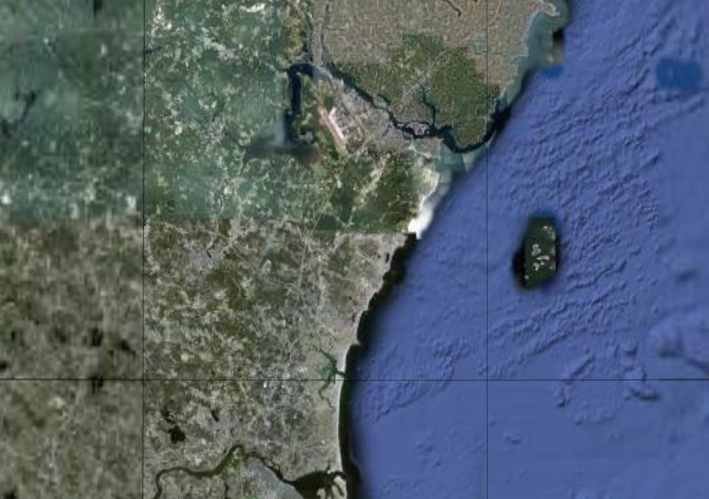
New Hampshire
Dover
Strawbery Banke
Exeter
1641: The four NH towns join with the Massachusetts-Bay Colony.
1679: NH separates from MA
1688: Rejoins MA under the “Dominion of New England”
1691: Separates again, but shares the Mass. Governor
Hampton

Slide 7
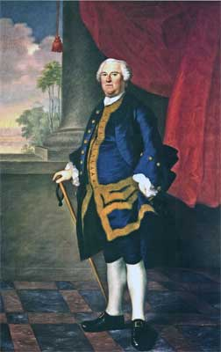
New Hampshire
1741: NH gets a governor of its own, Benning Wentworth (Serves from 1741-1766)

Slide 8
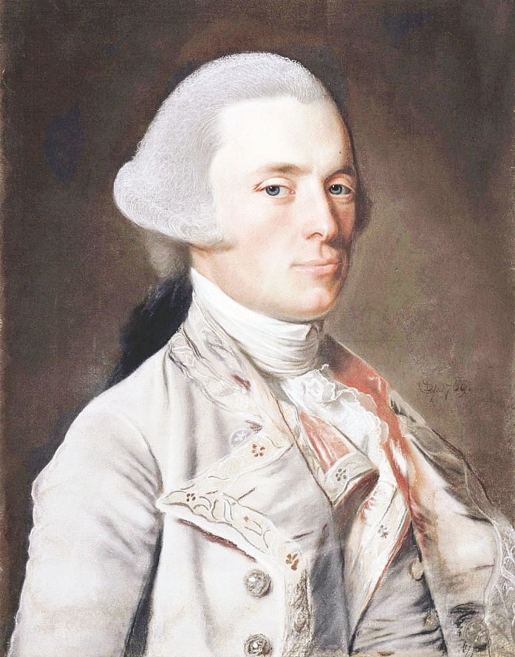
Second Royal Governor: John Wentworth (1766-1775)

Slide 9
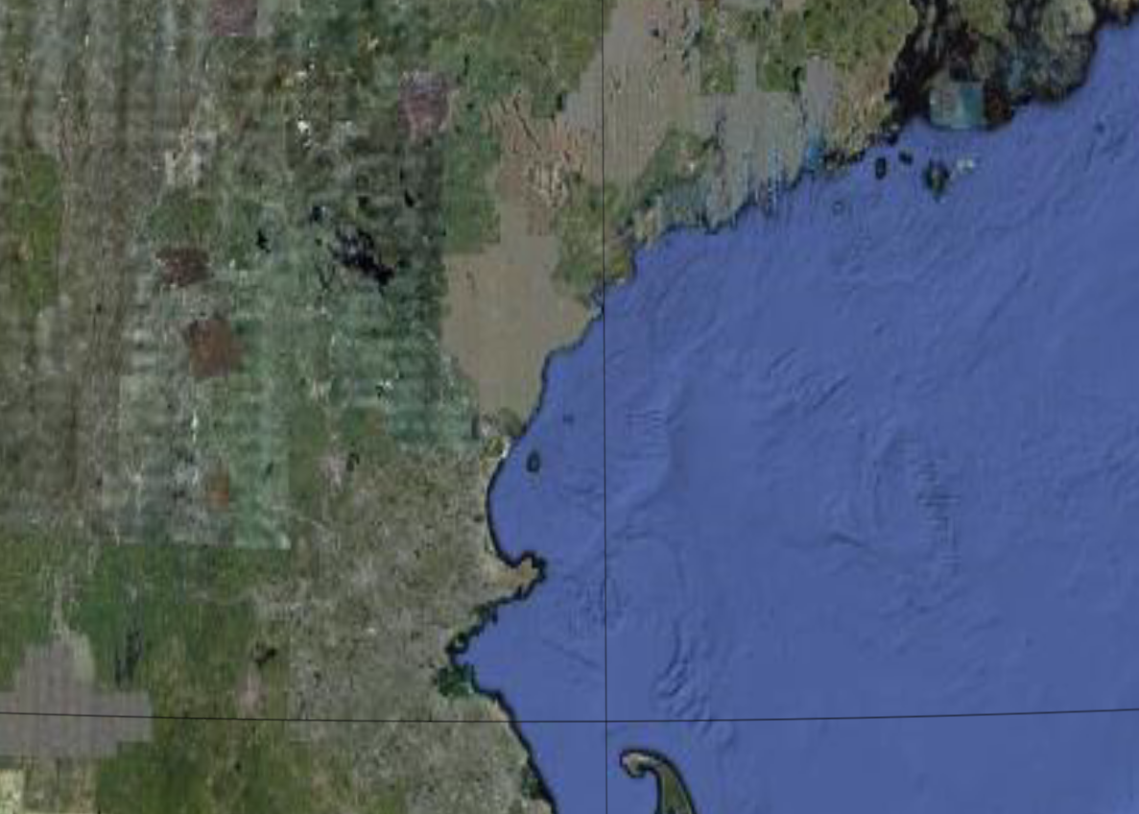
New Hampshire
Maine (MA)
Mass. claim
1741: NH/MASS boundary set at 3 miles north of the Merrimack River
New Hampshire
NH claim
Massachusetts

Slide 10
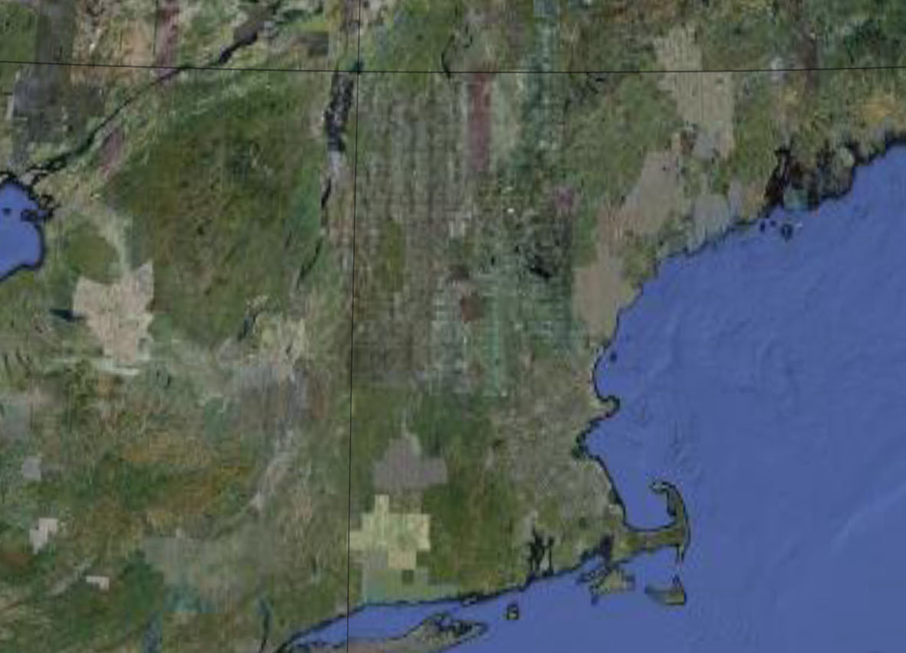
New Hampshire
Maine (MA)
NY Claim
New York
NH
Bennington
MA
1760s: Both NH and NY claim Vermont, called the “New Hampshire Grants”
Hudson River
CT
RI
PA
NJ

Slide 11
New Hampshire
Maine (MA)
New York
NH
MA
Hudson River
CT
RI
PA
NJ

Slide 12
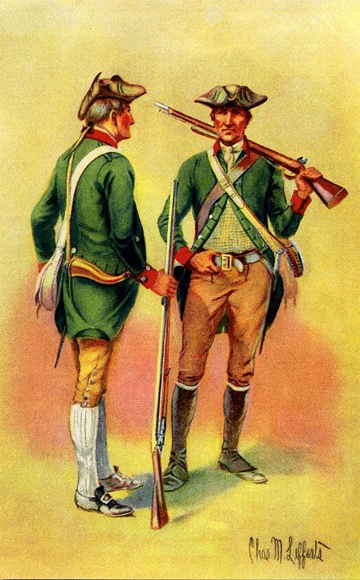
New Hampshire
1764: King George II awards NH Grants to New York. NH is awarded the Connecticut River.
“Green Mountain Boys” (leader: Ethan Allen): NH settlers who rebelled against NY, declaring independence in 1777.

Slide 13
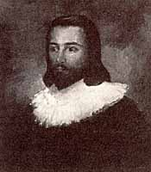
New Hampshire
Founded: 1623 (settled)
1629 (granted)
I never even got to see my colony!
Founder: Captain John Mason

Slide 14
New Hampshire
Reason: To make money through fishing, a counterweight to Puritan Massachusetts
Oh my cod! Why did you bite that hook!?
Just for the halibut…

Slide 15
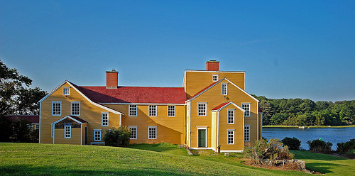
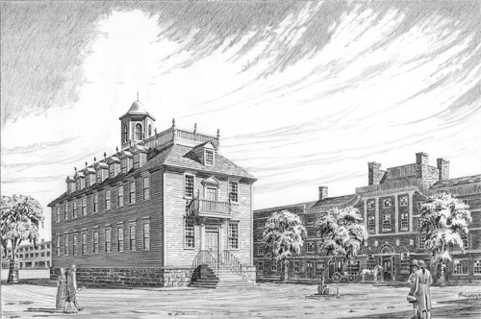
New Hampshire
Capital: Portsmouth

Slide 16
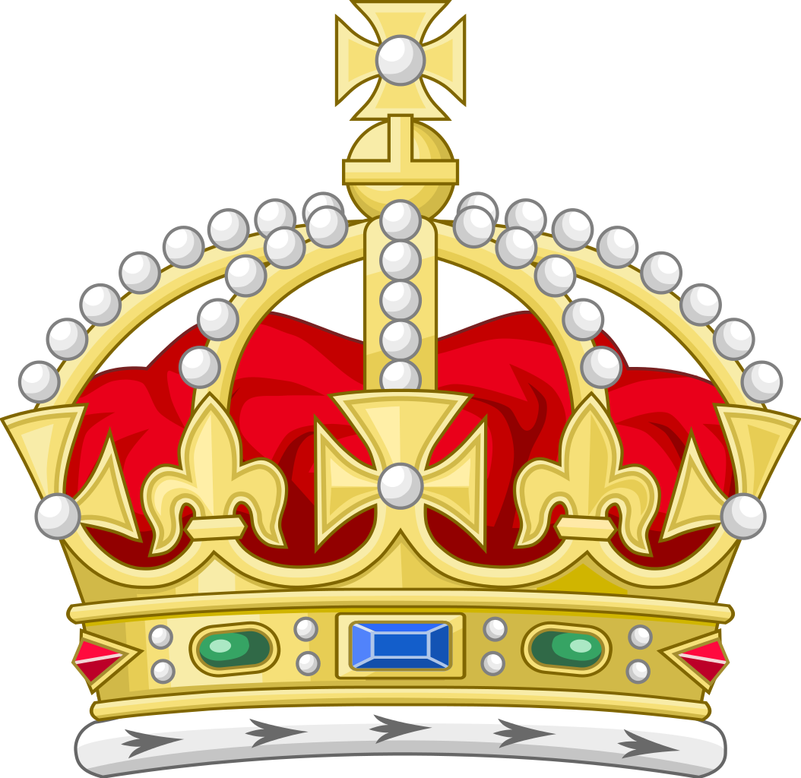
New Hampshire
Colony type: Royal

Slide 17
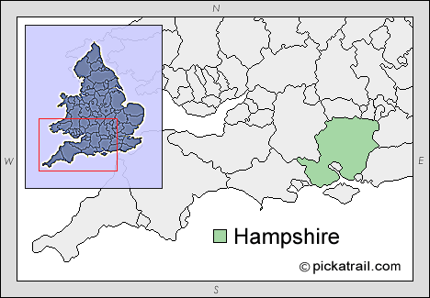
New Hampshire
Name: From Hampshire, an English county

Slide 18
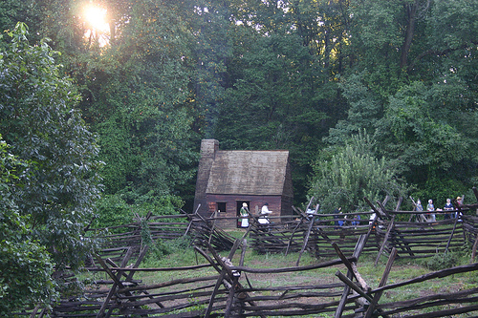
New Hampshire
Agriculture: subsistence farms

Slide 19
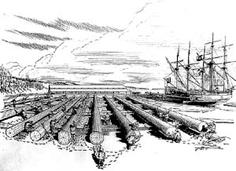
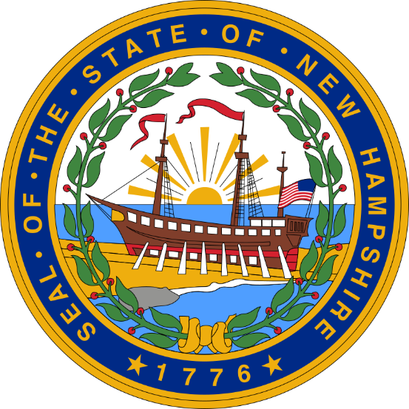
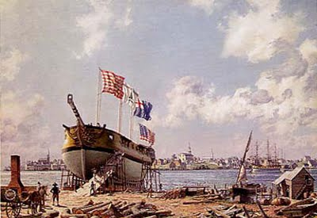
New Hampshire
Economy: masts, ship building, fishing

Slide 20
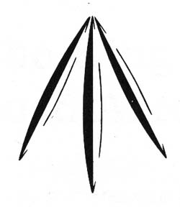
New Hampshire
Other Stuff:
Mast Pines: All straight pine trees over 12 inches in diameter were reserved for use by the Royal Navy, and marked with a:

Slide 21
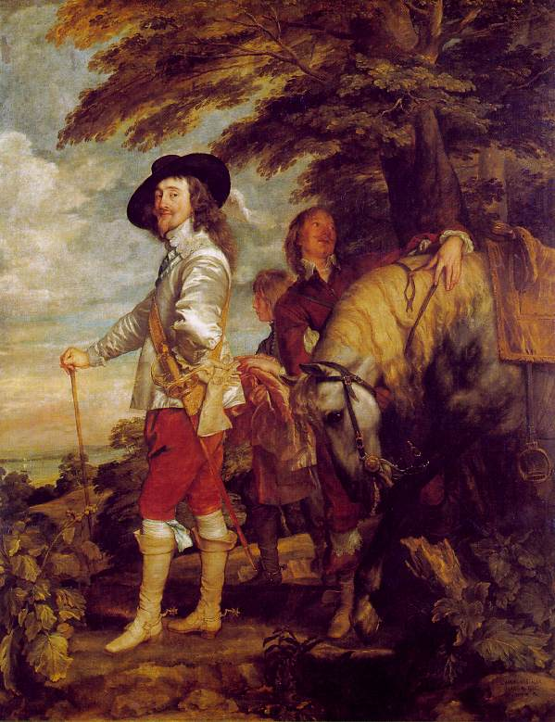
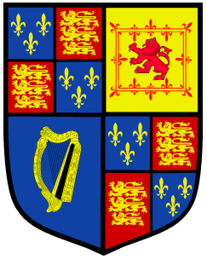
Charles I ”Charles, King of England, Scotland, France and Ireland, Defender of the Faith, etc."
Reign: 1625-1649
Notes:
English Civil War (Cavaliers vs. Roundheads)
Executed by Puritans

Slide 22
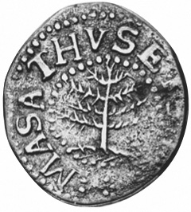
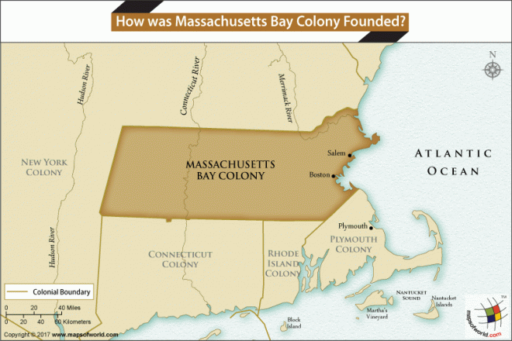
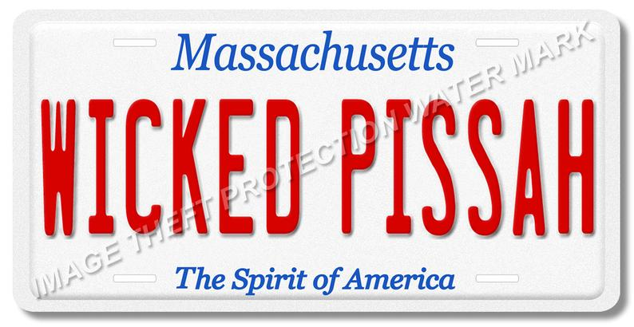
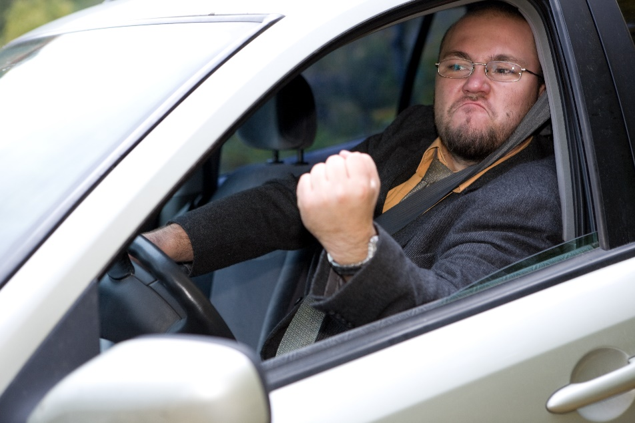
Massachusetts

Slide 23
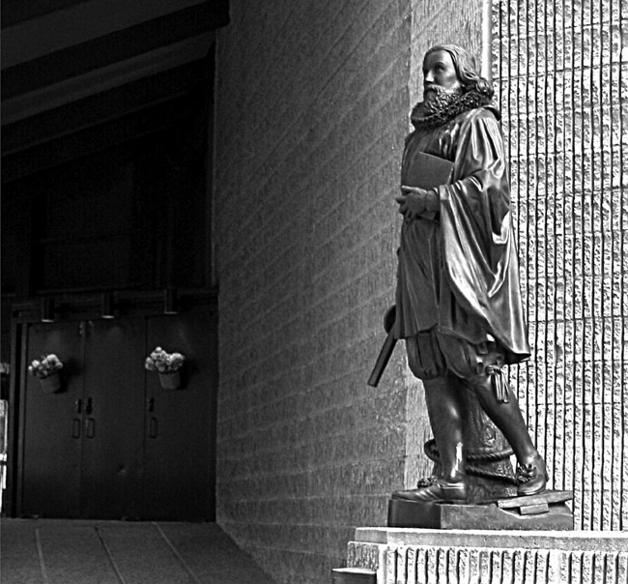
Massachusetts
Founded:
1628
Founder:
John Winthrop &
The Puritans

Slide 24
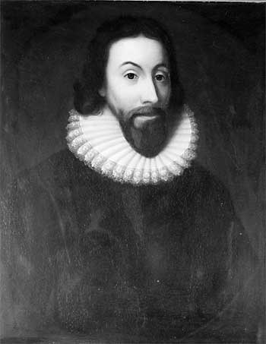
“We shall be as a city upon a hill, the eyes of all people are upon us… We shall be made a story and a byword throughout the world.”
-John Winthrop

Slide 25
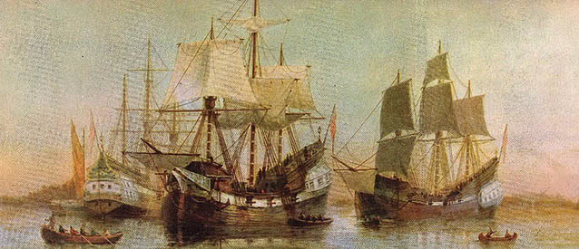
Massachusetts
Reason:
Religious Freedom for Puritans
We’re shipping up to Boston!

Slide 26
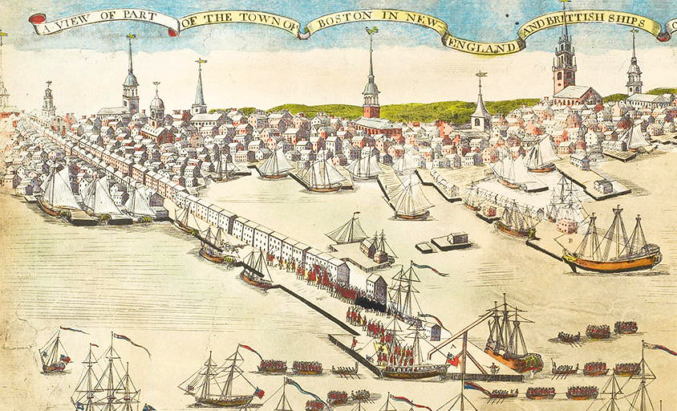
Massachusetts
Capital: Boston

Slide 27
Massachusetts
Colony type: Charter, then Royal
Masschufetts Bay

Slide 28
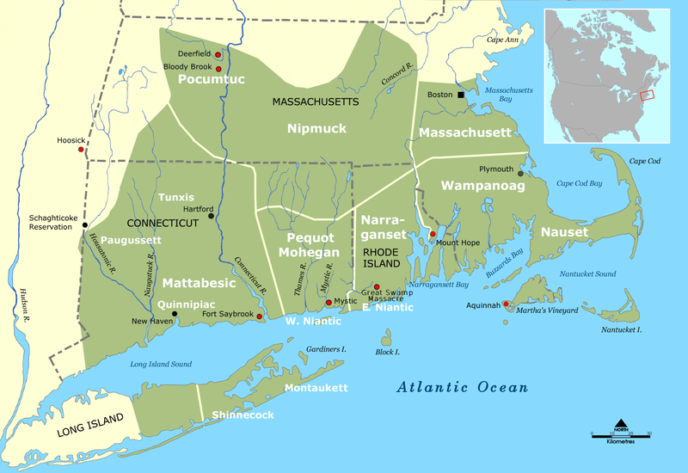
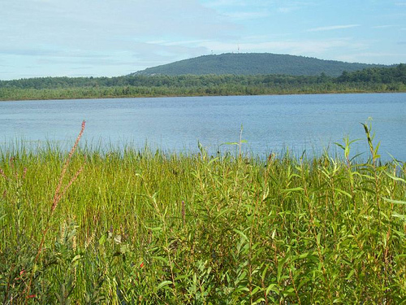
Massachusetts
Name: Massachusetts: After the local Massachusett Indian tribe

Slide 29
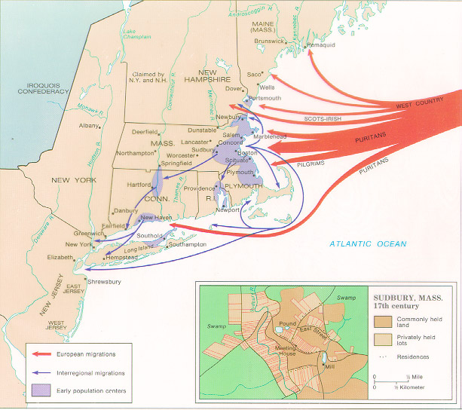
Other Terms:
The Great Migration (1630s): 20,000-30,000 Puritans migrate to New England
Massachusetts

Slide 30
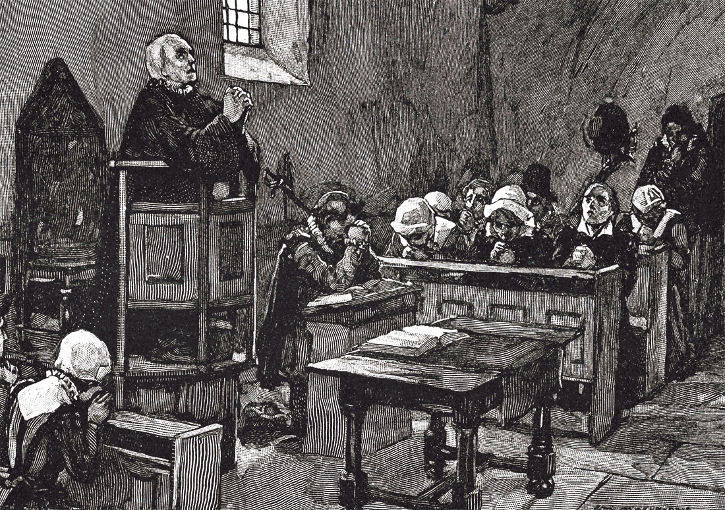
Other Terms:
Halfway Covenant: Puritans who had not had a profound “conversion” could still be church members, but with only partial rights.
Massachusetts

Slide 31
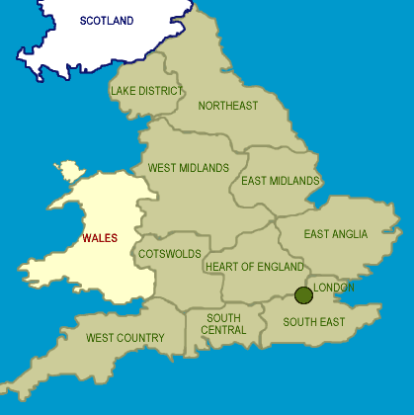
Migrants
Came as family groups, very few single men (like in Virginia).
Most came from East Anglia, England

Slide 32
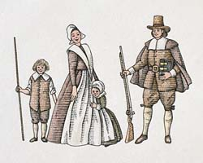
Puritan Families
Very close, with multiple generations living in the same house
Women weren’t considered equal, but could do most things men could
Single people couldn’t live by themselves, by law
Marriage was a civil, not a religious ceremony: divorce was legal and easy to get
Traditional family names were passed on to children
Loved their children deeply, but preferred the “tough love” school of child-rearing.
Children were sometimes sent to be raised by other families!

Slide 33
- Dating -
Puritan teens were free to date who they liked, but only supervised and with parental permission
Courting stick – a long, hollow tube dating teens used to whisper to each other in front of their families
Bundling: Teens could sleep together in the same bed, but were wrapped in blankets and separated by a sometimes jagged board.
Sex before marriage could be punished by death
Once married, intimacy was encouraged – but only in private. Even couples kissing in public could be punished severely.

Slide 34
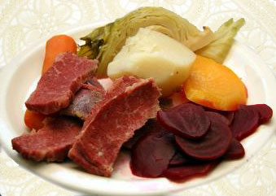
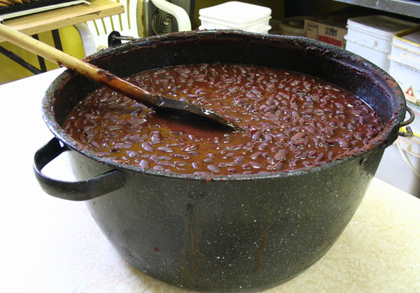
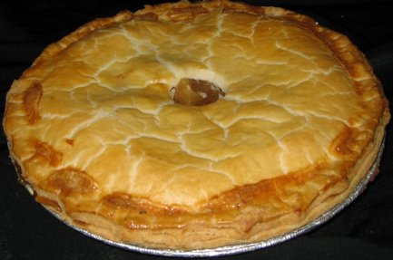
Puritan Food
Baked beans/peas: could be baked on Saturday, eaten on Sunday without having to work on the “Sabbath.” Was usually eaten with brown bread.
Boiled dinner: meat and vegetables boiled together with no seasoning
Baked goods: Pies and cakes were very popular
Refused to eat lobsters, shellfish, wild game, unless completely necessary.

Slide 35
The Wicked Good Accent
Based on East Anglian speech
Gets rid of H after W (Whale=Wale)
The Long A sound (aunt vs ant)
Gets rid of R after vowels (There = theah, Father = Fa-thah, Yesterday = Yestidy)
Last syllables are clipped (Hahv’d, Swed’n)
R is added where none existed: (idea = idear)
Long words appear out of nowhere: rambunctious, splendiferous
Vowel sounds changed: stone = stun
Time: Used “Quarter ‘till” and “Half past.”

Slide 36
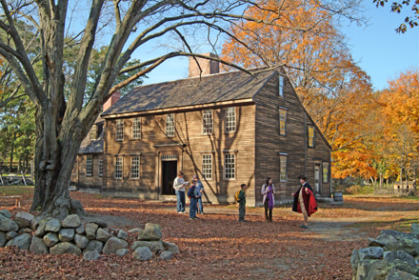
- Houses -
Made of wood, sided with clapboards (Clabberds, clabbids)
Held together with wooden pegs, mortices, and post-and-beam construction
Often 2-story
The Saltbox

Slide 37
Style
“sadd” colors: various shades of brown (“liver” “russet” “puce”), orange, dark green, purple. Also, black and gray (the more formal and distinguished in the community)
Wore the tall felt “steeple” hats, but hatbands were illegal!
No: Long hair, silver buckles, lace, or short sleeves
No baths: but scented powders and leaves were used
Toothpaste: made of sulphur, butter, and gunpowder

Slide 38
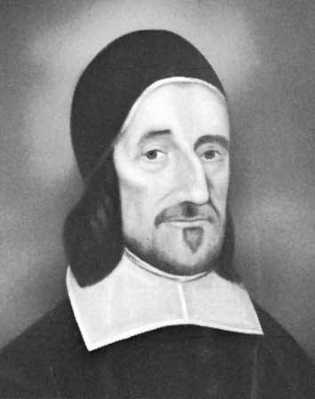
Church Services
Were called “meetings” (hence, the meetinghouse)
Started by having people confess their sins for public punishment and shame
Had 2, 2-hour sermons (and possible a third shorter sermon later)
Prayers often lasted an hour or more
Men often came armed
The “tithing-rod” was used to awaken sleepers

Slide 39
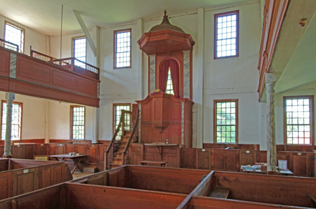
The Meetinghouse
Meetinghouse was unheated, with wooden benches or enclosed pews
The pulpit was at the front of the room, with a large window behind.
Outside you might find wolf heads, slips of paper with announcements, etc
Usually placed on a hilltop

Slide 40
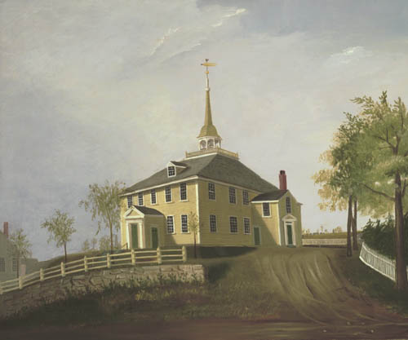

Slide 41
Witches
Puritans believed evil existed and was all around them. Nothing ever happens “by accident” and bad things were caused on purpose by someone or some thing.
The existence of witchcraft was a common belief across Europe and especially Britain. During the Colonial Period, 344 New Englanders (mainly women) were accused of witchcraft, and 35 were executed – including 20 during the “Salem Witch Trials.”

Slide 43
DEATH
Puritans believed you should face up to death, because it could happen to you at any time. So be prepared for it!
Funerals were extremely simple and plain – but the gathering afterward was like a party!

Slide 44
Sports and Recreation “Idle Hands are Tools for the Devil”
There was very little free time for recreation, but sports did exist, including:
The “Boston Game,” which eventually became football
The “New England Game” or “Town Ball,” which eventually became baseball.

Slide 45
Holidays
Holidays: They did NOT celebrate Christmas, Easter, etc. Their holidays were:
MUSTER DAY: Training the militia. Spring.
ELECTION DAY: Choosing town officers for the coming year. Early Spring.
COMMENCEMENT DAY: Feasting to celebrate new ministers graduating from the colleges. July.
THANKSGIVING: November or early December.

Slide 46
MARYLAND

Slide 47
MARYLAND
Founded: 1632
George Calvert, 1st Lord Baltimore
Cecil Calvert, 2nd Lord Baltimore
Founder: Lord Baltimore

Slide 48
MARYLAND
Reason: A safe colony for Catholics
But Maryland had an Anglican majority from the very beginning!

Slide 49
MARYLAND
Capital: St. Mary’s, later Annapolis

Slide 50
MARYLAND
Colony type: Proprietary, then Royal

Slide 51
MARYLAND
Name: Either for Queen Henrietta Maria or for the Virgin Mary
?

Slide 52
MARYLAND
Agriculture & Economy:
Tobacco & fishing

Slide 53
MARYLAND
Other Terms:
The Mason-Dixon Line: Boundary between Maryland and Pennsylvania that eventually became the boundary between Northern/free and Southern/slave states

Slide 54
MARYLAND
Other Terms:
Act of Toleration: Colonial law that allowed freedom of religion for all Christians (this included Catholics).
In effect from 1649 - 1692

Slide 55
Connecticut

Slide 56
Connecticut
Founded: 1636
Stop laughing at
my name!
I founded a whole colony. What have you done lately?
Founder:
Rev. Thomas Hooker

Slide 57
Connecticut
Reason: Political/Religious difference with Massachusetts: Government should not be controlled by religious leaders, but be freely elected*
Let’s thank God that we aren’t in Massachusetts anymore!
* According to the will of God, that is
Side Note: To the Southeast, John Davenport started the New Haven Colony. This ultra-Puritan colony lasted for 30 years, until it merged with Connecticut.

Slide 58
Connecticut
Capitals: New Haven and Hartford

Slide 59
Connecticut
Colony type: Charter
Ye
Connecticutt
Colonie

Slide 60
Connecticut
Name: From the Mohegan quinnitukqut, meaning "place of long tidal river".

Slide 61
Connecticut
Agriculture: Small farms, some specialty crops (like onions)

Slide 62
Connecticut
Economy: Trading, ship building, rum, furniture

Slide 63
Connecticut
Other Terms:
Fundamental Orders of Connecticut:
The first written constitution in history
Provided for representative government through a popularly elected legislature, which in turn elected the governor
Written in 1639 and parts are still in effect today

Slide 64
Rhode Island
H O P E

Slide 65
Rhode Island
Founded: 1636
I’m lost and need a good Rhode map….
Founder:
Rev. Roger Williams

Slide 66
Rhode Island
Reason: Political/Religious differences with Massachusetts
I was kicked out!

Slide 67
Rhode Island
Capitals: Providence, Newport

Slide 68
Rhode Island
Colony type: Charter
Rhode Island
And ye
Providence
Plantations

Slide 69
Rhode Island
Name: From the Dutch Roodt Eylandt, for “red land".

Slide 70
Rhode Island
Agriculture: Small farms

Slide 71
Rhode Island
Economy: Slave trade, ship building, rum

Slide 72
Rhode Island
Important to know:
Roger Williams’ desire for religious freedom for all

Slide 73
Rhode Island
Other Terms:
Antinomian Dispute: Debate between Puritans over “free grace”, the power of the Holy Spirit, and the role of women in religion. Led by Rev. John Cotton, John Wheelwright, and Anne Hutchinson, who was banished from Massachusetts to Rhode Island.
Catholic View: Justification by works – God rewards those who do good deeds.
Protestant View: Covenant of Grace – God rewards those who believe in him, who in turn do good deeds to show they are Chosen.
Antinomian View: God rewards those who believe in him, through Grace alone.

Slide 74
Oliver Cromwell

Slide 75
Oliver Cromwell, Lord Protector of England (PURITAN) Born in 1599 and died in 1658 (SEPTEMBER) Was at first (ONLY) MP for Huntingdon (BUT THEN) He led the Ironside Cavalry at Marston Moor in 1644 and won. Then he founded the New Model Army And praise be, beat the Cavaliers at Nasby! And the King fled up North like a bat to the Scots…..

Slide 76
SPOKEN: BUT UNDER THE TERMS OF JOHN PIMM'S SOLEMN LEAGUE AND COVENANT, THE SCOTS HANDED KING CHARLES I OVER TO...

Slide 77
Oliver Cromwell, Lord Protector of England! (AND HIS WARTS) Born in 1599 and died in 1658! (SEPTEMBER) But alas (OY VAY!) Disagreement then broke out (BETWEEN) The Presbyterian Parliament and the Military who meant To have an independent bent. And so...

Slide 78
The 2nd Civil War broke out… And the Roundhead ranks Faced the Cavaliers at Preston Banks And the King lost again, silly thing…
(STUPID GIT)

Slide 79
…AND CROMWELL SEND COLONEL PRIDE TO PURGE THE HOUSE OF COMMONS OF THE PRESBYTERIAN ROYALISTS LEAVING BEHIND ONLY THE RUMP PARLIAMENT...
Which appointed a High Court at Westminster Hall To indict Charles I for...tyranny (OOOOHHH!) Charles was sentenced to death Even though he refused to accept that the court had...jurisdiction!
SAY GOODBYE TO HIS HEAD

Slide 80
Poor King Charles…
laid his head…
on the block…. (JANUARY 1649) Down came the axe,
and...
IN THE SILENCE THAT FOLLOWED, THE ONLY SOUND THAT COULD BE HEARD WAS A SOLITARY GIGGLE, FROM...

Slide 81
Oliver Cromwell!
Lord Protector of England! (OLE!) Born in 1599, died in 1658 (SEPTEMBER) Then he smashed IRELAND!
Set up the Commonwealth
AND MORE…

Slide 82
He crushed the Scots at Worcester And beat the Dutch at sea in 1653…
and then
He dissolved the Rump Parliament And with Lambert's* consent Wrote the instrument of Government Under which Oliver was Protector at last
The end! *No Relation, thank you

Slide 83
Oliver Cromwell ”Lord Protector of the Commonwealth of England, Scotland, and Ireland."
Reign: 1649-1659
Notes:
Puritan Dictator
“Posthumously executed”
Don’t forget me!

