Slide 1
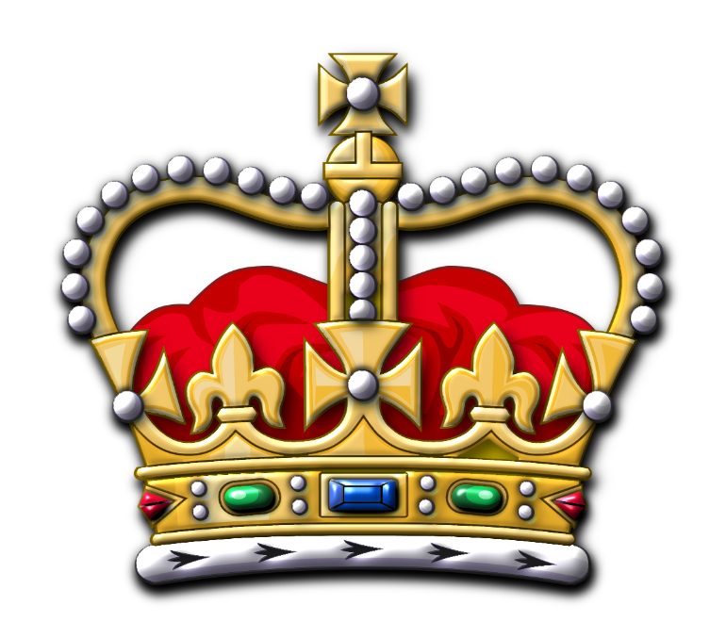
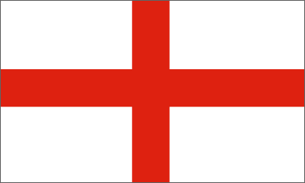
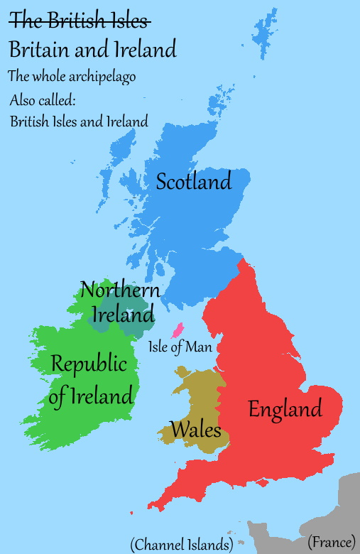
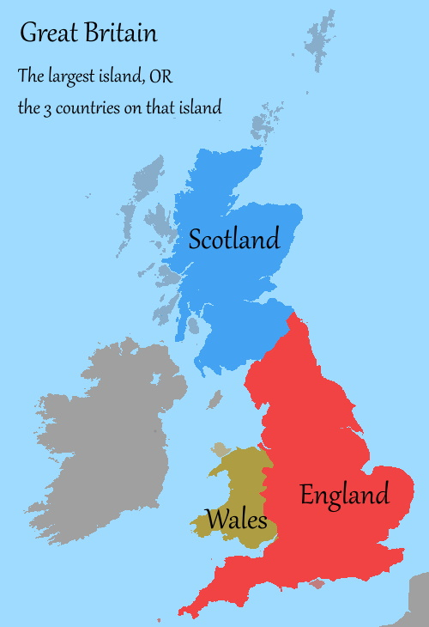
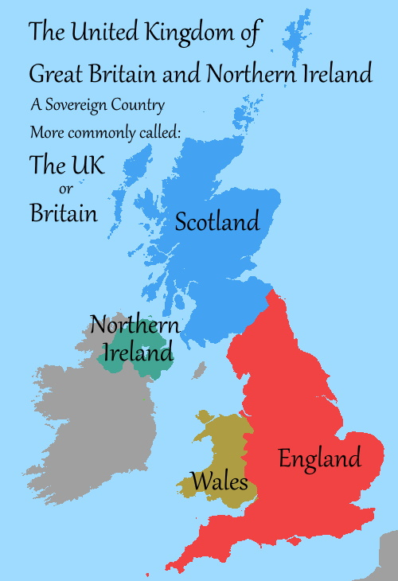
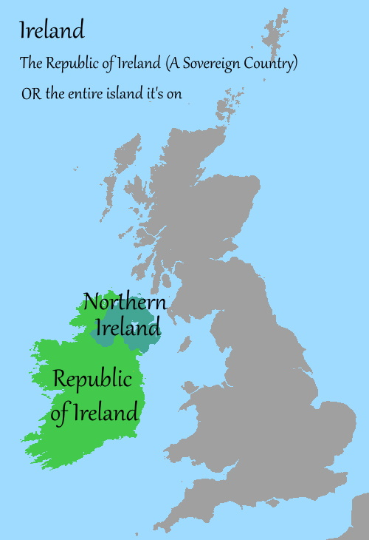

Slide 2
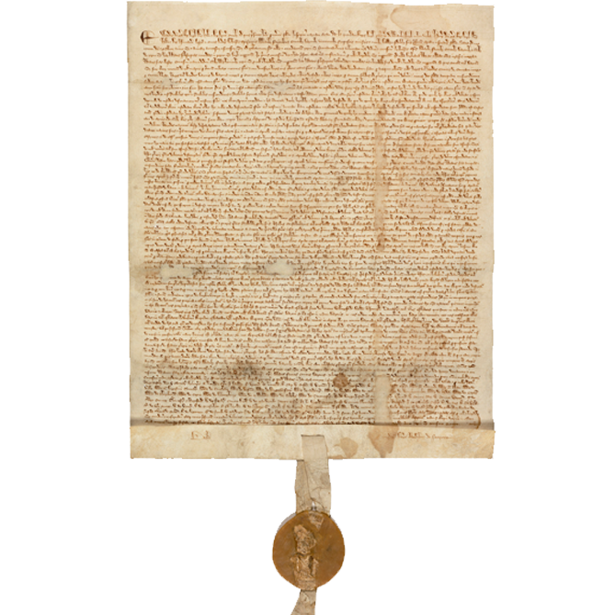
Magna Carta - 1215
Document signed by King John at Runnymede
Limited the power of the King over the nobles
The origin of English law and liberty
Considered the forerunner of the US Constitution and Bill of Rights

Slide 3
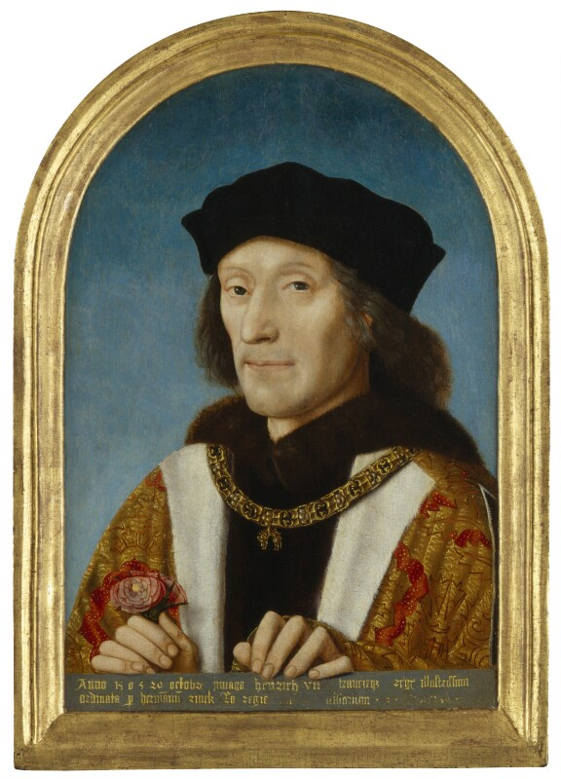

Slide 4
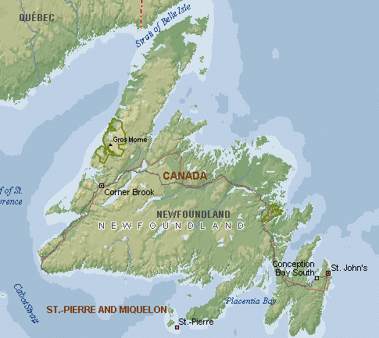
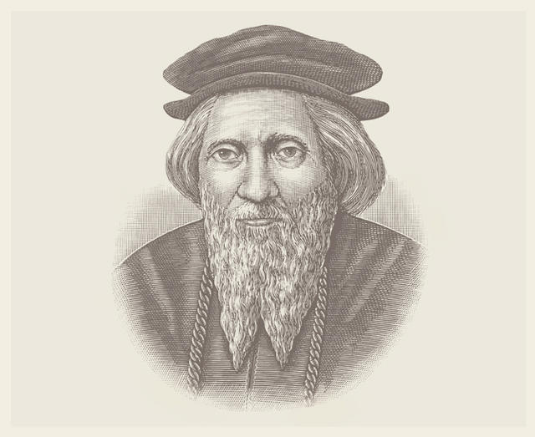
John Cabot
Giovanni Caboto
(And his son Sebastian)
Discovered Newfoundland in 1497
English fishing grounds (mostly cod), but few permanent settlements until 1620s.

Slide 5
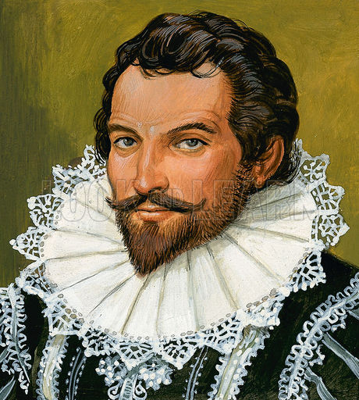
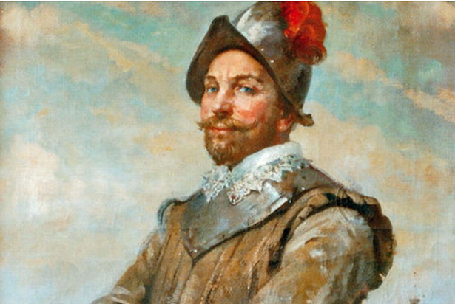
Walter Raleigh
Francis Drake
Set up “Lost Colony” of Roanoke
English “sea dog” who also sailed to California and circumnavigated the globe.

Slide 6
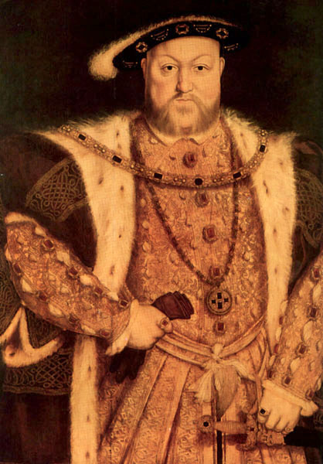
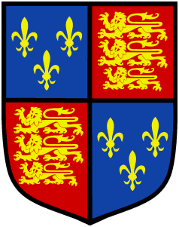
Henry VIII “Henry the Eighth, by the Grace of God, King of England, France and Ireland, Defender of the Faith and of the Church of England and also of Ireland in Earth Supreme Head”
Reign: 1509-1547
Notes:
Founder of the Anglican Church
Had 6 wives – killed 2

Slide 7
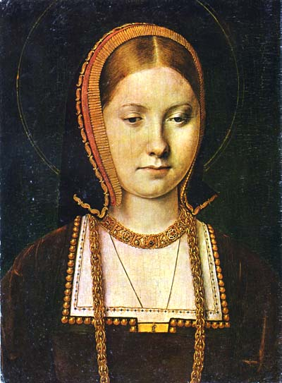
Catherine of Aragon – Wife #1

Slide 8
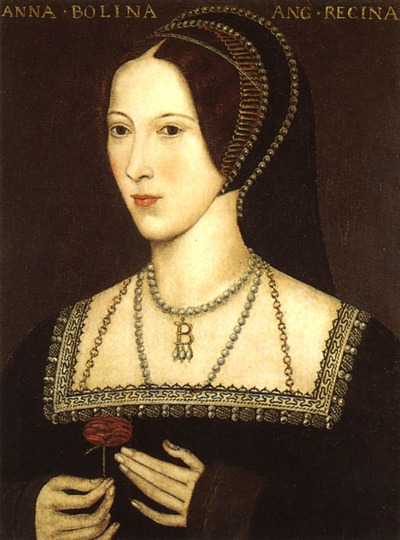
Anne Boleyn – Wife #2

Slide 9
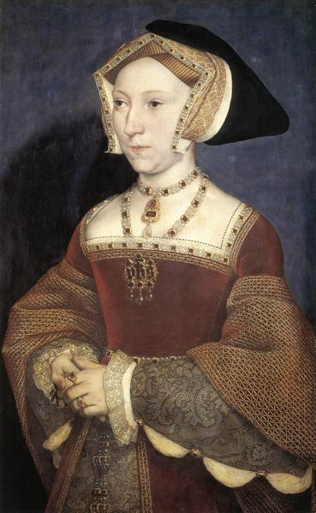
Jane Seymour – Wife #3

Slide 10
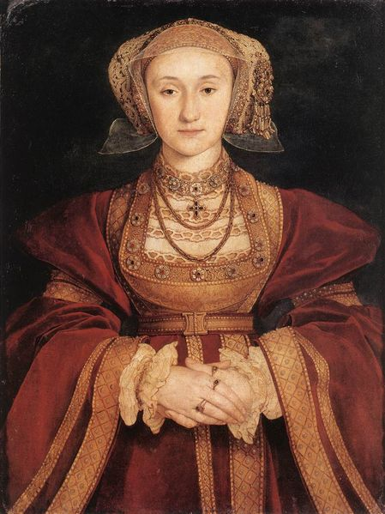
Anne of Cleves – Wife #4

Slide 11
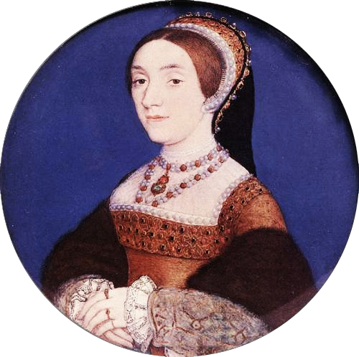
Catherine Howard – Wife #5

Slide 12
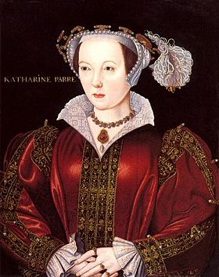
Catherine Parr – Wife #6

Slide 13
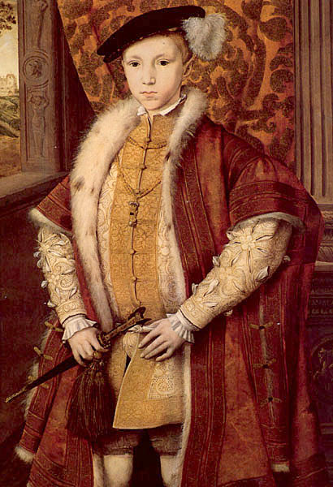
Edward VI “Edward the Sixth, by the Grace of God, King of England, France and Ireland, Defender of the Faith and of the Church of England and also of Ireland in Earth Supreme Head”
Reign: 1547-1553
Notes:
Sickly, died at age 15

Slide 14
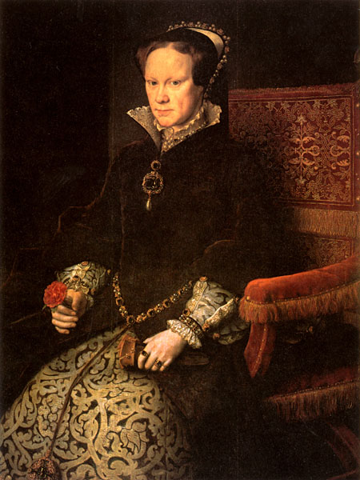
Mary I “Mary, by the Grace of God Queen of England, Spain, France, Jerusalem, both the Sicilies and Ireland, Defender of the Faith, Archduke of Austria, Dukes of Burgundy, Milan and Brabant, Count of Habsburg, Flanders and Tyrol”
Reign: 1553-1558
Notes:
Persecuted Anglicans; known as “Bloody Mary”

Slide 15
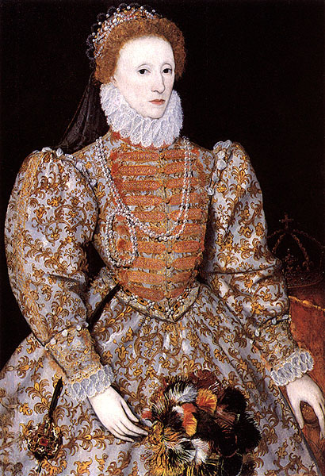
Elizabeth I "Elizabeth, by the Grace of God, Queen of England, France and Ireland, Fidei defensor, etc."
Reign: 1558-1603
Notes:
Defeated Spanish Armada
“The Virgin Queen” died without an heir

Slide 16
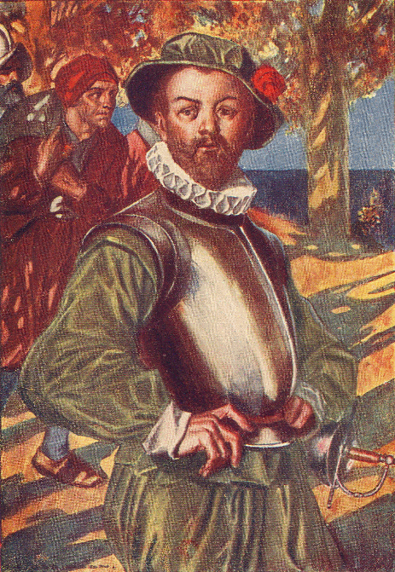
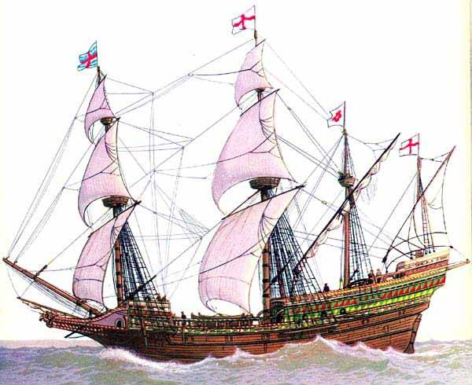
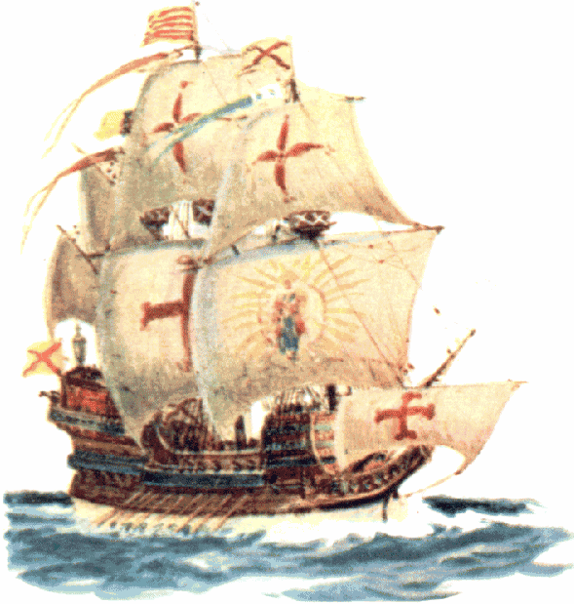
The Spanish Armada - 1588
-The Catholic Spanish attempt to conquer Protestant England
-The invasion fails, and Spanish Navy is destroyed.
-Opens up New World to non-Spanish colonization.
We gave the Spanish a sound drubbing!

Slide 17
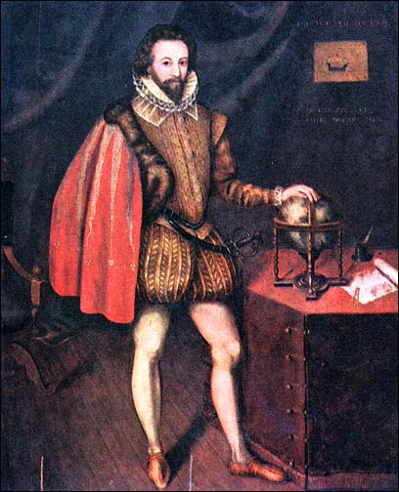
Sir Walter Raleigh
To earn Queen Elizabeth’s favor, decided to colonize America
Named his colony “Virginia” in her honor
Later executed by James I

Slide 18
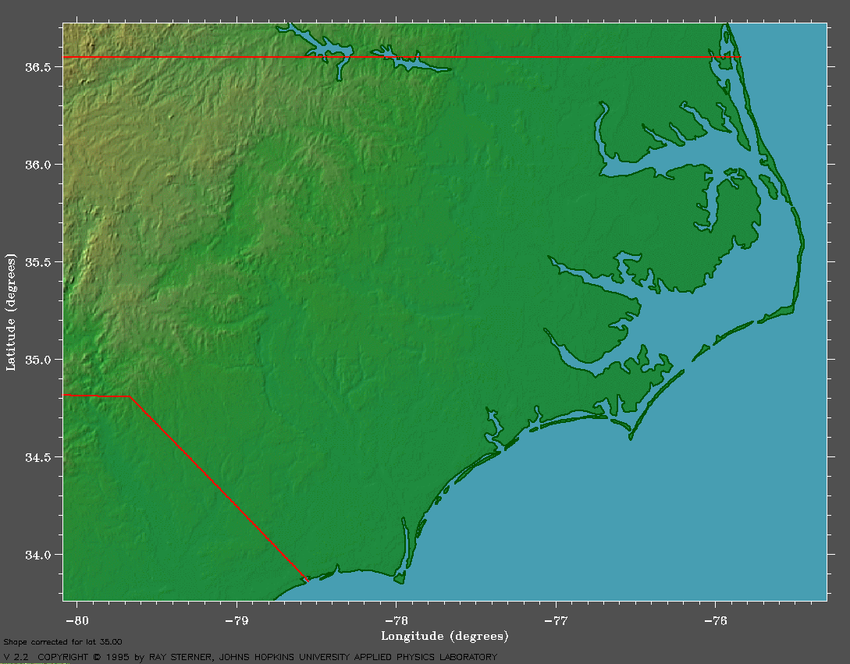
Roanoke – The Lost Colony
Sir Walter Raleigh sent 100 settlers in 1585, but they returned home
120 Settlers travel in 1587, but the settlement disappears within the next 3 years.

Slide 19
CROATOAN
May have been destroyed by the Spanish
May have been hit by a plague
May have been destroyed by Indians
May have sailed for home, but lost at sea
May have joined the local Hatteras Indians

Slide 20
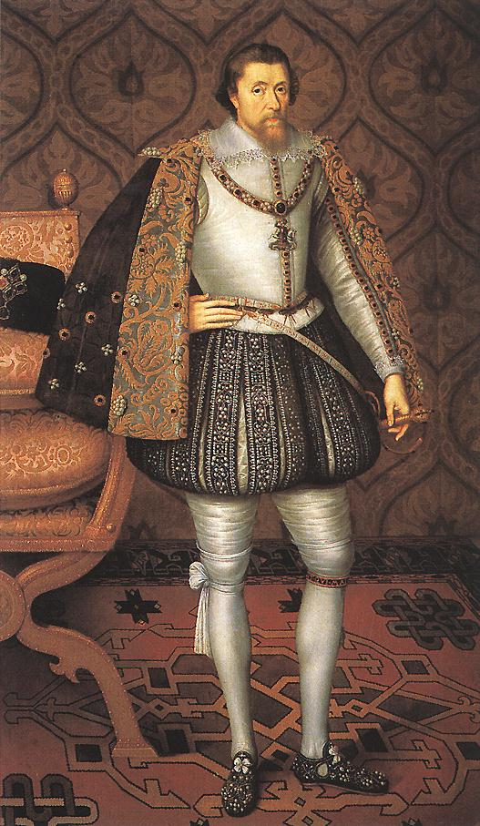
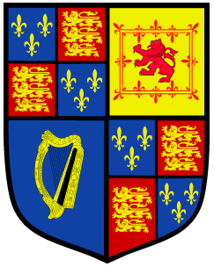
James I "James, King of England, Scotland, France and Ireland, Defender of the Faith, etc."
Reign: 1603-1625
Notes:
United thrones of England and Scotland

Slide 21
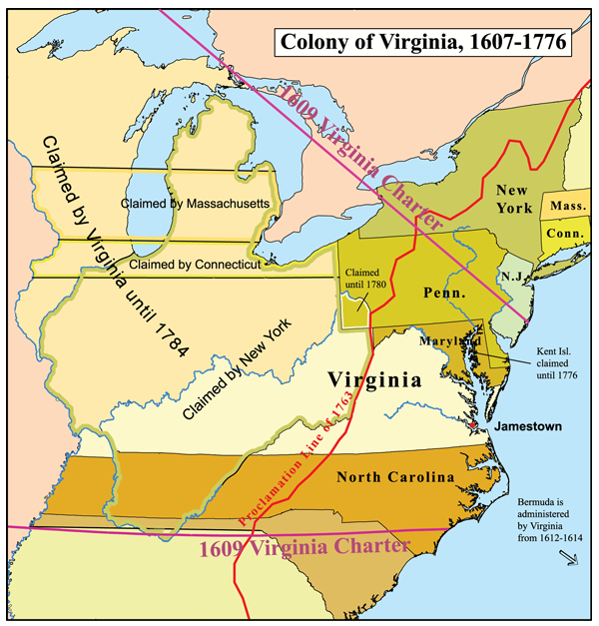
VIRGINIA

Slide 22
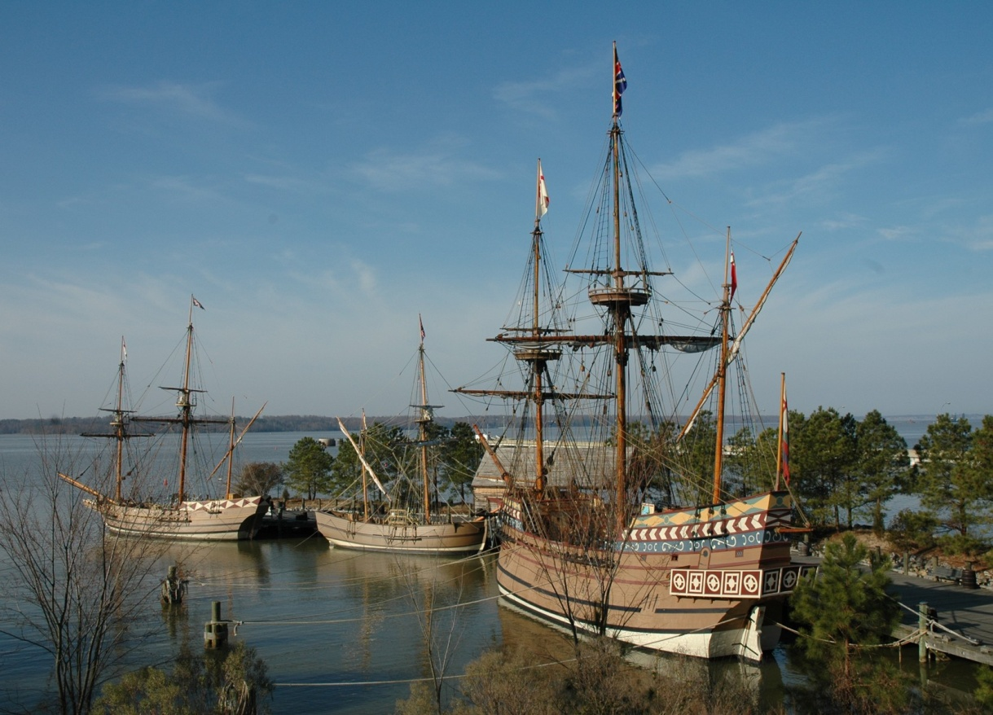
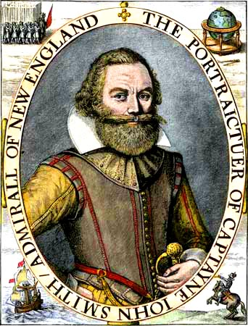
VIRGINIA
Founded: 1607
Founder: The Virginia Company (a joint stock company) and John Smith

Slide 23
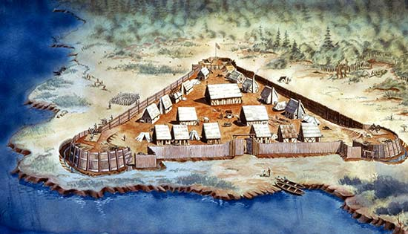
VIRGINIA
Reason: To start a successful English colony in America, get rich (gold?)

Slide 24
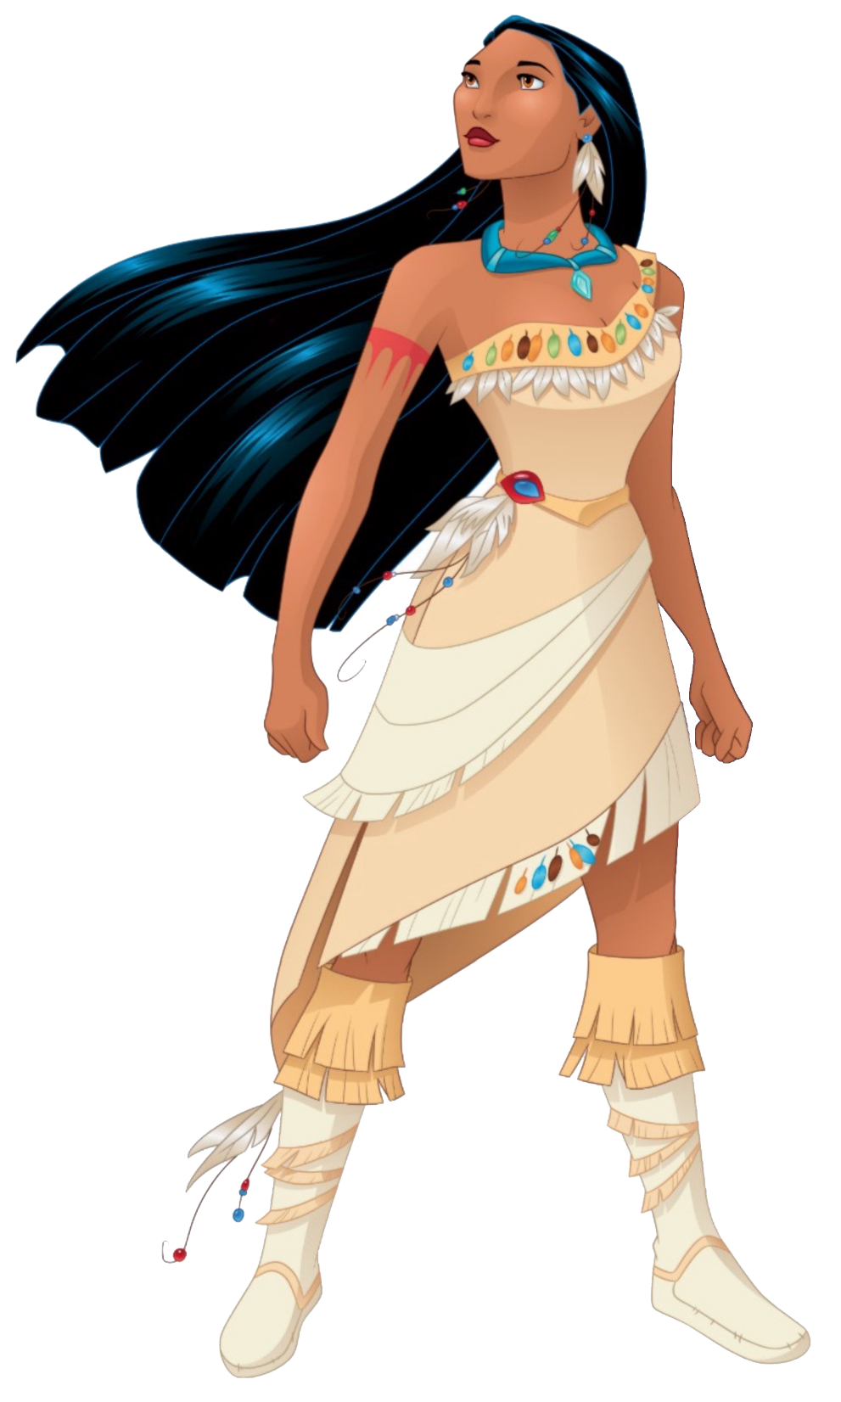
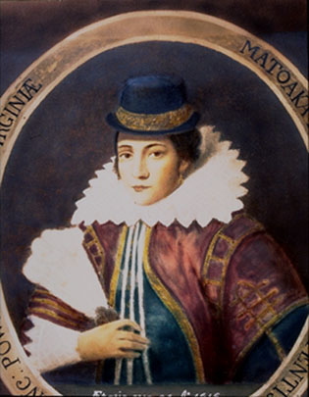
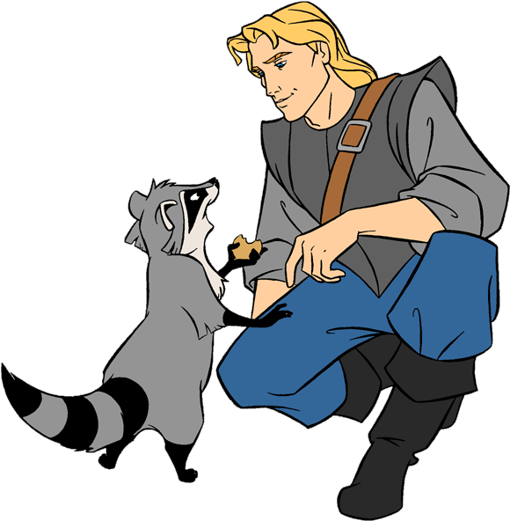
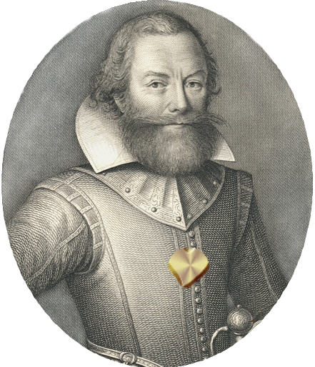

Slide 25
St. Augustine vs. Jamestown
St. Augustine
-100 farmers
-100 sailors
-300 soldiers
-Supplies for 1 year
-500 settlers (including women, children, tradesmen)
-12 priests
-100 horses
-200 calves
-400 hogs
-400 sheep
Jamestown
-48 gentlemen
-12 tradesmen
-5 carpenters
-7 soldiers
-1 preacher
-6 councilors
11 Laborers
15 “other”
Whatever supplies are left on the boat

Slide 26
Jamestown Notes
First “successful” English colony in the New World
The colony lost 440 of 500 original settlers by 1610, especially during “The Starving Time.”
In 1612, tobacco was introduced by John Rolfe – this made the colony successful. His wife was Pocahontas.
1619: First House of Burgesses is elected, the representatives of the people who made laws for the colony. This is the first elected assembly in America – representative government.
1619, the colony imported the first African slaves in English America.

Slide 27
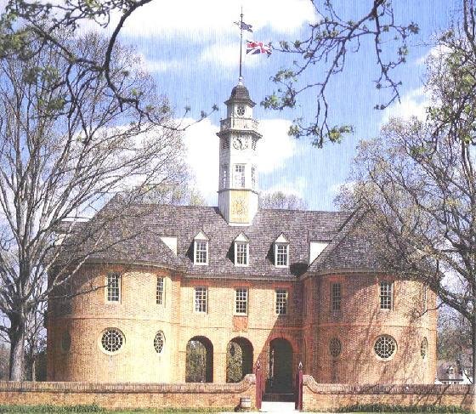
VIRGINIA
Capital: Jamestown, later Williamsburg

Slide 28
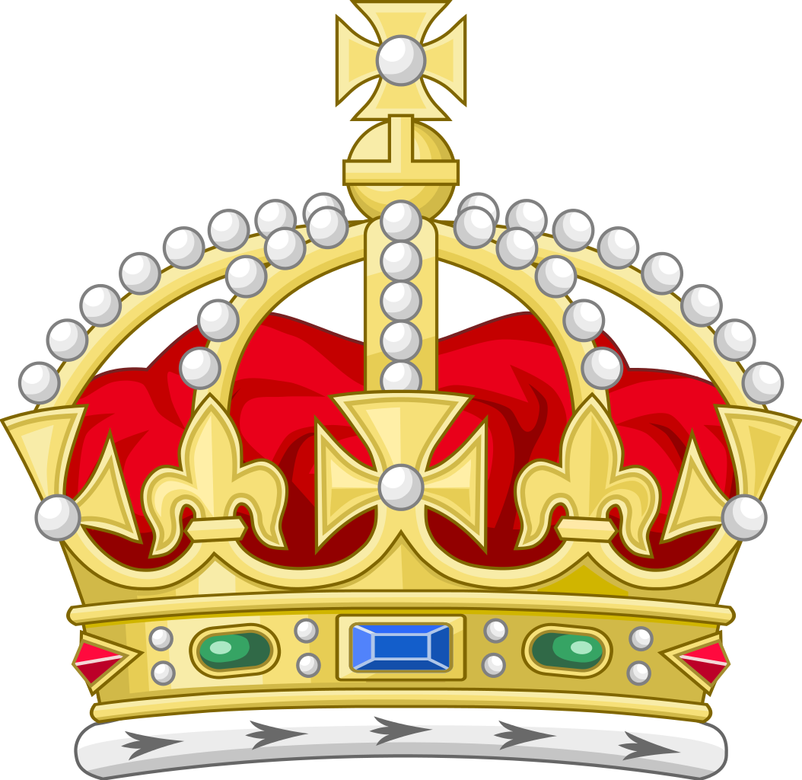
VIRGINIA
Colony type: Originally Charter, later Royal
Charter/Corporate: Run by a charter or rules given by the Crown.
Royal: Run directly by the Crown, using a Royal Governor.
Proprietary: Ruled by the property owner.
Virginia Colony

Slide 29
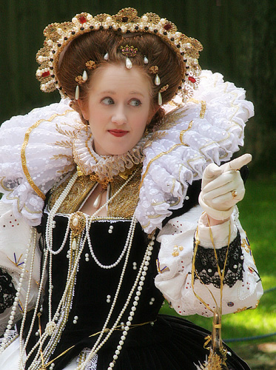
VIRGINIA
Name: For Queen Elizabeth
(The “Virgin Queen”)
Keep your snarky comments about my nickname to yourselves.

Slide 30
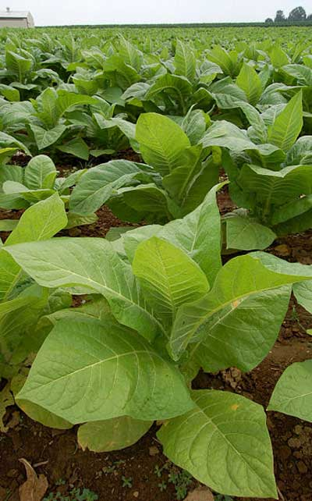
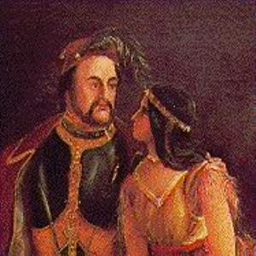
VIRGINIA
Agriculture & Economy:
Tobacco (introduced by John Rolfe)
John Rolfe
Rebecca Rolfe
(AKA, Pocahontas)

Slide 31
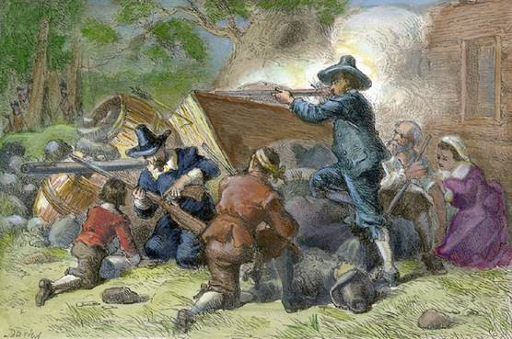
VIRGINIA
Other Terms:
Bacon’s Rebellion: Nathaniel Bacon and western, rural Virginia farmers against the royal governor Sir William Berkeley (1676) and his planter-class followers.

Slide 32
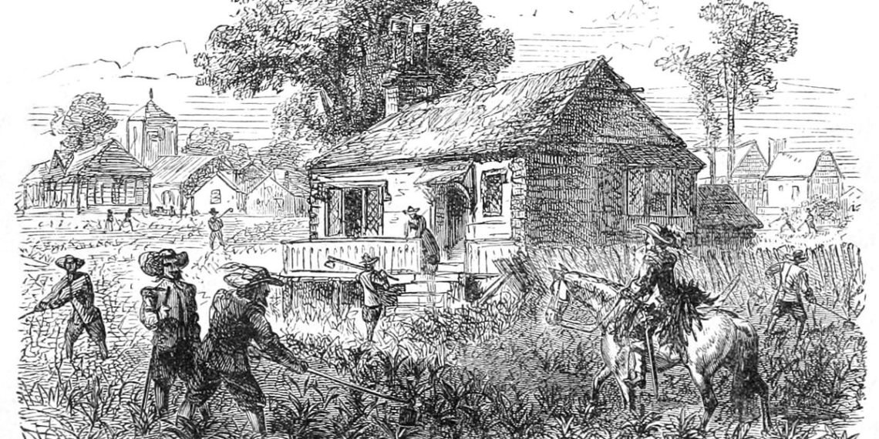
VIRGINIA
Other Terms:
Indentured servants: people who volunteered to work for someone for 4-7 years in return for passage to America and a fresh start after the term of the indenture.

Slide 33
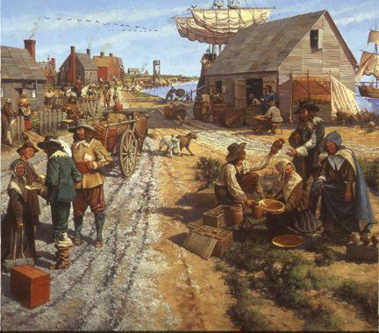
VIRGINIA
Other Terms:
Headright system: Attempt by Virginia to lure more settlers – 50 acres of land to anyone who immigrated or if you paid for the immigration of another.

Slide 34
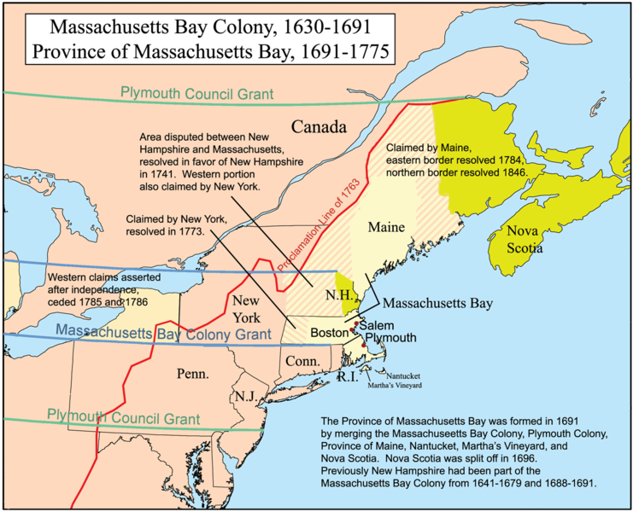
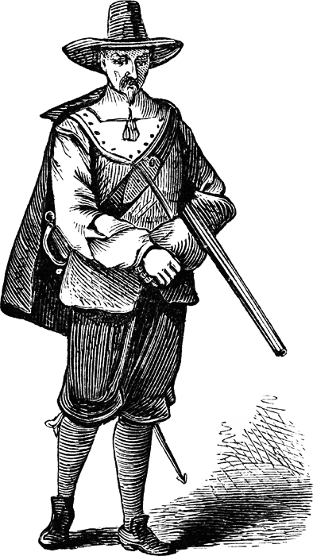
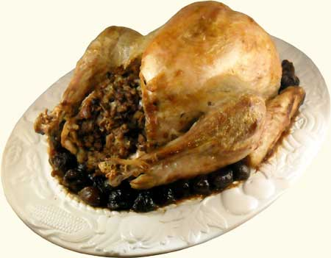
Plymouth

Slide 35
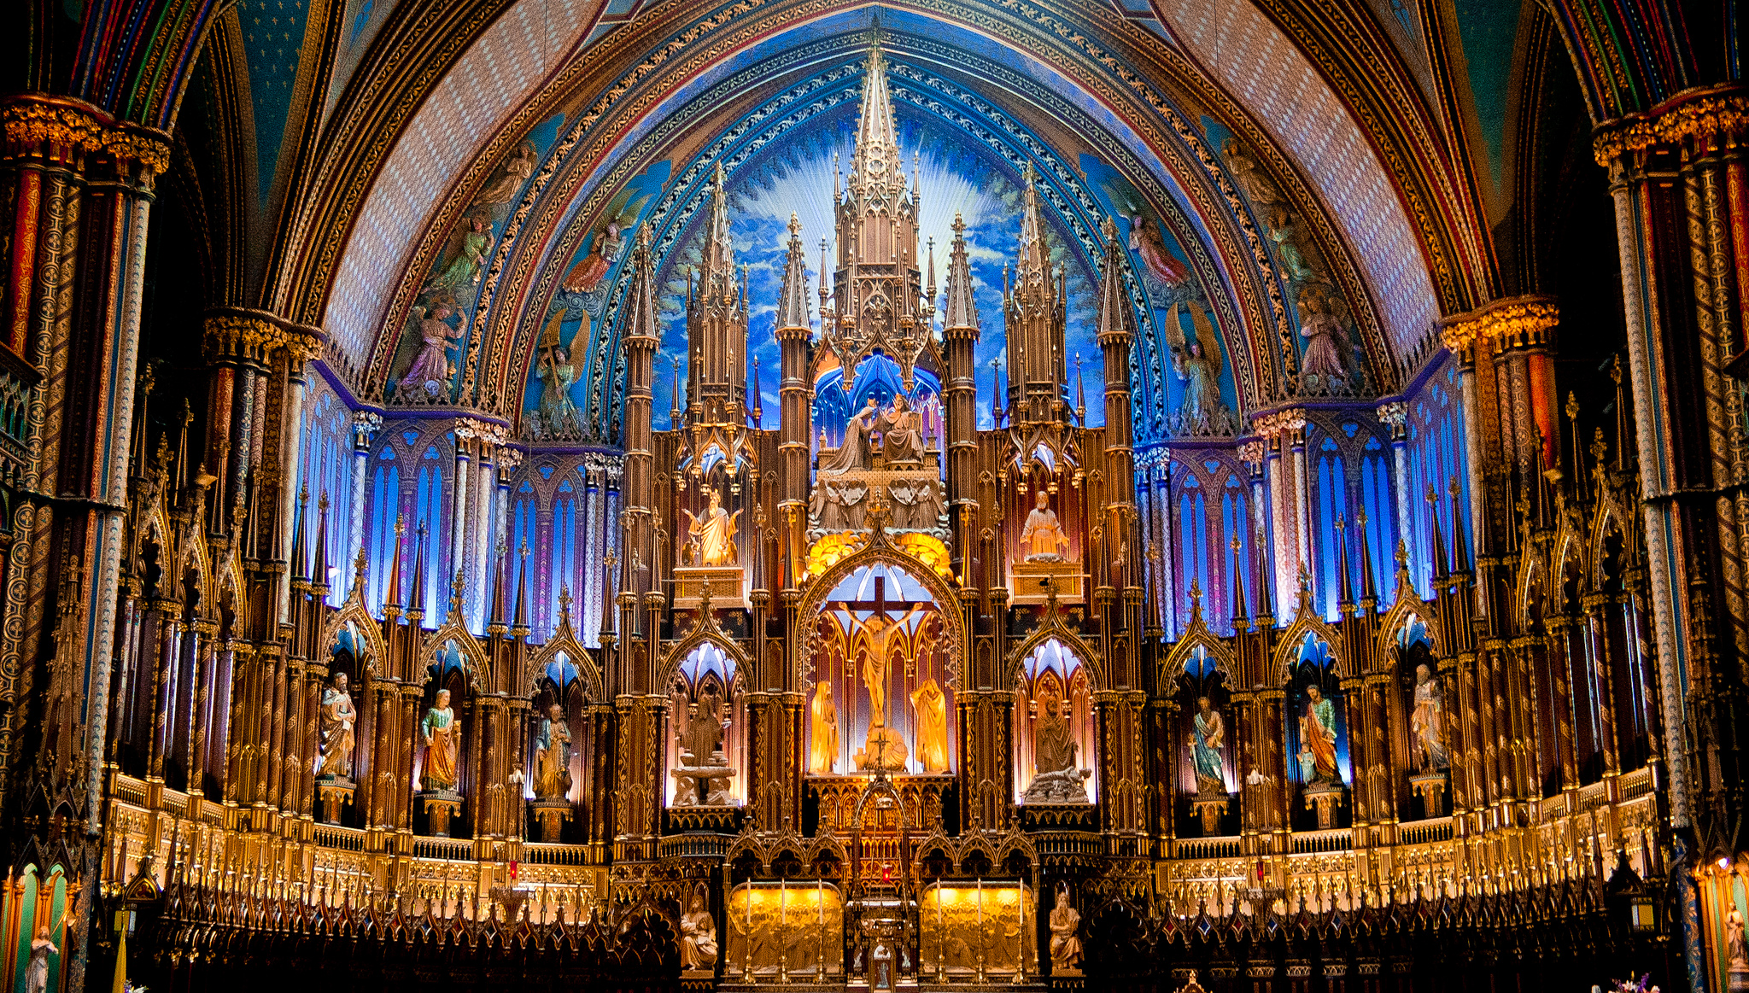
Catholics
I like statues, fancy ornamentation, stained glass, and the authority of the Pope.

Slide 36
Anglicans
I like most of the stained glass, and statues, like the Catholics. Except for that Pope thing.

Slide 37
Puritans
I hate fancy stuff in church – but I want to PURIFY the Church from within.

Slide 38
Separatists
I hate fancy stuff, and want nothing to do with the Anglicans OR Puritans.

Slide 39
The Pilgrims
Were “Separatists” - not Pilgrims
Originally fled persecution in England for the Netherlands, but feared their children would grow up “Dutch”

Slide 40
The Mayflower
100 feet long
-25 feet wide
Crew of 25-30
Additional 102 passengers
Journey of 66 days

Slide 42
Half of the “Pilgrims” die the first year, but are aided by Squanto, Samoset, and the nearby Wampanoag tribe (Leader: Massasoit)

Slide 44
- “First Thanksgiving” held in 1621 – probably as a harvest festival, not a day of Thanksgiving

Slide 45
Plymouth
Founded:
1620
Founder:
The Separatists – Future leader: William Bradford

Slide 46
Plymouth
Reason:
Religious Freedom for Separatists
We just want to be left alone!

Slide 47
Plymouth
Capital: Plymouth

Slide 48
Plymouth
Colony type: Charter
Plymouth Colony

Slide 49
Plymouth
Name: After Plymouth, England.

Slide 50
Plymouth
Agriculture: Small farms

Slide 51
Plymouth
Economy: Trading, Rum, ship building, fishing, whaling, skilled crafts

Slide 52
The Mayflower Compact
Document which served as the basis for Plymouth’s original government
An example of self-government
Partially the basis for the US Constitution and New England town meetings
In the name of God, Amen. We, whose names are underwritten, the loyal subjects of our dread Sovereign Lord King James, by the Grace of God, of Great Britain, France, and Ireland, King, defender of the Faith, etc. Having undertaken, for the Glory of God, and advancements of the Christian faith and honor of our King and Country, a voyage to plant the first colony in the Northern parts of Virginia, do by these presents, solemnly and mutually, in the presence of God, and one another, covenant and combine ourselves together into a civil body politic; for our better ordering, and preservation and furtherance of the ends aforesaid; and by virtue hereof to enact, constitute, and frame, such just and equal laws, ordinances, acts, constitutions, and offices, from time to time, as shall be thought most meet and convenient for the general good of the colony; unto which we promise all due submission and obedience.
In witness whereof we have hereunto subscribed our names at Cape Cod the 11th of November, in the year of the reign of our Sovereign Lord King James, of England, France, and Ireland, the eighteenth, and of Scotland the fifty-fourth, 1620

